Slide 1
Nighttime Visibility for Safety
An EDC-7 Safety Initiative
ARDOT TRC Meeting 5/24/2023
Joe Heflin, FHWA Office of Safety

Slide 2
Disclaimers
Except for any statutes or regulations cited, the contents of this presentation do not have the force and effect of law and are not meant to bind the States or the public in any way. This presentation is intended only to provide information regarding existing requirements under the law or agency policies.
The U.S. Government does not endorse products or manufacturers. Trademarks or manufacturers’ names appear in this presentation only because they are considered essential to the objective of the presentation. They are included for informational purposes only and are not intended to reflect a preference, approval, or endorsement of any one product or entity.
Unless otherwise indicated, FHWA is the source for all images in this presentation.
Notes:
Mandatory FHWA Disclaimers

Slide 3

Agenda
Why is Nighttime Visibility Important?
EDC-7 Nighttime Visibility for Safety Initiative
Roadway Departure Benefits
Intersection Benefits
Pedestrian & Bicyclist Benefits
Let’s Talk about Lighting!
Wrap-up

Slide 4
The Problem:
Nighttime vs. Daytime Fatality Rates
Source: NHTSA FARS 2015-2019
Notes:
Welcome and Introduction
4

Slide 5
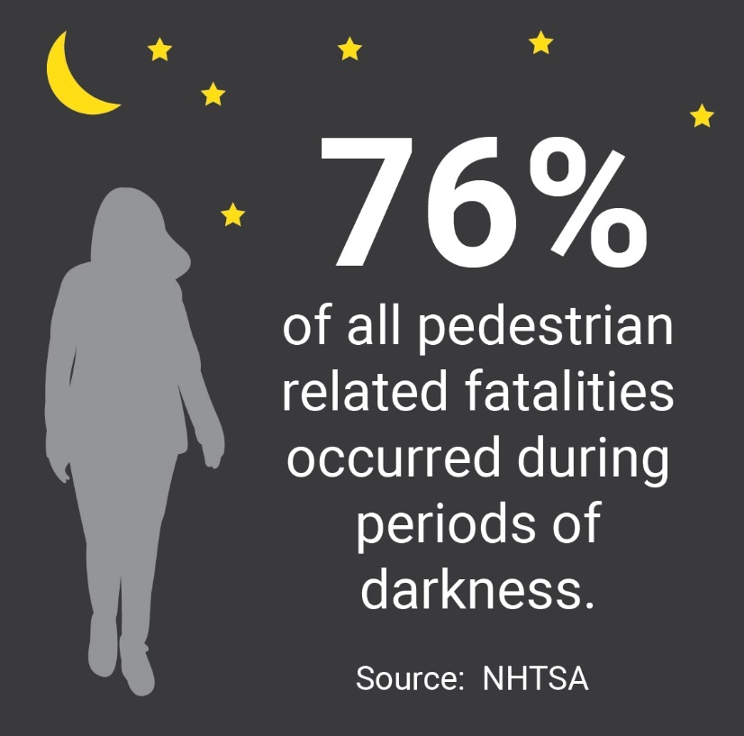
Pedestrian Fatalities in Dark Conditions
Source: NHTSA
Graphic. Infographic for nighttime pedestrian fatalities.
Dark condition pedestrian fatalities/year and dark condition pedestrian fatalities/year as a percentage of total pedestrian fatalities
Figure 5 Pedestrian Lighting Primer (dot.gov)

Slide 6
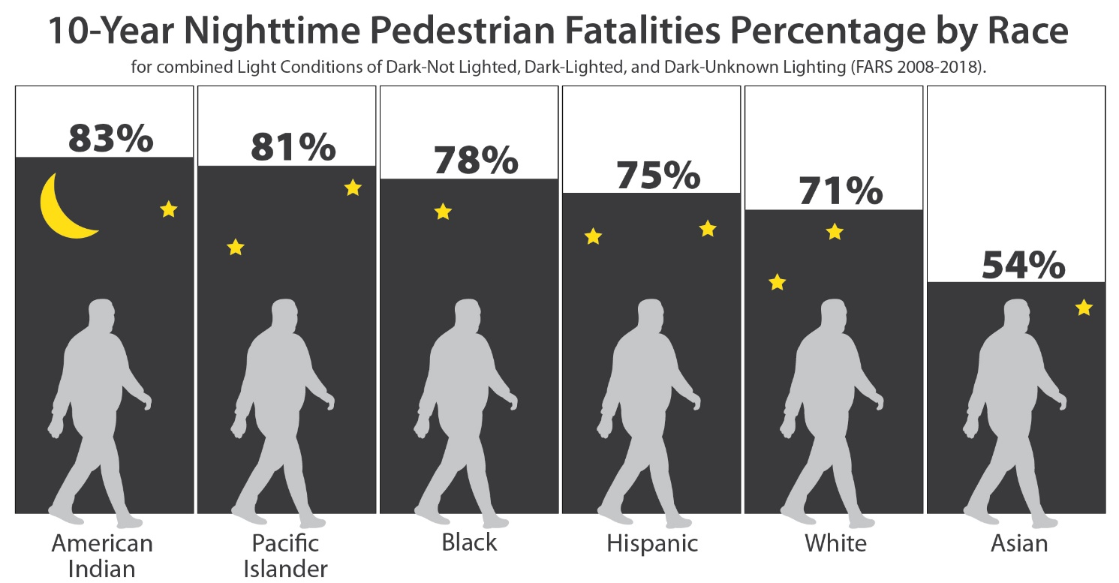
Equity and Nighttime
Source: NHTSA FARS (2008–2018)
Pedestrian Lighting Primer (dot.gov)

Slide 7
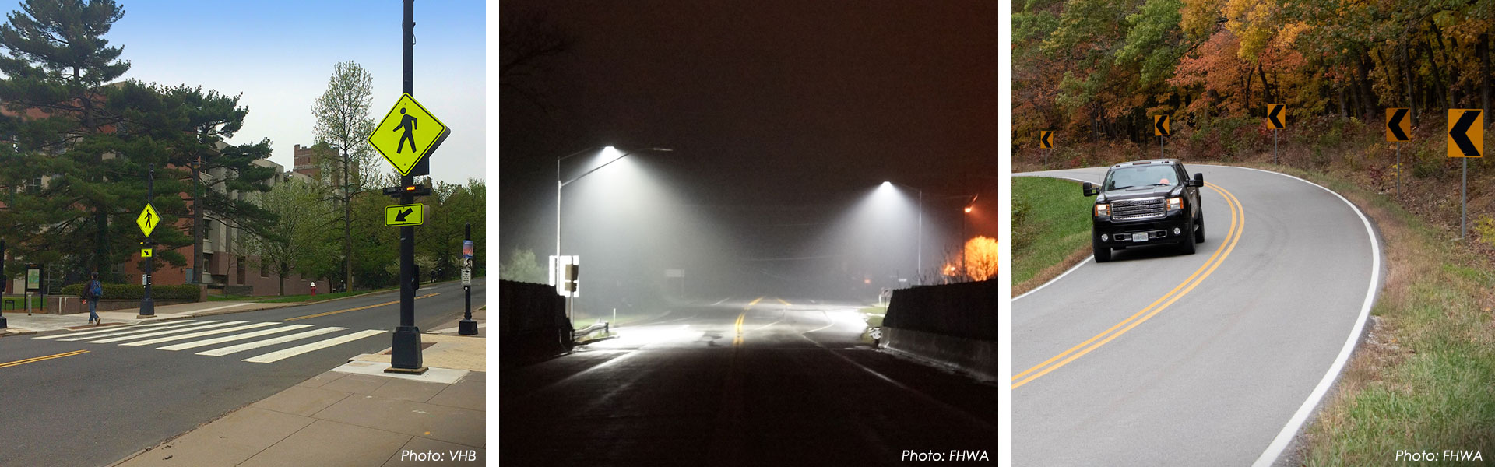
EDC-7 Nighttime Visibility for Safety Initiative
Enhancing Nighttime visibility along corridors, intersections, and pedestrian crossings can help reduce fatalities. This initiative promotes traffic control devices and properly designed lighting to improve safety for all users

Slide 8



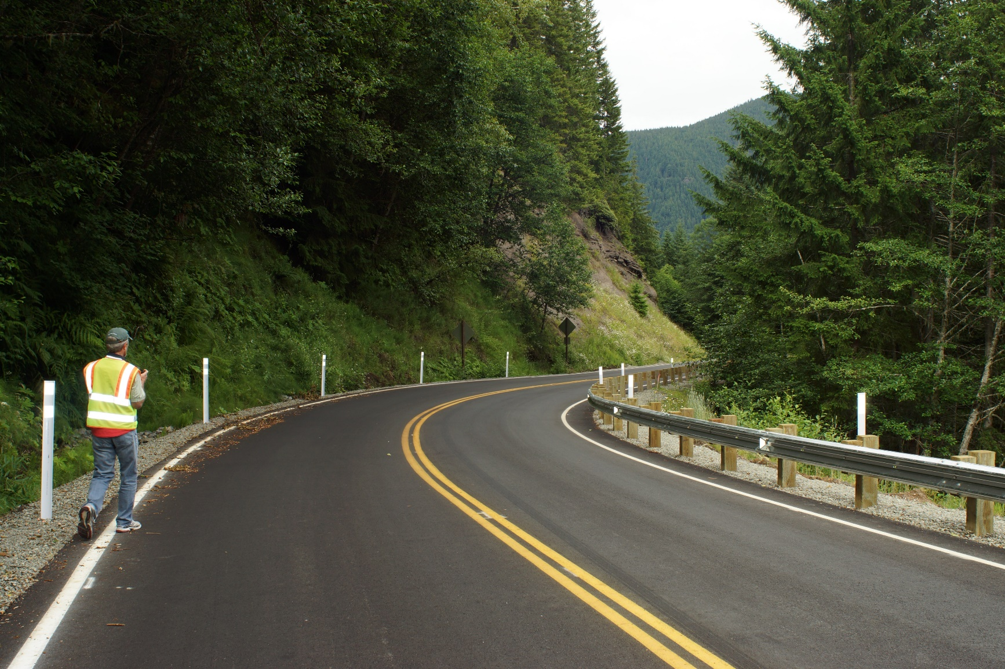
Roadway Departure Benefits
Horizontal curve delineation enhancements through the use of chevrons (16- to 25-percent reduction)
Edge and center line markings (24-percent reduction)
Fluorescent sheeting for warning signs (18-percent reduction)
Other enhancements like retroreflective raised pavement markers and delineators
Data Sources: https://highways.dot.gov/safety/proven-safety-countermeasures/enhanced-delineation-horizontal-curves and CMF Clearinghouse CMF ID 101

Slide 9
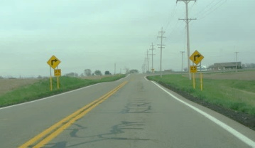
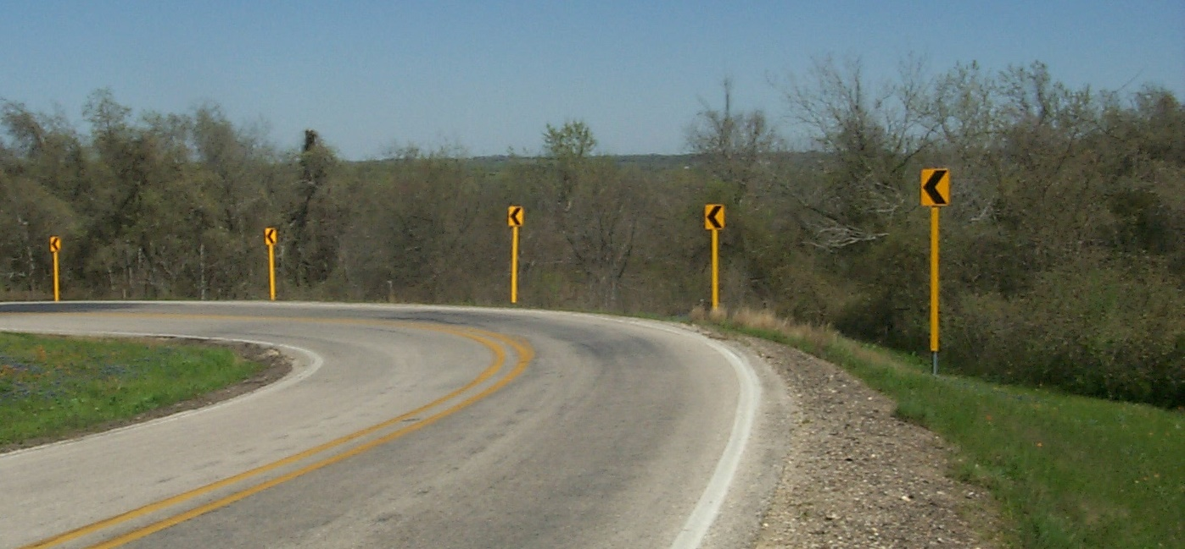
Curve Sign Enhancements
In some cases, additional treatments that enhance conspicuity may be appropriate
Bigger signs
Doubling-up
Fluorescent yellow prismatic sheeting
Overhead placement
Warning beacon
Reflectorized posts
Others in MUTCD 2A.15

Slide 10
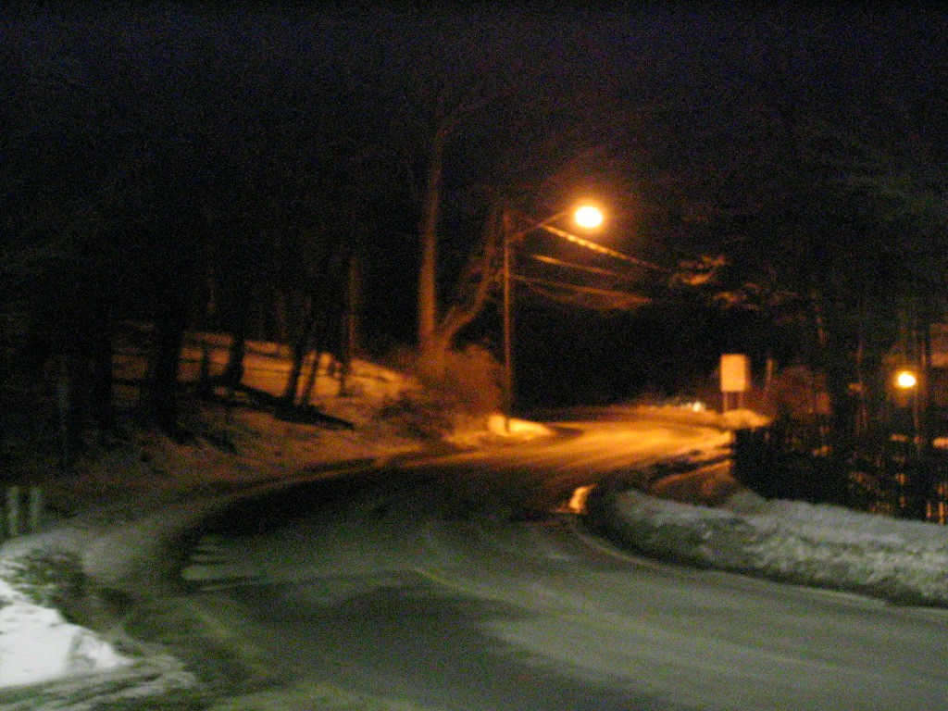
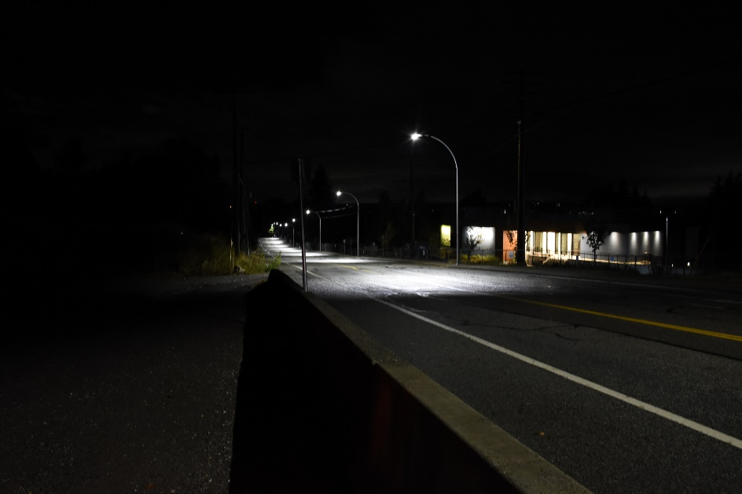
Increase Nighttime Visibility for Safety: Roadway Departure
Range of practice:
  Focused improvements at locations with known crash history and/or travel ways for roadway departure benefits
    Enhanced conspicuity of traffic control devices
    Installation of lighting for curves
    Maintain Minimum Retroreflectivity

Slide 11
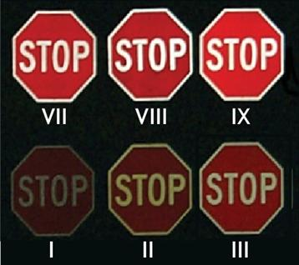

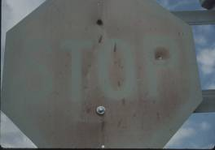
Why is Traffic Sign
Retroreflectivity Important?
Signs provide critical information to drivers but
…retroreflectivity degrades over time.
https://mutcd.fhwa.dot.gov/htm/2009r1r2/part2/part2a.htm#section2A08
Notes:
Welcome and Introduction
11

Slide 12
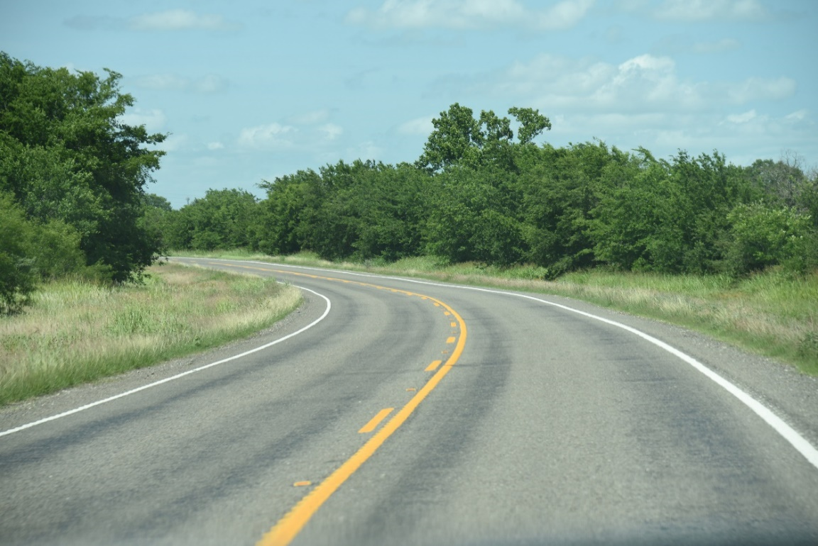

Why is Pavement Marking Retroreflectivity Important?
Visibility is critical for nighttime driving
Daytime - many cues available
Nighttime - few cues remain
Notes:
Welcome and Introduction
12

Slide 13
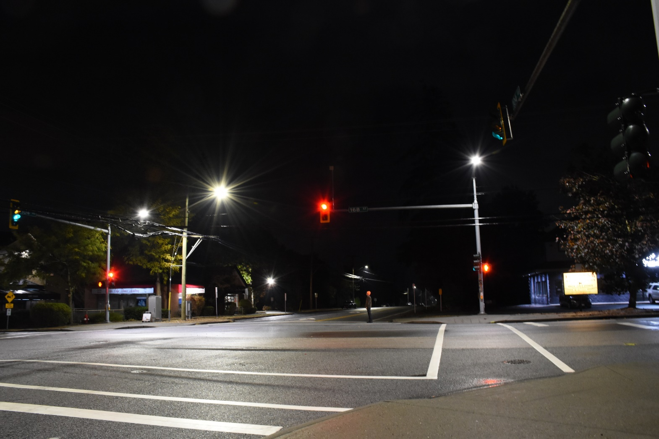
Intersection Benefits
Retroreflective backplates for signals can reduce crashes by 15-percent.
Properly designed lighting at rural and urban intersections can reduce nighttime crashes by up to 38 percent.
Adequate intersection lighting can help reduce pedestrian fatalities by 42-percent.
Improved visibility with improved sight distance reduces crashes.
Data sources: Crash Modification Factors (CMF) Clearinghouse www.cmfclearinghouse.org CMF IDs 1410, 2376, 433, and 436

Slide 14
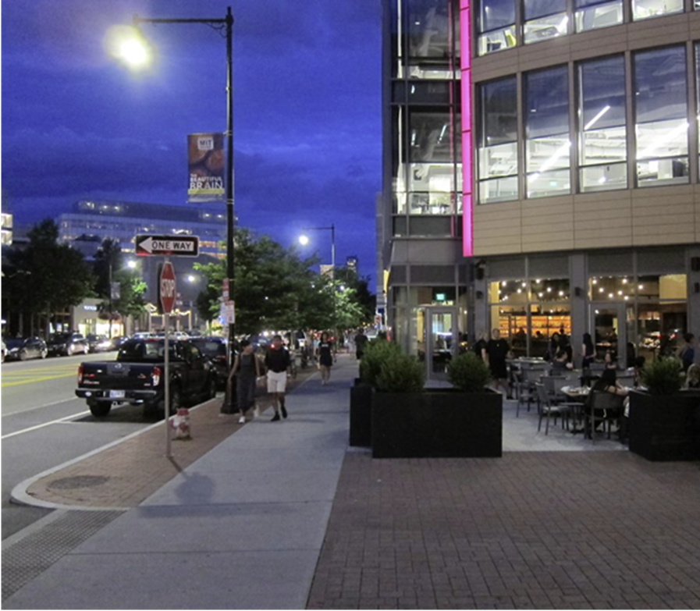

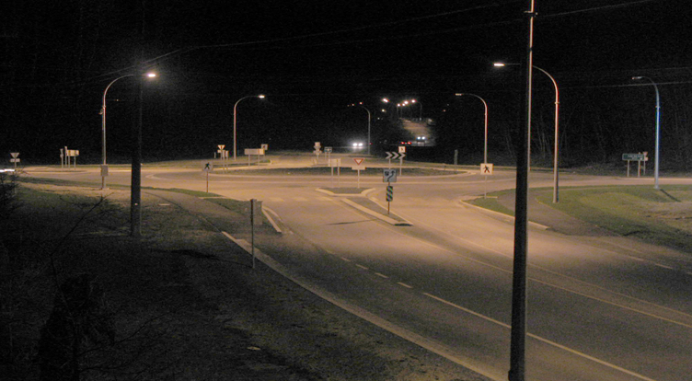
Increase Nighttime Visibility for Safety: Intersections
Range of practice (examples):
  Focused improvements at intersections with known crash history and/or near target locations such as schools, activity centers, transit stops etc.
    Enhanced conspicuity of traffic control devices
    Install luminaire at candidate rural intersections
    Install well-designed lighting
    Improve intersection site distance

Slide 15
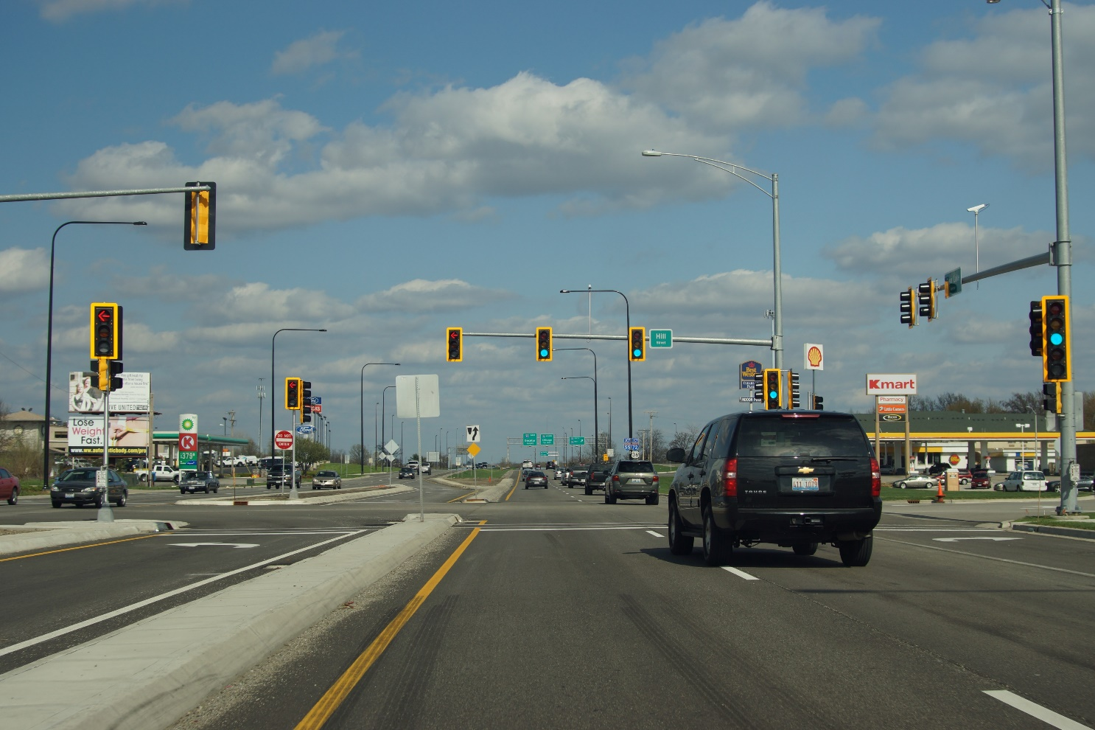
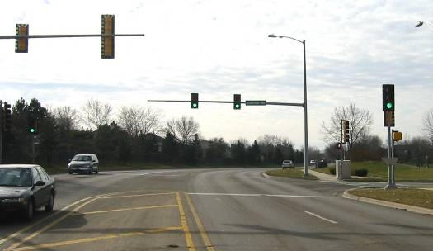
Traffic Signal Enhancements
Treatments that enhance conspicuity
Bigger signs
Doubling-up
Fluorescent prismatic sheeting
Warning beacon
Reflectorized posts
Advance warning signs and systems
Others in MUTCD 2A.15
Use 12-inch signal indications
Add supplemental signal heads
Add retroreflective borders to backplates
Source: FHWA

Slide 16
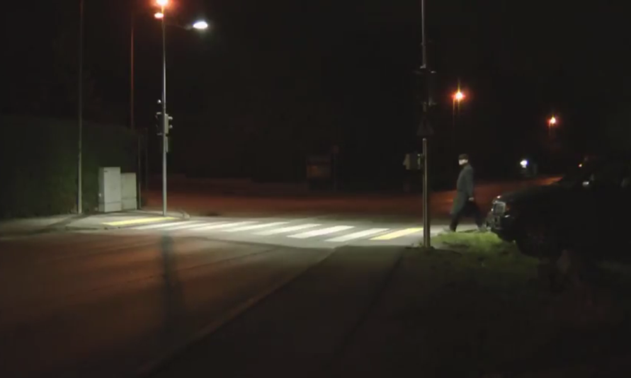
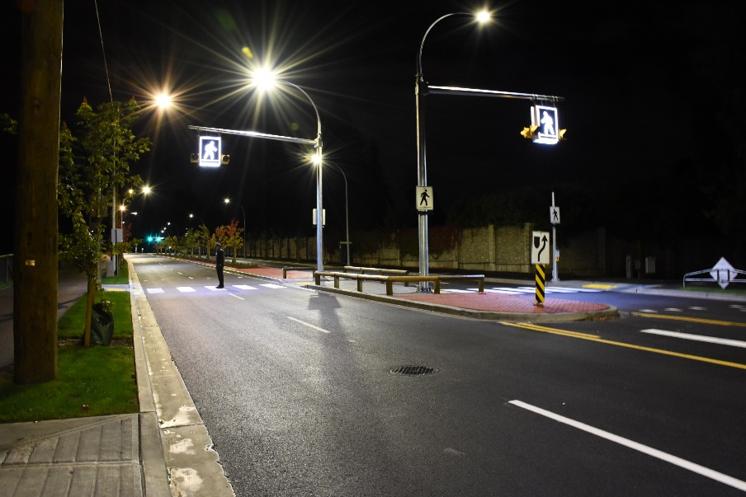
Pedestrian & Bicyclist Benefits
Crosswalk visibility enhancements for pedestrians, such as those in STEP, can reduce pedestrian crashes up to 47-percent!
Advance markings and signs make it safer for people to cross a road.
Improved pedestrian lighting design at intersections and mid-block crossings provide safer experiences at activity centers like schools, transit stops, and entertainment venues.
Source: Screen capture of SWARCO “Cross Walk Street Lighting” YouTube Video (at 1:16)
Data source: Rectangular Rapid Flashing Beacons (RRFB)

Slide 17



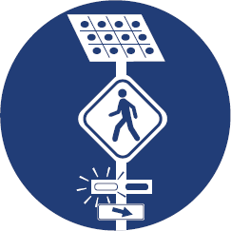



Safe Transportation for Every Pedestrian (STEP) Countermeasures
Crosswalk Visibility Enhancements
Raised Crosswalks
Pedestrian Refuge Island
Rectangular Rapid Flashing Beacon (RRFB)
Pedestrian Hybrid Beacon (PHB)
Road Diets
Leading Pedestrian Interval (LPI)

Slide 18
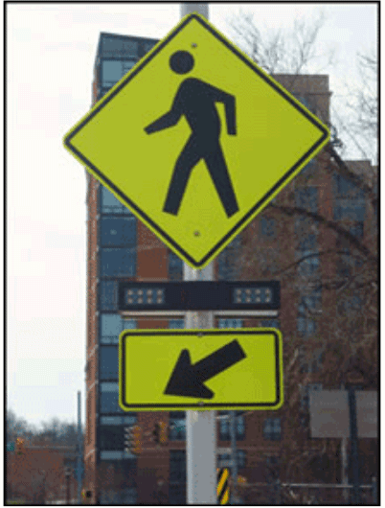
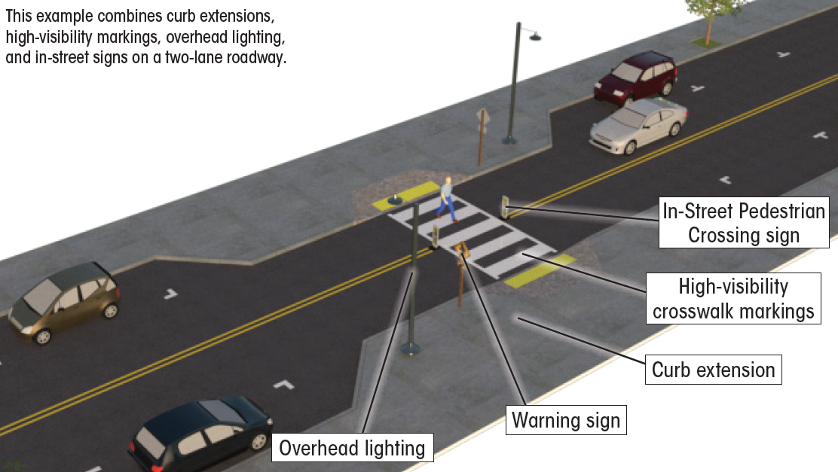
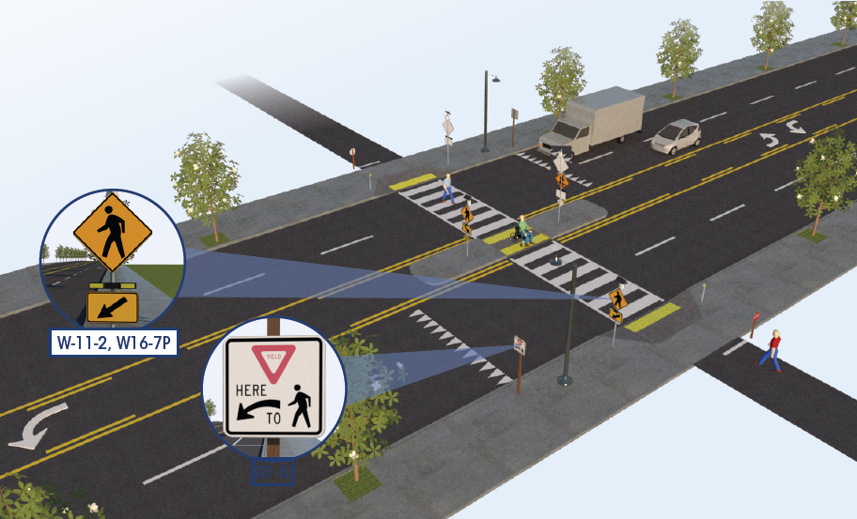
Crosswalk Visibility Enhancements and Rectangular Rapid Flashing Beacon (RRFB)
47% Reduction in Pedestrian Crashes
Intersection Lighting 42% Reduction in Nighttime Pedestrian Crashes
Data Source: https://highways.dot.gov/safety/proven-safety-countermeasures/crosswalk-visibility-enhancements

Slide 19
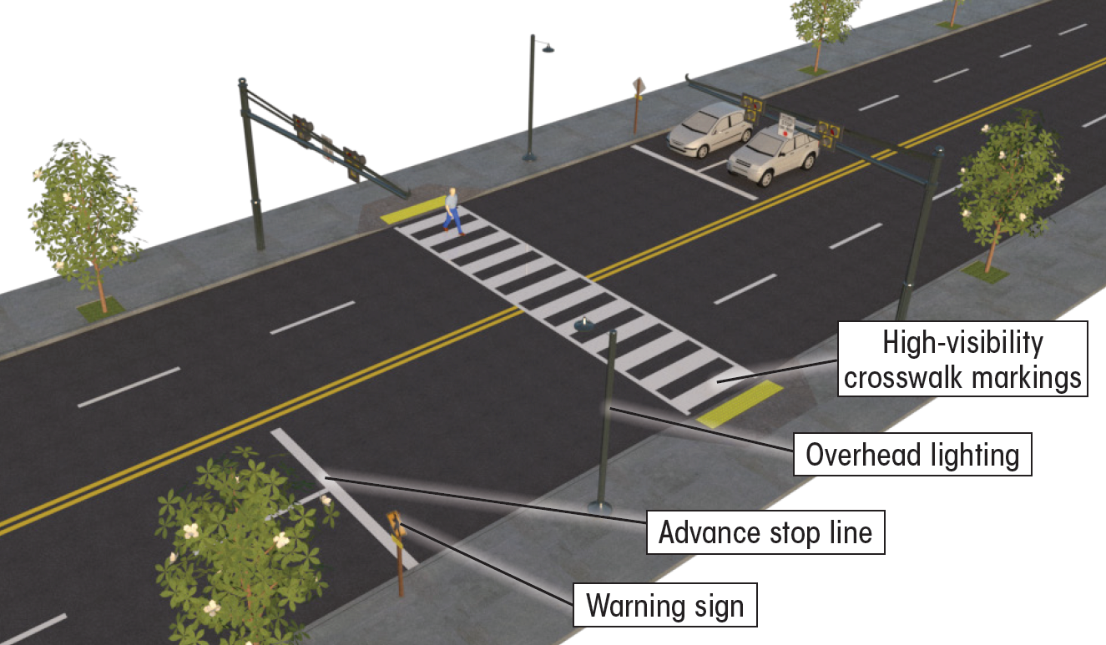
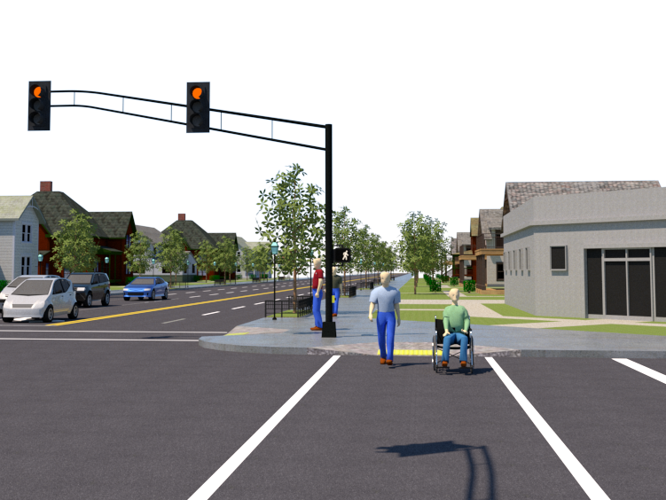
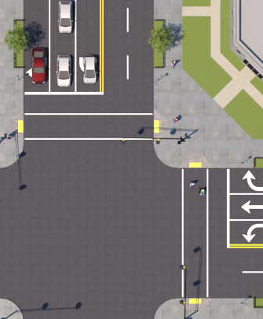
Pedestrian Hybrid Beacon (PHB) and Leading Pedestrian Interval (LPI)
55% Reduction in Pedestrian Crashes
13% Reduction in Pedestrian-Vehicle Crashes
Data Source: https://highways.dot.gov/safety/proven-safety-countermeasures/pedestrian-hybrid-beacons

Slide 20
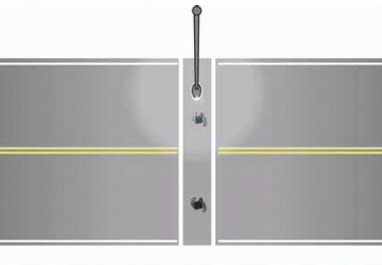
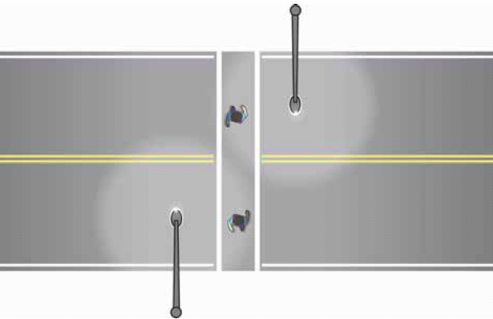
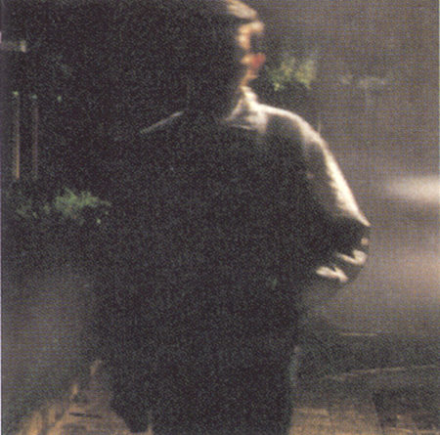
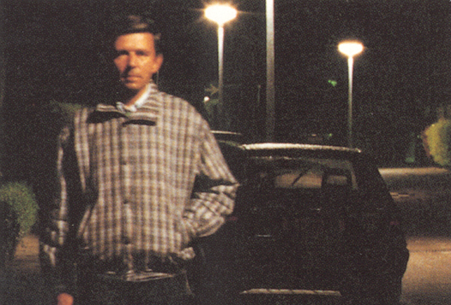


Lighting Over Crosswalks - Positive Contrast
Negative Contrast
Positive Contrast
Fig 11. Traditional midblock
crosswalk lighting layout
Fig 12. New design for midblock
crosswalk lighting layout
Figure 7 FHWA Lighting Handbook (2012)
Figure 7 FHWA Lighting Handbook (2012)
https://www.fhwa.dot.gov/publications/research/safety/08053/

Slide 21
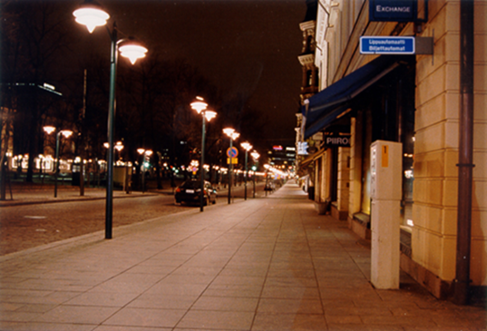
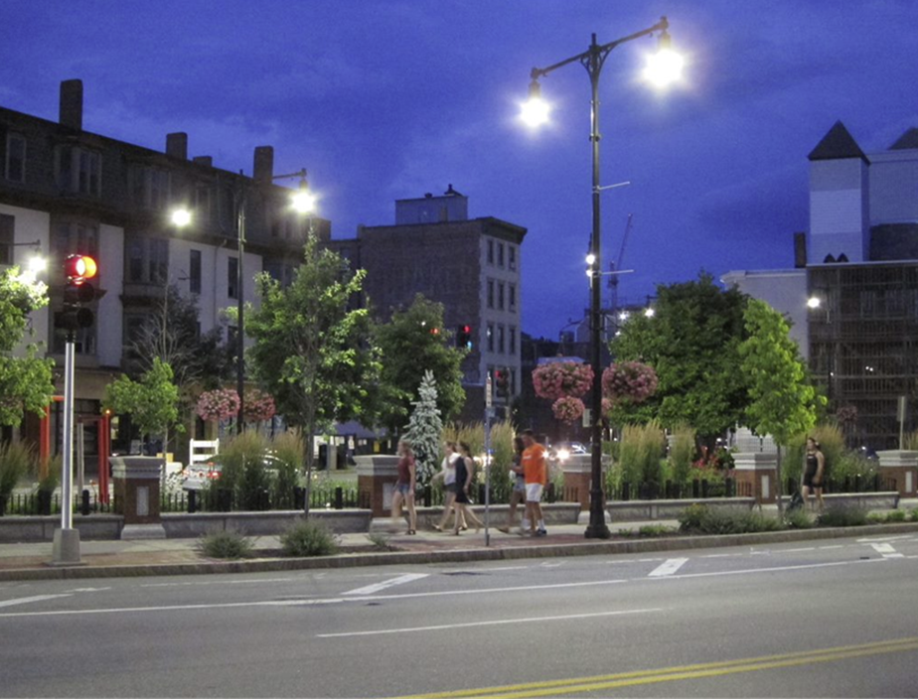
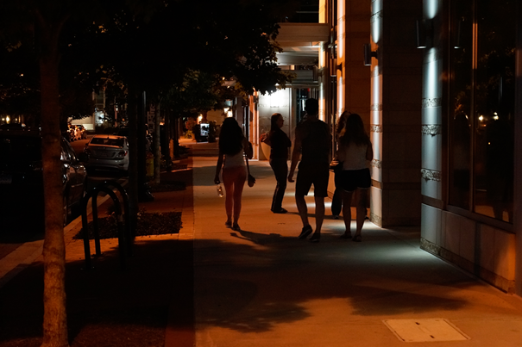
Increase Nighttime Visibility for Safety: Bicyclists and Pedestrians
Range of practice:
  At locations with known crash history and/or near target locations such as near schools, activity centers, transit stops etc.
    Enhanced conspicuity of traffic control devices
    Geometric enhancements
    Install well-designed lighting
    Enhanced visibility at midblock crossings

Slide 22
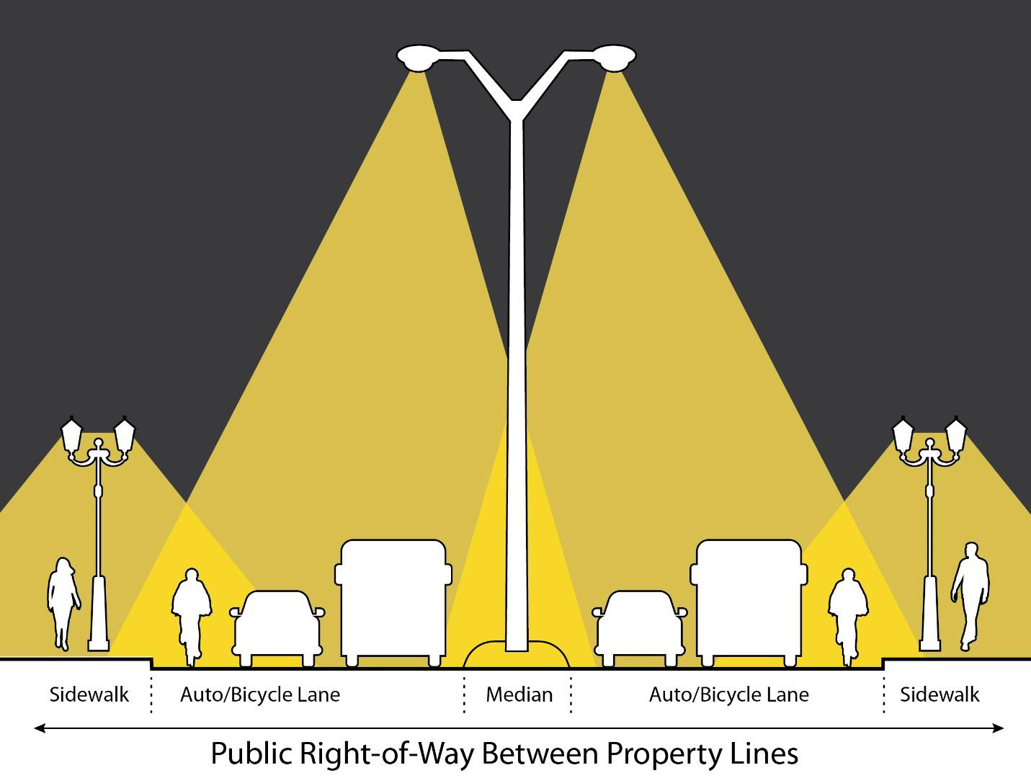
Let’s Talk About Lighting!
Safety
  Security
    Equity

Slide 23
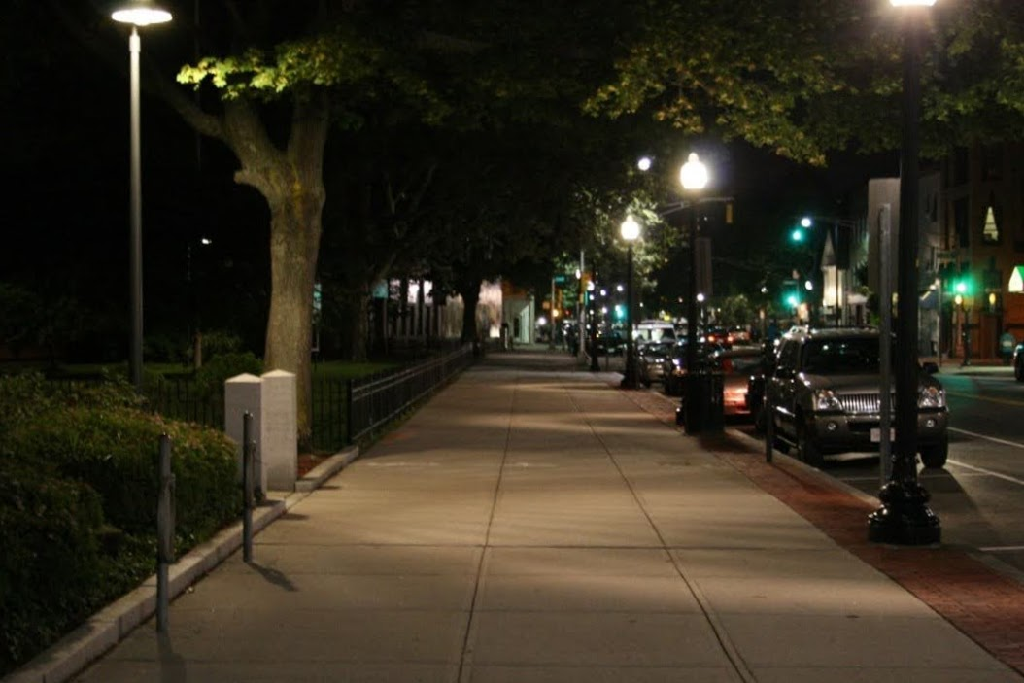
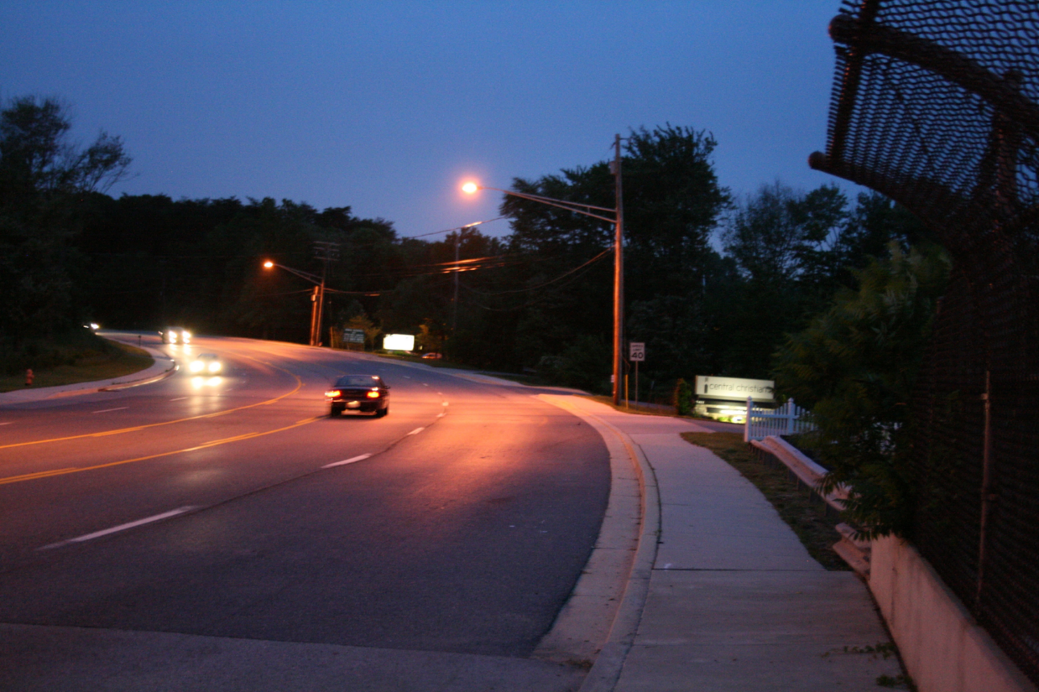
Safety Benefits of Lighting
Lighting can reduce crashes up to:
42-percent for nighttime injury pedestrian crashes at intersections
33- to 38-percent for nighttime crashes at rural and urban intersections
28-percent for nighttime injury crashes on rural and urban highways
Data Source: https://highways.dot.gov/safety/proven-safety-countermeasures/lighting
Notes:
.

Slide 24
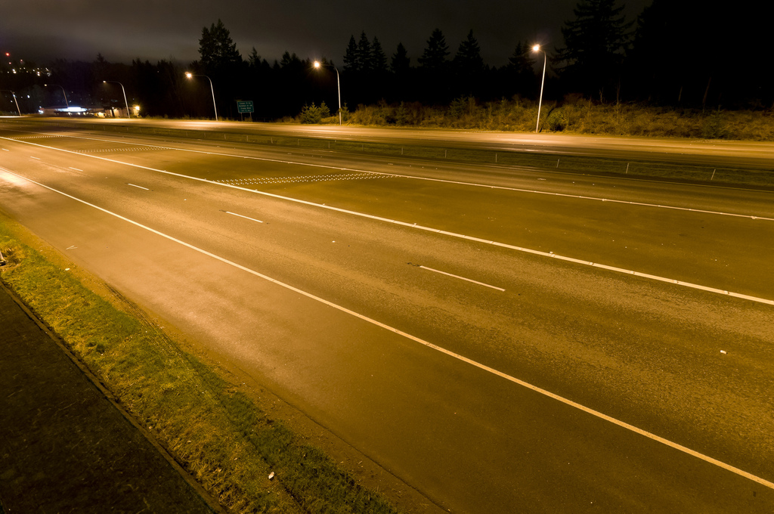
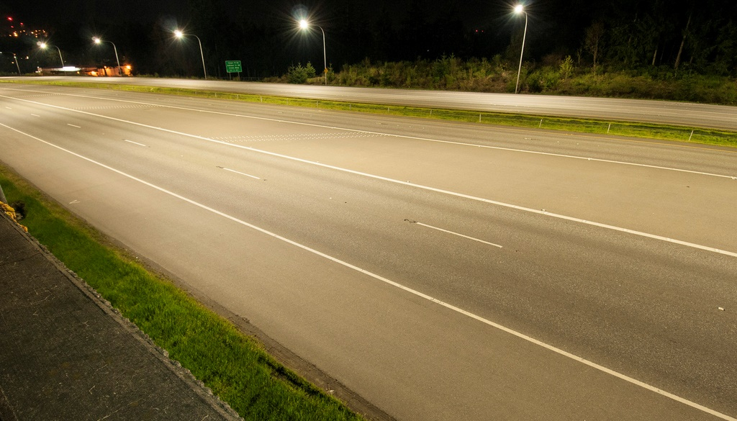
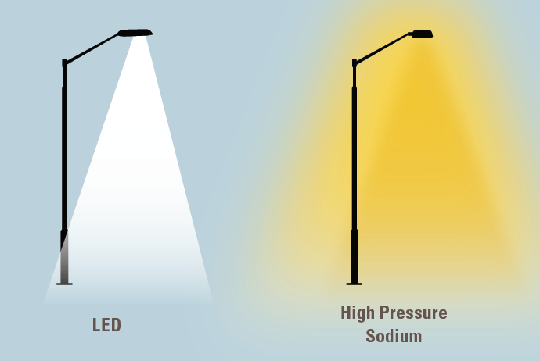
New Lighting Technologies
Source: FHWA
Acutely dimmed to specific levels
Can be turned on and off rapidly (no warm-up period needed)
Can be fine-tuned for color output
Energy efficiency
Higher initial cost but longer life cycle
High Pressure Sodium HPS Lights
Source: FHWA
Light Emitting Diode Lights

Slide 25
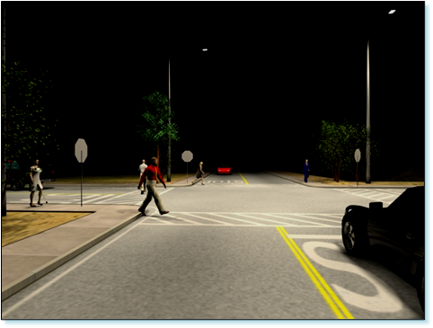
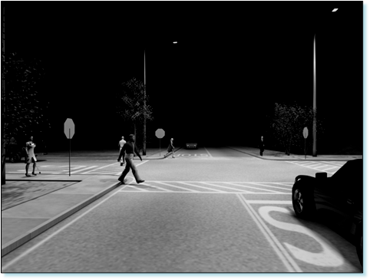
Color Contrast With LED Lighting
Image showing color contrast between LED and HPS lighting.
Figure 7 FHWA Lighting Handbook (2012)
Image showing color contrast between LED and HPS lighting.

Slide 26
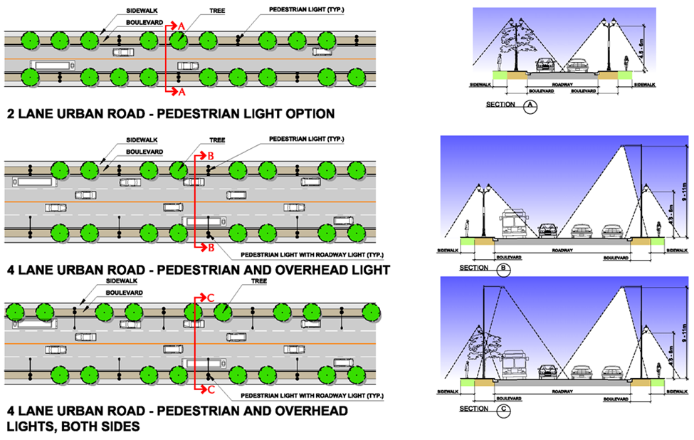
Urban Streetscape Design
Figure 47 FHWA Lighting Handbook (2012)

Slide 27
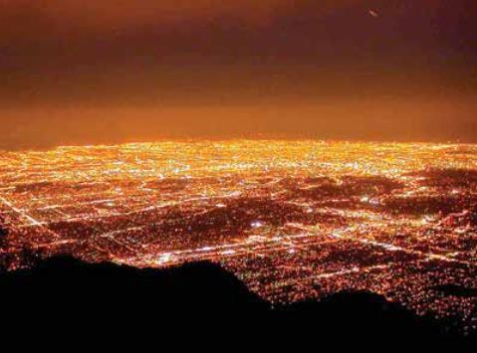
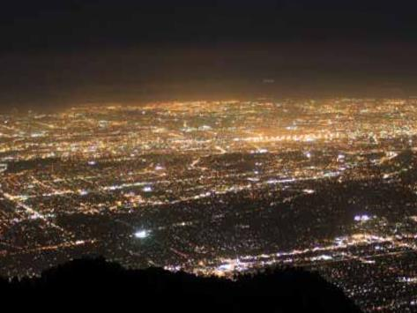
Dark Sky and LED Mitigation Shielding
View from Mt Wilson light pollution in Los Angeles, before and after LED deployment
Source – IES RP-33
Example of how shielding only lights up targeted areas

Slide 28
Increase Nighttime Visibility for Safety: Lighting
Range of practice:
  Focused improvements at locations with known crash history and/or near target locations such as near schools, activity centers, transit stops etc.
    Working with municipalities and/or energy providers to discontinue the use of HPS systems and evolving toward modern lighting technology
    Retrofitting of existing luminaires with modern lighting technology
    Retrofitting of existing luminaires with well-designed lighting improvements
    Installation of new, modern well-designed lighting
    Evaluation of Lighting policies

Slide 29
Tools & Resources
Proven Safety Countermeasures
Past EDC Initiatives
  STEP (Safe Transportation for Every Pedestrian)
  FoRRRwD (Focus on Reducing Rural Roadway Departures)
Opportunities: training, webinars, peer exchanges, tools, guides, checklists, demonstrations, etc.
Recommendations for lighting design and new tools for application of traffic control devices

Slide 30
Thank you!
Find Additional Resources at:
EDC-7: Nighttime Visibility for Safety (https://www.fhwa.dot.gov/innovation/everydaycounts/edc_7/nighttime_visibility.cfm)
Joe Heflin
Transportation Specialist
FHWA Office of Safety
Joseph.Heflin@dot.gov
501-324-6443
Questions or Comments?

