Slide 1
Pavement Materials Innovation with Recycled Tire Rubber & Balanced Mix Design

Slide 2
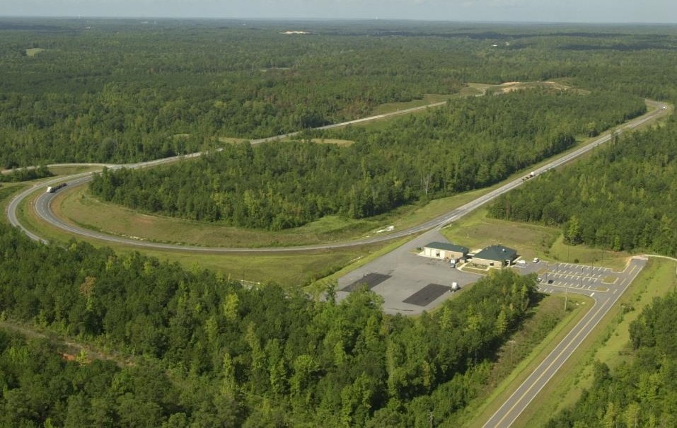
NCAT Pavement Test Track
National Center for Asphalt Technology @ Auburn since 1986
Innovative, relevant, and implementable research projects
Advancement of safe and sustainable asphalt pavements
Mix/materials₈₆, structural pavement design₀₃, and preservation₁₂
1.7-mile nonprofit Track since ‘00, rebuild/reset every 3 years.

Slide 3
11 States + FHWA + 8 Industry

Slide 4
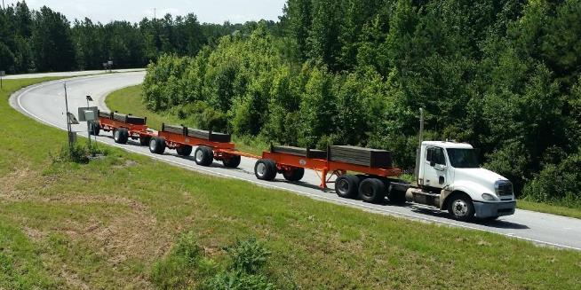
2021 NCAT Pavement Test Track
32 sponsored sections
16 traffic continuations
7 mill/inlay sections
9 structural sections
16 repaved/rebuilt sections
~1/3 of the Track (typical).

Slide 5
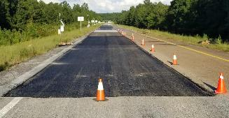
Traffic Continuations₁₆
Higher RAP with recycling agents – CA_{N3}
Foamed cold central plant recycle (CCPR) base – VA_{N4}
High performance thinlays (DGA, SMA) – AL_{N10,N11}
Crack prevention interlayers – GA_{N12,N13}
Soybean based polymer modified asphalt – SB_{W10}
BMD via recycling agents, gradation change, etc. – OK_{S1}, TX_{S10,S11}
Impact of base stabilization, subgrade modification – MS_{S2}
Long term benefit of surface rejuvenators – MS_{S3}
Full depth rapid rebuilds (grinding vs thinlays, HiMA) – SC_{S9}
Open graded friction surface rejuvenation – SR_{E1}
Impact of density on performance – FL_{E5,E6}

Slide 6
2012 “Green Group” Experiment
Purpose of Each Layer | N5 Control | S5 Higher RAP | S6 RAP+RAS | S13 Recyc Tires
Durable, Rut Resistant Surface | 20% RAP₂₀ 67-22/82-16 DG | 25% RAP₁₁ 67-22/76-22 SMA | 5% RAS₂₁ 67-22/88-16 SMA | VIRGIN 82-22₁₂ SMA
Stiff, Strain Reducing Middle | 35% RAP₃₉ 67-22/88-10 DG | 50% RAP₄₁ 67-22/82-16 DG | 50% AGED₂₆₋₂₄ 67-22/94-10 DG | 35% RAP₃₇ 82-22₁₂ DG
Fatigue Resistant Base Layer | 35% RAP₃₉ 67-22/88-10 DG | 35% RAP₃₄ 94-28/94-10 DG | 25% RAP₂₄ +76-22/88-16 DG | VIRGIN 88-22₂₀ AZ
13½ lbs
11½ lbs
29 lbs
Green = Evotherm Q1 Additive, Blue = Astec Green Foamer
“Coarse” RTR at ~17,000 pounds per mile of paving

Slide 7
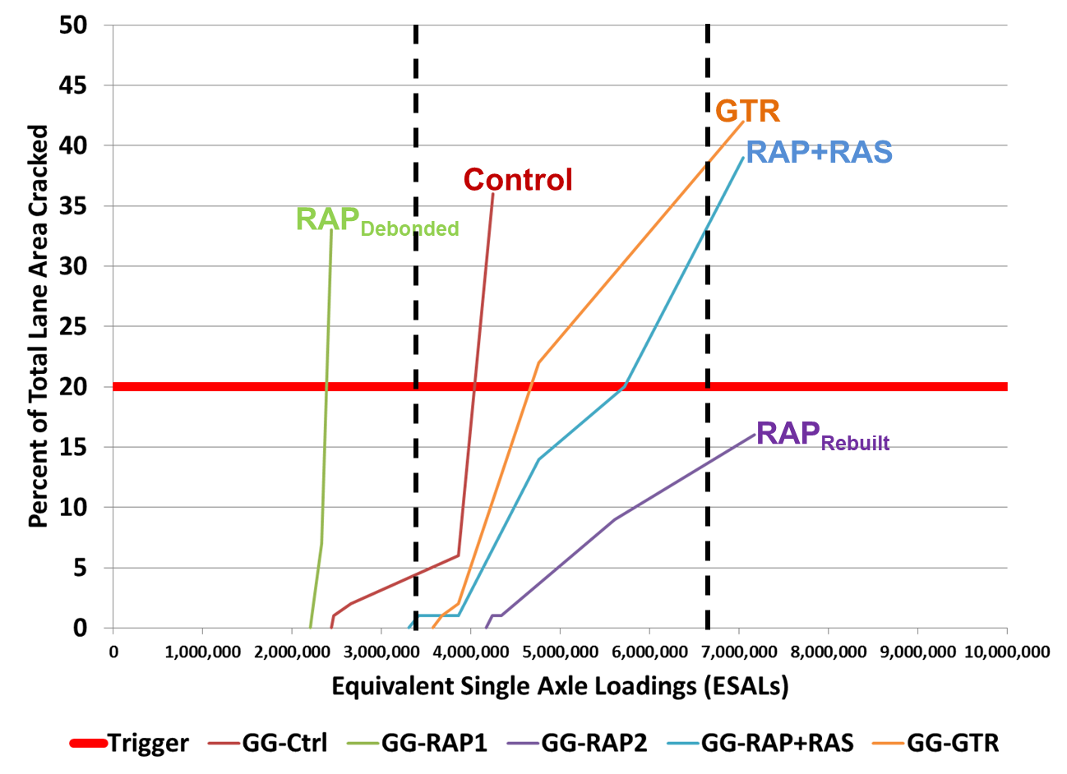
2012 “Green Group” Experiment

Slide 8
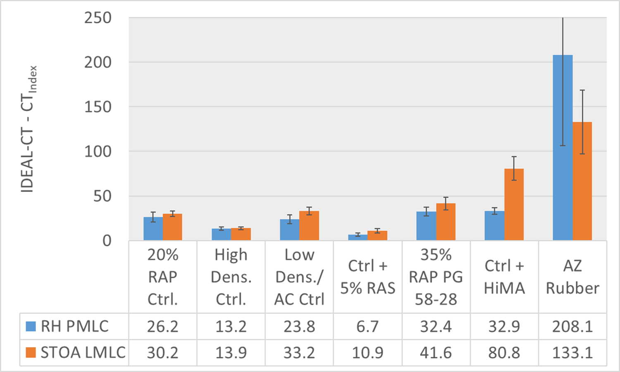
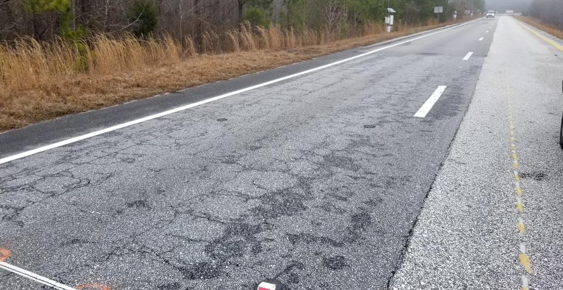
2015 “Cracking Group” Experiment

Slide 9
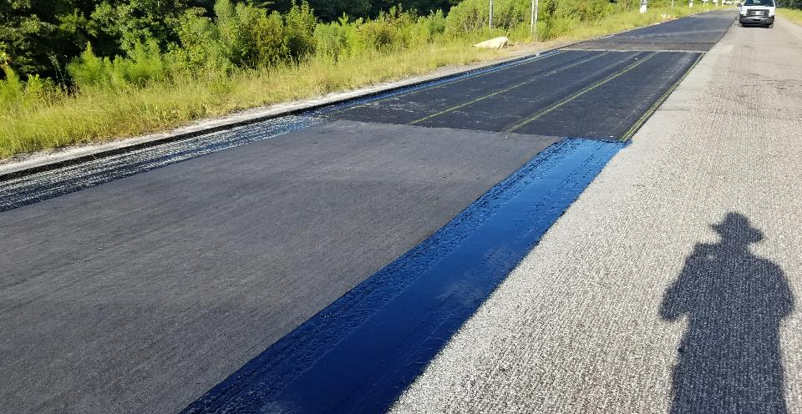
2018 Reflective Crack Prevention Interlayers

Slide 10
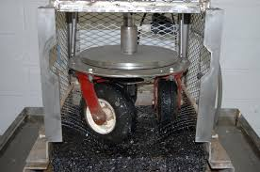
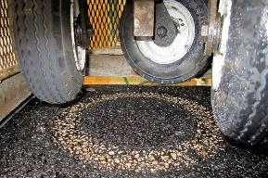
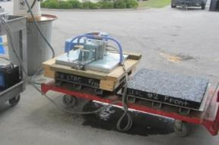
New Mill/Inlay Sections₇
BMD via additives, gradation – OK_{N8,N9}, TX_{N6}
BMD with SGC and Marshall for QC – TN_{S4}
Bond strength with different tack products and/or rates – NC_{W4}
“BMD+Friction” mix optimization – KY_{S7}
High performance OGFC surface – AL_{E9}

Slide 11
“Dry” Recycled Tire Rubber in N9₂₀₂₁

Slide 12
New Structural Sections₉
Minimum HMA thickness over cold (re)recycling – VA_{S12}
Additive Group (AG) study for additive impact on pavement life
“AG+” New polymer from old recycled tire rubber – Sigmabond HP_{S8}
“AG+” High polymer performance with reduced viscosity – BASF_{S13}

Slide 13
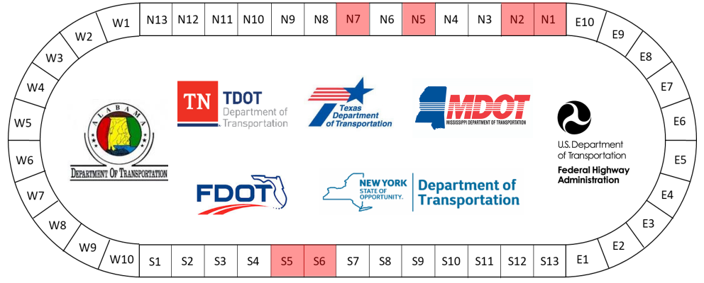
2021 Additive Group (AG) Study
Performance
Framework

Slide 14
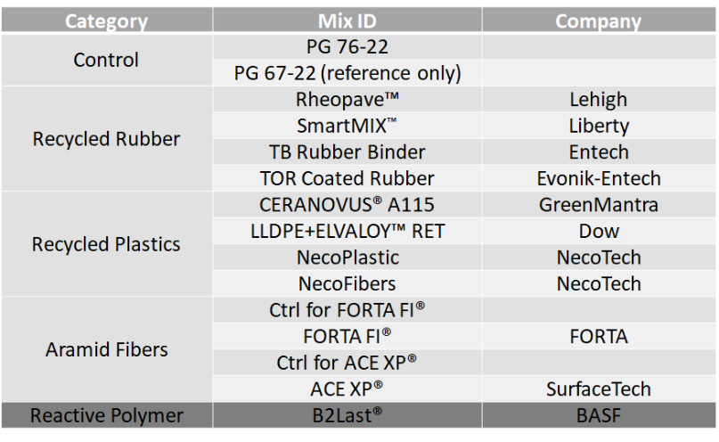
Phase 1 Studies (BMD+Fatigue)

Slide 15
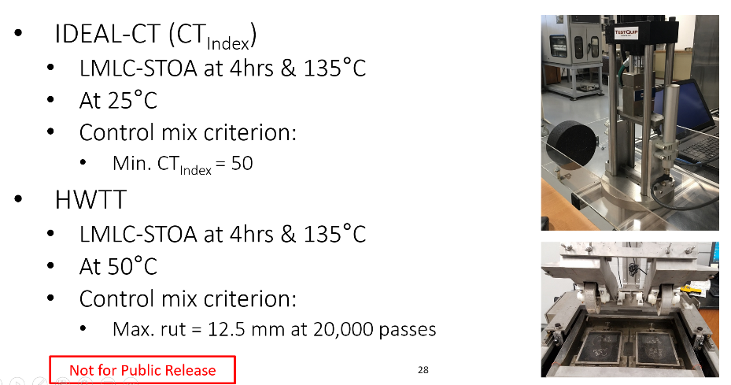
Balanced Mix Design for AG+ Study

Slide 16
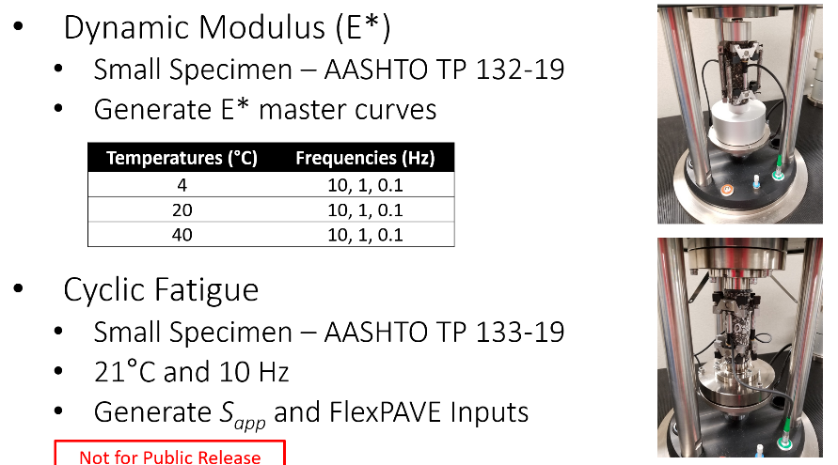
Fatigue Testing and Modeling

Slide 17
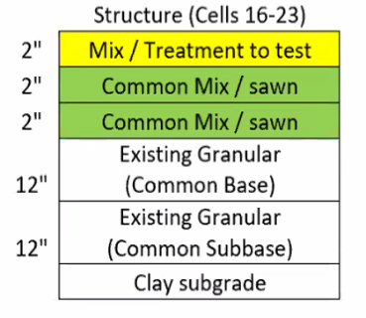
Agency Selected AG Treatments
Recycled tire rubber
“Dry” Smart Mix in PG67-22_{N1}
“Wet” Entech PG76-22_{N2}
Recycled low density plastic
“Dry” pellets with PG76-22_{S5}
“Wet” Dow with Elvaloy PG76-22_{S6}
High strength aramid fibers
Surface Tech ACE XP with PG76-22_{N5}
Control with PG76-22_{N7}
MnROAD in 2022

Slide 18
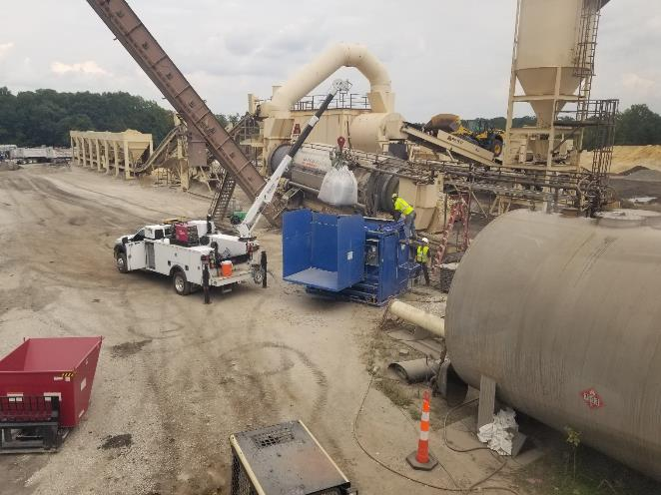
Astec Double Barrel with Hi-Tech Feeder

Slide 19
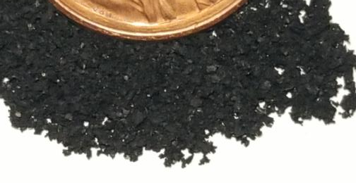
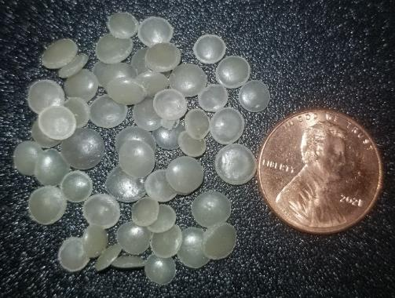
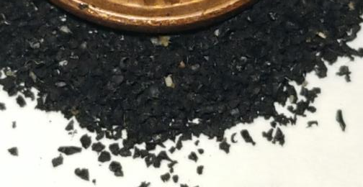
Hi-Tech Asphalt Solutions Feed System
← Smart Mix₁₂
Dry Plastic_{8½}→
← Asphalt Plus₁₂

Slide 20
Smart Mix₁₂
13½ lbs “fine” RTR per ton of asphalt
Great Lakes area source
Moving to GA for ‘22 AL projects
2M AL tires processed in GA
AL intake increase likely in ’22.

Slide 21
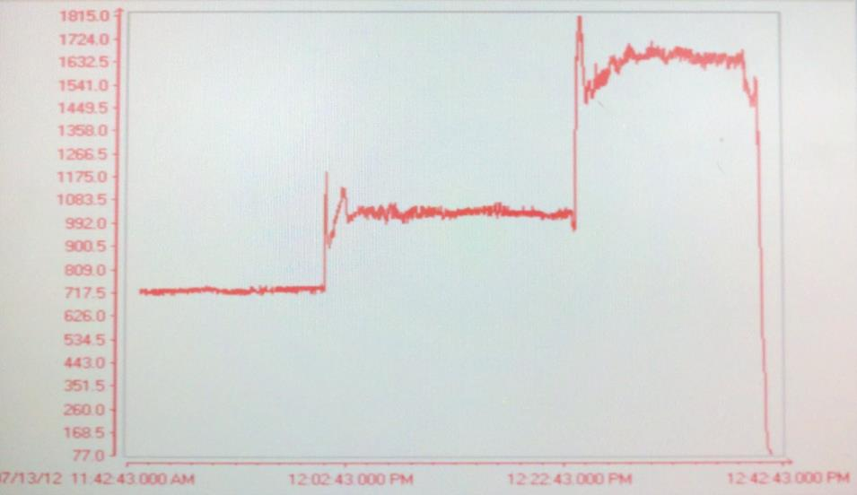
Inline Vibrating Wire Viscometer
“Wet” RTR
SBS-Modified
Neat Binder

Slide 22
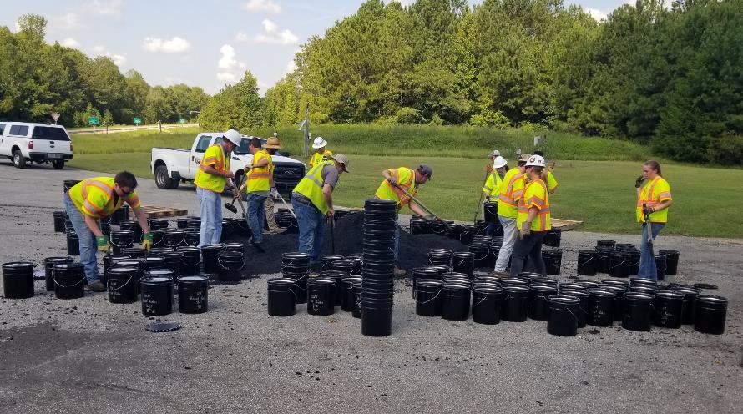
Bulk Research Sampling

Slide 23
Track Takeaways
Regional investigation/adoption of BMD requirements
Additives are nothing to fear by industry/agencies
Gap graded rubber mix in top, bottom, middle layers
BMD compliance is “easier” than volumetrics
“Easy Button” for dialing up IDEAL-CT?
Higher cracking indicator from production
No critical aging for non-surface mixes
No difficulty meeting densities with healthier mixes.

Slide 24
Questions and Answers

