Slide 1
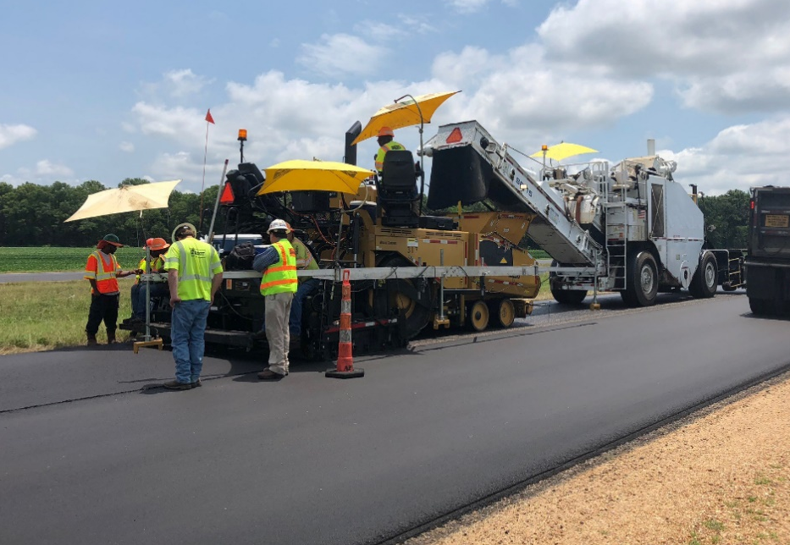
Targeted Overlay Pavement Solutions (TOPS)
Image source: NAPA
A solution for extending the life of an existing pavement investment.
Image source: ACPA
Tim Aschenbrener, P.E.
Senior Asphalt Engineer
Pavement Materials Team
FHWA: Office of Infrastructure

Slide 2
Disclaimer
Except for any statutes or regulations cited, the contents of this presentation do not have the force and effect of law and are not meant to bind the public in any way. This presentation is intended only to provide information to the public regarding existing requirements under the law or agency policies.

Slide 3
Abbreviations & Acronyms
AADT: Average annual daily traffic
ARGG: Asphalt Rubber Gap-Graded
CAM: Crack Attenuating Mixture
CRCP: Continuously reinforced concrete pavement
DOT: Department of Transportation
EDC: Every Day Counts
FHWA: Federal Highway Administration
HiMA: Highly Modified Asphalt
HPTO: High-Performance Thin Overlay
HWTT: Hamburg Wheel Tracking Test
NMAS: Nominal Maximum Aggregate Size
OGFC: Open-Graded Friction Course
OT: Overlay Test
PCC: Portland cement concrete
PG: Performance Grade
SMA: Stone Matrix Asphalt
TOPS: Targeted Overlay Pavement Solutions
UTBWC: Ultra-thin bonded wearing course
VMA: Voids in the Mineral Aggregate

Slide 4
EDC-6 TOPS Team
Asphalt Experts
Tim Aschenbrener, FHWA HQ
Derek Nener-Plante, FHWA Resource Ctr.
Robert Blight, NJ DOT
Peter WU, GA DOT
Sheila Hines, GA DOT
Howie Moseley, FDOT
Ryan Barborak, TXDOT
Tom Bennert, Rutgers University
Tom Scullion, TTI
Buzz Powell, NCAT
Wayne Jones, Asphalt Institute
Brett Williams, NAPA
Concrete Experts
Bob Conway, FHWA Resource Ctr.
Steve Norton, CTDOT
Todd Hanson, Iowa DOT
Andy Naranjo, TXDOT
Jeff Uhlmeyer, WSDOT
Eric Prieve, CODOT
John Adam, Iowa State University
Tara Cavalline, Univ. of NC at Charlotte
Leif Wathne, ACPA
Rich Rogers, Cement Council of Texas
Lisa Lukefahr, TX Concrete Paving Assoc.

Slide 5
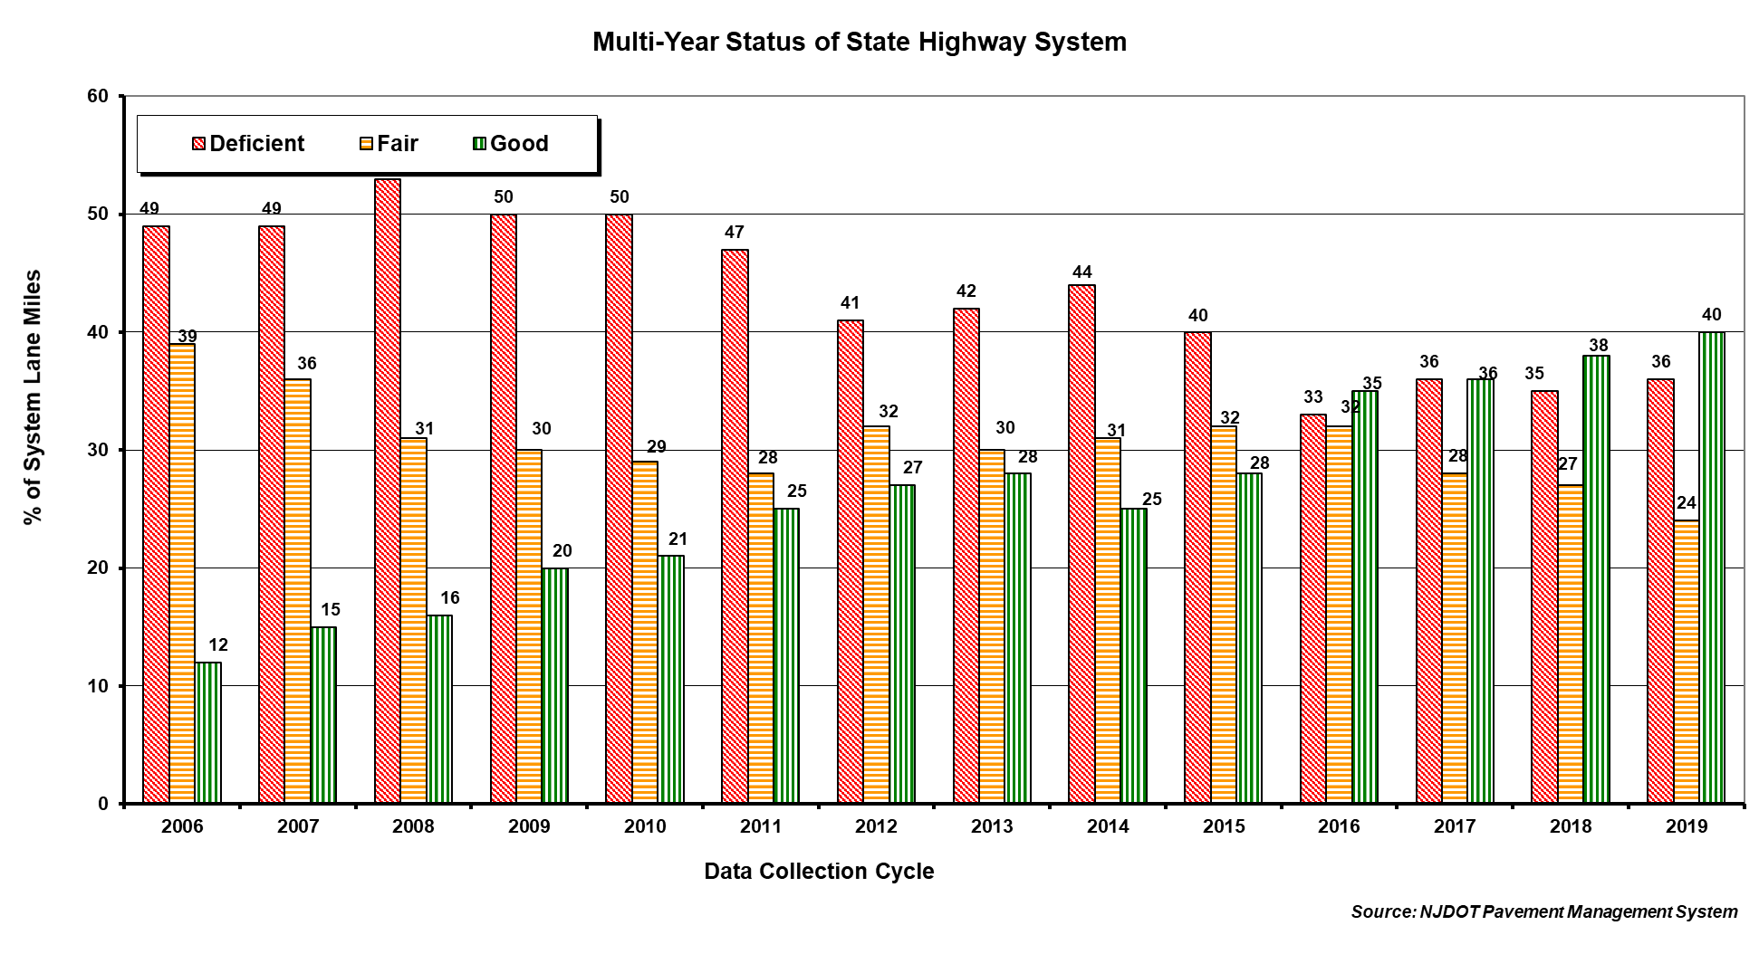
The “Why” & Potential Benefits of TOPS NJDOT Benefits: Overall Pavement Network Improvements
Specialty asphalt mixtures (BMD) for targeted overlay pavement solutions
5

Slide 6
Background
Over 25% of all infrastructure funds go to pavements overlays.
Agencies have 2.8 million miles to manage.
Image source: Iowa State University
Information Source: FHWA; Pavement, Materials, and Construction Costs for FY2021, FY2020, and FY2019

Slide 7
How is this different than typical overlays?
TOPS matches treatments to high-priority, high-need locations.
Image source: Georgia DOT

Slide 8
Where should TOPS be used?
Rural/urban and or primary/interstate pavements
Intersections
Bus lanes
Ramps
Curved alignments
High-Priority/High-Maintenance Areas
May be beneficial in wide range of traffic, environmental, and underlying pavement conditions.

Slide 9
Extend pavement life, increase load-carrying capacity, and improve safety, mobility, and user satisfaction in a cost-effective and sustainable manner by delivering targeted pavement overlay solutions to Federal, State, and local transportation agencies.
TOPS EDC Mission
Image source: iStock

Slide 10
Asphalt
Alternative materials and mixture design for higher-performance and durability
Alternative overlay mixture designs & surface types to address:
Friction
Noise
Drainage
Image source: NAPA

Slide 11
What’s in the TOPS toolbox?
Asphalt overlay products:
High-Performance Thin Overlay (HPTO) 11 states
Crack Attenuating Mixture (CAM) 7 states
Highly Modified Asphalt (HiMA) 10 states
Enhanced friction overlay 7 states
Stone matrix asphalt (SMA) 5 states
Asphalt Rubber Gap-Graded (ARGG) 4 states
Open-Graded Friction Course (OGFC) 3 states
Ultra-thin bonded wearing course (UTBWC) 3 states
Fact sheet and “one pagers” at: https://www.fhwa.dot.gov/pavement/tops/

Slide 12
TOPS Potential Benefits
Improved Safety
Improved Performance
Retained Investments
Cost Savings
Environmentally Sound

Slide 13
Potential Benefits
Overlays may reduce maintenance, maximize previous investments, and reduce user delays (fewer work zones) due to extended service life of pavement structure.
Safety Benefits | TOPS Asphalt Products
Increase skid resistance | Enhanced-friction overlay
Reduce splash and spray | Ultra-thin bonded wearing course Open-graded friction course

Slide 14
Potential Benefits
Overlays may reduce maintenance, maximize previous investments, and reduce user delays (fewer work zones) due to extended service life of pavement structure.
Performance Benefits | TOPS Asphalt Products
Adds durability to high traffic locations (truck routes, intersections, roundabouts) | Stone-matrix asphalt Asphalt rubber gap graded Highly modified asphalt
Provides solutions for distressed existing pavements with extensive cracking, marginal base, etc. | Crack attenuating mixture Ultra-thin bonded wearing course
Preserves existing pavement through thin durable overlays | High-performance thin overlays Highly modified asphalt

Slide 15
Potential Benefits
Overlays may reduce maintenance, maximize previous investments, and reduce user delays (fewer work zones) due to extended service life of pavement structure.
Environmental Benefits | TOPS Products
Reduces noise | Open-graded friction course Ultra-thin bonded wearing course

Slide 16
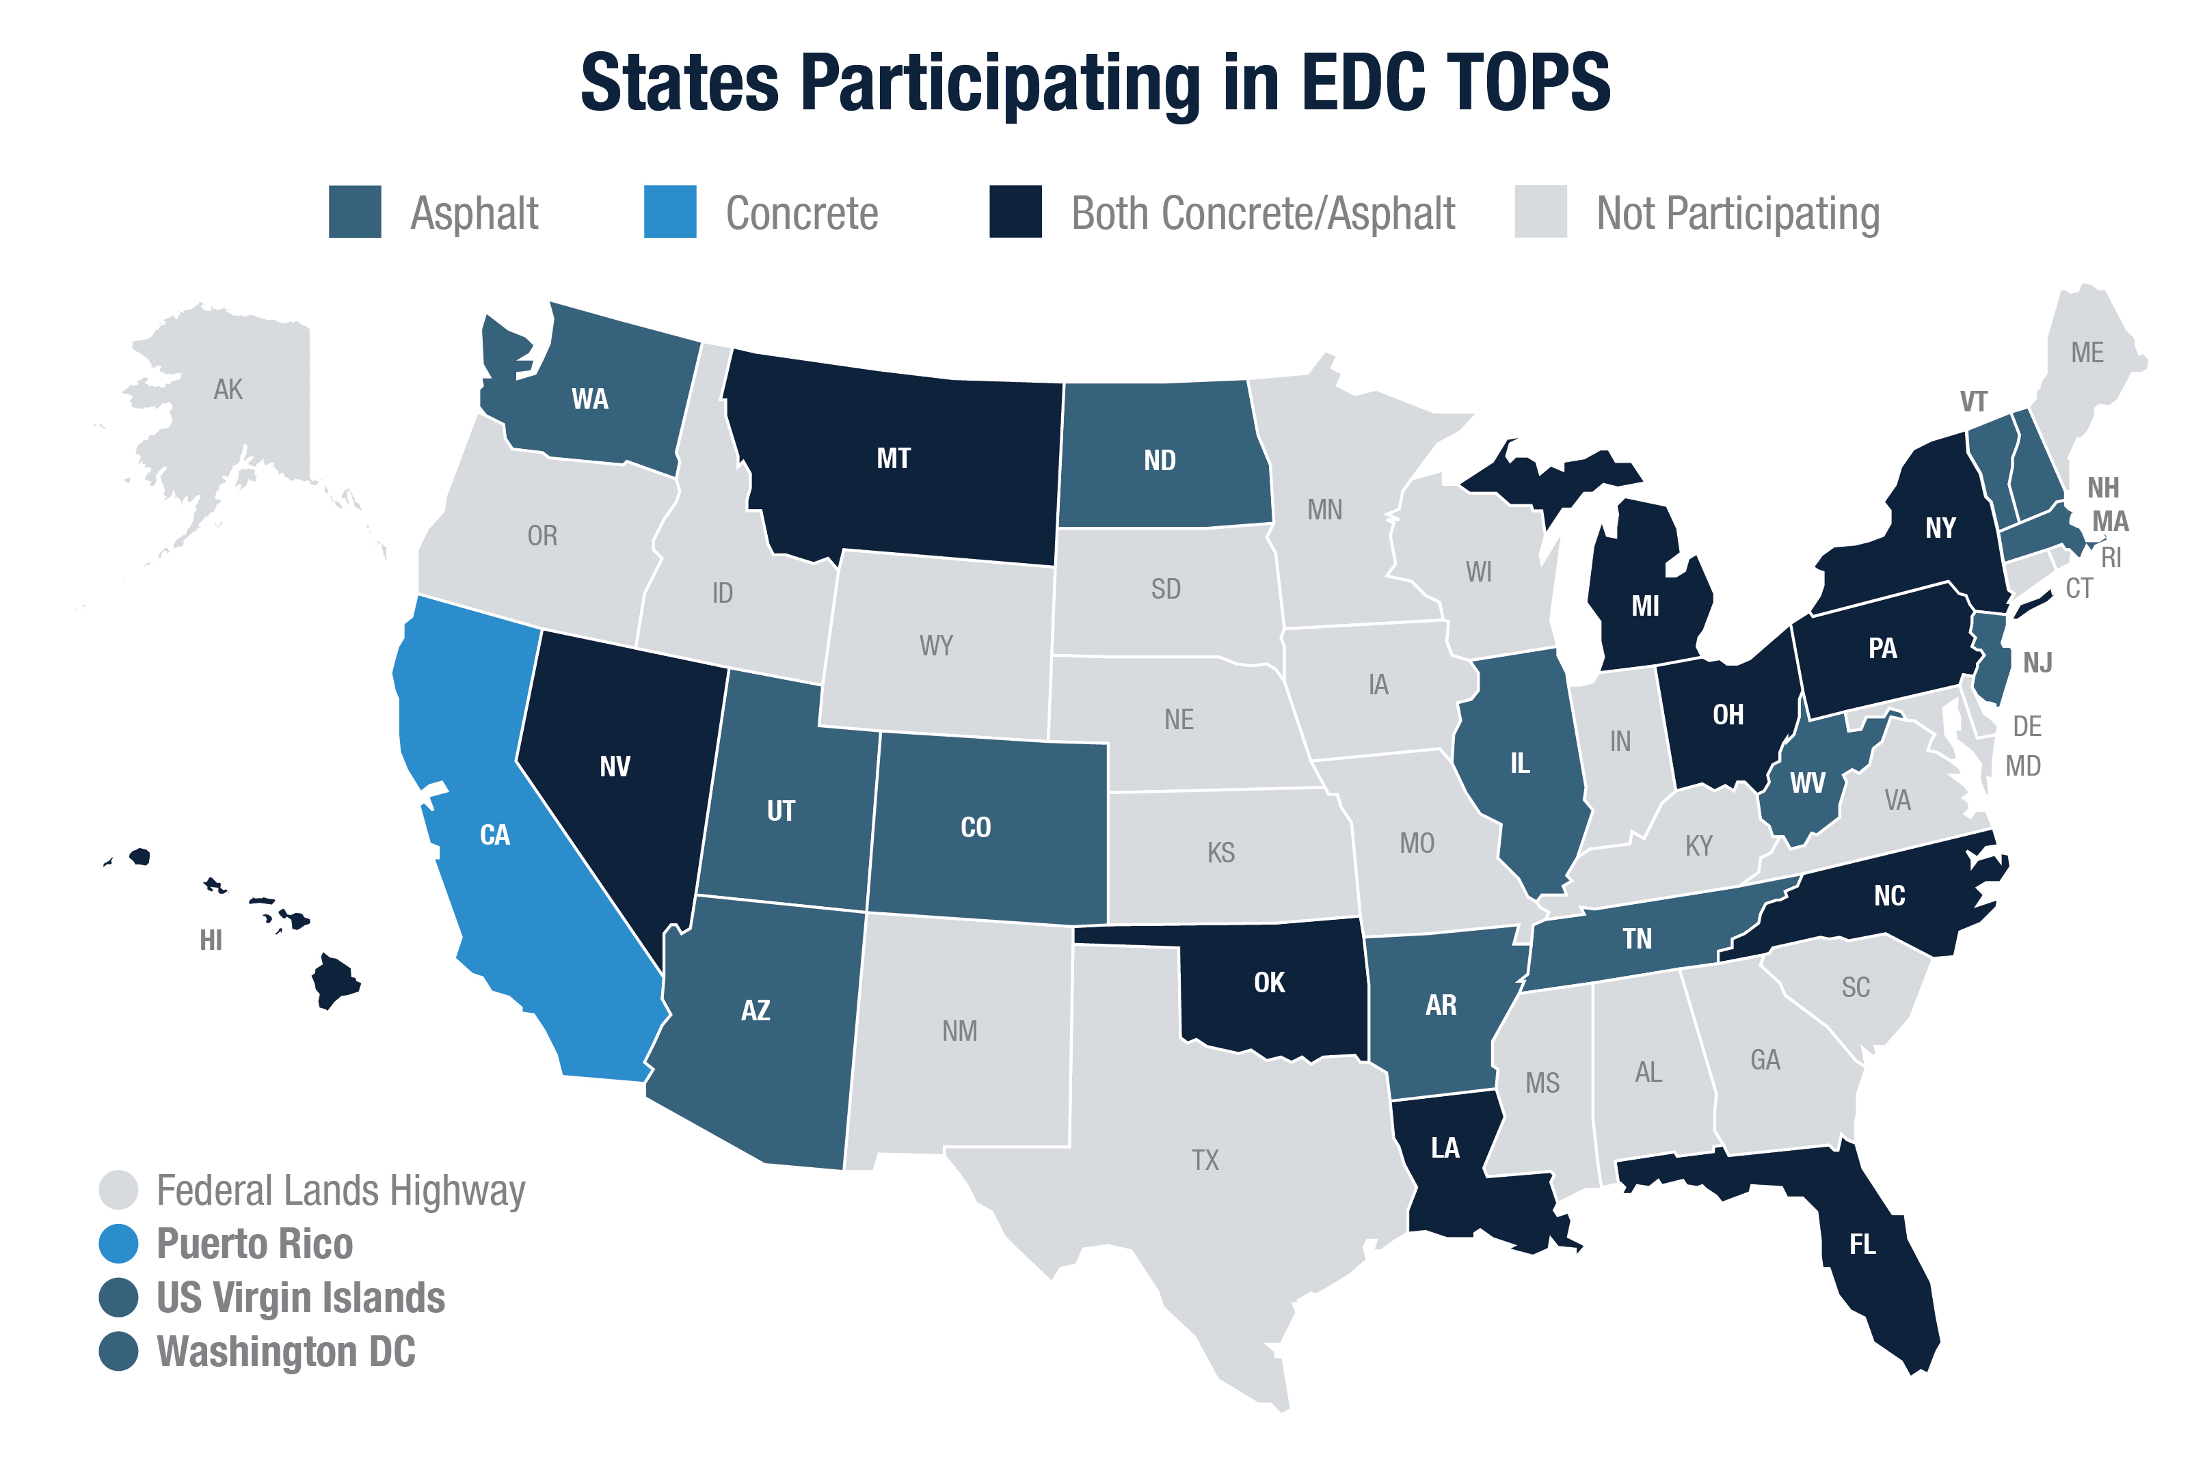
Notes:
29 total states
27 Asphalt
15 Concrete
Of which 13 states are participating in both

Slide 17
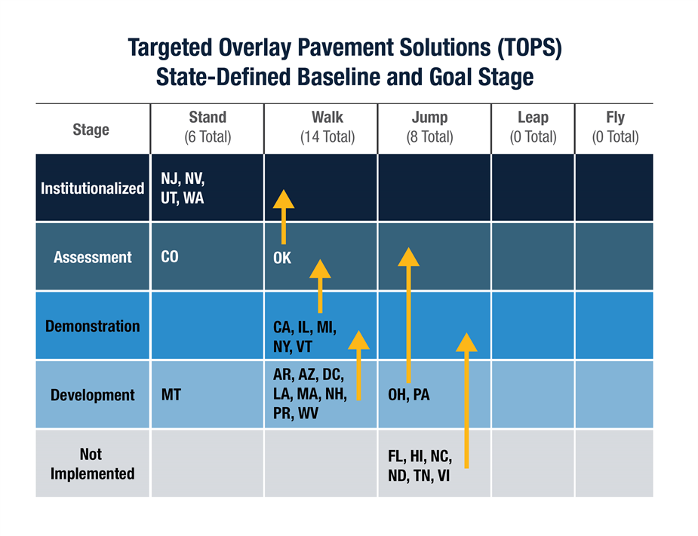

Slide 18
Asphalt Options
Image source: NAPA
TOPS
https://www.fhwa.dot.gov/pavement/tops/

Slide 19
High Performance Thin Overlay (HPTO)

Slide 20
High Performance Thin Overlay (HPTO)
Rut resistant
Crack mitigation
Preserve pavement
Balanced Mix Design

Slide 21
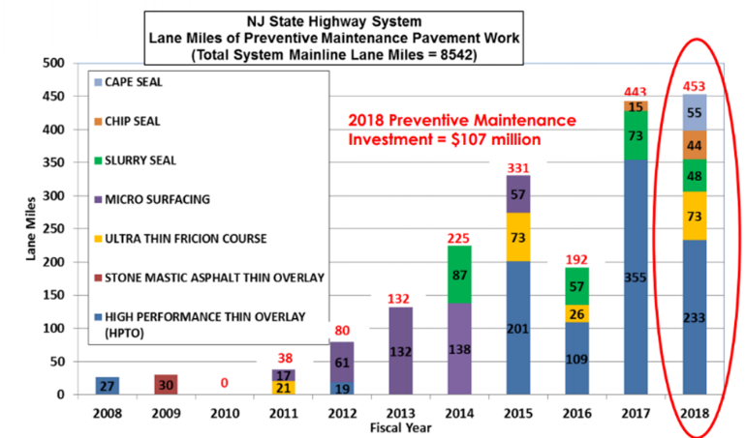
New Jersey DOT Experience w/HPTO
Critical preservation and maintenance tool for New Jersey DOT (NJDOT).
“Work Horse” of the preservation program.
Successful performance by increasing service life or delaying resurfacing needs
Interstate projects with high traffic volumes for flexible, rigid, and composite pavement types.
Source: NJDOT

Slide 22
New Jersey DOT Experience w/HPTO
The advantages and benefits of HPTO as a surface mixture as identified by NJDOT are listed below:
Applicable to State Highway Systems with high traffic volumes.
Can improve ride quality, with a caveat that it will not always improve ride quality. There are limitations with how much a 1-inch lift can improve the ride quality.
Reduces noise and increases long-term skid resistance.
Renews the road surface and provides a good seal, and therefore extends pavement life.
Causes minimal impact on traffic with short road closures.

Slide 23
New Jersey DOT Experience w/HPTO
Example projects:
HPTO application with a micro-mill on Rigid Pavement (JRCP) –
Rt. 70 Cherry Hill
Existing pavement:
SDI = 1.58
IRI = 269 inches/mile
Work performed:
1” micro-mill, limited repairs (<10%) and 1” HPTO
Delivered IRI = 76 inches/mile
Current condition (four years later):
SDI = 4.5
IRI = 90 inches/mile
HPTO application on Full Depth Asphalt Pavement –
I-295 Logan Township
Existing pavement:
SDI = 3.45
IRI = 87 inches/mile
Work performed:
1” micro-mill, limited repairs (<10%) and 1” HPTO
Current condition (eleven years later):
SDI = 4.0
IRI = 87 inches/mile

Slide 24
New Jersey DOT Experience w/HPTO
Specifications
Elevated VMA using 3/8” NMAS mixture
HPTO specifications heavily reliant on performance testing
Asphalt Pavement Analyzer for rutting
Overlay Test (OT) for cracking
Source: NJDOT

Slide 25
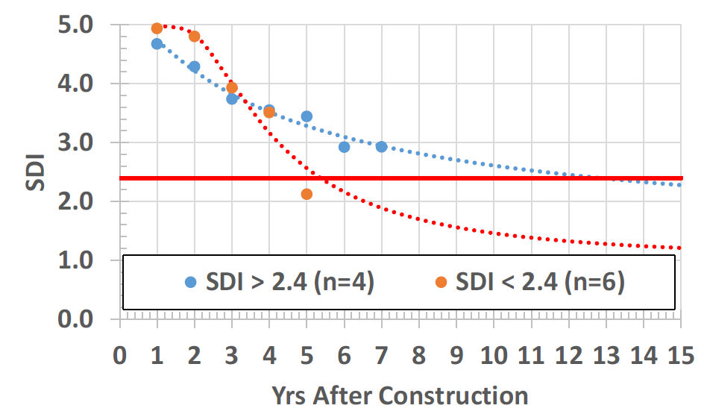
New Jersey DOT Experience w/HPTO
Performance
Essential to consider timing of the application to get the most benefit:
When applied to existing pavement in "good" condition, more than doubles the service life compared to HPTO applied to fair condition pavements.
Source: Dr. Thomas Bennert
Notes:
Rutgers University summarized the performance of 10 different HPTO sections using NJDOT PMS data in 2016. The pre-existing condition of pavement before overlay was used to categorize the projects. The first category included pavements with an SDI greater than 2.4 before overlay. The second category included pavements with a pre-overlay SDI of less than 2.4 before overlay. It was observed that the sections with pre-existing SDI of less than 2.4 provided average service life of 5 years. “Service life” is described here as the number of years where the pavement is still considered good to fair condition (SDI<2.4). When HPTO was placed on the pavement with an existing SDI>2.4, service life trended towards 13 years (see Figure 18). Therefore, the preservation benefits when the pavement is still considered "fair to good" condition are nearly twice that of pavements with more surface distresses.

Slide 26
Crack Attenuating Mixture (CAM)

Slide 27
Crack Attenuating Mix (CAM)
Distressed pavement with extensive cracking
Interlayer for concrete rehabilitation
Balanced Mix Design
CAM

Slide 28
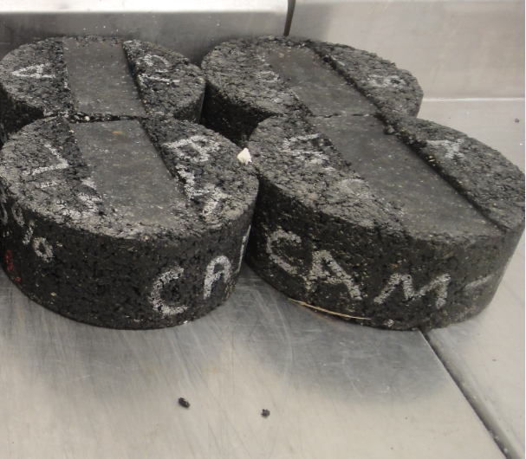
Texas DOT Experience w/CAM
Texas DOT (TxDOT) using CAM since the early 2000s.
Initially developed as reflective cracking mitigation solution for Continuously Reinforced Concrete Pavement (CRCP) rehabilitation.
Successfully used CAM on concrete and asphalt structures where crack mitigation desired.
Source: Tom Scullion, TTI

Slide 29
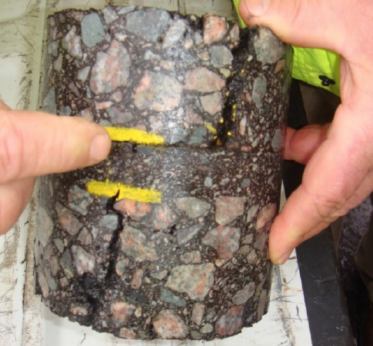
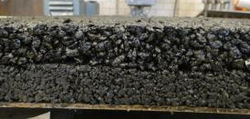
Texas DOT Experience w/CAM
CAM used as interlayer by TxDOT paired with thin overlay for surface material (TOM in TxDOT specification).
Source: Tom Scullion, TTI
Source: Tom Bennert

Slide 30
Texas DOT Experience w/CAM
Example Project
Interstate 69 in Houston District
Design AADT = 300,000 vehicles/day.
Original continuously reinforced concrete pavement (CRCP) built in 1960’s.
Severally cracked and spalled surface.
TxDOT goals to provide a new overlay to maintain riding surface while leaving CRCP in place.
TxDOT performed surface repairs, 1” CAM interlayer and 1” TOM surface in 2014.

Slide 31
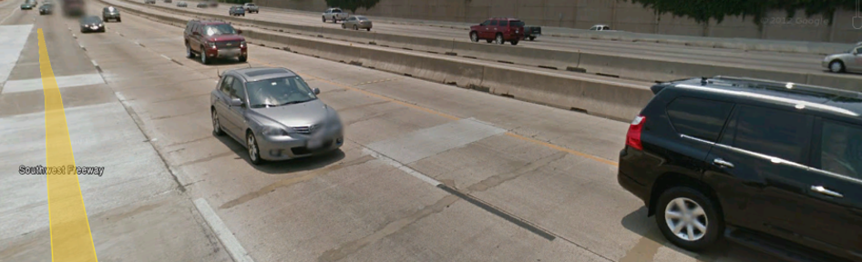
Texas DOT Experience w/CAM
Source: Tom Scullion, TTI
TxDOT reports that pre-overlay repairs critical to performance.
Houston District pleased with performance of CAM overlay system on Interstate 69.

Slide 32
Texas DOT Experience w/CAM
Source: TxDOT
Specifications
Adjusted volumetric mix design for CAM and TOM with goal of getting additional asphalt binder.
Test Property | Test Method | CAM Requirement
Minimum Binder Content, percent | N/A | 7.0
Design VMA, percent | N/A | 17.0
Plant Produced VMA, percent | N/A | 16.5
Design Gyrations | Tex-241-F | 50
Target Laboratory Molded Density, percent | Tex-207-F | 98.0
Tensile Strength, dry, psi | Tex-226-F | 85-200
Dust/Asphalt Ratio | N/A | 1.4 Max
Boil Test | Tex-530-C | N/A
Drain-down, percent | Tex-235-F | N/A

Slide 33
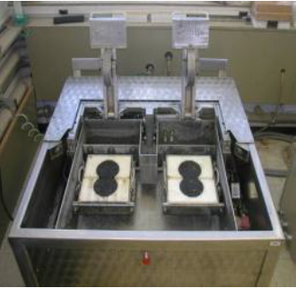
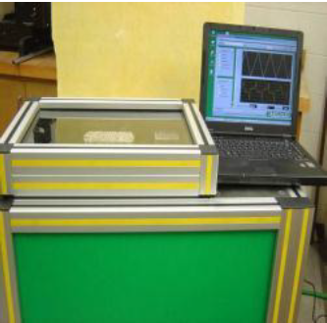
Texas DOT Experience w/CAM
Specifications (cont.)
Use of performance tests for mix design key.
High-Temperature Binder Grade | HWTT Requirements minimum passes at 0.5” (12.5-mm) rut depth tested at 122˚F | OT Requirements Minimum number of cycles to failure
PG 64 or lower | 10,000 | 750
PG 70 | 15,000 | 750
PG 76 or higher | 20,000 | 750
Source: TxDOT
Source: TxDOT

Slide 34
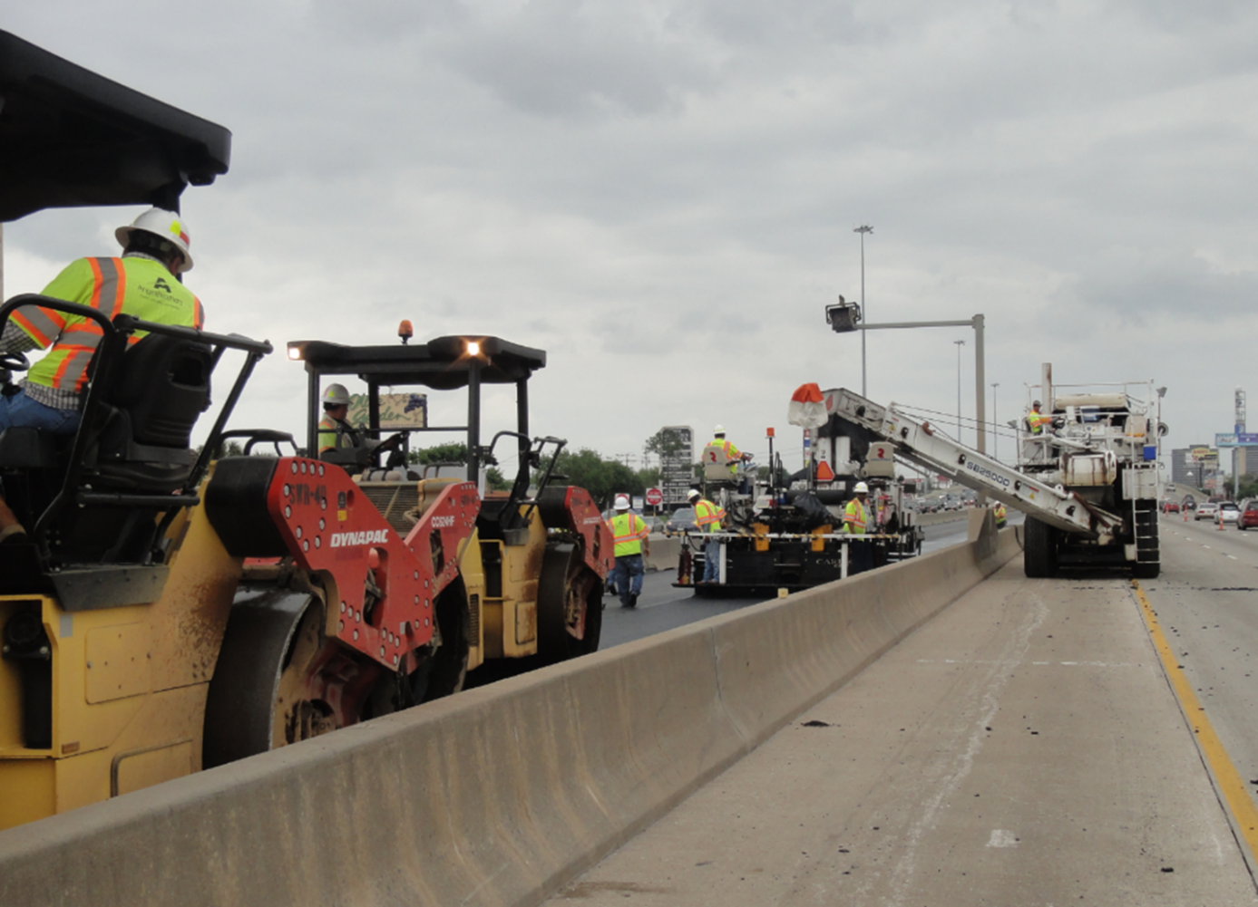
Texas DOT Experience w/CAM
Source: Tom Scullion, TTI
Construction
Proper bonding of thin overlays is key to performance (TxDOT).
Compaction windows are shorter due to thin lifts.
TxDOT recommends dual breakdown rollers.
TxDOT compaction requires between 94.0% – 98.0% compaction on CAM.
Quality construction practices key to successful CAM placement.

Slide 35
Texas DOT Experience w/CAM
Final Considerations
Properly designed CAMs can reduce reflective cracking up to 50 percent (Blankenship 2019).
Pair CAM interlayers with proper surface for best performance to prevent crack jumping.
TxDOT uses performance testing to ensure CAM interlayers have adequate crack mitigation properties without compromising rut resistance.
TxDOT states bonding is the primary issue in thin overlay construction (TxDOT 2014) - using superior bonding products and using QA procedures to ensure bonding is paramount.

Slide 36
Thank you
Want more information on TOPS?
Contact the TOPS lead:
Tim Aschenbrener, P.E.
Senior Asphalt Engineer
FHWA – Pavement Materials Team
Timothy.Aschenbrener@dot.gov
Questions / Comments Please?

Slide 37
References
Scullion T., Zhou, F., Walubita, L., and Sebesta, S. (2009). Design and Performance of Very Thin Overlays in Texas, report number FHWA/TX-09-0-5598-2, Austin, Texas.
Scullion, T and Von-Holdt C. (2004). Performance Report on Jointed Concrete Pavement Repair Strategies in Texas, report number FHWA/TX-05/0-4517-1. Austin, Texas.
Hilbrich, S.L., (n.d.). Shear Bond Strength Testing, available online: http://slideplayer.com/slide/17976291/, last accessed July 19, 2021.
TxDOT (2019). Shear Bond Strength Test, TxDOT designation Tex-249-F, available online: https://ftp.dot.state.tx.us/pub/txdot-info/cst/TMS/200-F_series/pdfs/bit249.pdf, last accessed July 19, 2021.
TxDOT (2019). Overlay Test, TxDOT designation Tex-248-F, available online: ftp://ftp.dot.state.tx.us/pub/txdot-info/cst/TMS/200-F_series/pdfs/bit248.pdf, last accessed July 19, 2021.
TxDOT (2019). Hamburg Wheel-Tracking Test, TxDOT designation Tex-242-F, available online: https://ftp.dot.state.tx.us/pub/txdot-info/cst/TMS/200-F_series/pdfs/bit242.pdf, last accessed July 19, 2021.
FHWA (2016). Tack Coat Best Practices, report number FHWA-HIF-16-017, Washington DC.
TxDOT (2016). Pavement Management Information System Rater’s Manual, available online: ftp://ftp.dot.state.tx.us/pub/txdot-info/cst/raters_manual.pdf, last accessed July 19, 2021.
TxDOT (2019). Memo Dated October 21, 2019, Statewide Special Specification 3085 (14) Underseal Course and Interlayer Material Guidelines, available online: https://www.texasasphalt.org/blog_home.asp?display=81, last accessed July 19, 2021.
TxDOT (2021). Pavement Manual 2021-02, available online: http://onlinemanuals.txdot.gov/txdotmanuals/pdm/manual_notice.htm, last accessed July 19, 2021.

Slide 38
References (cont.)
Bischoff, D. (2007). Evaluation of Strata Reflective Crack Relief System, report number FEP-01-07, Madison, Wisconsin.
Bennert, T. (2018). NJDOT Pavement Support Program: An Overview, North Eastern States’ Materials Engineers Association, October 17, 2018.
Bennert, T (2021). Design, Evaluation, and Construction of AC Overlays of PCC, FHWA Composite Pavements Peer Exchange, May 11-12, 2021.
Blankenship, P.B. (2019). Reflective Crack Relief (Asphalt) Interlayer, Richmond, Kentucky, available online: https://www.blankenshipasphalttech.com/news/2019/10/18/reflective-crack-relief-asphalt-interlayer, last accessed July 19, 2021.
TxAPA (n.d.). Texas Asphalt Pavement User Guide, available online: https://www.texasasphalt.org/guide, last accessed July 19, 2021.
FHWA (n.d.). Targeted Overlay Pavement Solutions (TOPS) Crack Attenuating Mix, FHWA-HIF-21-002, available online: https://www.fhwa.dot.gov/pavement/tops/pubs/asphalt_tops_combined_508_2.pdf, last accessed July 19, 2021.
TxDOT (2014). Special Specification 3000 Crack Attenuating Mixture.
TxDOT (2014). Austin District’s Guidelines on the Use of Thin Surface Mixes (TSMs), Austin, Texas.
TxDOT (2017). Specification Item 347 Thin Overlay Mixtures.

