Slide 1
ARDOT Alternative Project Delivery Methods
Tom Fisher, P.E.
Mark Trickey, P.E.

Slide 2
Alternative Delivery Implementation
Project Update
Looking Forward for Alternative Delivery

Slide 3
Keli Wylie, P.E. Alternative Project Delivery Administrator
Mark Trickey, P.E. Alternative Delivery Project Engineer
Tom Fisher, P.E. Alternative Delivery Project Manager
Scott Eldridge Lead Alternative Delivery Project Coordinator

Slide 4
Design-Bid-Build
Owner
Designer
General Contractor
Notes:
Traditional & most common project delivery method utilized by ARDOT
Since 2013,
92% of projects let to contract have utilized DBB
Creates silo effect, grouping people into subject matter discipline by phase
Limits the ability to transfer knowledge between phases
Has multiple points of adversity
Owner
Designer
Contractor
Can result in major cost changes through change orders
Since 2013, change orders have accounted for ~ $700M

Slide 5
Design-Bid-Build
Owner
Designer
General Contractor

Slide 6
Project Delivery Models Comparison
Planning Phase
Preconstruction Phase
Construction Phase
Owner
D-B-B
Owner
General Contractor
Owner
Notes:
Using the traditional project delivery method of Design-Bid-Build, the Owner (Department) solicits a construction contractor to build a project after design completion, with the Contract awarded to the lowest bidder. D-B-B typically relies on unit pricing.

Slide 7
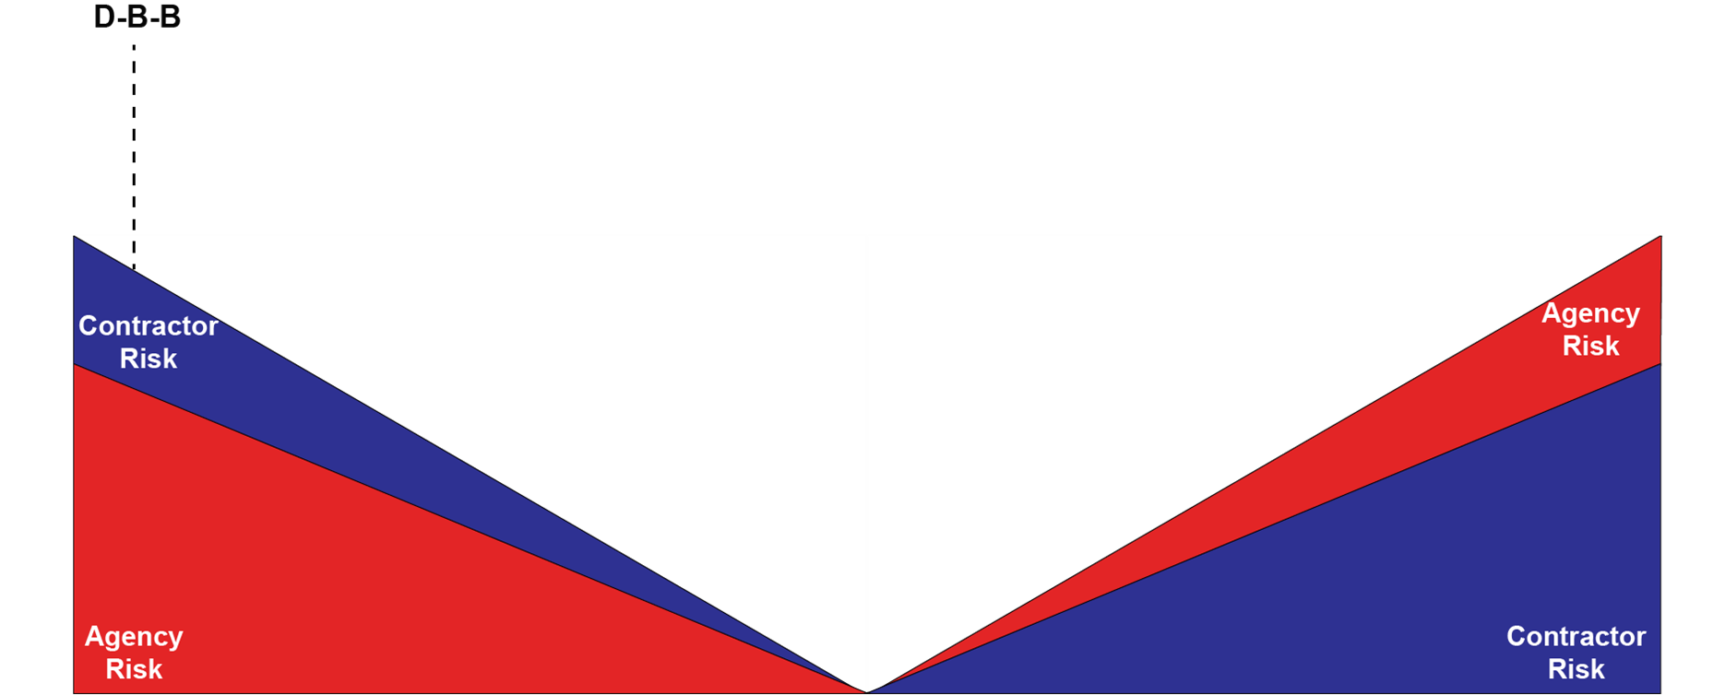
Risk Allocation in Design-Bid-Build
Notes:
Looking at the Risk Allocation Figure for Design-Bid-Build, the Department carries the majority of the risk, in part because we produce the Plans & Specifications for the project. The owner bears the risk if actual quantities differ from the estimates that formed the bids, which can lead to cost overruns and project delays.
The contractor does carry some risk due to their own operations/schedule, material availability & escalation.

Slide 8
Alternative Delivery Implementation
Notes:
Now I want to talk a little bit about alternative delivery,
what it means – a delivery method when a contractor or contractor team is involved in the preconstruction activities on a project
the types of delivery methods that ARDOT has implemented,
Design-Build
Construction Manager/General Contractor
Progressive Design Build

Slide 9
Design-Build
Definition
Project delivery method in which the design and construction of a project are combined into one contract, usually awarded on either a low bid or best-value basis.
Authority
Act 460 of 2003
Up to 2 projects, each with a value of $50M or higher
Authorized use to DB and required ARDOT to establish procedures and regulations for qualifications-based selection
Act 541 of 2013
Allowed unlimited use of DB projects when state highway revenues are not required
Allowed DB contracts under the Connecting Arkansas Program only (sunset of July 1, 2023)
Act 704 of 2015
Allowed for Design-Build-Finance
Removed all restriction regarding time and funding; unlimited use
Notes:
The first type of Alternative Delivery Method that we will focus on is Design-Build
the Commission shall have the authority to enter into contracts that combine the design, construction, and construction engineering phases of a project into a single contract that shall be referred to as a “design-build project contract”.
Develop Design Build Procurement Documents (Qualifications Based Selection)
Receive solicited and unsolicited proposals
Award a project that offers the greatest value for the state
Enter into DB agreement to design and construct qualified projects

Slide 10
Alternative Delivery Value – The Power of Collaboration
Innovation
Design
Cost
Schedule
Innovation can potentially address project complexities
Contractor input during the design phase can maximize innovation and reduce constructability issues
Transfer of knowledge
Design can be tailored to accommodate the Contractor’s preferred means and methods
Potentially reduce delays on projects with tight corridors, extensive third-party involvement, complex maintenance of traffic components
Improve cost certainty or cost control
Open book pricing
Fair Market Value rather than low bid
Built in Value Engineering
Schedules can be optimized
Impacts on the traveling public may be minimized
Schedule informed from contractor early involvement on means and methods
Notes:
Alternative Delivery Methods have several benefits for the Department and Contracting team; among them are
Innovation, Design Refinement, Cost Certainty and Project Schedule Optimization.
Through innovation, the Designer and Department are able to address project complexities and reduce potential constructability issues.
Working closely together also allows the Designer to accommodate the Contractor’s preferred means and methods in specific areas of design of the project. This partnering also assists in the discussion of ways to reduce Utility and Right-of-Way Delays during the Preconstruction Phase of the project.
In Alternative Delivery, typically both parties work with the Independent Cost Estimator to improve cost certainty through Open Book Pricing, which allows for establishing a Fair Market Value of the project.
There is also collaboration to optimize the project Schedule, which minimizes the impacts to the traveling public and allows for construction with reduced time delays on the project.

Slide 11
Design-Build
Owner
Design-Builder
Designer
Subcontractors
Notes:
Design-Build team comprised of both Contractor and Designer, and includes the Contractors subcontractors, as well.
The Owner/Department is responsible for Environmental Documentation, Right-of-Way & Utilities Coordination, as well as Public Involvement and Information.

Slide 12
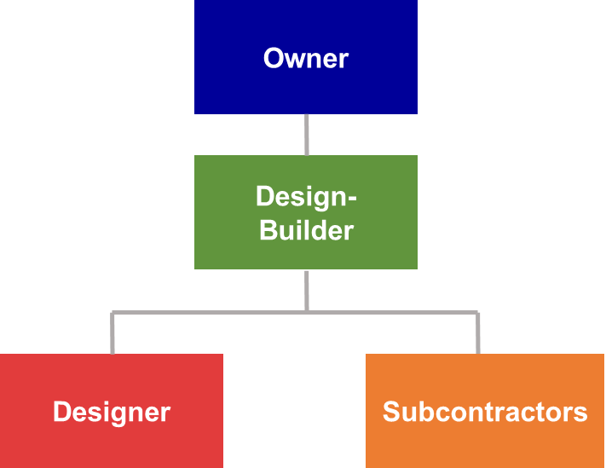
Design-Build
Notes:
-Innovative Design which is needed for complex projects
-Fixed Price at D-B team selection
-Accelerated Project Delivery
-Reduced Constructability Issues though early Contractor involvement

Slide 13
Project Delivery Models Comparison
Planning Phase
Preconstruction Phase
Construction Phase
Owner
D-B-B
Owner
General Contractor
Owner
D-B
Owner
Design-Builder
Owner
Notes:
In the Design-Build delivery method process, the D-B team is able to start construction while the design process is still underway, which allows for significant schedule acceleration.
The Department is still responsible for Planning Phase Activities, such as the preparation of Project Environmental Documents (PED) and obtaining required environmental and regulatory clearances.

Slide 14
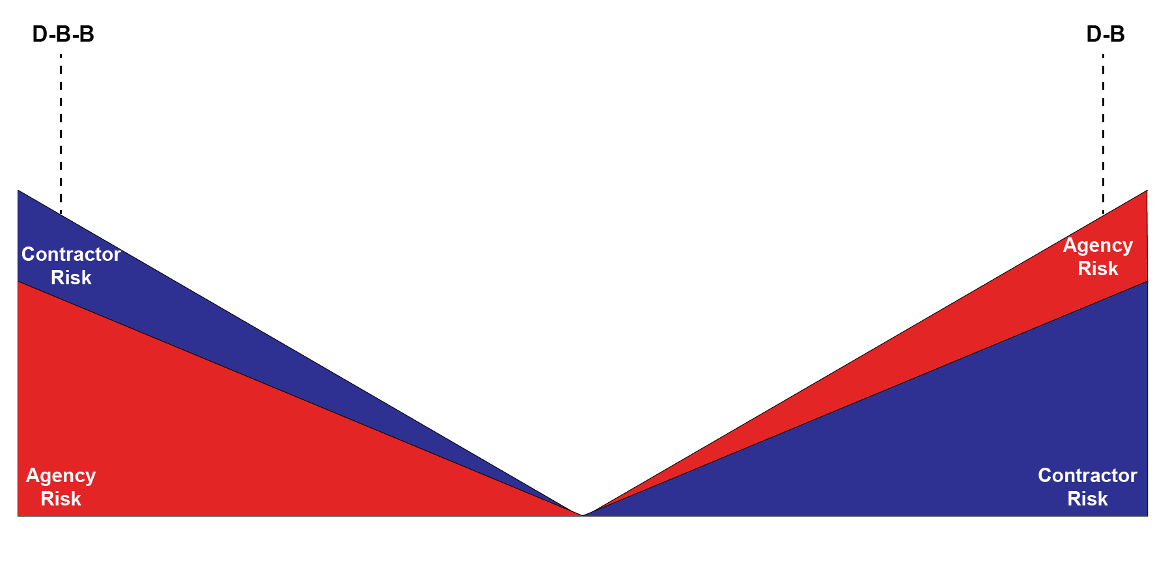
Risk Allocation in Design-Build
Notes:
Looking again at our Risk Allocation Figure, the Design-Build team produces plans for the projects; therefore, the contractor carries the majority of the risk, including risks associated with design errors and incomplete design, as well as materials, operations/schedules, subcontractors, etc.
Design-Build method does not completely eliminate the Owner from carrying risk, but does greatly reduce exposure.

Slide 15
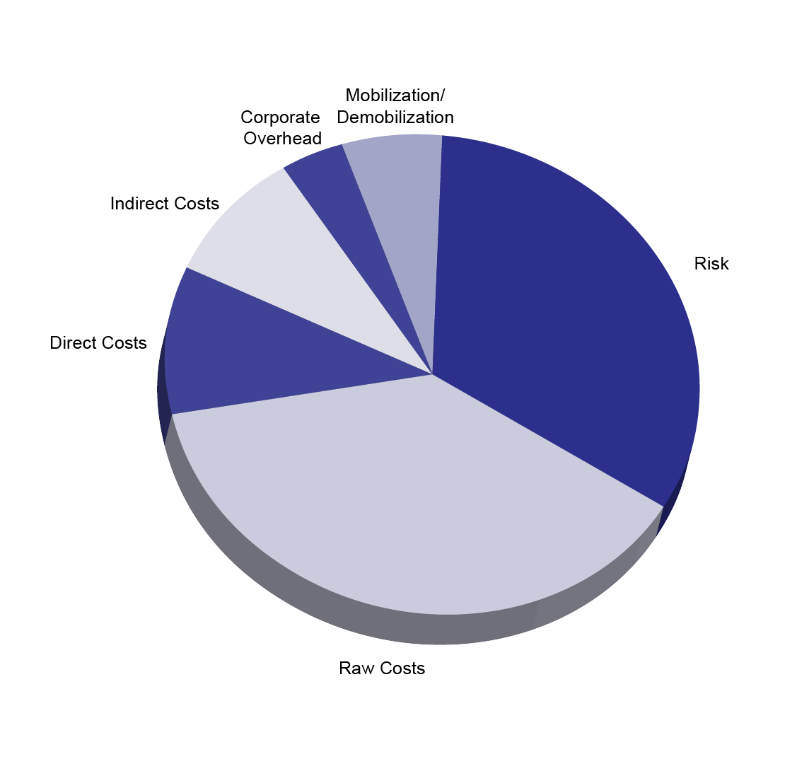
Fixed Price Approach on D-B-B and D-B Projects
Notes:
Overall costs for projects, utilizing Unit Pricing for Design-Bid-Build and Fixed Maximum Pricing for Design-Build, carry various types of cost. Among them are Direct & Raw Costs, as well as Overhead and Indirect Costs. Risk is also included in the overall cost, especially under current situation where material and labor escalation is difficult to determine.

Slide 16
Construction Manager – General Contractor (CM-GC)
Definition
Two phase delivery method – design and construction. Separate contracts for Pre-Construction and Construction.
Authority
Act 809 of 2017 – Pilot legislation
Act 1019 of 2019 – Amended Act
Provision
Independent Cost Estimator
3 projects; sum of construction cost estimates not to exceed $200M total
First project construction cost estimate not to exceed $70M
5 projects; sum of construction cost estimates not to exceed $200M total
Single project construction cost estimate not to exceed $100M
Guaranteed Maximum Price (GMP)
GMP not to exceed ICE estimate by more than 10%
Notes:
The second Alternative Delivery Method we will focus on is CM-GC
Act 809 of 2017 (pilot legislation – terminates June 30, 2024)
Act 1019 of 2019 – maximum of 5 projects at a total maximum cost of $200M – no single project to exceed $100M

Slide 17
Construction Manager-General Contractor
CM-GC
Owner
Designer
Construction Manager
* Upon Successful Negotiation of Guaranteed Maximum Price and Design Completion
General Contractor *
Notes:
Using the CM-GC Delivery Method, the Department uses a procurement process to select a Contractor to assist in the design and deliver construction of the project upon negotiation of a Guaranteed Maximum Price.

Slide 18
Project Delivery Models Comparison
Planning Phase
Preconstruction Phase
Construction Phase
Owner
D-B-B
Owner
General Contractor
Owner
D-B
Owner
Design-Builder
Owner
Designer
CM-GC
Owner
Owner
General Contractor
CM-GC
Notes:
Under CM-GC, the Owner procures a Construction Manager to work with the Department’s designer to maximize innovations and reduce constructability issues during the Preconstruction Phase of project.
The CM-GC may also provide Right-of-Way and Utility Services through subconsultants in the Preconstruction Phase.
Designer and CM-GC not contractually obligated to each other, but required to work collaboratively together.
Work collaboratively to identify risks, mitigate where possible, and assign the risk to the entity best suited to handle the risk.

Slide 19
Progressive Design-Build
Progressive Design-Build
Owner
Design-Builder
Designer
Subcontractors
Notes:
The 3rd type of Alternative Delivery utilized by the Department is Progressive Design –Build. Using the Progressive Design-Build Delivery Method, the Department uses a procurement process to select a PD-B team to design and construct a project under the direct supervision and direction of the Department.

Slide 20
Project Delivery Models Comparison
Planning Phase
Preconstruction Phase
Construction Phase
Owner
D-B-B
Owner
General Contractor
Owner
D-B
Owner
Design-Builder
Designer
Owner
Designer
CM-GC
Owner
Owner
General Contractor
CM-GC
CM-GC
Owner
Owner
Owner
Contractor
PDB
PD-B
PD-B
PD-B
Notes:
Using the Progressive Design-Build Method, the PD-B team handles Planning and Preconstruction Phases responsibilities with assistance from Department, while the PD-B team delivers the Construction of the project.

Slide 21
Construction Manager-General Contractor and Progressive Design Build
CM-GC
Progressive Design Build
Owner
Independent Cost Estimator
Owner
Design-Builder
Designer
Construction Manager
* Upon Successful Negotiation of Guaranteed Maximum Price and Design Completion
General Contractor *
Designer
Subcontractors
Notes:
Independent cost estimating is critical
Cost certainty
Cost transparency
Helps establish a Guaranteed Maximum Price (GMP)
Provides a contractor-style, production-based estimate
Double blind pricing, i.e. pricing is not shared with contractor team
Should NOT rely on historical bid pricing but instead Fair Market Value

Slide 22
CM-GC and PD-B
Notes:
FOCUS ON:
Minimized procurement cost
Cost Certainty
Owner Transparency into Cost
Reduced Constructability Issues through early Contractor involvement

Slide 23
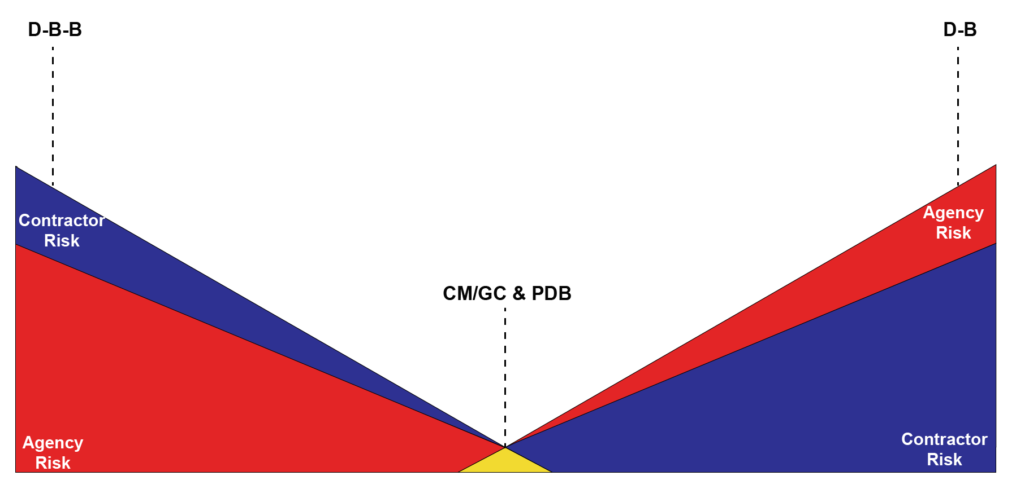
Risk Allocation in CM-GC and PD-B
Notes:
Looking at the Risk Allocation Figure for CM/GC and Progressive Design-Build shows that these delivery methods do not eliminate risk completely. However, the process allows for collaboration among the team for:
Identification
Mitigation
Assign risk to entity best equipped to handle

Slide 24
The Power of Collaboration
Select most qualified teams using a qualifications based process
Establish a process to facilitate rapid Department decision making
Obtain maximum efficiencies from the collaborative environment
Establish a process to escalate and resolve issues rapidly
Hold regular collaborative meetings to review project status and issues
Alignment between team members on approach to pricing early in process leads to cost certainty
Establish a fair pricing approach via open book pricing, verified by ICE
Manage the risk register and innovation log throughout project development
Notes:
The benefits and advantages of Alternative Delivery Methods are able to be achieved through Collaboration between the Contracting team, the Independent Cost Estimator and the Department. Effective collaboration is achieved through regular Task Force Meetings as the project progresses through the Planning, Pre-Construction and Design Phases of the project, as well as through the Construction Phase. Partnering through collaboration allows for a stream-lined process to facilitate decision-making and to establish a process to resolve issues quickly. This aids in maximizing the efficiency of the various phases of project and also helps to reduce potential impacts. Parties also partner together in the management of the Risk Register and the Innovation Log, as well as working together to determine the cost drivers and associated risks to better understand those that are viewed as most critical to the cost of the project.

Slide 25
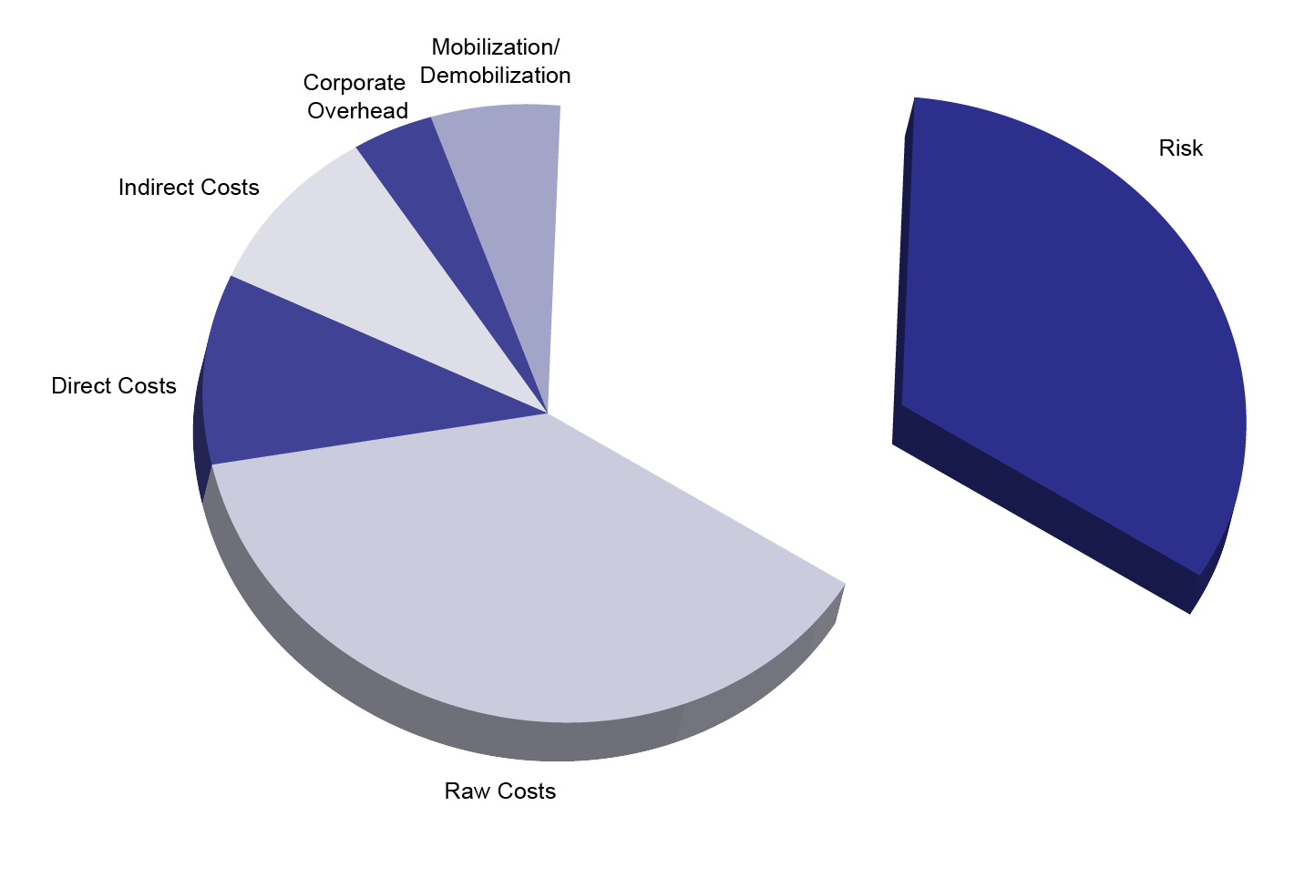
Moving Beyond Fixed Price Approach for Greater Collaboration
Notes:
Through collaboration and the effective management of project risks, we are able to reduce contingencies and spend money on things that matter more. Open Book Pricing allows for greater transparency into the contingencies that are included in the cost of the work; this allows all parties to consider risk mitigation strategies to improve the project value by determining the project’s cost drivers.

Slide 26
Project Update

Slide 27
Alternative Delivery Projects
Project | Model | Selection Date | Value | Contractor
30 Crossing | Design-Build | 2019 | $540M | Kiewit-Massman Construction
Cantrell Road Widening | CM-GC | 2018 | $81M | Kiewit
I-49/Highway 62 Interchange | CM-GC | 2021 | $50-60M | Manhattan R&B-APAC Central
I-40/I-55/Highway 77 | Progressive Design Build | 2021 | $30-40M | Key, LLC

Slide 28
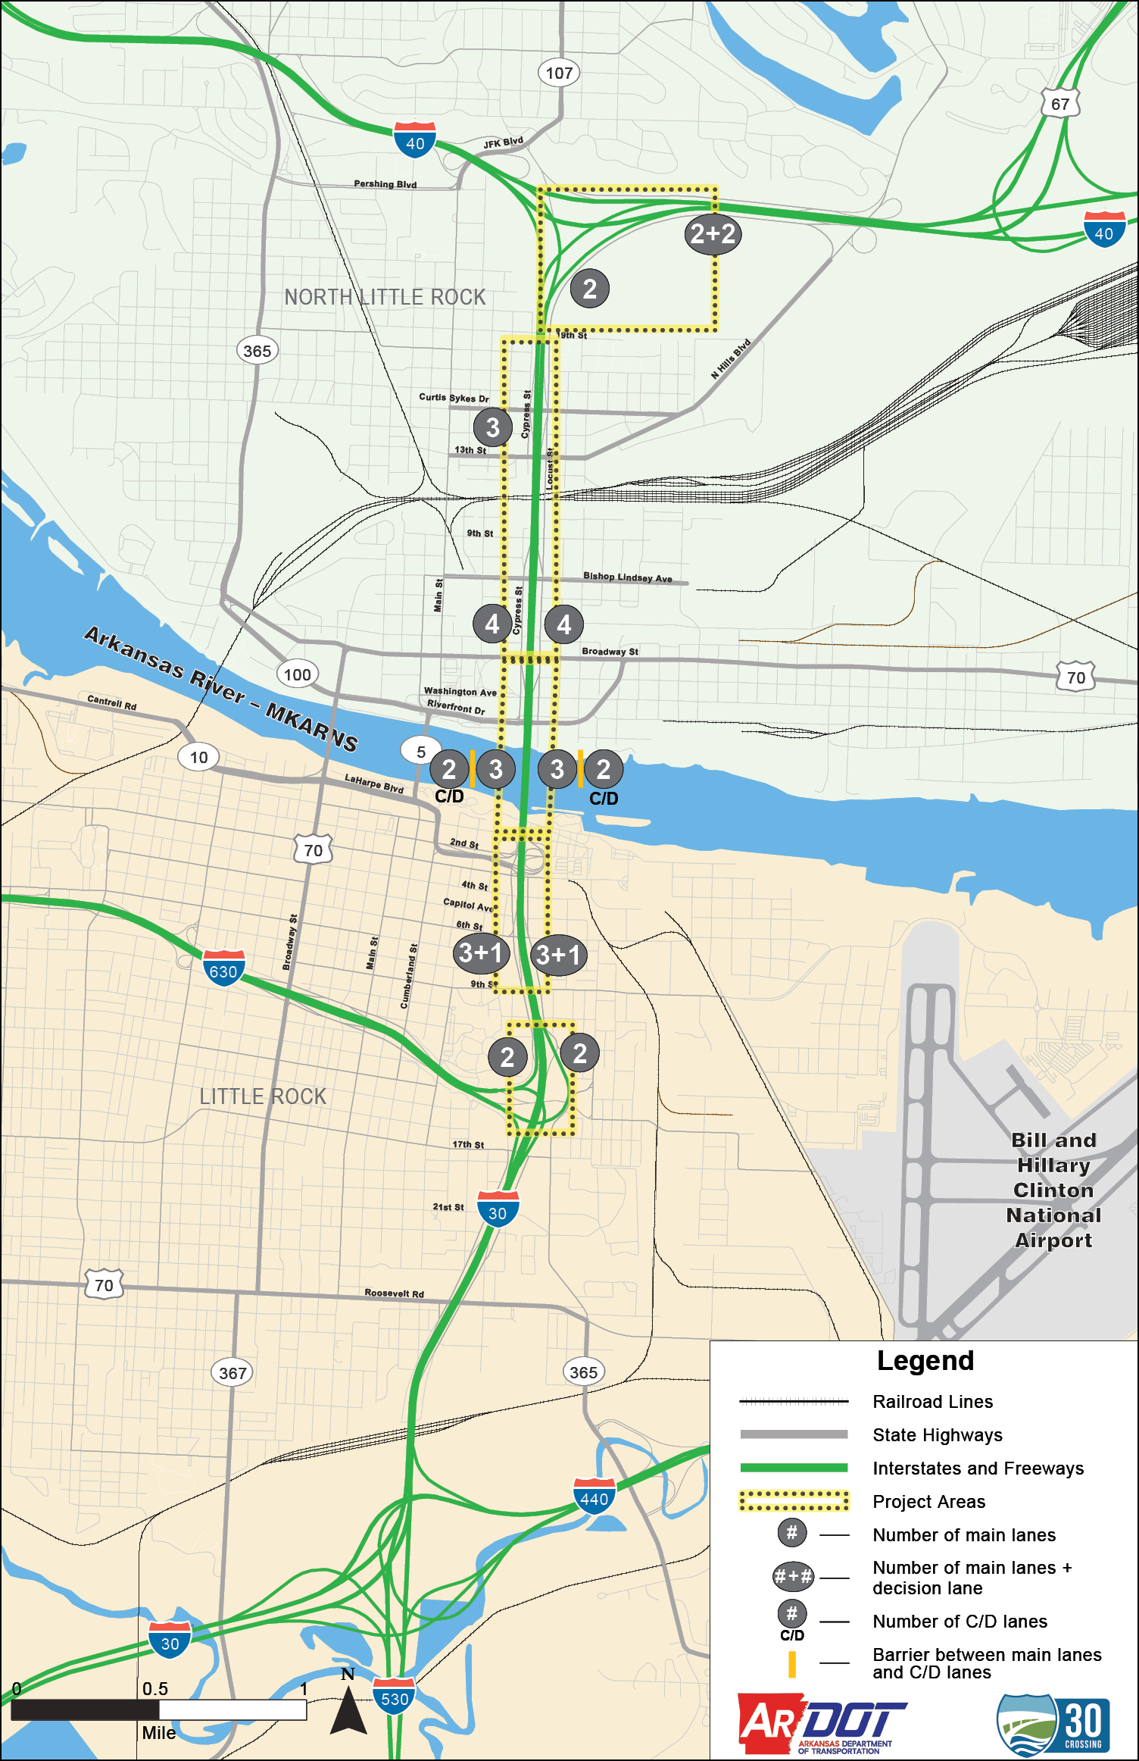
30 Crossing – Phase 1 Little Rock, AR
$633M Project Budget
Design-Build Delivery Model
Key Elements
Approximately 4.7-mile interstate reconstruction project at the convergence of six major highways in the state’s busiest corridor
Replaces infrastructure that is functionally and structurally deficient in the business districts of two cities
Includes a major river bridge and two UPRR rail yard crossings
Undertook major collaborative value engineering effort to optimize and refine project design with contractor

Slide 29
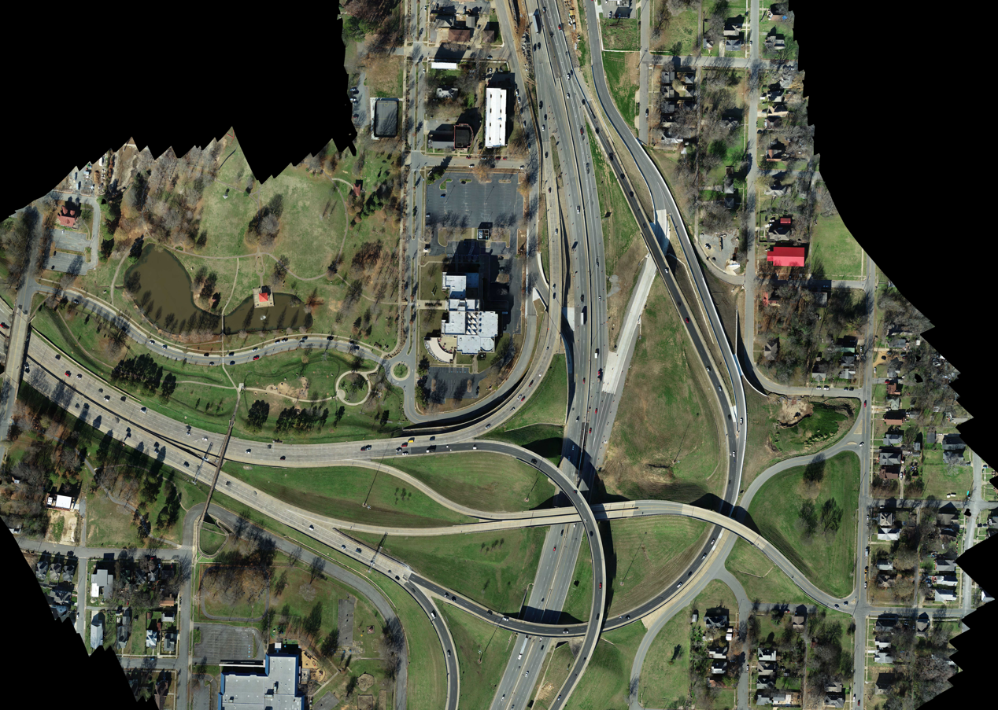
I-630 Interchange December 25, 2021
Design-Build Delivery Model

Slide 30
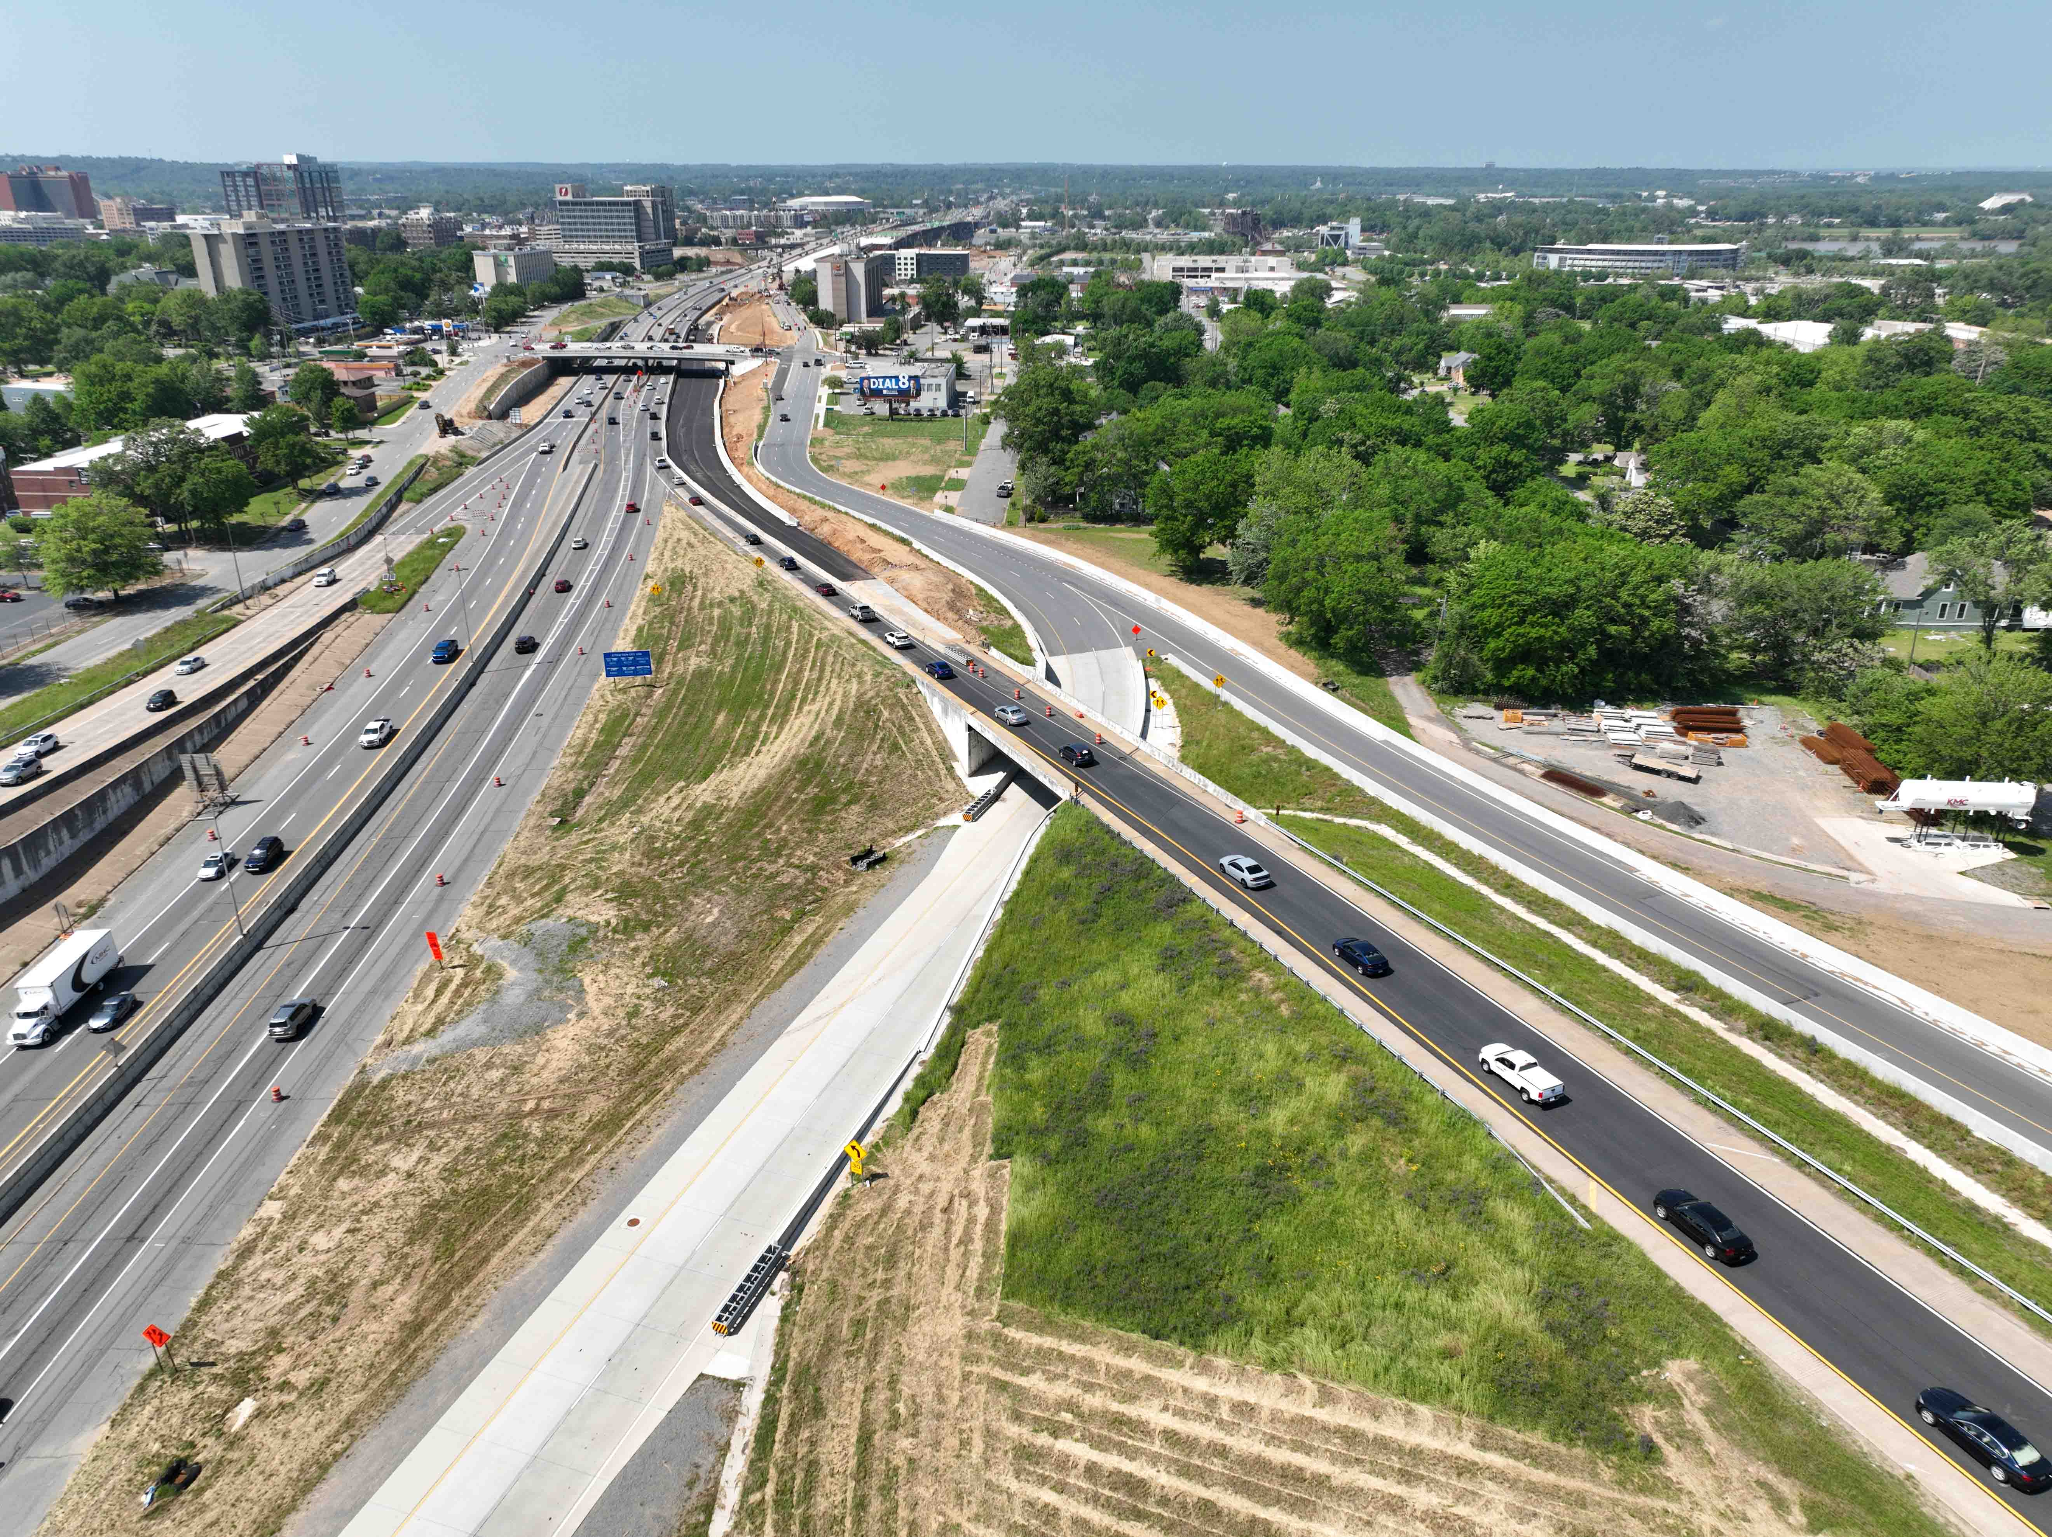
I-630 Interchange May 9, 2022
Design-Build Delivery Model

Slide 31
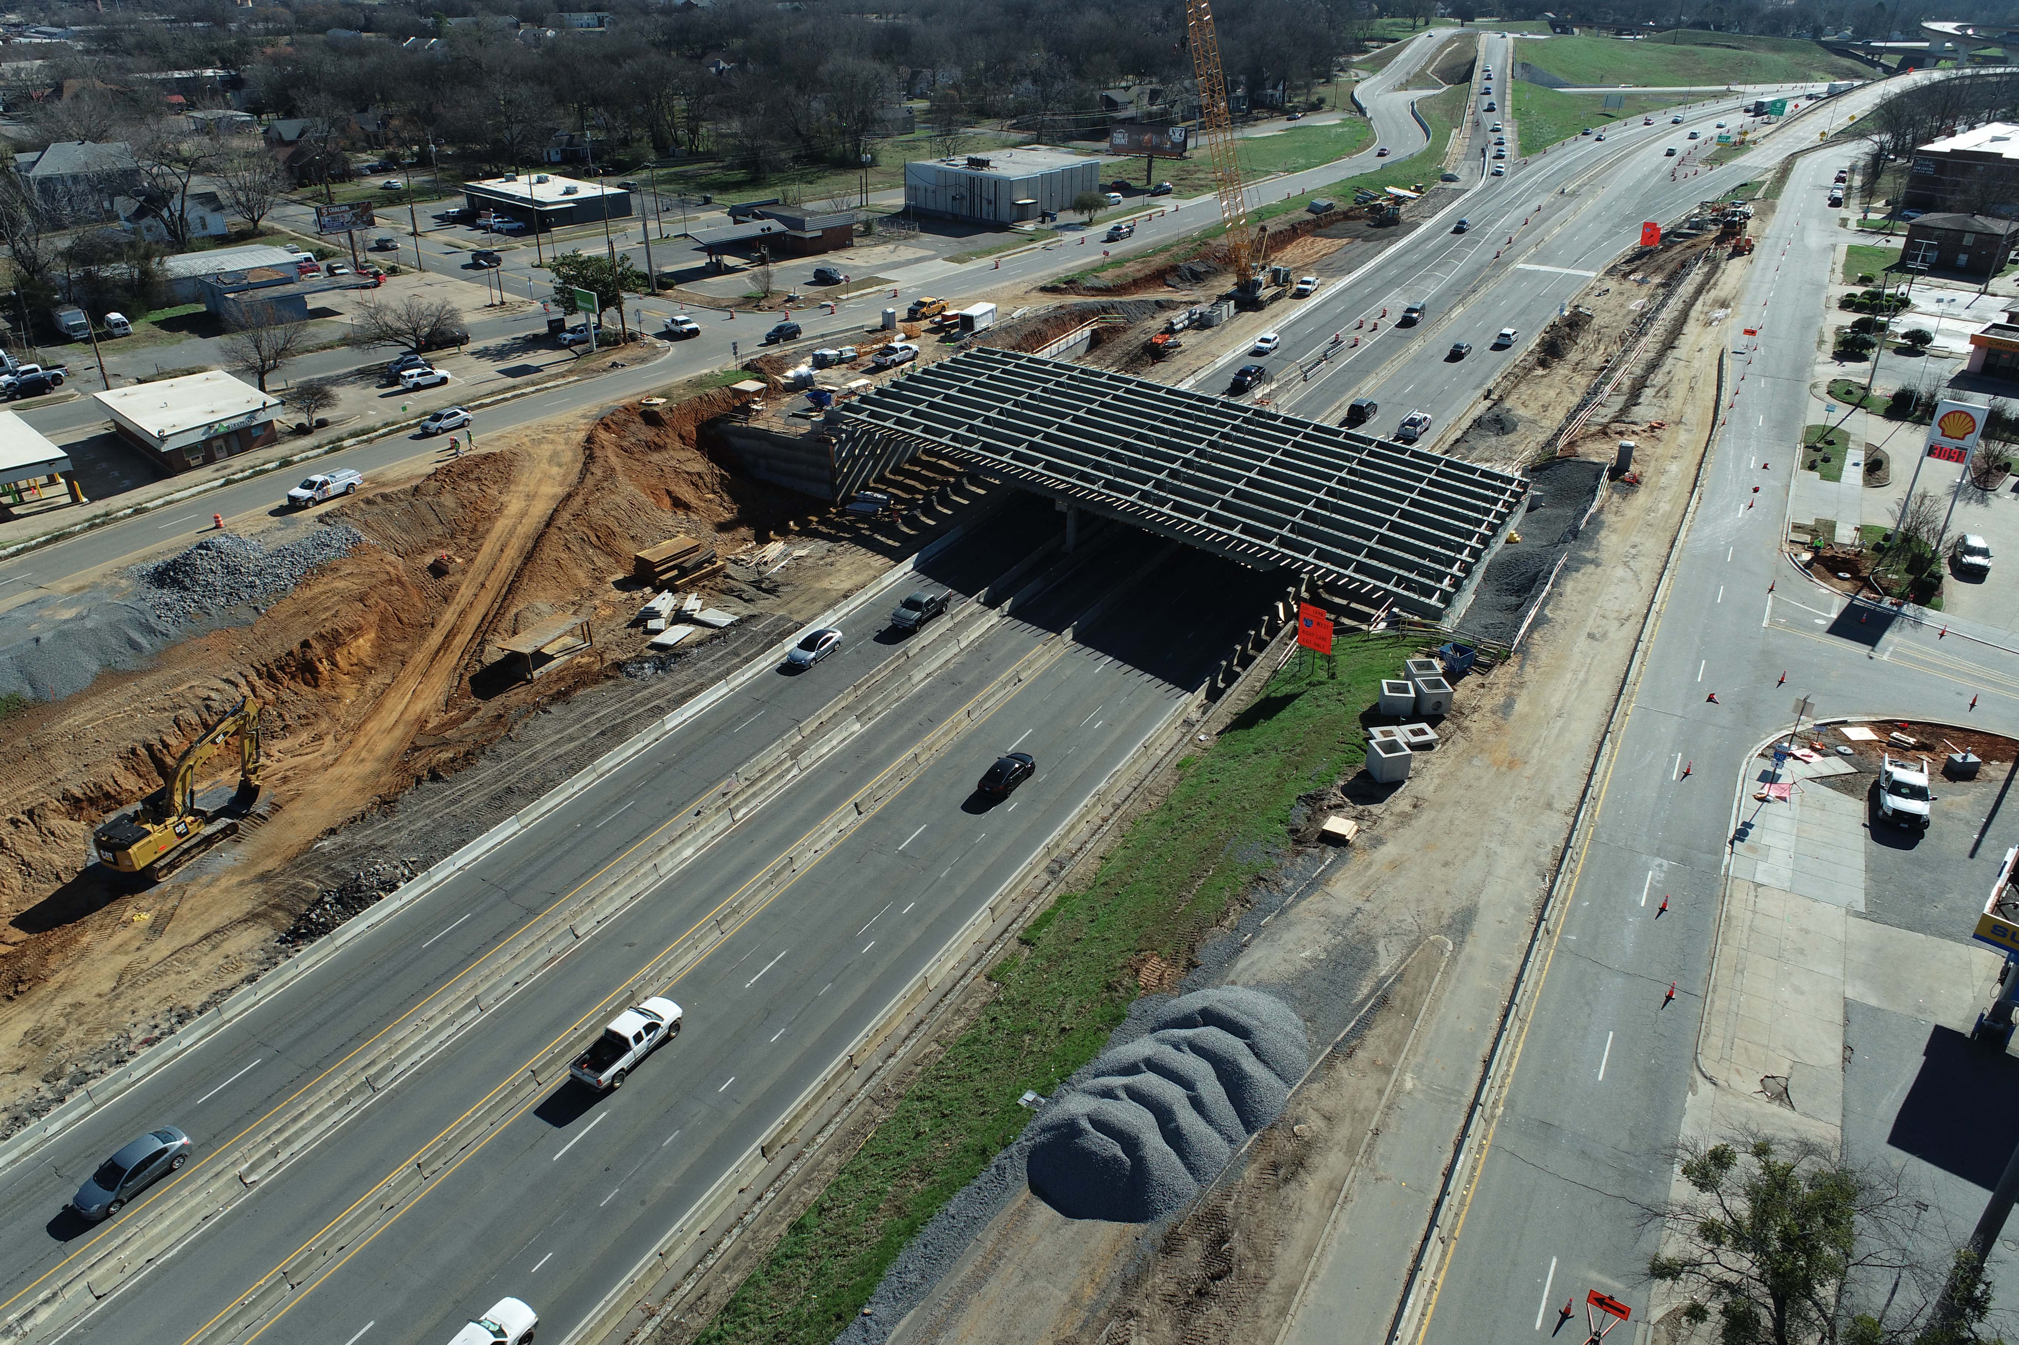
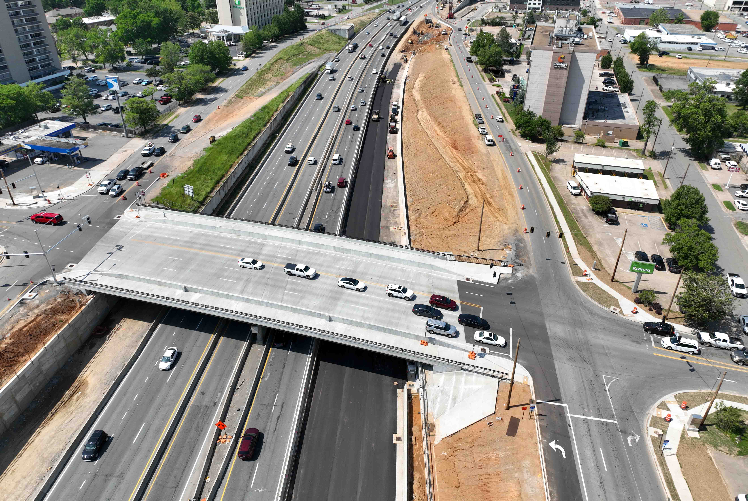
9th Street May 9, 2022
9th Street January 5, 2022
Design-Build Delivery Model

Slide 32
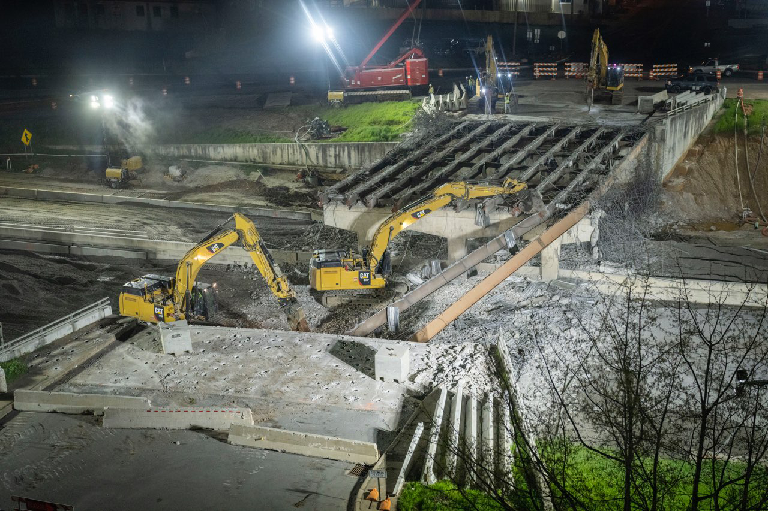
6th Street Bridge May 9, 2022
6th Street Bridge April 8-10, 2022
Design-Build Delivery Model

Slide 33
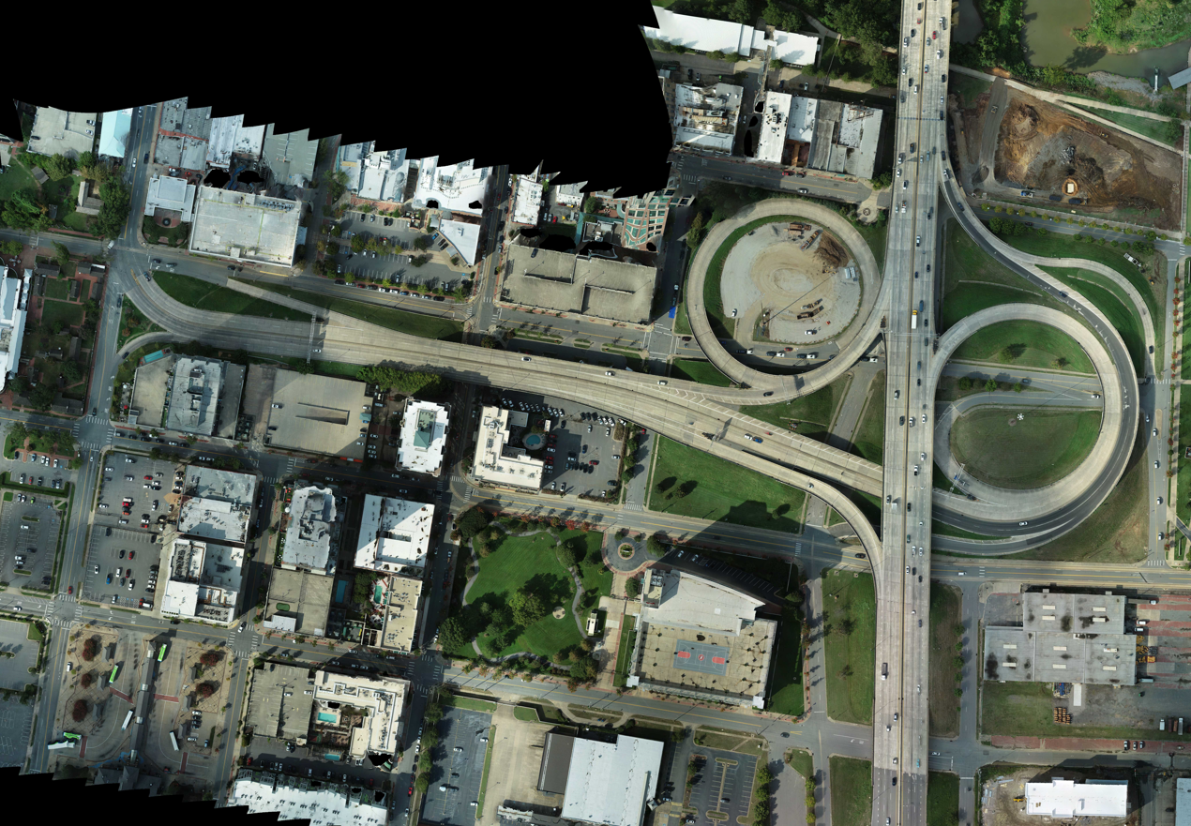
Ramps at I-30 September 25, 2020
Design-Build Delivery Model

Slide 34
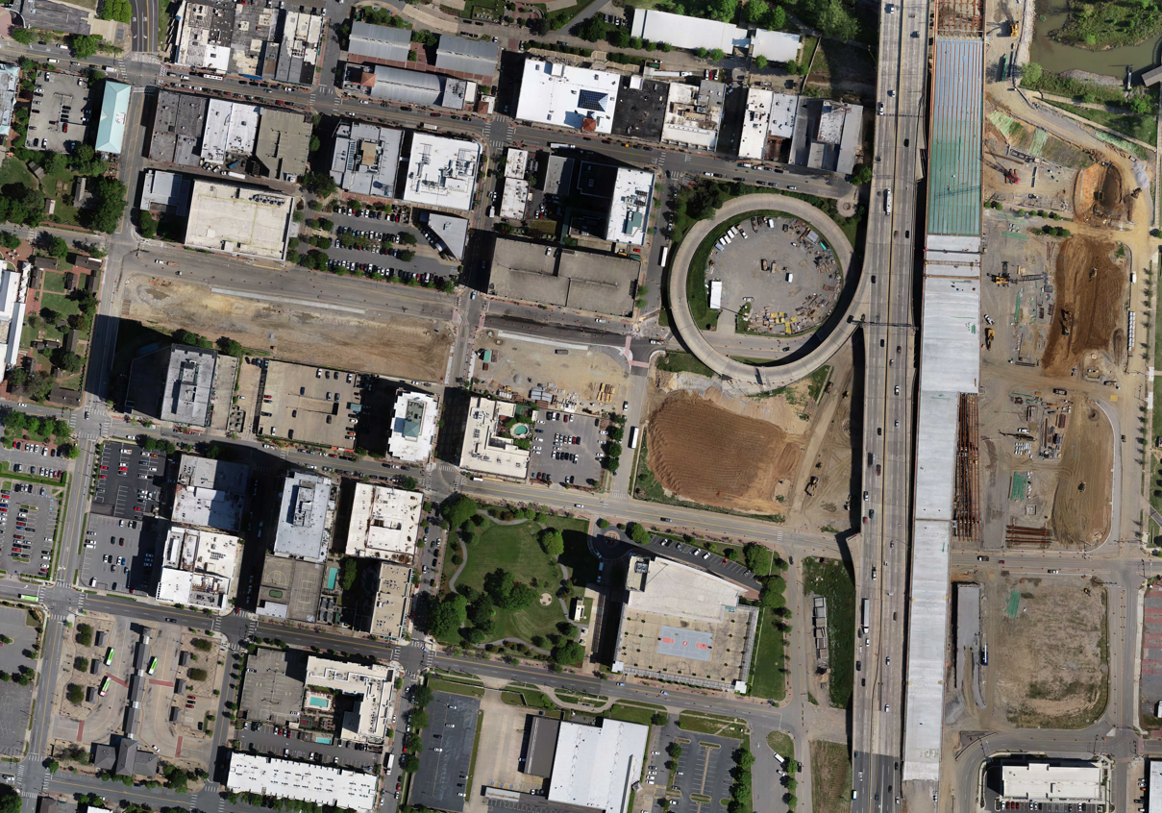
Ramps at I-30 September 25, 2020
Ramps at I-30 May 9, 2022
Design-Build Delivery Model

Slide 35
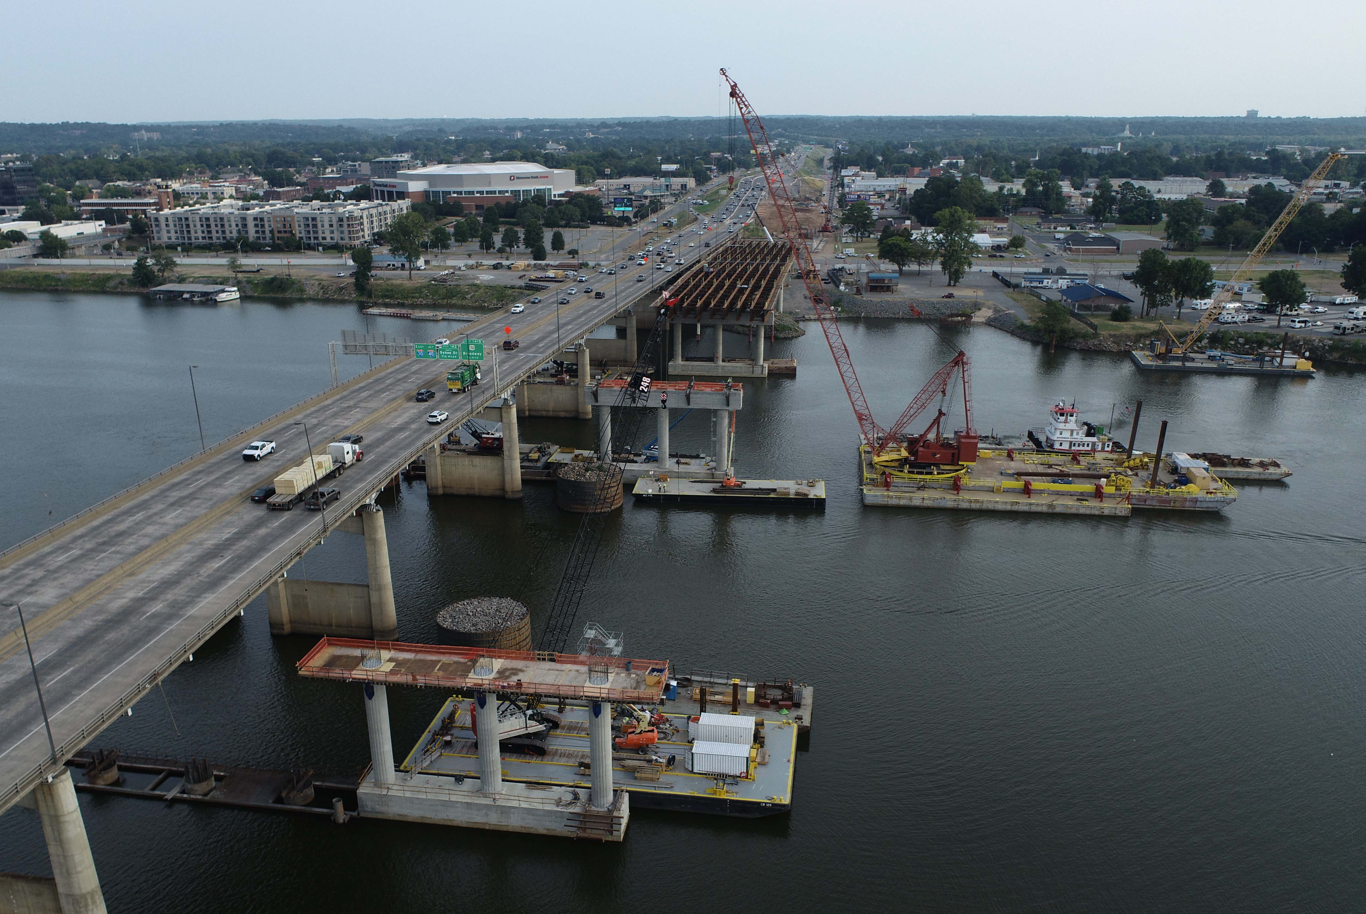
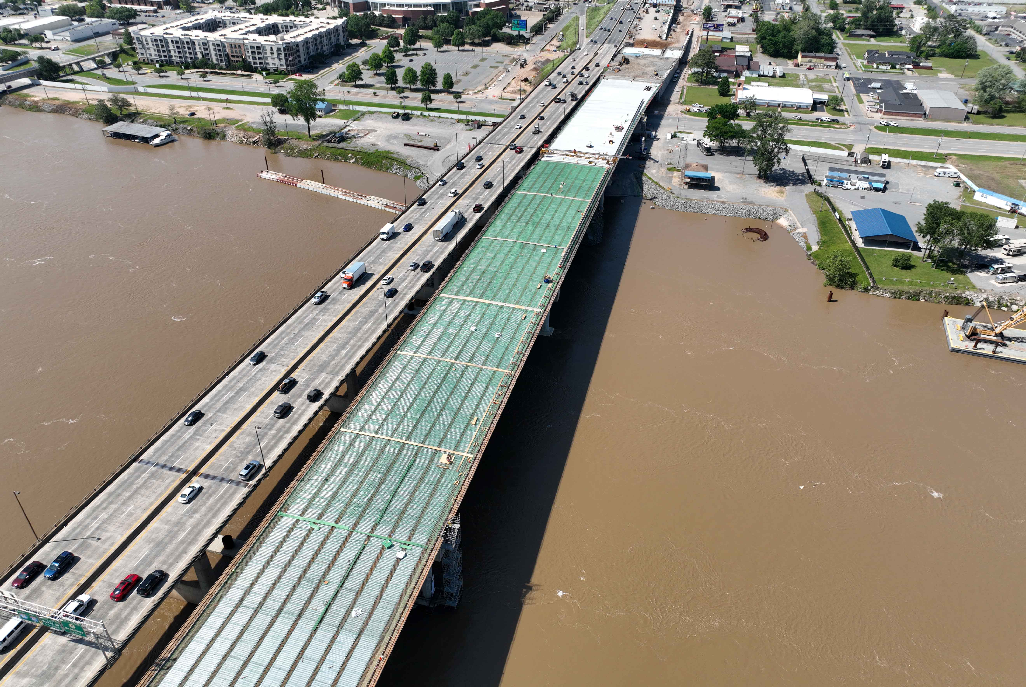
River Bridge May 9, 2022
River Bridge September 8, 2021
Design-Build Delivery Model

Slide 36
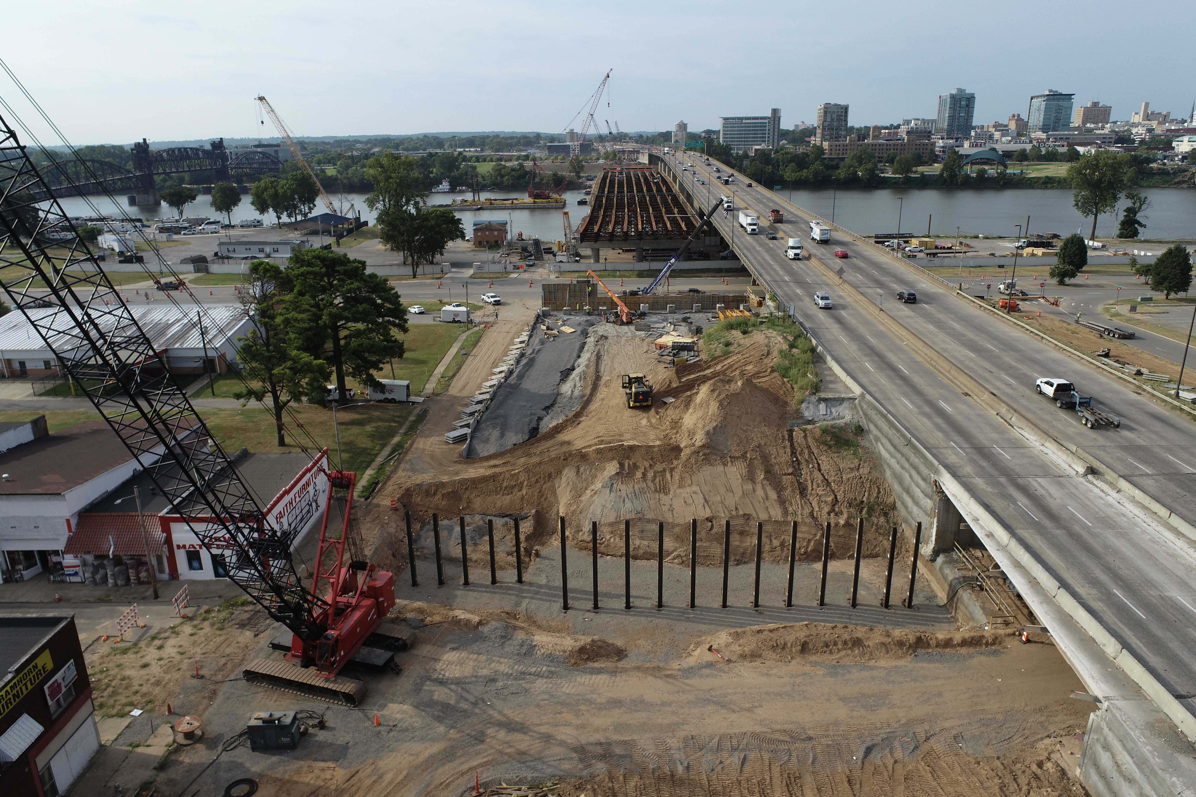
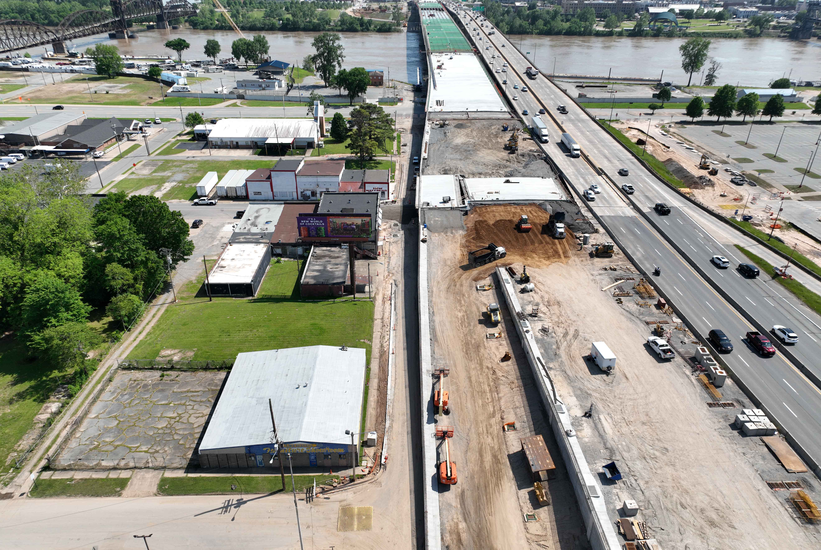
North Approach May 9, 2022
North Approach September 8, 2021
Design-Build Delivery Model

Slide 37
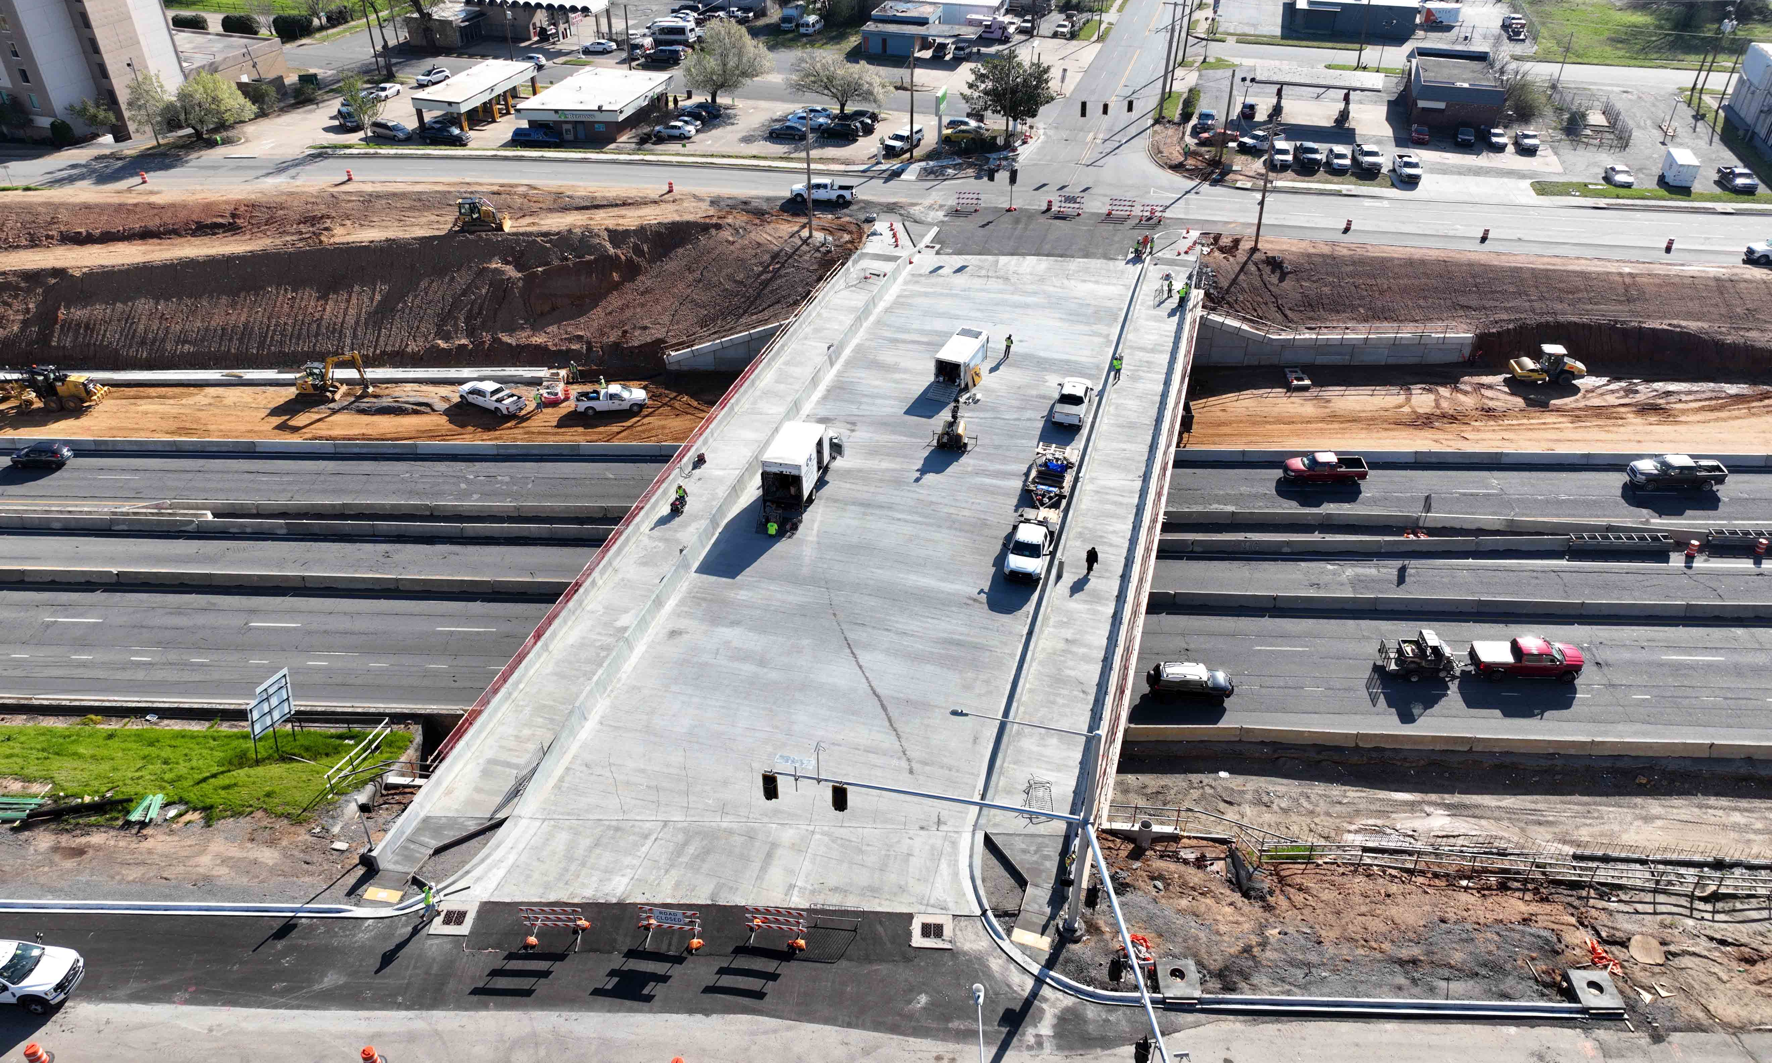
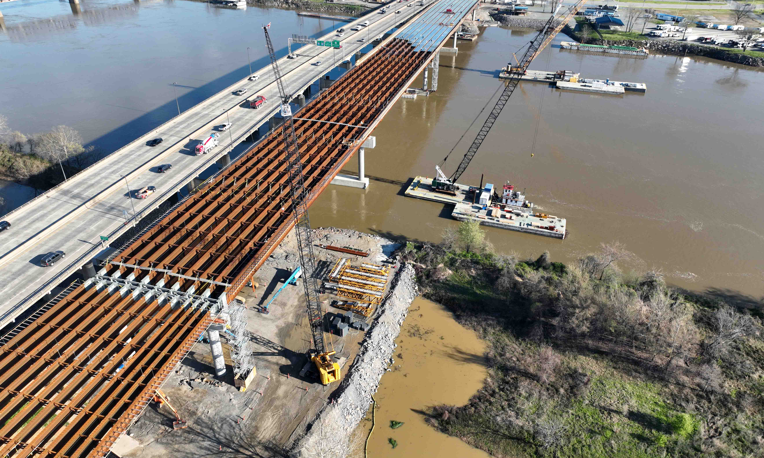
Phase 1 Construction Milestones
Little Rock
River Bridge
North Little Rock
Jan – April
2022
Open 9th Street Bridge
Set Girders at Broadway
Demolish 6th Street Bridge
May – Aug
2022
Final EB Bridge Deck Pour
Open EB On-Ramp at 4th St.
Open EB Bridge to EB Lanes
Bridge Deck Pour at Broadway
Open New EB Broadway Exit
Sept – Dec
2022
Close WB Exits (2nd & 6th St.)
and Open WB Exit (9th)
Set Girders on 6th St. Bridge
Close WB Broadway Entrance and Open Temporary Ramp at Bishop Lindsey
Design-Build Delivery Model

Slide 38
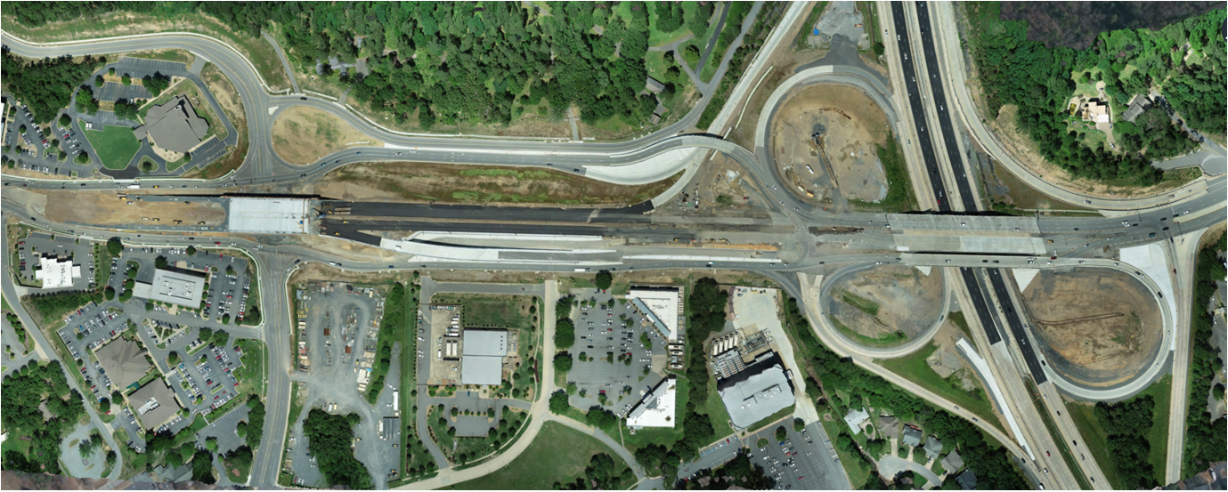
Cantrell Road Widening Little Rock, AR
Widens 1.3 miles of Highway 10, improves I-430 interchange, and adds 4 bridges
Choke point used by 54,000 vehicles per day
$81M Project Budget
First CM-GC contract to be used in the state
CM-GC Delivery Model

Slide 39
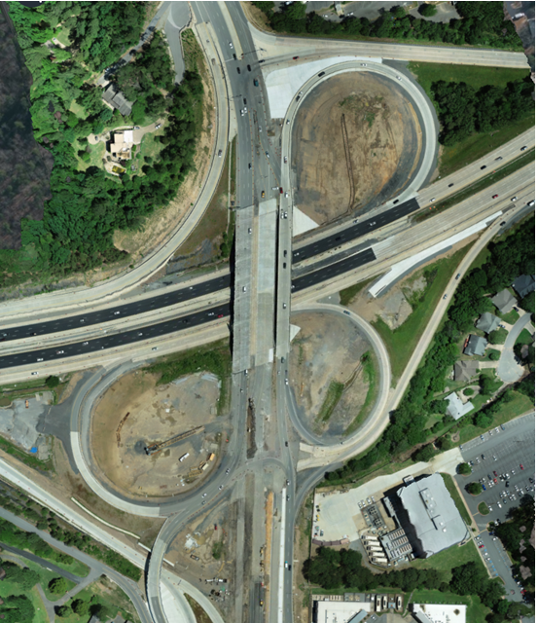
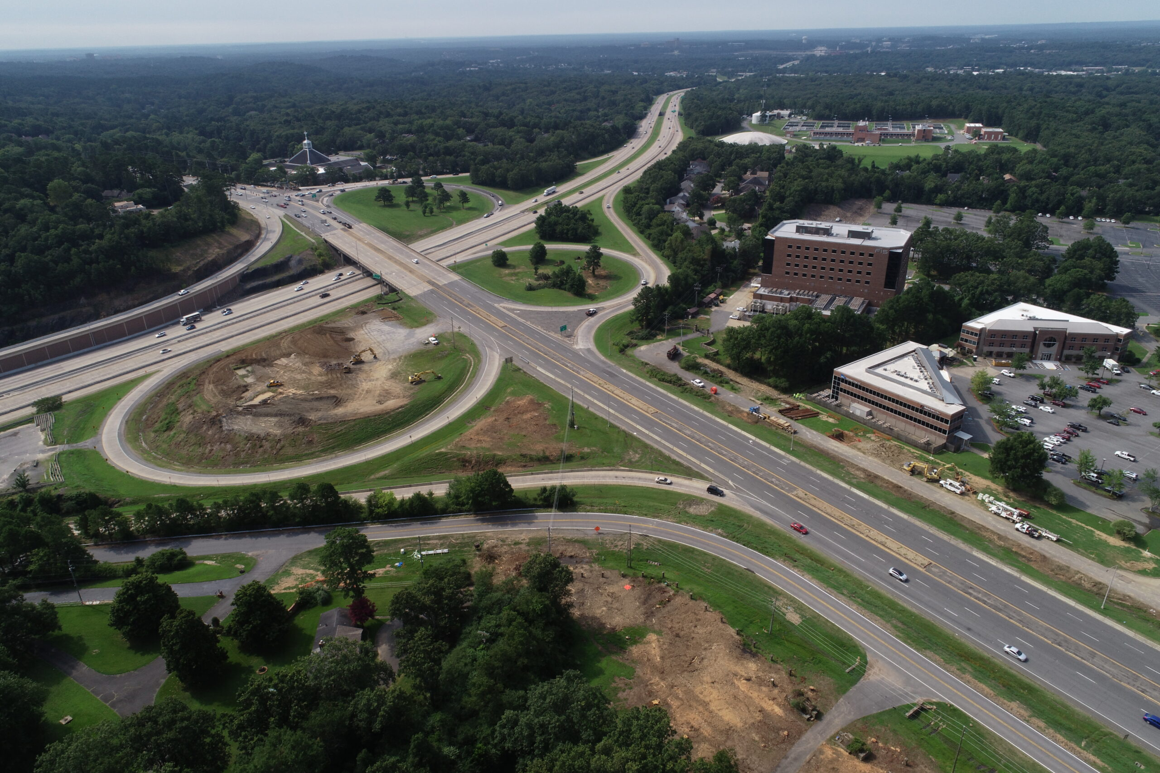
Cantrell Road Widening Little Rock, AR
I-430 Interchange July 2020
I-430 Interchange April 2022
CM-GC Delivery Model

Slide 40
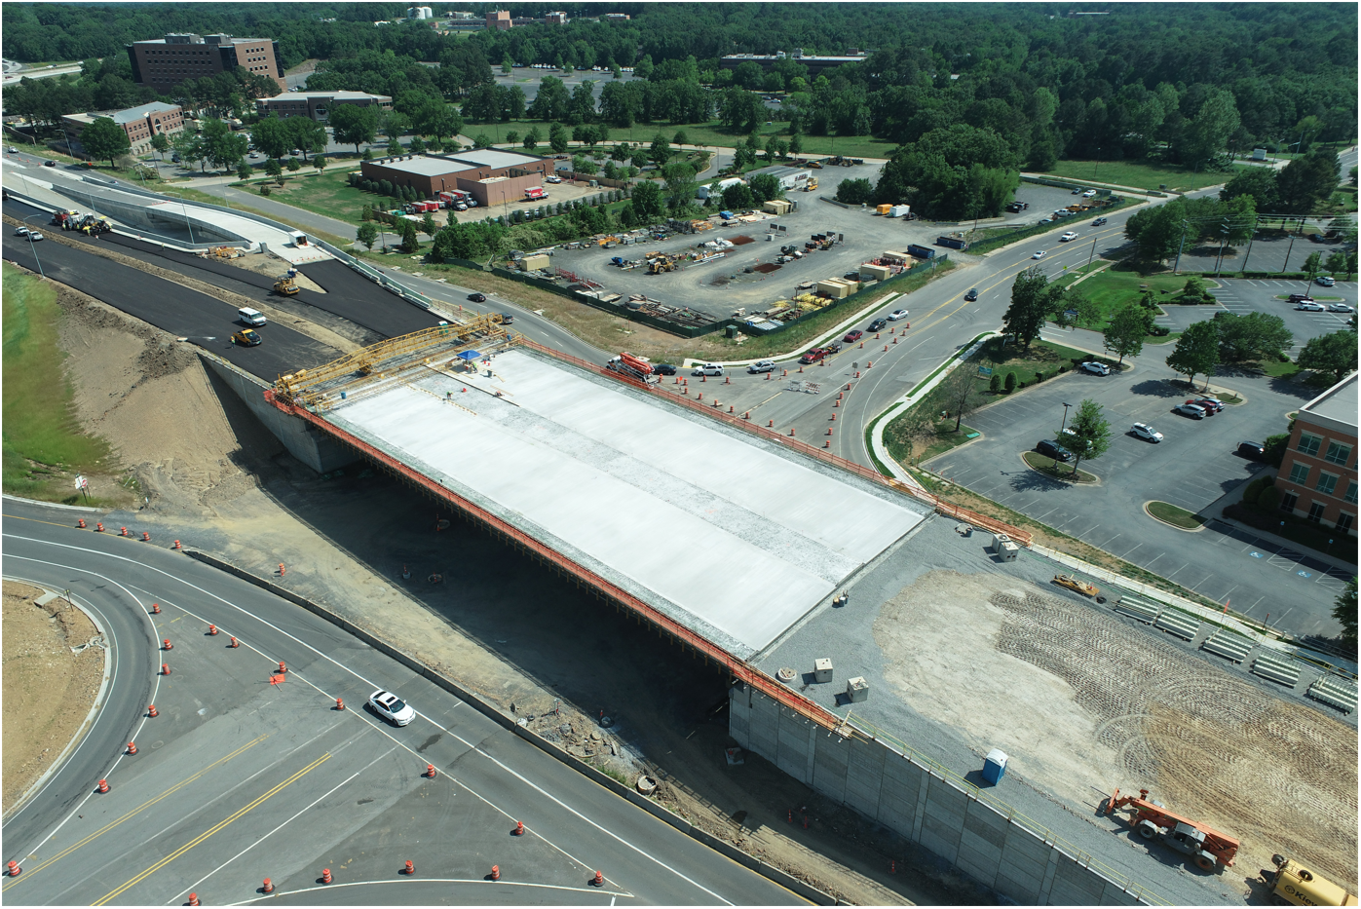
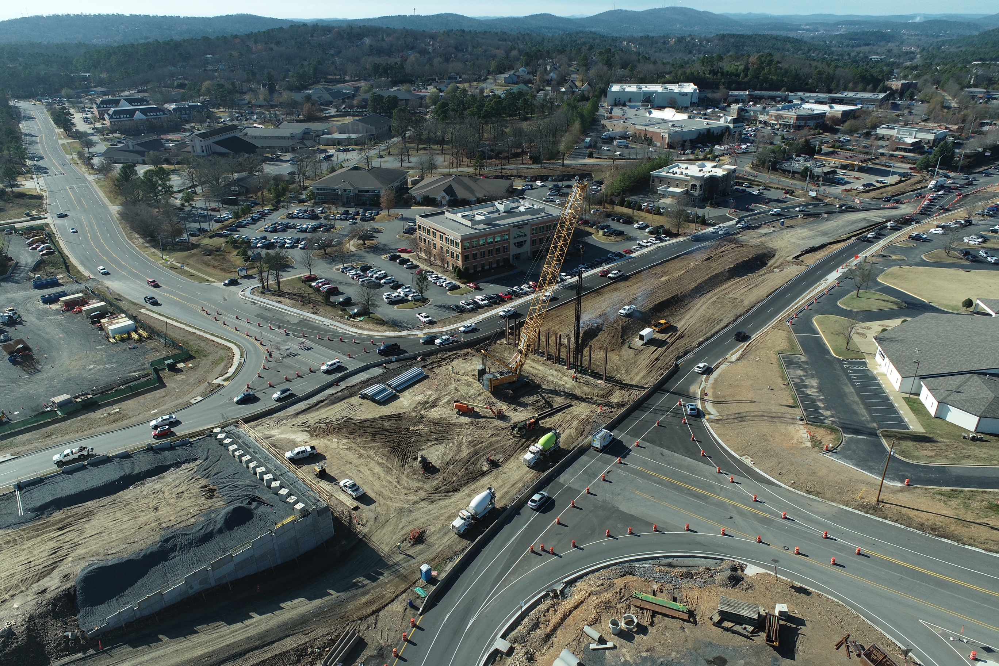
Cantrell Road Widening Little Rock, AR
SPUI Overpass Bridge December 2021
SPUI Overpass Bridge May 2022
CM-GC Delivery Model

Slide 41
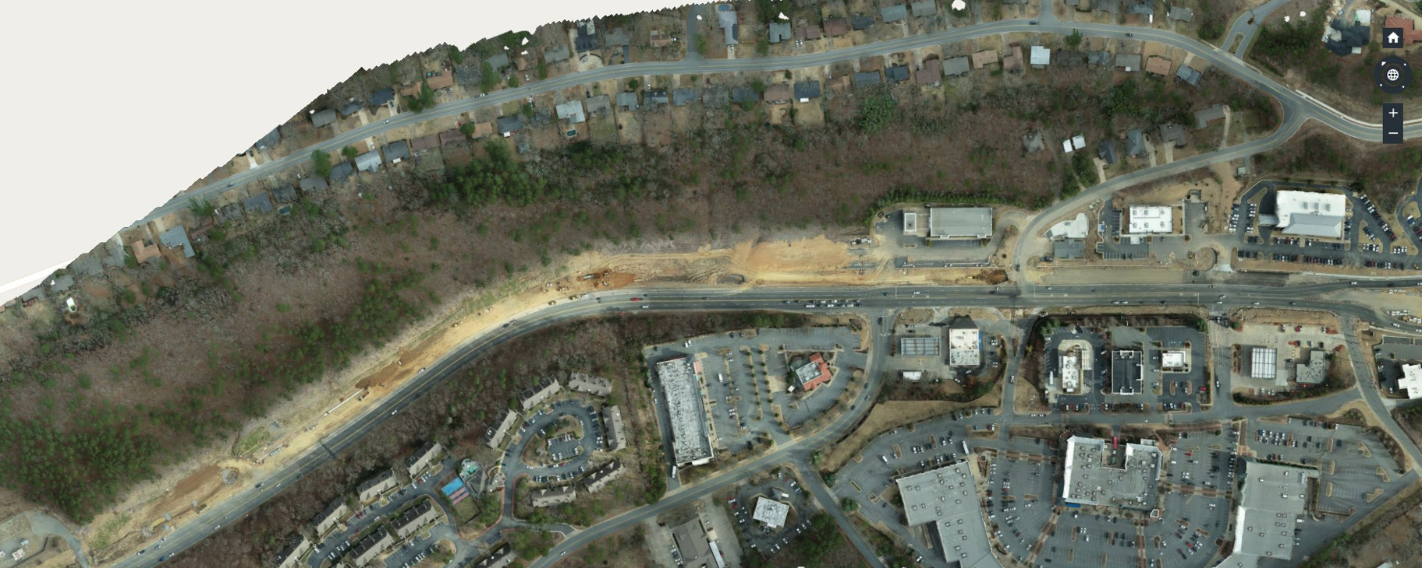
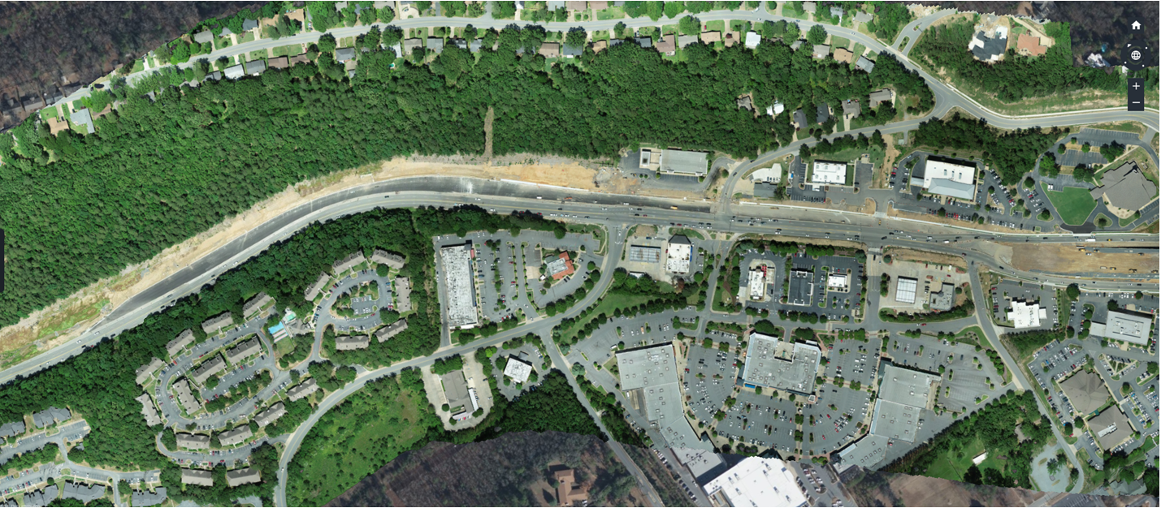
Cantrell Road Widening Little Rock, AR
West End January 2022
West End May 2022
CM-GC Delivery Model

Slide 42
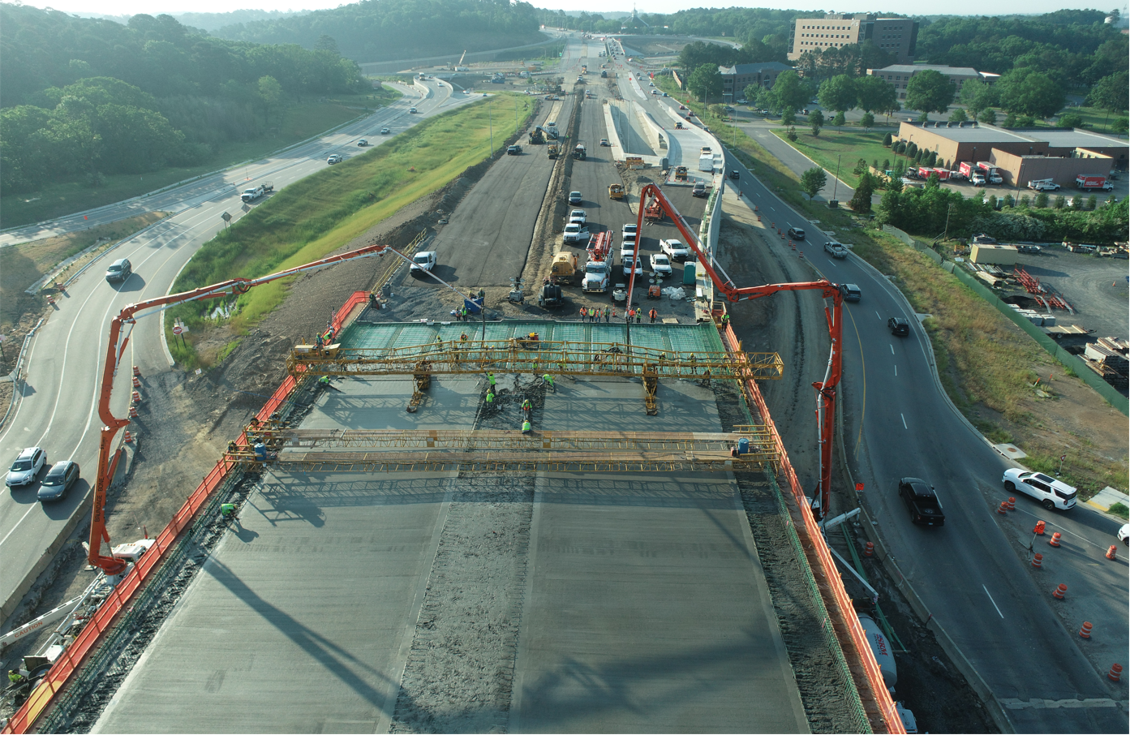
Cantrell Road Widening Little Rock, AR
Project Milestones
May – July
2022
SPUI Overpass Bridge Deck Pour
West End Widening Operations
SPUI Intersection In-Service
Pleasant Valley to Reservoir Road
Mill & Inlay
I-430 SB Ramp Tie-Ins (CRCP)
Aug – Dec
2022
SPUI Overpass Bridge Deck Pour
May 12, 2022
Jan - Mar
2023
ACHM Final Surface/Striping/Signage
Permanent Signals
Substantial Completion
CM-GC Delivery Model

Slide 43
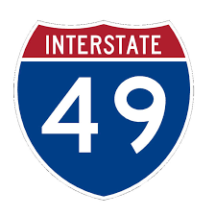
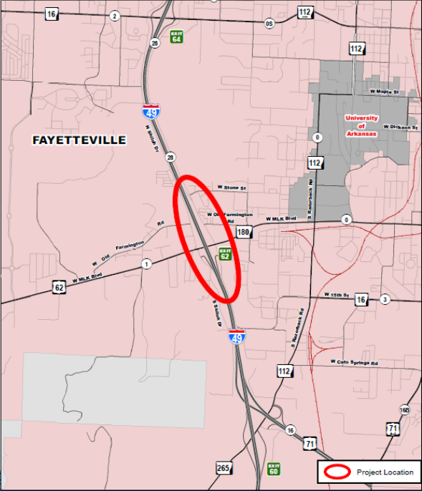
I-49/Highway 62 Interchange Fayetteville, AR
$50-60M Project Budget
CM-GC Delivery Model
Key Elements
Widens 3.5 miles of I-49, constructs frontage road diamond interchange at I-49/ Hwy. 62, capacity improvements on Hwy. 62, and adds overpass at 15th Street with roundabouts at frontage road intersections
Hwy. 62 used by 42,000 vehicles per day
Close proximity to the University of Arkansas and local high school campuses

Slide 44
I-49/Highway 62 Interchange Fayetteville, AR
Manhattan Road & Bridge & APAC-Central JV selected in March 2021 as the CM-GC team
CM-GC Delivery Model
Notes:
Job No. 040846 with Manhattan Road & Bridge & APAC-Central selected in March 2021 to serve as the CM-GC team for the project.
In the Pre-Construction Phase
-30% Plans developed
-30% Plan Quantity Reconciliation in June
-30% Opinion of Probable Construction Cost (OPCC) in July
-Utility Services & R/W Services are ongoing
Construction is planned to being in Early 2024.

Slide 45
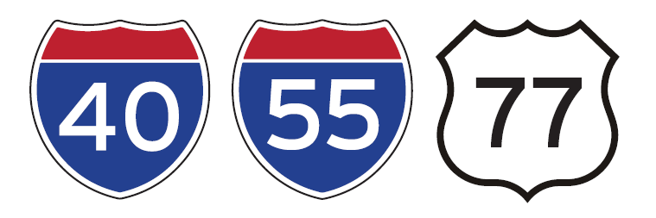
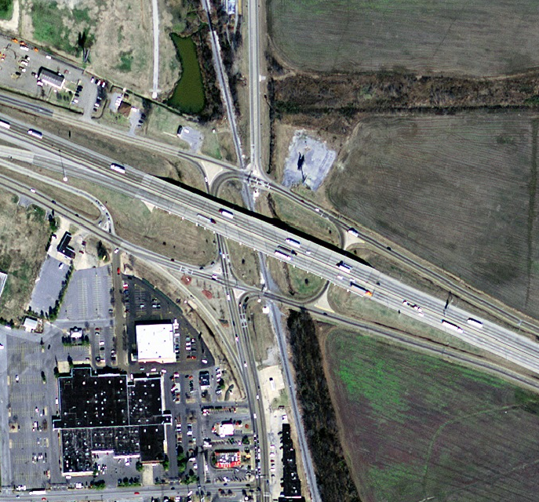
I-40/I-55/Hwy. 77 Interchange
West Memphis, AR
$30-40M Project Budget
PD-B Delivery Model
Key Elements
Second highest estimated existing travel delays due to high percentage of truck traffic
One of highest forecasted traffic volumes in state
Risk to emergency vehicle movements due to
at-grade railroad crossings

Slide 46
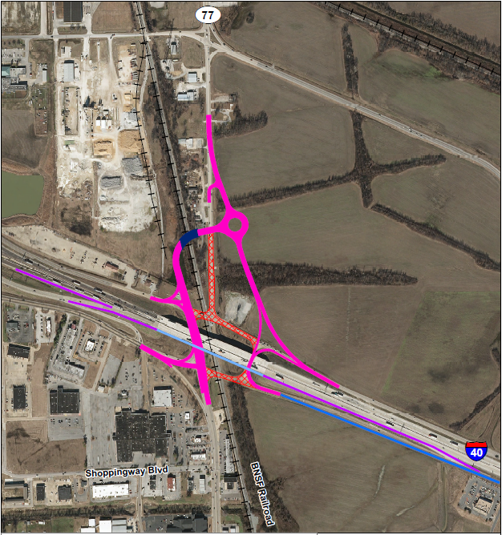
I-40/I-55/Hwy. 77 Interchange
West Memphis, AR
Key/Garver was selected in July 2021 as the Progressive Design-Build team
Design alternative removes two (2)
at-grade RR crossings
Design alternative constructs Hwy 77
RR Overpass
Design alternative adds a 3-legged roundabout and relocates approximate 1,100 ft of Hwy 77
Design alternative widens approximately 4300 ft of I-40 EB main lanes and bridge overpass
PD-B Delivery Model
Notes:
Job No. 110651 with Key-Garver selected in July 2021 to serve as the Progressive Design-Build team to deliver the project.
In the Planning Phase
-NEPA Process ongoing
-Moving toward 30% Plans
-OPCC/Risk Workshop planned for June
Construction is planned for 2024.

Slide 47
Looking Forward for Alternative Delivery

Slide 48
The Future of Alternative Delivery
On-Call Construction Manager-General Contractor Services (2021-2024)
Minute Order authorized by Highway Commission July 28, 2021
Extensive outreach with local contractors
Issuance of Request for Qualifications – April 26, 2022
Announcement of Shortlist for On-Call CM-GC Respondents – July 28, 2022
Request for Proposals on individual CM-GC projects
3 projects left to award under Pilot Program
Project #1 – September 2022
Project #2 – November 2022
Project #3 – April 2023
Notes:
Outreach included:
-Industry Workshop to discuss CM-GC Delivery Method
-One-on-One Meetings with interested firms to discuss On-Call CM-GC Procurement Process
-Pre-SOQ meeting with registered RFQ Respondents to discuss required submittal Forms

Slide 49
Job 040846 Hwy. 62 Intchng. Impvts. (F) $40-50 million
Job 100979 Caraway Rd. – I-555 (Jonesboro) (S) $10-15 million
Job 080619 Hwy. 60 – 1-40 Inters. Impvts. (Conway) (F)
$10-15 million
Job 061331 Pleasant Ridge Rd. – Pleasant Valley Dr. (L.R.) (F) $81.0 million
Construction Manager – General Contractor (CM-GC)
Job 061632 Hwy. 183 – Pulaski Co. Line (Widening) (Bryant) (S)
$10-15 million
Current CM-GC Projects
Recommended CM-GC Projects
Notes:
3 remaining projects that have been identified are:
Job No. 061632 - located in Bryant in Saline County, which includes approximately 3.2 miles of improvements to Hwy 5 from Hwy 183 north to the Pulaski County Line.
Job No. 080619 - located in Conway in Faulkner County and consists of 0.6 mile of improvements to Hwy 65B/Dave Ward Drive west of I-40 Exit 129.
Job No. 100979 - located in Jonesboro in Craighead County and includes approximately 2.7 miles of improvements to Hwy 1 south of I-555 Exit 42.

Slide 50
Tom Fisher, P.E.
thomas.fisher@ardot.gov
Mark Trickey, P.E.
mark.trickey@ardot.gov

