Slide 1
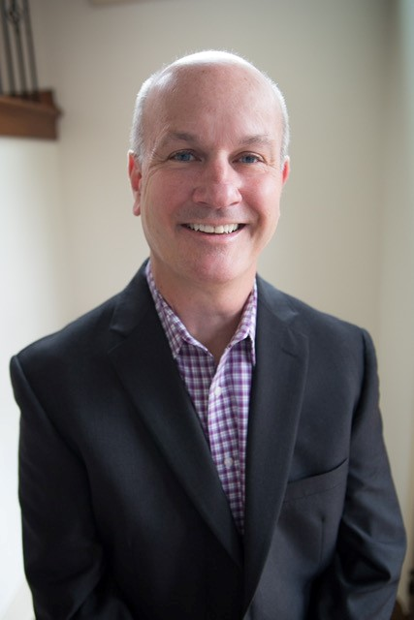
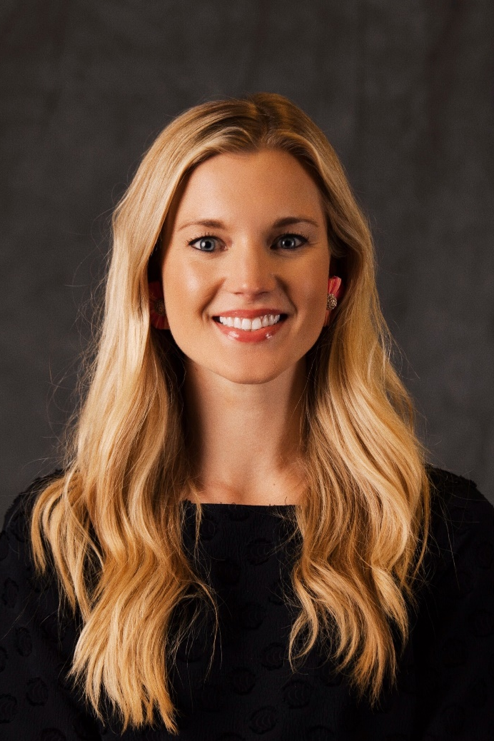
People, Potholes, and Public Information
Dave Parker
Public Information Officer
Ellen Coulter
Media Communications Manager
Notes:
For those of you who don’t know me, I’m Dave Parker and this is Ellen Coulter.
Very happy to be here. Obviously our 1st TRC appearance.
I wanted to explain a little more about the Public Information Team and what we do and how our work plays into the whole ArDOT brand.
They asked me to come up with a catchy title for today’s presentation, that’s the best I could do—People, Potholes and Public Information.
But after offering that up—it hit me, that’s really about right. Every day is different for the PIO team. But simply our job or mission is to get information of all kinds out to the public.
We gather the material and we get it out in the best possible way.

Slide 2
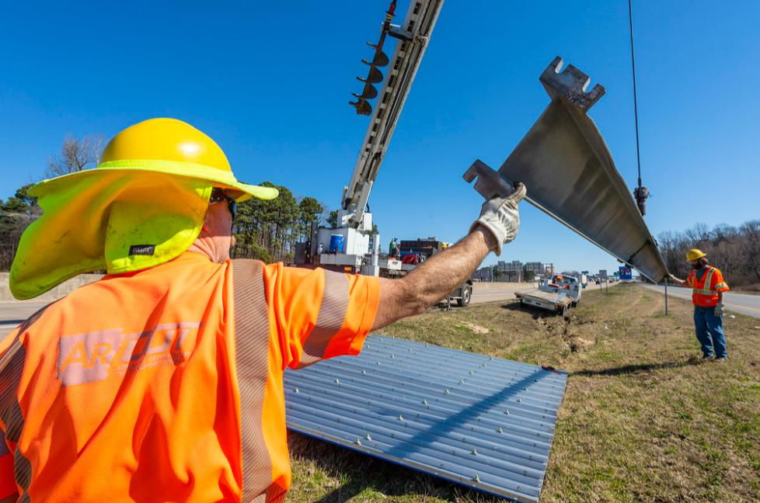
Building a Product
Notes:
I started with ArDOT about 18 months ago. Shortly after being hired, one of the first things the Director said to me was “Parker, tell our story better. Take all the good work we are currently doing and make it even better.”
Make sure the public knows and understands.
ArDOT was doing some good work—but maybe the public didn’t know about it and that message wasn’t consistent.
I started thinking about it—and really all the hard work we do, every single day goes into “building a product.” It could be that worker out on a project, could be someone in Right of Way, Environmental, Public Information—every thing we do helps build that ArDOT product.
So, if you have a product, who is the customer. Who are working for—well that’s easy, it’s the citizens of Arkansas. They are our most important customer. Hands down.
Now remember I started with ArDOT in the middle of COVID, October of 2020. I had many days alone in my office, few people on the 10th floor.

Slide 3
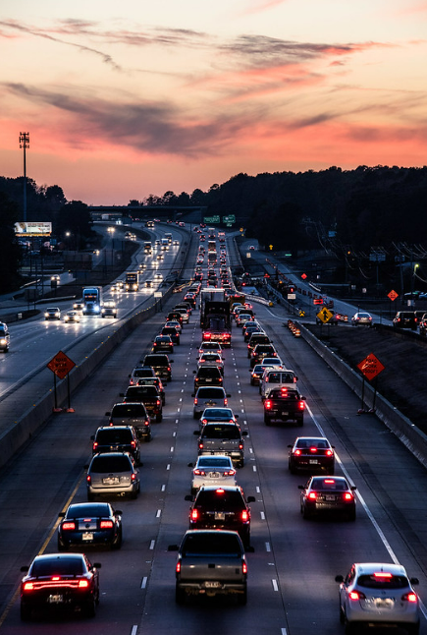
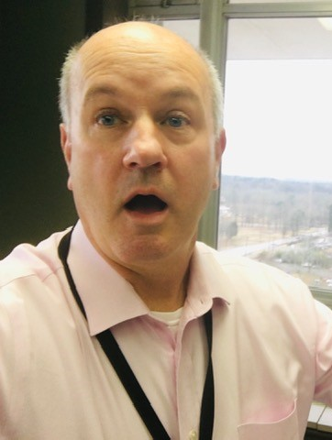
Content
Stories
Employee Input
Notes:
*CLICK THIS SLIDE SIX TIMES FOR REVEALS*
I would often sit and think, so ArDOT is the product, the public is the customer. How can we the PIO best tell that story. I spent 30 plus years working in television news. Now I’m with ArDOT.
And one Friday, close to quitting time—IT HIT ME!
The LIGHTBULB went off. Instead of taking my TV skills and fit them into ArDOT, I’m going to take all things ArDOT and fit them into my TV skills.
It all starts with CONTENT, THE STORIES, THE GREAT THINGS WE ARE DOING—WE SIMPLY NEED TO TELL MORE OF THOSE STORIES AND DO IT EVERY DAY. People need to be able to depend on us, to trust us, to understand we work for them and we are one of them.

Slide 4
Notes:
So I started building the PIO Team.
There are 20 of us.
Our CORE VALUES:
TRANSPARENCY, we must be completely upfront, we let the public know what’s going on, we hold nothing back.
ACCOUNTABILITY, we must ask ourselves the tough questions, are we doing the best we can, we always aim for the truth.
OBJECTIVITY, we deliver the facts. We look at the numbers. Our opinions or personal thoughts cannot get in the way.
RESPONSIBILITY, we take it very seriously, we must get the public the most accurate information and to them as quickly as possible.
SERVICE, we care about the people of Arkansas and we work hard to inform, empower and serve them.

Slide 5
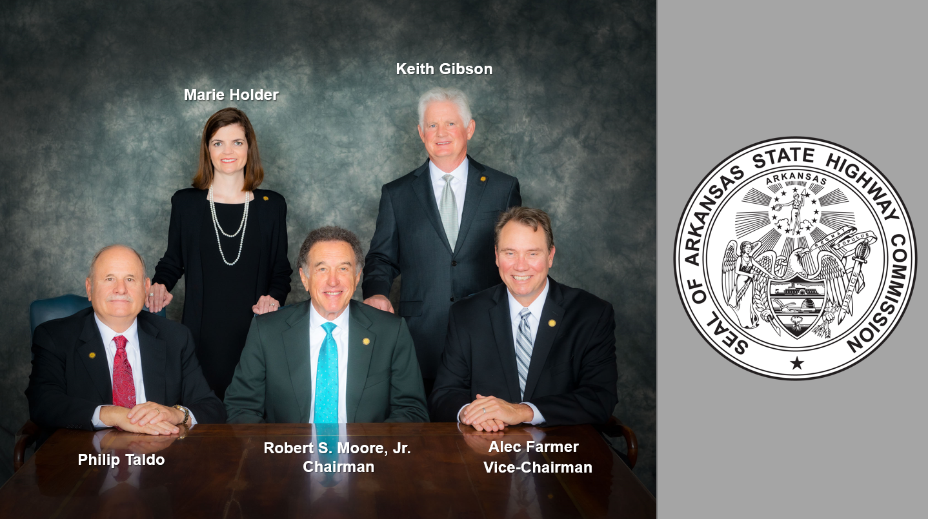
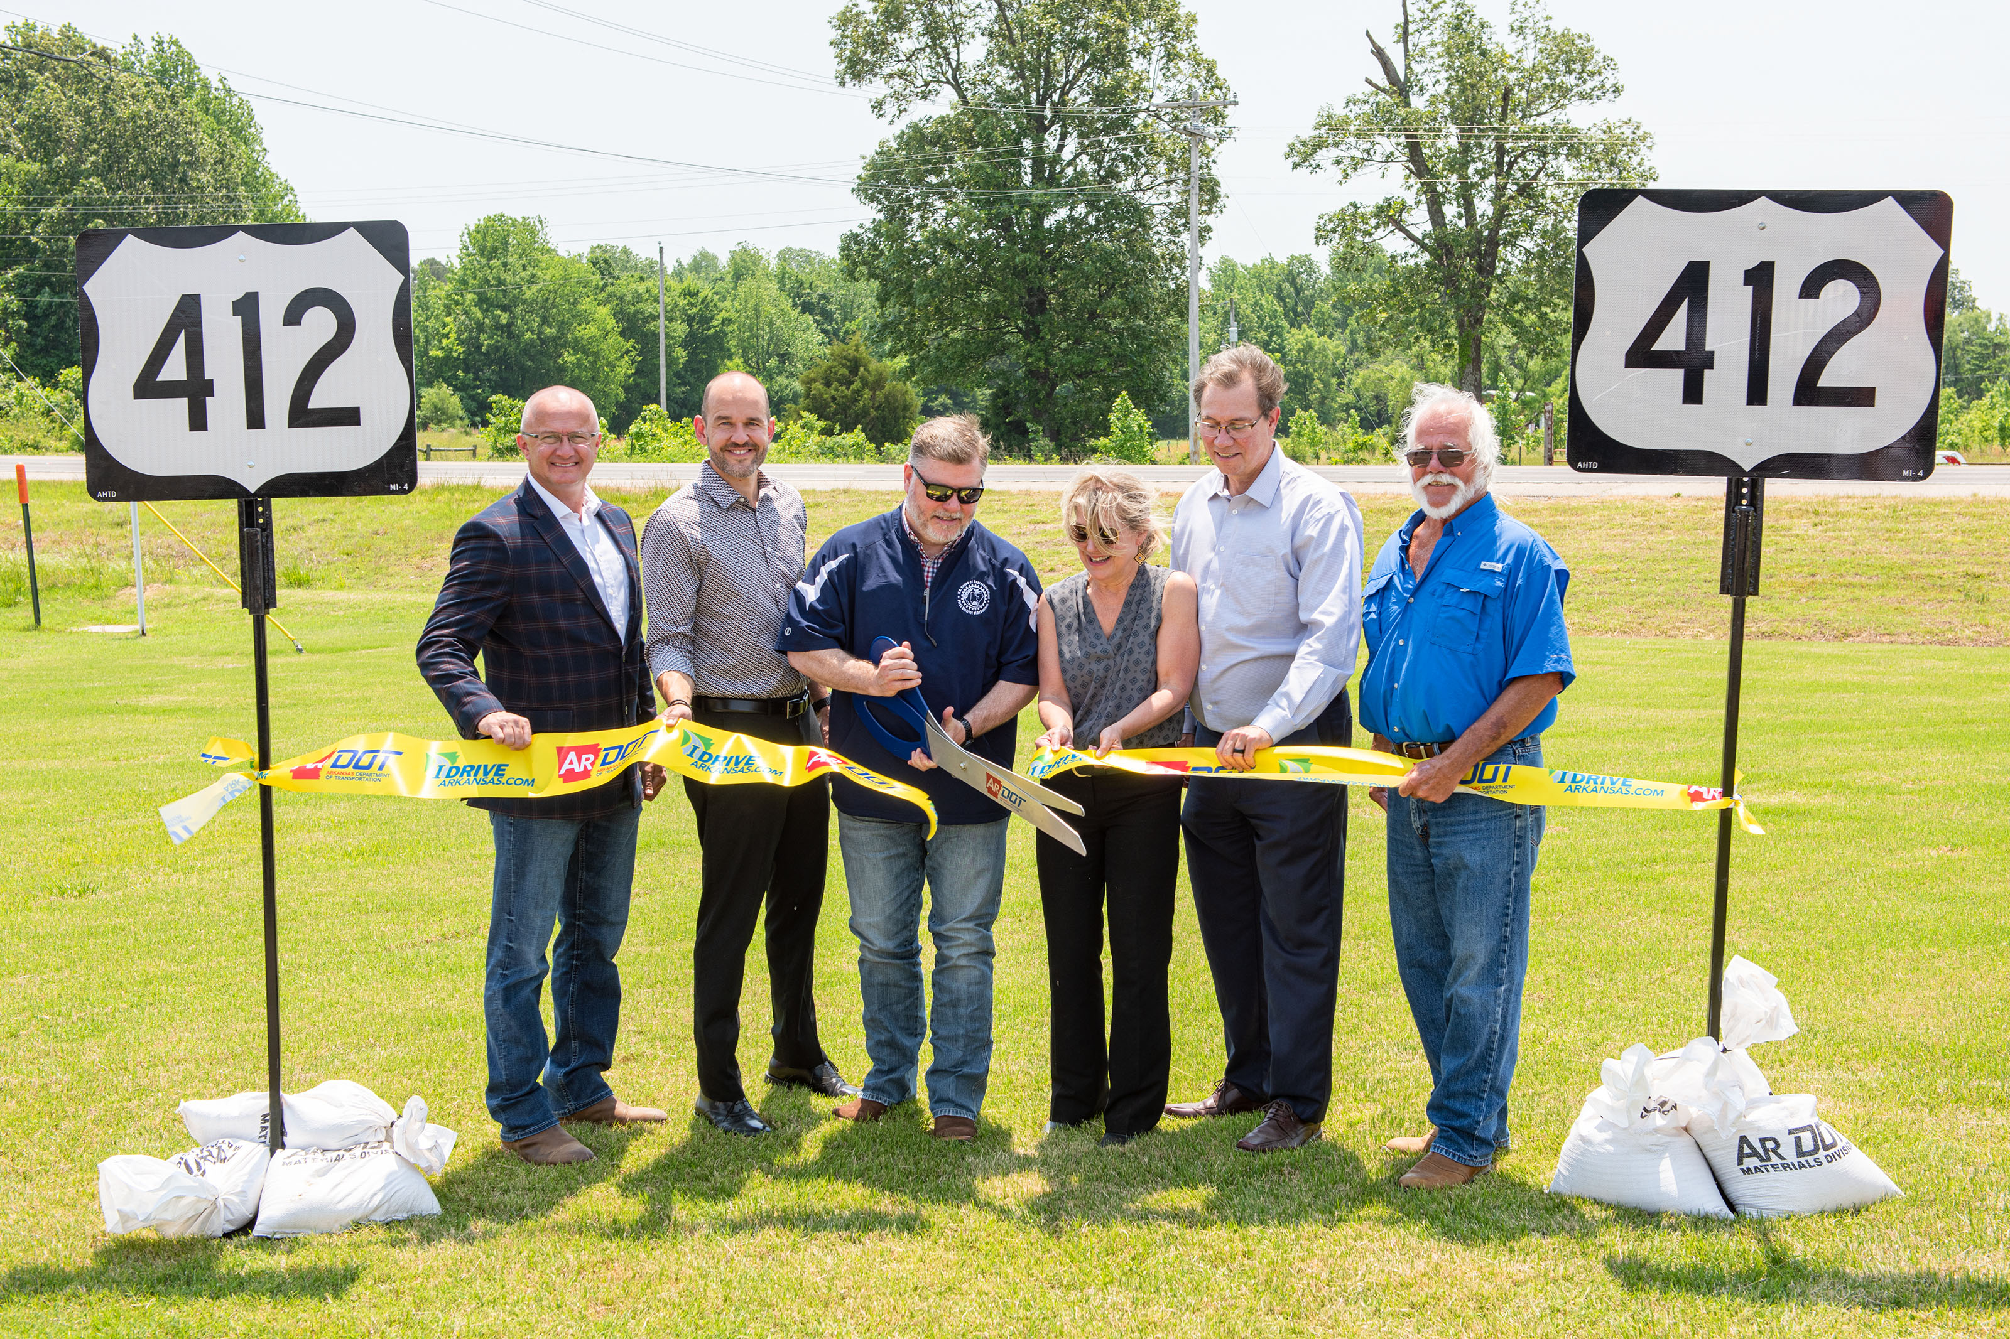
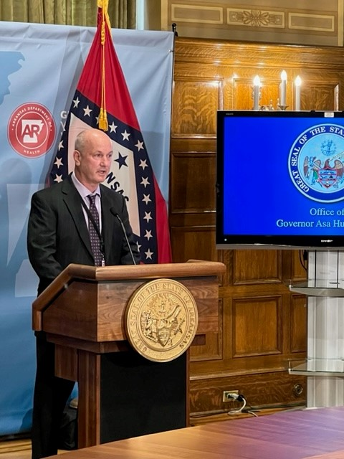
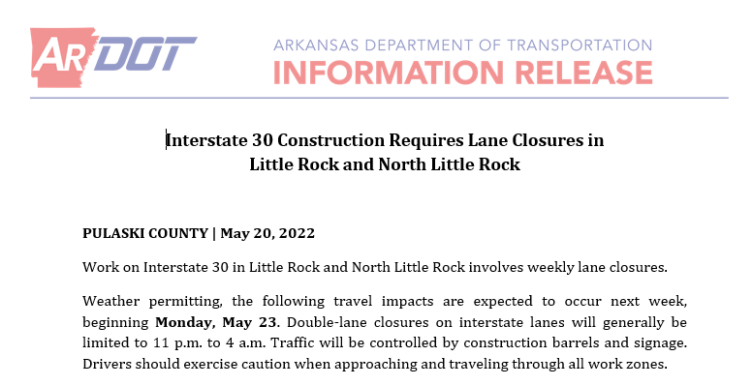
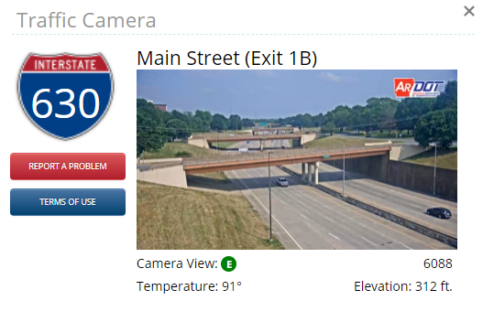
Notes:
So, we have the product, the customer, the team to gather all that content.
Just exactly how do we get the message out there.
A variety of ways.
The Freedom of Information Act, a FOIA, we get these all the time. If a citizen of Arkansas wants records on a certain project or event—sometimes we ask them to formally request that. It’s our job to get them that info just a few days after we received that FOIA.
We have various tools like IDrive Arkansas which is a great, but we the PIO team monitors and oversees Idrive.
There’s our website ARDOT.gov.
We report on what the Highway Commission is doing, we report on what the Director is doing, it might be a ribbon cutting or a groundbreaking.
I do media interviews all the time, especially during severe weather events.
We send out News Releases every day.
And then of course, there’s social media.

Slide 6
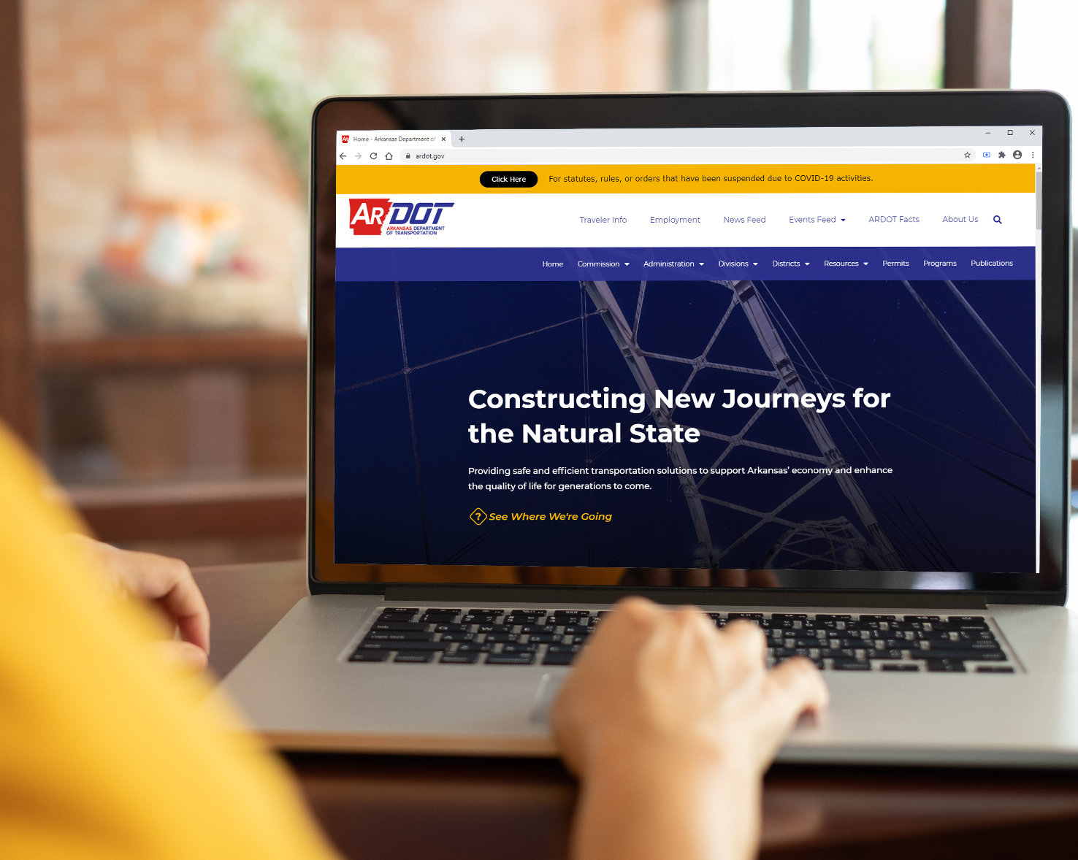
ARDOT IS ONLINE!
Find us on social media @myardot.
Scan the QR code to see our linktr.ee!
Notes:
When I started with ArDOT, there was Twitter, there was the website.
But really I saw an opportunity with social media---there were many other ways we could get that ArDOT story out there.
We needed 2 things for sure, we needed to get the word out to all of ArDOT to let us know what’s going on, what’s new, what’s interesting, you never know how great a story it might be, but it helps the public understand us better. We needed people like you to communicate more often with us about what’s going on in your areas and we needed to grow social media.
That’s one of the main reasons I hired Ellen Coulter, to help build our social media footprint, and with that I’ll toss it over to Ellen.
(TOSS TO ELLEN)

Slide 7
Facebook
@myardot
Followers: 3,832
Reach: 237,424
Page visits: 18,544
Instagram
@myardot
Followers: 253
Reach: 7,256
Profile visits: 1,274
Twitter
@myardot @idrivearkansas
Followers: 54,877 Followers: 4,561
Reach: 1.8 million Reach: 4.2 million
Visits: 290,600 Visits: 219,500
Notes:
We launched our ARDOT Facebook page January 3rd.
Already we’ve picked up thousands of new followers.
Being on Facebook gives us just another way of communicating with the public and to let everyone know what is going on.
At the same time—we also started our Instagram account.
And our 2nd Twitter channel which we launched this time last year now has more than 54-thousand followers.
Again-these digital platforms are all tools that allow the public to reach us quicker with their questions, concerns, and ideas.

Slide 8
Why is social media important?
Reach
Engagement
Behind the scenes video
Campaign launch
iDrive Arkansas promo
Fun fact about ARDOT
News release
Work zone safety
Winter weather update
Job opening
Notes:
Why is it so important for an agency like ARDOT to be on social media?

Slide 9
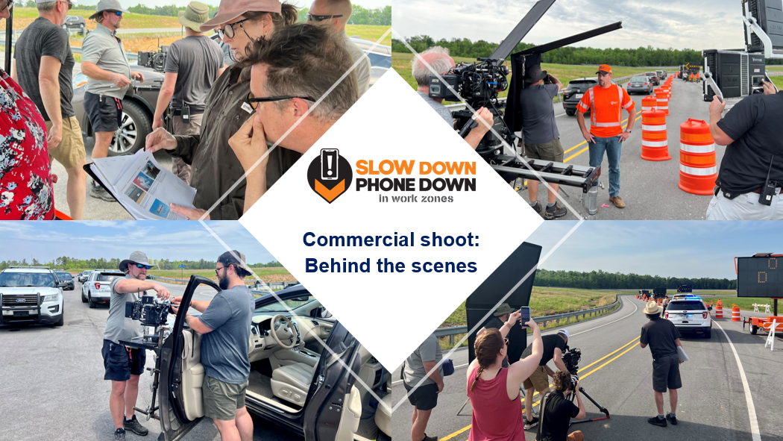
Notes:
Breaking boundaries in Public Information – first-ever commercial of this scale with an outside agency

Slide 10
Tell us what’s happening in your department: socialmedia@ardot.gov or (501) 765-9117
What do we mean by
content?
“Content”
Anything of public interest
To be shared externally
Graphics
Pictures
Educational Information
Jobs
News
Unique stories
Videos
Updates
Questions from the public

Slide 11
Find us on social media!
@myardot

