Slide 1
Performance Engineered Mixtures for Concrete Pavements
Arkansas DOT
Transportation Research Committee
5-25-22
Jerod Gross, PE, LEED AP
jgross@snyder-associates.com
515-669-7644
Notes:
This presentation is all about concrete evolution, about a new approach to engineering our concrete mixtures to assure that our concrete pavements will perform to the expectation of all involved with design and construction.

Slide 2
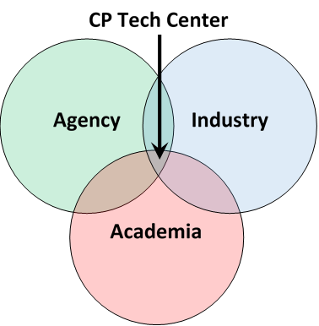

CPTech Mission
Making a difference
  helping you deliver better concrete pavements
  www.cptechcenter.org
Notes:
Mission Statement
The Center seeks to place itself at the junction of all three communities, providing resources to all of them
We are unique from other universities because we do focus on implementation, which necessitates collaborating with all these groups

Slide 3
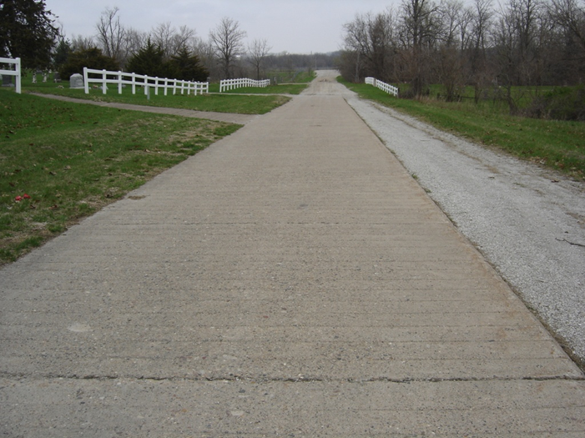
Outline
Why change?
What is PEM?
6 Properties for Durability
Sustainability
PEM Update

Slide 4
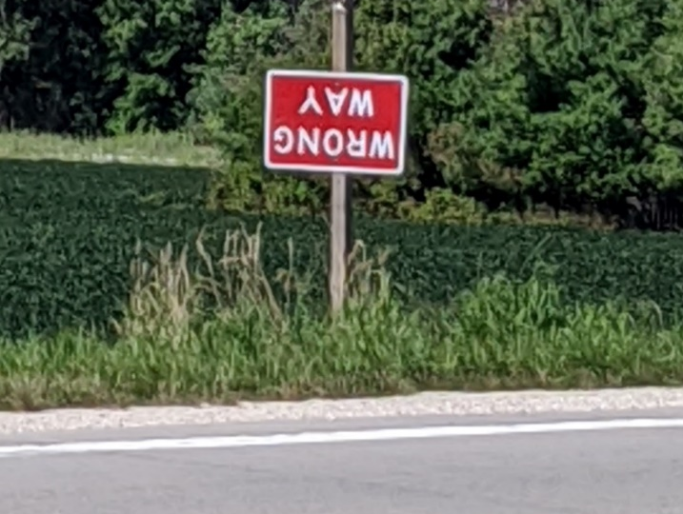
Why bother with change?
Current approaches
  May not measure critical parameters
  Are often built around previous failures – thereby introducing unintended consequences
  Limit innovation
Need to reduce risk of premature failure
Good concrete is a long-life pavement
Notes:
e.g. Strength is low – so add cement = increased shrinkage and cracking risk.

Slide 5
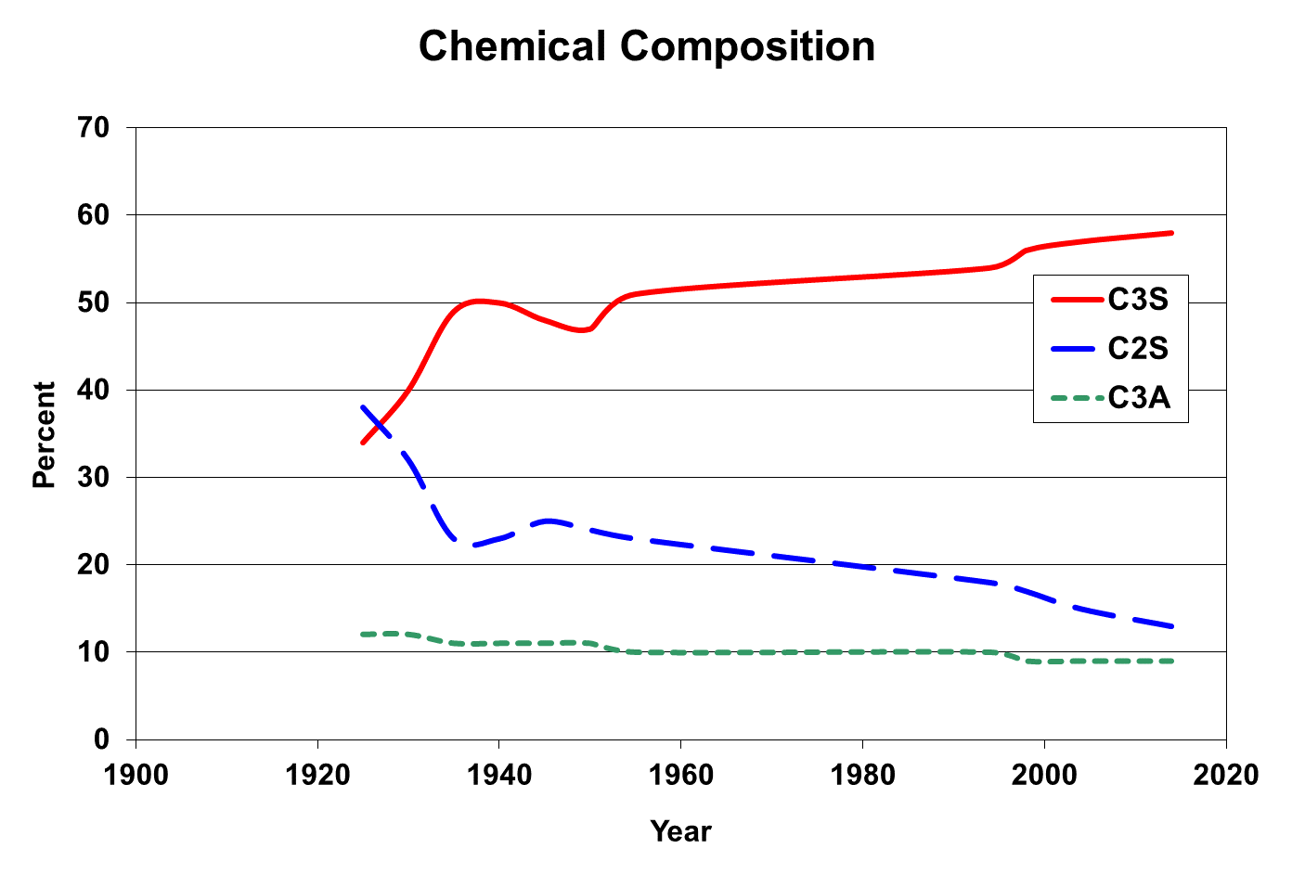
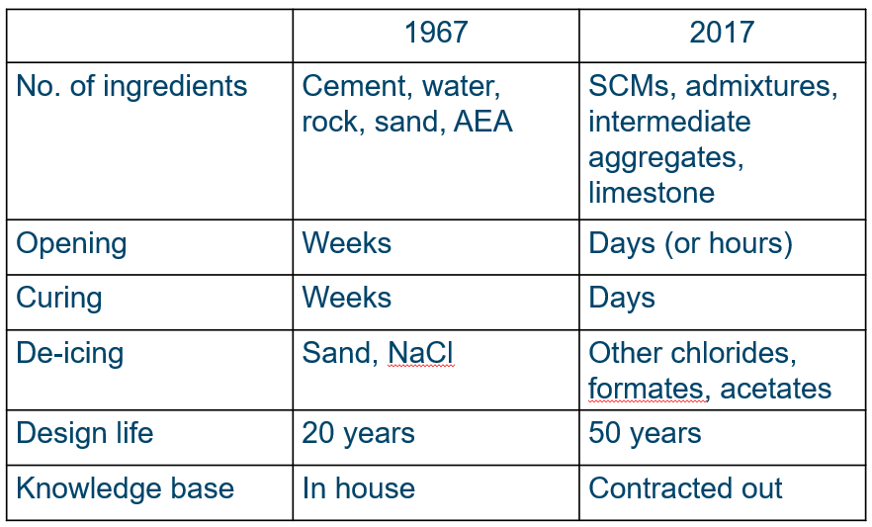
Then and Now
Then:
Cements
  Wet kilns
  High C₂S / low C₃S
  Straight OPC
  Now:
  Cements
  Dry kilns
  High C₃S / low C₂S
  SCMs
  Slag cement and fly ash
Admixtures
  Air entrainers
  Water reducers

Slide 6





Performance Engineered Mixtures (PEM)
A broad initiative with a goal of implementing performance specifications for concrete, including an increased emphasis on durability
19 States + FHWA & Industry
PEM TPF-5(368)
Notes:
5-year contract (currently year 4)
Task 1 – Implementation
technical assistance, spec review, shadow testing, data collection
Task 2 – Monitoring
Collect data, mine LTPP data
Task 3 – Test methods
Transport, thermodynamics, water movement,
water content, constructability
Task 4 – Test refinement

Slide 7
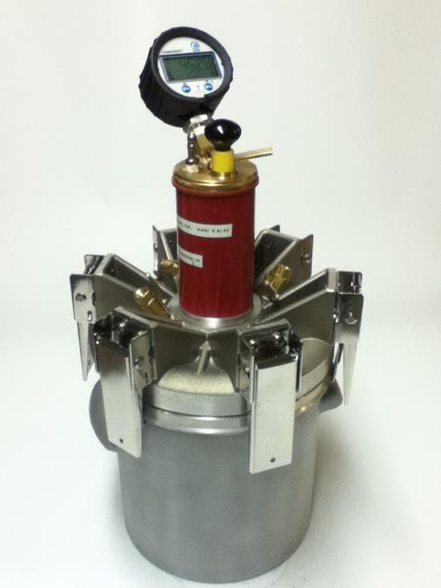
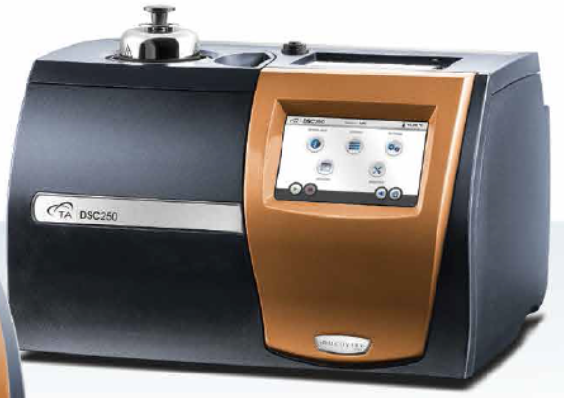
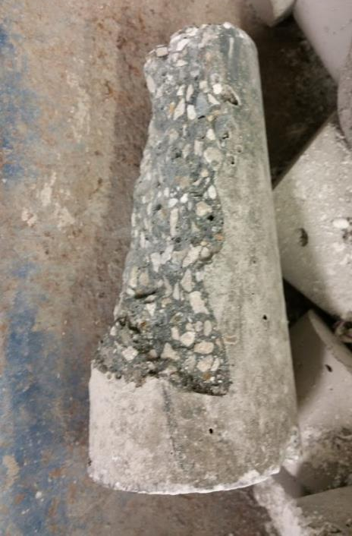
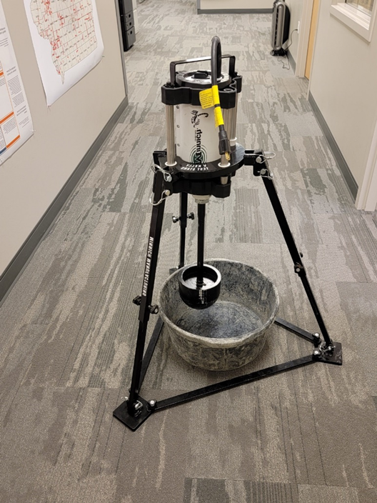
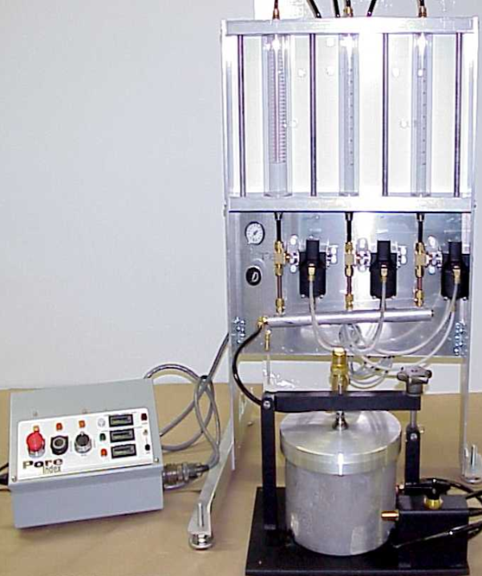
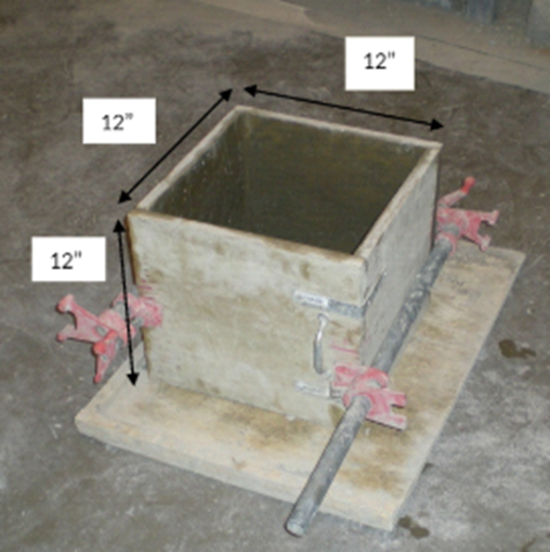
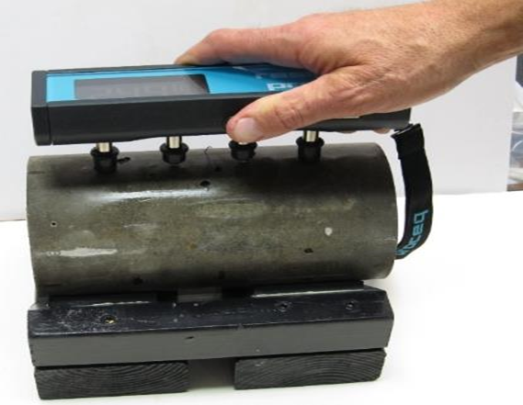
6 Properties of a Durable Concrete Mix
Transport properties (permeability)
Aggregate stability
Cold weather resistance
Strength
Shrinkage
Workability
Cold weather resistance
Strength
Transport
(permeability)
Aggregate Stability
Workability
Notes:
We need to be concerned with the things that matter!
We need to understand the right properties measured at the right time
Prequalification
Process control
Acceptance
A buffet of approaches is available (AASHTO R101)
Prescriptive: w/cm, paste volume
Performance: formation factor(resistivity)

Slide 8
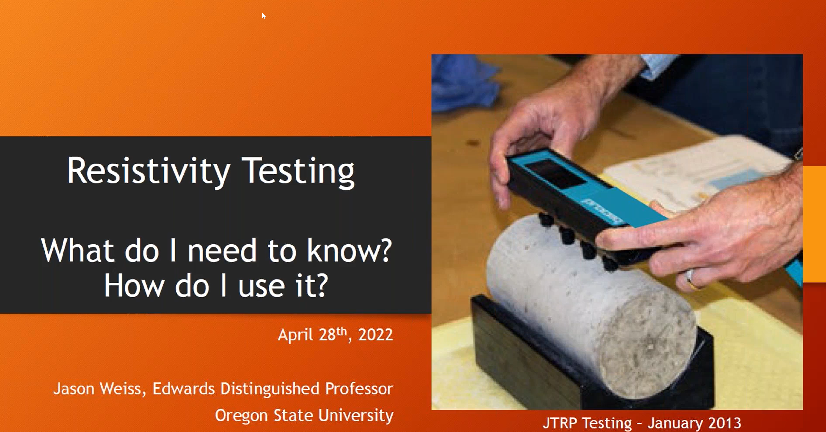
Transport properties (permeability)
Resistivity
  Store a cylinder in a fixed salt solution
  Pull out at desired age
  Read and put back
  Repeat
  AASHTO TP 119
  AASHTO T358
  Prequalification
  QC
cptechcenter.org/pem
(Resistivity webinar)
Notes:
All deterioration mechanisms involve fluid movement
Keep water out = longer life
Measurement has been difficult
Prequalification
QC
Acceptance

Slide 9
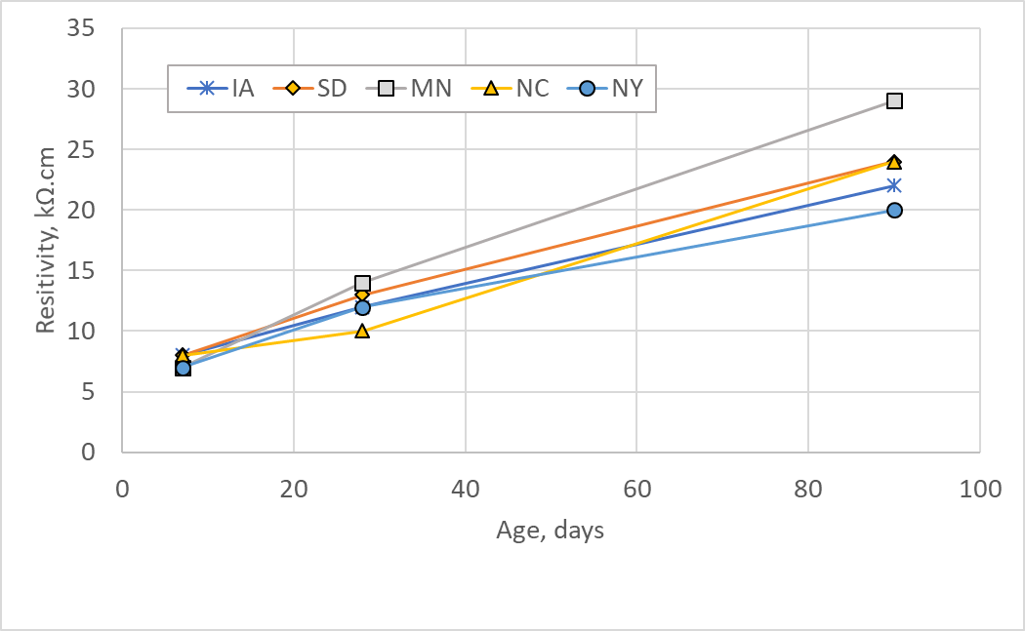
Transport properties (permeability)
SCMs & w/cm affect durability and permeability
Results take time
28-day correlation being studied
Low chloride penetrability
Moderate chloride penetrability
High chloride penetrability
Notes:
This is from a draft of the final PP-84 table 1

Slide 10
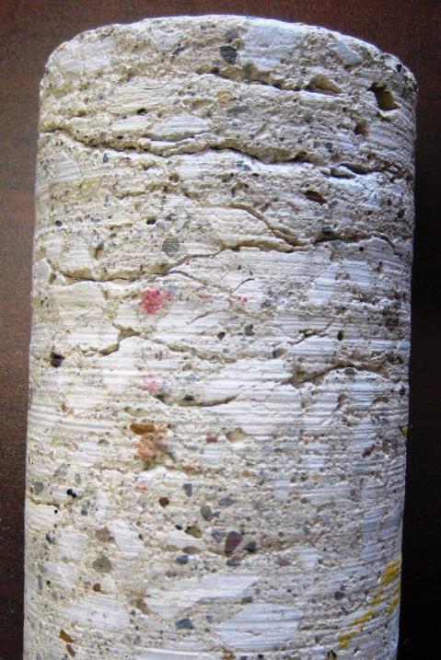
Aggregate Stability
Aggregate growing due to
  Alkali silica reaction
  (Alkali carbonate reaction)
  D-Cracking
Prequalification

Slide 11
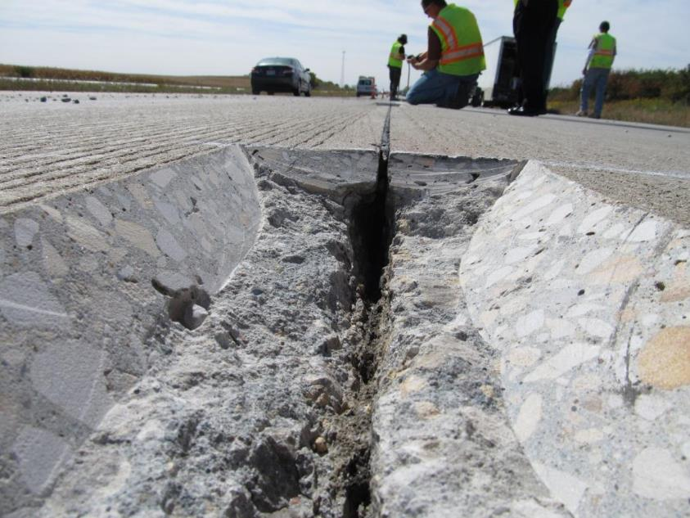
Cold Weather Resistance
Freeze-thaw
Saturation
Entrained air
De-icing salts
Sufficient SCM
  Super Air Meter
  Reports air content and SAM number
  SAM number correlates with freeze thaw testing
  Prequalification
Ley
Notes:
What if it is bad?
Review AEA type and dose
Review WRA interactions
Review SCM interactions
Run Foam drainage test

Slide 12
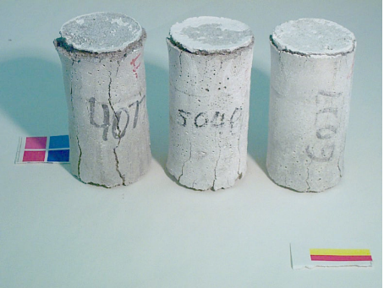
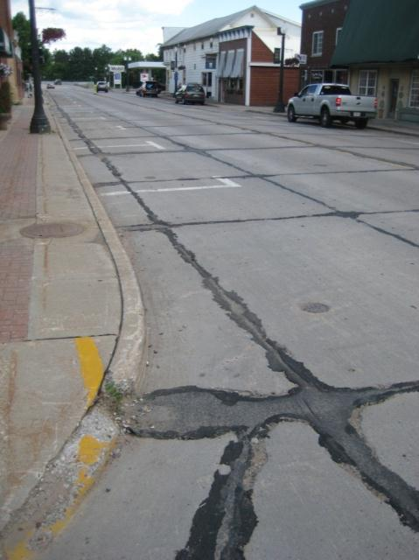
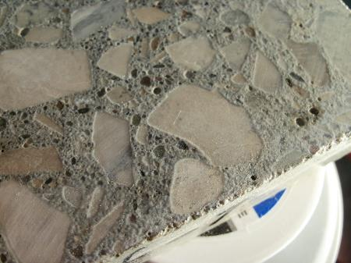
Salts can cause chemical attack
Calcium oxychloride
  Reaction between Ca(OH)₂ and calcium or mag chloride
  Expands more than ice
  Forms above 32°F
Prevention
  Enough SCM
CaCl₂ @ 40°F
CP Tech Center testing
Notes:
There are signs of chemical attack in some cases. The oxychloride later decomposes and disappears. This from Larry Sutter’s work for SD. Have to have the right temperature.
CP Tech can test for oxychloride using: Low temperature differential scanning calorimetry (LT-DSC) and an expansion test
This can be requested at the prequalification stage

Slide 13
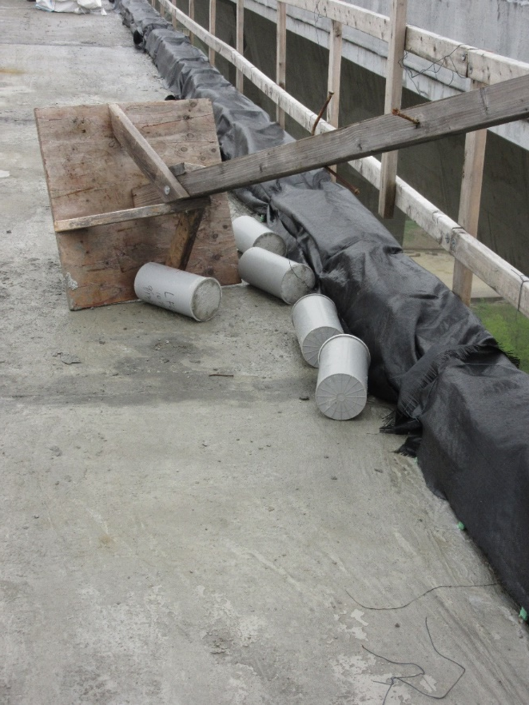
Strength
Strong enough to carry loads
  (and not much more)
  More cement = more strength
Prequalification
QC
Acceptance
Notes:
Too much cement increases w/cm ratio, too high w/cm ratio, potential for shrinkage cracks
Should be strong enough to carry loads, measured using: Cylinders, beams or maturity
Tested at : Prequalification & Acceptance

Slide 14
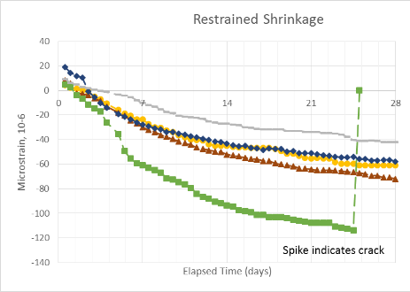
Shrinkage
Influences cracking risk
Controls warping
Prequalification
Watch paste content from batch sheet
  25% max. (pavements)
How to reduce risk?
  Reduce paste content
  Check clay content of aggregate
  Consider internal curing
  Consider shrinkage reducing admixtures

Slide 15
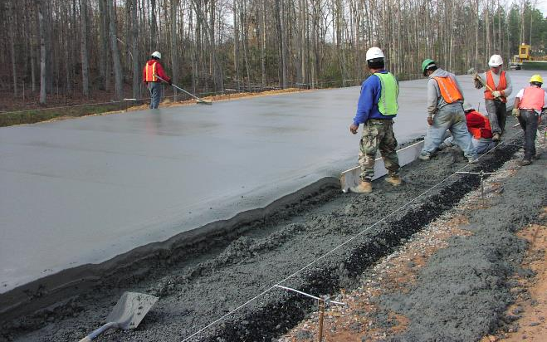
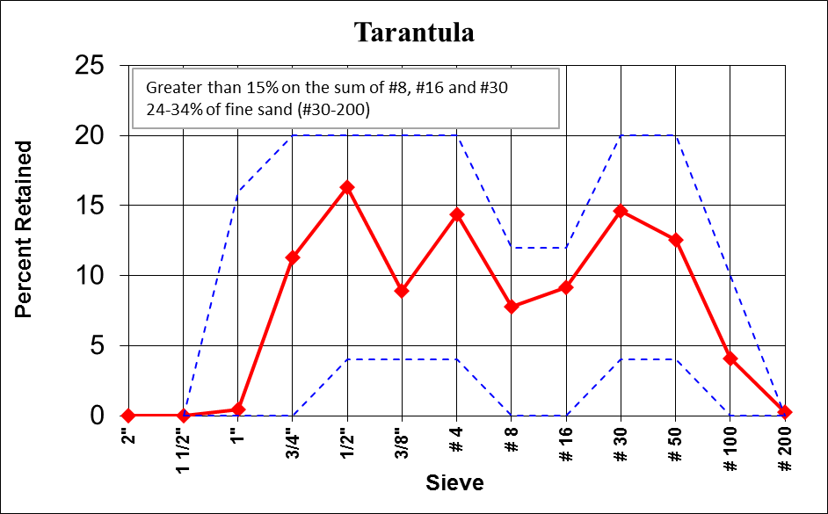
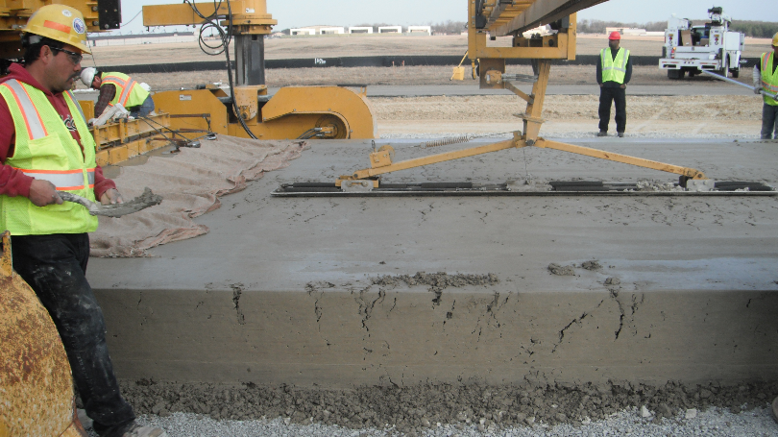
Workability
Not too wet / Not too dry
Right for the equipment you are using
Response to vibration
Aggregate gradation
Prequalification
Notes:
For conversation, how does box and VKelly work for concrete coming out of the pump?

Slide 16
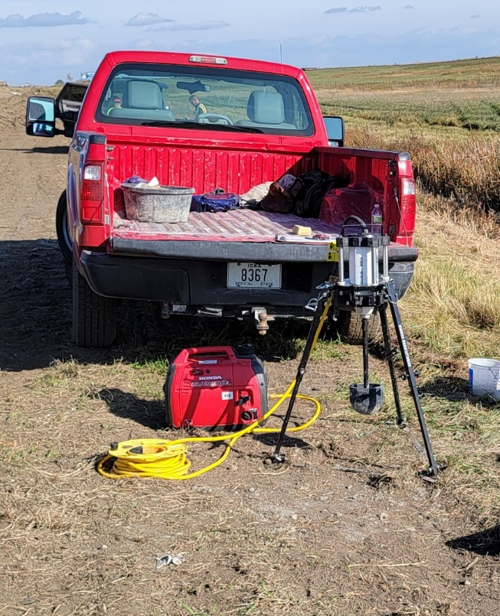
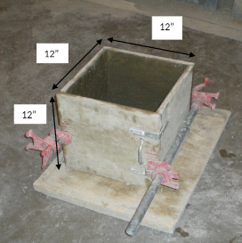
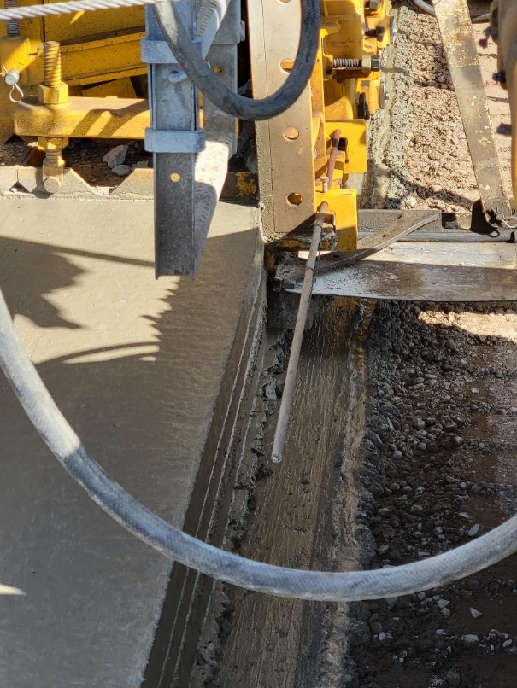
Workability
Slump does not tell us about response to vibration
VKelly and Box
Notes:
VKelly
Informs about response to vibration
Prequalification

Slide 17
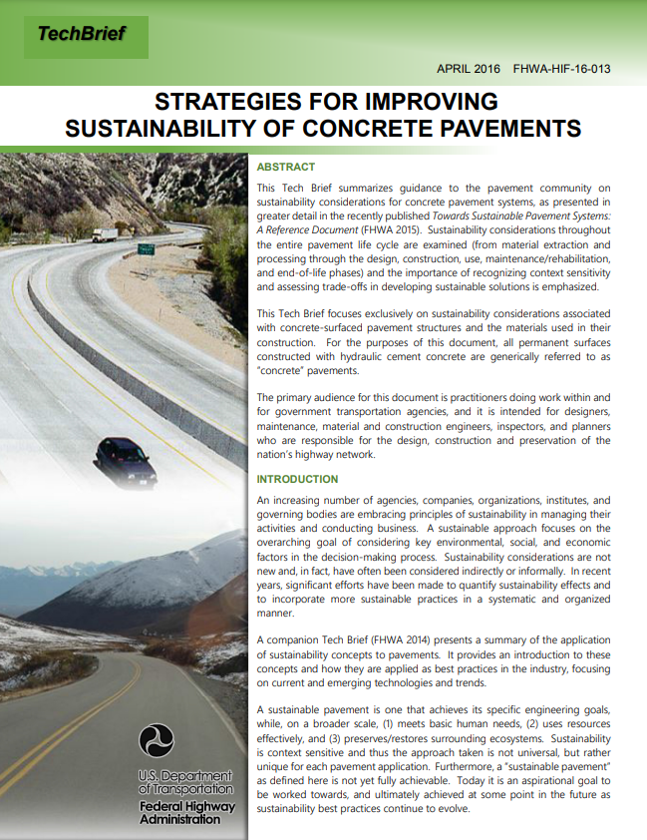
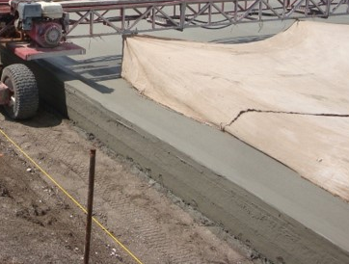
Optimization = Sustainability
Not new – raises bar for good engineering
  Fly ash, etc.
Demand by Public, FHWA, DOT
Emphasize technologies that increase pavement life and reduce energy intensive or environmentally damaging materials
CP Tech has a spreadsheet to assist in optimized aggregate gradation
  Intermediate aggregate
https://www.fhwa.dot.gov/pavement/sustainability/hif16013.pdf

Slide 18
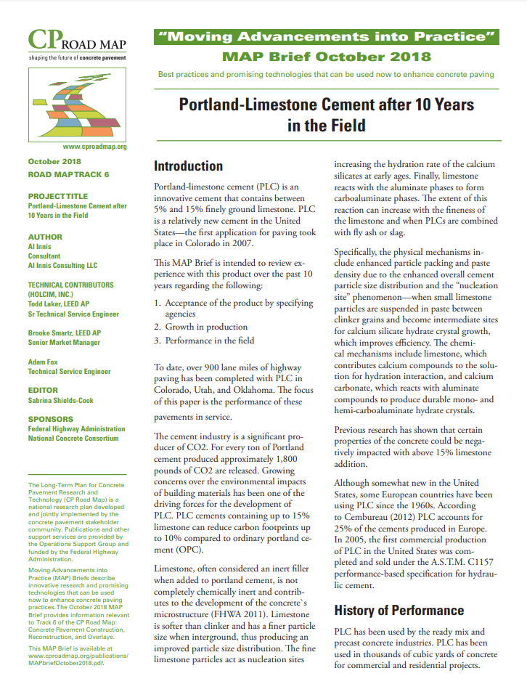
Type IL (Portland Limestone Cement) is Sustainable
Typical Type I/II already has ~5% limestone addition
Portland Limestone Cements
  Up to 15% ground limestone
  Similar performance
  Will become the normal cement in 2022
Reduces carbon footprint of concrete
https://intrans.iastate.edu/app/uploads/2019/10/MAPbriefOctober2018.pdf
Notes:
Some states are pushing the 15% replacement and testing at 20% and over.

Slide 19
Carbon Reduction by Reducing Cement
10% Limestone
20% SCM
Optimized Aggregate
571 pcy Portland Cement
514 pcy Portland Cement
411 pcy Portland Cement
371 pcy Portland Cement
C3WR Mix
35% reduction of Portland cement

Slide 20
PEM Update

Slide 21
PEM Implementation Incentive
PEM Implementation Incentive Pilot Project

Slide 22
PEM Projects Across the Nation
Shadow Projects (Incentive)
2018
2019
2020
Demo Projects (PEM testing)
20172018
2019
2020

Slide 23

Regional State - Industry Discussions

Slide 24
PEM PROGRESS – Training
4
3
PEM overview webinar
One day workshop
Technician training
Open house
3
PEM Training Locations

Slide 25
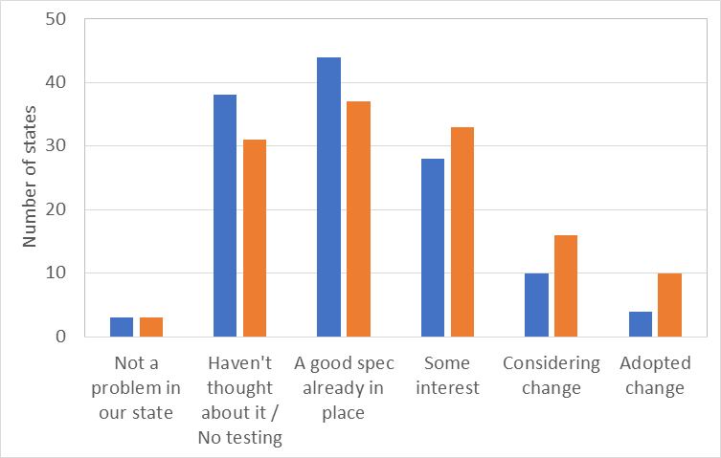
PEM is Advancing
Advancement

Slide 26
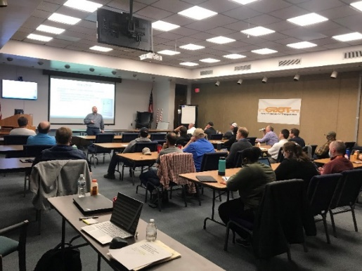
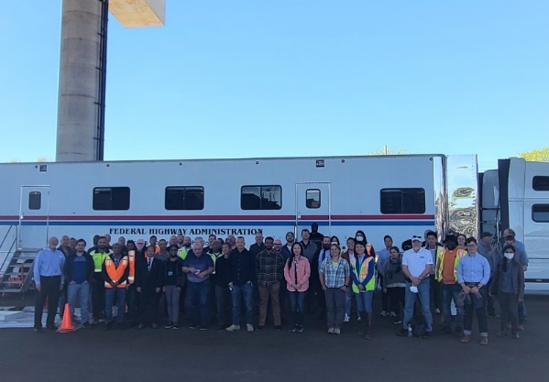
2021 – 2022 PEM Update
August 2021 - Tennessee DOT PEM Workshop
September 2021 Webinar - Advancements in PEM
January 2022 - PP 84 becomes R 101
March 2022 – Georgia DOT PEM Workshop
May 2022 – MCTC & CP Tech Open House NYC
PEM TRB Circulars (NY, IA, MI, NC)
2022 MCTC PEM visits: MN, ID

Slide 27
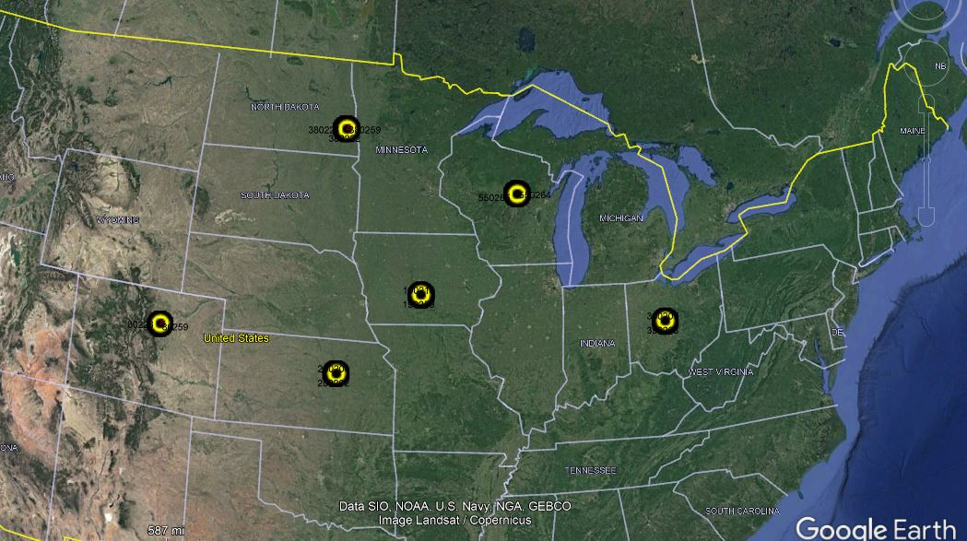
PEM SPS-2 Samples
Comparing performance and PEM tests with
pavements from LTPP program
Summer 2021, 101 cores, 6 states:
Colorado, Iowa, Kansas
Ohio, North Dakota, Wisconsin
SPS-2 Data:
Air, cement type, cement amount, SCM, w/cm, # aggregates, distress type / performance noted
Testing for:
Hardened Air, Oxychloride, Porosity, Resistivity, Distress / performance
Notes:
Core samples were taken from in the summer of 2021 utilizing traffic control where possible during the SPS-2 site evaluations as part of the LTPP program. Samples were sent to Oregon State University and Oklahoma State University for testing.
Each of the sample sites have data on mixture proportions, SCM type, air content and w/cm ratio. The pavement performance for the samples were noted.

Slide 28
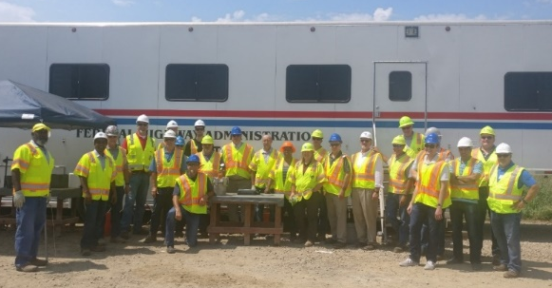
What are States doing?
Iowa
  5 PEM projects, 34-45 lbs reduction in cement (pcy)
Kansas
  Annual SAM training, SAM specifications, resistivity, optimized gradation
  Colorado
    2019 specs: removed max and min cement content, allows optimized gradation, box test in mix design, resistivity, max. shrinkage

Slide 29
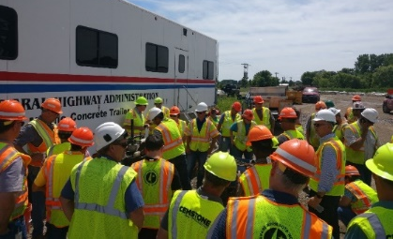
What are States doing?
  Minnesota
  0.40 w/c ratio, optimized gradation, SAM interest, Phoenix
  Michigan
  Close to SAM Mix Design spec, incentives for lower w/c, optimized gradation
  Wisconsin
  Close to SAM acceptance spec, incentive for optimized gradation (then removed), 44 pcy reduction (564 to 520 pcy)

Slide 30
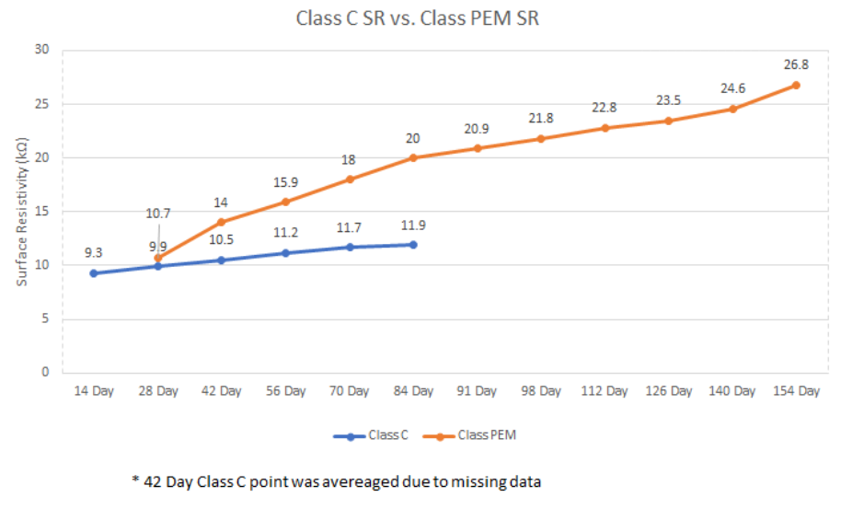
What are States doing?
  Pennsylvania
  2020 spec lowered w/c ratio to 0.42, shrinkage (bridge decks), contractor supports PEM
  New York
  PEM placement, 56-day resistivity, structural
  Open house May, 2022
  North Carolina
  Box, SAM & Resistivity incorporated into QC after training (contractor)

Slide 31
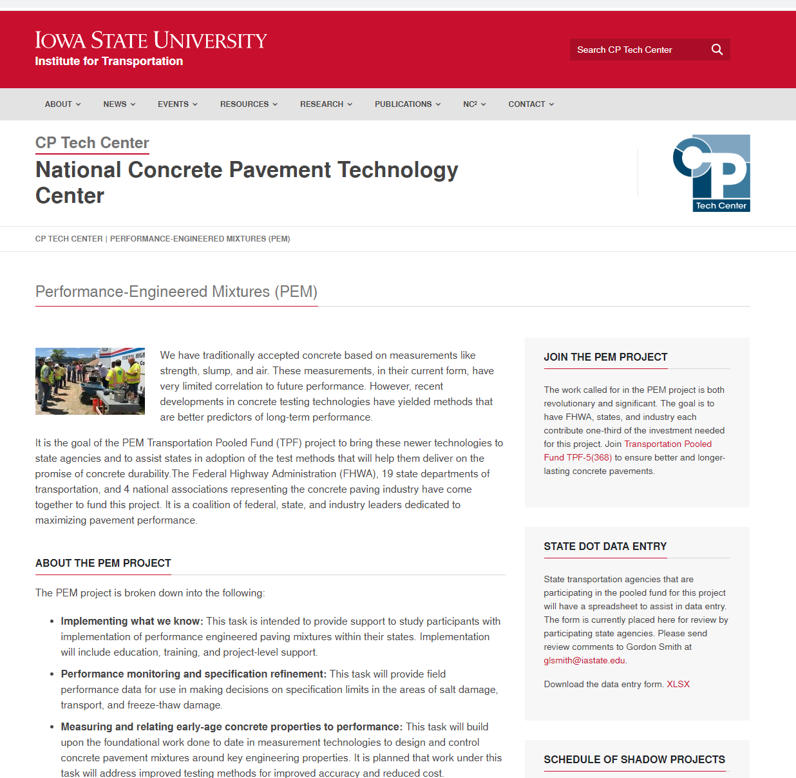
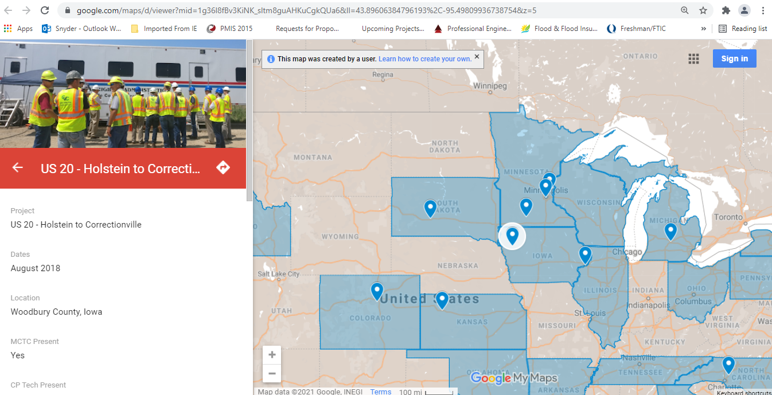
PEM Website
cptechcenter.org/pem

Slide 32

FHWA Virtual Technician Training
– Box Test / V-Kelly Test (single session) | – Aggregate Gradation Software
– Surface / Bulk Resistivity Meter | – HIPERPAV
– Super Air Meter | – Maturity
– Phoenix (water content of fresh concrete) | – MIT dowel scan
– Semi-Adiabatic Calorimeter | – MIT scan T3
https://intrans.iastate.edu/app/uploads/sites/7/2020/09/MCTC_Technician_Training_Flyer.pdf
Notes:
The free training will be very informal to facilitate interaction between the attendees and the instructors. This practical training is designed for technicians and engineers to increase proficiency in several new materials and construction testing equipment/test methods, including “tips and tricks” the MCTC staff have learned in the field.
Attendees will be encouraged to perform tests along with the instructors during the training. Due to the format of the training, the MCTC says 5 or 6 attendees is ideal for each session; however, group sizes of 10 attendees can be accommodated. Sessions will be administered using Microsoft Teams.

Slide 33
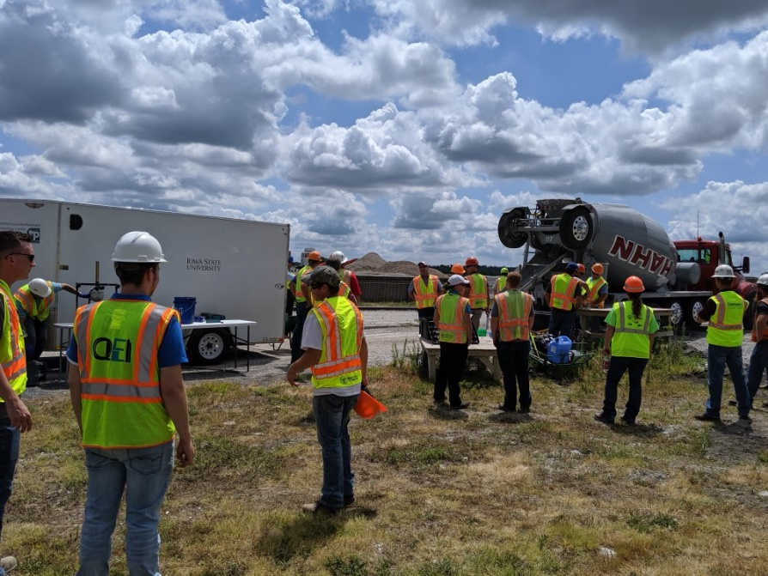
CP Tech Center Assistance
CP Tech Center will visit your projects
Side by side testing
Test instruction
Collaboration
Mix optimization

Slide 34





Our PEM Team
FHWA - Gina Ahlstrom, Mike Praul, Robert Conway
Researchers – Jason Weiss, Tyler Ley
Consultants – Tom VanDam, Cecil Jones
CP Tech – Peter Taylor, Gordon Smith, Jerod Gross
Diversified Engineering Services, Inc
Notes:
To improve concrete performance and reliability, we need to develop a better specification
Dr. Peter Taylor, ISU
Dr. Tyler Ley, Oklahoma State
Dr. Jason Wiess, Oregon State
Dr. Tom VanDam, NCE
Cecil Jones, Diverified
Jerod Gross, Snyder and Associates
Mike Praul and Robert Conway, FHWA
Gordon Smith, CP Tech Center

Slide 35
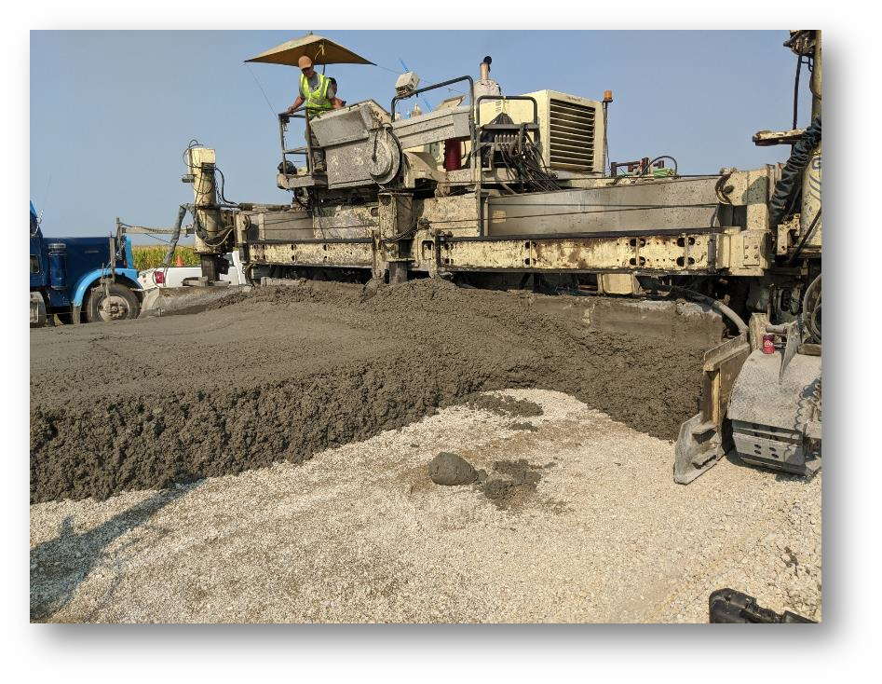
PEM 2 . . . . an ongoing commitment
Continue to assist state agencies on specification improvements and procedures to enhance performance
Continue shadow and pilot projects
Continue to offer program training
Explore operational innovations to advance reliability of concrete pavements
FHWA CoOp: precision & bias testing, monitor and measure for sustainability and resiliency

Slide 36
Thank you!
Jerod Gross
jgross@snyder-associates.com
515-669-7644

