Slide 1


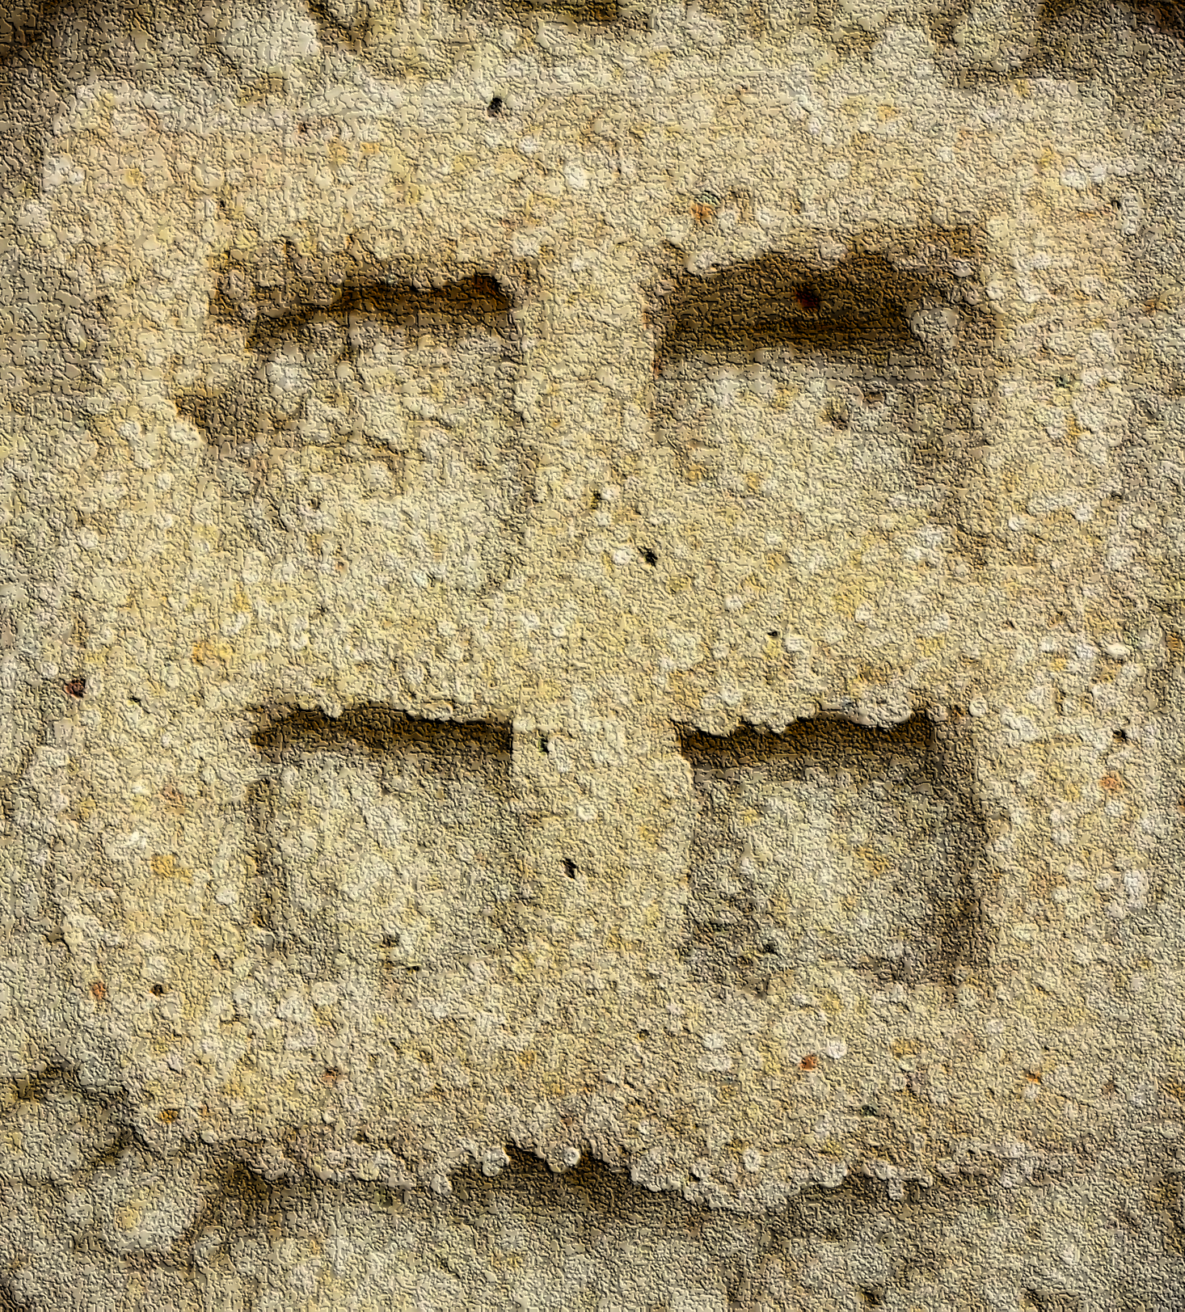
3D Printing Soils using Bio-cementation Techniques
Michelle L. Barry, PhD, PE
Associate Professor, Civil Engineering
mlbernha@uark.edu
Christina Childress
Graduate Research Assistant

Slide 2

Background
Additive Manufacturing or 3D Printing
FDM
SLA
SLS
PBBJ
EXTRUSION

Slide 3
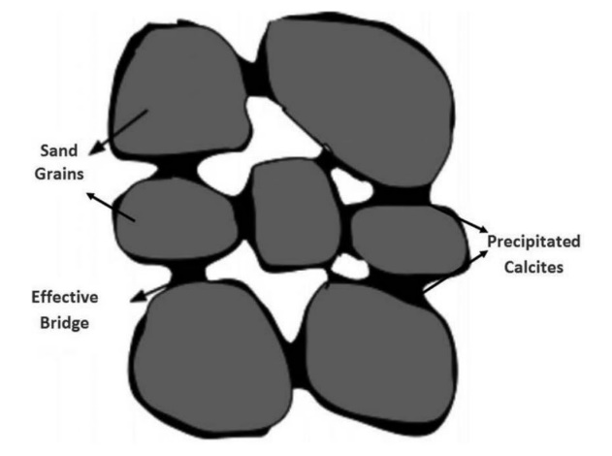
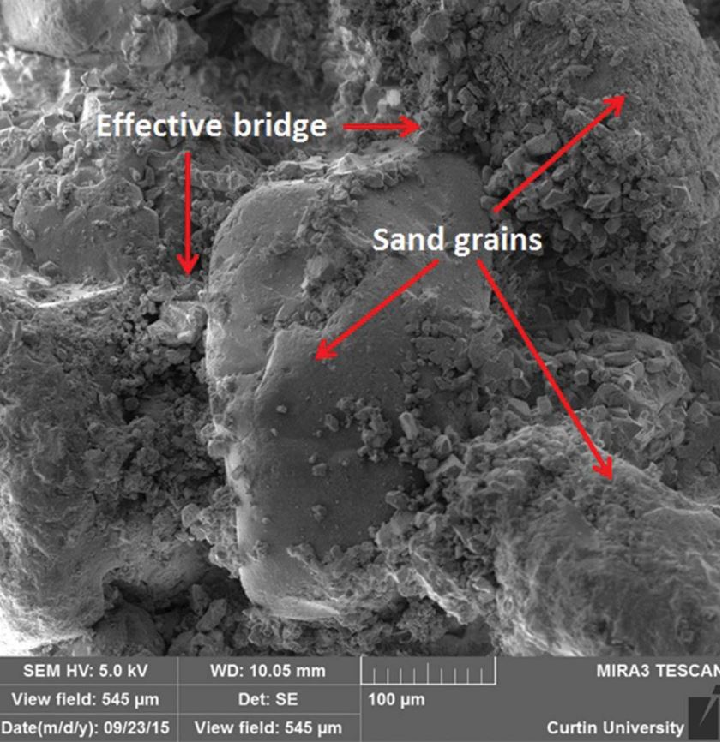
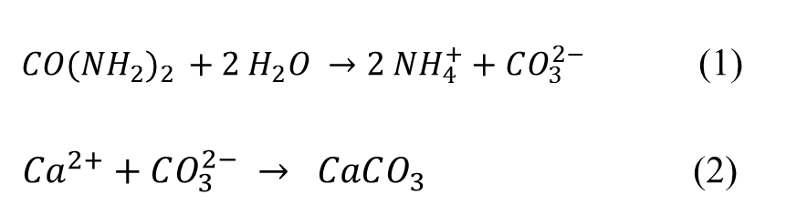
Background:
Microbially Induced Calcite Precipitation (MICP)
${CO(NH_{2})}_{2 }+2 H_{2}O →2 NH_{4}^{+}+CO_{3}^{2−}$ (1)
${Ca}^{2+}+CO_{3}^{2−} → CaCO_{3}$ (2)
Notes:
Most common method for activating calcite precipitation is Urease hydrolysis Eq. 1. Once carbonate ions precipitate the ions react with calcium to form calcite Eq. 2.

Slide 4
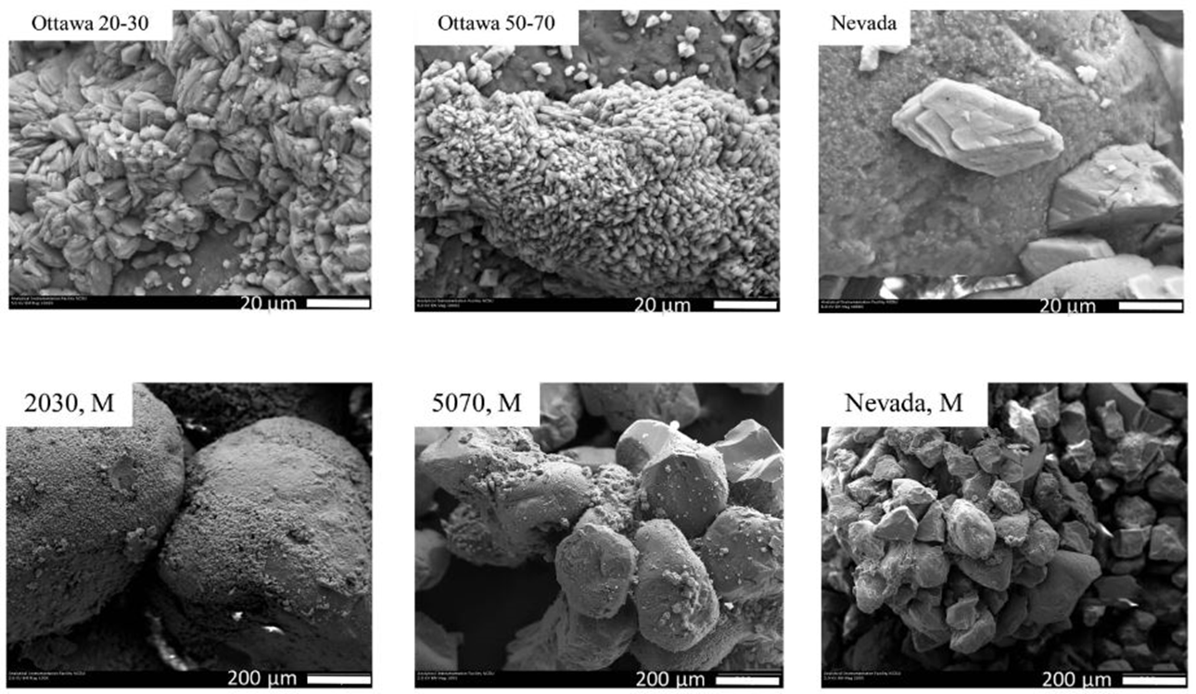
Background:
SEM images of MICP

Slide 5
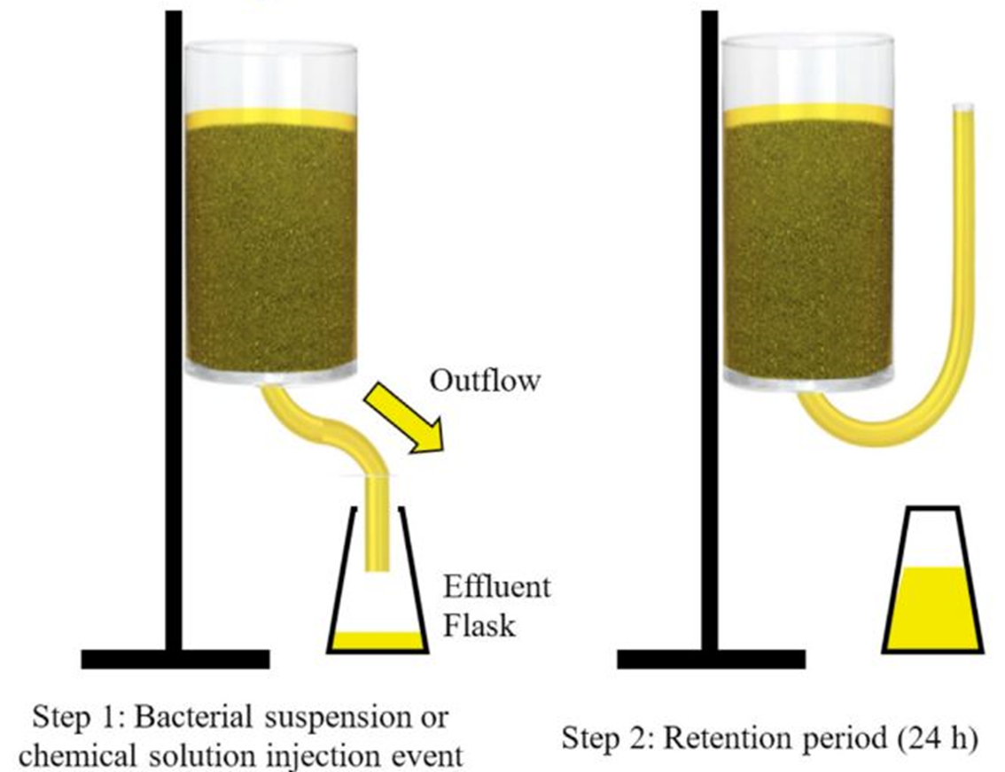
Background:
MICP Methods
Injection method (pictured here).
Premixing method
Surface spraying method
(Konstantinou et al., 2021)

Slide 6
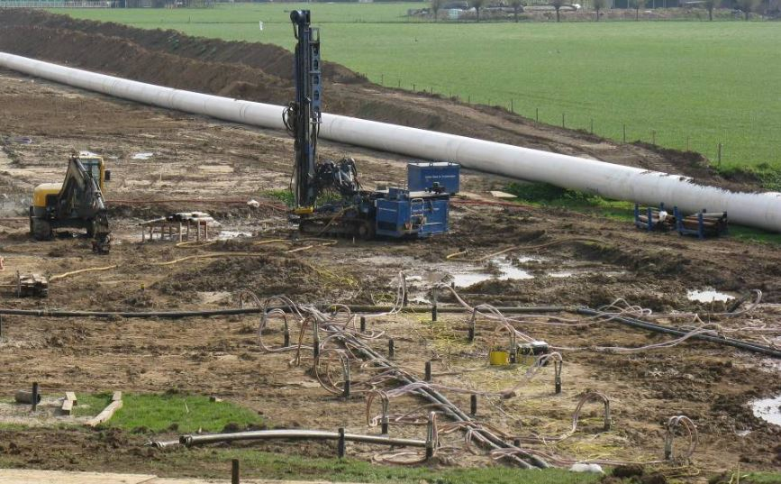
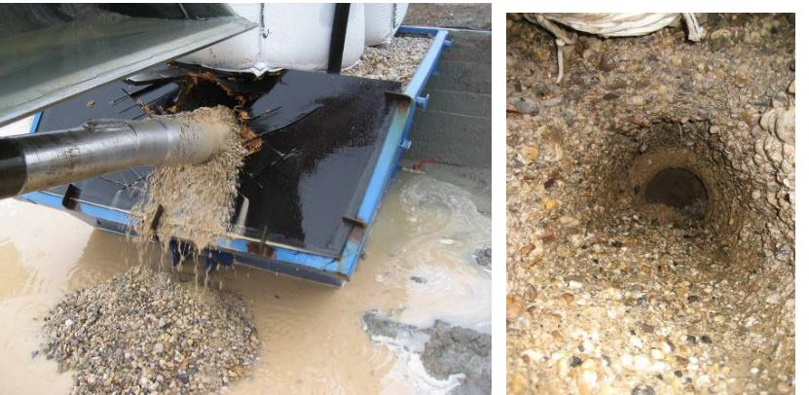
Background: Injection method
Field-scale Application: Borehole Stabilization
(van Paassen, 2011)

Slide 7
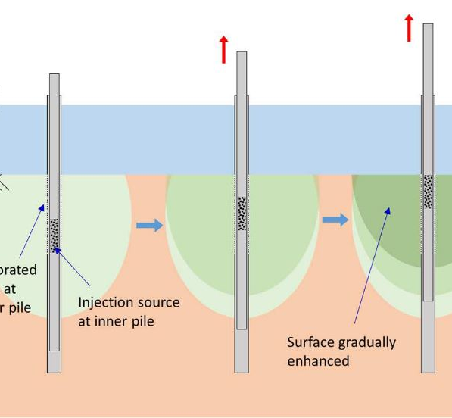
Background: Injection method
Field-scale Application: Scour Resistance
(Do et al., 2020)

Slide 8
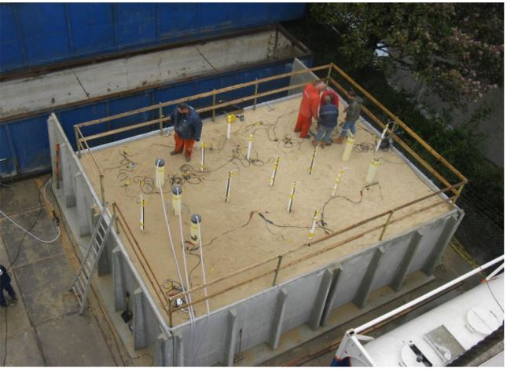
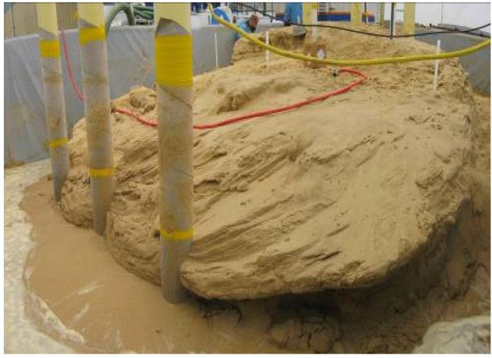
Background: Injection method
Field-scale Application: Liquefaction Resistance
(van Paassen et al., 2009)

Slide 9
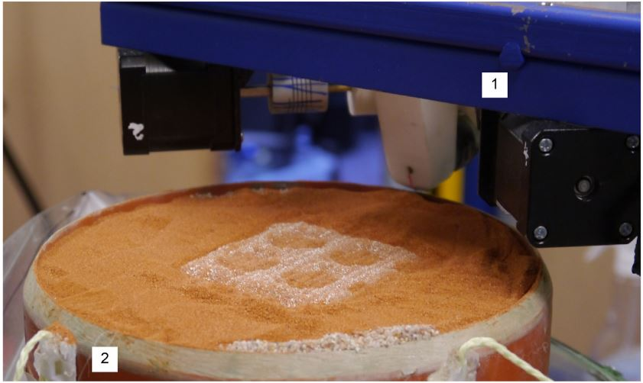
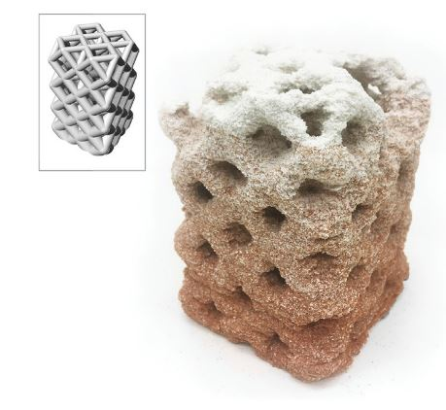
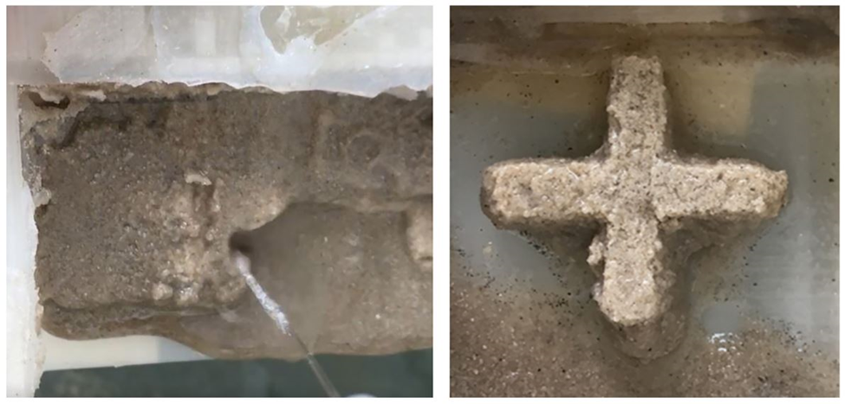
Background: Premixing method
Laboratory-scale Application: Additive Manufacturing
(Nething et al., 2020)

Slide 10
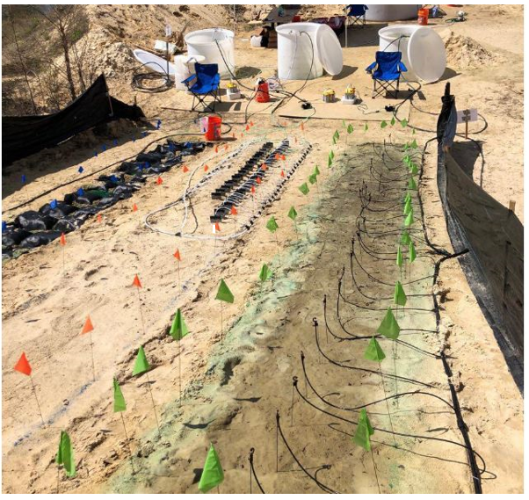
Background: Spraying method
Field Scale Application: Coastal Erosion Resistance
(Kumar et al., 2020)

Slide 11
Background: MICP
Increased Strength
EFFECTS OF MICP ON ENGINEERING PROPERTIES
Alter soil classification
Increased friction angle
Decreased compresibility
Increased cohesion
Decreased permeability

Slide 12
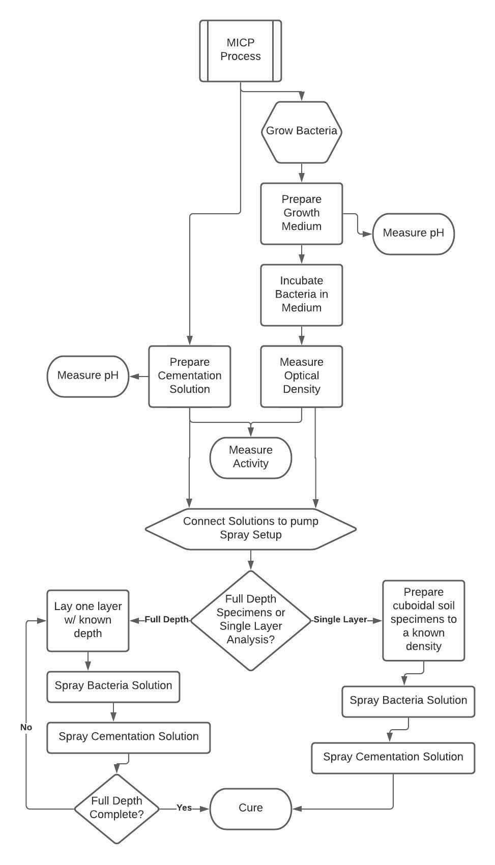
MICP Spray Methodology
Solution Preparation & Process
Sporosarcina Pasteurii Bacteria
Yeast extract
Ammonimum sulfate
Agar
Tris buffer
Urea-calcium solution (1.5:1)
Scanning spectrophotometer at 600 nm wavelength
Electrical conductivity

Slide 13
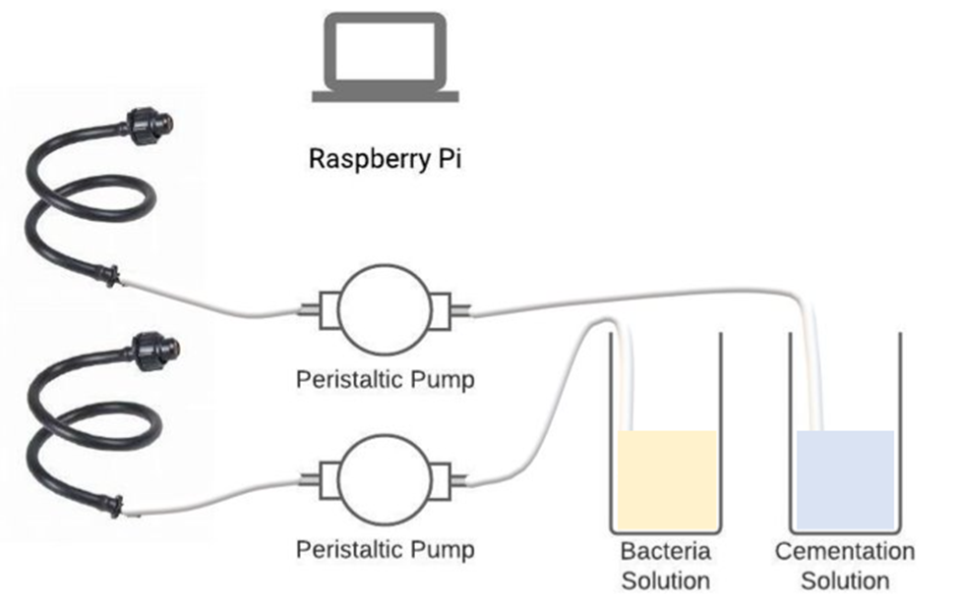
MICP Spray Methodology
Prototype Spray System & Process

Slide 14
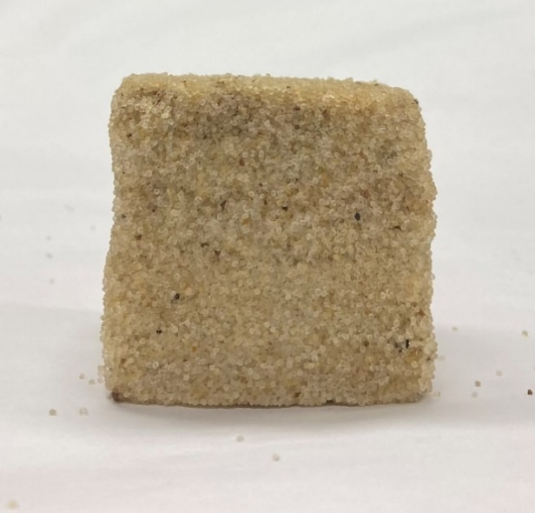
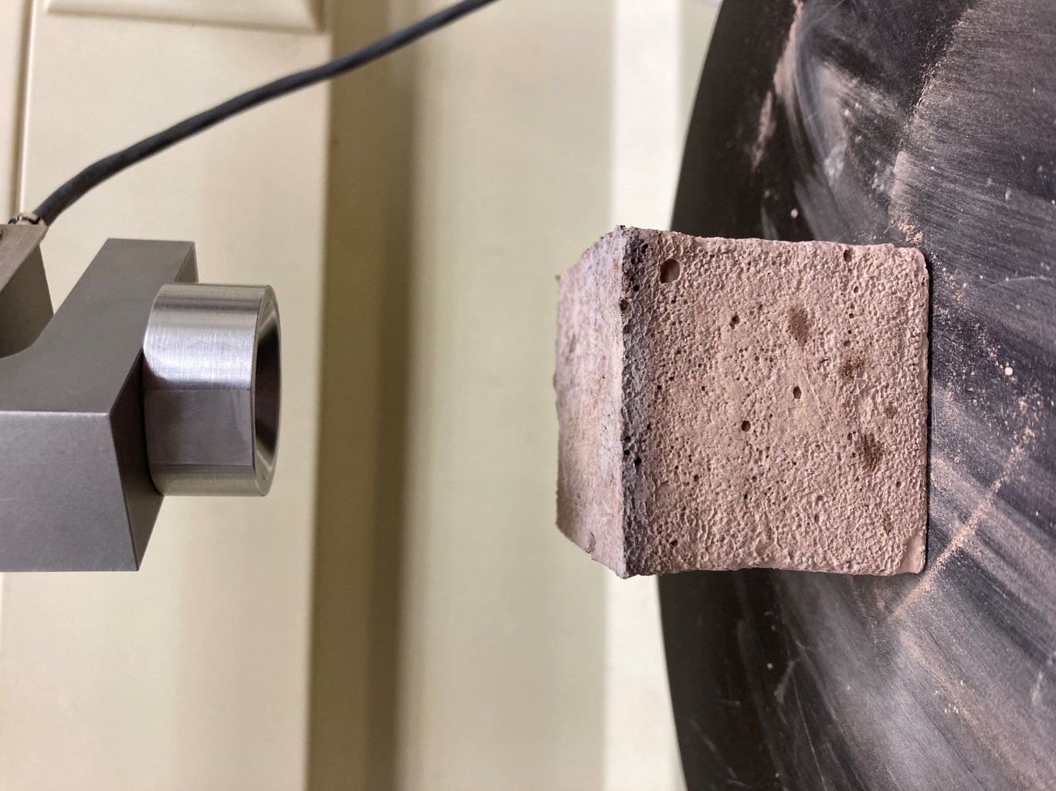
MICP Spray Methodology
Soil Mixtures Considered
100% Ottawa Sand
50% Clay 50% Sand

Slide 15
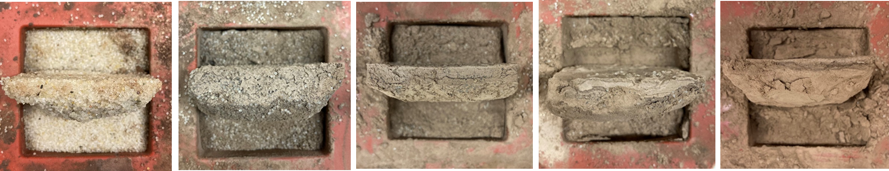
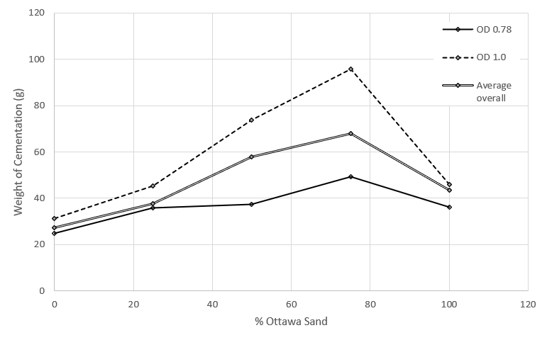
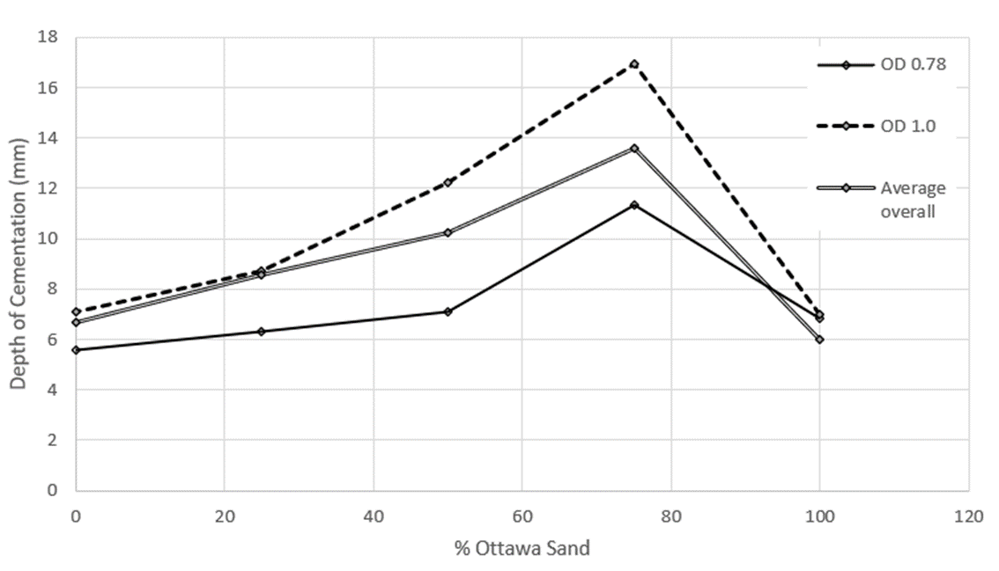
Results: Depth and Spread
Determining the layer thickness and spread for each soil type
0% Ottawa Sand
25% Ottawa Sand
50% Ottawa Sand
75% Ottawa Sand
100% Ottawa Sand

Slide 16
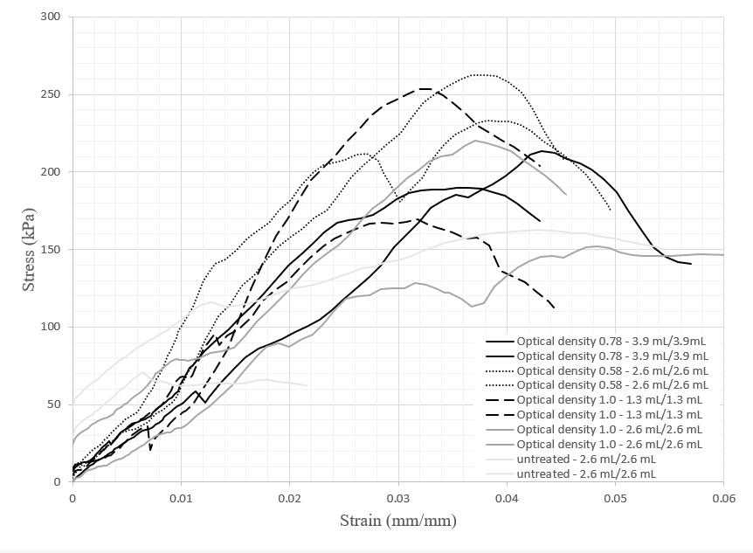
Results: Strength
50% Clay - 50% Sand Mixtures
 | Optical density | Spray volume (mL) | Density (g/cm³) | Peak stress (kPa)
Treated | 0.58 | 2.6 | 1.588 | 233.3
 | 0.58 | 2.6 | 1.594 | 262.6
 | 1.00 | 2.6 | 1.605 | 152.2
 | 1.00 | 2.6 | 1.583 | 220.1
Untreated | n/a | 2.6 | 1.627 | 162.9
 | n/a | 2.6 | 1.566 | 70.3

Slide 17
Results: Strength
50% Clay - 50% Sand Mixtures
 | Optical density | Spray volume (mL) | Density (g/cm³) | Peak stress (kPa)
Treated | 0.58 | 2.6 | 1.588 | 233.3
 | 0.58 | 2.6 | 1.594 | 262.6
 | 1.00 | 2.6 | 1.605 | 152.2
 | 1.00 | 2.6 | 1.583 | 220.1
Untreated | n/a | 2.6 | 1.627 | 162.9
 | n/a | 2.6 | 1.566 | 70.3

Slide 18
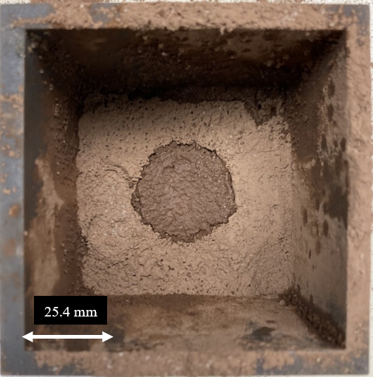
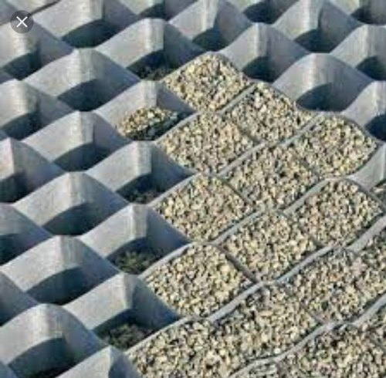
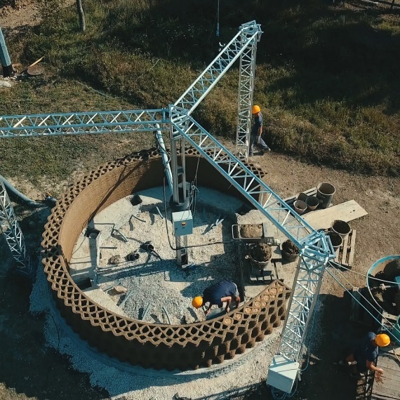
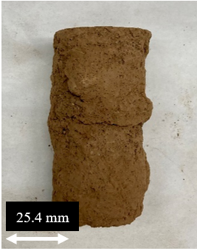
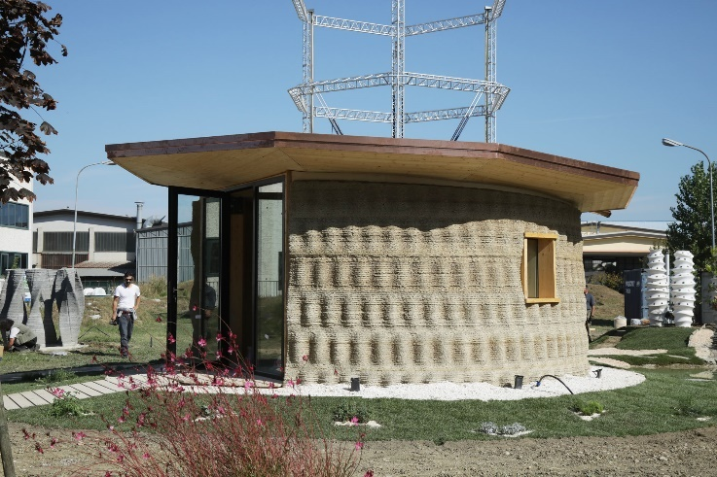
Future Applications
Cemented Soil Columns
Cemented Soil Geo Cells
Vertical construction

Slide 19

Michelle L. Barry, PhD, PE
Associate Professor, Civil Engineering
mlbernha@uark.edu

