Slide 1
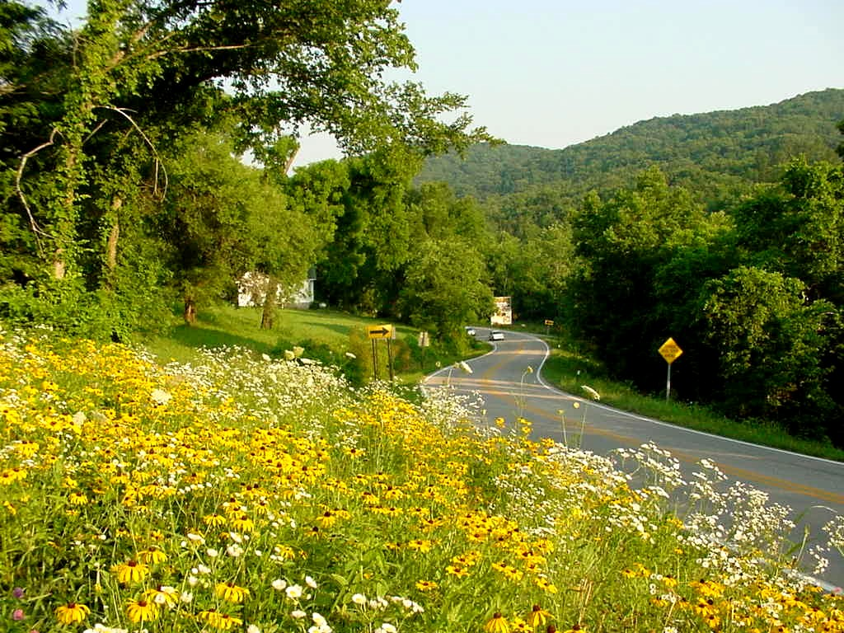
Arkansas Department of Transportation
Wildflower and Pollinator Programs
Joe Ledvina, Botanist

Slide 2
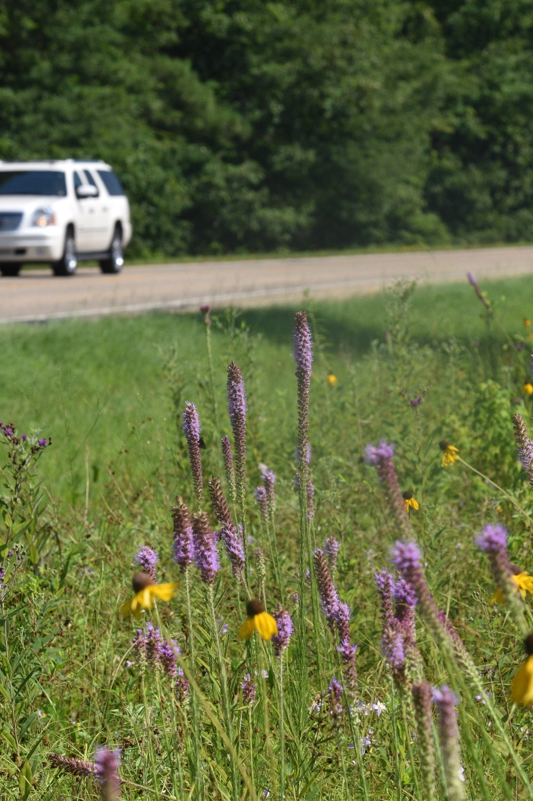
ArDOT Wildflower and Pollinator Programs
Conservation Measures
Conservation mowing guidelines
Wildflower Routes
Wildflower Area Signs
Rare plant population rescues
Enhancement Measures
Standard Seed Mix
Special Seed Mix
Operation Wildflower
Milkweed Enhancement Program*
Plantings on Mitigation Properties*
Voluntary Prelisting Agreement
Monarch Butterfly and Six Additional Species
Notes:
Our wildflower program can be divided into conservation measures and enhancement measures. Conservation of diverse native plant communities is extremely important because these communities have taken decades to centuries to develop. If we damage them too much, they may never be the same. Some efforts, like our mowing guidelines and wildflower routes, encompass massive amounts of area.

Slide 3
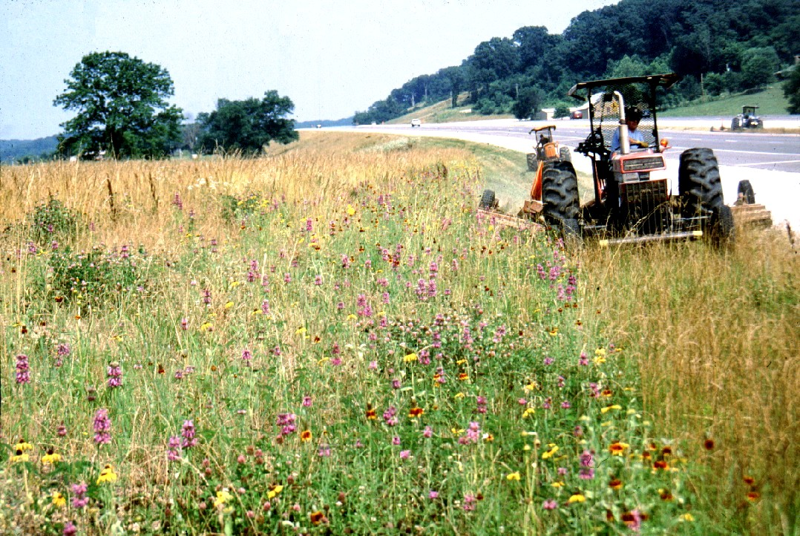
CONSERVATION MEASURES
Conservation mowing guidelines
Notes:
Prior to our conservation mowing guidelines, AHTD mowed the full width of the right-of-way during every mowing. Our guidelines now establish a more conservative approach, where we mow the full width only during one mowing per year, and we mow a clear zone, next to the pavement more often. The clear zone both improves sight lines for safety and also provides for a safe space for vehicles to pull off of the road. You can see here that the wildflowers have been maintained through this once-annual mowing, but the swath that the mower is about to hit is more dominated by grasses.

Slide 4
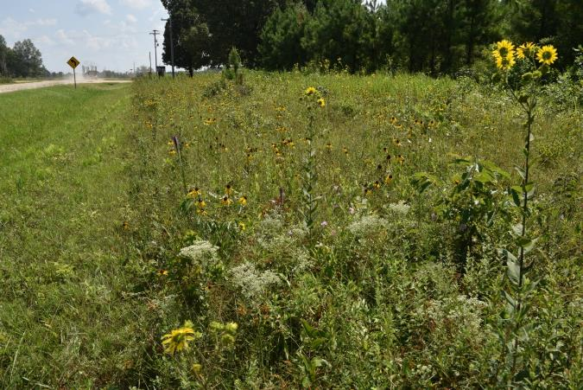
CONSERVATION MEASURES
Conservation mowing guidelines
Exceptions:
Municipalities mow interchanges
“Good Neighbor” policy
Many private landowners mow our ROW
↑ Clear Zone (10’-30’) ↑Transition Zone↑ Natural Zone
Notes:
Here you can see the roadside zones as specified in the guidelines. On a typical highway that’s not a freeway, the clear zone is 10 feet wide, and then the transition zone is up to 30’ wide. This is the area where we want wildflowers to thrive. Typically, the ROW fence is 30’ or 40’ from the pavement, though it is sometimes narrower or wider. If the ROW is wider than 40’, those are the areas where we allow trees to grow.
On freeways, because of the higher speeds and the need for better sight lines at on-ramps, the clear zone is expanded to 30’, and the transition zone can be up to 50’. We still mow the transition zone because otherwise trees would become established, which would eventually shade out the wildflowers and could cause safety issues by obscuring sightlines, shading the road during icy conditions, or just falling into the roadway.
Mowing in the fall in southern Arkansas is particularly tricky, because many of the roadsides become wet quickly as soon as fall hits. If the soil is wet, the tractors and mower wheels will get bogged down and creates ruts in the roadsides. This soil disturbance can create areas where invasive species could take hold. Our mowing window for the fall is from October 1 to Thanksgiving, which means the some of this mowing occurs while stands of wildflowers are still blooming. We don’t have the resources to tighten this window, even with contractors, since there are a limited number of contractors and many of them move from county to county throughout the mowing windows. Some counties, mostly in the MAP, where water management for rice means that the roadsides fill up with water even earlier, have been allowed to mow the full width during the July mowing instead of the fall. While this reduces the risk of chewing up the soil, it still impacts wildflowers and pollinators, just a different set of species. However, many plants that bloom in the summer, including some milkweeds, will quickly recover and flower again. We are evaluating whether we can convert some of these routes in southern Arkansas to mow the full width only every other fall. However, that’s also the part of Arkansas with the longest growing season, where trees might get too big for the mowers in just 2 years.
We have several major exceptions to this policy: our good neighbor program where we will mow the full width each time in front of the landowner’s lawn. Most cities and towns also do their own supplemental mowing, especially at interchanges. Finally, many landowners mow in front of their own property. In my limited time in Arkansas and in this position, it’s possible that I have been noticing an increase in the percentage of our ROW that’s kept as a frequently-mowed lawn, but it’s also likely that I really learned to look for it only a couple of years ago. Anywhere where you see the ROW looking like a lawn you would see in a front yard, it is most likely the landowner, and not us, doing that work.

Slide 5
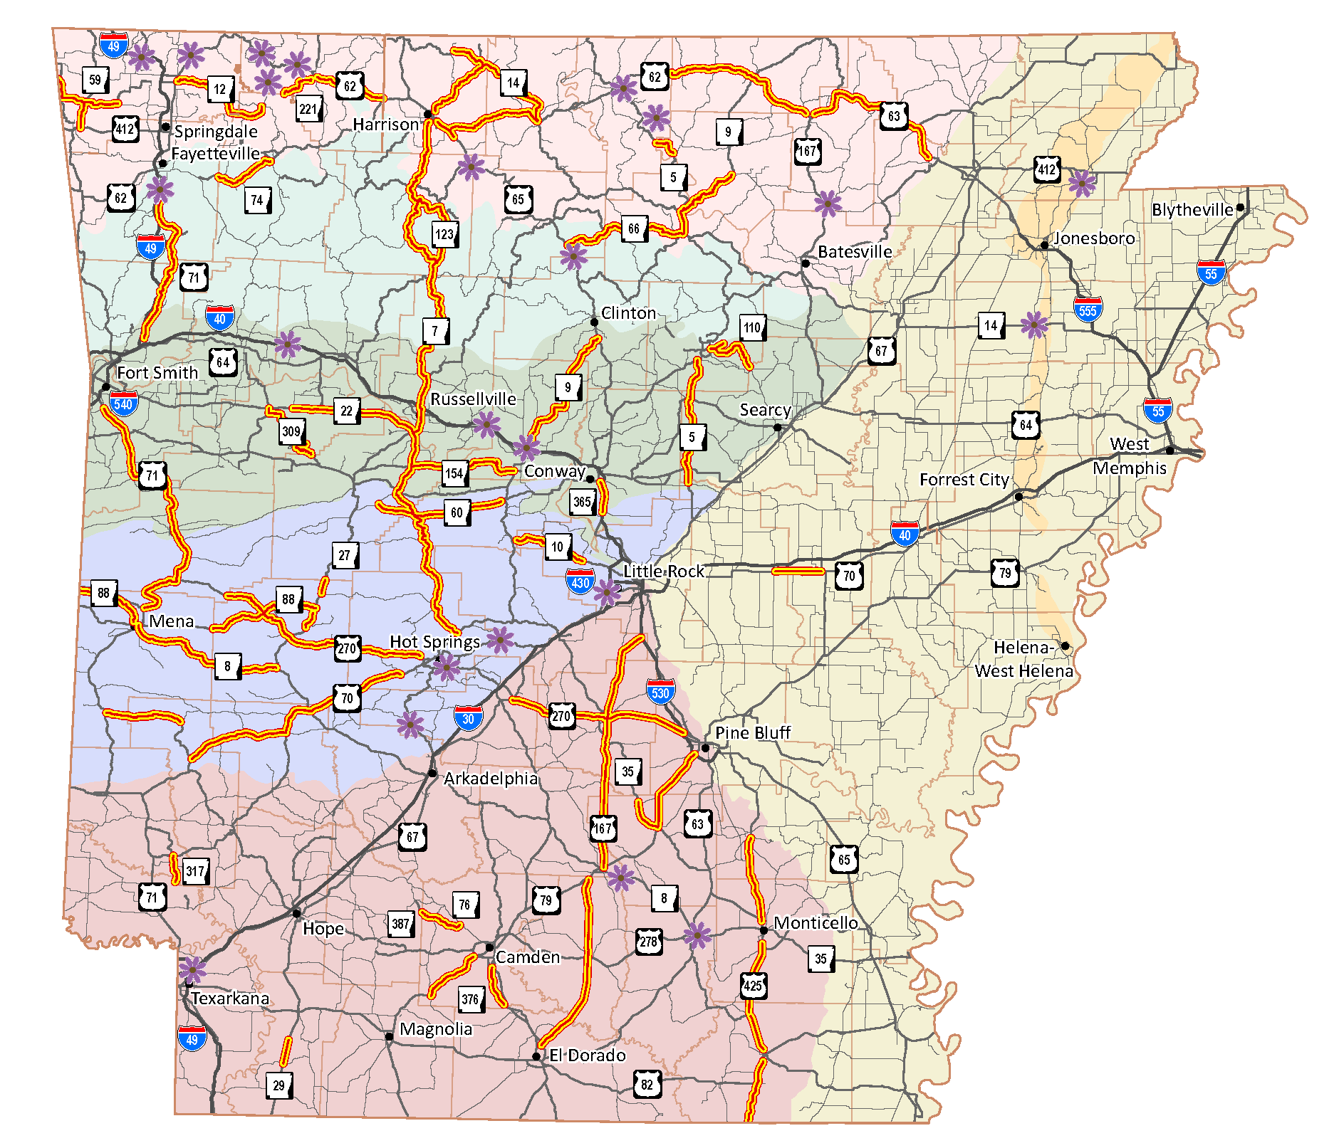
CONSERVATION MEASURES
Wildflower Routes
Notes:
Our wildflower route program was begun in the late 90s, with over 1000 miles of roads designated. The wildflower routes now total nearly 1300 miles, including the most recent addition to protect a long stretch of habitat for the frosted elfin butterfly.
These are miles-long stretches of roads that have important wildflower displays. Mostly, these are areas with showy displays of native wildflowers. Some of them, like that frosted elfin route, protect large populations of rare species.
Within these routes, broadcast herbicide is prohibited – even in the clear zone. Spot treatment of invasive species is allowed.
You’ll notice that the MAP, on the east side of the state, is pretty lacking in these routes, with just the one strip along where some of the Grand Prairie Natural Areas are. For most of the rest of the MAP, there might be small patches of natives hanging on here and there, especially where minimal management of woody vegetation has been done by the railroads for decades, but we don’t know of any miles-long stretches of native wildflowers. I have been suspecting that some roads in Crowley’s Ridge could qualify, but have not had the chance to survey in both May/June and September/October.

Slide 6
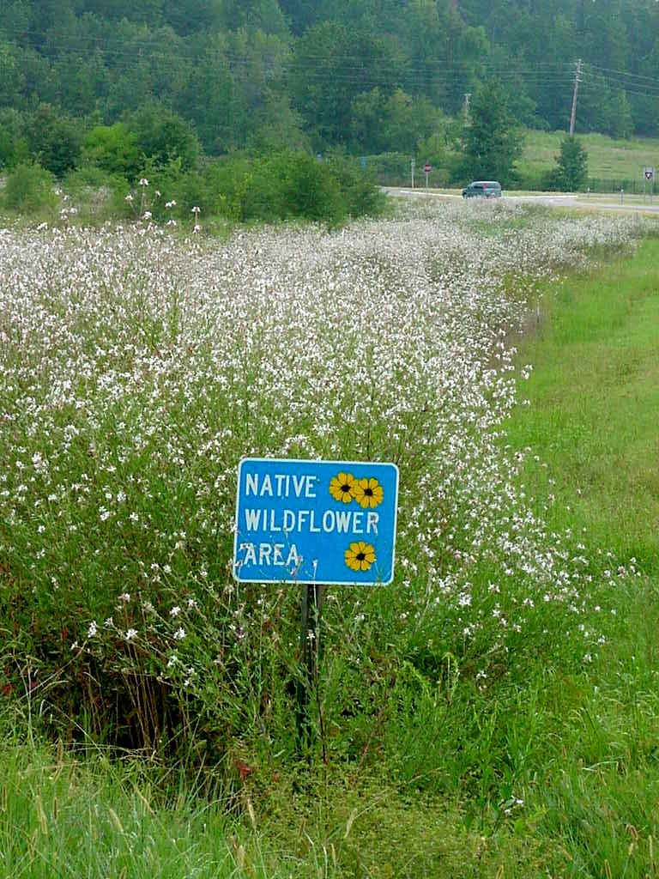
CONSERVATION MEASURES
Native Wildflower Areas
Notes:
After these routes were designated, we later added a Native Wildflower Area sign program. These are smaller areas, again some of them protecting diverse or impressive displays less than a mile long, and some protecting populations of rare species. On the right here is a big display of longflower beeblossom. On the left is a curious one of these wildflower areas, designating a huge patch of Texas Paintbrush in the median of I-40 in western Johnson County. This patch has been there for decades, but this species is only known historically from a couple of Arkansas Counties, and not in Johnson County.

Slide 7
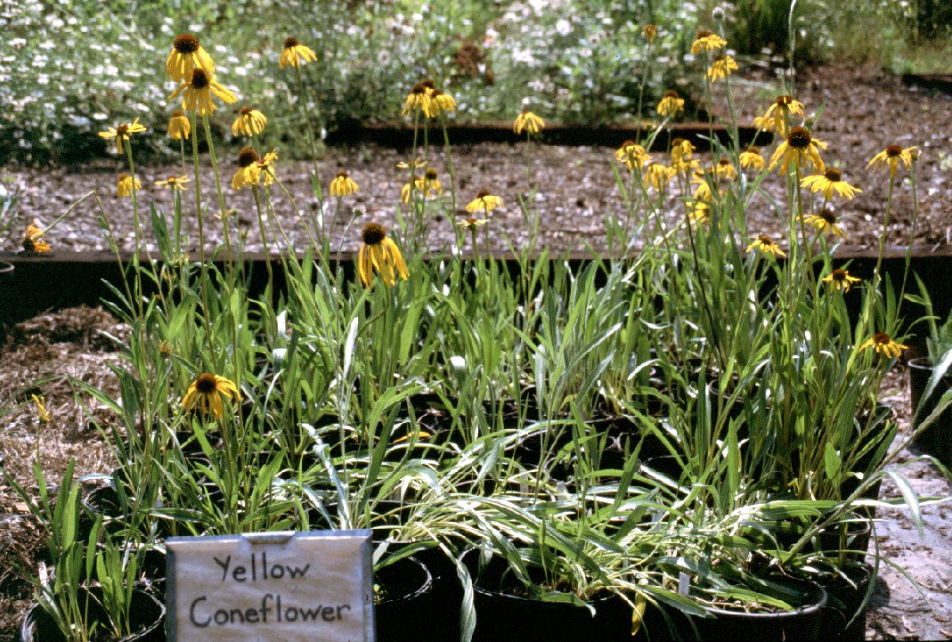
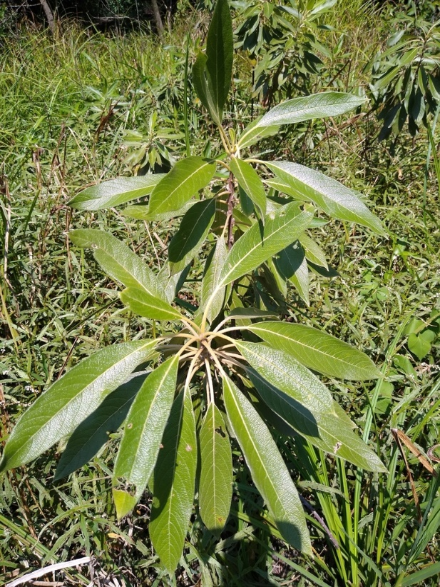
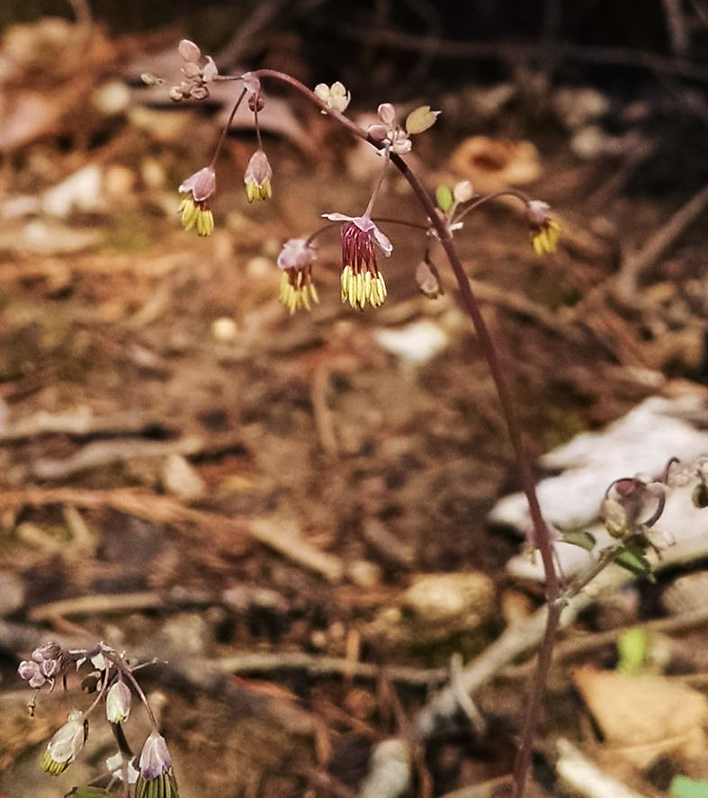
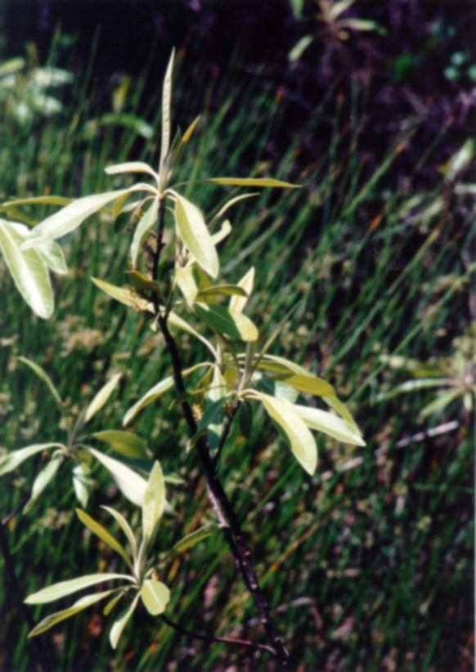
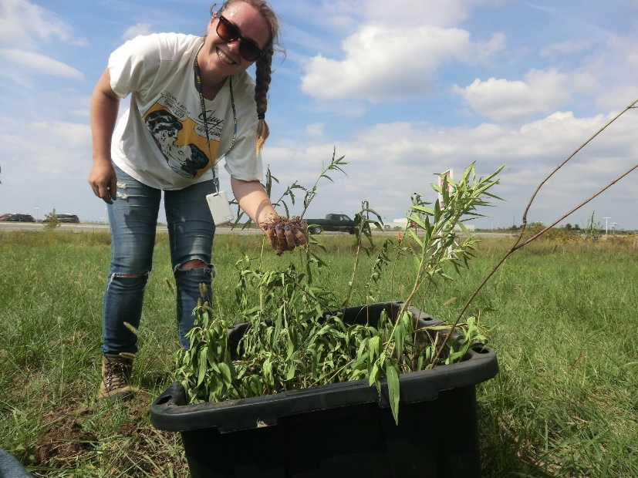
CONSERVATION MEASURES
Native Plant Rescues
Notes:
We also conserve native populations by doing plant rescues.
The plant in the upper right is yellow coneflower, Echinacea paradoxa. Hwy 21 in Carroll County was being widenened. They dug up plants and brought them to our nursery here in Little Rock, then planted them back out after the construction was completed. Follow up surveys the next year saw excellent survivorship.
Lower left is corkwood, a rare small wetland tree. This had been considered the single species in the genus Leitneria, Leitneria floridana, scattered in very limited areas In FL, GA, AR, MO, and TX, but recent genetic and morphological data point to it being 2 species, with those in AR and MO being the subspecies L. pilosa ssp. ozarkana. One of the first things I did when I started as an intern with ARDOT was to help dig up dozens of these plants and transport them to our Walnut Ridge Mitigation Area. I stopped by there last year and saw the populations thriving. We have a pending bridge replacement job near Lake Village with a small patch of these, and we have a similar plan to move those.
Lower middle is Arknsas meadow rue. This species, Thalictrum arkansanum, is known only from a narrow band from central AR into OK. This population is right here in Little Rock, just down the road from my office. Crooked Creek was flooding at I-30, and so plans were developed to broaden the floodplain. Kayti moved dozens of plants from one side of the creek, in the construction zone, to the other, where they are still doing well.
Lower right is my predecessor in this position and now my supervisor, Kayti Ewing, transporting some swamp milkweed out of a construction zone and into Fayetteville’s Woolsey Wet Prairie preserve.

Slide 8
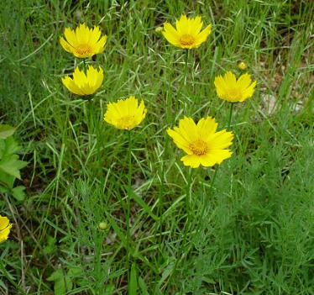
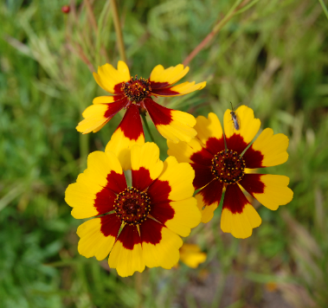
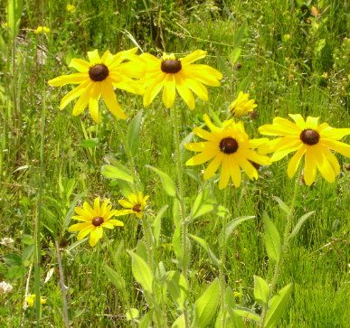
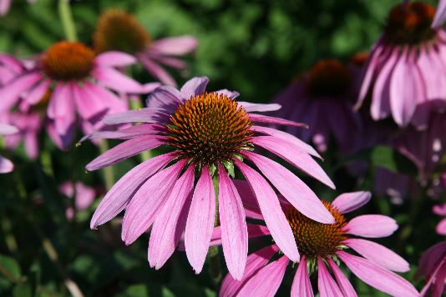
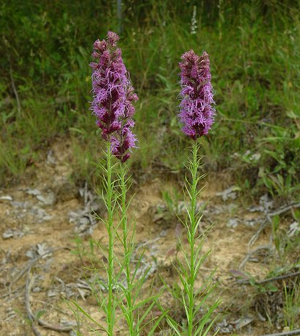
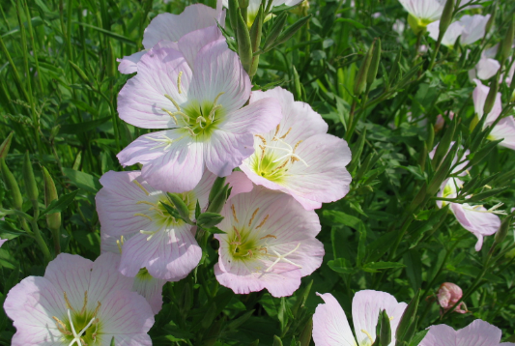
ENHANCEMENT MEASURES
Standard Seeding Specification
6 Native Wildflowers
Special Seeding Specification
8 Native Wildflowers
3 Native Grasses
Notes:
Lanceleaf coreopsis
Plains coreopsis
Black-eyed susan
Prairie blazing star
Showy evening primrose
Purple coneflower
SPECIAL SEEDING MIX adds ASCTUB, CHAFAS, A. gerardii, S. nutans, S. scoparium. Used on projects involving federal or state property – national forests, national parks, military, state parks, etc. This follows executive order 13112 that established the invasive species council – can’t spend federal money on planting invasives.

Slide 9
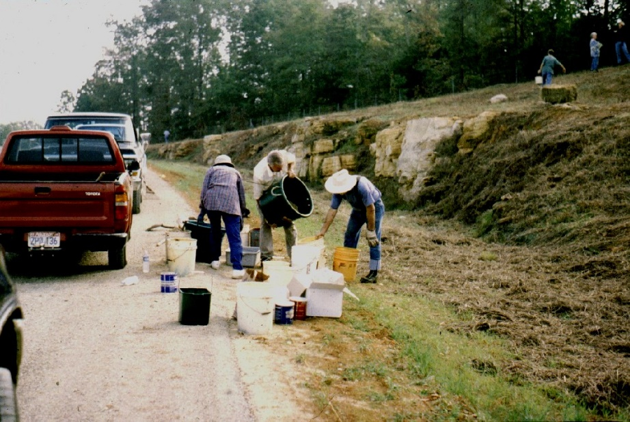
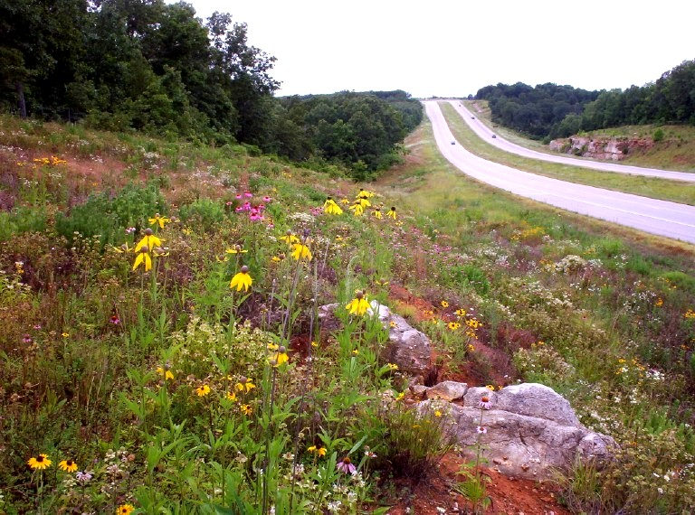
ENHANCEMENT MEASURES
Operation Wildflower
Notes:
Mountain Home Master Gardeners project on the Mountain Home Bypass. Planted 2000
We have planted a few acres of these in most of the past several years. The minimum size is one acre, and we try to avoid doing these in 10- or 20-foot strips, so it can sometimes be challenging to find suitable areas, especially considering the number of landowners who are mowing.

Slide 10
VOLUNTARY PRELISTING CONSERVATION PROGRAM
Goals
Reduce likelihood that covered species become listed
Improve and safeguard ArDOT’s roadside maintenance practices
Increase wildflower enhancement implementation
Monitor both natural and planted roadside habitat
Monarch © Lisa Thornberg
Notes:
VPCP – agreement with the USFWS, developed in cooperation with them, with the goal of conserving the monarch and 6 other species that have been petitioned to be listed. The main goal of this program is to reduce the likelihood that the covered species will become listed. We described our mowing and herbicide policies and pledged to follow these policies. The program not only benefits the covered species, but it benefits ARDOT if the species do become listed.
Converted to B.O. which will streamline consultations with the fish & wildlife service for both construction jobs and for our maintenance practices

Slide 11
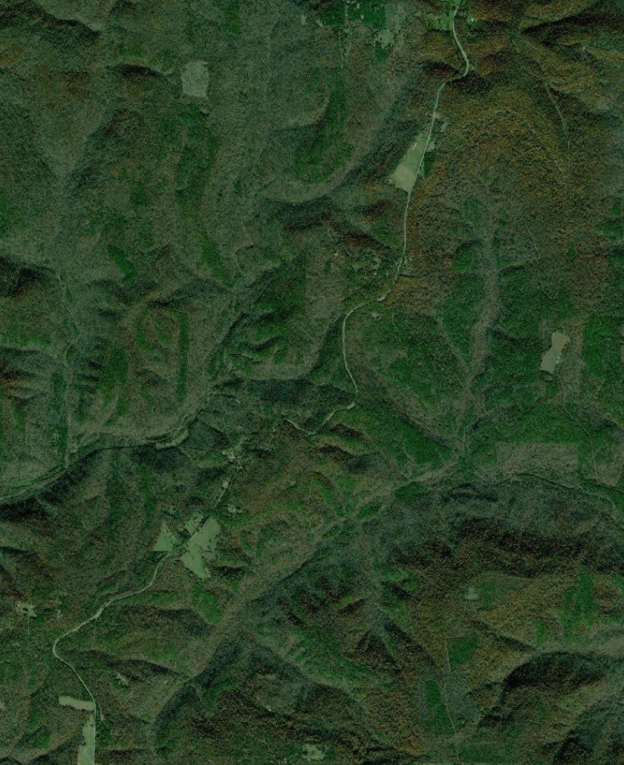
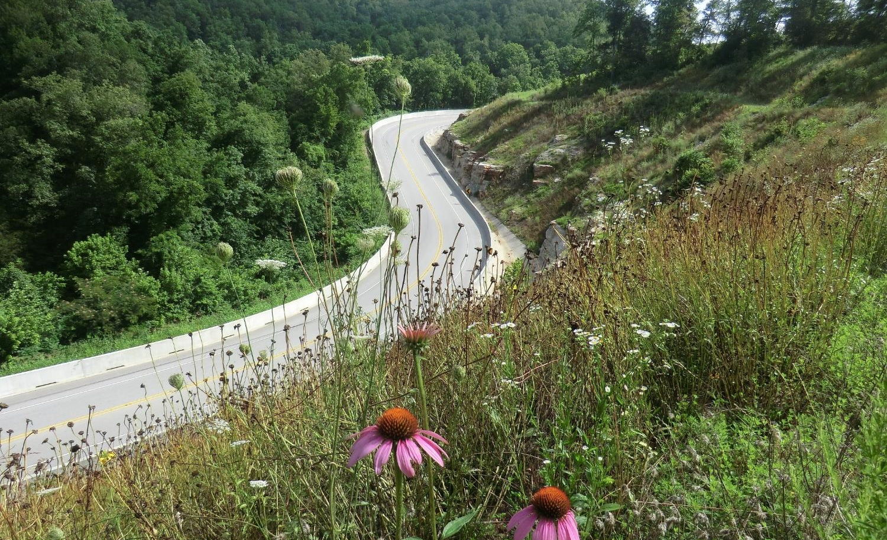
Roadside Habitat Benefits Monarchs and other Pollinators
VOLUNTARY PRELISTING CONSERVATION PROGRAM
Diverse stands of native wildflowers, grasses, and forbs provide habitat
High-quality habitat can sometimes reduce movement into roadways.
Vehicle collisions generally contribute only a minor proportion of mortalities
Roadsides provide corridors through less suitable habitat
Notes:
Roadsides that support diverse stands of native wildflowers, grasses, and forbs can provide valuable habitat for pollinators. These habitats can increase population sizes and offer stepping stones between larger areas of habitat. Studies have shown that large patches of high-quality habitat can actually prevent movement of pollinators into roadways, presumably because they have enough floral resources to stay put in the roadside. This is probably more applicable to species that are less mobile and wide-ranging than the monarch. Roadside mortality among pollinators does vary, and it can be higher for butterflies than for other pollinators; however, studies monitoring roadside butterfly populations for all sources of mortality have shown that vehicle collisions are not a major source of mortalities.
Roadsides can provide population connectivity and migration corridors through less suitable habitat. This includes through relatively dense forest, like you see here along Hwy 7 in Johnson County, in the Ozark National Forest and also through croplands, where landowners are increasingly spraying herbicides not only in their fields, but also along the field margins. Because the vast majority of eastern monarchs summer to the north of us, our Arkansas “monarch highways” may be particularly important.

Slide 12
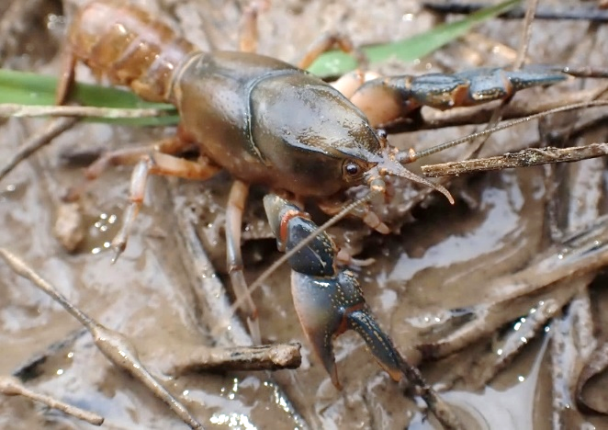
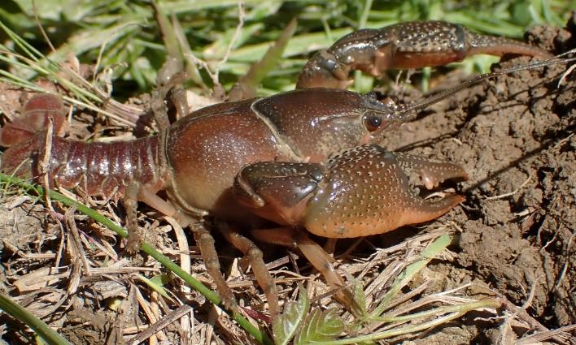
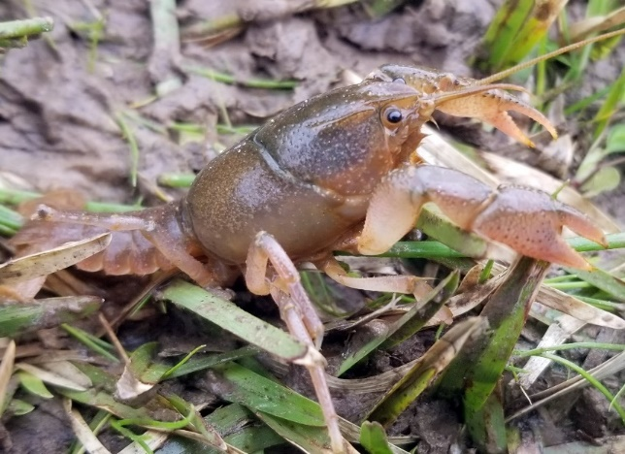
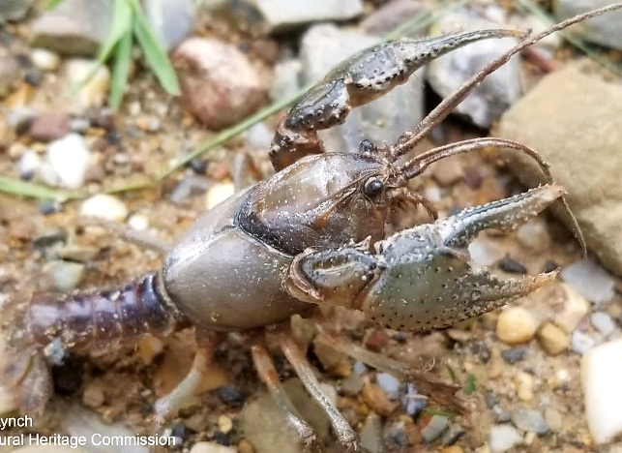
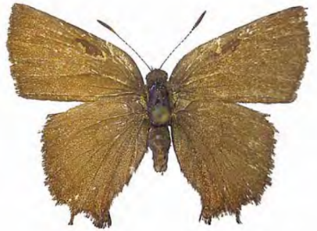
VOLUNTARY PRELISTING CONSERVATION PROGRAM
More than just Monarchs!
1. Bayou Bodcau Crayfish | 2. Jefferson County Crayfish | 3. Irons Fork Burrowing Crayfish
1
2
3
Brian Wagner
4
2021 Dustin Lynch
Arkansas Natural Heritage Commission
5
2020 Dustin Lynch
Arkansas Natural Heritage
6
7
4. Slenderwrist Burrowing Crayfish | 5. Ouachita Burrowing Crayfish | 6. Frosted Elfin | 7. Monarch Butterfly

Slide 13
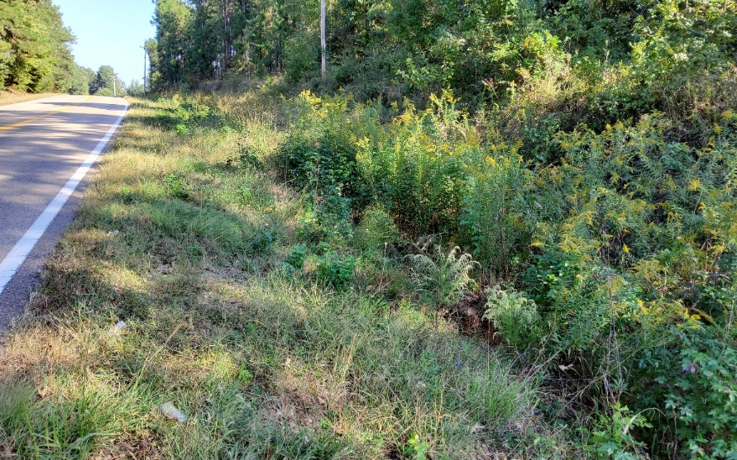
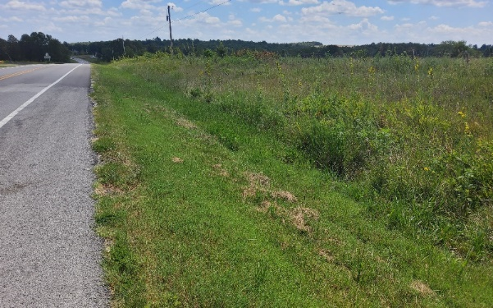
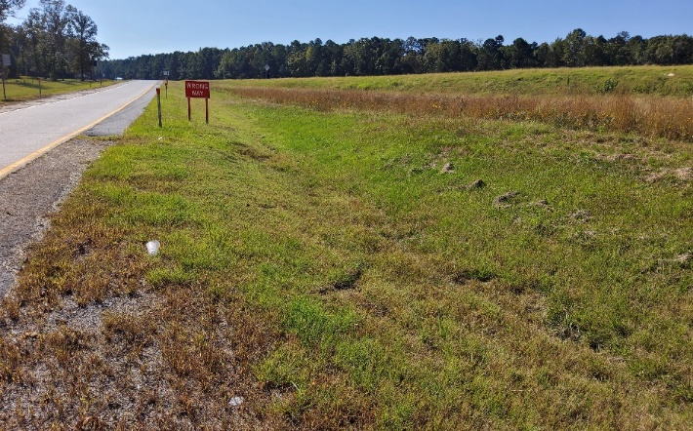
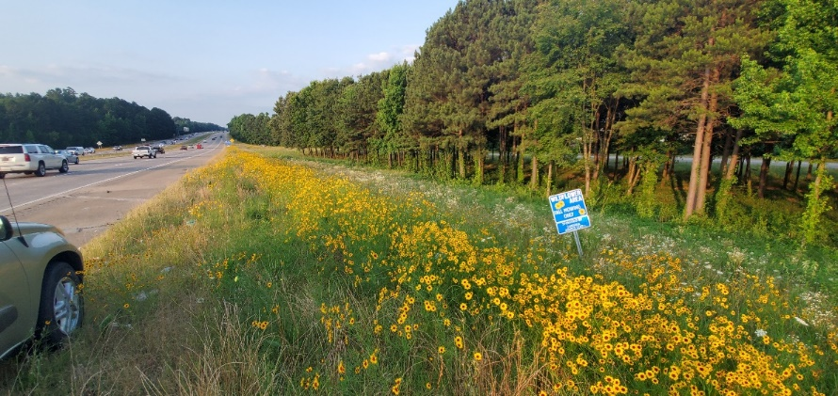
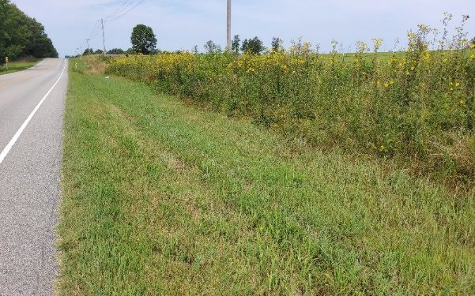
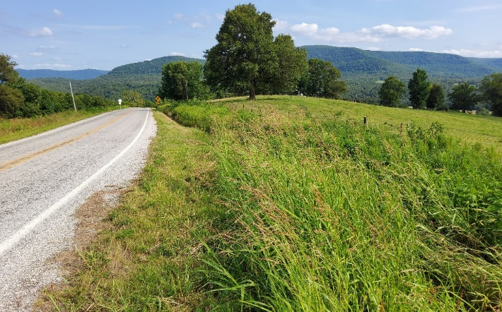
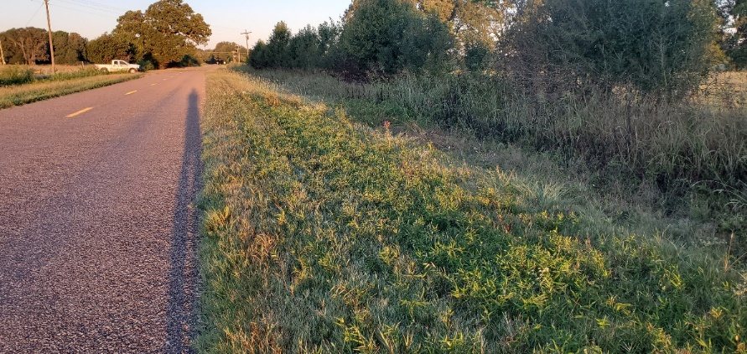
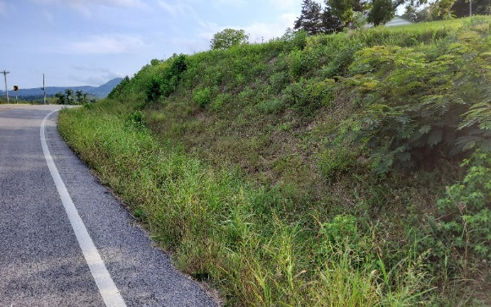
VOLUNTARY PRELISTING CONSERVATION PROGRAM
Collecting Baseline Data and Monitoring
Monarch Joint Venture’s
Rapid Roadside Habitat Assessments
Notes:
About 20% of the time, the point landed in an area of roadside that the adjacent landowner is mowing

Slide 14
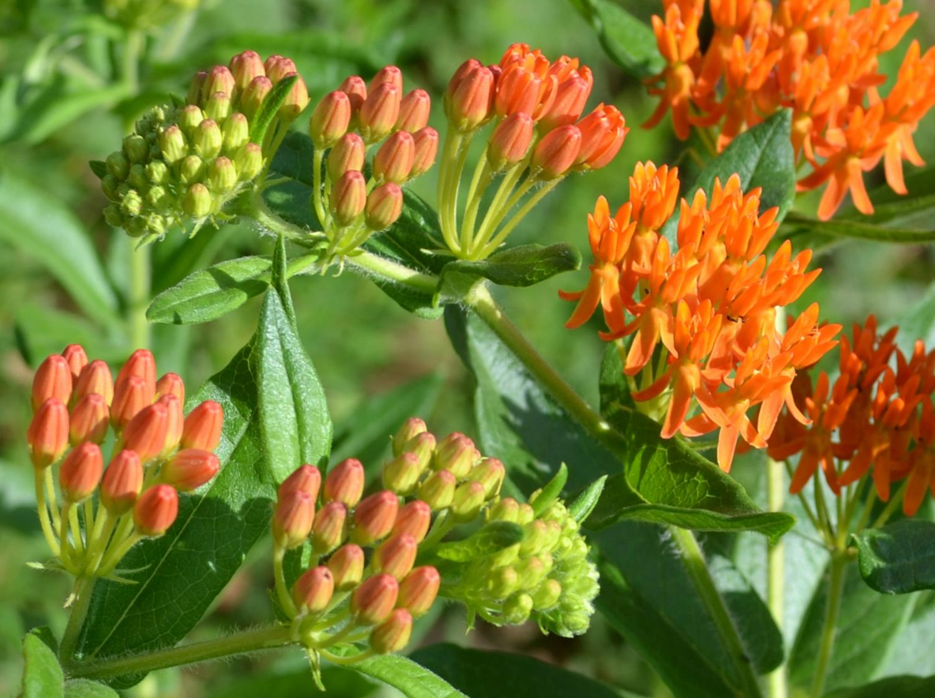
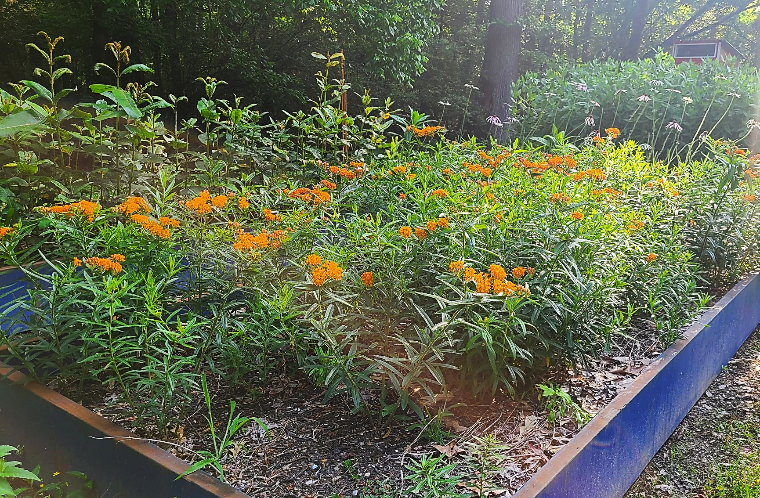
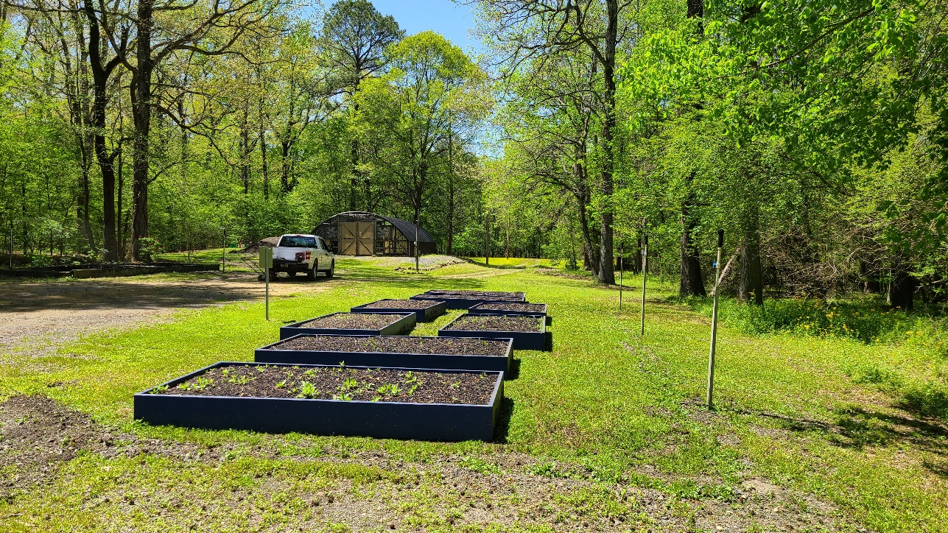
NEW ENHANCEMENT MEASURES
Amy Buthod
VOLUNTARY PRELISTING CONSERVATION PROGRAM
Milkweed Enhancement Program
Notes:
Started in 2014 with green milkweed opportunistically planted in dozens of locations on our ROW and in some of our mitigation properties. I mentioned the nursery being used for the yellow coneflower. The person in charge of our wildflower programs, Donna Gardner left in the late 2000s, and the nursery fell into disuse and disrepair. Kayti and then I did not have the background or the time to revive it, but we recently hired another botanist, Nick Dial, who has been rejuvenating the nursery. We plan to begin propagating our own milkweeds next year to create plugs to plant out along our roadsides and mitigation areas.

Slide 15
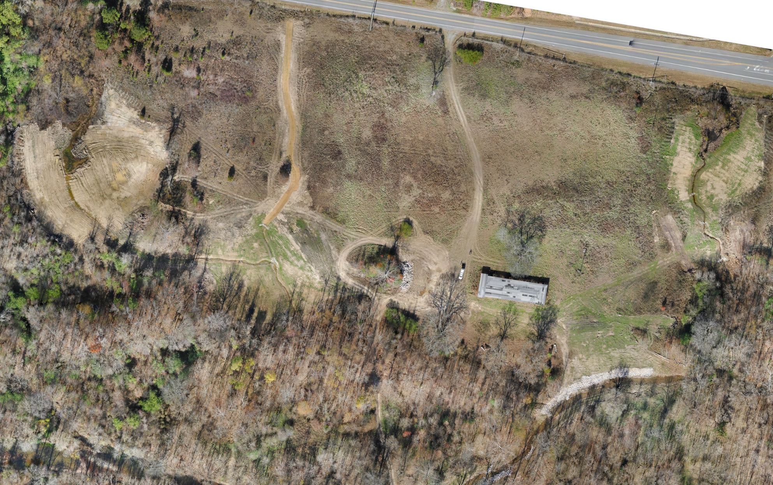
NEW ENHANCEMENT MEASURES
VOLUNTARY PRELISTING CONSERVATION PROGRAM
Wildflower Establishment on Mitigation Properties

Slide 16
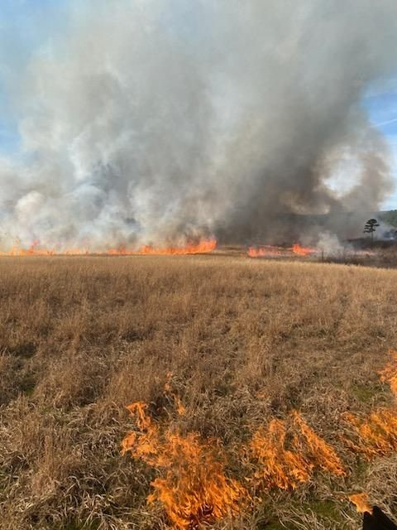
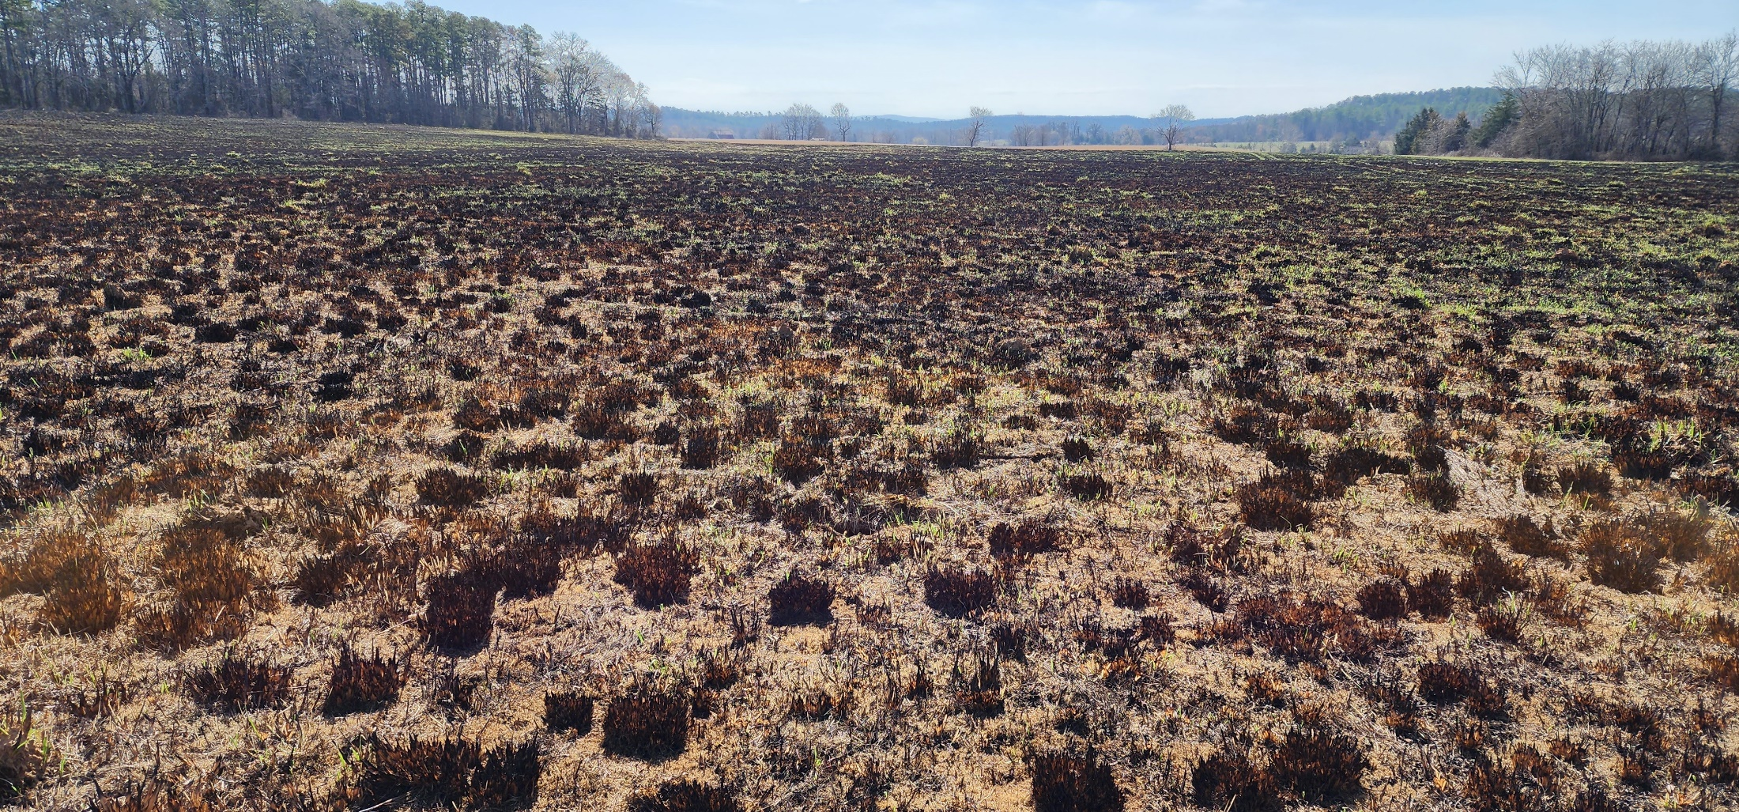
NEW ENHANCEMENT MEASURES
VOLUNTARY PRELISTING CONSERVATION PROGRAM
Wildflower Establishment on Mitigation Properties

Slide 17
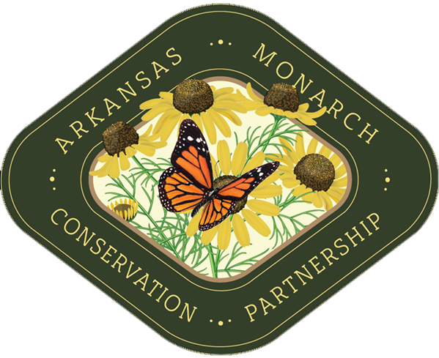
Joseph.Ledvina@ardot.gov
501-569-2520
Or use the “Ask a question” link on iDriveArkansas.com
ArkansasMonarchs.org

