Slide 1
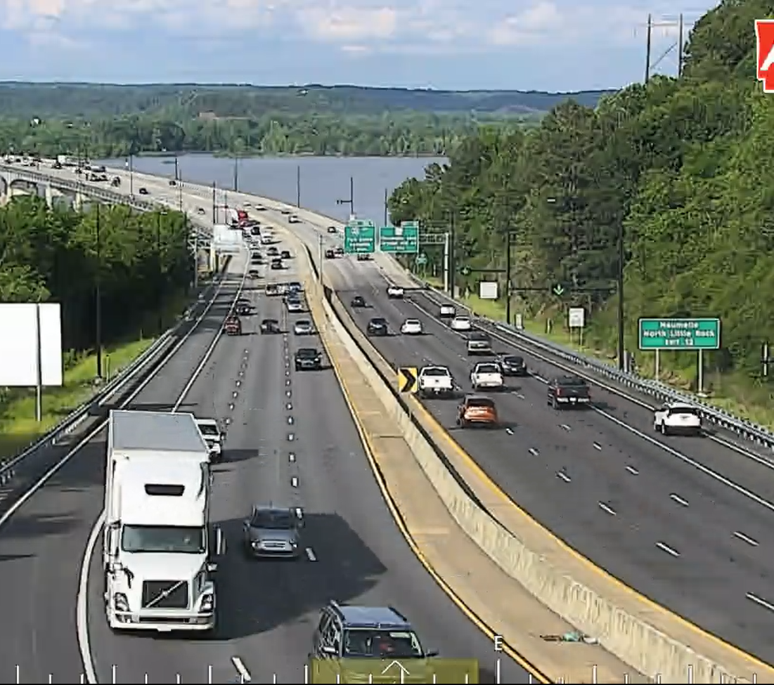
I-430 Managed Lane
Hussain Alfaraj, p.e.
Maintenance Staff engineer – ITS Management

Slide 2
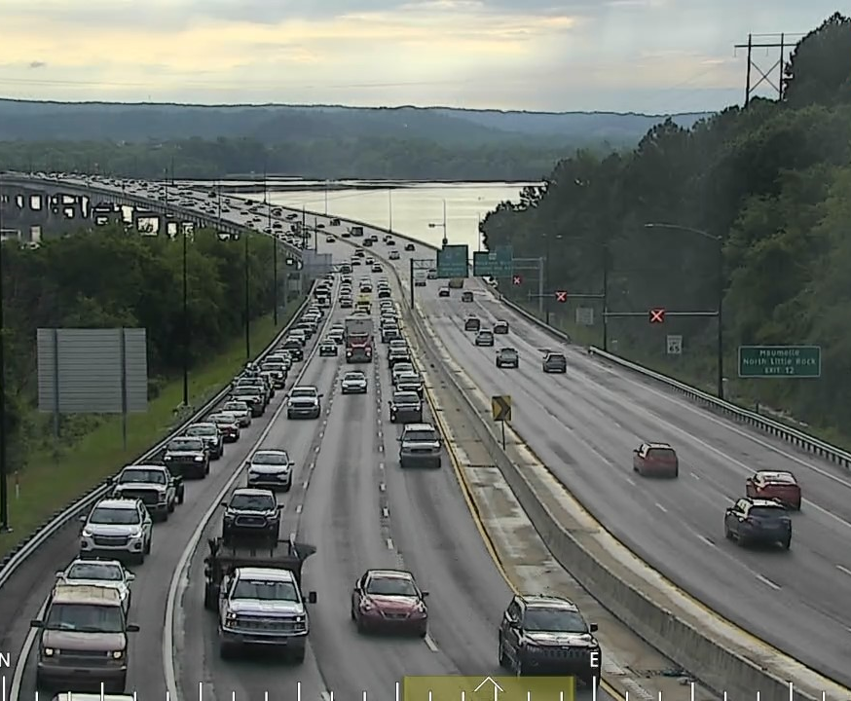
What is a Managed lane?
Notes:
Managed lane or Part-Time Shoulder Use is a form of active traffic Management (ATM). An Innovative way to manage congestion.
It is a transportation system management and operations (TSMO) strategy that allows use of shoulders as travel lanes during some hours of the day for addressing congestion and reliability issues.
It most appropriate for cost-effectively reducing delays and improving travel time reliability. Specially where alternatives are adding lanes or building bridges.

Slide 3
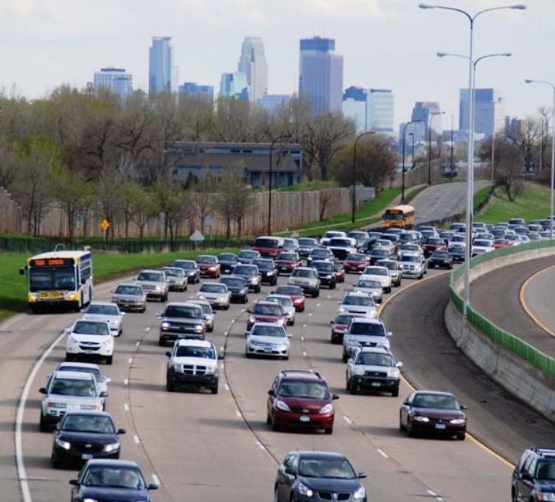
Background
Started in Germany in 1996
Implemented in Netherlands in 1999
Implemented In Minneapolis, Minnesota on I-35W in 2009
Notes:
The usage of shoulders as travel lanes started in Germany in 1996, and was next implemented in the Netherlands in 1999. The overall success of international implementations prompted their introduction in the United States. In 2009, D-PTSU (Dynamic Part-time Shoulder Use) was first implemented in the United States in Minneapolis, Minnesota on I-35W.

Slide 4
Map of Part-time Shoulder Use Locations in US 2015
Notes:
in 2016, FHWA published a Guide for the Use of Freeway Shoulders for Travel. It included this map with about 15 states that implemented the PTSU by 2015.

Slide 5
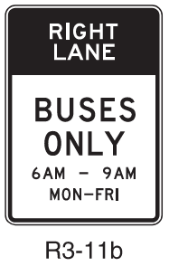
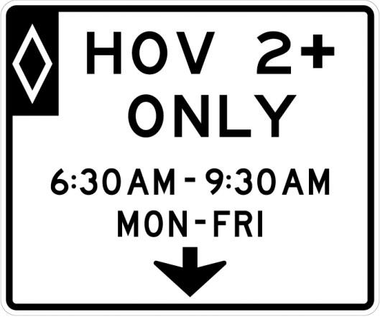
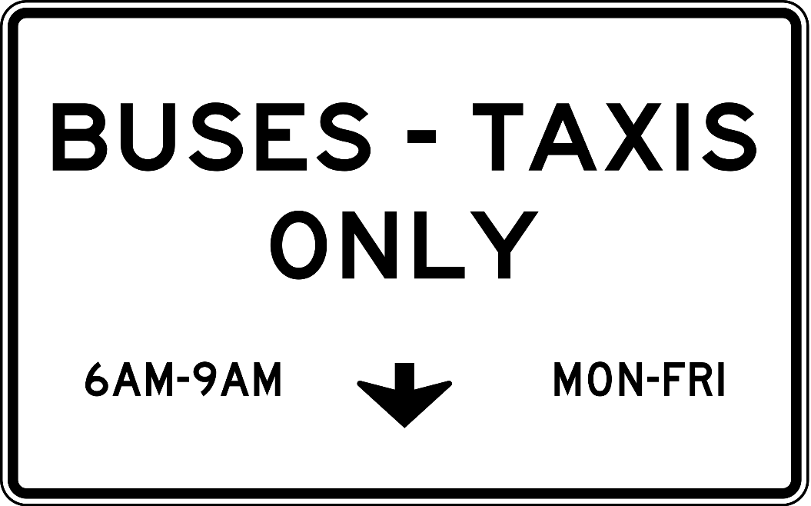
Part-time Shoulder Use
Static (S-PTSU)
Dynamic (D-PTSU)
Notes:
There are two types of PTSU: Static and Dynamic.
Static shoulder use is using static signs to open the shoulder as travel lane to vehicles during predetermined/fixed hours.
While Dynamic shoulder use is using dynamic message signs or lane control signals to open the shoulder for use to vehicles based on needs and real-time conditions. Basically, it can be opened or closed as needed—typically in response to observed or anticipated congestion.

Slide 6
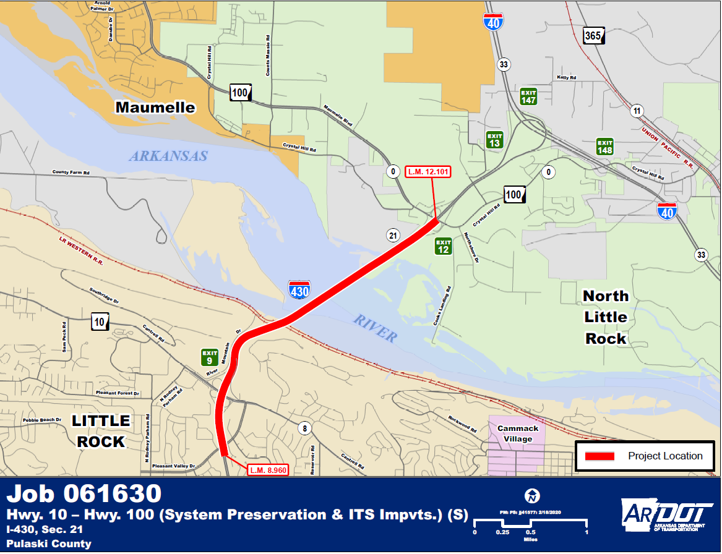
ARDOT Part-time Shoulder Use Study
Criteria
Location/Project Limits
Major Design Features
Lanes and shoulder Width
Operation Times
FHWA Guide
Notes:
ARDOT conducted a traffic operation study of the I-430 River Bridge - between Highway 10 in little rock and Highway 100 in North Little Rock.
Location: The project study area included the Highway 10/Cantrell Road north facing ramps and the Highway 100/Maumelle/Crystal Hill Road south facing ramps.
Major design features: Include use of the right shoulder as a travel lane during peak hours and two-lane exit ramps associated the shoulder lane at the highway 100 NB exit ramp.
Lanes Width: Lane widths are proposed to be changed from 3x12-foot lanes with 10-foot outside shoulder to 3x11.5-foot lanes with 11.5-foot outside shoulder.
Operation Times: Traffic would be allowed to use the outside shoulders during peak hours, with specific times to be determined.
FHWA Handbook: The publication “Use of Freeway shoulders for Travel……2016” provides detailed information regarding part-time shoulder use.

Slide 7
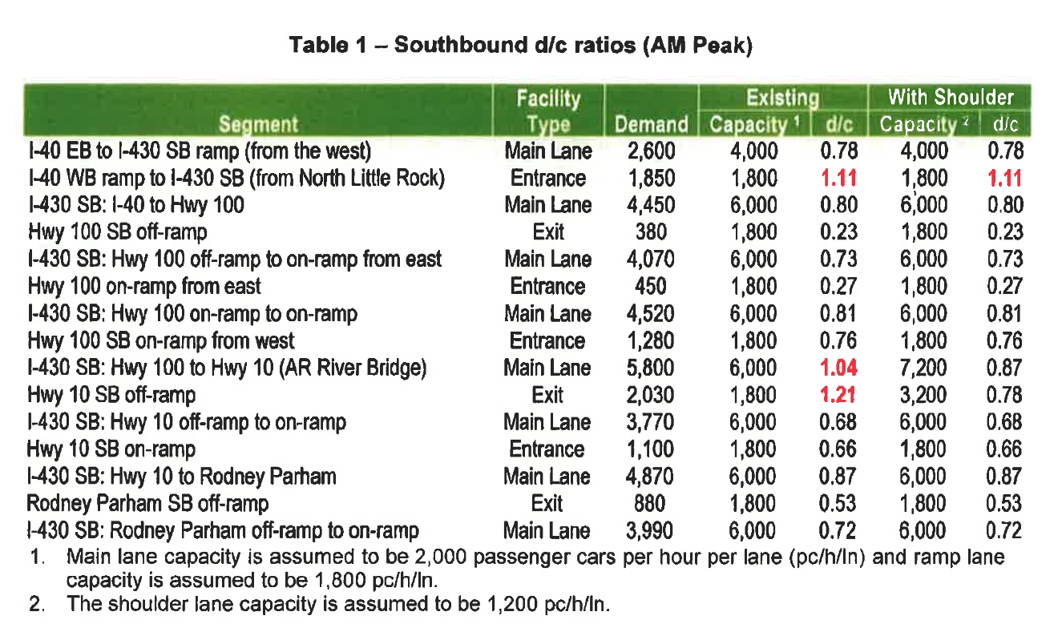
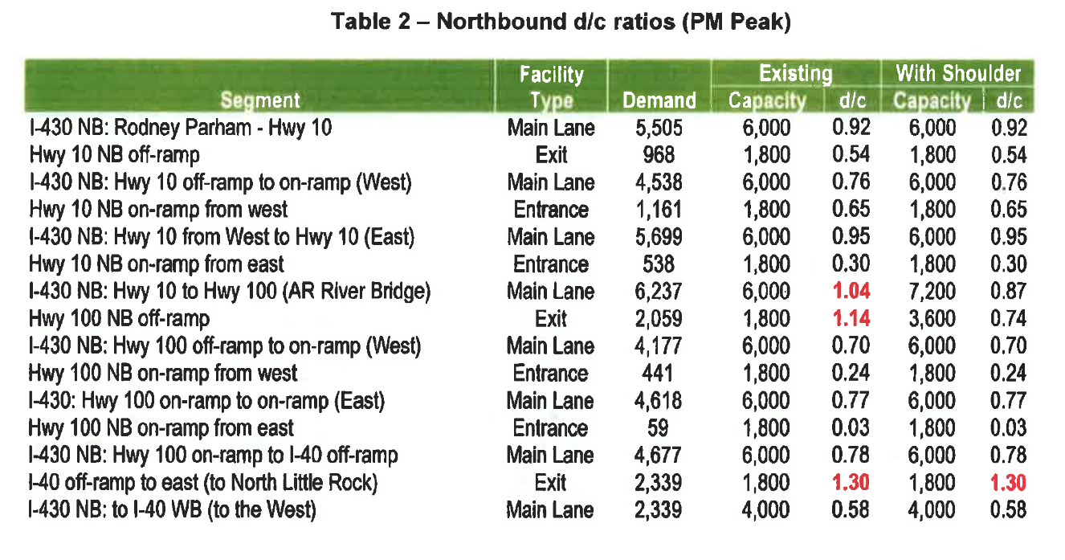
ARDOT Study Analysis
Demand/Capacity Ratio
LOS
Speed and Delay Impact
HCM Methodology
ADT and Crash Rates
MOT Review Summary
Notes:
The operation study included:
Demand/Capacity Ratio
LOS
Speed and Delay Impact
HCM Methodology
ADT and Crash Rates
MOT Review Summary
ADT:
The 2020 ADT counts are 96,000 vehicle per day with 3% truck traffic
The projected 2040 ADT are 112,000 vehicle per day with 3% truck traffic
Analysis:
Two analysis methods were used:
one that simply considered d/c ratios
Demand to Capacity Ratio screening (for the facility to operate satisfactorily, the d/c ration should be below 1.0)
The proposed part-time shoulder use would reduce the d/c ration on I-430 SB and at the Highway 10 SB off-ramp to less than 1. 0
The proposed part-time shoulder use should improve throughput and reduce main lane queues on I-430 River Bridge.
and a second that implemented the Highway Capacity Manual (HCM) freeway facilities methodology.
HCM was used to calculate LOS along with other traffic operation metric for SB-AM and NB-PM peak time periods. Both with and without the added shoulder lane.
The preliminary results are summarized in Table 3.
The HCS analysis indicates that the traffic operations would
be improved from a LOS F to a LOS D at the River Bridge and at the Highway 10 and Highway 100 ramps.
Freeway system speeds would improve during the AM and PM peak hours
And main lane queues would be reduced or eliminated.
Times:
the southbound (SB) direction during the morning (AM) peak
the northbound (NB) direction during the afternoon (PM) peak.

Slide 8
Is PTSU a suitable solution for the traffic congestion?
Notes:
Part-time shoulder use will improve the traffic operations on the I-430 River Bridge and exit ramps during the AM & PM peak hours.
This section of I-430 does not have the capacity to meet the traffic demand
The additional of PTSU would provide the needed capacity to meet the traffic demand
Part-time shoulder use on the I-430 Arkansas River Bridge has the potential to improve traffic operations on SB I-430 during the AM peak and NB I-430 during the PM peak
Exit ramps operations would improve by creating two-lane ramps in the respective peak hour at Highway 10SB exit ramp (AM ) and Highway 100 NB exit ramp (PM)

Slide 9
What is the cost for the PTSU?
Notes:
The estimated construction cost for replacement of the I-430 River Bridge and approaches is $258.6 Million (not including RUC)
The cost for PTSU is estimated to be $14.5 million in construction costs, which includes $8.5 million in bridge hydro demolition.

Slide 10
Job 061630 System Preservation & ITS Improvements
Notes:
ARDOT Job 061630
FED. AID PROJ. NHPP – 430-2(269)10
System Preservation & ITS Improvements
Pulaski County
Route I-430 Section 21
I-430 River Bridge between Hwy. 10 and Hwy. 100 (little rock and Maumelle/north Little Rock)
NHPP - National Highway Performance Program

Slide 11
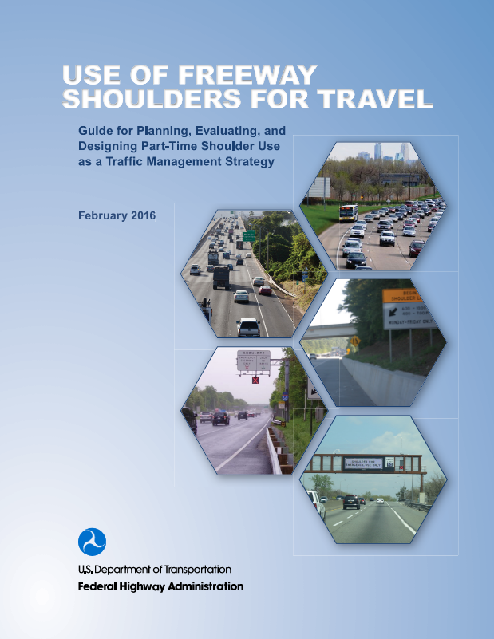
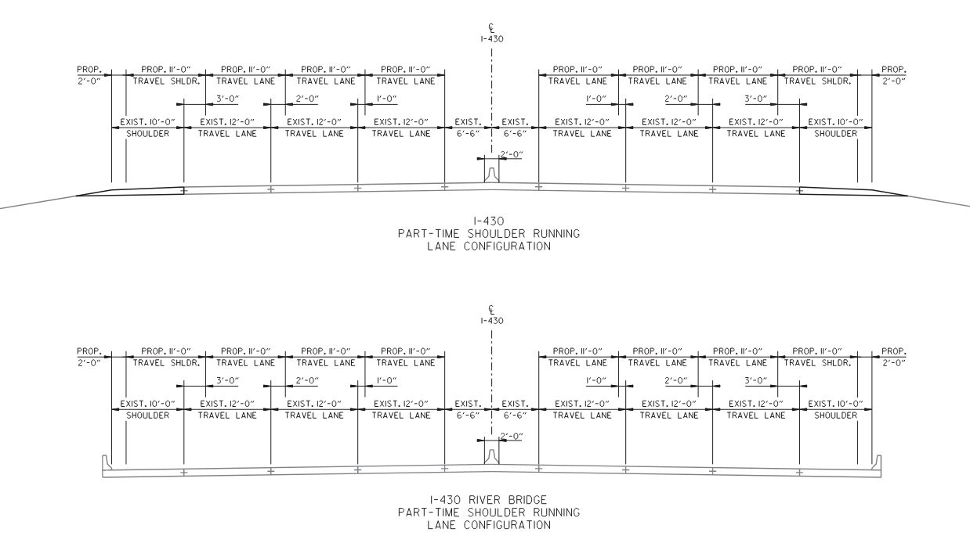
Roadway Design
FHWA Handbook Requirements
(Design Exception)
Notes:
1/17/2020 Exception request to FHWA for the part-time shoulder use for I-430
I-430 Log Miles 9.05-11.63 (Hwy. 10 to Hwy. 100) Job 061630 – Pulaski County
From 3 x12ft lanes in each direction with a variable inside shoulder (5.5-foot min) and 10ft outside shoulder
The lanes are divided by concrete median barrier wall south of the Arkansas River and 40-foot grassed median with wire rope safety fence north of the Arkansas River
Use FHWA Handbook “ Use if Freeway Shoulders for Travel-Guide for planning …… 2016”
11-foot travel lanes in each direction with a variable inside shoulder (5.5-foot min) and 11-foot outside shoulder with a 2-foot buffer space for the part time shoulder use shoulder.
Lane Width:
1.For shoulders designated for part-time travel, a width of 12 or more feet is generally preferred.
2. If trucks are prohibited from using the shoulder, then widths as narrow as 10 feet may be adequate.
3. A 10-foot shoulder may be inadequate for part-time shoulder use if the lateral offset to obstructions is less than 1.5 feet or high volume of larger vehicle such as buses is anticipated.
4. Shoulders less than 12-feet wide will typically require a design exception if they are designated for part-time shoulder use.
If an entire roadway is repurposed, and general purpose lanes are reduced to less than 12 feet wide to accommodate part–time shoulder use (for any shoulder width), a design exception is also required.
Bridge width:
The minimum width of a bridge shoulder that could be designated for part-time shoulder use is 11.5-feet
This dimension provides 10 feet of the shoulder as an effective part-time lane and 1.5 of the shoulder as an effective lateral offset to obstructions
Is it not necessary for the shoulder designated for part –time use on a bridge to be the same width as a shoulder designated for pat-time use on the approaching roadway; however, it does need to be 11.5 or more feet wide. In these circumstances, design exceptions may be needed for shoulder widths less than 12 feet and/or if the lateral offset to obstruction dimension is not met.

Slide 12
Intelligent Transportation System (ITS) Maintenance Division
System Engineering Analysis
ITS Design
PTSU will be Monitored and Controlled (Managed Lanes)
Notes:
Strategies used to mitigate this reduction in safety will include the closure of the part-time shoulder use lanes during non-peak times,
ITS monitoring
and the ability to close the lanes if the shoulder is blocked by a disabled vehicle
Static signage will be used in conjunction with a changeable green arrow and red “X” to indicate the opened/closed status if the shoulder.
Camera monitoring will be incorporated to allow for “sweeps” of the shoulder before it is opened and allow for notification if the shoulder needs to be closed due to an accident.
The proper implementation of part-time shoulder use will require various forms of public outreach. Press releases will be used to familiarize the traveling public with the concept of part-time shoulder.

Slide 13
What are the project needs?
Notes:
Improve safety
Decrease congestion
Reacquiring congestion
Congestion related to crashes
Reduce travel times
Improve travel time reliability
Increase the overall throughput of I-430 Corridor

Slide 14
Reasons for Implementing Managed Lanes
Notes:
Reasons for implementing D-PTSU include:
Routine recurring congestion
That is less predictable in time of occurrence and length of occurrence than typical morning and evening peak hours due to commuter traffic.
Southbound AM peak traffic
Northbound PM peak traffic
Ability and flexibility to more effectively close the shoulder
by LCS (Lane Control Signals) if an incident or emergency warrants it and revert to a safety shoulder.
Operations outside of the fixed schedule (off‐peak hours) due to high frequencies of non-recurring congestion for other reasons.
Seasonal congestion
during weekends and holidays primarily due to recreational travel.
Anticipated congestion due to special events.
Congestion due to incidents.
Provide benefits and flexibility outside of the fixed schedule (off‐peak hours)
Due to high frequencies of non-recurring congestion for other reasons.

Slide 15
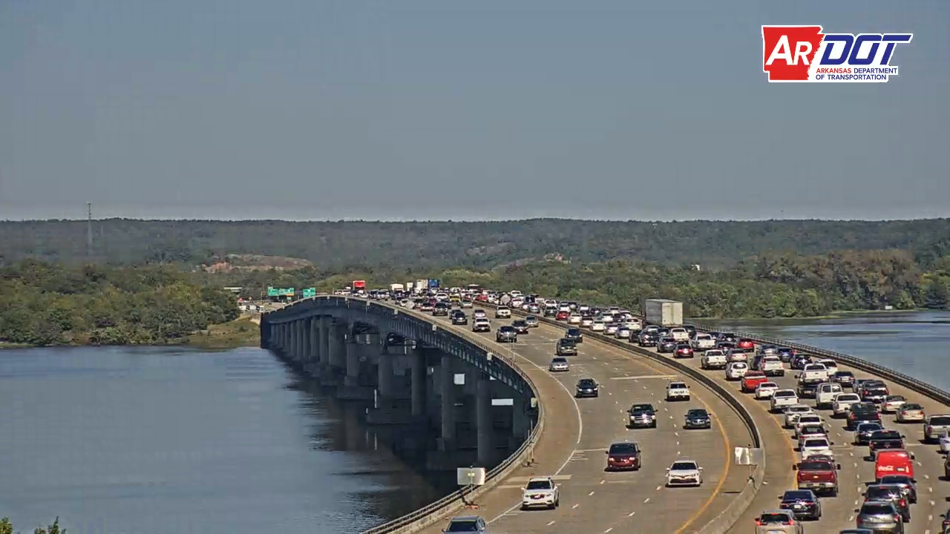

Slide 34
Notes:
Big Rock interchange – 3 miles away from 430 river bridge

Slide 35
Field Inspection

Slide 36
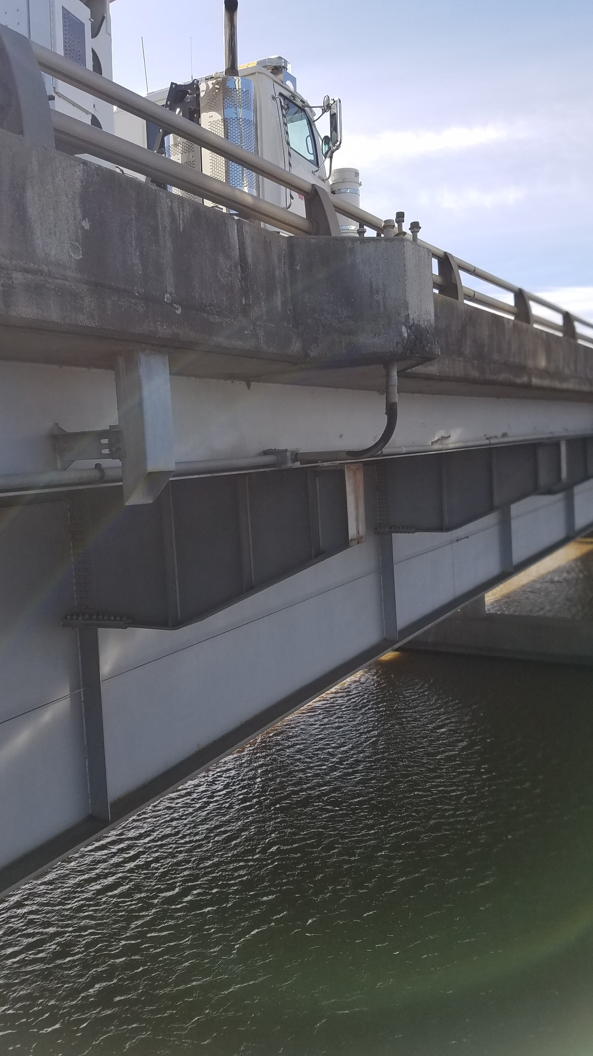
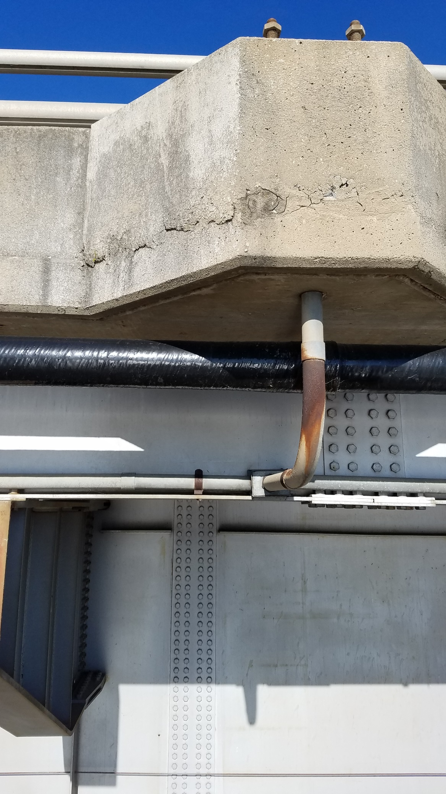
Notes:
Catwalk

Slide 38
Notes:
Existing Conduit and how it is mounted.

Slide 40
Cone Test
Notes:
Testing: horizontal and vertical curves
No 3d molding software so we had to do cone and trailer test.

Slide 41
Trailer Test

Slide 42
Notes:
FHWA requirement is to be able to see at least 1 LCS with a preference of 2 LCS.
In our case, we designed it to be able to view 3 LCS for
redundancy to address the vertical and horizontal curve
And to address the line of site being obstructed by larger vehicles

Slide 43
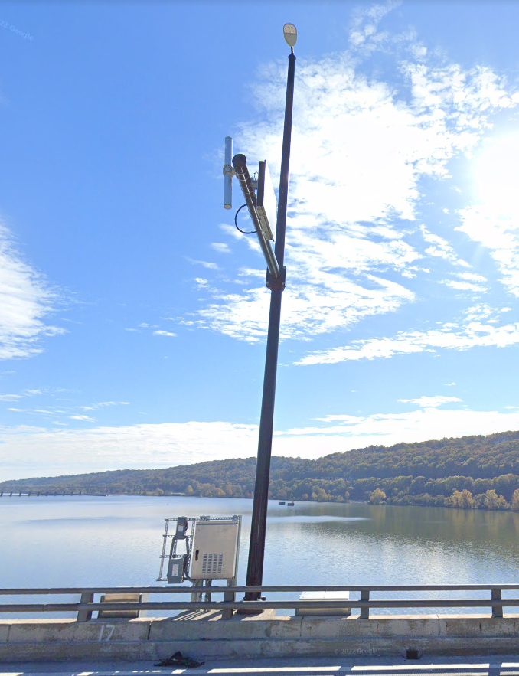
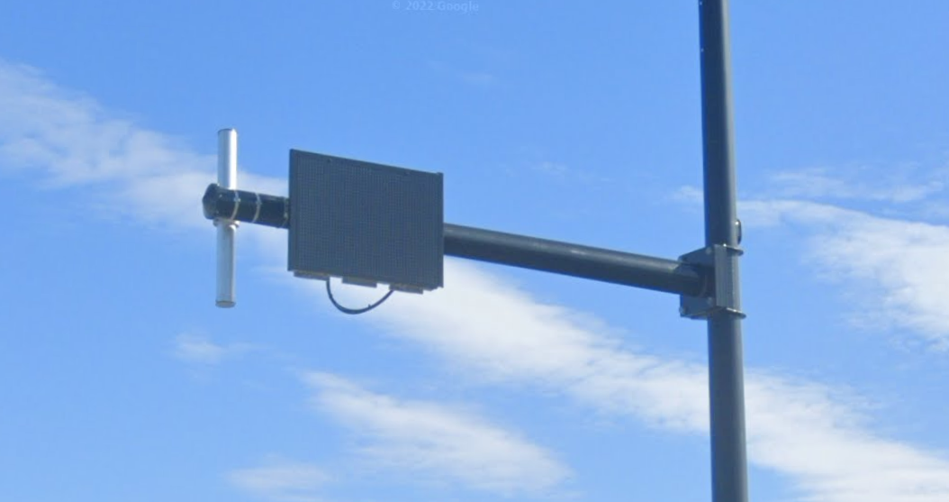
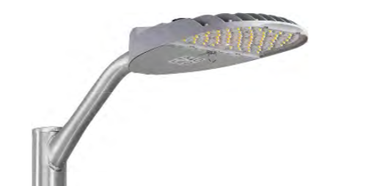
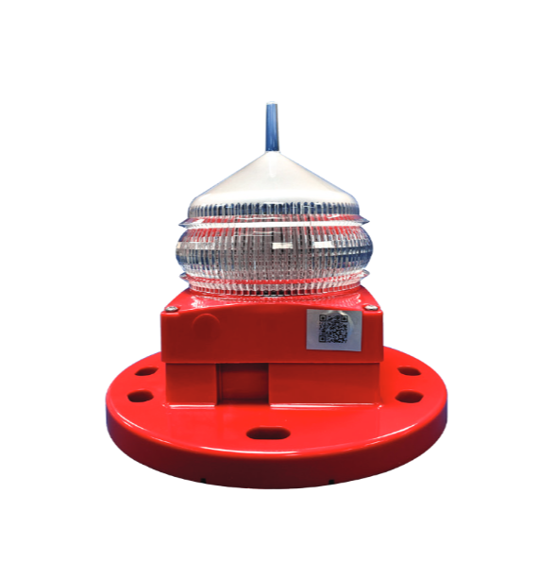
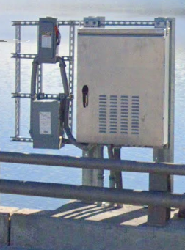
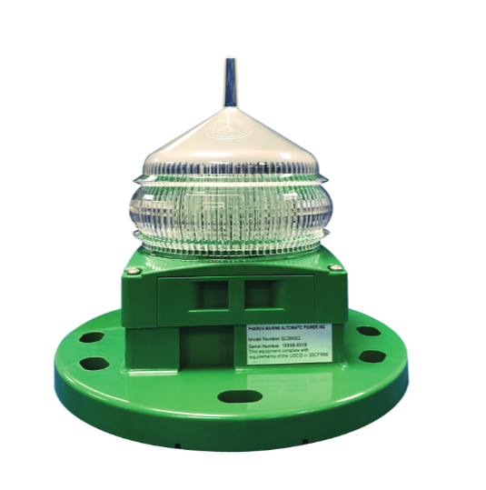
ITS Elements for Managed Lanes

Slide 44
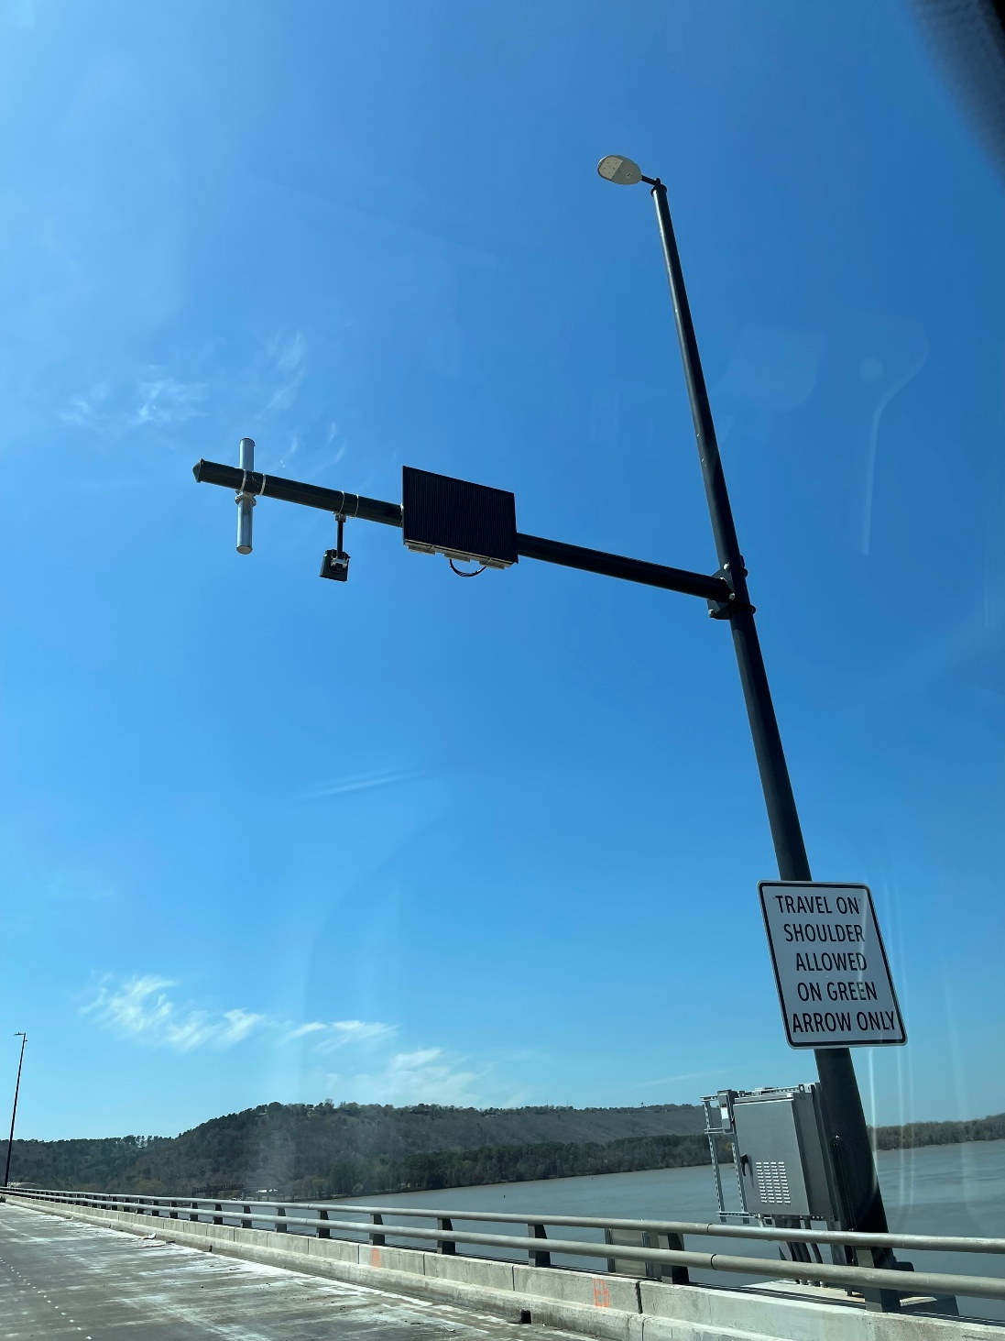
Hardware on I-430 River Bridge
Notes:
ITS Cabinets
Light Poles
Signal Poles with Mast Arms
Conduit System
Power Junction Boxes
Communication (Fiber) Boxes
Mast arms had to be as short as possible. And Devices had to be smaller as possible and be light weight.

Slide 45
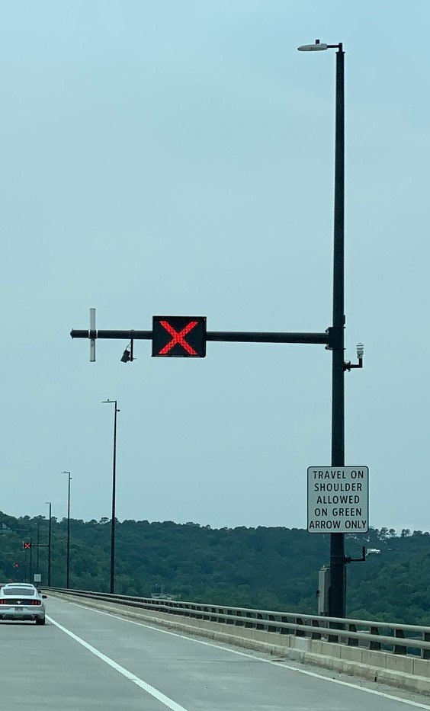
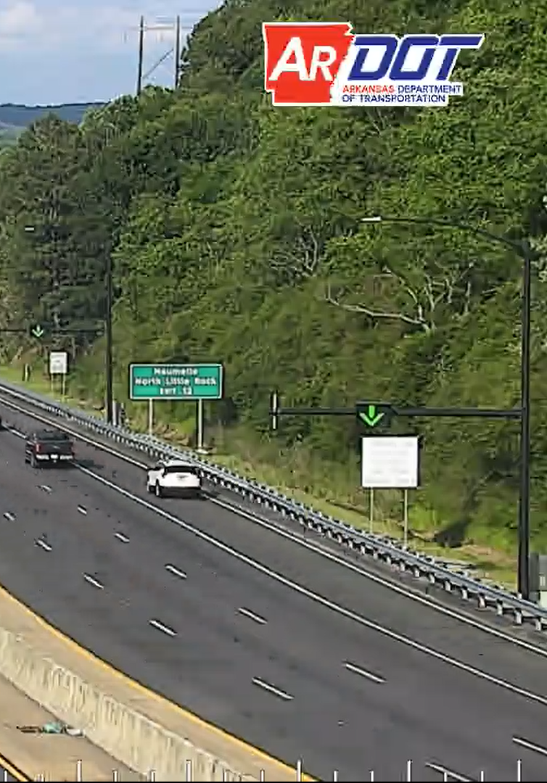
Lane-use Control Signals (LCS)
Notes:
Signs (Red X’s and green arrow’s board)
Total of 21 locations
9 locations for southbound
12 locations for northbound
The northbound has more due to the horizontal curve on the little rock side.
Visors

Slide 46
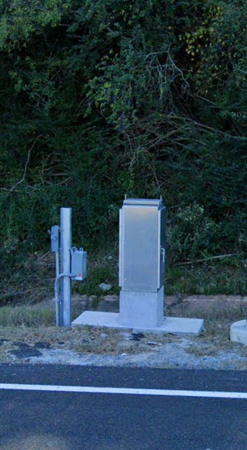
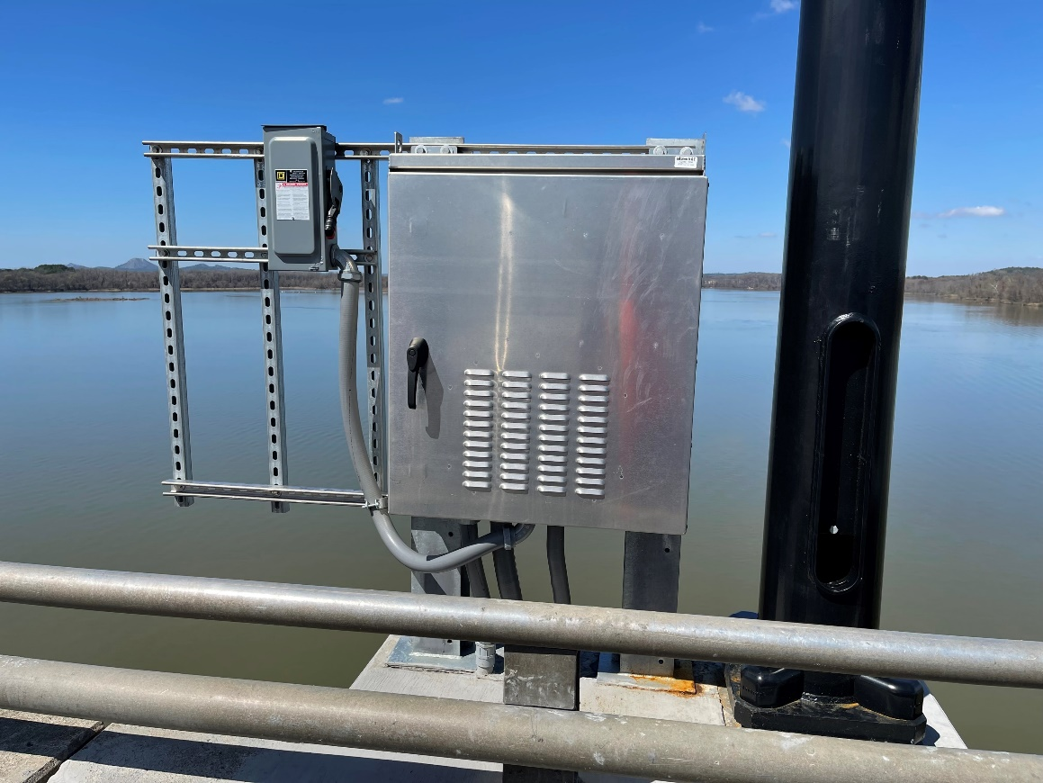
ITS Cabinets
Notes:
Ground Mount ITS Cabinet – 15 locations
Compact ITS Cabinet - 12 locations

Slide 47
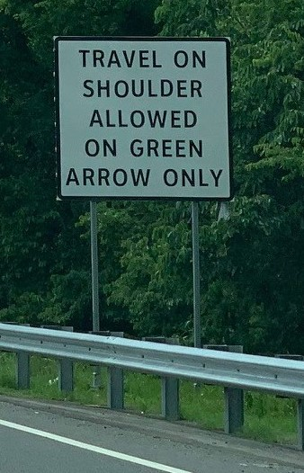
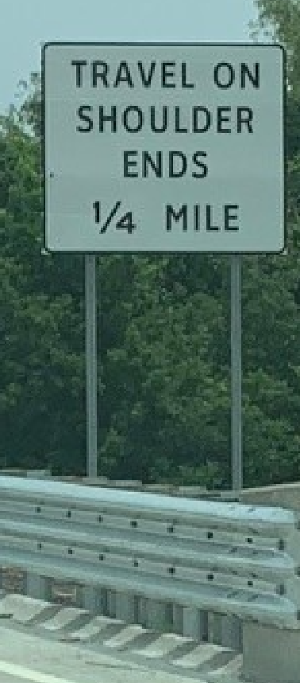
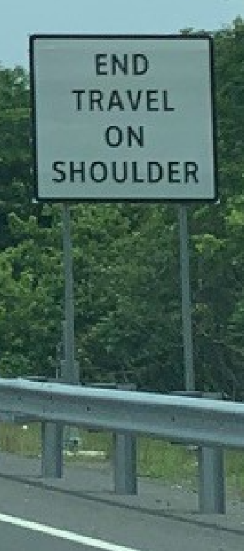
Static Signs
Notes:
Signage:
TRAVEL ON SHOULDER ALLOWED ON GREEN ARROW ONLY
Travel on Shoulder Ends ¼ Miles
End Travel Shoulder
Speed Limit

Slide 48
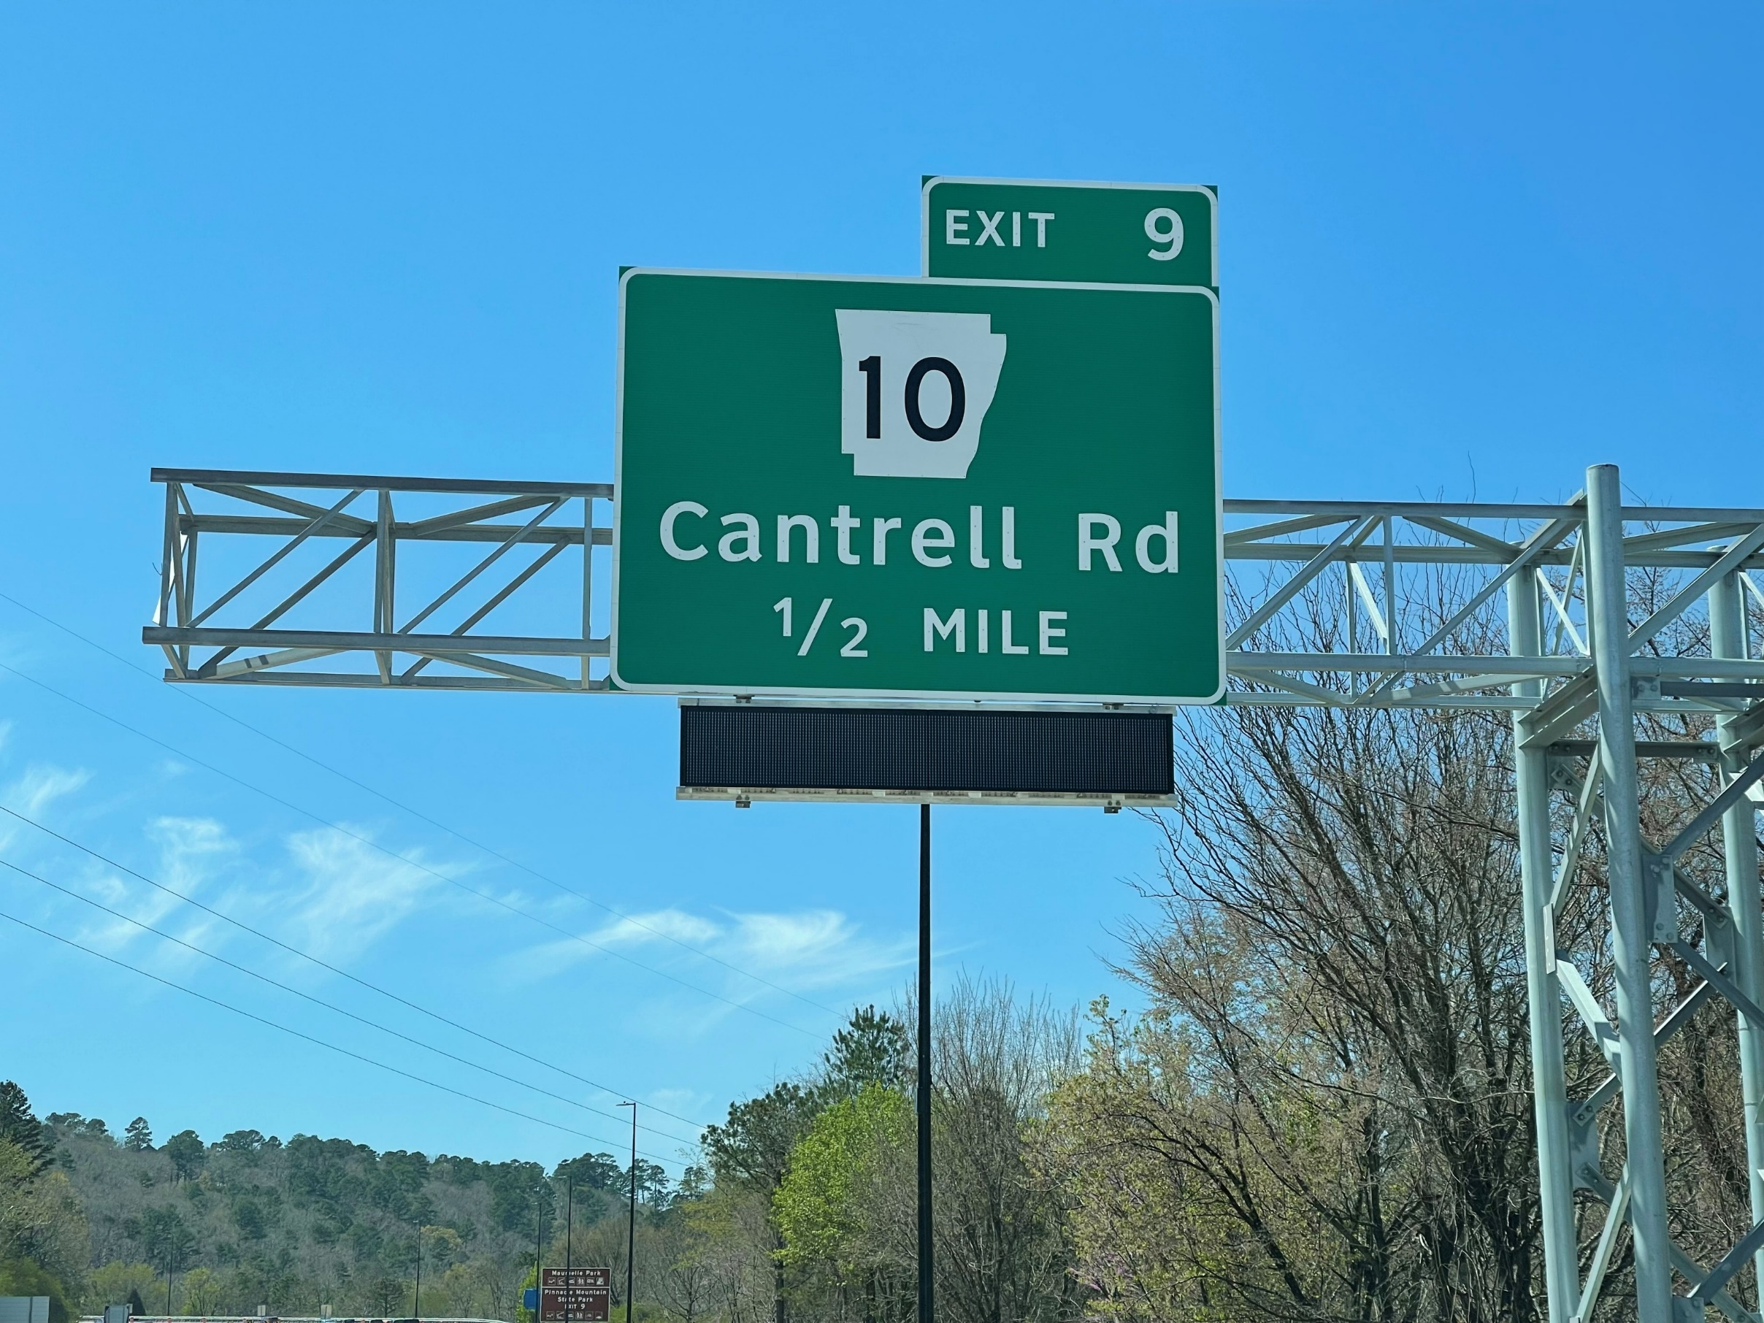
Dedicated Dynamic Message Signs
Notes:
Total of 6 DDMS at 4 locations.

Slide 49
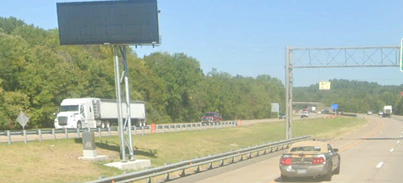
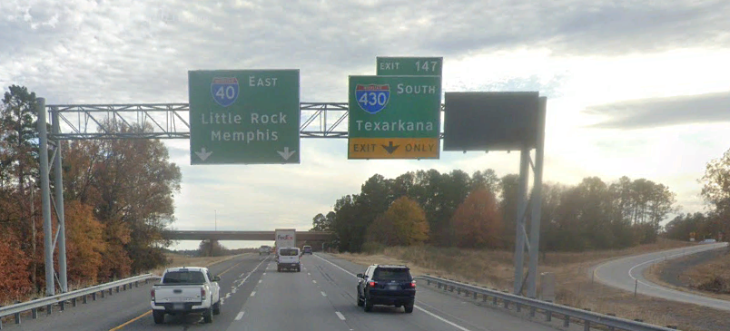
Advance Dynamic Message Signs
Notes:
Advance Dynamic Message Signs (DMS)

Slide 51
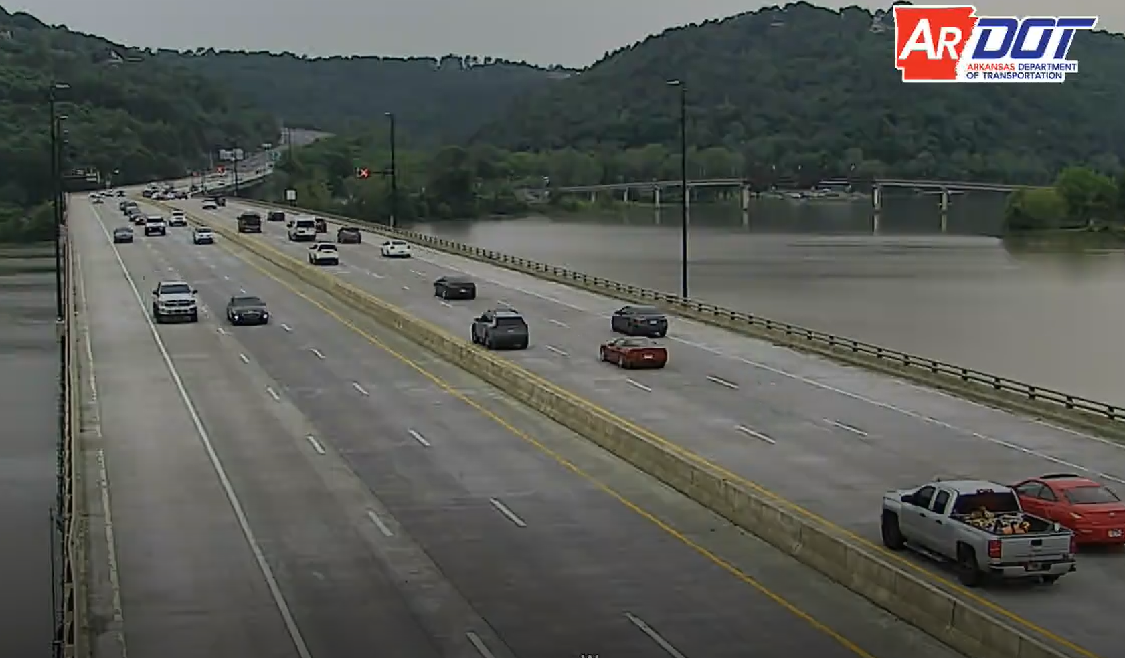
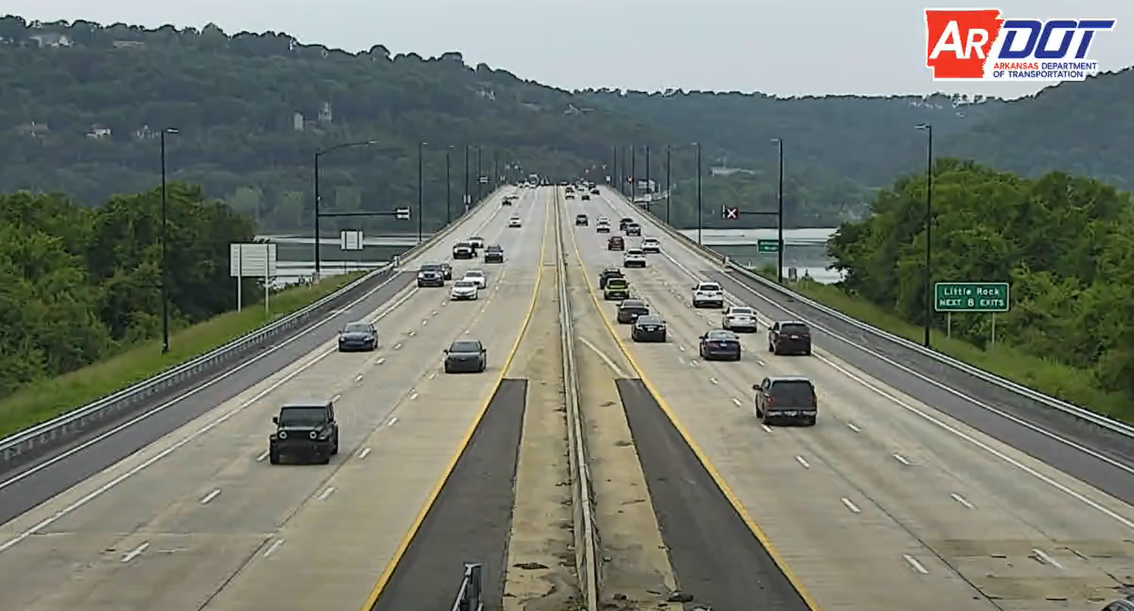
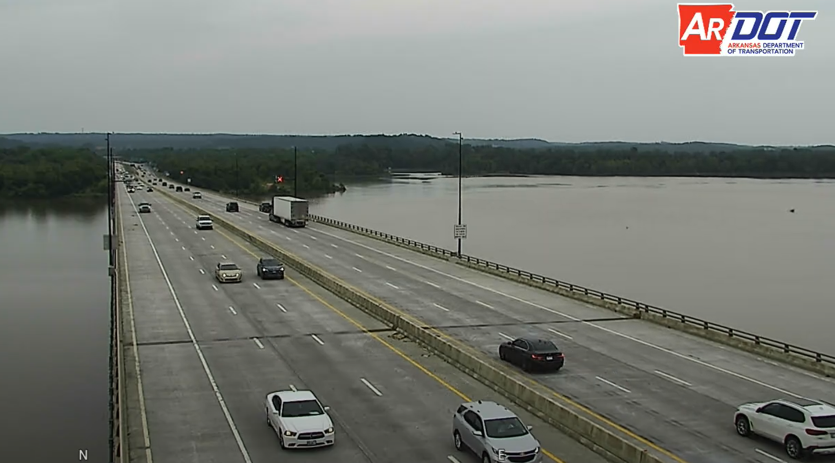
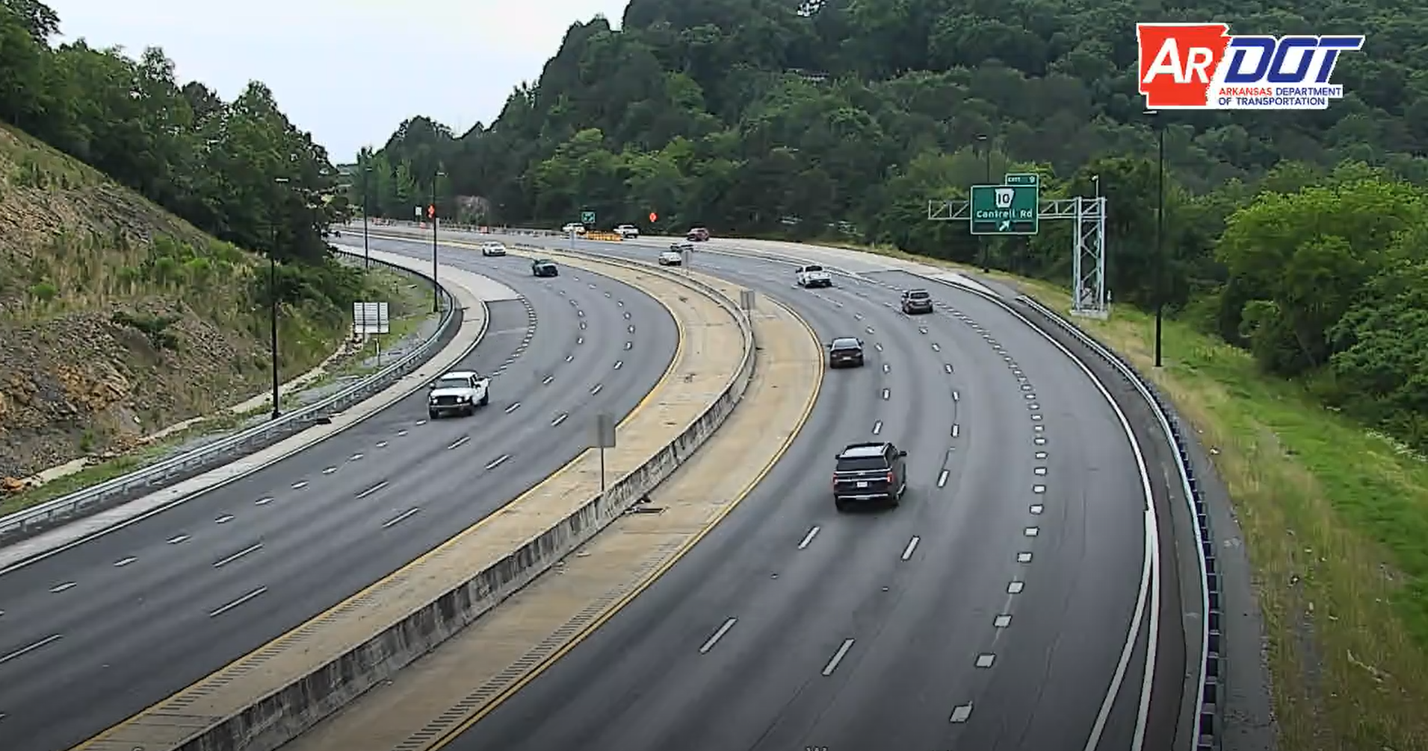
PTZ Cameras
Notes:
Cameras (PTZ)
Total of 11 cameras to cover all of the project limit.

Slide 52
IDriveArkansas.com

Slide 53
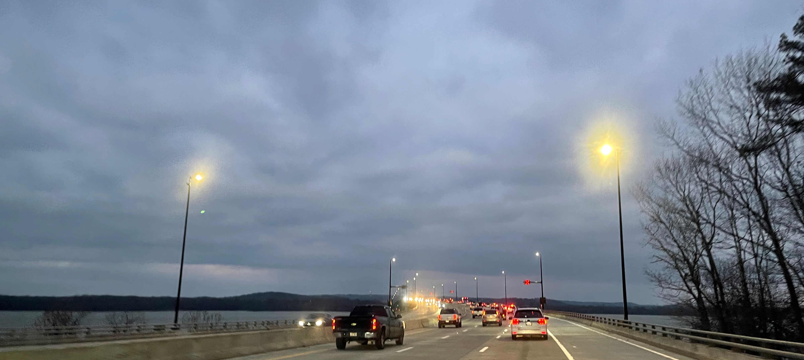
Illumination (Roadway Lighting)
Notes:
Total of 74 lighting pole
34 Light poles are mounted on the I-430 River Bridge
40 Lighting poles are ground mounted

Slide 54
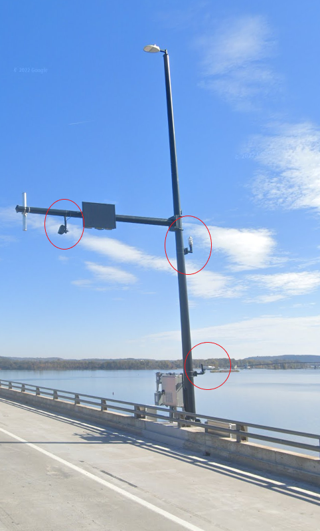
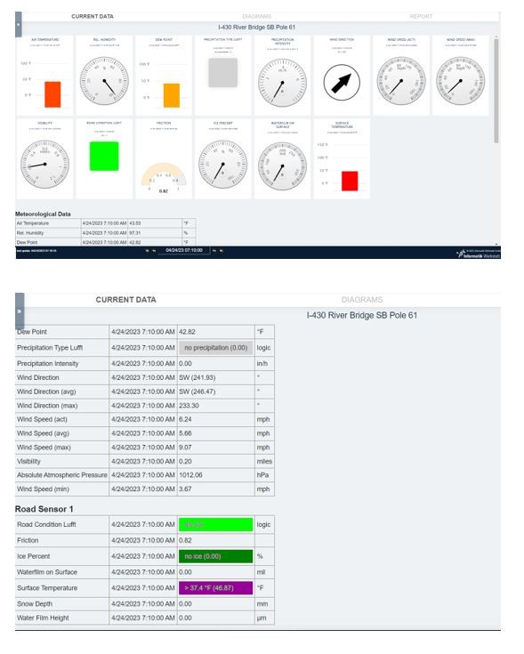
Weather Sensors
Notes:
3 Different Sensors at two locations on the bridge.

Slide 55
Communication System
Notes:
Network Design
Big pull boxes to accommodate the fiber
Verizon/ritter fiber back to main building
Tower:
Concrete tower
80ft Tower
Redundancy - backhaul
Big shout out to IT Division on handling the network setup and providing the switches to operate the system.

Slide 56
Power System
Notes:
Service points – Total of 7
Wire size
Transformers – step-up and step-down transformers
Easement – Issue with utility at one of the DMS Locations

Slide 57
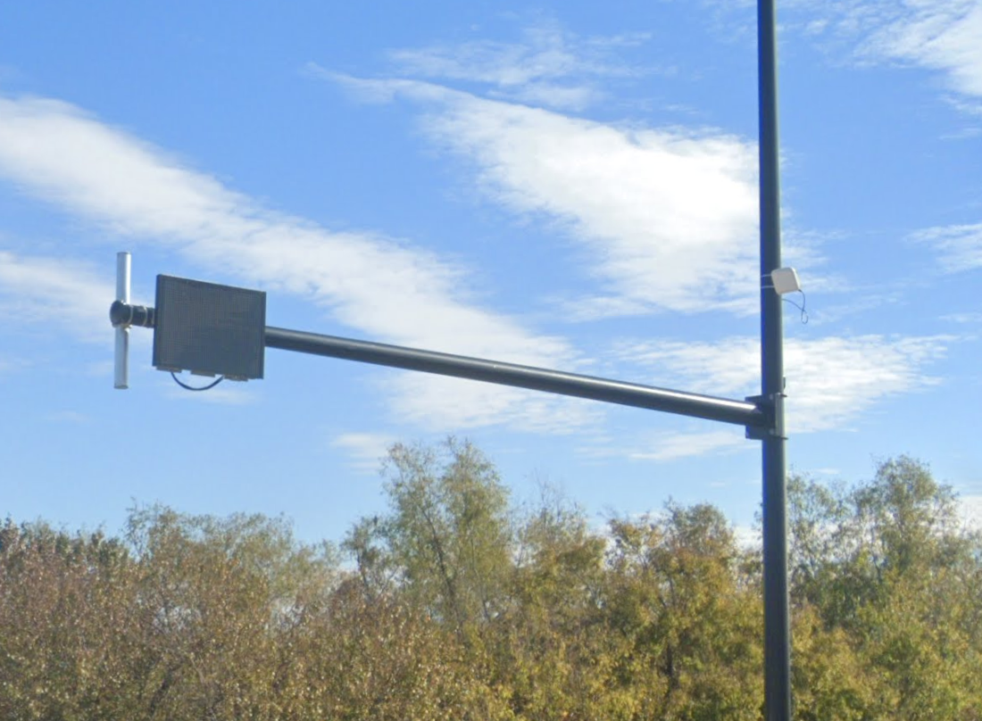
Other Systems
Navigation Lighting
Counters (Roadway Sensors)
Guardrail System

Slide 58
MAINTENANCE AND OPERATIONS
Notes:
DEDICATED TECH THAT LIVES IN MAMULLE
DOES A CHECK RUN EVERY MORNING ON HIS WAY TO WORK

Slide 59
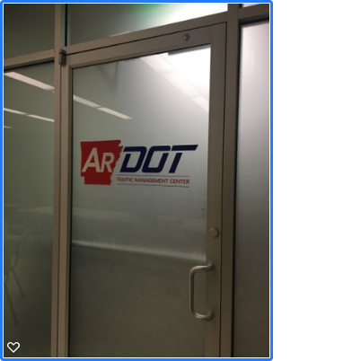
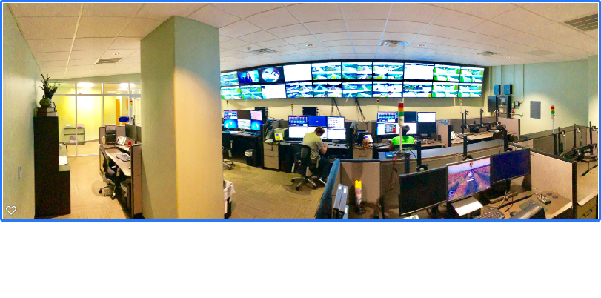
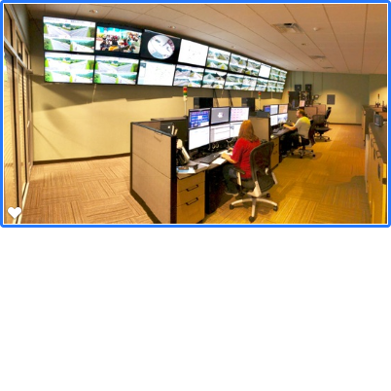
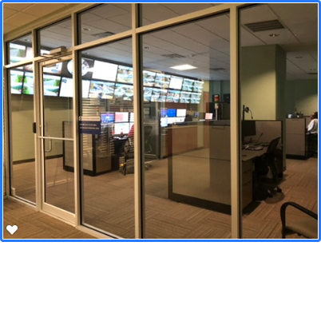
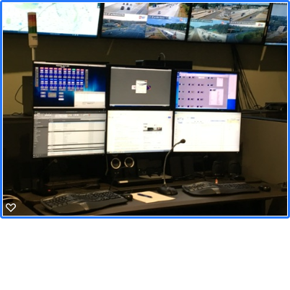
Operation of the Managed Lane
Notes:
TMC Role:
Operate I-430 Managed Lane
Monitor (check lights, objects on road, ….)
Turn On: Green Arrows on.
Turn Off: Red X’s on.
Incident Management.
Report any items on road to District
Report any Lighting issues
SOP for managed lane (standard Operating Procedures)
Command and control of managed lanes
Actively monitor lanes
Respond to issues
Reach out to 1st Responders
Track and support incident response
Provide real time actionable Driver Information on advance DMS boards
Incident reporting on iDriveArkansas
Radio Dispatching for Highway Police and District 6
Check Weather Sensors– Fog, Snow & Ice
Special Event – i.e. nearby closure that routes high volumes of traffic onto 430
Operating ITS Equipment: DMS, DDMS, PTZ, RWIS

Slide 60
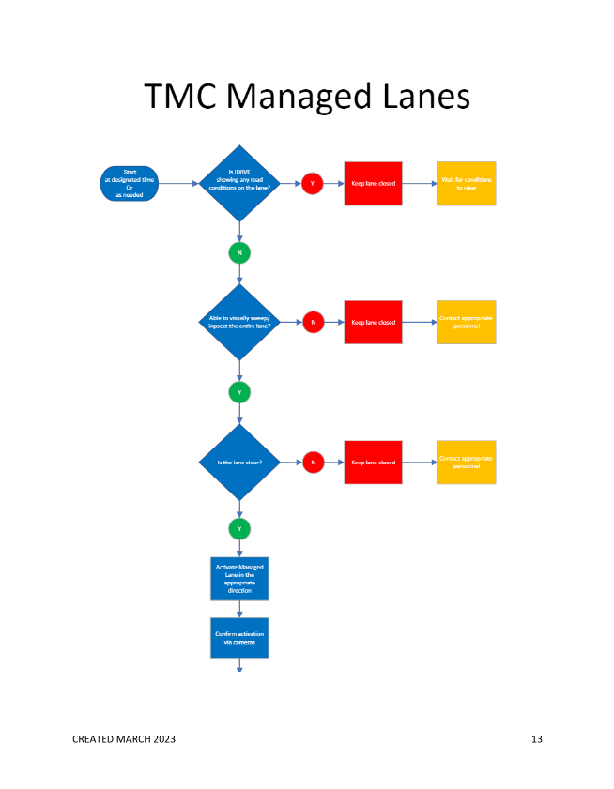
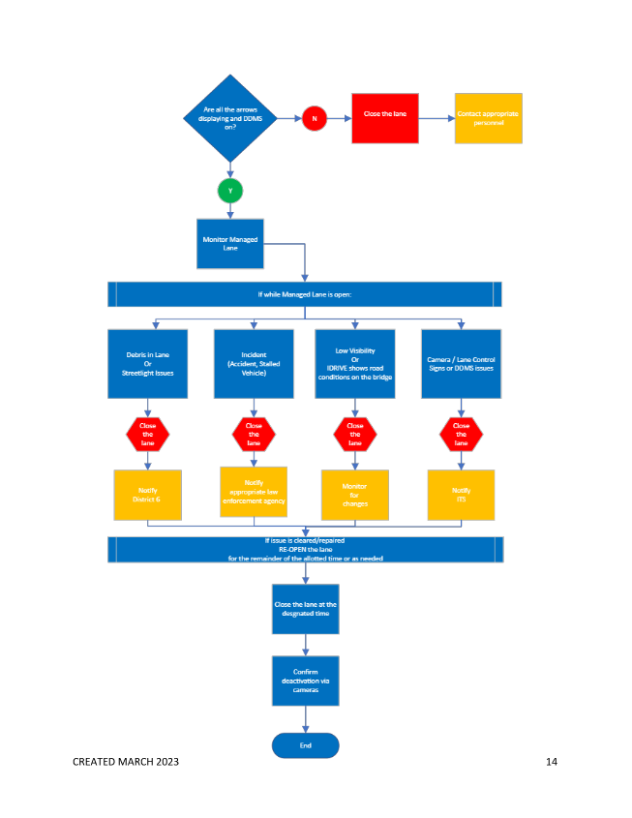
Notes:
The week of 3/13/2023 burn test (We had to do a burn test for 2 weeks)
3/27/2023 turn on of green arrow

Slide 61
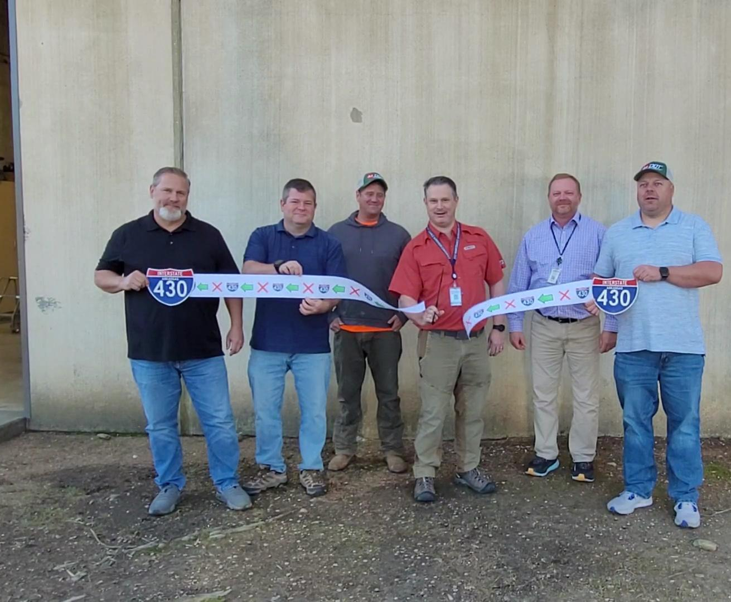
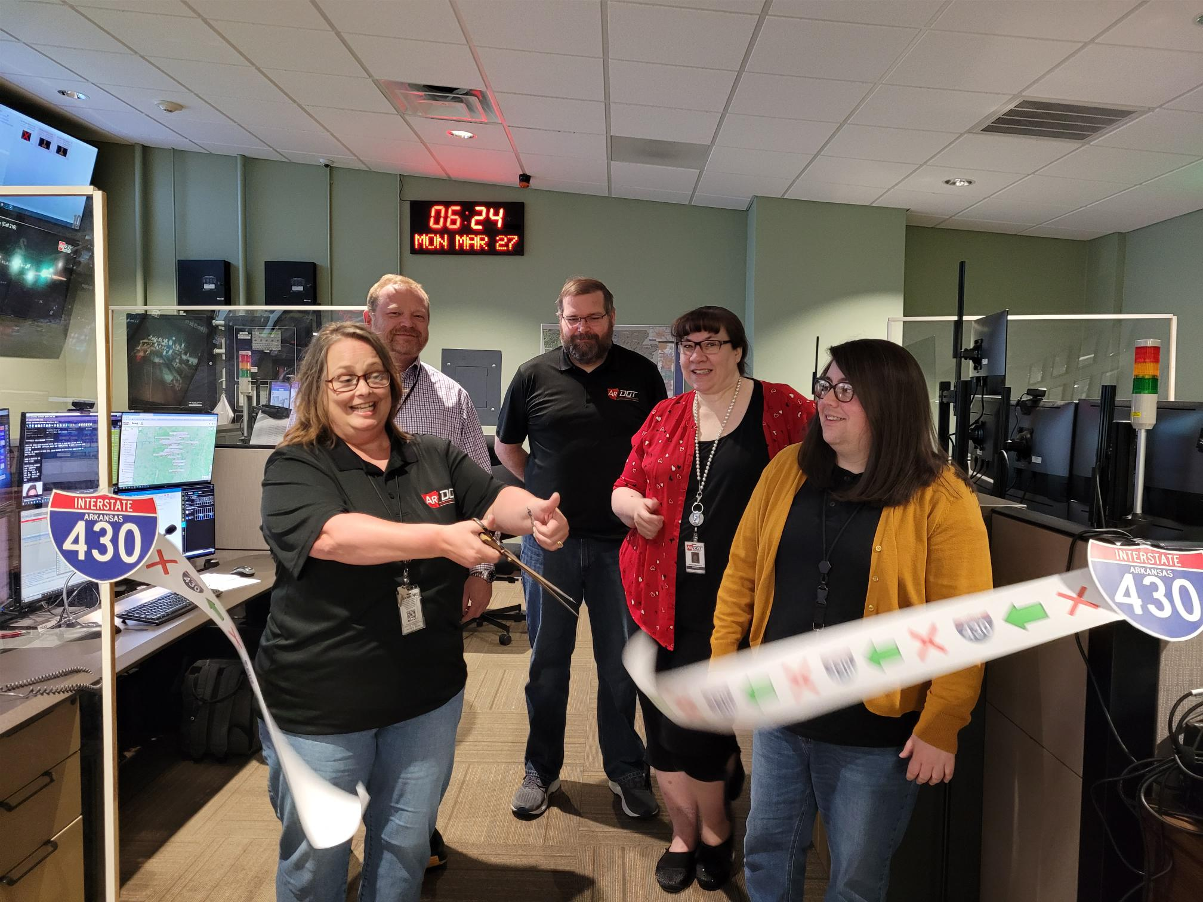
Ribbon Cutting Celebration
Notes:
The week of 3/13/2023 burn test
3/27/2023 turn on of green arrow

Slide 62
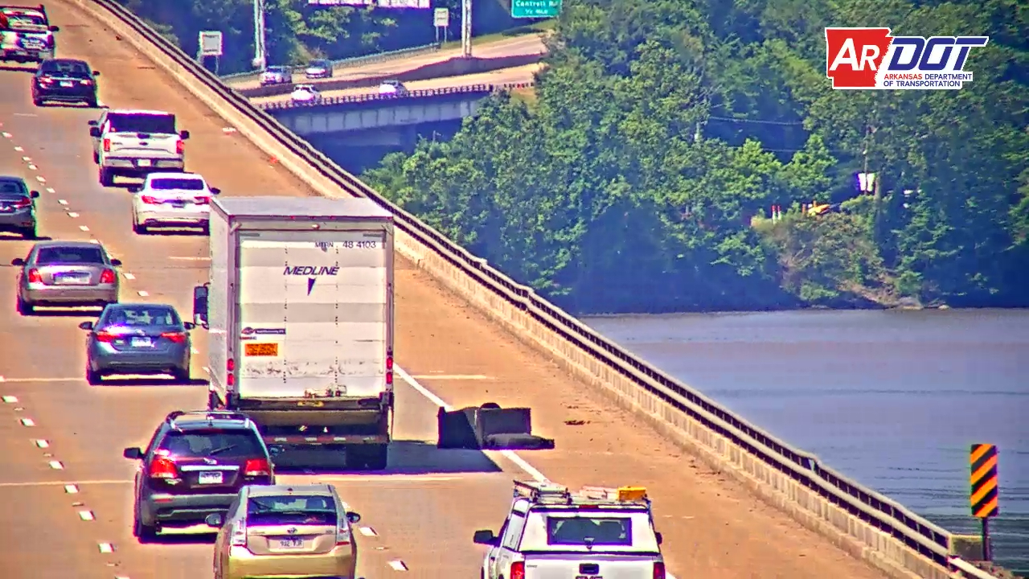
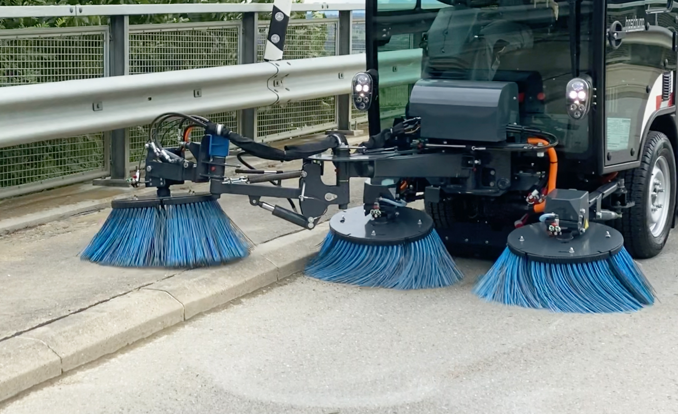
District Role
Notes:
Conduct full sweep
Respond to clear items on the road.
Maintenance of lighting system
Maintenance of guardrail system

Slide 63
Setbacks
Notes:
Pole design
Cisco Network switches
Fiber availability
Dark fiber of Verizon was not ready, so we had to change to Ritter
Visors (river test) (heavy Bridge did a drone view from the river side)
2 light poles and one cabinet got hit
Utility (including service point on Hwy 10 removal by Entergy)
Conduit system on the bridge
Design during COVID

Slide 64
Example
Notes:
It was on and got to turn off.

Slide 71
Notes:
ARDOT:
Maintenance Division (ITS Management and Heavy Bridge)
Roadway Design Division
Bridge Division
Construction Division (including District and RE office)
Information Technology (IT) Division
Public Information office (PIO)
Transportation Planning and Policies (TPP) Division
System Information & Research
Program Management
Arkansas Highway Police
Others
Arkansas State Police
Fire Departments
City of Little Rock
City of North Little Rock
Towing
Emergency Medical Services (EMS)
Local Fire and Police Departments
Arkansas Department of Emergency Management (ADEM)
Leadership:
Highway Commission and executive leadership who enterusted us with making the first Managed Lane project in Arkansas happen.

Slide 72
Video Wall
TMC Camera
Notes:
I-430 Video Wall
https://actis.idrivearkansas.com/index.php/cameras/view_wall/544,543,29,550,541,542,539,540,546,547,562,532,531,530
Ahtd39272
Hussain11
TMC Camera
http://192.168.201.6/#view

