Slide 1


TRC 2003
Data-Driven Methods to Assess Transportation System Resilience in Arkansas
Sarah Hernandez
University of Arkansas

Slide 2
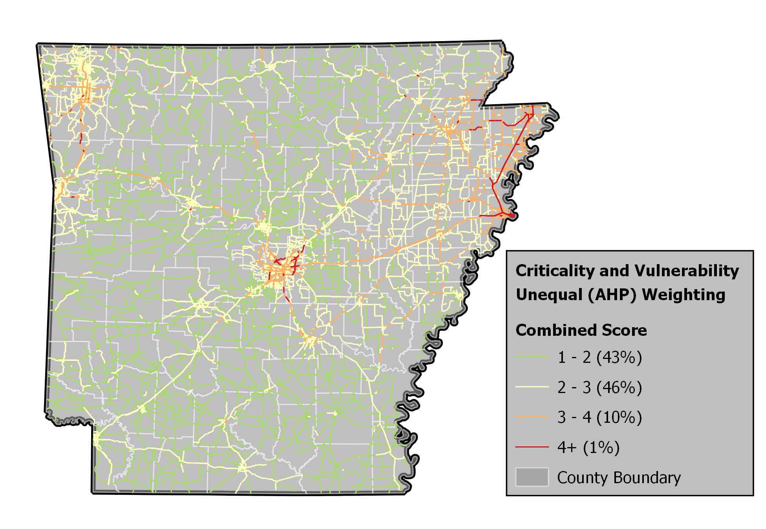
Combined Criticality and Vulnerability

Slide 3
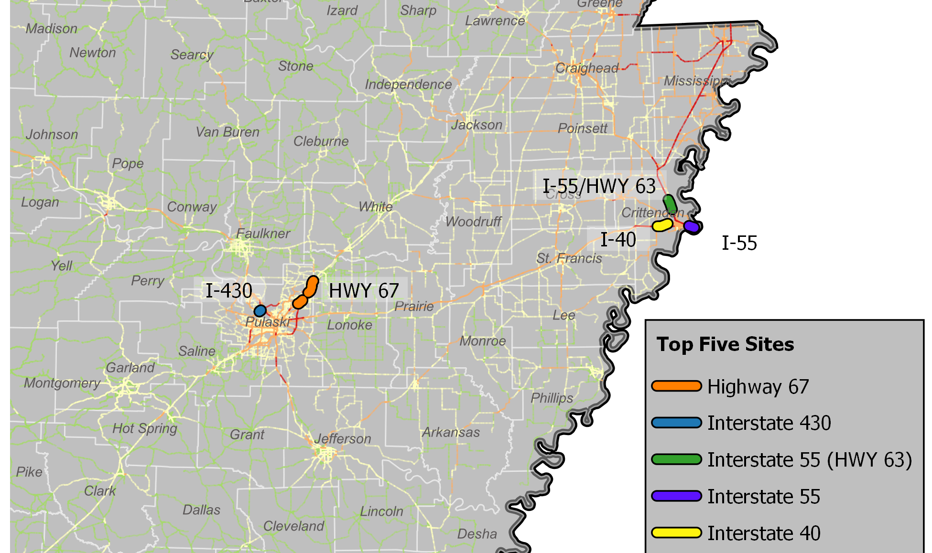
Top 5 Sites
Top 5 Sites
Highway 67: Pulaski County
(20 links, 9.58 miles)
Interstate 55 (Highway 64): Crittenden County
(8 links, 1.68 miles)
Interstate 40: Crittenden County
(12 links, 5.2 miles)
Interstate 430: Pulaski County
(6 links, 1.78 miles)
Interstate 55 (Highway 63): Crittenden County
(3 links, 3.1 miles)

Slide 4
Overview and Outline
Objective: Foundational and repeatable resiliency assessment methodology to identify the most critical and vulnerable highway assets.
1
Review of Practice
2
Criticality and Vulnerability Analysis
3
Application
to Statewide Assessment
4
Case Study B/C Evaluations

Slide 5
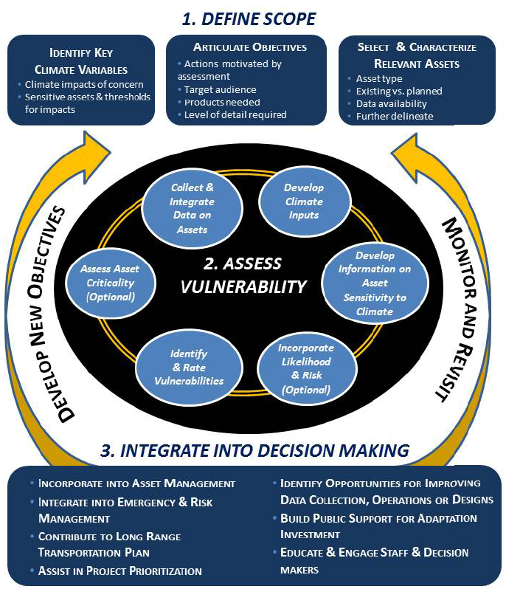
1. State-of-Practice Review
We focus on existing methods used by federal and state transportation agencies to measure resilience using repeatable processes and established frameworks.
See NCHRP Report 938: Resilience in Transportation Planning, Engineering, Management, Policy, and Administration for a full review of policy and practice regarding resiliency assessment
  19 climate vulnerability pilot studies.
  We developed an approach for Step 2 “Assess vulnerability” in accordance with FHWA.
  To assess vulnerability, FHWA recommends asset criticality assessment.
  2 approaches to asset criticality: desk review and stakeholder input.

Slide 6
Examples of Frameworks
CTDOT: Adaptative Capacity
Evaluated the hydraulic capacity of bridges and culverts in regions of the state with extreme rain event potential (Hogan and Lupes 2015).
Based on a system-level vulnerability assessment focused on the system’s adaptive capacity.

Slide 7
Examples of Frameworks
TnDOT: Climate Scenarios
System-wide asset assessment across multiple modes using historical and future climate scenarios (Jones and Lupes 2016)
Ranking of criticality was based on a stakeholder input survey that included 220 respondents.

Slide 8
Examples of Frameworks
MnDOT: Long Range Planning
Considered sensitivity:
  Asset condition (pavement rating, scour rating, culvert condition, etc.),
  Exposure as the flooding characteristics (stream velocity, floodplain attributes, land cover, and historical flooding issues), and
  Adaptive capacity as AADT, average annual daily truck traffic (AADTT), and detour length
Ranking of criticality was based on a stakeholder input survey that included 220 respondents.

Slide 9
Examples of Frameworks
CDOT: Multicriteria Risk and Resilience Assessment
Applied at the corridor level (single corridor analyzed).
Criticality score were derived through a series of workshops with department experts from all divisions within CDOT including traffic, engineering and design, hydraulics, planning, maintenance, bridge, and others

Slide 10
2. Criticality and Vulnerability
The criticality of an asset is defined as its importance to the study area such that removal from operation would result in significant losses (DHS 2007).
Vulnerability is defined by three components (FHWA 2017):
  Exposure – the degree to which an asset is in an area that experiences direct impacts of disruptions
  Sensitivity – the degree to which the asset fares when exposed to the disruption
  Adaptive capacity – the degree to which the system can cope with non-operation of the asset

Slide 11
Criticality Metrics
Criteria | Definition | Data Source | Resolution
Annual Average Daily Traffic (AADT) | Daily traffic volume for each roadway link. | Travel Demand Model (TransCAD) for the base year 2010 | Link
Roadway Classification | Functional class of roadway link: Interstate, Freeways & Expressways, Principal Arterials, Minor Arterials, and Major Collectors | Travel Demand Model (TransCAD) network | Link
Freight | Freight value in Millions of US dollars by county for the year 2017 | US Department of Transportation, Bureau of Transportation Statistics and Federal Highway Administration, Freight Analysis Framework, Version 4.5, 2019 | County
Tourism | Tourism value expressed as total county expenditures in millions of US dollars by county | 2019 Arkansas Tourism Economic Impact Report, Arkansas Department of Parks, Heritage, and Tourism (AR Tourism, 2022) | County
Social Vulnerability Index (SoVI) | SoVI measures the social vulnerability of US counties to environmental hazards. It is an indicator comprised of 29 socioeconomic variables that contribute to a county’s ability to prepare for, respond to, and recover from hazards. | University of South Carolina Hazards & Vulnerability Research Institute, 2010–2014 | County
Redundancy | The amount of additional travel time added to the network when a link is non-operational | Derived for this project using the statewide Travel Demand Model network and open-source computing tools | Link

Slide 12
Criticality Metric Scoring
Criteria | Criticality Score
 | 1 | 2 | 3 | 4 | 5
 | Very Low Impact | Low Impact | Moderate Impact | High Impact | Very High Impact
AADT (vehicles per day) | <=720 | 721–1900 | 1901–4600 | 4601–15000 | >15000
Roadway Classification | Major Collector | Minor Arterial | Principal Arterial | Freeway Expressway | Interstate
Freight ($M) | <=800 | 801–2085 | 2086–3898 | 3899–12250 | >12250
Tourism ($M) | <=85 | 86–270 | 271–567 | 568–928 | >928
SoVI | -4.49–2.93 | -2.92–1.24 | -1.23–0.67 | 0.68–2.51 | 2.52–5.40
Redundancy (vehicle-hours) | <=200 | 201–788 | 789–1870 | 1871–7500 | >7500
Ranges for the criterion corresponding to each score are based on natural breaks and distributions of the data

Slide 13
Criticality Ranking
Equal vs. Unequal Weights
Unequal weights generated via Analytical Hierarchy Process (AHP).
AHP determined via pairwise ranking survey distributed to project committee.
Criticality = weighted sum of the criteria

Slide 14
Vulnerability Metrics
Threat | Data Source | Data Description
Flood | ARDOT GIS Office | Historical (2011–2019) geospatial road closure due to flooding. Range from 48 to 214 unique occurrences by year . Probability of flooding estimated from frequency of occurrence.
Landslide | ARDOT GIS Office, US Geological Survey (USGS), and Arkansas Geological Survey (AGS) | Historical (latest is 2016) geospatial landslide occurrence data. Landslides are represented in the geospatial file as point locations, and the point locations were matched to the transportation network using a spatial buffer to associate their possible damage to a transportation network link. Of 765 landslides, 25 were within 1 mile of a network link, 23 within 0.5 mile, and 19 within 0.25 mile. Probability of landslide estimated based on frequency of occurrence.
Earthquake | Federal Emergency Management Agency (FEMA) Hazus Model | Predicted earthquake impacts from the New Madrid seismic zone (NE AR/SW MO). Predictions include the physical damage to bridge and road infrastructure including predicted economic losses. Probability of damage estimated for various damage categories, e.g., “complete” to “no damage”.

Slide 15
Vulnerability Metric Scoring and Ranking
Ranges for the criterion corresponding to each score are based on natural breaks and distributions of the data

Slide 16
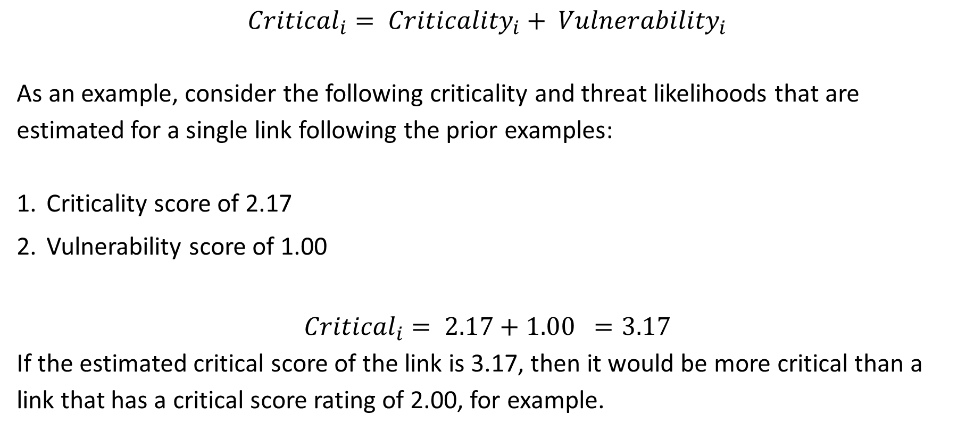
Combined Criticality and Vulnerability
$${{Critical}_{i}= Criticality}_{i}+ {Vulnerability}_{i}$$
As an example, consider the following criticality and threat likelihoods that are estimated for a single link following the prior examples:
Criticality score of 2.17
Vulnerability score of 1.00
$${Critical}_{i}= 2.17+1.00 =3.17$$
If the estimated critical score of the link is 3.17, then it would be more critical than a link that has a critical score rating of 2.00, for example.

Slide 17
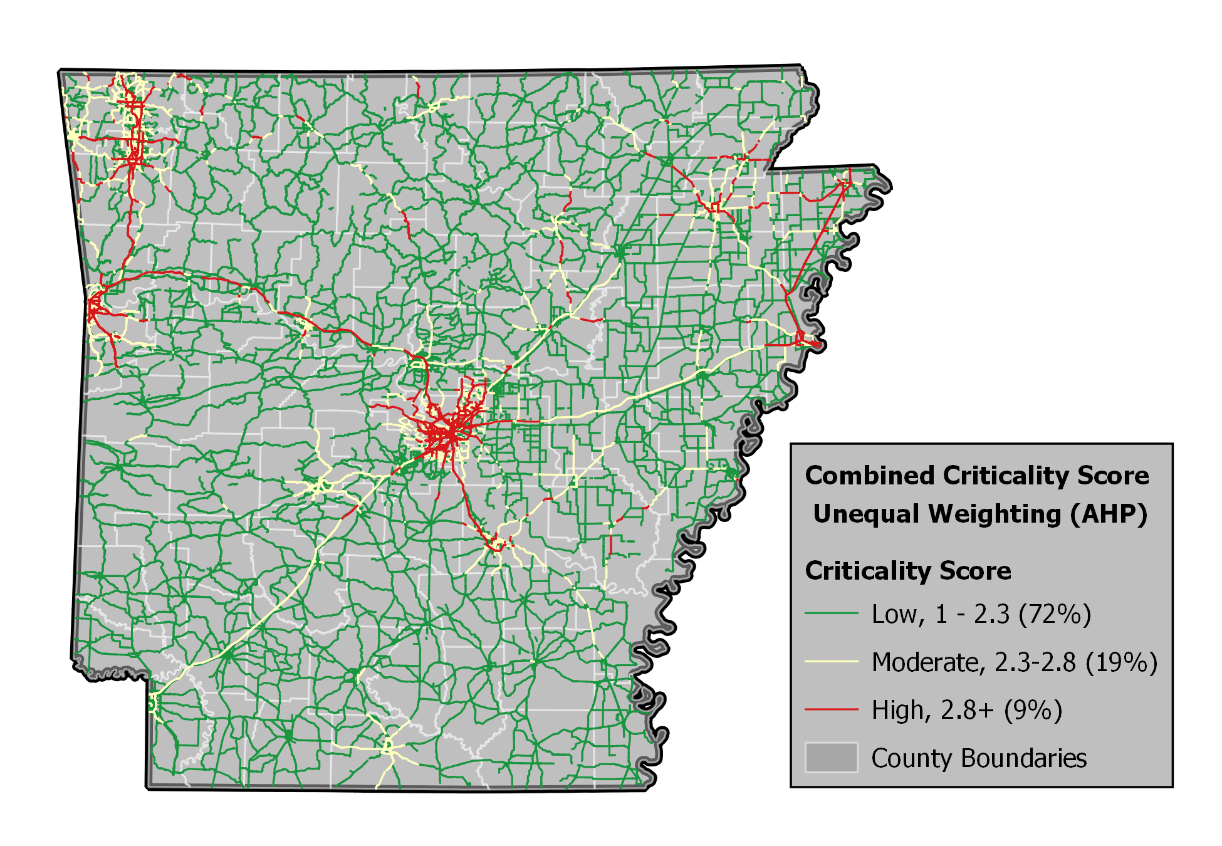
Criticality Score: Statewide Application
Top 5 Sites
US 67/167 from AR 440 to South Redmond Road, Pulaski County, score: 4.401
Garrison Avenue, Sebastian County, score: 4.315
I-55 from US 70 to the I-55 Memphis-Arkansas Bridge, Crittenden County, score: 4.225
I-430 from S. Shackleford Road to Stagecoach Road and from the I-40 to Crystal Hill Road (AR 100) interchange, Pulaski County, score: 4.214
I-40 from Crystal Hill Road to West Military Drive, Pulaski County, score: 4.214

Slide 18
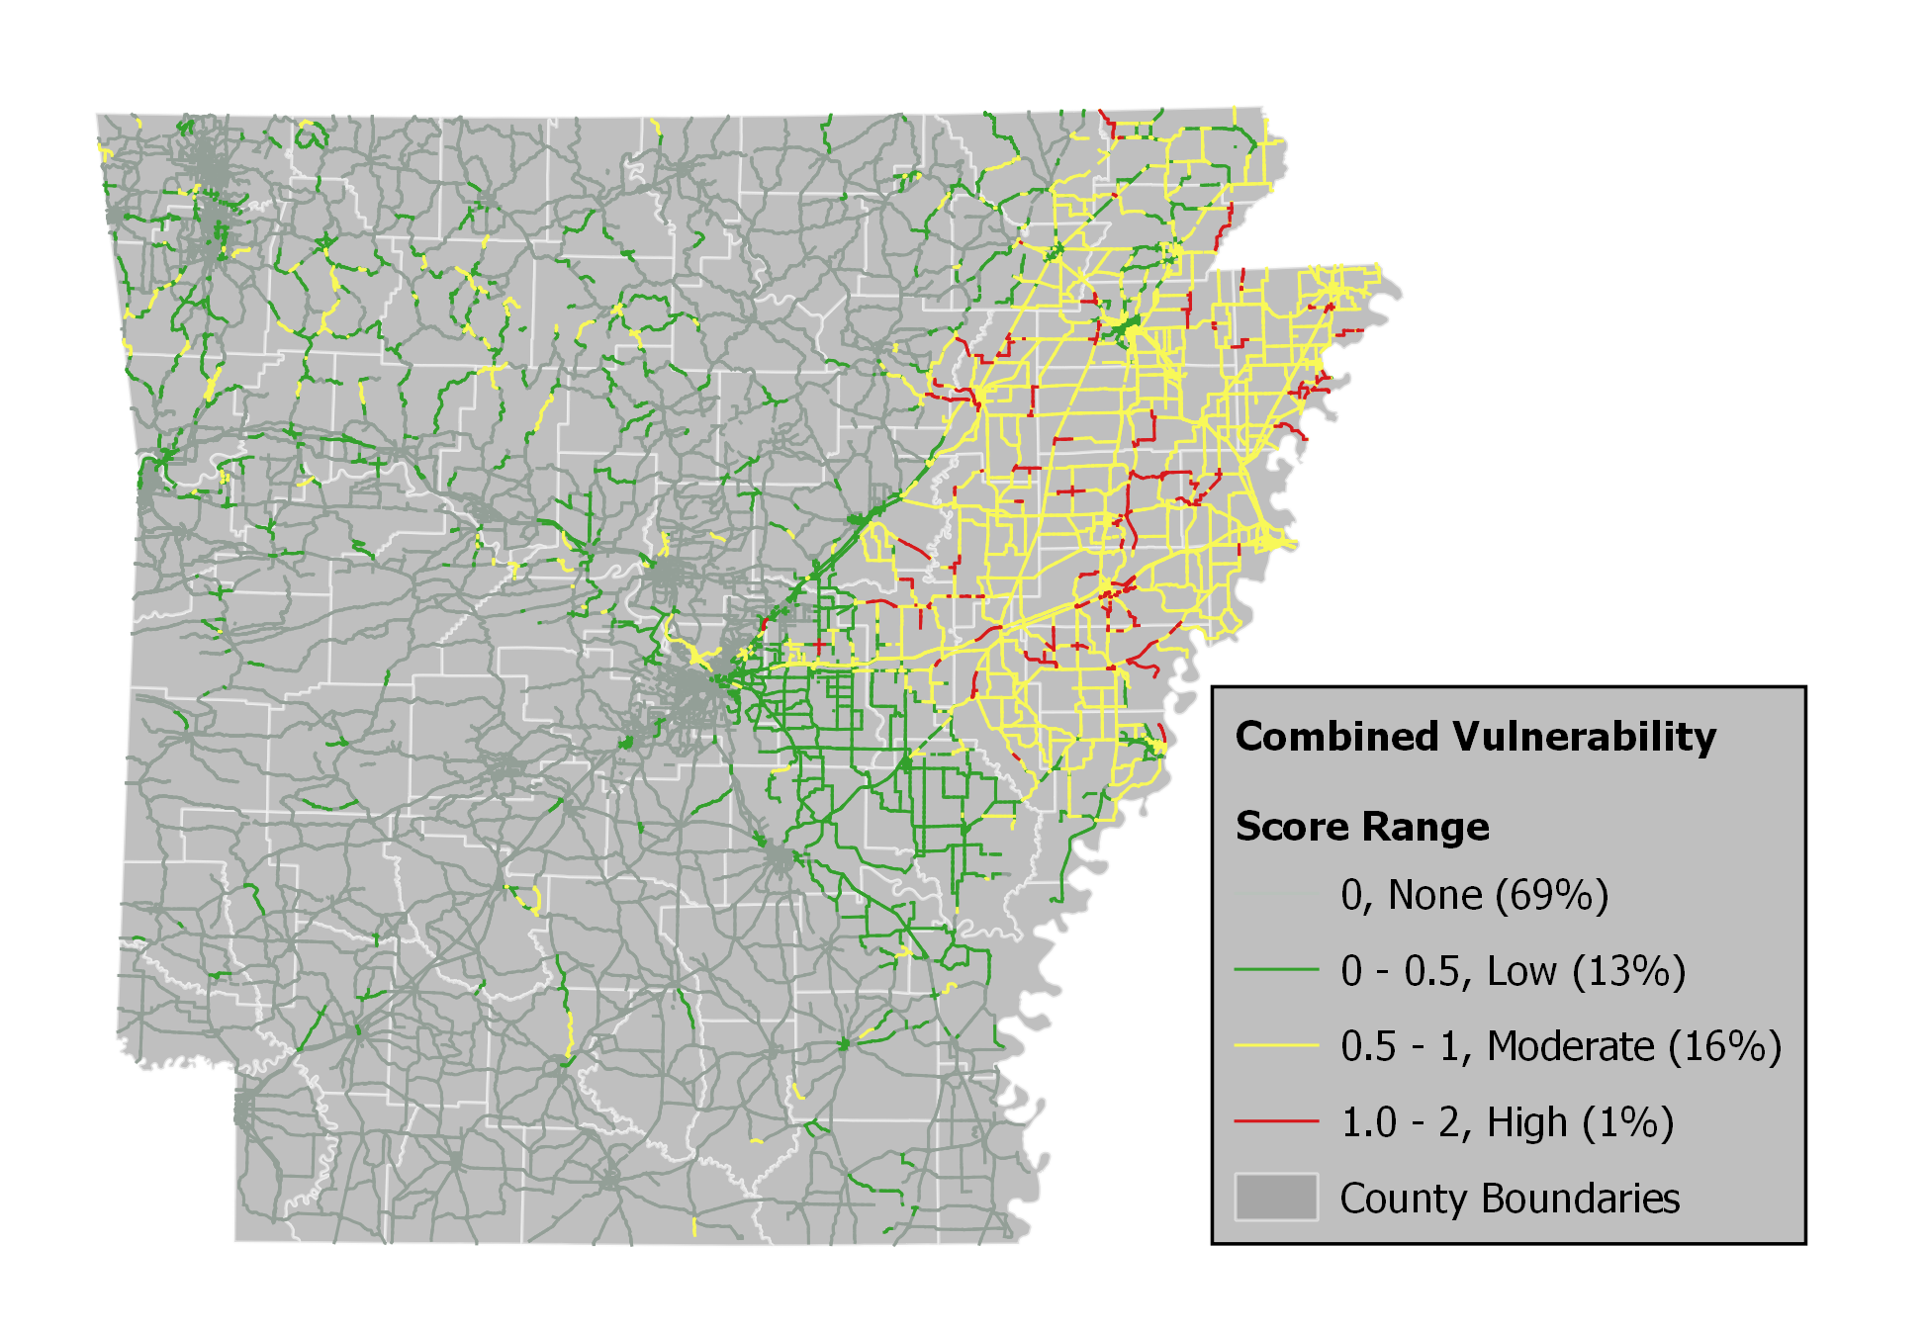
Vulnerability Score: Statewide Application
Roadway Class | Avg. Vulnerability Score
1: Major Collectors | 0.21
2: Minor Arterials | 0.20
3: Principal Arterials | 0.17
4: Freeway/Expressway | 0.32
5: Interstates | 0.29
Statewide Average | 0.20

Slide 19
Combined Criticality and Vulnerability

Slide 20
Top 5 Sites: Criticality + Vulnerability
Top 5 Sites
Highway 67: Pulaski County
(20 links, 9.58 miles)
Interstate 55 (Highway 64): Crittenden County
(8 links, 1.68 miles)
Interstate 40: Crittenden County
(12 links, 5.2 miles)
Interstate 430: Pulaski County
(6 links, 1.78 miles)
Interstate 55 (Highway 63): Crittenden County
(3 links, 3.1 miles)

Slide 21
3. Case Study Applications
Step 1: Threat Data Collection
Threat Data Source
Threat Likelihood
Step 5: Vulnerability Assessment
Threat-Asset Pair Vulnerability
Step 2: Asset Data Collection
Asset Data Needs
Step 6: Risk Assessment
Annual Owner Risk Calculation
Annual User Risk Calculation
Total Annual Total Risk
Step 3: Owner Consequence Calculation
Owner Worst Reasonable Case (WRC) for
Threat-Asset Pair
Step 4: User Consequence Calculation
User Worst Reasonable Case (WRC) for
Threat-Asset Pair
Vehicle Operating Cost (VOC) and
Lost of Wages (LW)
Step 7: Economic Analysis for Risk Management
Risk Assessment (existing asset)
Mitigation Identification
Economic Analysis

Slide 22
Case Study Summaries
Site | Segment Length | County | Threat | Asset
Hwy 67 | 9.6 miles | Pulaski | Flood | Culvert, Bridge
I-430 | 1.8 miles | Pulaski | Flood | Bridge
I-40 | 5.2 miles | Crittenden | Earthquake | Bridge
I-55 (Hwy 63) | 3.1 miles | Crittenden | Earthquake | Bridge
I-55 (Hwy 64) | 1.7 miles | Crittenden | Earthquake | Bridge

Slide 23
Mitigation Alternatives: Total Risk for Asset
Larger culvert
Cross culverts
Cross culverts
Seismic retrofit
Seismic retrofit
Seismic retrofit

Slide 24
Mitigation Alternatives:
Annual Mitigation Cost and Benefit

Slide 25
B/C Ratios

Slide 26
4. Spreadsheet Tool
Provides template and example calculations for threat-asset pairs found in AR:
  flood-culvert
  flood-bridge
  earthquake-bridge
Input data (right) gathered from ARDOT and National Bridge Inventory sources

Slide 27
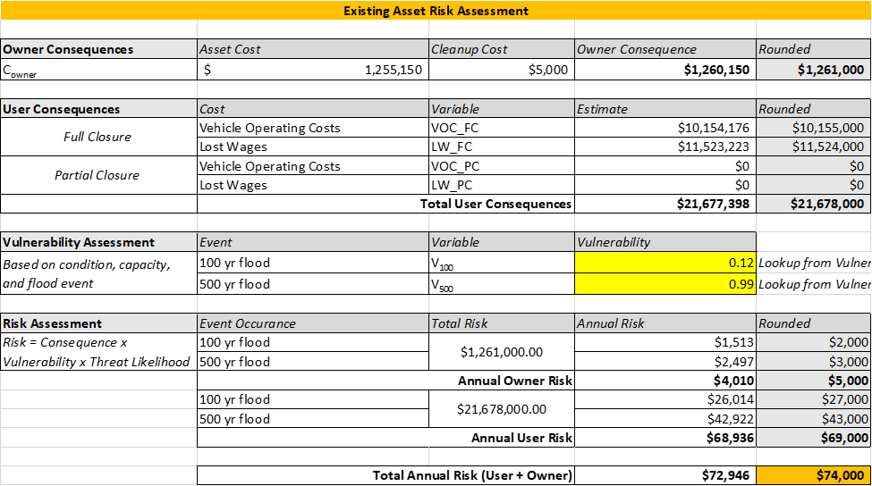
Spreadsheet Calculations: Owner, User, and Risk
Monetized estimates for:
  Owner (ARDOT) consequence
  User (drivers) consequence
  Risk (vulnerability)

Slide 28
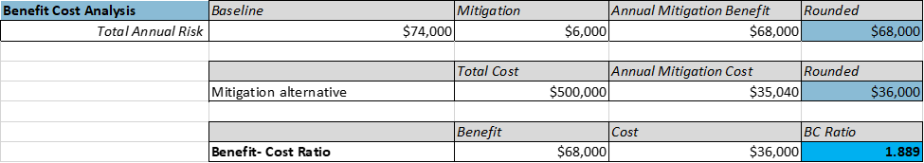
Spreadsheet Output: B/C Ratios
Inputs to B/C populated from data input table
Annualized costs
B/C ratio

Slide 29
Conclusions
Methodological contributions
  Statewide assessment
  Redundancy based on network topology and use following the TransCAD AR STDM model
  Weighted ranking of criteria
Key Findings
  Crittenden, Mississippi, and Craighead counties ranked highest in combined criticality and vulnerability
  Interstates have highest combined criticality and vulnerability
  B/C analyses for five study sites range between XX and XX

Slide 30
Files and Data Provided with Implementation Report
BaseNetwork (folder)- contains the .shp files representing the Arkansas roadway network.
Criticality Values and Scores (.xls)- contains the criticality values and scores for the six criticality metrics for each roadway segment.
Vulnerability Values and Scores (.xls)- contains the vulnerability values and scores for the three threat types evaluated in this project for each roadway segment.
NBI Arkansas Data (.xls)- contains the bridge and culvert characteristics and conditions data extracted from the National Bridge Inventory database.
StateOwnedReplacementCosts (.xls)- contains the ARDOT owned and operated bridge and culvert inventory including estimated replacement costs.
BC Analysis for Study Sites (.xls)- contains the templates for conducting a BC analysis for a study site.
Redundancy Code (.7zip compressed file) – contains the code for performing network assignment using Python scripting and the AequilibraE models.

Slide 31
Questions?
Sarah Hernandez, PhD, PE
sarahvh@uark.edu

