Slide 1
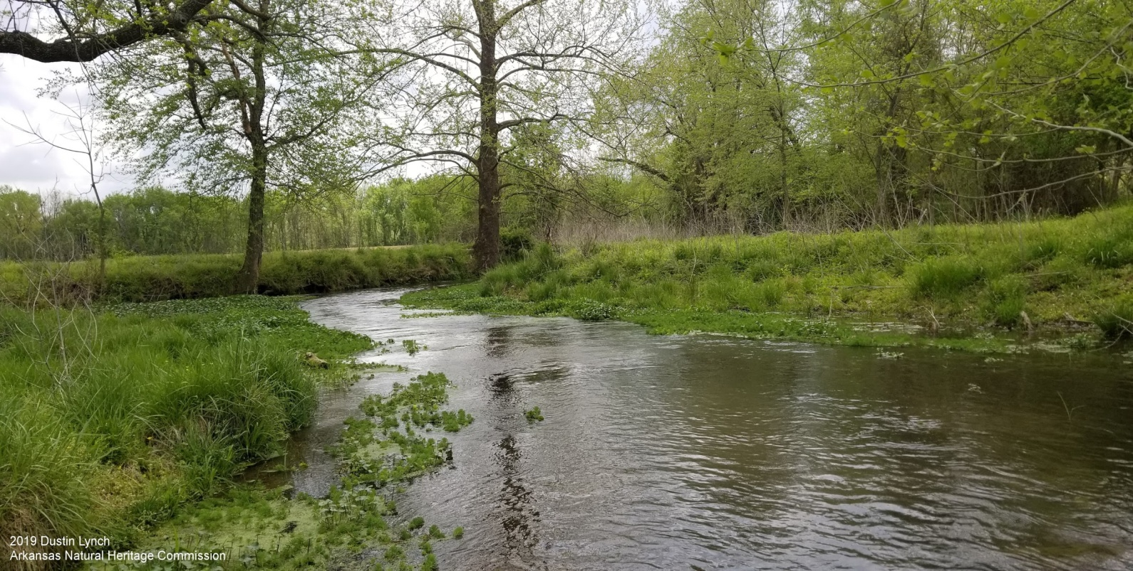
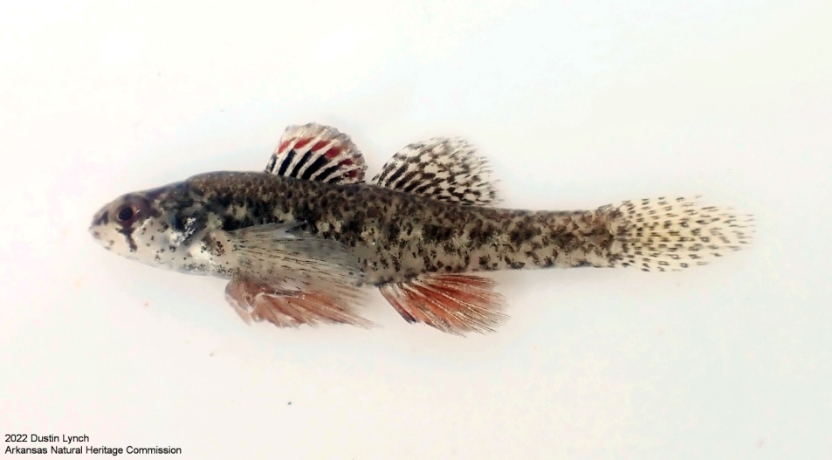
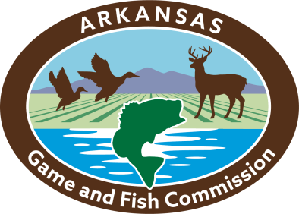
Healing Springs Natural Area: Rare Fish Species Drive Acquisition of a Natural Area in a Rapidly Urbanizing Landscape
Dustin Lynch¹
ANHC Aquatic Ecologist
www.arkansasheritage.com
Kayti Ewing²
Justin Stroman³
Brian Wagner³
Mike Slay⁴
Theo Witsell¹
2 Arkansas Department of Transportation
3 Arkansas Game and Fish Commission
4 The Nature Conservancy in Arkansas

Slide 2
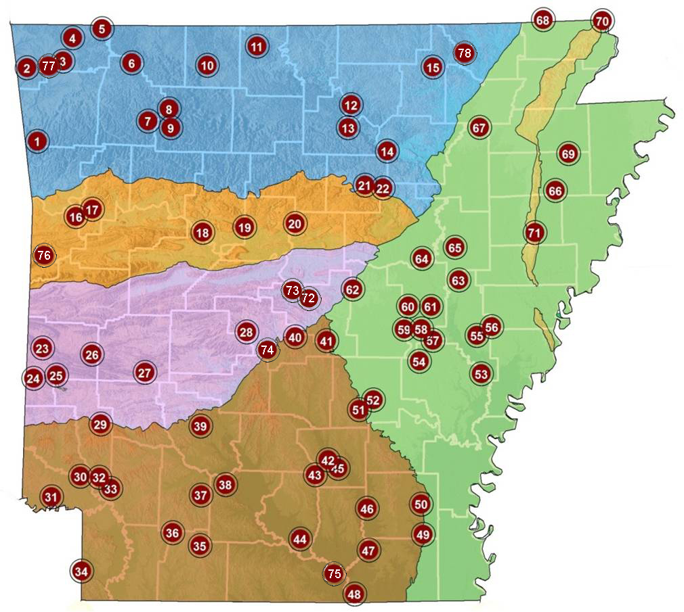
System of Natural Areas
79 Natural Areas
>74,000 acres
All ecoregions
Best of the last remaining vestiges of the state's natural communities
Managed to conserve rare species and to preserve and restore rare natural communities

Slide 3
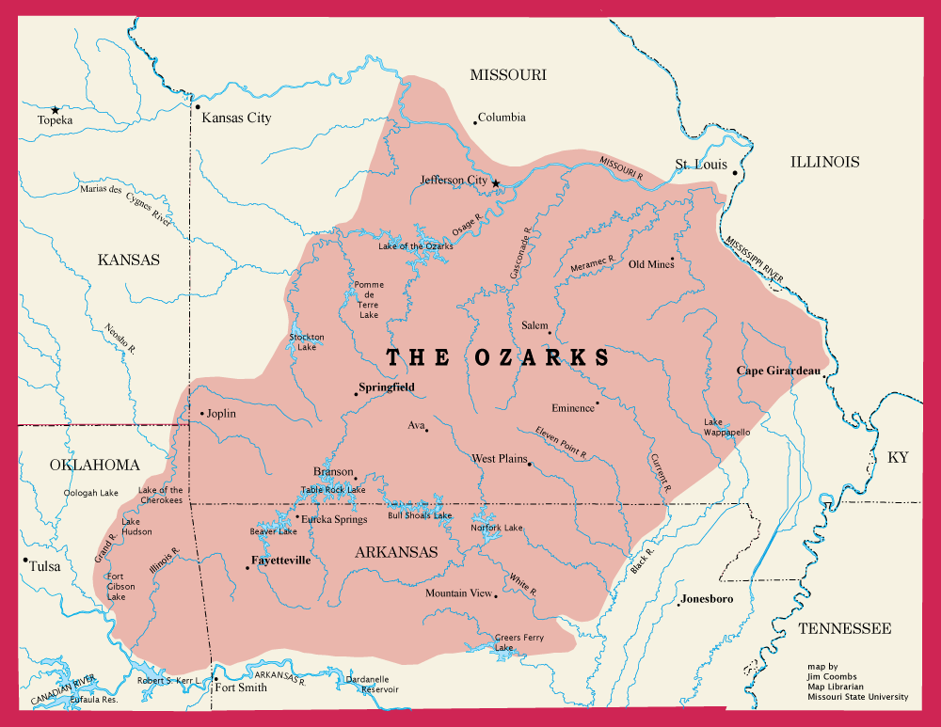
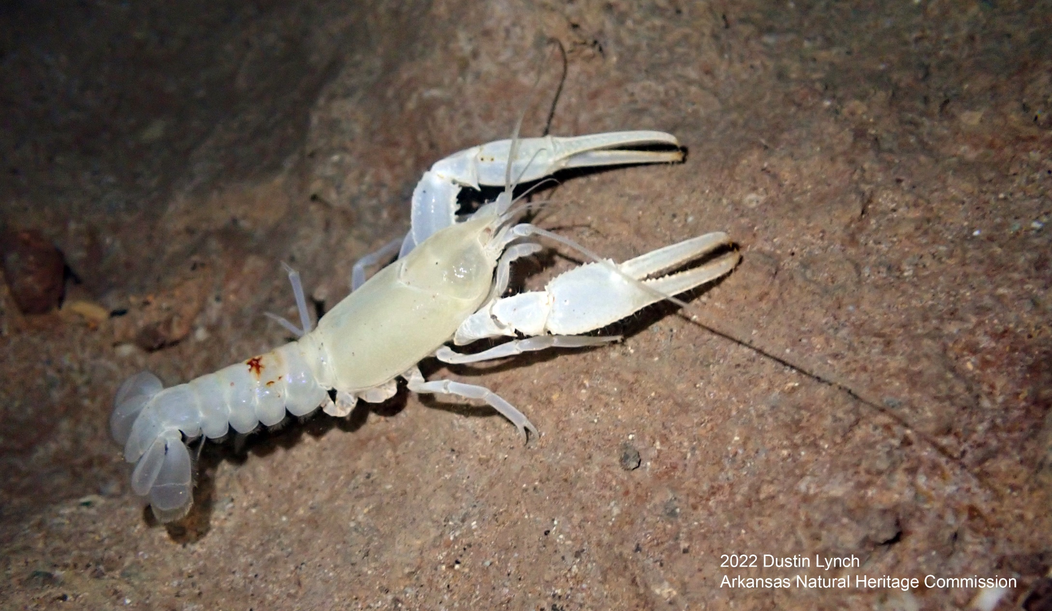
The Ozark Highlands: Biodiversity and Endemism
Level III Ecoregion
Eleven Level IV Ecoregions
Crucial center of biodiversity and endemism, terrestrial and aquatic
~200 species mostly restricted to the Ozarks
~160 of those true endemics
Benton County Cave Crayfish (Cambarus aculabrum)

Slide 4
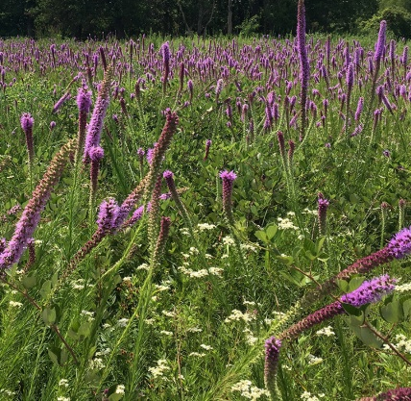
Prairie Ecosystems in the Ozark Highlands
70,000+ acres of treeless prairie mapped in the GLO Survey (early 1800s)
Historically an even larger area of savanna and open woodland
Critically imperiled today
Rich in rare biodiversity and a top conservation priority
Historical Prairie (GLO Plats)
Searles Prairie Natural Area
Darrell Bowman

Slide 5
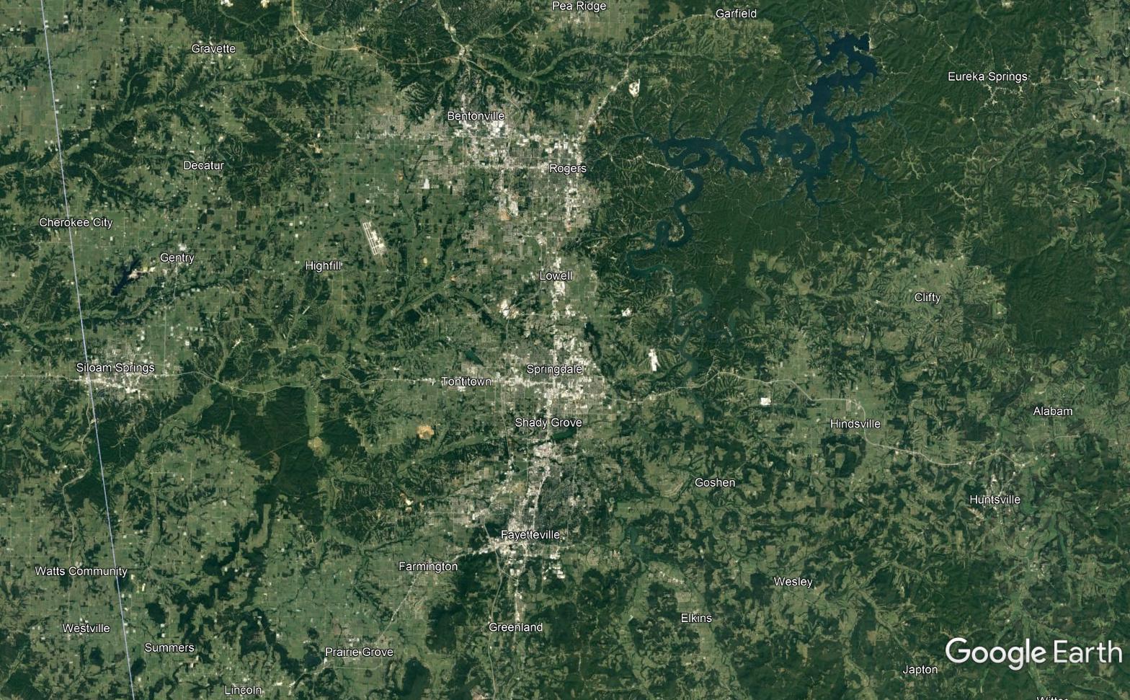
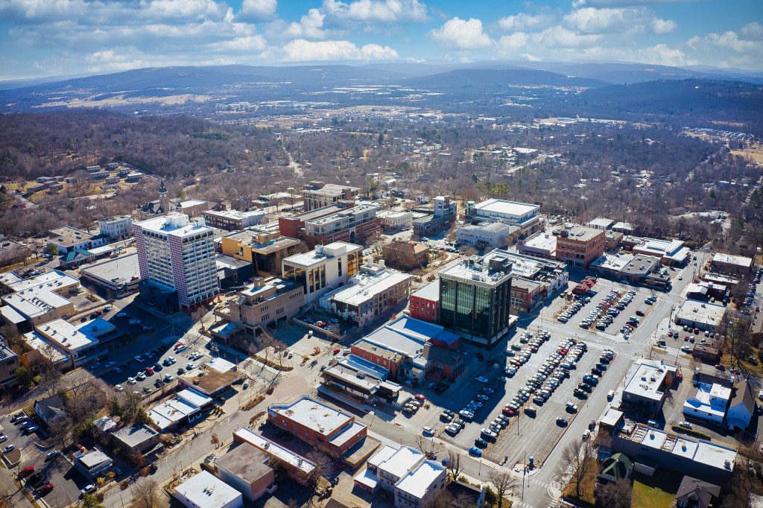
Rapid Urbanization in Northwest Arkansas
Fayetteville-Springdale-Rogers Metropolitan Statistical Area (NWA)
3,213 square-miles
Population: ~560,700
31st fastest growing
11,100 people last year
Double by 2045

Slide 6
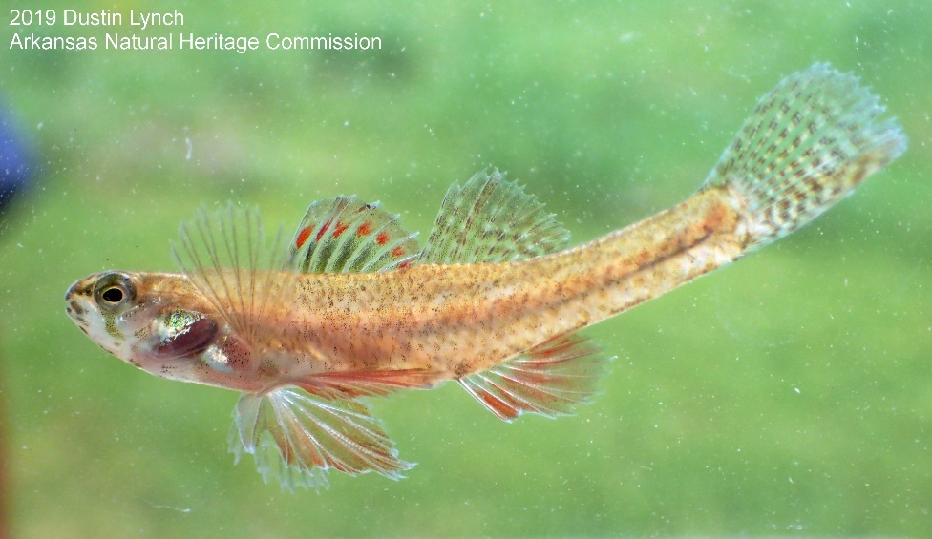
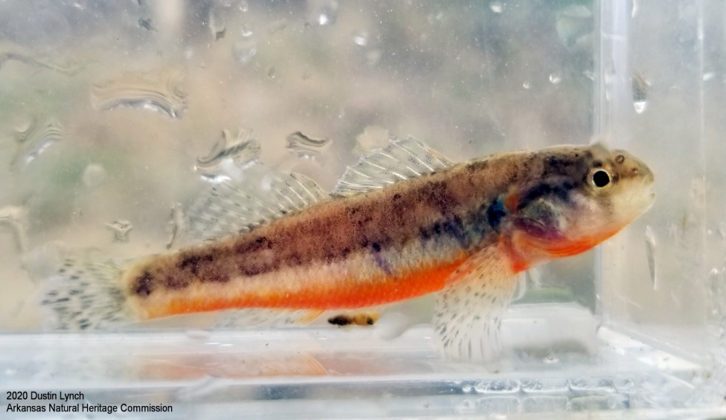
Least Darter and Arkansas Darter
Two fish species drove acquisition of the Arkansas Natural Heritage Commission’s Healing Springs Natural Area
Least Darter (Etheostoma microperca)
Arkansas Darter (Etheostoma cragini)
Two of the rarest fish species in Arkansas
All sites in or near NWA metro area
Very specific habitat requirements
Least Darter (Etheostoma microperca)
Arkansas Darter (Etheostoma cragini)

Slide 7
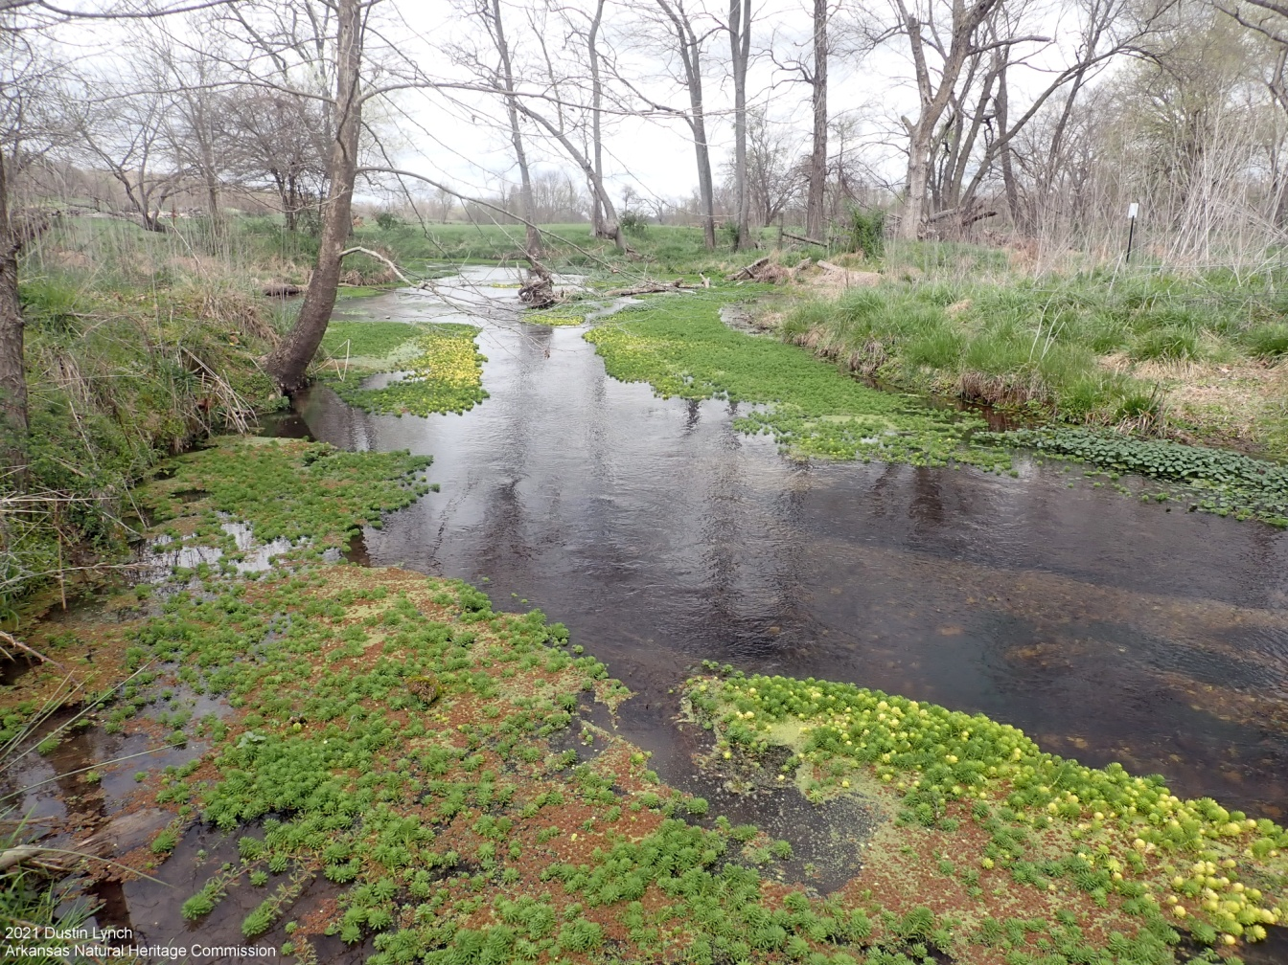
Little Darters on the Prairie?
Arkansas and Least Darters require:
Open canopy
<25% wooded shoreline
Dense aquatic vegetation
Fine substrate
Cold, spring-influenced water
Permanent flow, but not too fast
In AR, strictly found in Illinois River watershed on the Springfield Plateau of the Ozark Highlands
NW corner of the state

Slide 8
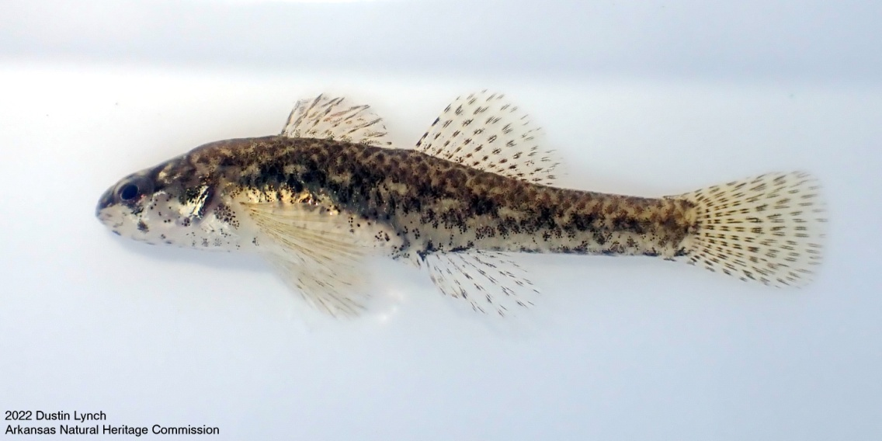
Least Darter (Etheostoma microperca)
Male
Female
Maps: Robison and Buchanan 2020

Slide 9
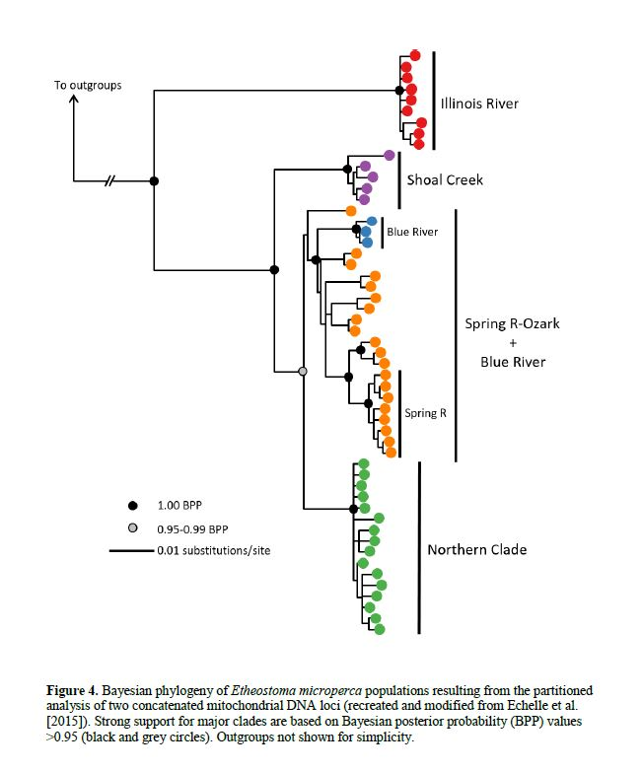
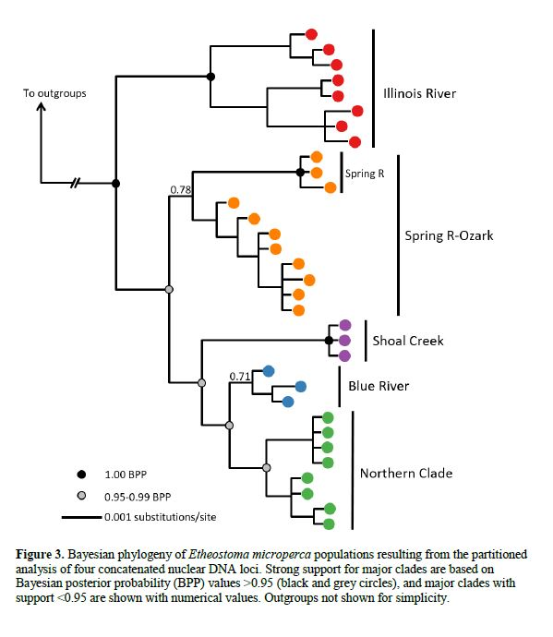
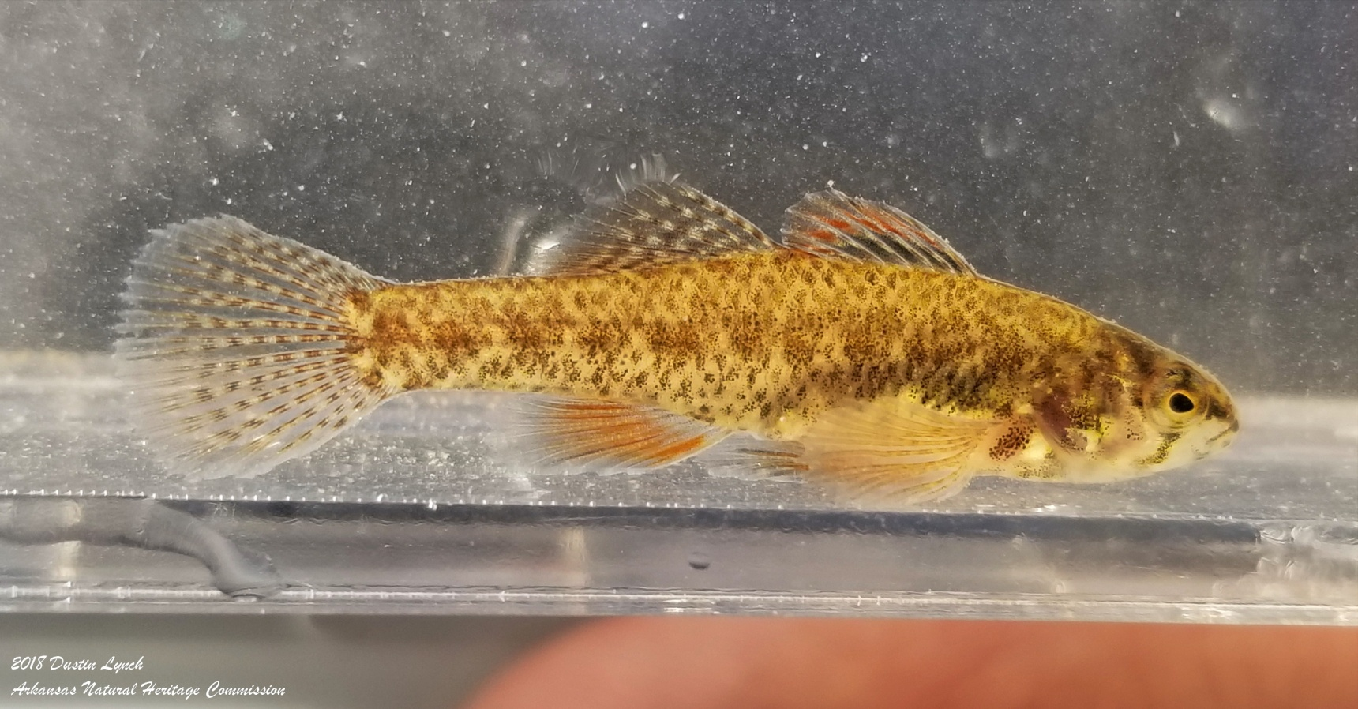
Least Darter (Etheostoma microperca)
NWA Populations represent an undescribed species (Tony Echelle - OSU)
Species description underway (Brook Fluker – ASU)
“Razorback Darter”
Species thought rare in AR but globally secure is really a globally critically imperiled state endemic
Fluker and Mross 2020

Slide 10
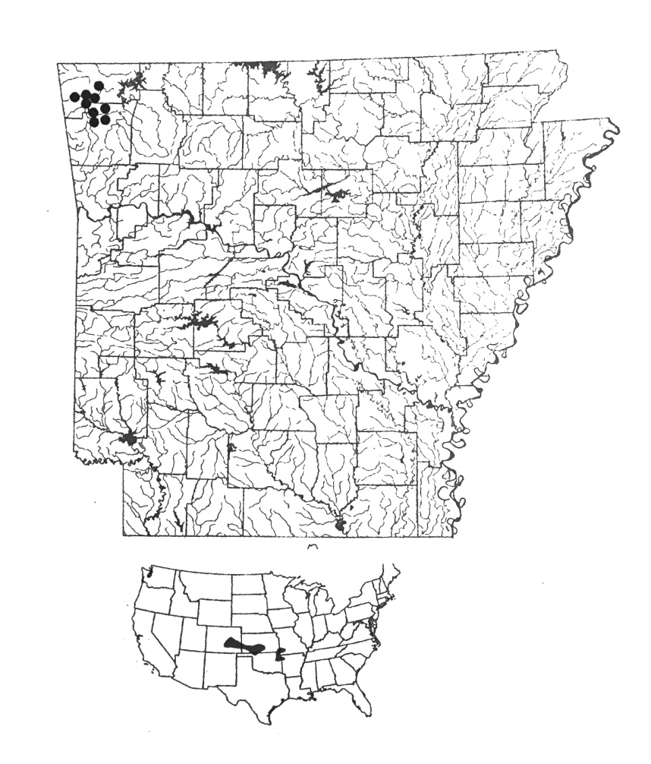
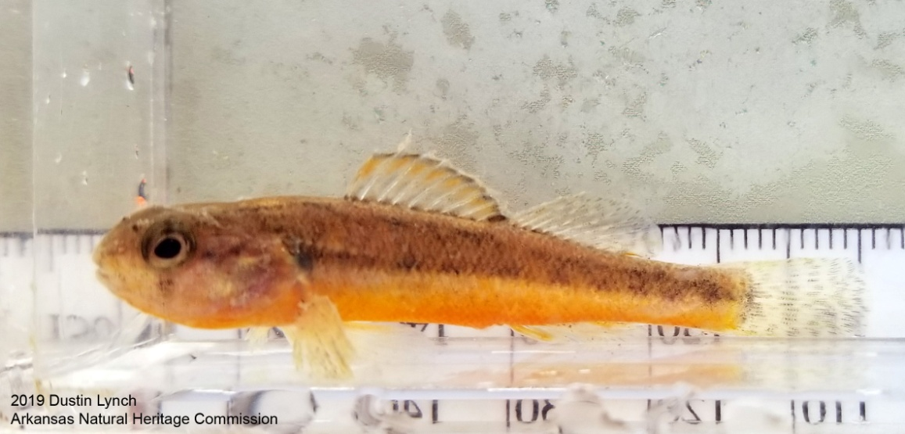
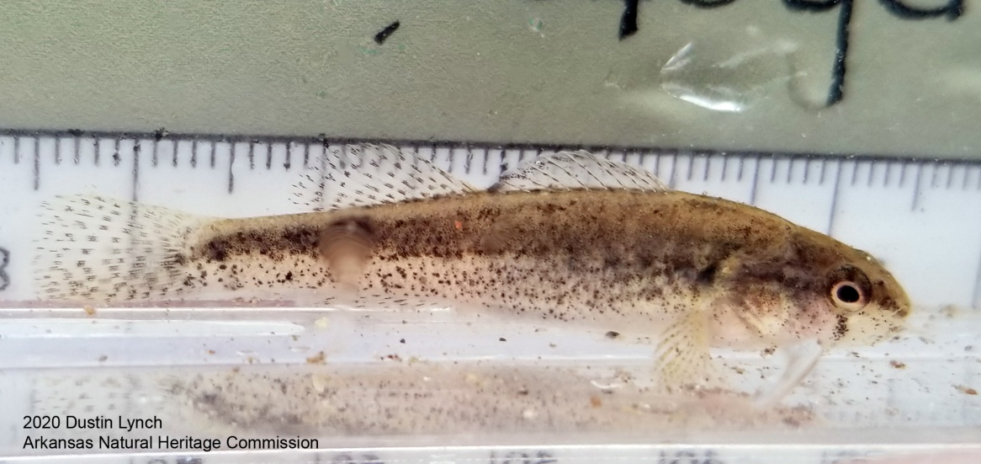
Arkansas Darter (Etheostoma cragini)
Male
Female
Maps: Robison and Buchanan 2020

Slide 11
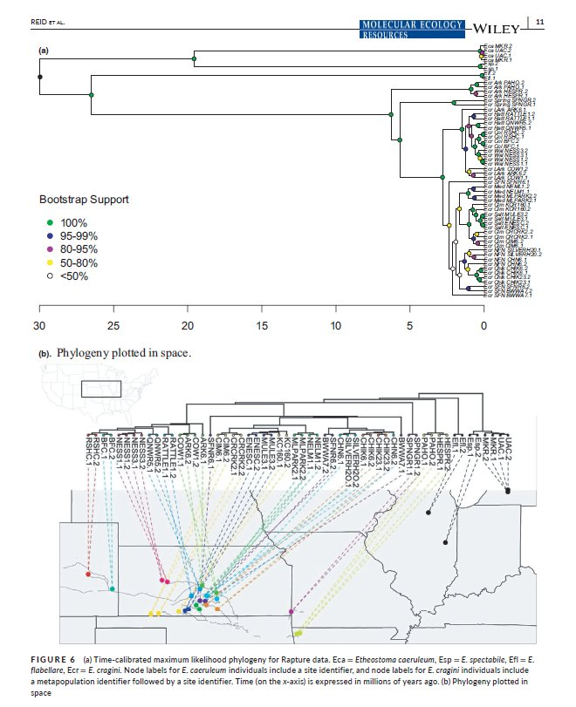
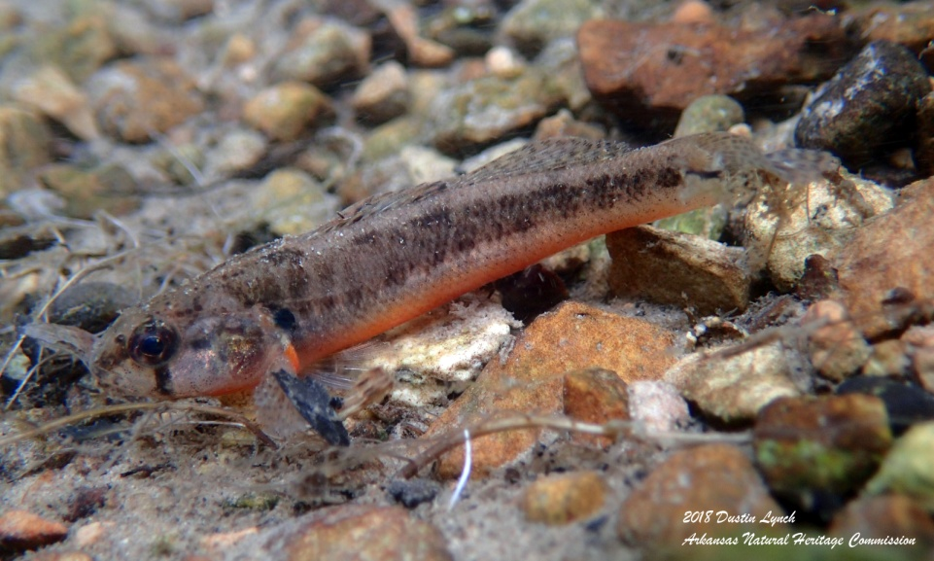
Arkansas Darter (Etheostoma cragini)
Reid et al 2020

Slide 12
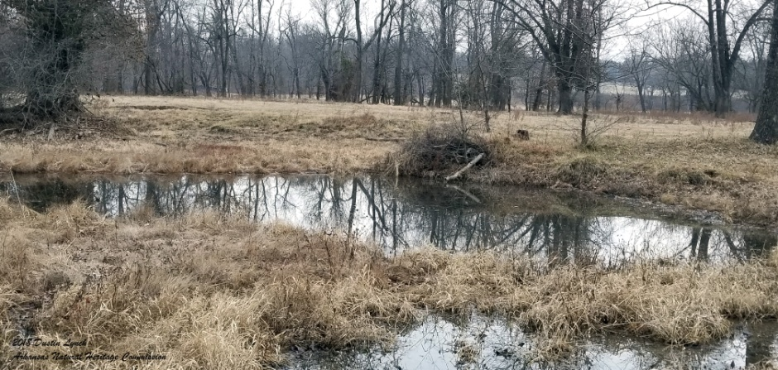
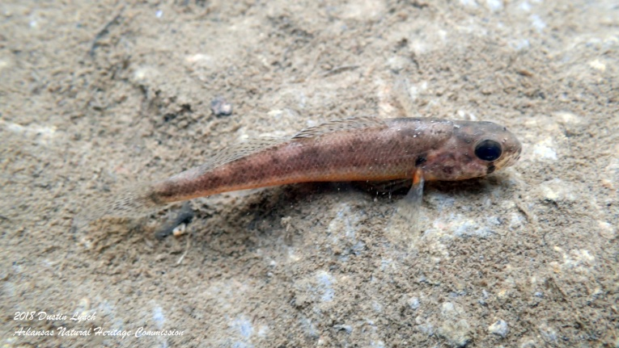
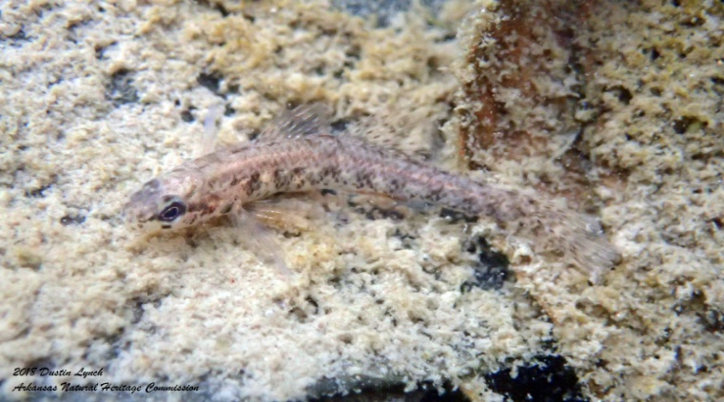
Little Darters on the Prairie?
Relatively few sites in NWA meet these criteria
Only three sites with both species
Isolated from one another
Cow pastures, golf courses, dug-out ponds, etc.

Slide 13
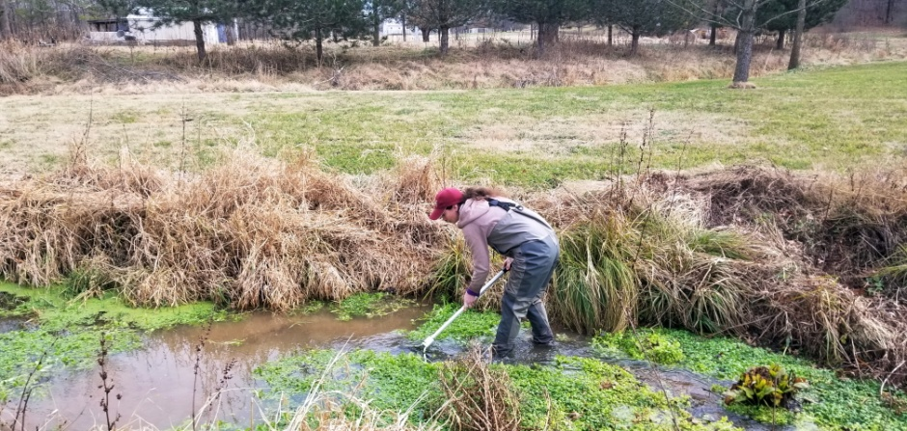
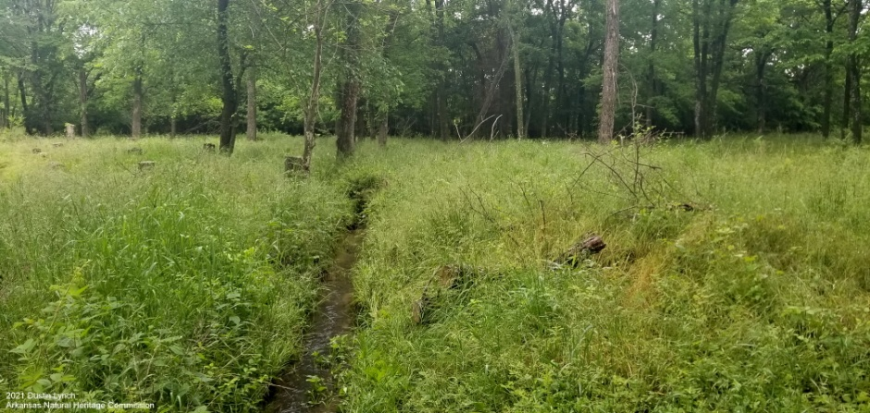
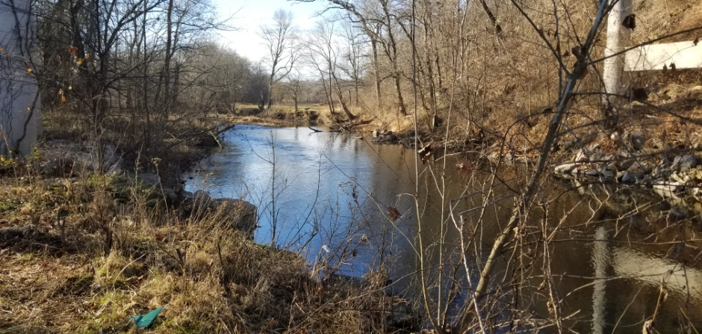
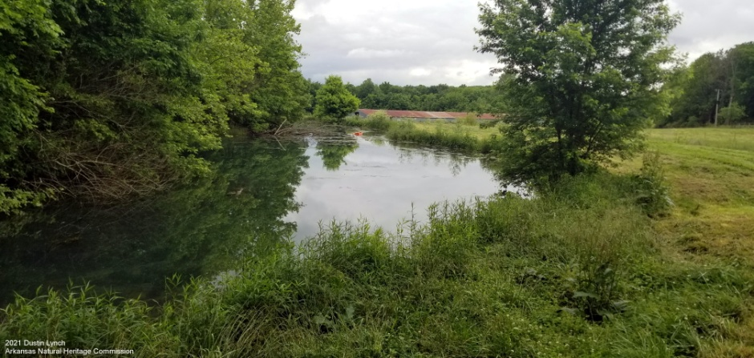
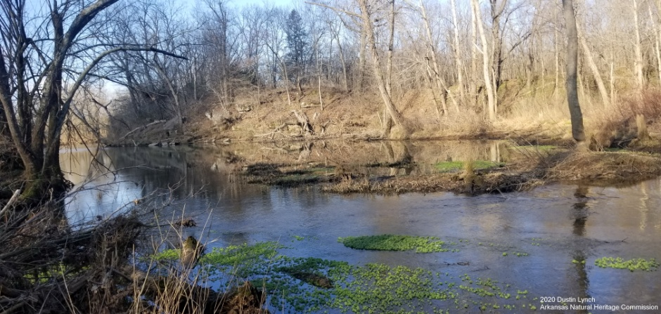
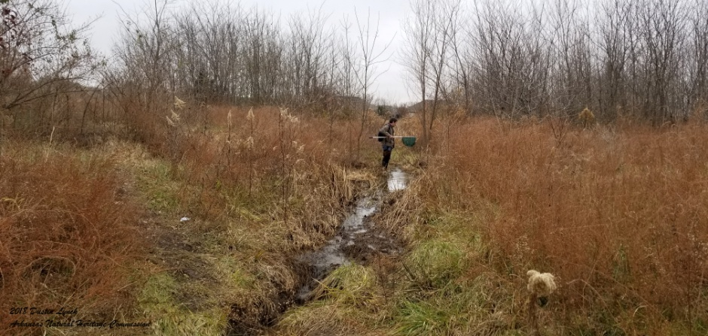
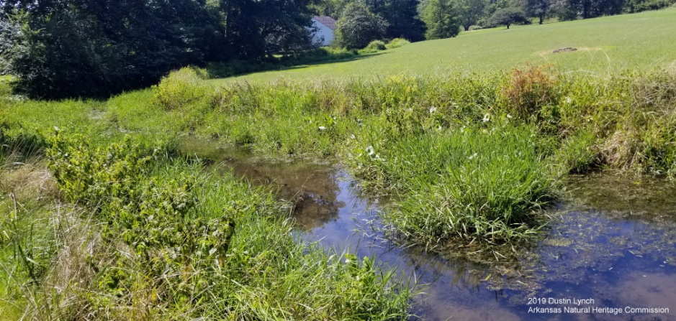
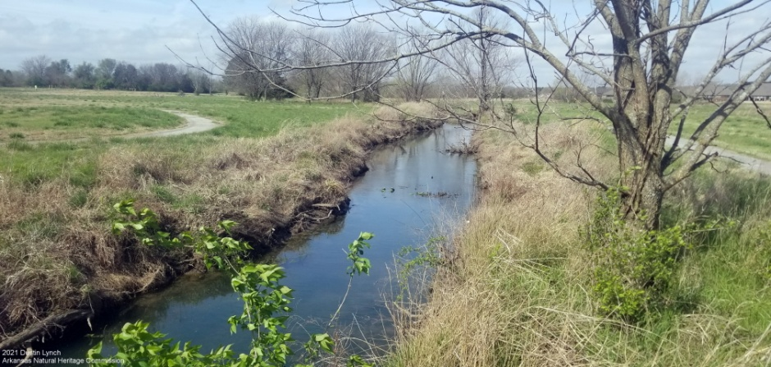
Arkansas and Least Darter Sites

Slide 14
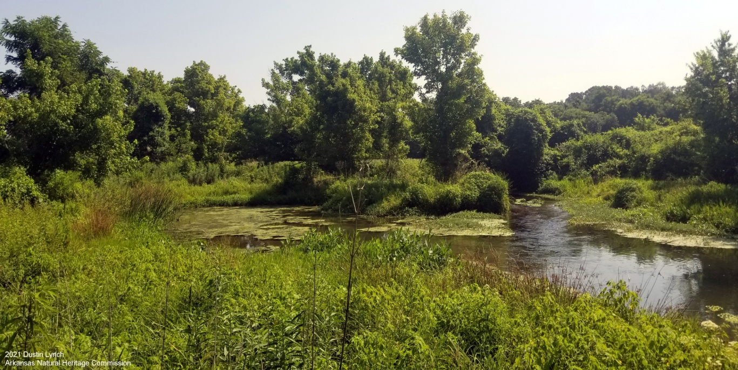
Little Darters on the Prairie?
Healing Springs – the single most important site for both species
Perennial groundwater-fed stream complex formed by two spring outflows
Tributary of Little Osage Creek
Ecologically Sensitive Waterbody (ADEQ)
Focal Watershed (ANHC)
Illinois River watershed (Arkansas River Basin)

Slide 16
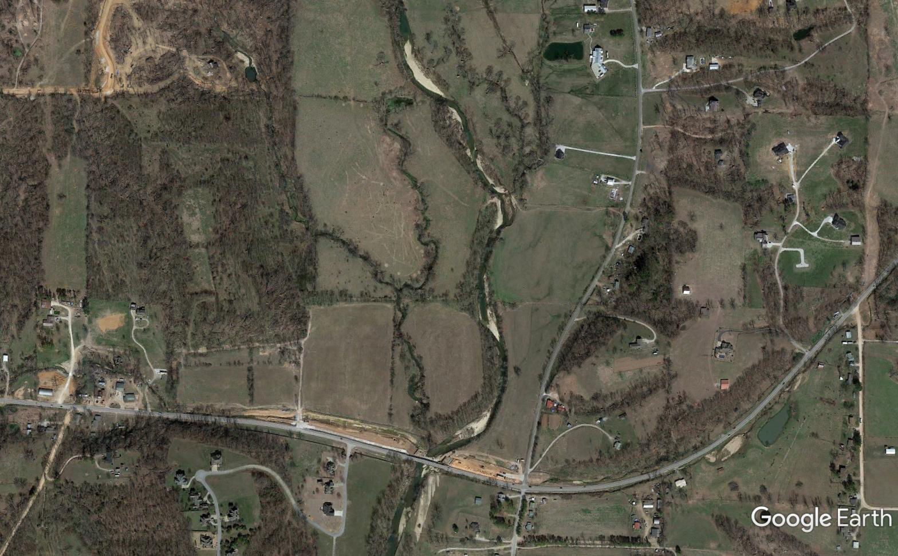
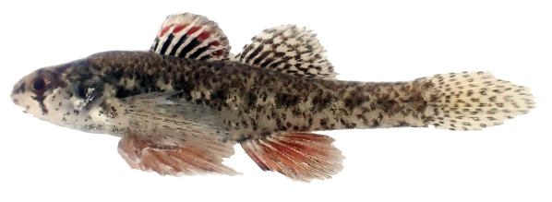
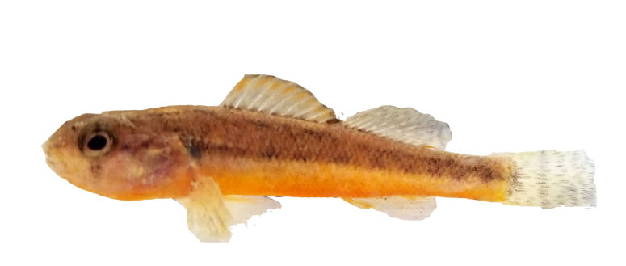
Fulbright Spring
Healing
Spring
Fulbright Branch
~0.87 miles of Least & Arkansas Darter Habitat
Healing Spring Branch
0.48 miles
0.35 miles
Little Osage Creek
0.25 miles

Slide 17
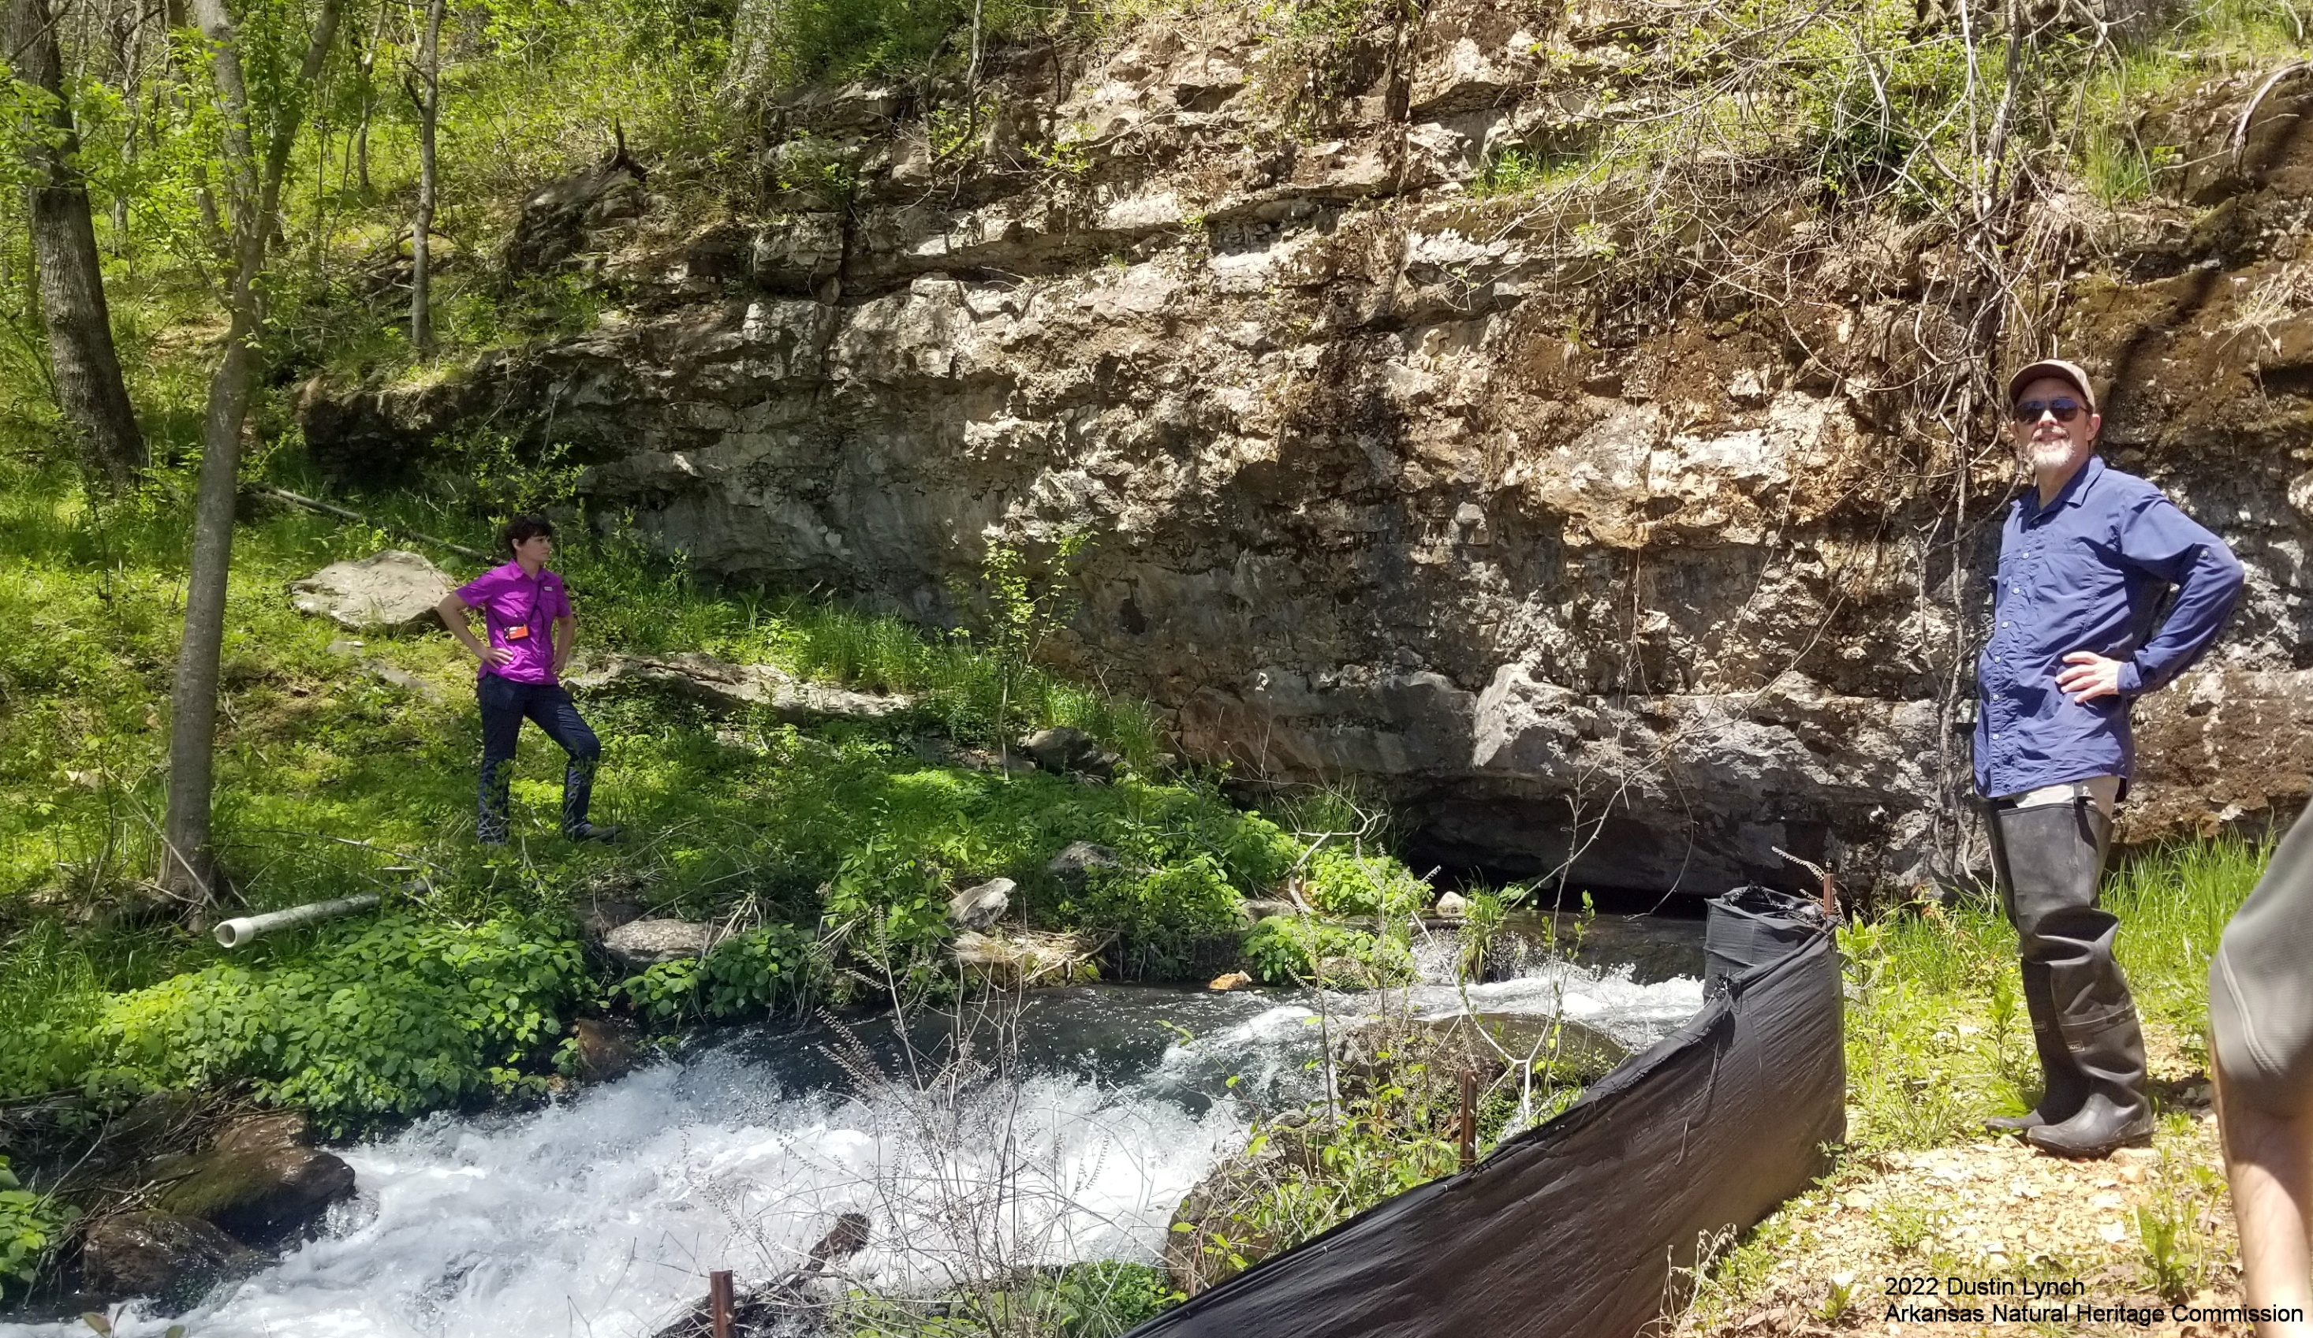

Slide 18
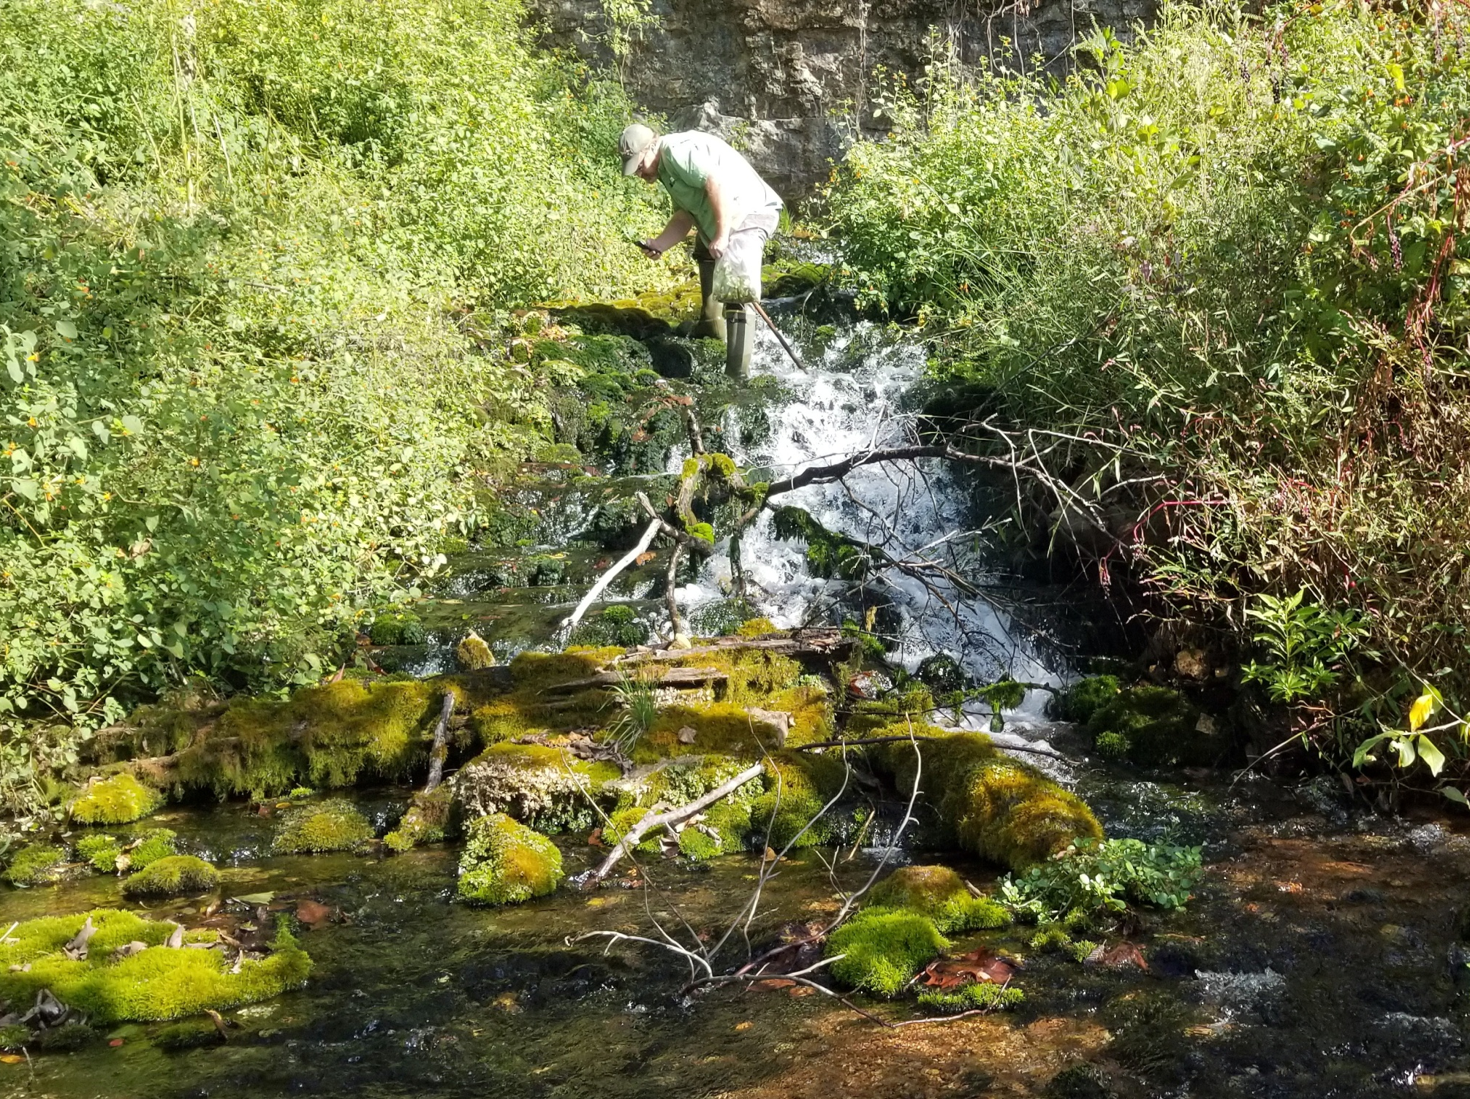
2021 Dustin Lynch
Arkansas Natural Heritage Commission

Slide 19
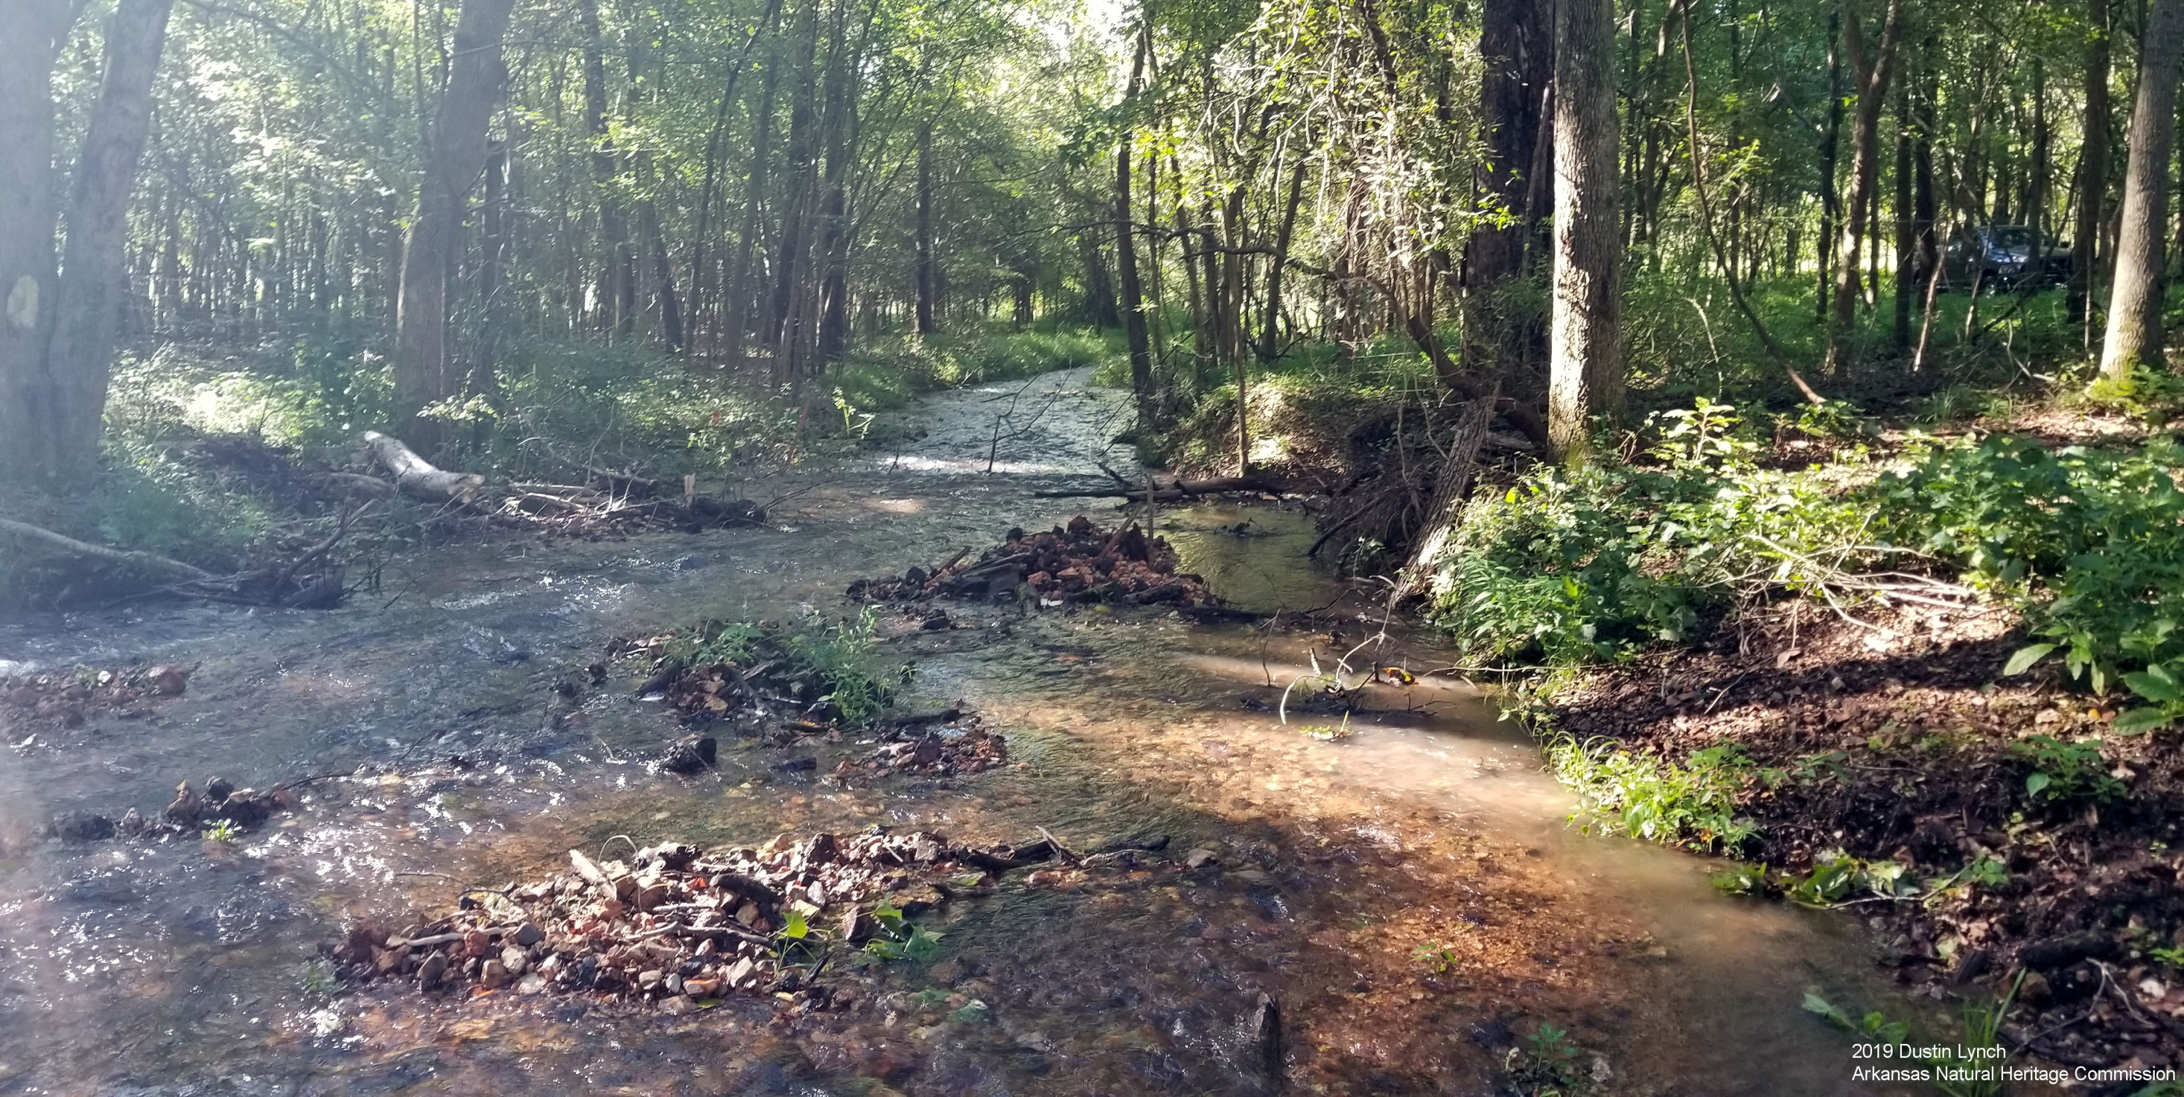
2019 Dustin Lynch
Arkansas Natural Heritage Commission

Slide 20
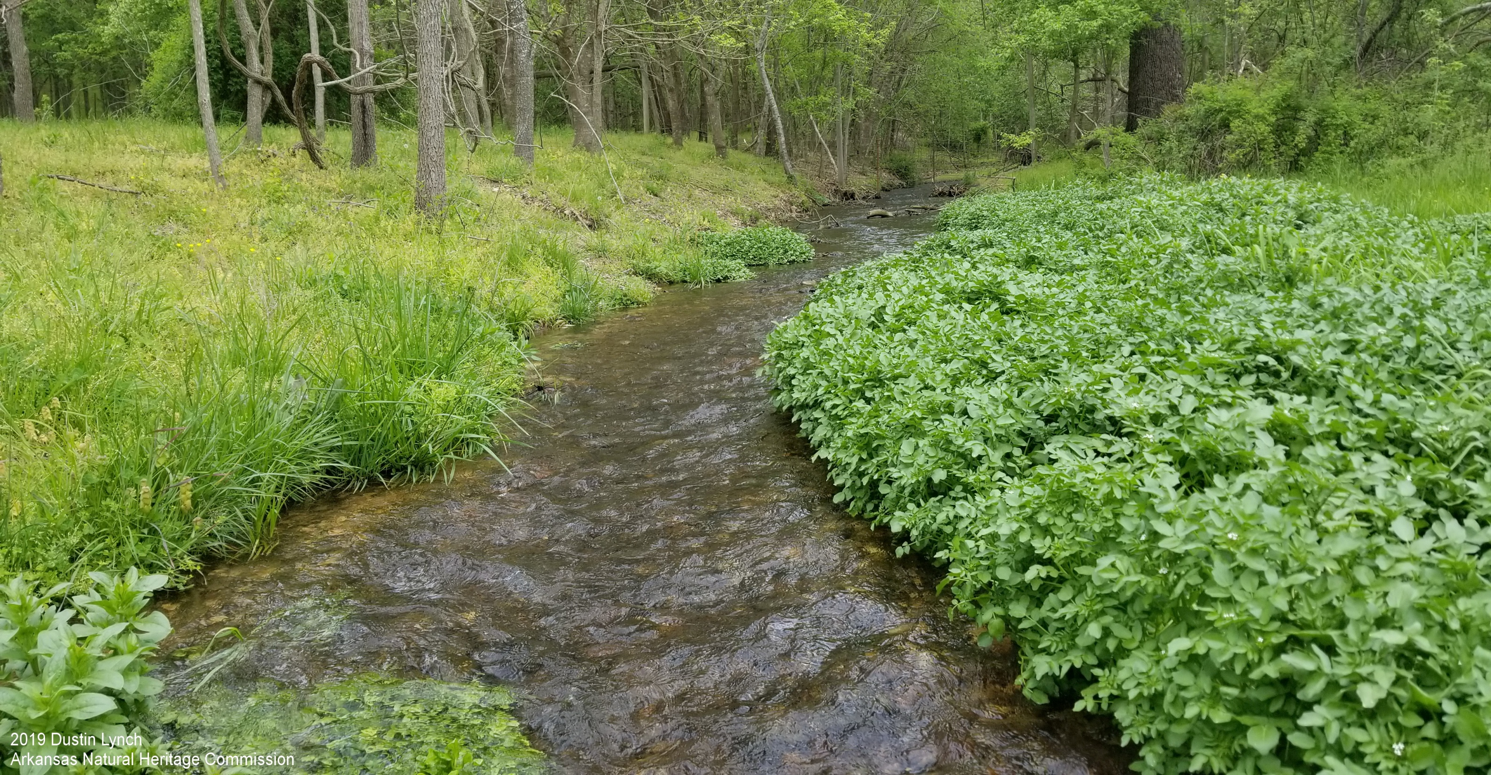
2019 Dustin Lynch
Arkansas Natural Heritage Commission

Slide 21
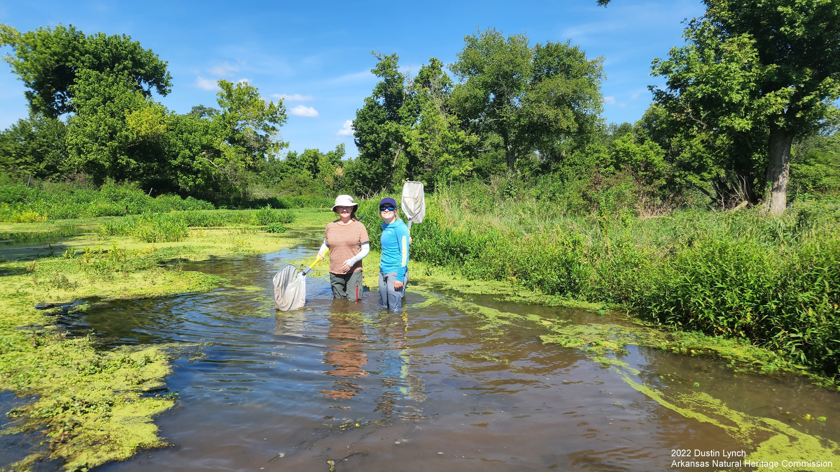
2022 Dustin Lynch
Arkansas Natural Heritage Commission

Slide 22
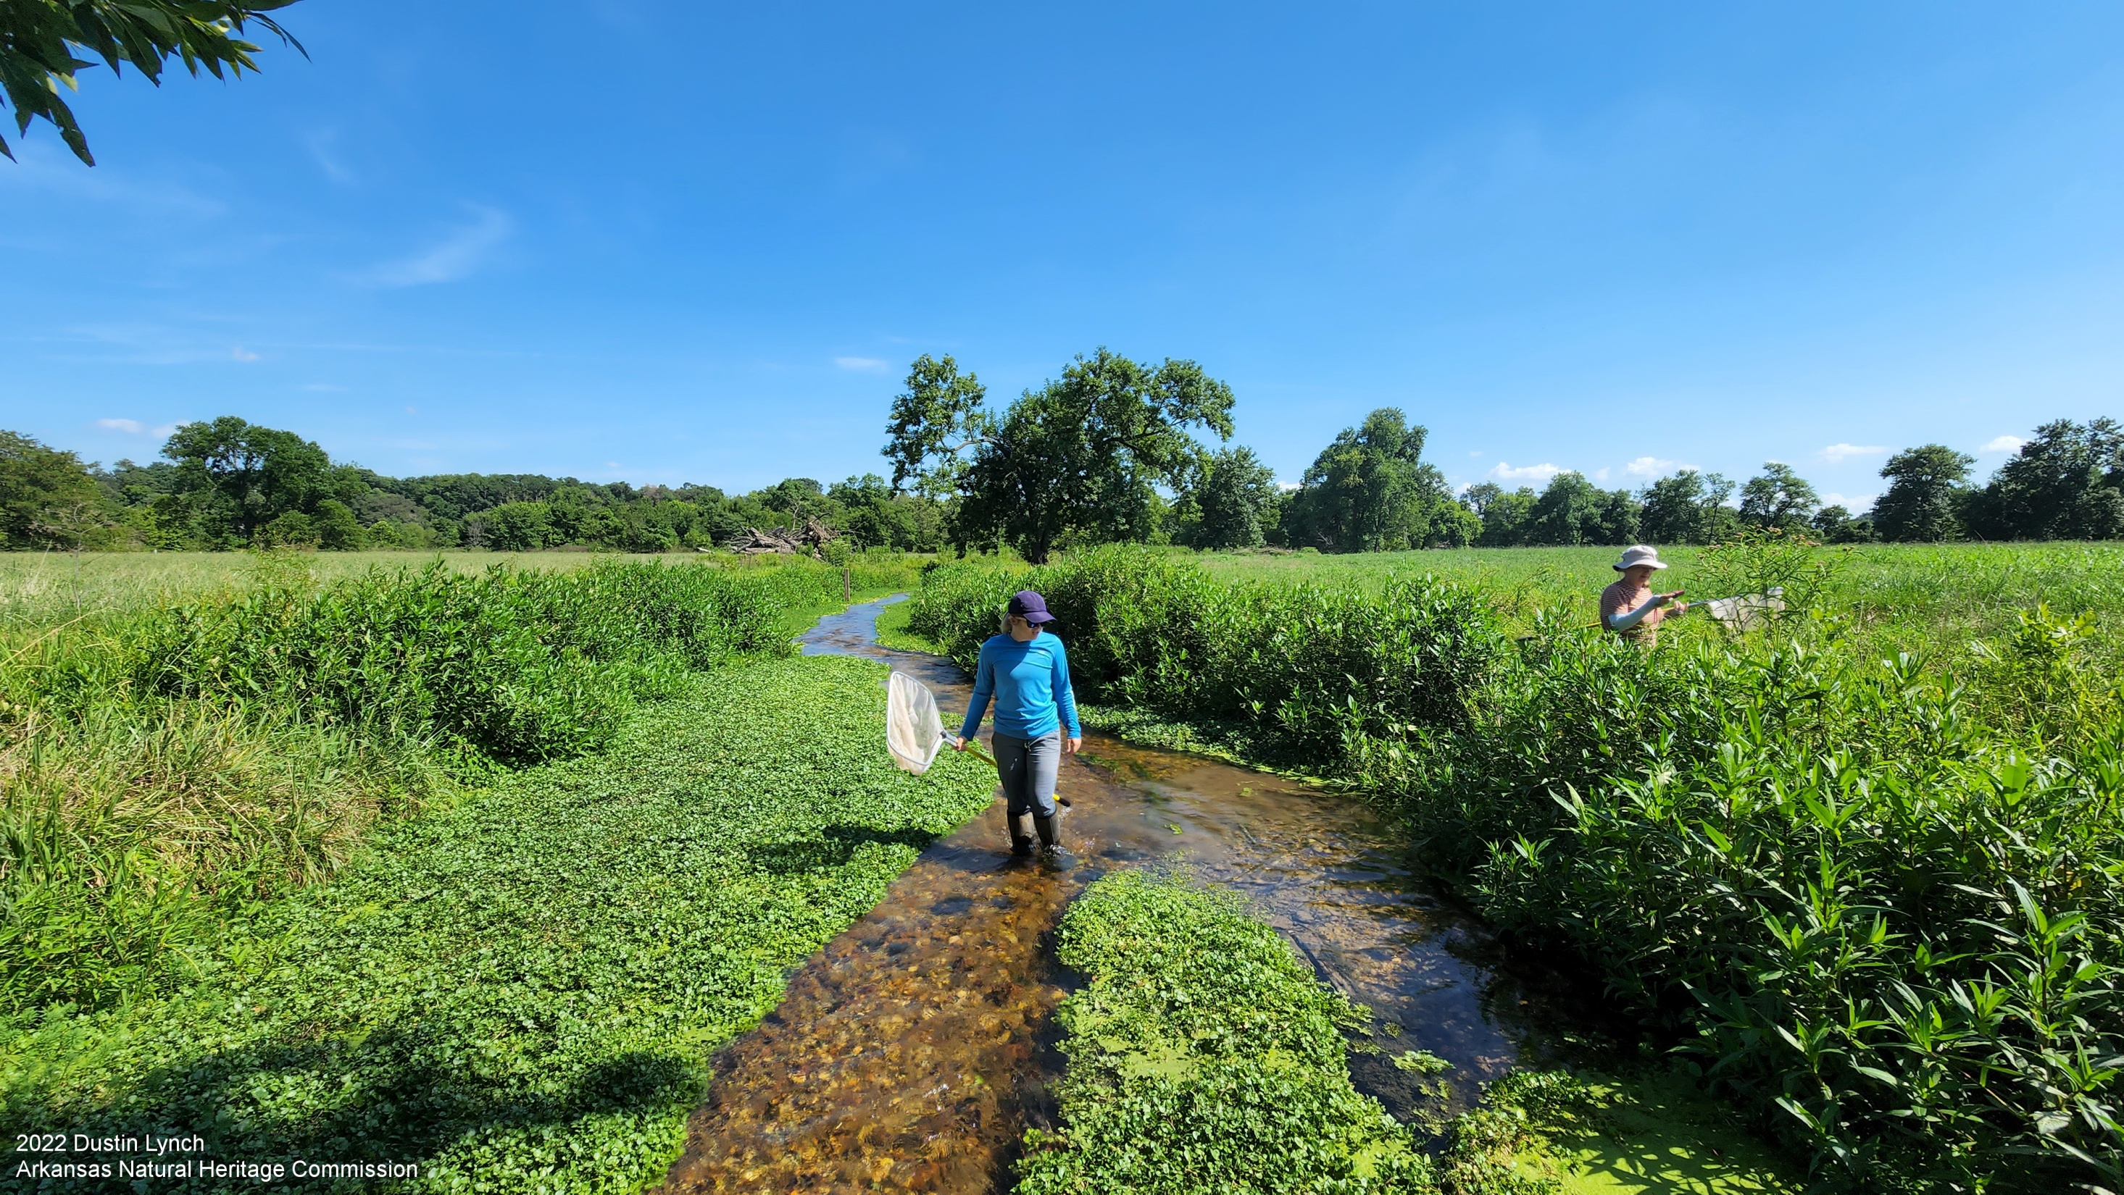
2022 Dustin Lynch
Arkansas Natural Heritage Commission

Slide 23
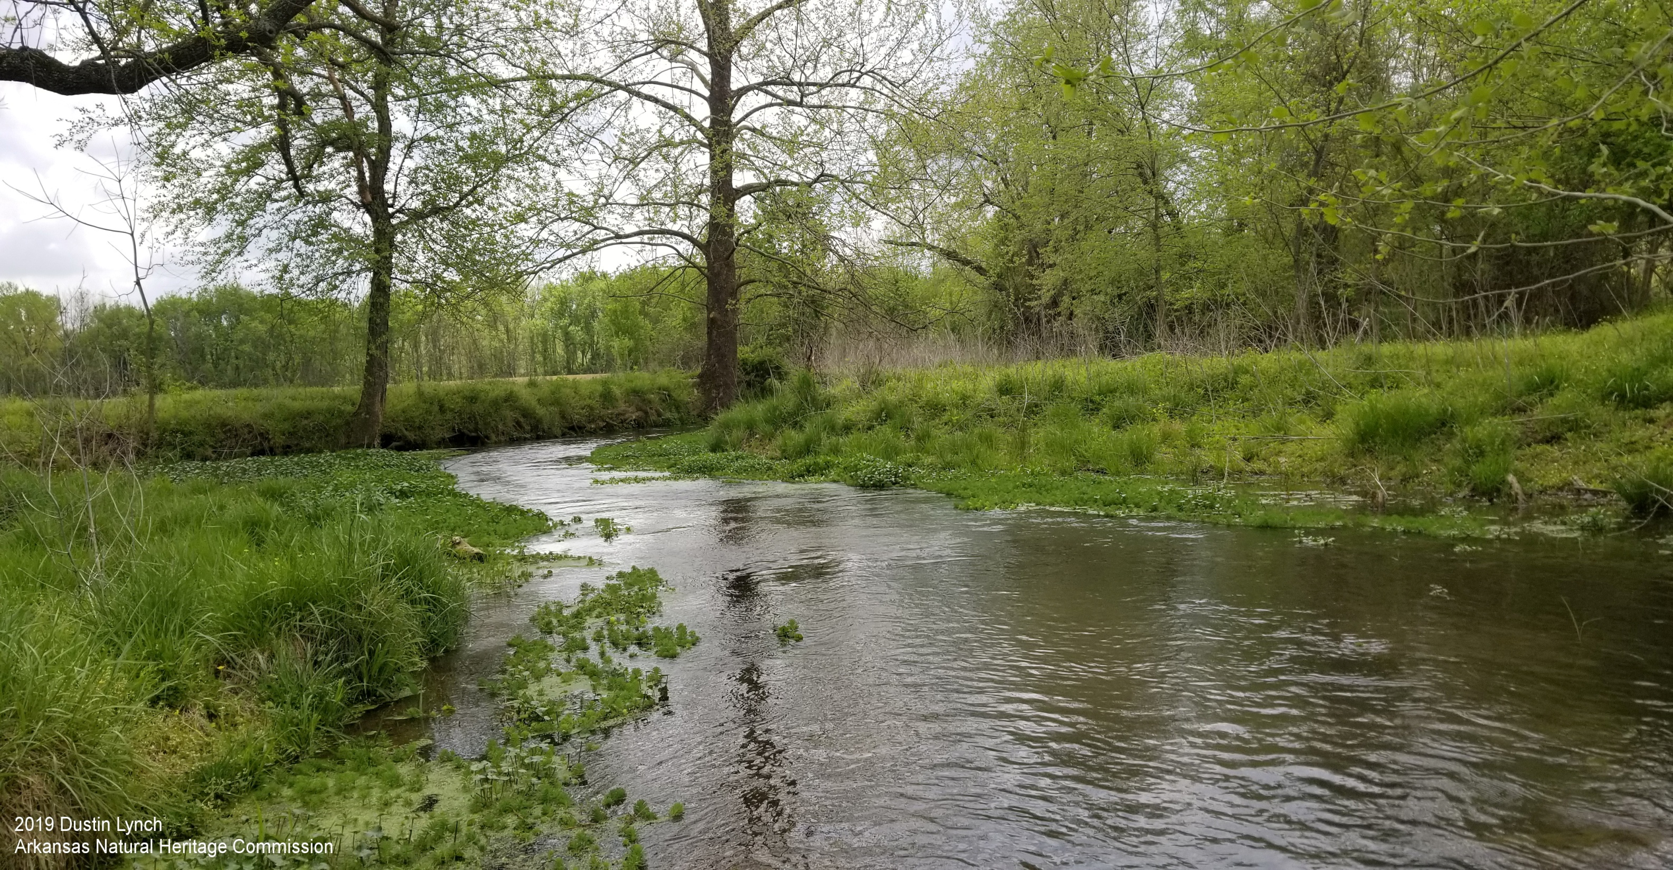
2019 Dustin Lynch
Arkansas Natural Heritage Commission

Slide 24
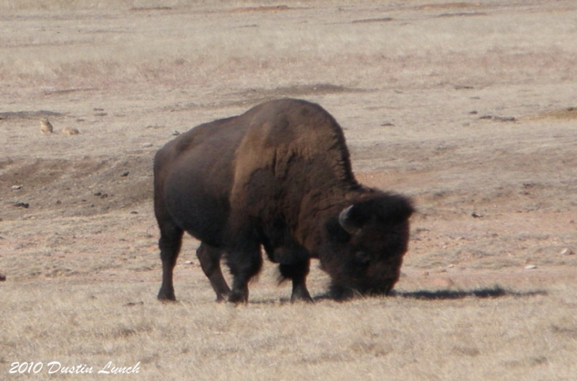
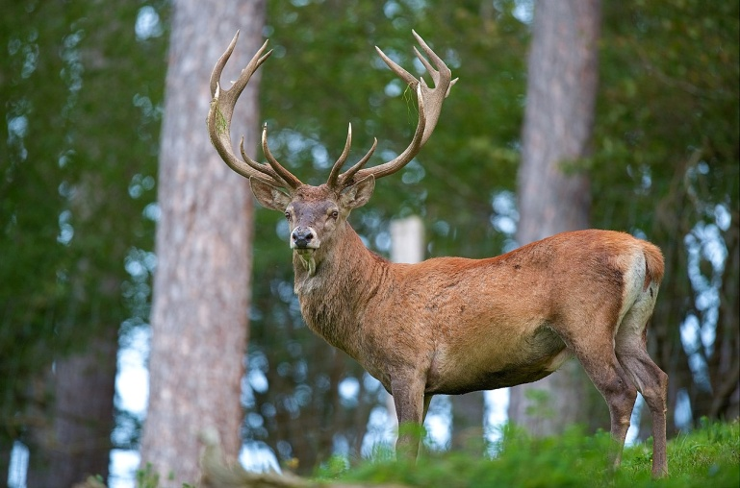
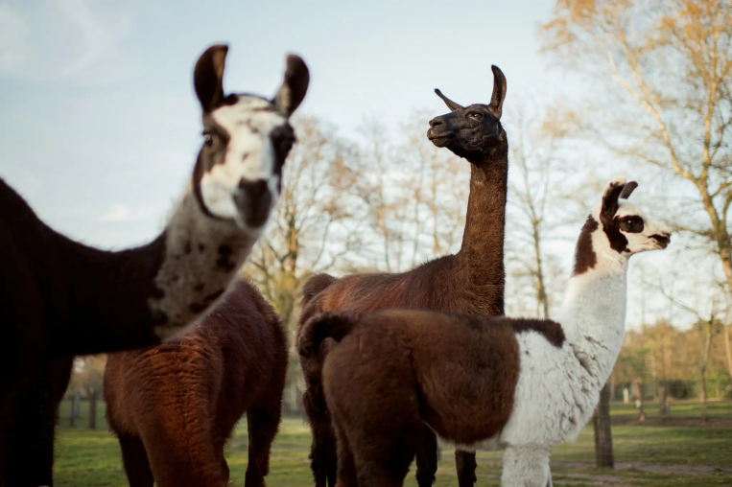
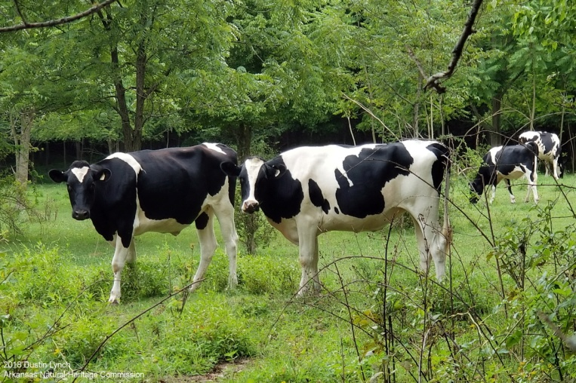
Healing Springs – Land Use History
Prior to European settlement: mosaic of tallgrass prairie and open oak savannah
American Bison
Heavily used for livestock grazing
European Red Deer
Llamas
Cattle

Slide 25
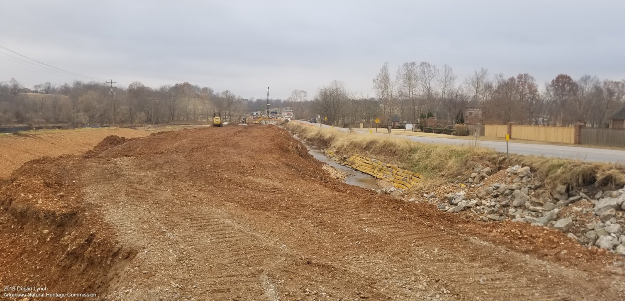
Healing Springs Natural Area Acquisition
2016 - Little Osage Creek bridge replacement scheduled by Arkansas Department of Transportation (ArDOT)
Compensatory mitigation under Clean Water Act
Need mitigation credits to offset impacts
Any combination of:
Restoration
Enhancement
Preservation

Slide 26
Property adjacent to bridge (now Healing Springs NA) went up for sale
84.5 acres
Numerous aquatic Species of Greatest Conservation Need (SGCN)
Site well known to Arkansas Game and Fish Commission (AGFC), Arkansas Natural Heritage Commission (ANHC), The Nature Conservancy (TNC), etc.
Little Osage Creek Bridge

Slide 27
Healing Springs Natural Area Acquisition
Late 2016 – staff from AGFC and ANHC submit letter to ArDOT expressing interest in acquisition
Early 2018 – ArDOT closed on property
Summer 2018 – meetings with ArDOT, ANHC, and AGFC
ArDOT does not do long-term management of land or rare species
ANHC will manage as part of ANHC System of Natural Areas
AGFC will provide enforcement and technical assistance
Throughout 2019 – management plan developed
May 6th, 2020 – Healing Springs officially becomes the 76th Natural Area

Slide 28
Healing Springs Natural Area Acquisition
A very important and unique Natural Area
From aquatic standpoint, one of most important in the state
But an imperfect solution
Protected 0.38 miles out of 0.87 miles of darter habitat
~43% of total
Unprotected
0.49 miles of darter habitat (~57%)
Both springs

Slide 29
Healing Springs Acquisition
July 2020 – a developer buys adjacent 90 acres including the rest of the Healing Springs complex
Begins clearing trees off upland portions
Plans new housing edition
November 2020 – AGFC/ANHC learn about situation
2020 to 2022– meetings between developer, ArDOT, ANHC, and AGFC
Intense negotiations for either all or part of the property
Land is very expensive in NWA
Acquiring floodplain and buffer around streams and springs more feasible than full tract
Summer 2022 – ArDOT and developer reach a deal
Expands Healing Springs by an additional 27 acres

Slide 30
HSNA will now protect:
100% of Least and Arkansas Darter habitat
Healing Spring
All of Healing Spring Branch
Most of Fulbright Spring Branch
Housing development
Large lots
Area around Fulbright Spring will not be developed
Undeveloped green space
Homeowners association
Will work with ANHC and other partners
Future steps
Trails
Interpretive panels
Continued restoration
Regular monitoring
Bank Stabilization of Little Osage Creek

Slide 31
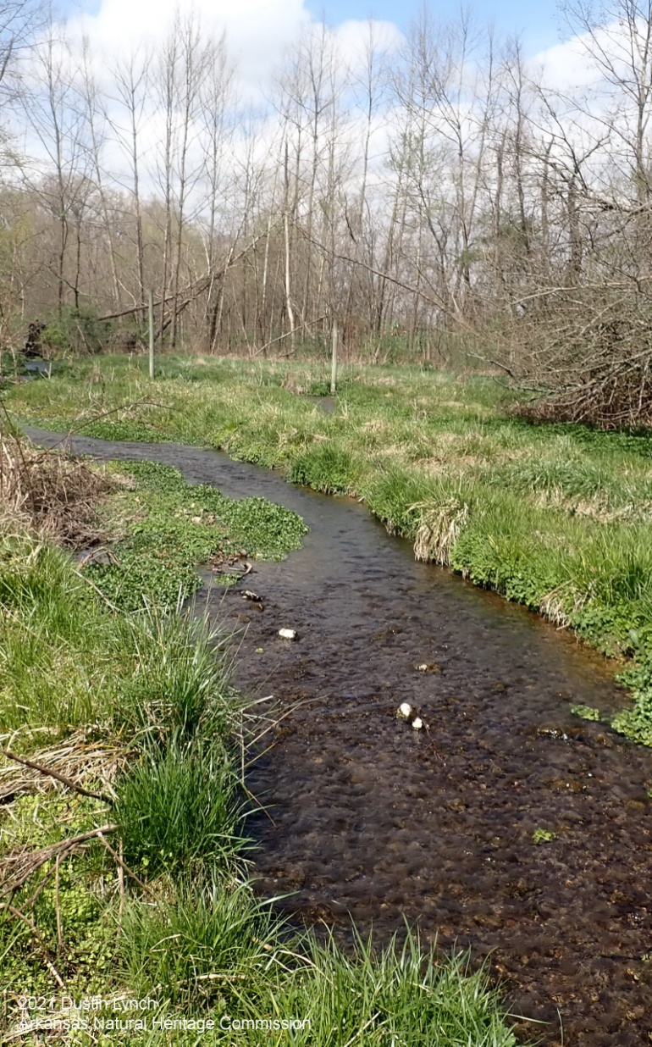
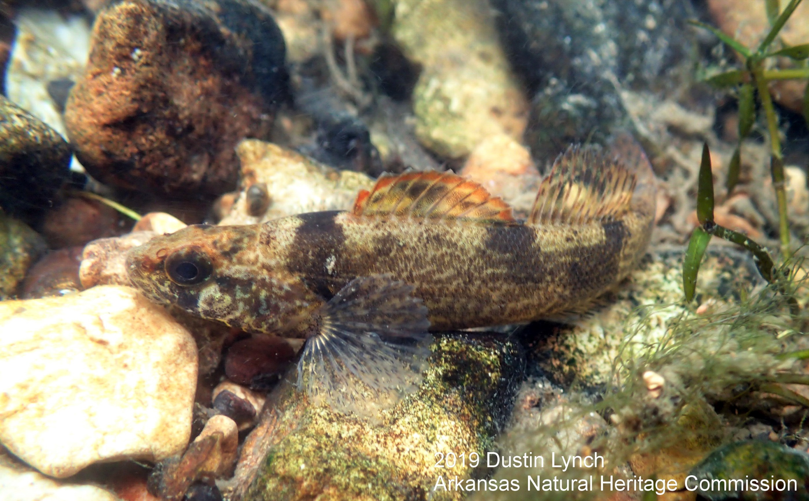
Rare Fish at Healing Springs Natural Area
Arkansas Darter
(Etheostoma cragini)
Sunburst Darter
(Etheostoma mihileze)
Healing Springs
Natural Area
Least Darter
(Etheostoma microperca)
Redspot Chub
(Nocomis asper)

Slide 32
Rare Crayfish at Healing Springs Natural Area
Two rare stream-dwelling species
Midget Crayfish (Faxonius nana)
Meek’s Short-pointed Crayfish (Faxonius meeki brevis)
Both narrow range endemics
Found only in the Illinois River watershed (NW AR and NE OK)
2022 Dustin Lynch
Arkansas Natural Heritage Commission
Midget Crayfish (Faxonius nana)
Meek’s Short-pointed Crayfish (Faxonius meeki brevis)

Slide 33
Rare Crayfish at Healing Springs Natural Area
One primary burrowing species
Osage Burrowing Crayfish (Procambarus liberorum)
Only in western AR and eastern OK
Prairie remnants
2022 Dustin Lynch
Arkansas Natural Heritage Commission
Osage Burrowing Crayfish (Procambarus liberorum)

Slide 34
Rare Crayfish at Healing Springs Natural Area
Excavation of an Osage Burrowing Crayfish (Procambarus liberorum) at Healing Springs Natural Area

Slide 35
Rare Plants at Healing Springs Natural Area
Leafy Pondweed (Potamogeton foliosus)
American Brooklime (Veronica americana)
Mosquito Fern (Azolla mexicana)

Slide 36
Genetic Variation of Cucurbita pepo gourds at Healing Springs Natural Area

Slide 37
Federally Threatened Ozark Cavefish (Troglichthys rosae)

Slide 38
Questions?

