Slide 1
Safety Benefits of Wet Reflective Pavement Markings
3M Transportation Safety Division

Slide 2
19 Lives Saved 43 Serious Injuries Avoided
Notes:
I’ll start by asking a rhetorical question – how often have

Slide 3
Pavement markings must be visible both day and night

Slide 4
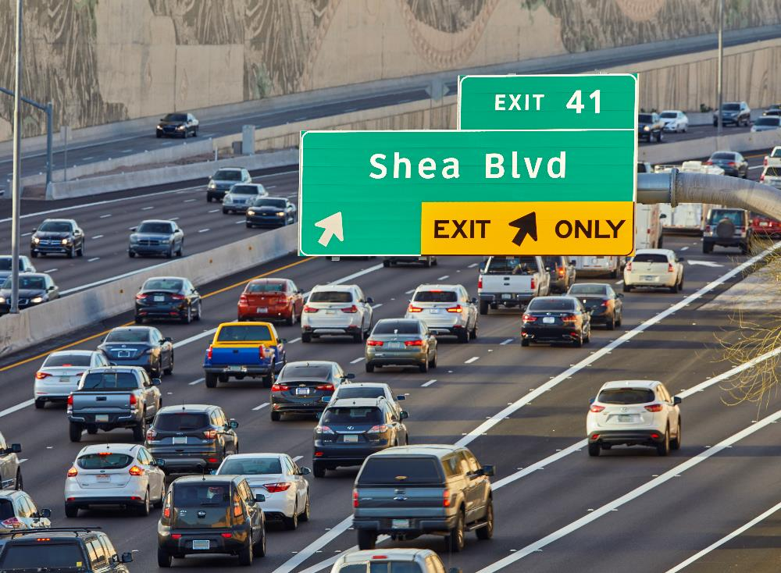
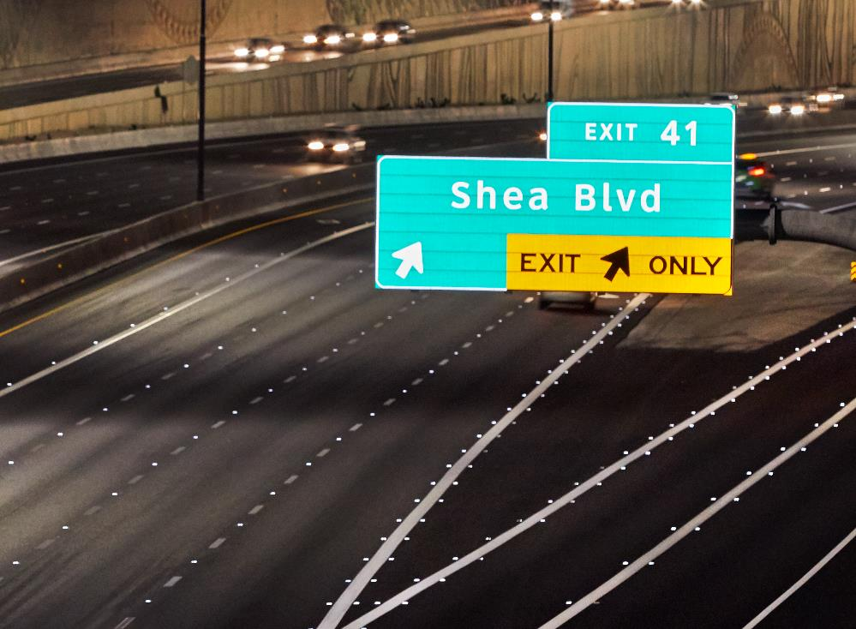
Only 25% of travel occurs at night².
Notes:
Yet we know that roughly 25% of vehicle travel occurs at night – so despite the fact that only 25% of travel occurs at night, over half of the fatalities happen in these conditions. The data is clear, driving at night in the rain is a big problem and these two conditions rain are over aggravating factors in crash risk.
2) Source: US DOT National Highway Traffic Safety Administration. Passenger Vehicle Occupant Fatalities by Day and Night – A Contrast. May 2007, https://crashstats.nhtsa. dot.gov/Api/Public/ViewPublication/810637

Slide 5
In 2017, 6,952 people died in crashes on U.S. roads when it was raining¹.
Notes:
According to the latest data from the USDOT, 6952 people lost their lives on American roadways while it was raining – that’s roughly the equivalent of a commercial airline crash every other week.
1) Source: US DOT National Highway Traffic Safety Administration, Fatality Analysis Reporting System (FARS). 2017 – Available from: https://www.nhtsa.gov/researchdata/fatality-analysis-reporting-system-fars

Slide 6
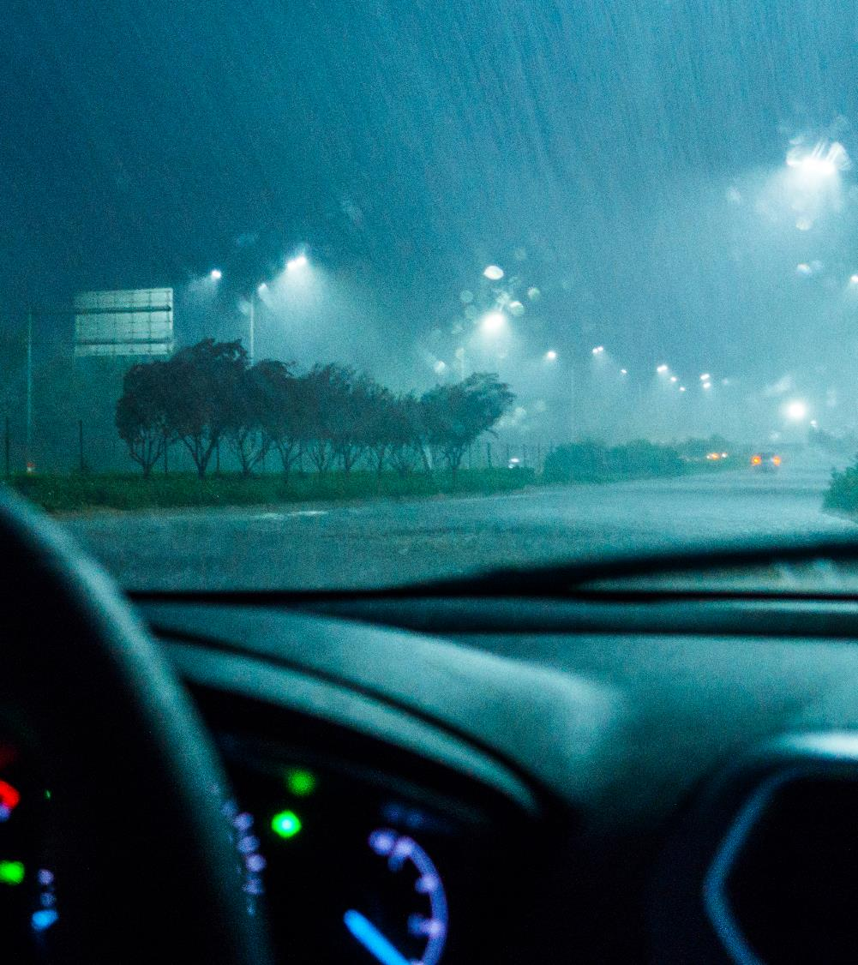
55% (or 3,811) of those deaths occurred at night or in low light conditions¹.
Notes:
Over half of those fatalities occurred at night or in low light conditions, that is the equivalent of closer to 1.5 commercial airliner crashes every month.
1) Source: US DOT National Highway Traffic Safety Administration, Fatality Analysis Reporting System (FARS). 2017 – Available from: https://www.nhtsa.gov/researchdata/fatality-analysis-reporting-system-fars

Slide 7
Driving at night in the rain is a big problem
Notes:
I’ll start by asking a rhetorical question – how often have

Slide 8
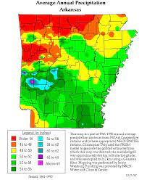
Average Annual Rainfall in Arkansas
Arkansas ranks 8th in annual rainfall
On average, Arkansas receives 49.6 inches of rain.
95 days/ nights with rainfall
116 Roadway Fatalities during night/wet conditions in the last 3 years

Slide 9
Arkansas crash data at night in the rain
Driving at night in the rain in Arkansas is big problem…
Count of Fatalities in Dark or Low Light Conditions in Rain
Count of Crashes in Dark or Low Light Conditions in Rain
2019
2020
2021
2019
2020
2021
Total Night/Wet Crashes
Crashes with Injuries
Sources: AR Safety Portal

Slide 10
Not all pavement marking optics are created equal
Notes:
Now I’m going to turn it over to Tom, one of 3M’s division scientists for Pavement markings to explain the science behind wet reflective markings – before I do that, I’d like to show a short video

Slide 11
Driving at night in the rain is a big problem
Driving at night in the rain…in a work zone…. is a bigger problem

Slide 12
Why Wet Reflective Pavement Markings Matter

Slide 13
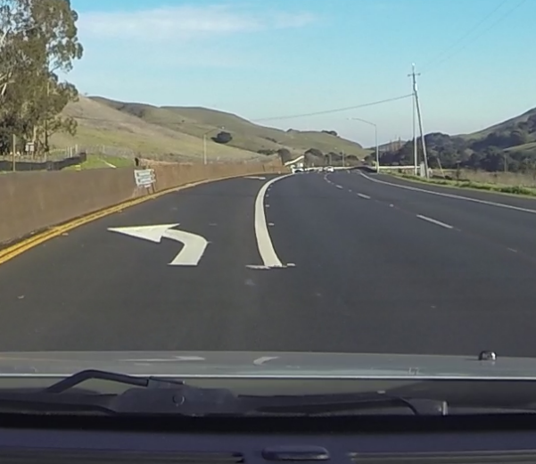
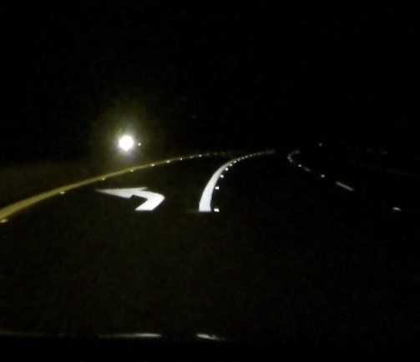
What do drivers see?
Daytime Dry
Night-time Dry
Night-time Rainy

Slide 14
Retro reflectivity Levels
600
300
200
150
100
50
Notes:
This picture shows the significance of an adequate retro reflectance level. Although not a law, the generally accepted minimum level of reflectivity performance is 100 Milicandelas.
Point out a few of our products that have similar Retro reflective luminance in dry conditions:
600
200
100 Standard PM tape

Slide 15
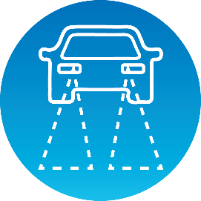
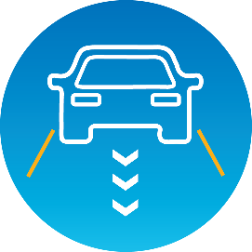
What happens when pavement markings disappear?
Reduced
Visibility³
Increased Discomfort³
Less Effective
Lane Guidance⁴
Increased
Crash Risk⁵
Notes:
There has been recent research to document the safety effects of not being able to see pavement markings at night in the rain.
In 2016, the European Road Federation concluded a multi-year study that found that when markings aren’t visible at night in the rain driver visibility is reduced and driver discomfort is significantly increased.
More recently in 2019, studies have looked at how pavement marking visibility at night in the rain impacts guidance systems on connected and autonomous vehicles – not surprisingly if we humans can’t see the lines then camera systems on these cars can’t see them either decreasing the effectiveness of these important safety features
And finally all of these risk factors lead to increased crash risk – a 2019 study published in Accident Analysis and Prevention found that crash risk increased as high as 80% when it was raining at night.
So we’ve now established that 1) driving at night in the rain is a big problem and 2) pavement marking visibility at night in the rain matters but do wet reflective markings actually help solve the problem?
Sources:
3) Konstandinos Diamandouros, and Michael Gatscha. “Rainvision: The impact of road markings on driver behavior – wet night visibility”. 6th Transport Research Arena, April 18-21, 2016. European Road Federation
4) Pike, A., Clear, S., Hedblom, T., and Whitney, J. “How Might Wet Retroreflective Pavement Markings Enable More Robust Machine Vision?” Transportation Research Record 1-6, 2019
5) Omranian, S., Sharif, H., Dessouky, S., Weissmann, J., “Exploring rainfall impacts on the crash risk on Texas roadways: A crash-based matched-pairs analysis approach.” Accident Analysis and Prevention, vol. 117, 2018, pp. 10-20

Slide 16
Research links wet reflective markings to helping reduce crashes
Safety Evaluation of Wet Reflective Pavement Markings: FHWA-HRT-15-083
46%
41%
12%
Reduction in Run-off-road crashes on multi-lane roads
Reduction in crashes with injury on multi-lane roads
Reduction in crashes with injury on freeways

Slide 17
Research links wet reflective markings to helping reduce crashes
Safety Effects of Wet-Weather Pavement Markings: TRB 19-04199
32%
49%
Reduction in Wet – Night Crashes
Reduction in Wet – Night Fatalities

Slide 18
Safety Counter Measures in actions

Slide 19
CMF Study In Florida

Slide 20
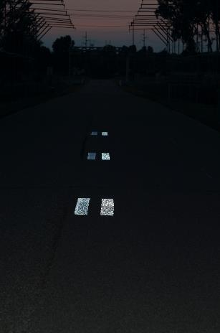
Wet reflective pavement markings help bring families home safely
A data driven safety case for wet reflective pavement markings
Rain at night is a big problem
Wet Reflective Markings Matter
Proven Safety Countermeasure
Dry
Rainy
Rain and light conditions are over
aggravating factors in crash risk
At night, during rainy conditions, non-wet reflective markings disappear
Recent research links wet reflective markings to helping reduce crashes
6952 fatalities on US roads during rain event¹
25% of road travel occurring at night²
55% of fatalities during rain occurred at night¹
Reduced driver visibility³
Less effective CAV guidance systems⁴
Increased crash risk⁵
FHWA*: 46% reduction run off road crashes⁶
FHWA*: 40% reduction crashes with injuries⁶
TTI: 49% reduction wet night fatalities⁷
*On multi-lane roads
Sources: USDOT Federal Highway Administration, European Road Federation, Transportation Research Record, Accident Analysis And Prevention, Texas Transportation Institute
Notes:
Sources:
1) US DOT National Highway Traffic Safety Administration, Fatality Analysis Reporting System (FARS). 2017 – Available from: https://www.nhtsa.gov/researchdata/fatality-analysis-reporting-system-fars
2) US DOT National Highway Traffic Safety Administration. Passenger Vehicle Occupant Fatalities by Day and Night – A Contrast. May 2007, https://crashstats.nhtsa. dot.gov/Api/Public/ViewPublication/810637
3) Konstandinos Diamandouros, and Michael Gatscha. “Rainvision: The impact of road markings on driver behavior – wet night visibility”. 6th Transport Research Arena, April 18-21, 2016. European Road Federation
4) Pike, A., Clear, S., Hedblom, T., and Whitney, J. “How Might Wet Retroreflective Pavement Markings Enable More Robust Machine Vision?” Transportation Research Record 1-6, 2019
5) Omranian, S., Sharif, H., Dessouky, S., Weissmann, J., “Exploring rainfall impacts on the crash risk on Texas roadways: A crash-based matched-pairs analysis approach.” Accident Analysis and Prevention, vol. 117, 2018, pp. 10-20
6) US DOT Federal Highway Administration. Safety Evaluation of Wet-Reflective Pavement Markings. Dec. 2015, FHWA-HRT-15-083
7) Park, ES., Carlson, P., Pike, A., “Safety Effects of Wet-Weather Pavement Markings.” Transportation Research Board 2019 Annual Meeting: Available from: https://trid.trb.org/view/1572259

Slide 21
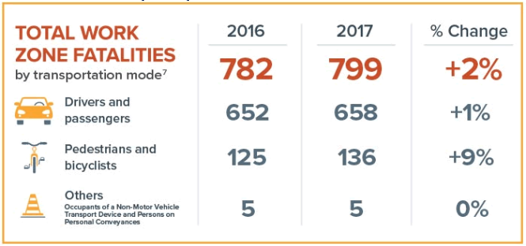
Work Zone Exposure: In the US, one work zone fatality occurs for every 4 billion vehicle-miles of travel and for every $112 million worth of roadway construction expenditures. Work Zone Fatalities: Between 2016 and 2017, fatal crashes in work zones increased by 3 percent while fatal crashes outside of work zones decreased by 1.5 percent. Work Zone Congestion: Work zones account for an estimated 10 percent of overall congestion and 24 percent of unexpected freeway delays.
FHWA Work Zone Facts and Statistics
Source: https://ops.fhwa.dot.gov/wz/resources/facts_stats.htm

Slide 22
How Wet Reflective Technology Works

Slide 23
Optics in the pavement markings return light back toward its source.

Slide 24
When light travels from air into water, the direction changes. This change is called refraction.

Slide 25
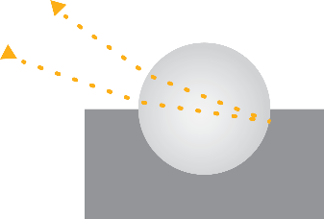
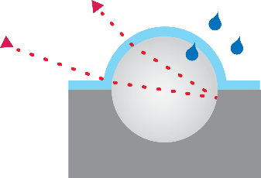
1.5 refractive index glass beads are commonly used for dry conditions, but fail in wet/rainy conditions
Dry 1.5 Refraction Index
Wet 1.5 Refraction Index

Slide 26
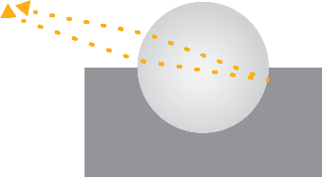
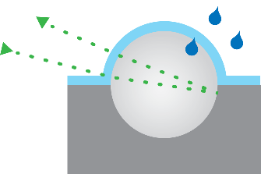
For beads, only 2.4 optics provide useful light return
in nighttime rainy conditions
Dry 2.4 Refraction Index
Wet 2.4 Refraction Index

Slide 27
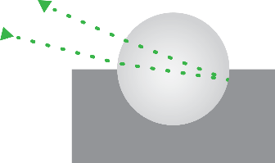
1.9 refractive index beads are more efficient and increase light return in dry conditions, but still fail in wet/rainy conditions
Dry 1.9 Refraction Index
Wet 1.9 Refraction Index

Slide 28
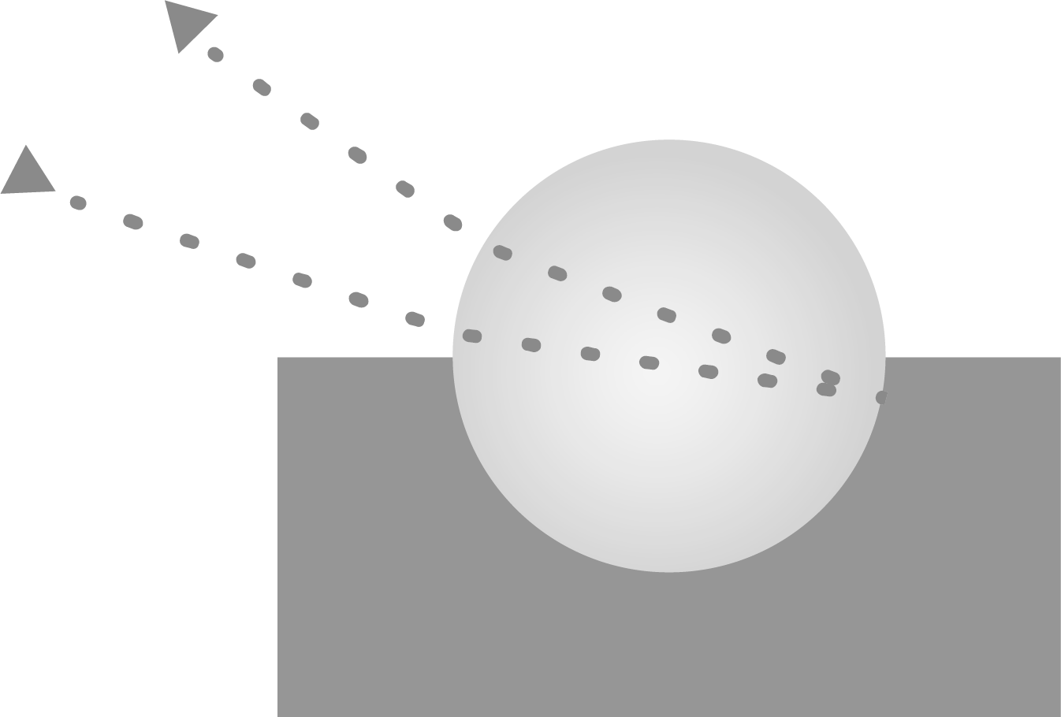
For all weather performance you want both 1.9 and 2.4 refractive index optics.
Dry 1.5 Refraction Index
Dry 1.9 Refraction Index
Dry 2.4 Refraction Index
Wet 1.5 Refraction Index
Wet 1.9 Refraction Index
Wet 2.4 Refraction Index

Slide 29
Basic of ADAS camera systems and how they see pavement markings.

Slide 30
What is Machine Vision

Slide 31
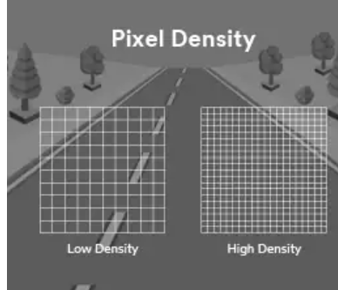
4 Ways Machine Vision Algorithms Detect Key Features
1. Difference in Light and Dark Pixels. The simplest algorithms calculate the absolute difference between the values of adjacent pixels.
2. Edge Detection Scheme. A slightly more complex scheme calculates the rate of change of the pixel values in the image, then creates a graph with a linear slope. The algorithm is looking for a steep slope,
3. Corner Detection Scheme. This scheme uses some of the same calculations as the Edge Detection Scheme. However, instead of simply calculating the pixel value rate of change in one direction, the algorithm simultaneously considers the rate of change over two directions.
4. Convolutional Neural Network (CNN), a form of machine learning. These are the most complex algorithms used by autonomous vehicles, and the direction many manufacturers are heading.

Slide 32
Pavement Markings

Slide 33
Pavement Marking Optics - Video
Notes:
https://multimedia.3m.com/mws/media/1610708O/reflective-optics-animated-video.mp4

Slide 34
Help Improve Work Zone Safety with Wet Reflective Pavement Markings

Slide 35
Arkansas crash data in Work Zone
Driving at night in the rain in Arkansas is big problem…
Count of Crashes in the WZ during Wet Weather Conditions
WZ Crashes in under all Conditions
2019
2020
2021
2019
2020
2021
Total WZ Crashes
Crashes with Injuries
Sources: AR Safety Portal

Slide 36
Arkansas crash data in Work Zone
Driving at WZ in Arkansas is big problem…
Count of Fatalities in the WZ during All Weather Conditions
2019
2020
2021
Sources: AR Safety Portal

Slide 37
Technologies that help improve the visibility of work zone infrastructure
Full-Cube Technology
for Signing
Wet Reflective Technology for Temporary Pavement Markings
Fluorescent Technology
For Signs & Devices

Slide 38
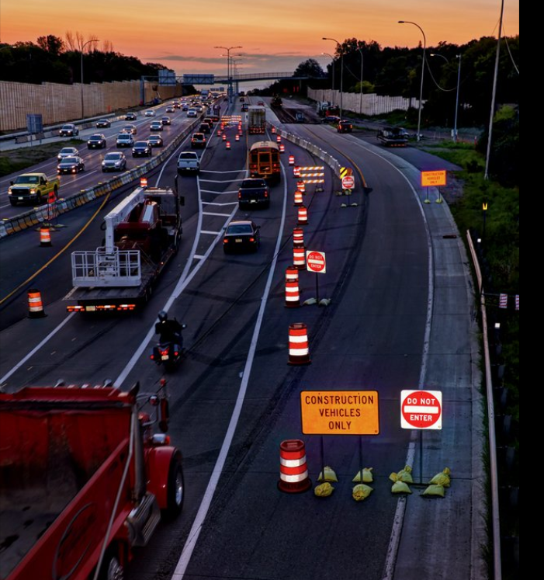
Temporary pavement markings are a critical element of a Traffic Control Plan.

Slide 39
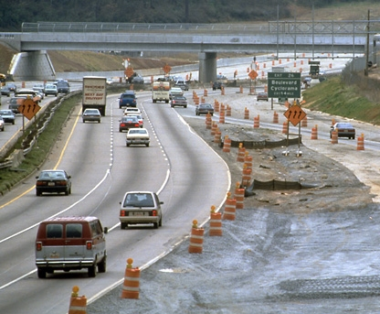
Motorists and workers are increasingly exposed to work zones
More than 11 billion vehicle miles of travel are estimated to drive through work zones each year.
Motorist encounter an active work zone 1 out of every 100 miles driven on the NHS.
(FHWA Facts & Statistics 11/28/06)
There were 87,606 crashes in work zones in 2010
(FHWA Facts & Statistics 05/03/2012

Slide 40
Work Zone Exposure: In the US, one work zone fatality occurs for every 4 billion vehicle-miles of travel and for every $112 million worth of roadway construction expenditures. Work Zone Fatalities: Between 2016 and 2017, fatal crashes in work zones increased by 3 percent while fatal crashes outside of work zones decreased by 1.5 percent. Work Zone Congestion: Work zones account for an estimated 10 percent of overall congestion and 24 percent of unexpected freeway delays.
FHWA Work Zone Facts and Statistics
Source: https://ops.fhwa.dot.gov/wz/resources/facts_stats.htm

Slide 41
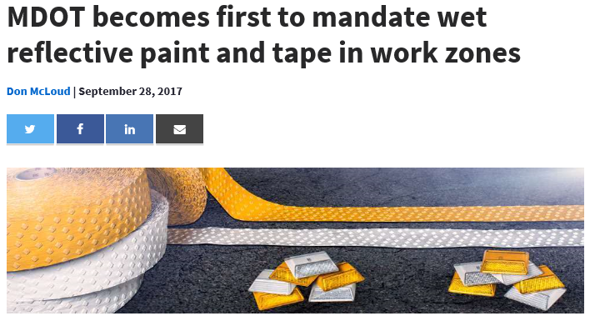
Michigan DOT Implements First All Wet Reflective Work Zone Standard in the Nation
Background: Data showed that about 35 percent of work zone crashes occurred during dusk, dawn or rainy periods. As a Toward Zero Deaths (TZD) partner, the department knew it was important to prioritize construction zone line markings to make lane assignments clearer.
Project: In 2015, the department’s work zone team worked with a local contractor to test wet
reflective paints for performance. After developing
and selecting the permitted products, MDOT implemented the new standard for
all wet reflective work zones in the state in 2016.
https://www.equipmentworld.com/mdot-becomes-first-to-mandate-wet-reflective-paint-and-tape-in-work-zones/

Slide 42
Key Takeaways
To learn more visit: www.3M.com/wetreflective
Rain and light conditions are aggravating factors in crash risk
2.4 refractive index optics provide optimal light return during rainy conditions at night
At night, during rainy conditions, non-wet reflective markings can’t be seen
Recent research links wet reflective pavement markings to helping reduce crashes
Not all pavement marking optics have the same performance capabilities
Work zone safety continues to be a high–priority issue for traffic engineering professionals and highway agencies.

Slide 43
Thank you!

