Slide 1
Update of ardot hot in-place recycling (HIR) projects
Chris Dailey
Staff Construction Engineer

Slide 2
HIR projects since 2020
100886 Hwy 181 – Hwy 61
A80002 E. of Ola – Perry County Line
A00009 Hwy 63B West – Greene County Line
A50012 Moorefield - Hwy 122

Slide 3
100886
Hwy. 18, Section 6
Let Date: 01/08/20
Substantially Complete: 11/06/20
RE 05 – Bob Reddell

Slide 4
100886

Slide 5
100886
Contract Amount: $4,493,701.31
Prime Contractor: Dustrol
292,254 SY HIR Asphalt Concrete
$5.80/ SY

Slide 6
100886

Slide 7
100886

Slide 8
A80002
Hwy. 10, Section 4
Let Date: 04/07/21
Substantially Complete: 03/03/22
RE 86 – Mike Hays

Slide 9
A80002

Slide 10
A80002
Contract Amount: $1,011,420.26
Prime Contractor: Dustrol
80,678 SY HIR Asphalt Concrete
$4.74/SY

Slide 11
A80002

Slide 12
A80002

Slide 13
A80002

Slide 14
A00009
Hwy. 63, Sections 3 & 4
Let Date: 05/18/22
Substantially Complete: 07/05/22
RE 06 – Aaron Vowell

Slide 15
A00009

Slide 16
A00009
Contract Amount: $6,564,285.11
Prime Contractor: Delta Asphalt
Subcontractor: Dustrol
321,493 SY HIR Asphalt Concrete
$5.95/SY

Slide 17
A00009

Slide 18
A00009

Slide 19
A00009

Slide 20
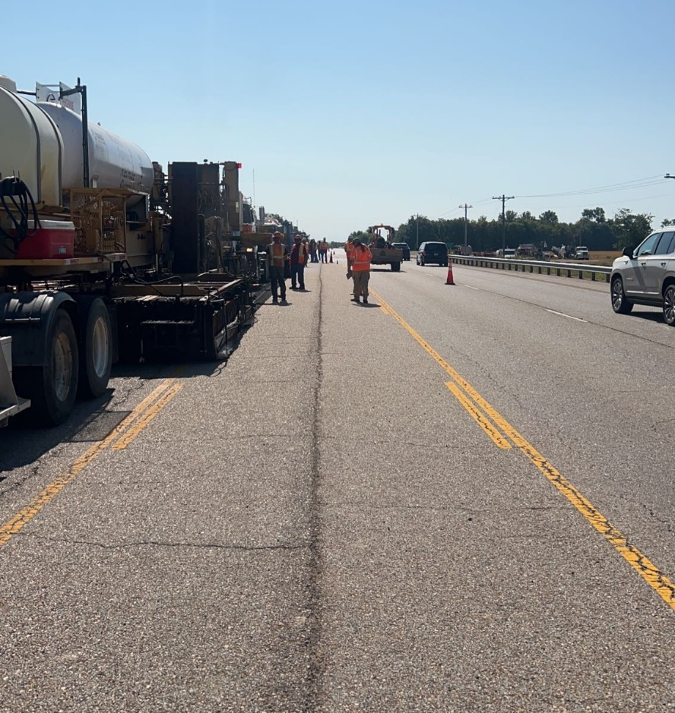
A00009

Slide 22
A50012
Hwy. 69, Section 3
Let Date: 05/18/22
Substantially Complete: 11/02/22
RE 52 – Dustin Treadway

Slide 23
A50012

Slide 24
A50012
Contract Amount: $2,894,437.09
Prime Contractor: Atlas Asphalt
Subcontractor: Dustrol
168,657 SY HIR Asphalt Concrete
$6.11/SY

Slide 25
A50012

Slide 26
A50012

Slide 27
A50012

Slide 28
HIR Projects
Lessons Learned
Site Selection
Lane Width
Straight Alignment
Existing Pavement

Slide 29
questions
?

