Slide 1
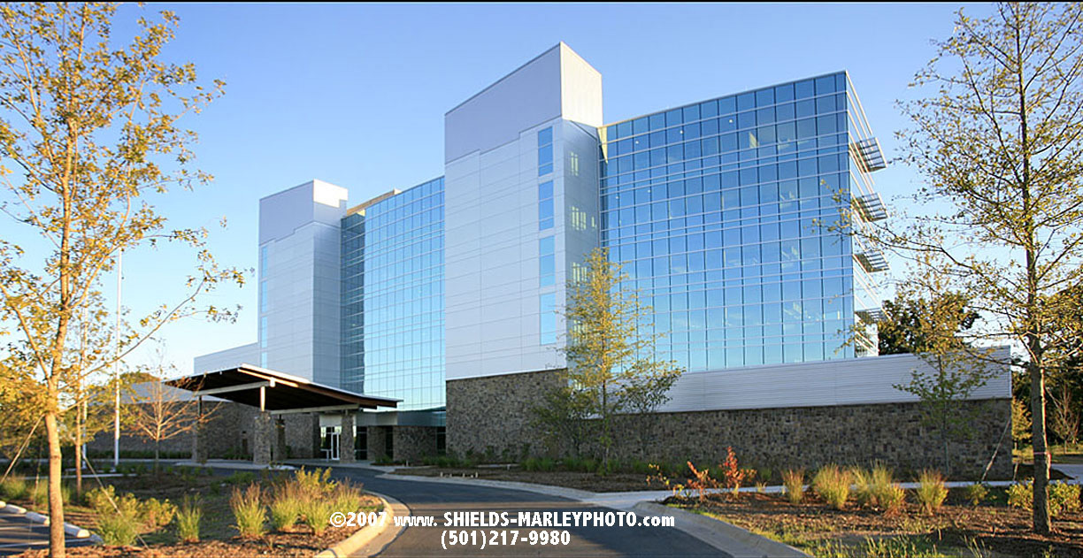

SEEK
The Future of Permitting for DEQ

Slide 2
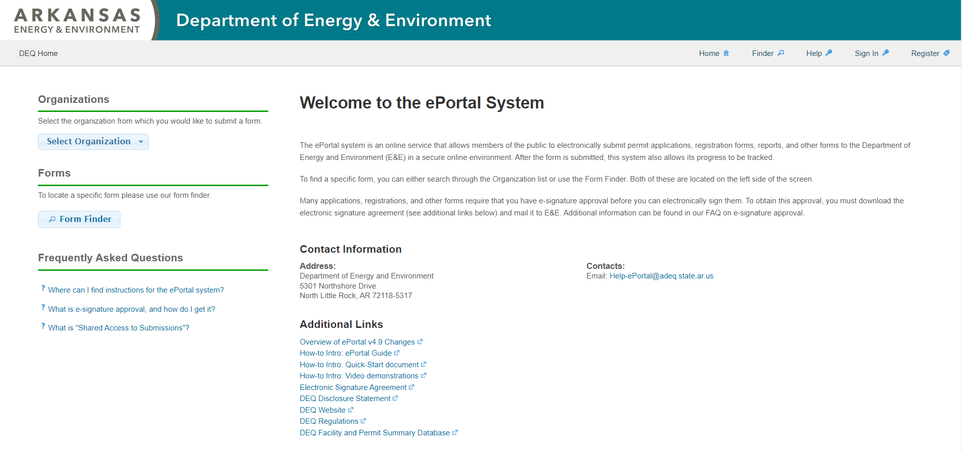
ePortal (Current System)

Slide 3
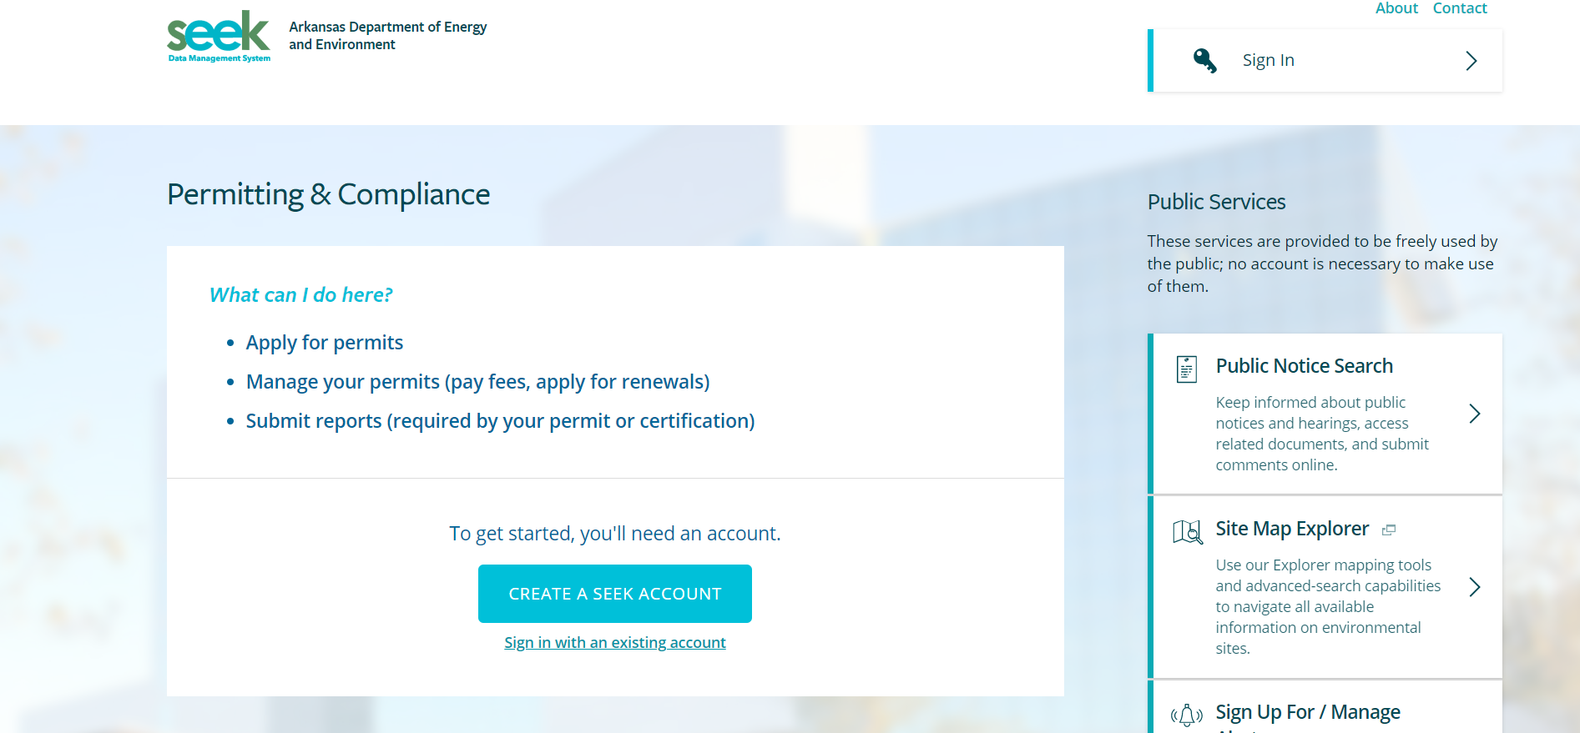
SEEK (System in Development)

Slide 4
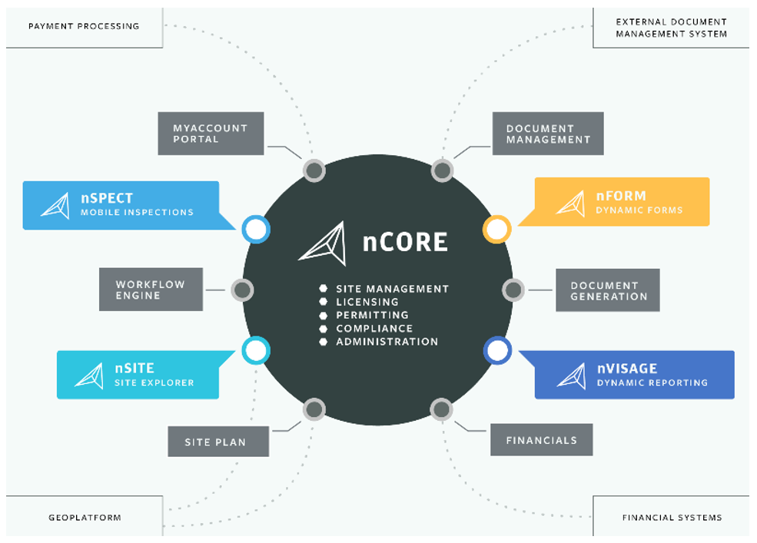

Slide 5
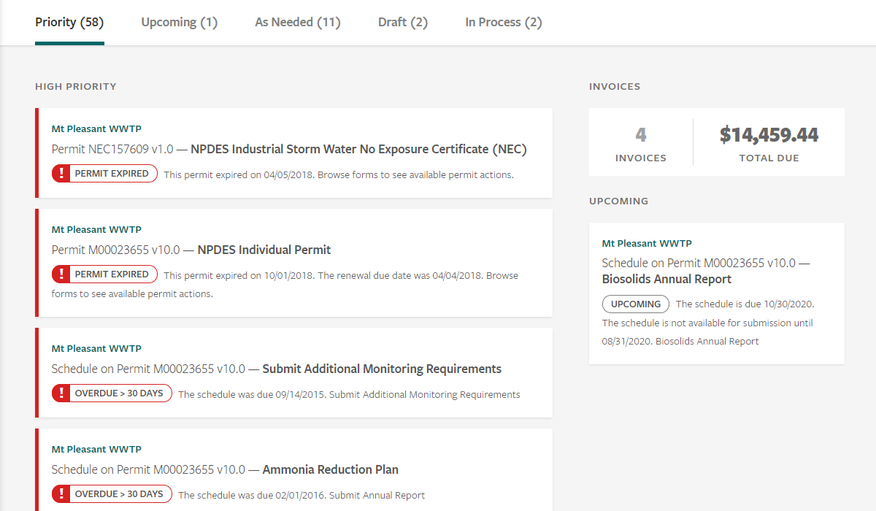

Slide 7
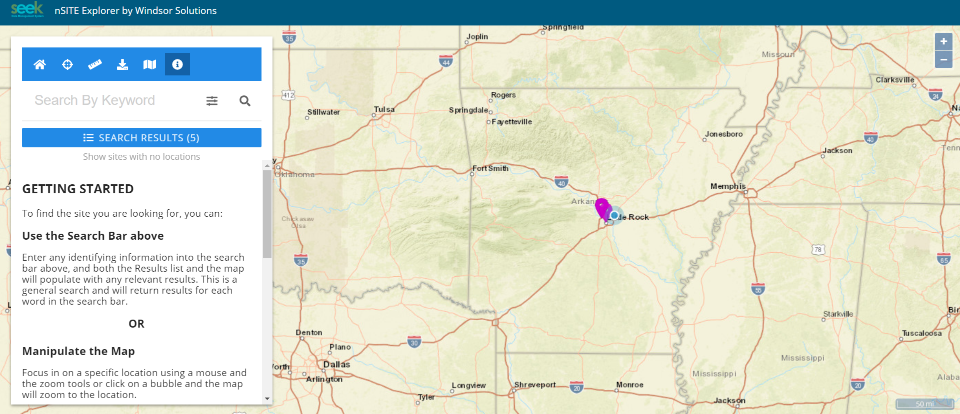

Slide 8
KEEP IN TOUCH
DEQ
5301 Northshore
City, State, Zip Code
PHONE
t: 501.682.0047
EMAIL
Ralph.Ungerank@adeq.state.ar.us
@AREnergyEnvironment
@ArkansasEE

