Slide 1

Why Do You Lose Air Volume When Pumping Air-Entrained Concrete??? and Why Does the Air Come Back?
Justin Becker, Nick Seader, Chad Staffileno
Tyler Ley PE, PhD

Slide 2
Acknowledgements
Oklahoma DOT
FHWA
Colorado DOT
Kansas DOT
Nebraska DOT
Iowa DOT
Minnesota DOT
Idaho DOT
North Dakota DOT
Pennsylvania DOT
Connecticut DOT
Illinois DOT
Indiana DOT
Michigan DOT
Wisconsin DOT
New Jersey DOT
RMC Foundation
American Concrete Pumping Association

Slide 3
Acknowledgements
Vermont DOT
Jim Wild
Justin LaRoche

Slide 4

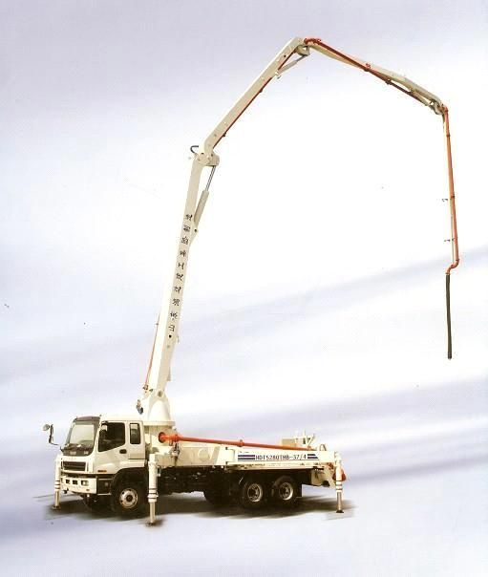


Slide 5

Overview
Why do we add air to concrete?
Why do pumps change the air content of concrete?
Why does the air come back?
If you see Pistol Pete then that means that something is very important!!!!

Slide 6
Why Do We Add Air to Concrete?
Air-entrained bubbles are a key to the freeze-thaw resistance of concrete
Air volume = freeze-thaw performance
Smaller bubbles are more effective in providing freeze-thaw resistance and have less of an impact on our concrete than larger bubbles

Slide 7
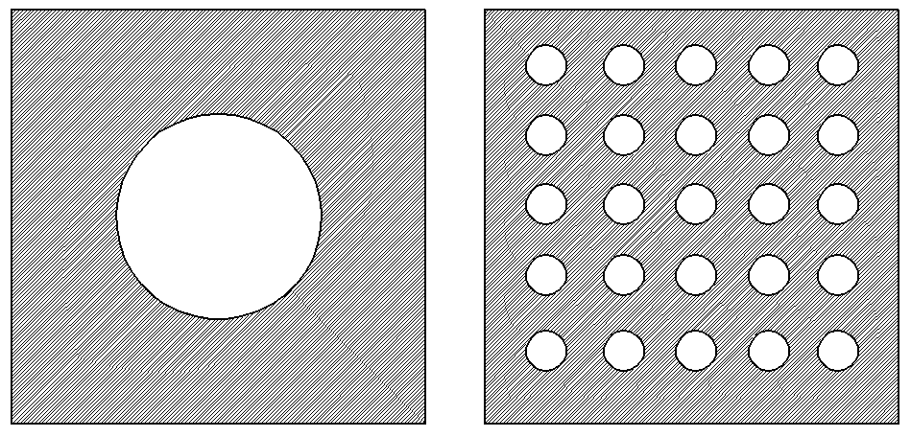
What Do You Want in an Air-Void System?
A
B
Volume of air provided is the same for both.
Case B has a better air void distribution.

Slide 8
What Do You Want in an Air-Void System?
A
B
Volume of air provided is the same for both.
Case B has a better air void distribution.

Slide 9
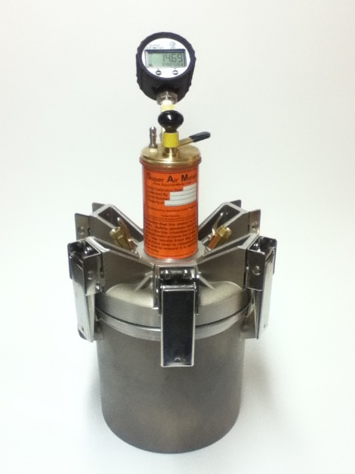
AASHTO R101
Freeze Thaw Field Acceptance
Super Air Meter
Air Volume > 4%
SAM Number < 0.30

Slide 10
AASHTO R101
Freeze Thaw Field Acceptance
Super Air Meter
Air Volume > 4%
SAM Number < 0.30
Where is this from?

Slide 11
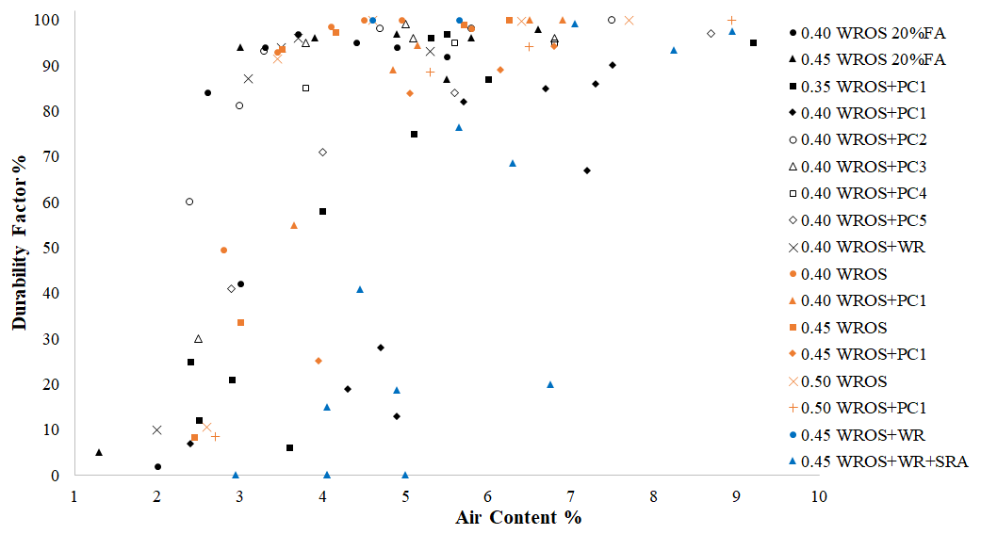
What air content do you use?
3.5 Months
Recommended
Not
Recommended
5 mins

Slide 12
What air content do you use?
3.5 Months
Recommended
Small bubbles
Not
Recommended
Large bubbles
5 mins

Slide 13
98 mixtures
91% agreement
3.5 Months
Recommended
Not
Recommended
Cliff of Doom
10 mins

Slide 14
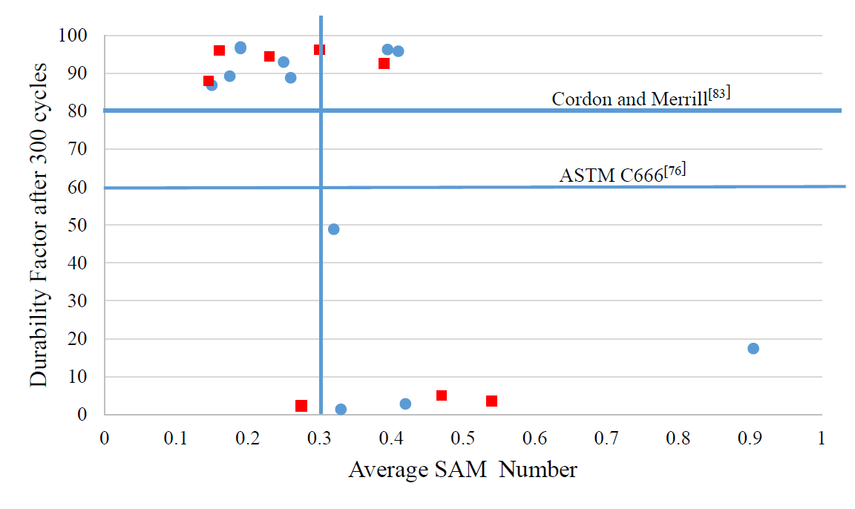
UNC Charlotte

Slide 15
Discussion
The SAM Number can better predict freeze thaw performance than the air volume.
The SAM Number can be determined in fresh concrete in about 10 mins.

Slide 16
Why are we doing this?
Concrete pumps are essential tools in the industry but it is hard to predict how pumping will impact the air void system in concrete.

Slide 17
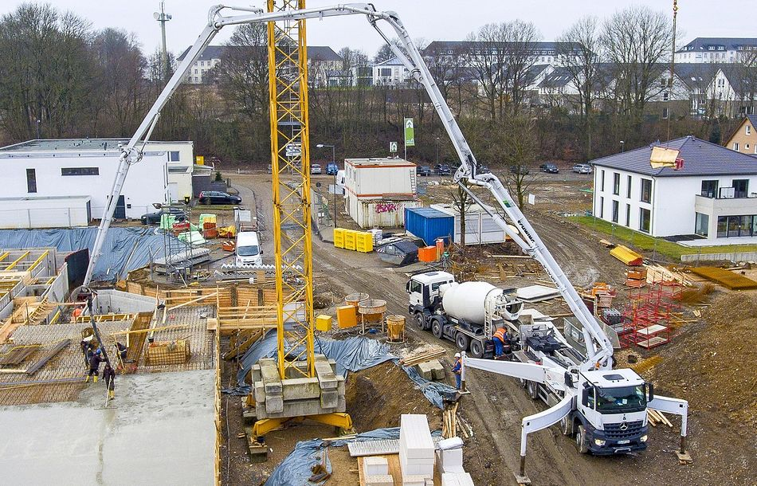

Slide 18
Concrete is delivered here

Slide 19
Concrete is delivered here
Concrete is sampled here

Slide 20


Slide 21


Ready Mix
General Contractor

Slide 22
Ready Mix
General Contractor
I brought you concrete with the right air!

Slide 23
Ready Mix
General Contractor
I brought you concrete with the right air!
It doesn’t have the right air any more!!!

Slide 24
How do people deal with this?
Increase the air volume before it goes into the pump so that it still has enough air when it comes out.
One time this worked….

Slide 25
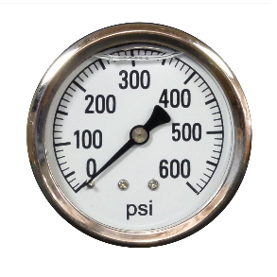

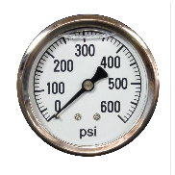


Mechanisms
How does pumping change air?
1. Pressure
2. Vacuum
3. Impact

Slide 26
Mechanisms
How does pumping change air?
1. Pressure
2. Vacuum
3. Impact

Slide 27
Methods
Investigate the following before and after pumping:
Air volume
SAM Number (air void spacing) AASHTO T 395
Spacing factor (air void spacing) ASTM C 457
Freeze-thaw performance ASTM C 666

Slide 28
Mixture Design
0.45 w/cm
20% Class C ash
6.5 sacks (611 lbs)
Limestone and natural sand
5” to 8” slump
Air contents from 4% to 8%
With and without water reducer/retarder
33 lab mixtures

Slide 29
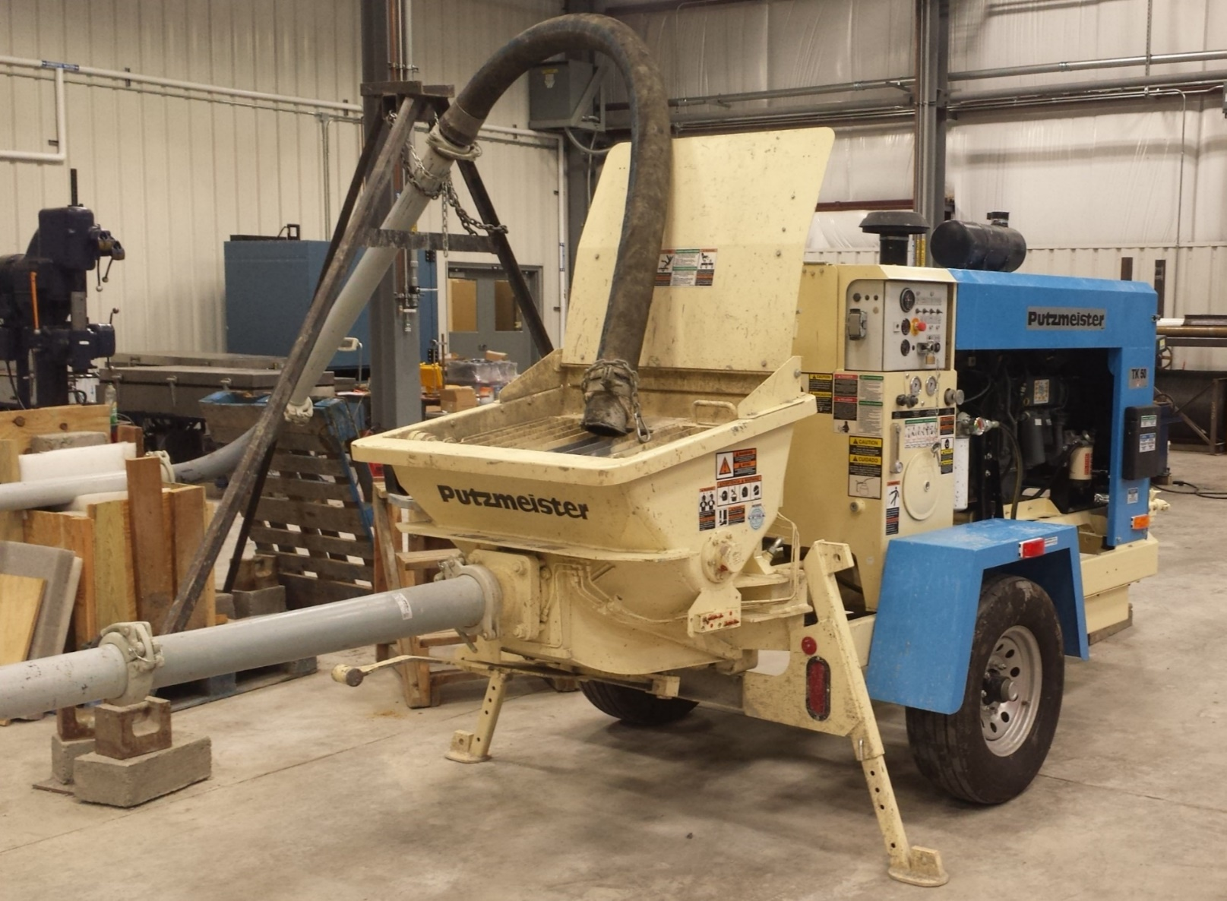

Slide 30
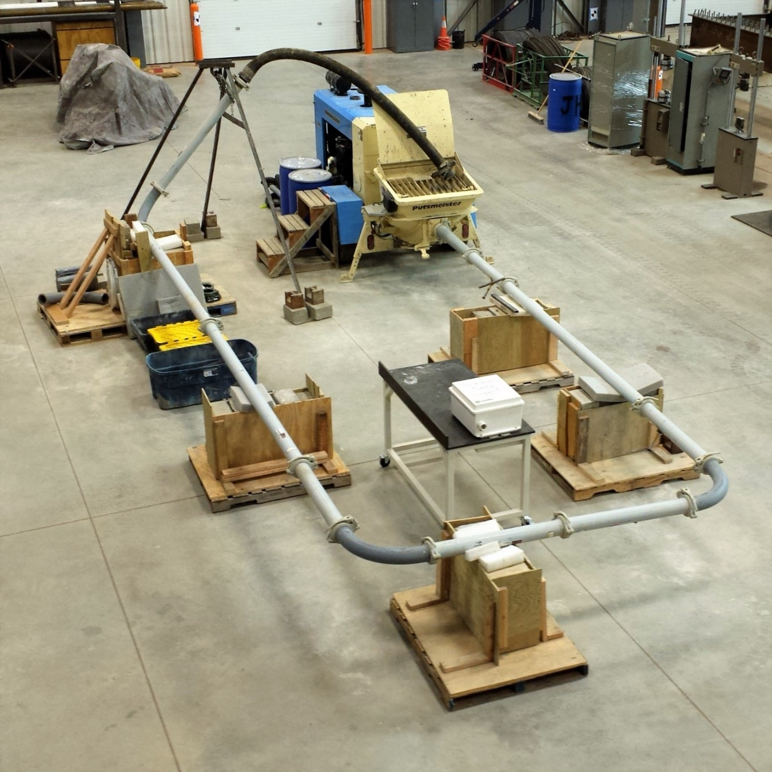
Pipe Network

Slide 31
Lab Pumping Information
4” diameter pipe
60’ of steel pipe
10’ Rubber hose
pumping pressures from 55 to 110 psi

Slide 32
Lab data

Slide 33
Pumped concrete
Non-pumped concrete
Lab data

Slide 34

Summary
Before Pumping
After Pumping
Hardened Concrete
33
Fresh Air > 4.0%
SAM # < 0.32
Notes:
Acceptable before pumping, Air greater than 4% and SAM less than 0.30.

Slide 35

Summary
Before Pumping
After Pumping
Hardened Concrete
33
Fresh Air > 4.0%
SAM # < 0.32
11
Fresh Air > 4.0%
SAM # < 0.32
22
Fresh Air < 4.0%
SAM # > 0.32
Notes:
Acceptable before pumping, Air greater than 4% and SAM less than 0.30.

Slide 36
Summary
Before Pumping
After Pumping
Hardened Concrete
33
Fresh Air > 4.0%
SAM # < 0.32
11
Fresh Air > 4.0%
SAM # < 0.32
33
ASTM C666
Durability Factor > 70%
22
Fresh Air < 4.0%
SAM # > 0.32
Notes:
Acceptable before pumping, Air greater than 4% and SAM less than 0.30.

Slide 37
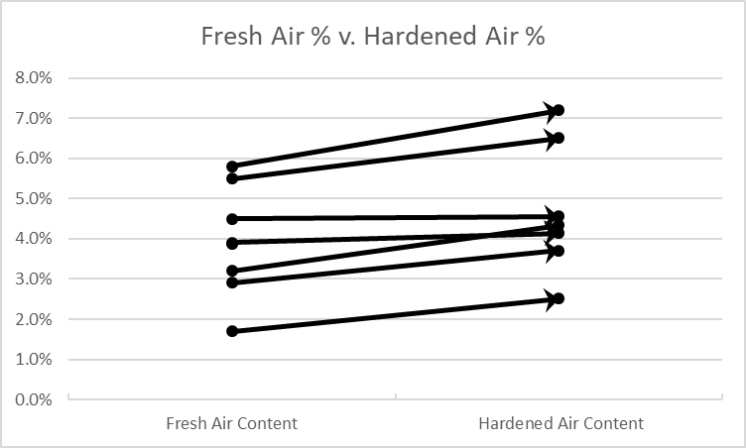
A Clue!!!
Fresh air content after pumping
Hardened air content after pumping
Notes:
Acceptable before pumping, Air greater than 4% and SAM less than 0.30.

Slide 38
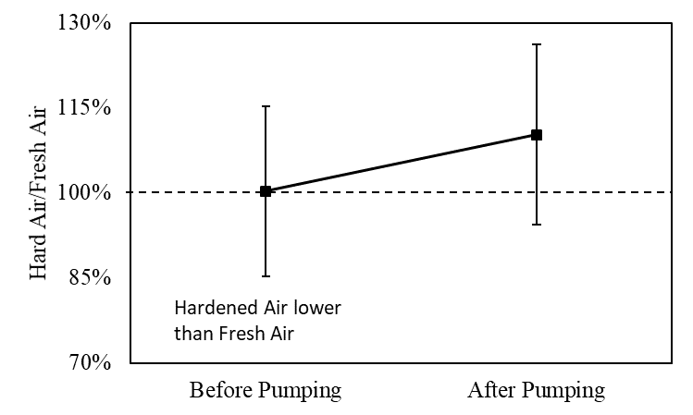
Hardened air higher than fresh air
Hardened air lower
than fresh air

Slide 39
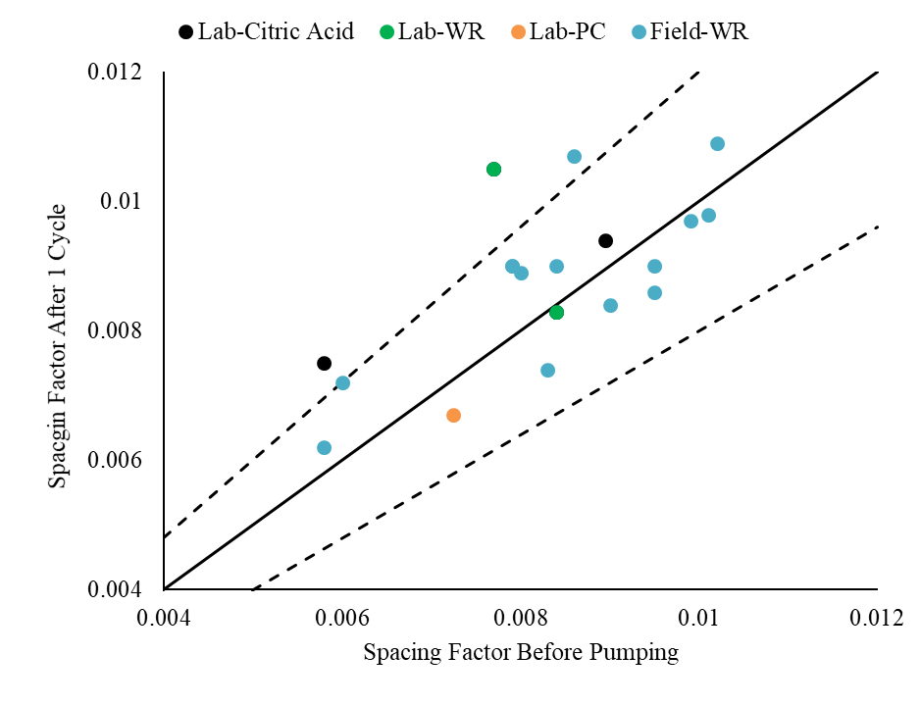
Line of agreement
Variation of test method

Slide 40
Discussion
Satisfactory freeze thaw performance of pumped concrete was observed even though there were low air contents and high SAM Numbers after pumping.
BUT! There is minimal change in the spacing factor measured on the hardened concrete taken before and after pumping.

Slide 41
Discussion
The hardened and fresh measurements closely matched prior to pumping.
After pumping the hardened air content was on average 1.15x higher in the fresh air content.
For example – After pumping 6% fresh and about 7% in hardened concrete
The fresh measurements after pumping do not represent the performance or properties of the hardened concrete.

Slide 42
Reliable
Reliable
Unreliable
Before Pumping
After Pumping
Hardened Concrete
33
Fresh Air > 4.0%
SAM # < 0.32
11
Fresh Air > 4.0%
SAM # < 0.32
33
ASTM C666
Durability Factor > 70%
22
Fresh Air < 4.0%
SAM # > 0.32
Notes:
Acceptable before pumping, Air greater than 4% and SAM less than 0.30.

Slide 43
Does this hold for other equipment and mixtures?
What is going on in the field?

Slide 44
Field Pumping Information
30 different projects
62 different mixtures tested
Bridge decks, walls, sidewalk, parking lot, drilled shaft
18 Different Types of Pumps
Boom lengths ranged from 100’ to 180’
Pipes from 4” to 6” in diameter
Used three different boom configurations

Slide 45
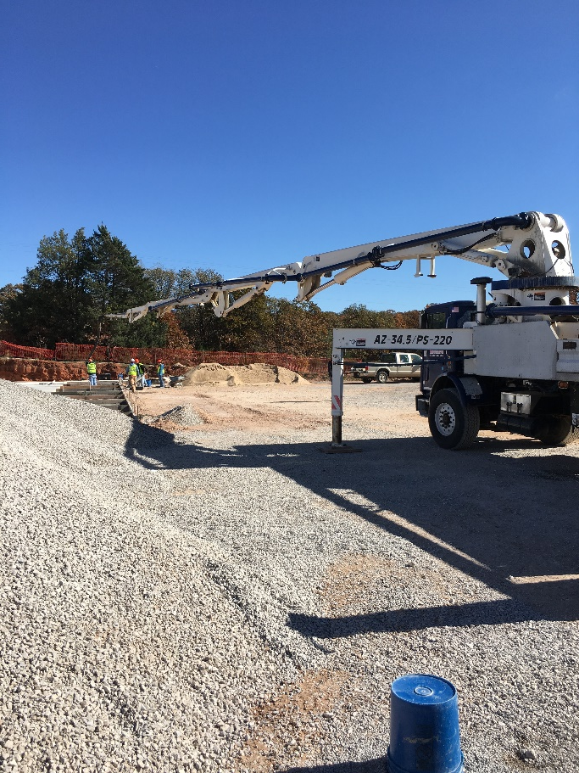
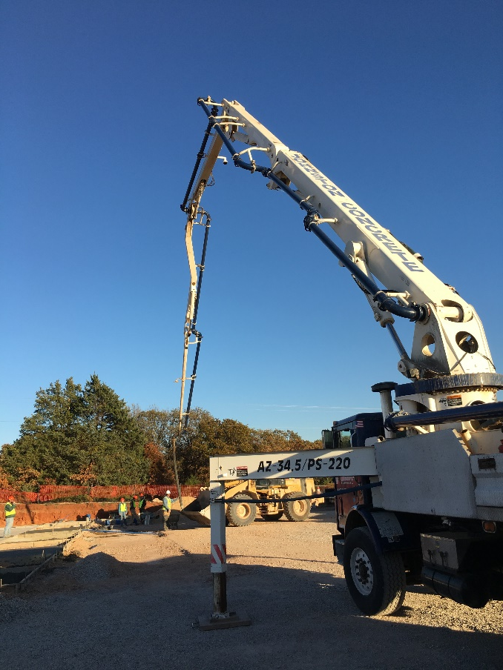
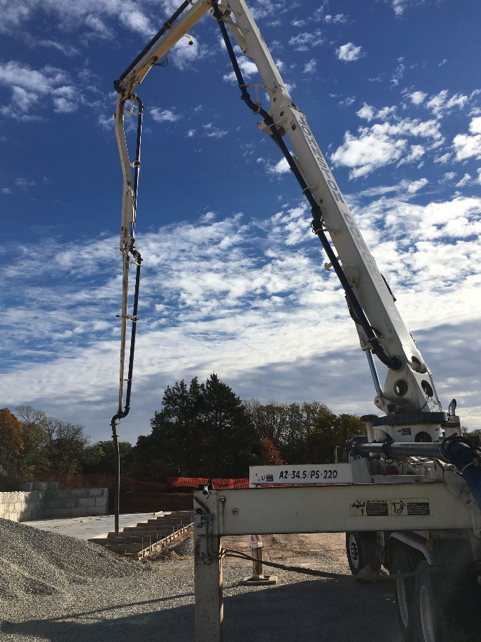
Flat
Arch
A-Frame

Slide 46
Pump configurations
Flat
Arch
A-frame

Slide 47
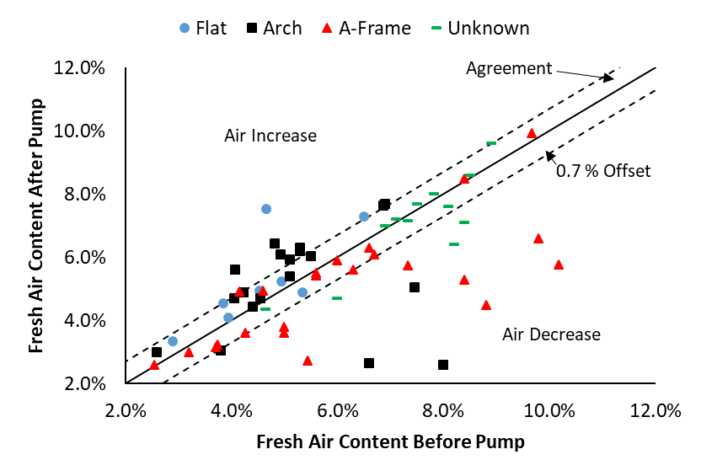

Slide 48
24% Decrease
- 35% A-Frame
- 21% Arch

Slide 49
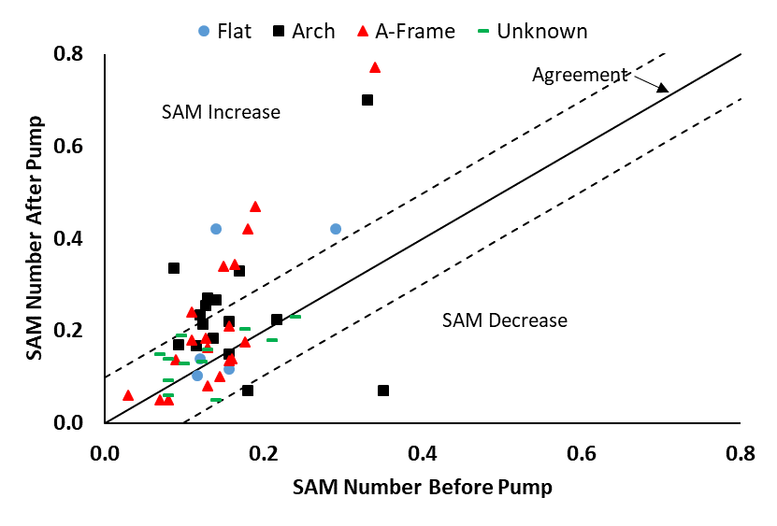
0.098 offset

Slide 50
29% Increase
- 32% A-Frame
- 44% Arch
- 40% Flat
0.098 offset

Slide 51
Discussion
Air Content
  24% of samples show a significant decrease
  A-frame caused the most impact on the air volume after pumping
SAM Number
  29% of samples increased significantly
  Arch configuration caused the most impact on void spacing after pumping

Slide 52
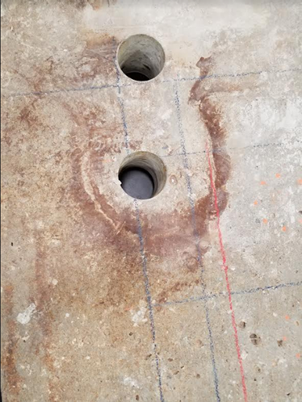
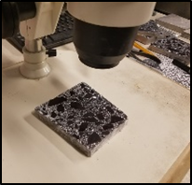
How about the hardened concrete?

Slide 53
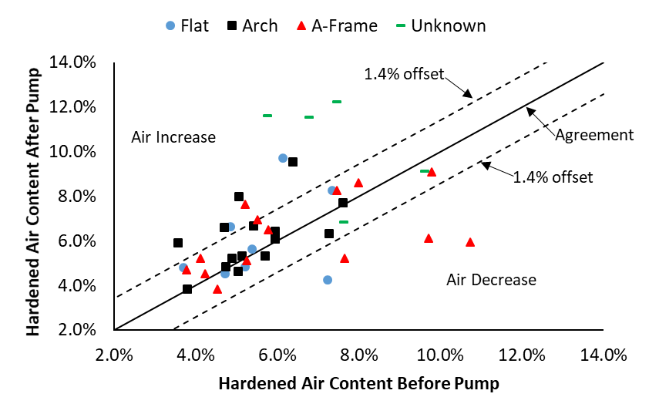

Slide 54
23% Increase!

Slide 55
Hardened air higher than fresh air
Hardened air lower
than fresh air
Before Pumping
After Pumping
Field data
Arch results are similar. Flat shows little loss in air.
55

Slide 56
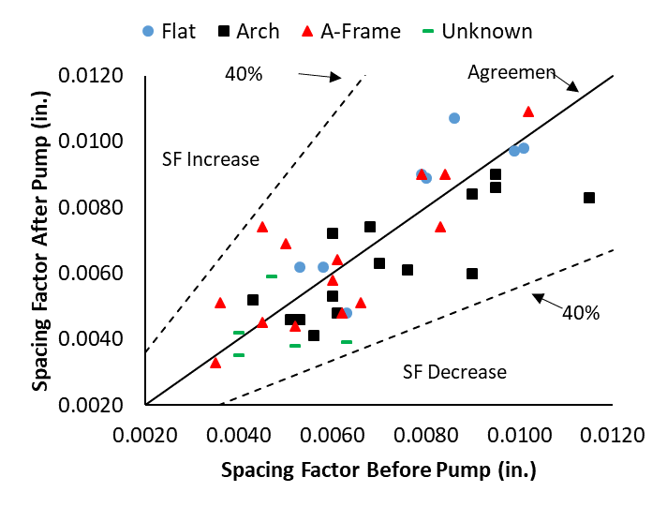

Slide 57
Discussion
The hardened and fresh measurements closely matched prior to pumping.
After pumping the hardened air content was on average 1.15x higher than the fresh air content.
For example – After pumping 6% fresh and about 7% in hardened concrete
There is no significant change in the spacing factor when comparing data before and after pumping.

Slide 58
Discussion
These are the same findings from the lab but with different pump configurations, equipment, and materials!!!!
The fresh measurements after pumping do not seem to represent the performance or properties of the hardened concrete.

Slide 59
What is happening?

Slide 60
What is happening?
Back to the lab!!!!

Slide 61
Where does the air change within the pump network?

Slide 62
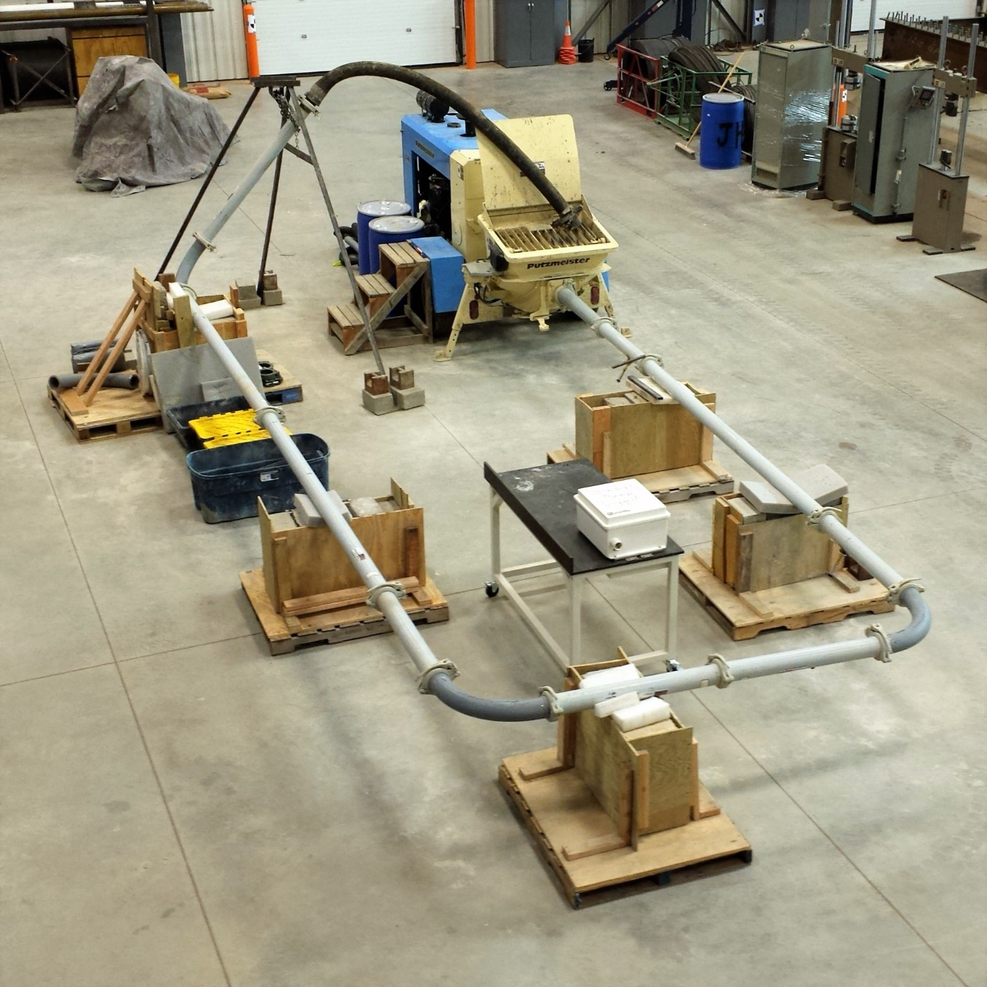
a
b
f
c
e
d

Slide 64
Discussion
The air is lost right after the pump and stays almost constant throughout the pipe network.
Additional piston strokes (pressure cycles) did not cause additional air to be lost.
The air loss coincides with point of highest pressure.

Slide 65
Why does this happen?
  Henry’s Law – p=kc
      p=partial pressure of the gas
      c=concentration of the dissolved gas in solution
      k=constant
  Pressure
  Dissolved gas

Slide 66
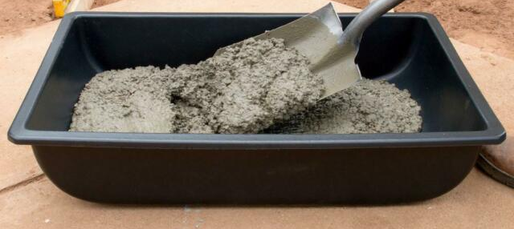
Air and SAM over time
We pumped concrete and measured how the air volume and SAM Number change over time.
Sampling time
after pumping
15 min
30 min
45 min

Slide 69
Bubbles go away
Bubbles come back?

Slide 72
Bubble spacing increases
Bubble spacing decreases?

Slide 73
What is happening???
The pressures from pumping causes the small bubbles to temporarily dissolve
But good performance in the petrographic analysis, freeze-thaw testing, and reducing SAM Number over time suggests that the dissolved air comes back before the concrete hardens.
When the air comes back it seems to be well dispersed and provides a similar spacing factor to what went into the pump.

Slide 74

Notes:
Acceptable before pumping, Air greater than 4% and SAM less than 0.30.

Slide 75
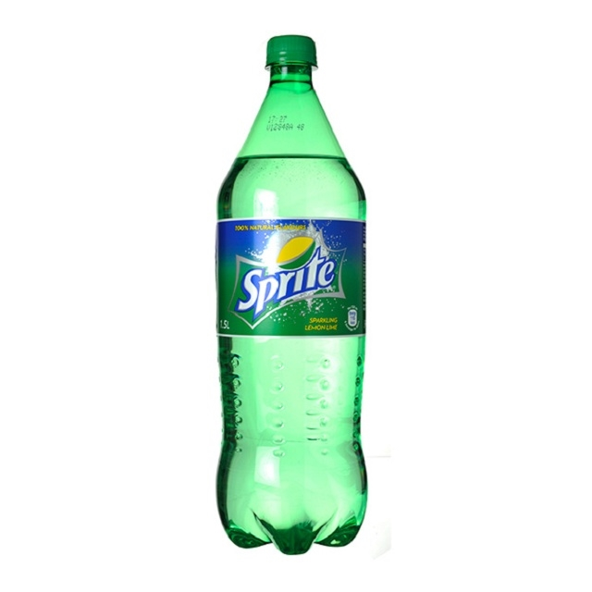
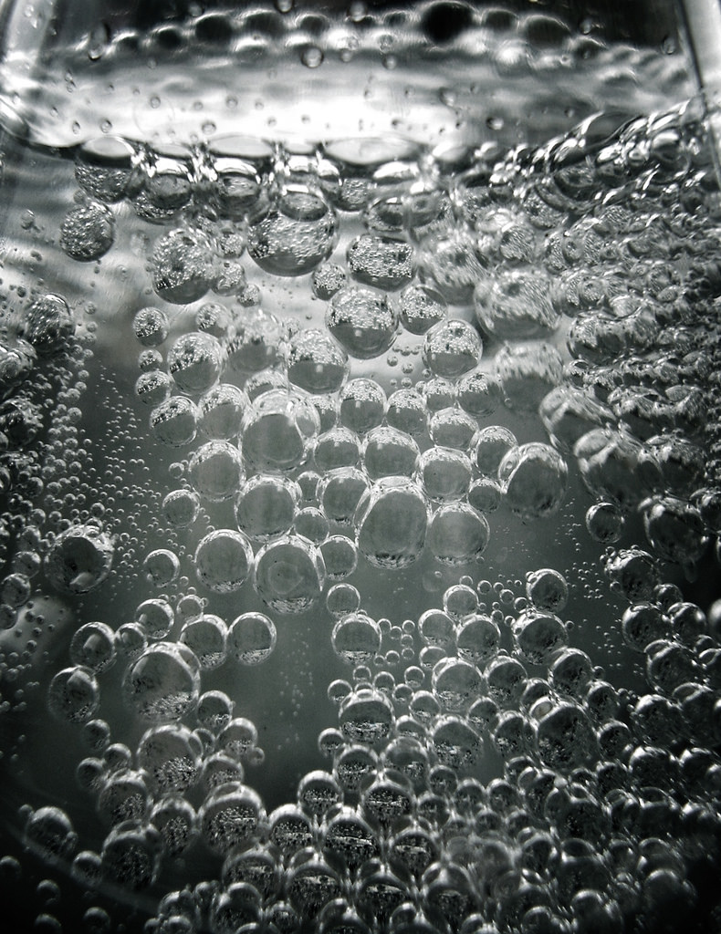

Slide 76


Slide 77









BUBBLES

Slide 78
What does this mean?
Air Content and SAM testing after pumping are not representative of the hardened concrete.
If this is true then concrete should not be rejected for low air or high SAM Number after pumping.
It appears that sampling the concrete prior to pumping is a good indicator to the air void system in the hardened concrete.

Slide 79
What do I think needs to happen?
Testing air at the point of discharge from a pump is dangerous and it is not representative of the properties of the hardened concrete.
We need to test concrete before pumping and not require testing at the point of placement.

Slide 81
Concrete is delivered here

Slide 82
Concrete is sampled here
Concrete is delivered here

Slide 83
What do I think needs to happen?
I think our air testing needs to be done with the SAM because it better correlates with freeze thaw performance.
We need to have local discussions about how we need to change specifications and construction practices.

Slide 84
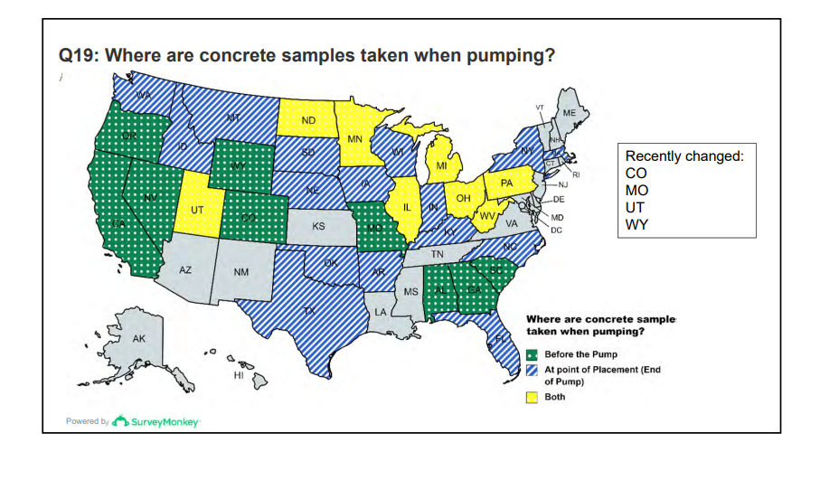
OK
Doing research
MN, IA, WI, KS, AR

Slide 85
OK
12 States no longer test before the pump
Doing research
MN, IA, WI, KS, AR

Slide 86
Specification changes are being discussed in the following states
Minnesota
Iowa
Wisconsin
Kansas
Arkansas

Slide 87
Specification changes
FHWA is sponsoring more research with me right now to produce more data.
The testing is done and we are preparing the reports.
There are no changes to my conclusions or recommendations.

Slide 88
Conclusion
Pumping was observed to modify the air content and SAM Number in both the lab and the field testing.
Based on the hardened air void analysis, freeze thaw testing, and changing SAM Number over time, the small bubbles seem to return to the concrete with a similar air void distribution and freeze thaw performance as was in the concrete before pumping.
The SAM was an invaluable tool to give insights into the performance of air before and after a concrete pump.

Slide 89
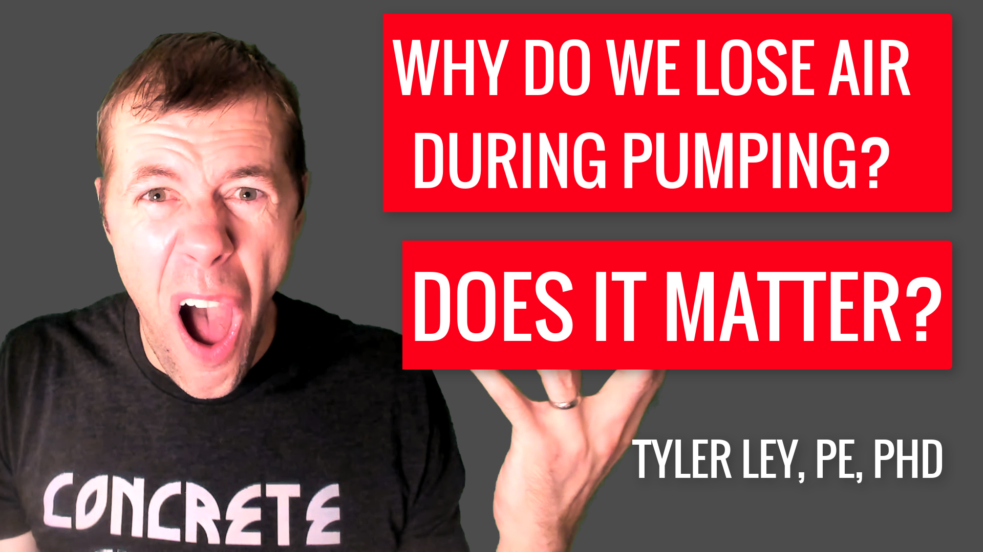
www.youtube.com/tylerley

Slide 90


Questions?
www.tylerley.com
Tyler.ley@okstate.edu

Slide 92
What can I do to avoid air loss?
Air loss seems to happen more in the following situations:
  Higher pumping pressures
  Smaller diameter lines
  Mixtures with poor aggregate gradations
  Lower slump mixtures
  A-frame and arch configurations

Slide 93
How does this change the bubble size distribution?

Slide 94
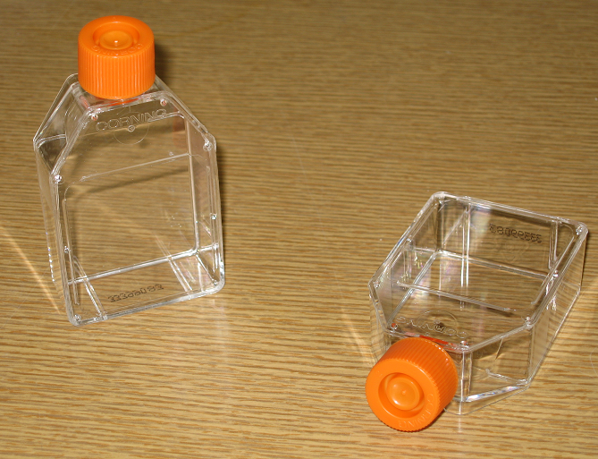
0.75”
2”
0.75”
2”

Slide 95
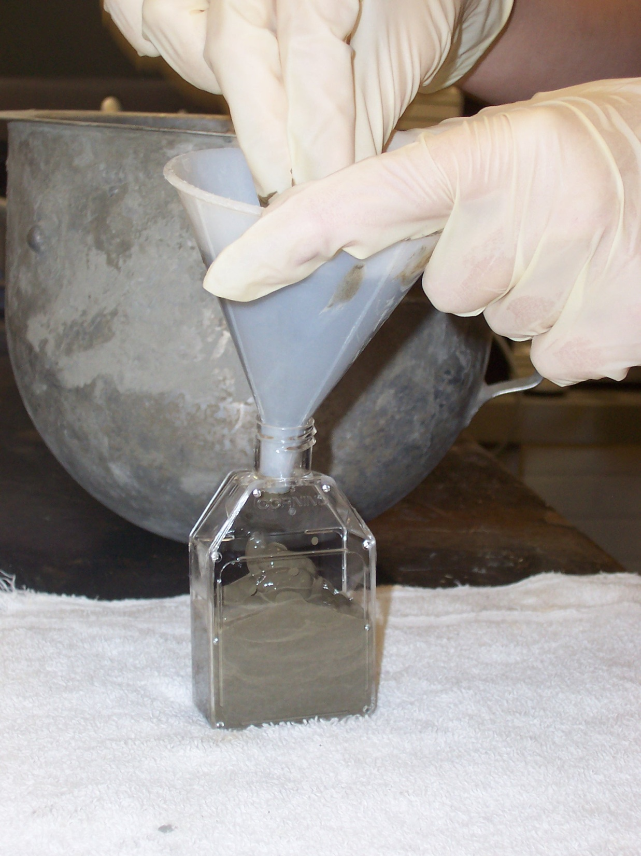

Slide 96
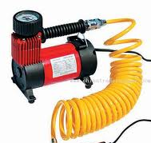
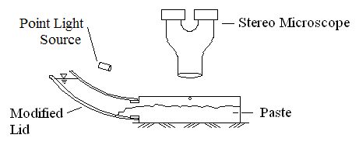
Air pump

Slide 97
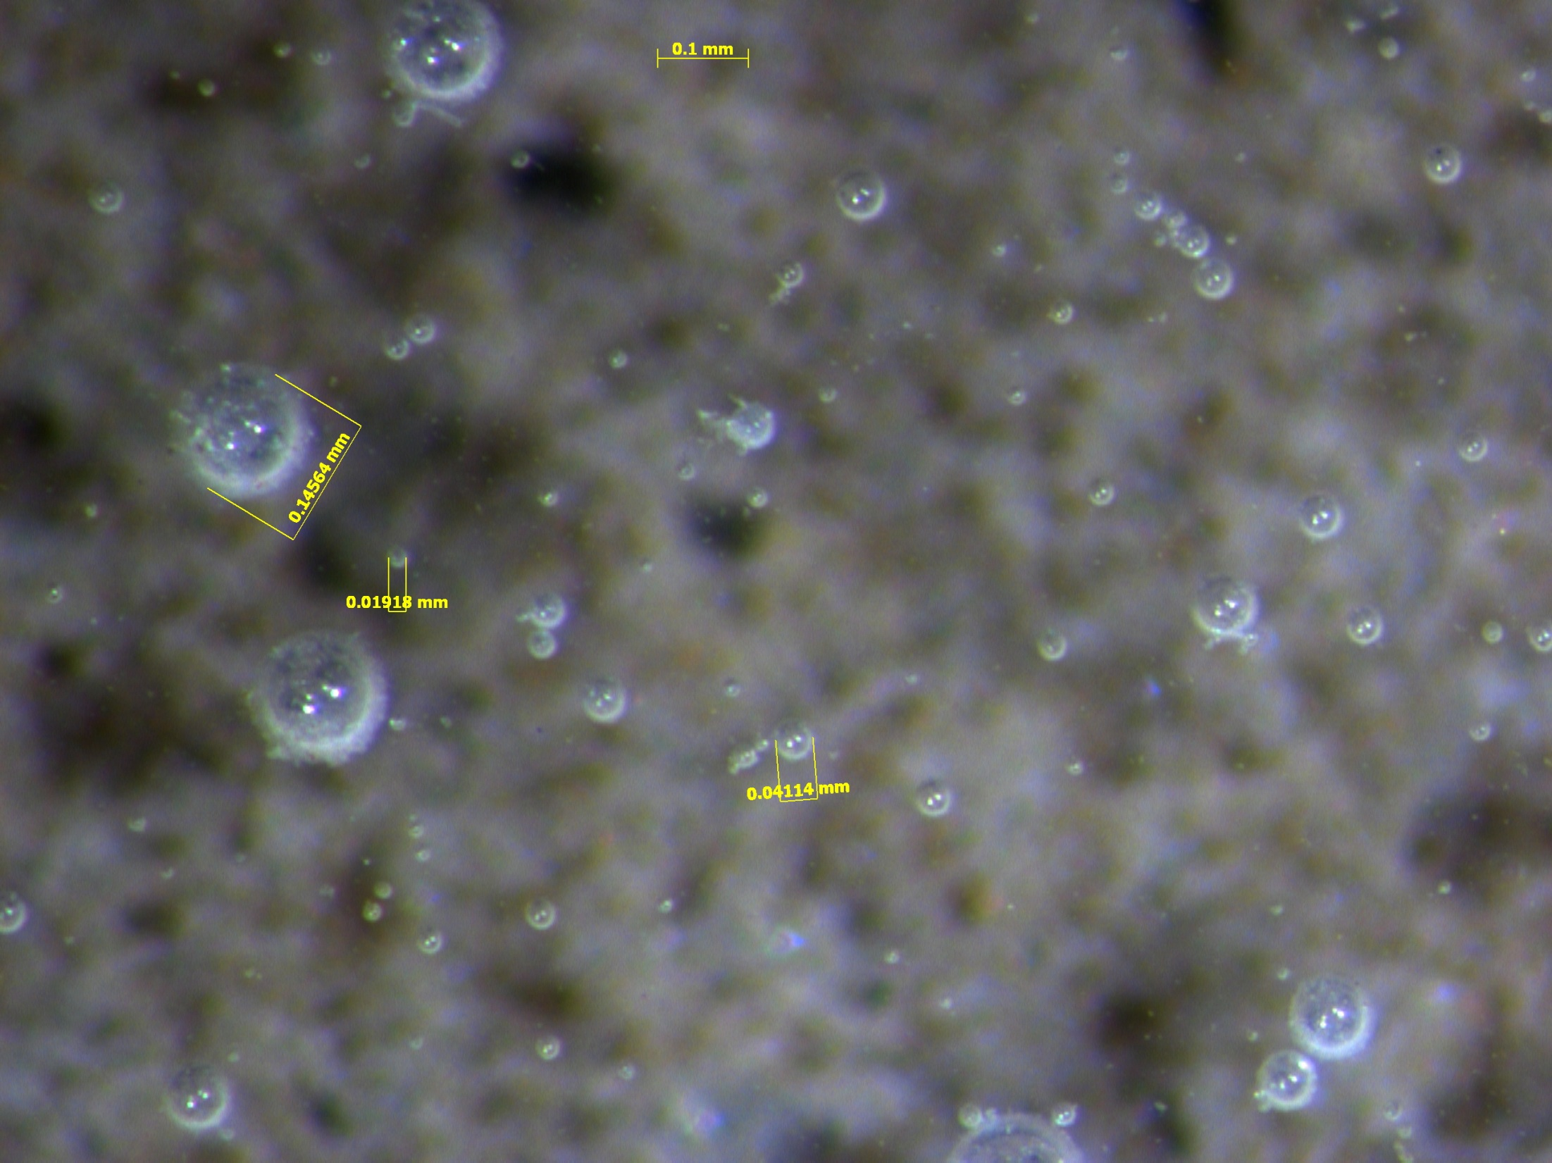
pressure step 0
atmospheric pressure
synthetic AEA

Slide 98
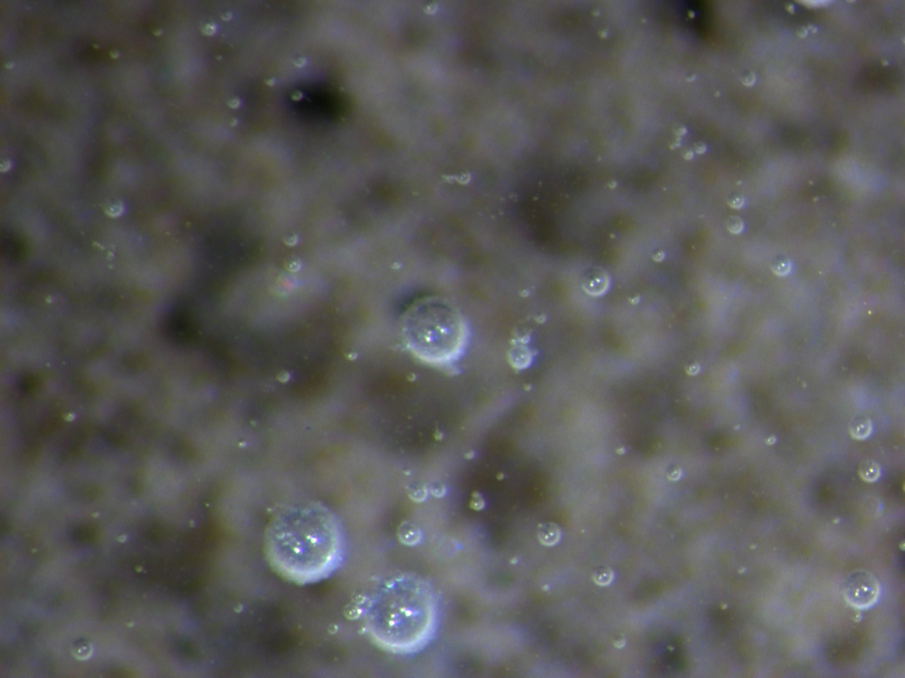
pressure step 1

Slide 99
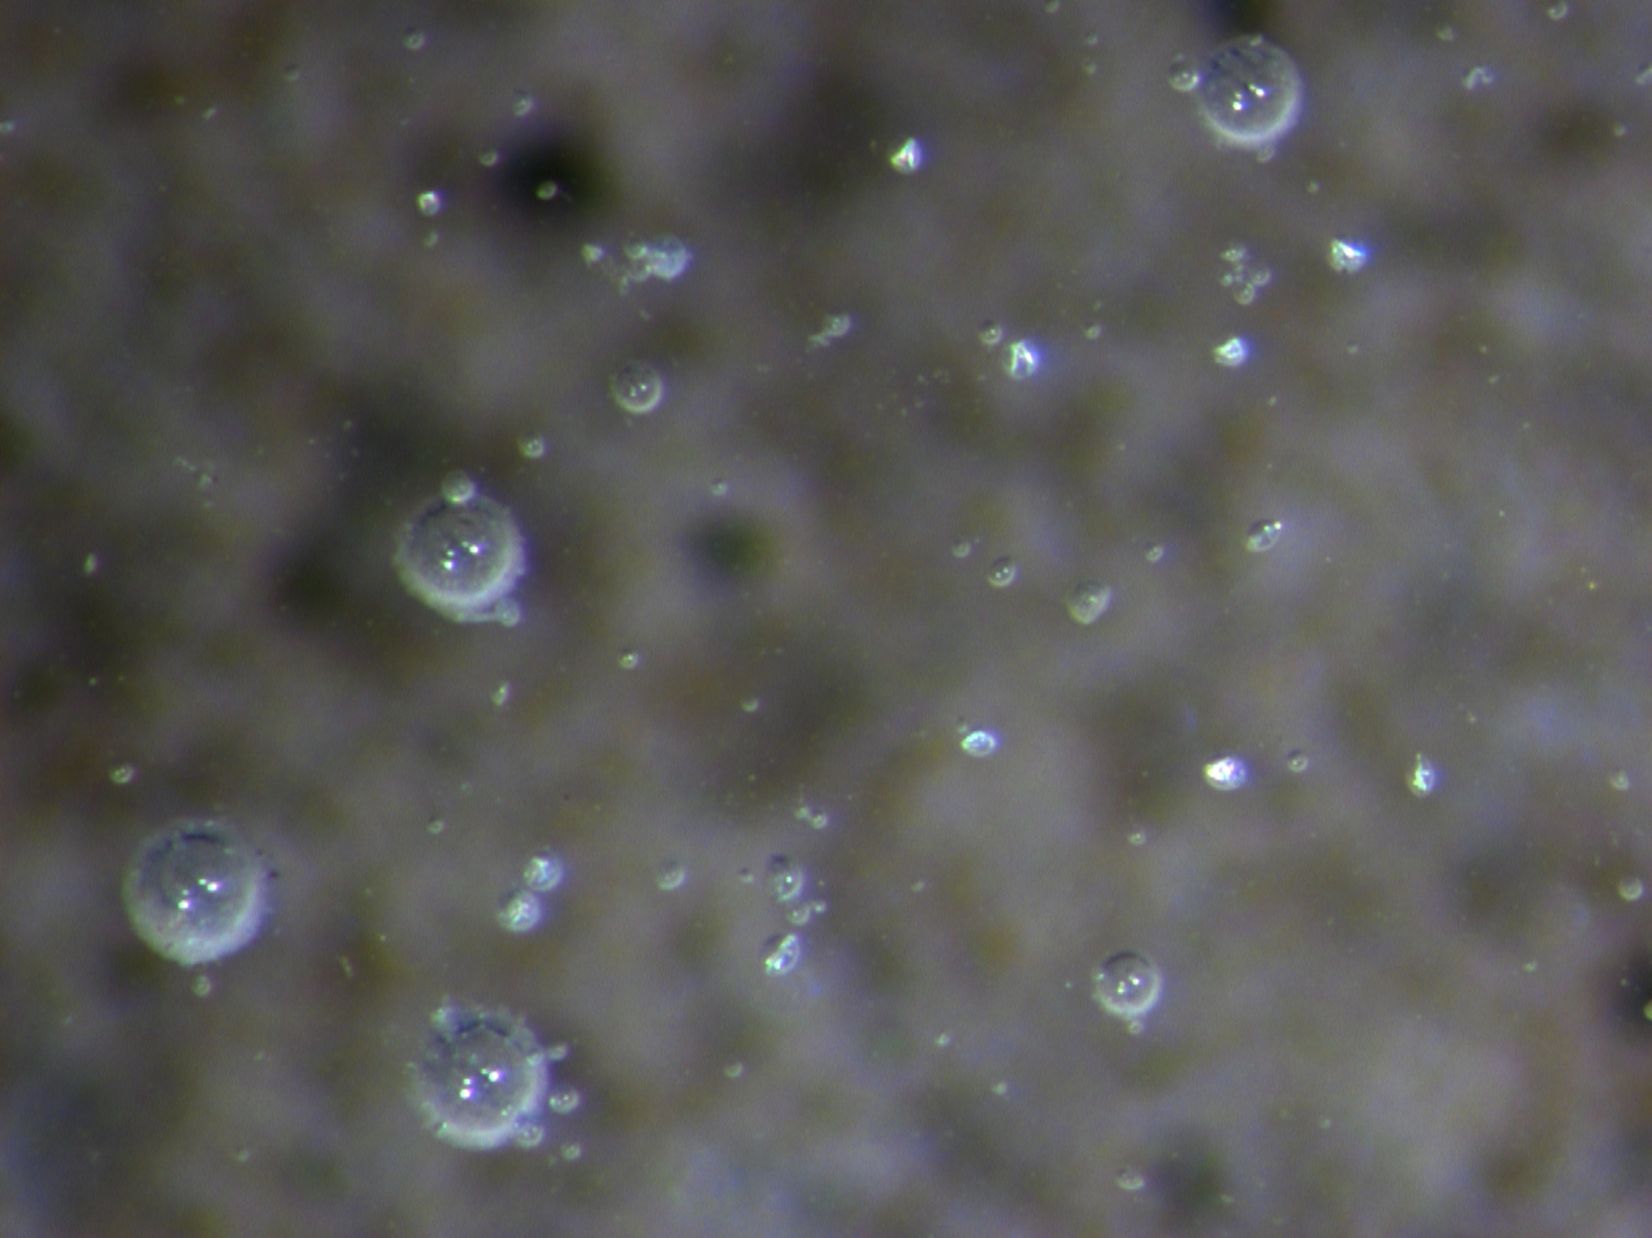
pressure step 2

Slide 100
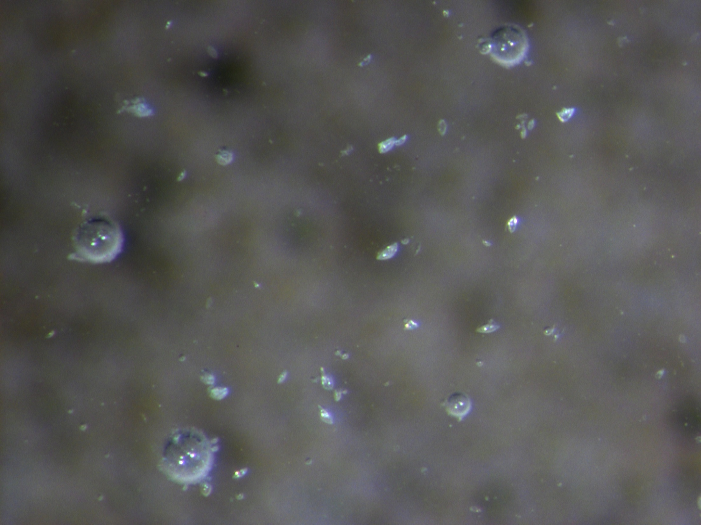
pressure step 3

Slide 101
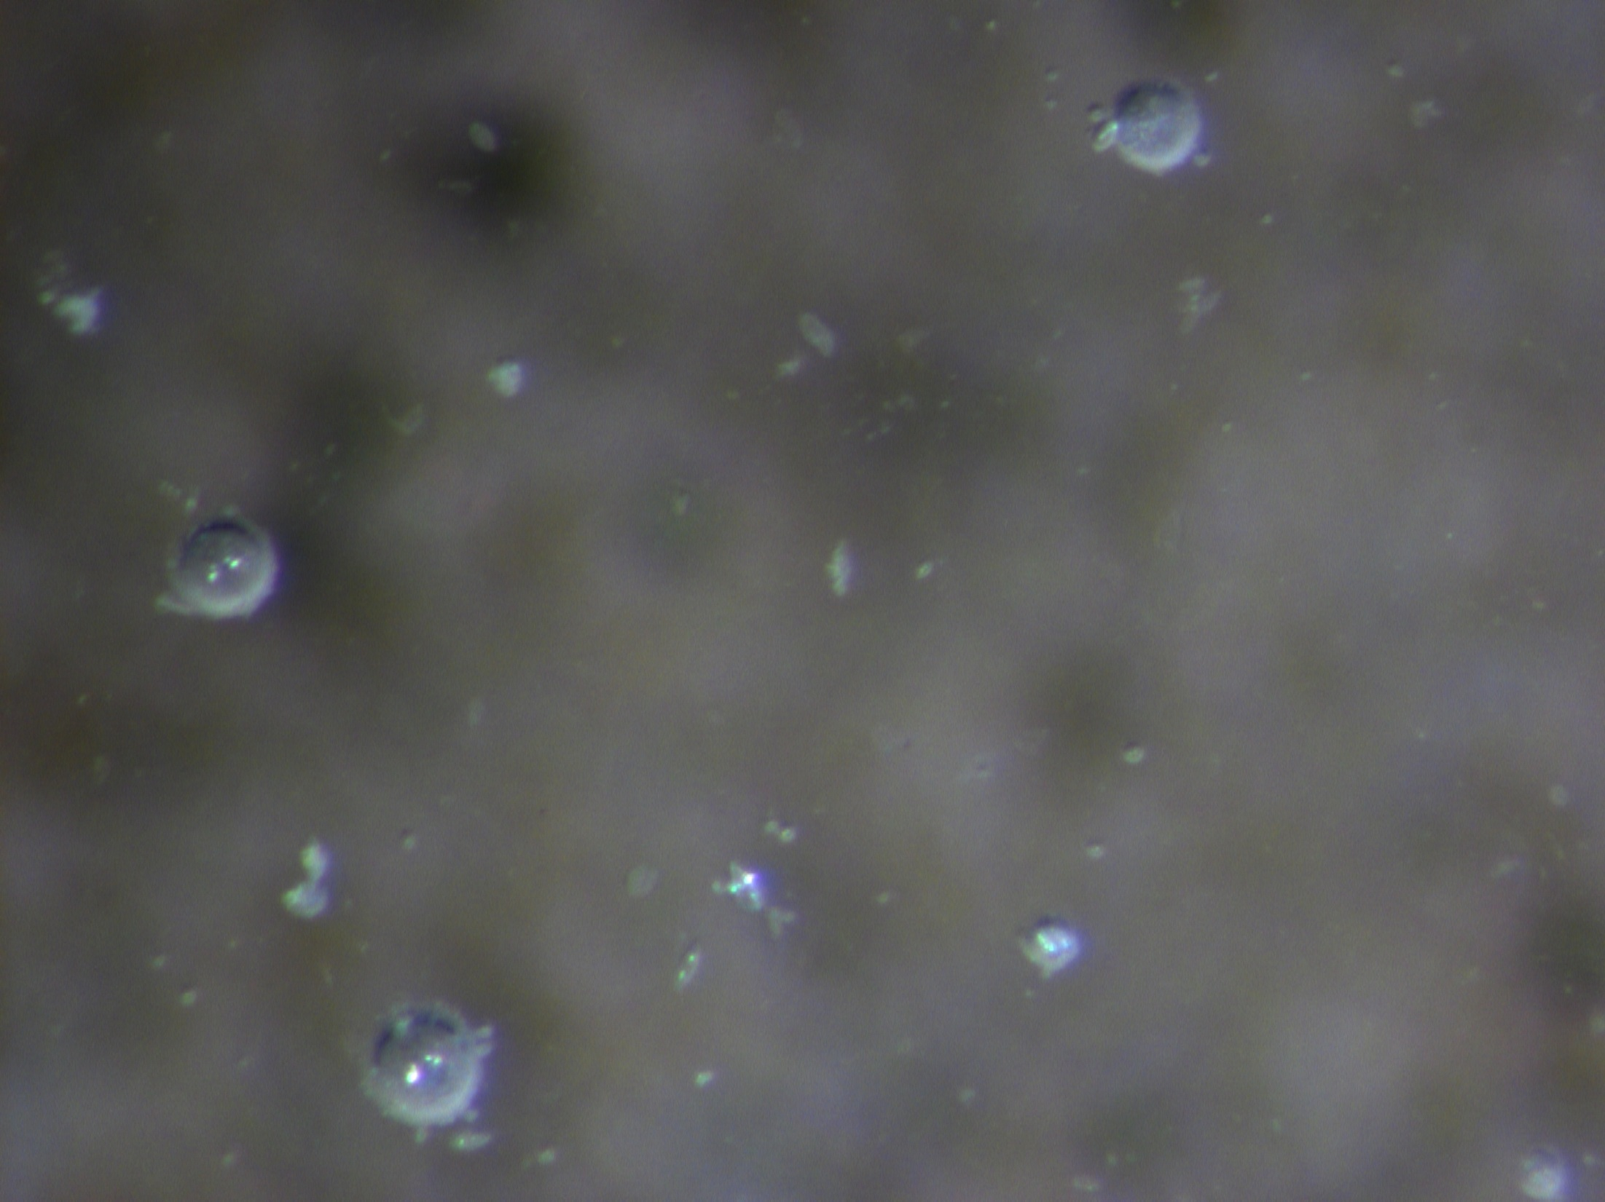
pressure step 4

Slide 102
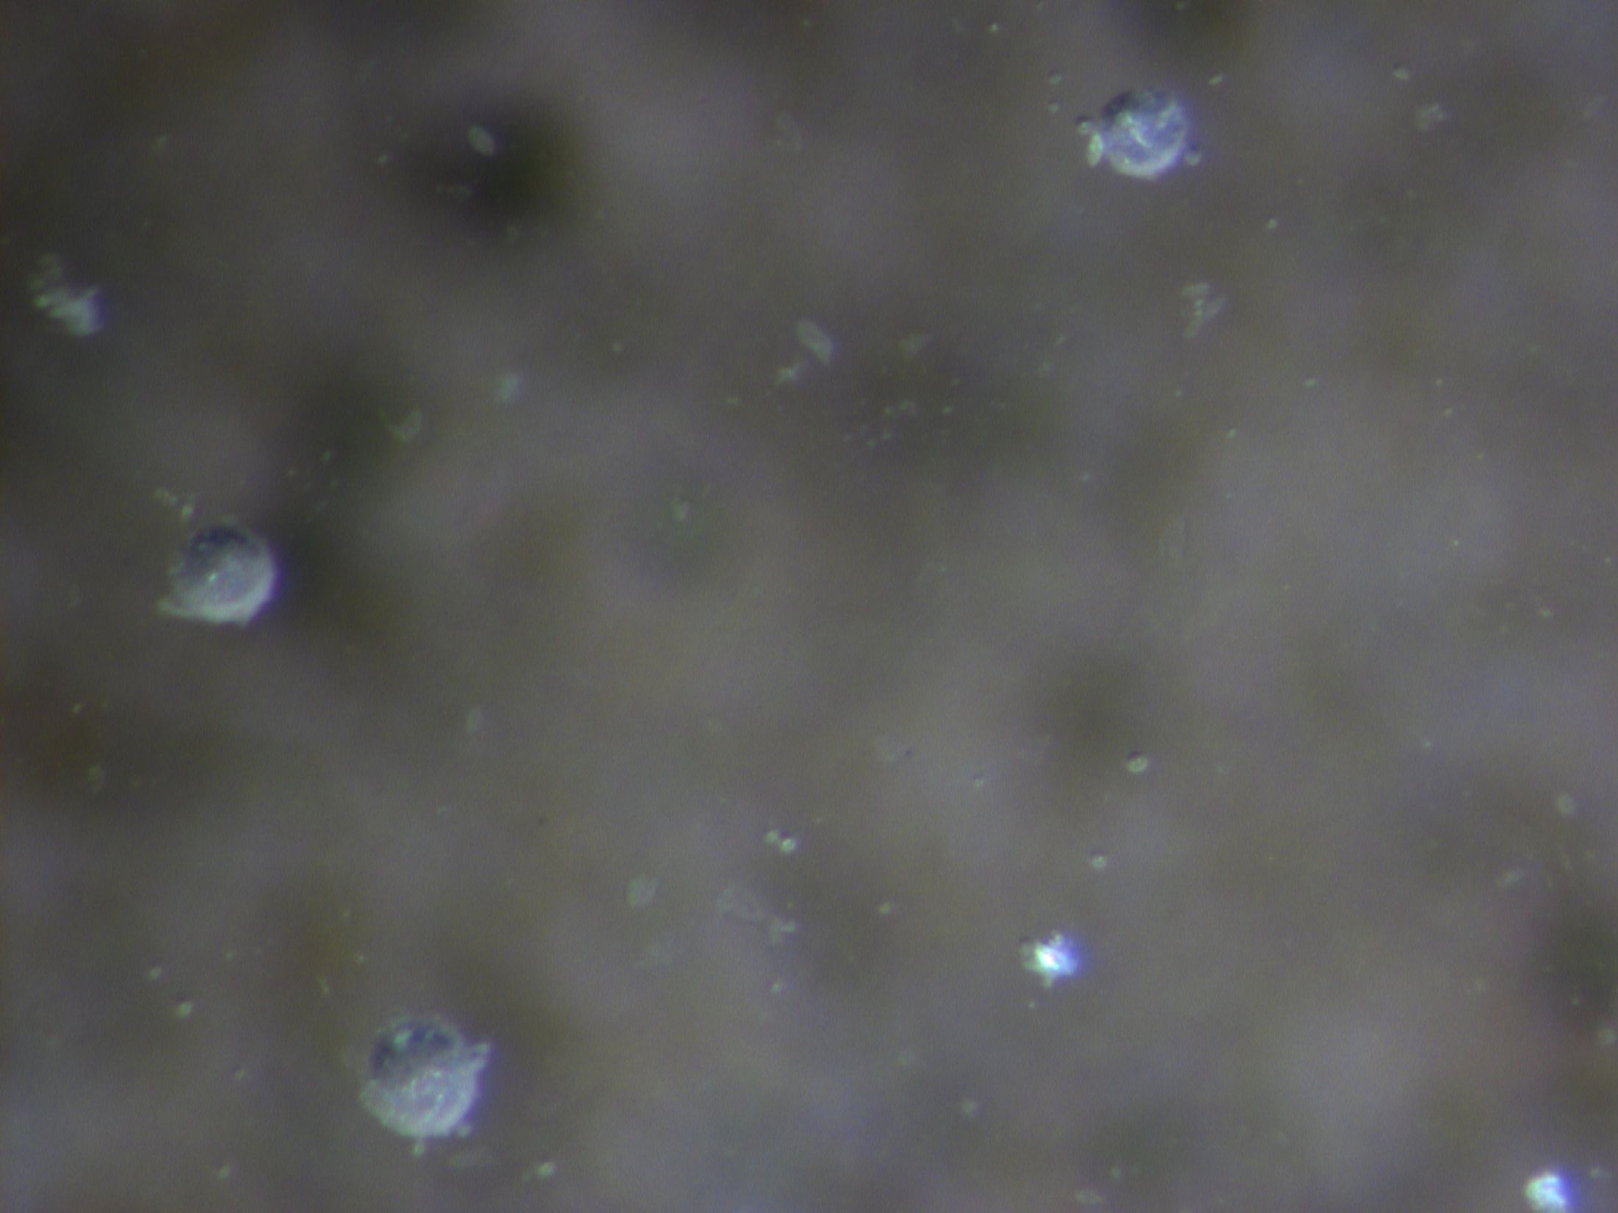
pressure step 5

Slide 103
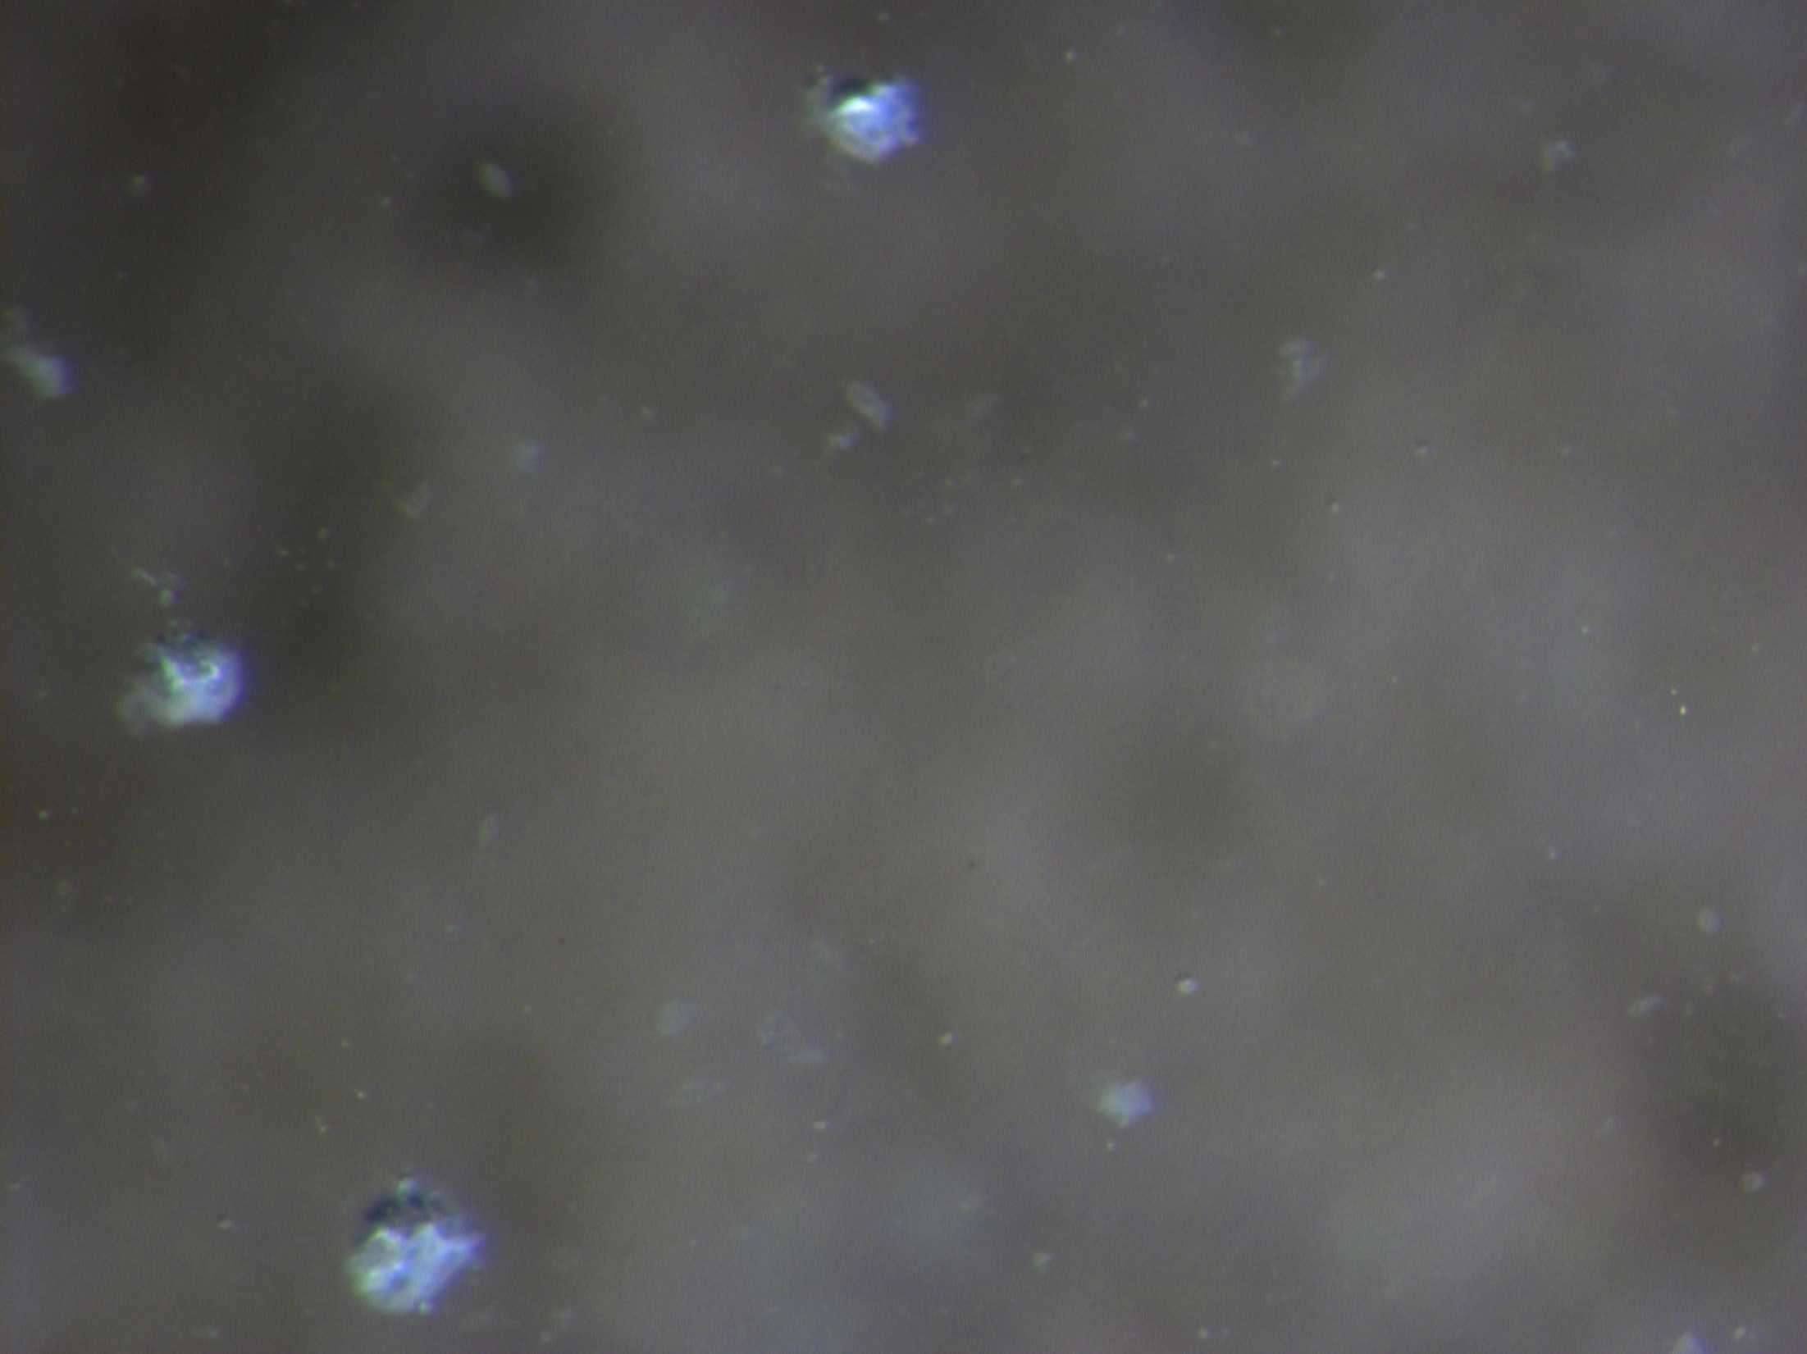
pressure step 6

Slide 104
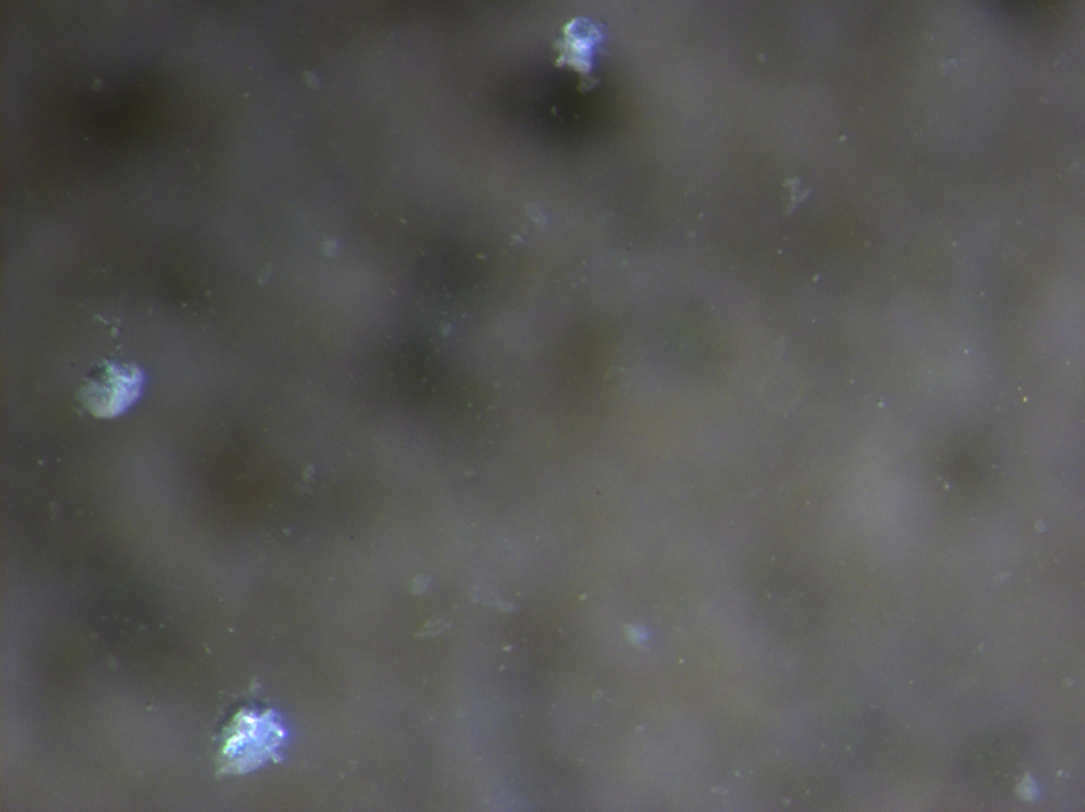
pressure step 7

Slide 105
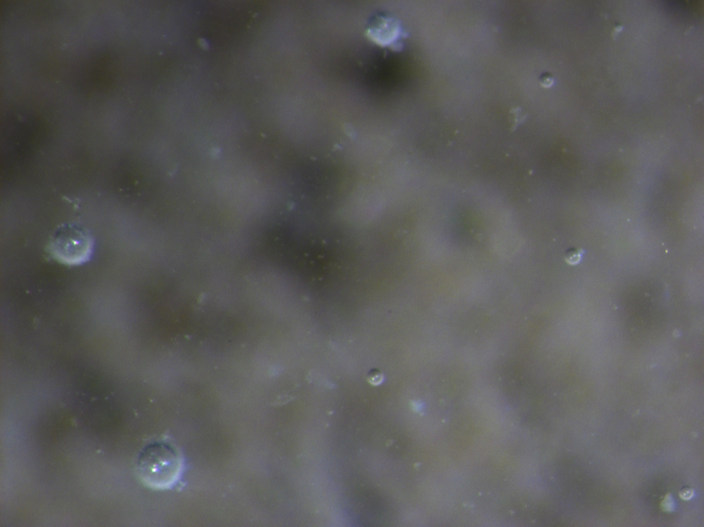
Atmospheric pressure

Slide 106
pressure step 0
atmospheric pressure

Slide 107
Discussion
1. As the pressure increases the small bubbles dissolve into the surrounding solution
2. These bubbles do not immediately come back when you decrease the pressure.

Slide 108
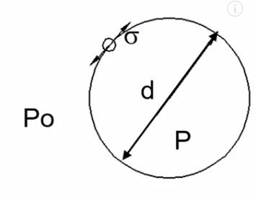
Why do the small bubbles dissolve???
  Laplace-Young Equation
  P1=P0+4σ/d
        P₁=internal pressure of the air bubble
        P₀=pressure of fluid surrounding the bubble
        σ=surface tension of the bubble film
        d=bubble radius
This means the small bubbles have higher pressure than the large bubbles.

Slide 109
Why do the bubbles dissolve?
Why do the small bubbles dissolve???
The small bubbles have a large curvature. This makes it easier for the bubble walls to become damaged and the air will dissolve.

Slide 110
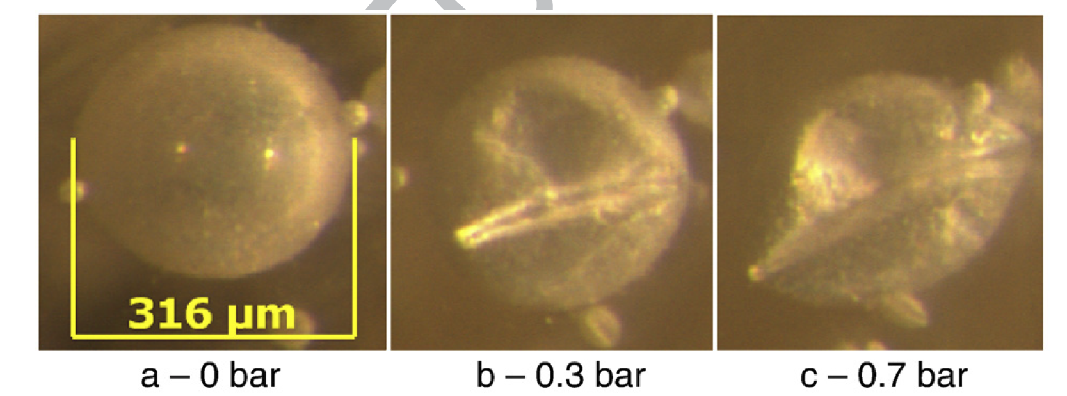

Slide 111
What does this mean?
The pressures during pumping causes the small bubbles to dissolve and so they are not present in the fresh concrete when it discharges from the pump.
This is why the air volume decreases and the SAM Number increases.

Slide 112
Remember!!!!

Slide 113
Remember!!!!
This means the air comes back with about the same spacing

Slide 114
What does this mean?
Air Content and SAM testing after pumping are not representative of the hardened concrete.
If this is true then concrete should not be rejected for low air or high SAM Number after pumping.
It appears that sampling the concrete prior to pumping is a good indicator to the air void system in the hardened concrete.

Slide 115
What do I think needs to happen?
Testing air at the point of discharge from a pump is dangerous and it is not representative of the properties of the hardened concrete.
We need to test concrete before pumping and not require testing at the point of placement.

Slide 116
What do I think needs to happen?
I think our air testing needs to be done with the SAM because it better correlates with freeze thaw performance.
We need to have local discussions about how we need to change specifications and construction practices.

Slide 118
Concrete is delivered here

Slide 119
Concrete is sampled here
Concrete is delivered here

Slide 120
Ready Mix
General Contractor
I brought you concrete with the right air!

Slide 121
Ready Mix
General Contractor
I brought you concrete with the right air!
YAY!!!
I love you.

Slide 122
BUBBLES

Slide 123
Conclusion
Pumping was observed to modify the air content and SAM Number in both the lab and the field testing.
Based on the hardened air void analysis, freeze thaw testing, and changing SAM Number over time, the small bubbles seem to return to the concrete with a similar air void distribution and freeze thaw performance as was in the concrete before pumping.
The SAM was an invaluable tool to give insights into the performance of air before and after a concrete pump.

Slide 124
Quick update on spec changes
Alaska, New York, Oklahoma, Utah and Oregon do not test after the pump in most conditions.
Minnesota, Wisconsin, Kansas, and Arkansas are doing their own testing to change their specs.
FHWA is sponsoring more research with me right now to produce more data. The testing is done and there are not changes in my conclusions.

Slide 125
www.youtube.com/tylerley

Slide 126
Questions?
www.tylerley.com
Tyler.ley@okstate.edu

Slide 128








BUBBLES

Slide 129
Sam Field Study
21 State DOTs + 1 Canadian Province helped analyze 231 concrete mixtures from 110 different projects
More than: 15 different SAMs and operators, 62 different aggregates, 19 cement sources, 20 different fly ashes , 39 different admixtures
60% pavements, 20% bridge decks, and 20% other
self-consolidating, precast, ready mix, and central mix concrete
Thank you to all that helped!

Slide 130
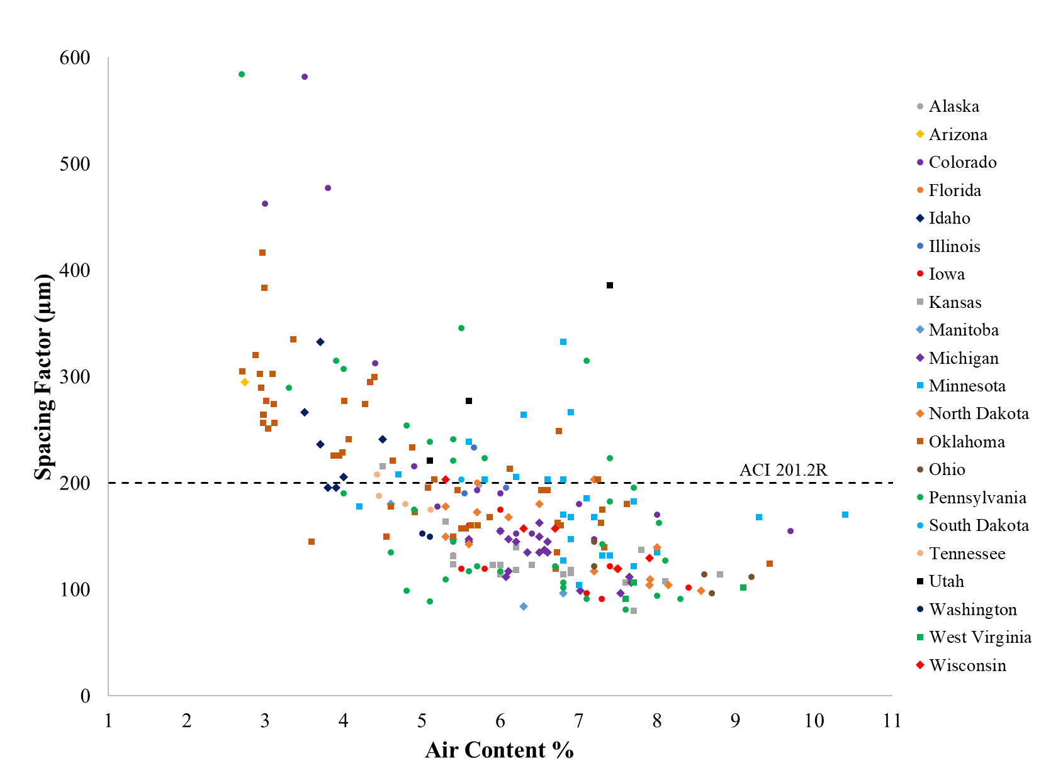
What air content do you specify?
231 field mixes
0.008”
spacing factor
Air content between 3.75% and 7.75% for 0.008” spacing factor

Slide 131
231 field mixes
These mixtures have good air contents and spacing factors that are not recommended
BAD BOX!
0.008”
spacing factor
Air content between 3.75% and 7.75% for 0.008” spacing factor

Slide 132
231 field mixes
These mixtures have good air contents and spacing factors that are not recommended
1/4 have a spacing factor > 0.008”
BAD BOX!
0.008”
spacing factor
Air content between 3.75% and 7.75% for 0.008” spacing factor

Slide 133
Summary
We need to know the size of bubbles within the concrete
The volume of air does not tell you about bubble size
25% of the time we are accepting concrete that does not meet the recommended air void quality
What if we could measure this in the fresh concrete???

Slide 134
Other studies with similar findings
Iowa DOT
Pennsylvania DOT
Vermont DOT
NCHRP Project lead by Peter Taylor
Lafarge Holcim
UNC Charlotte
Polish Researchers

Slide 135
Limits to signify a significant change
In order to determine if the air volume and spacing factor significantly changed the following standard deviations and coefficient of variations were used.
Concrete Parameter | 95% Confidence Boundary (2SD’s) | Referenced Standard
Fresh Air Content (%) | 0.7 | ASTM C231
SAM Number | 0.098 | AASHTO TP 118
Hardened Air Content (%) | 1.42 | ASTM C457
Spacing Factor (%) | 40.2* | ASTM C457

Slide 136
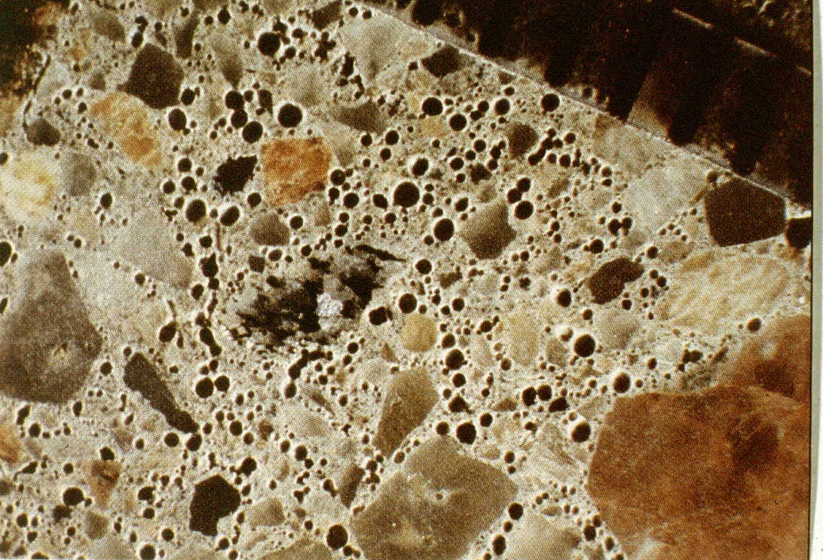
Hardened Air Void Analysis
From Hover

Slide 137
Hardened Air Void Analysis
From Hover

Slide 138
frequency
small voids
large voids
Freeman et al., 2012

Slide 139
frequency
Small bubbles
Large bubbles
small voids
large voids
Freeman et al., 2012

Slide 140
Spacing Factor – ½ of the average distance of an average sized void uniformly distributed in the paste
Desired Value < 0.008 in (ACI 201)
real concrete
idealized concrete
Spacing factor
from Hover

Slide 141
frequency
High spacing factor
Low spacing factor
small voids
large voids
Freeman et al., 2012

Slide 142
Small Bubbles
Large Bubbles
Ley et al., 2017

Slide 143
Summary
We need to know the size of bubbles within the concrete
The volume of air does not tell you about bubble size
What if we could measure this in the fresh concrete???

Slide 144
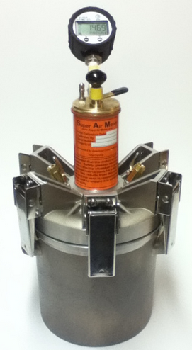
Super Air Meter
(SAM)
digital
gauge
six clamps!

Slide 145
Small Bubbles
Large Bubbles
Ley et al., 2017

Slide 146
Small Bubbles
Large Bubbles
Ley et al., 2017

Slide 147
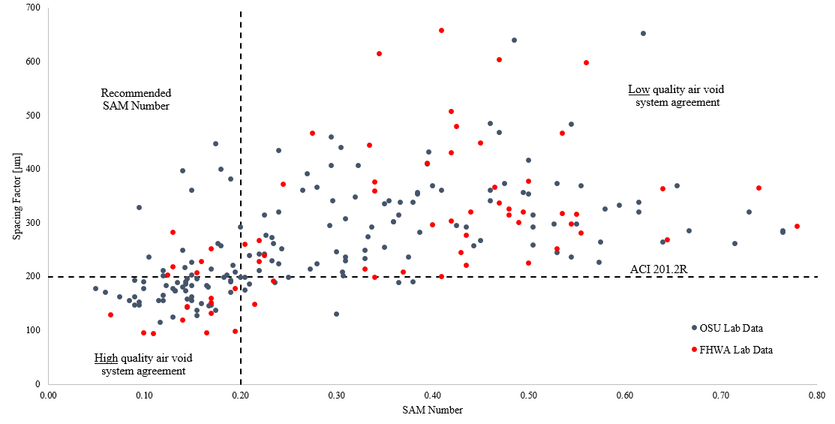
14 days
0.008”
spacing factor
10 mins in fresh concrete
88% agreement
Over 227 lab mixtures from two different research groups
Ley et al., 2017

Slide 148
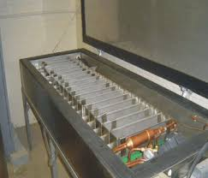
What about freeze thaw?

Slide 149
Lab data

Slide 150
Pumped concrete
Non-pumped concrete
Lab data

Slide 151

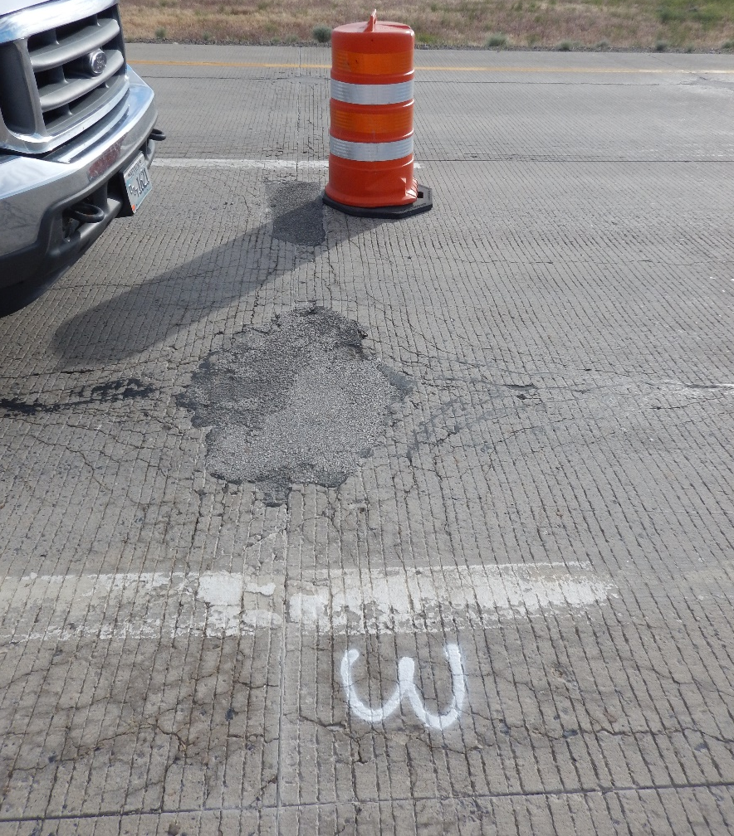
Large Bubbles
Small Bubbles

