Slide 1

Using BCSA Cement for Structural Concrete
Cameron Murray, Ph.D., P.E., Assistant Professor, University of Arkansas
Gabe Johnson, Elizabeth Poblete, Behzad Farivar, GRA, U of A
Gabe Cook, Oncor Electric Delivery, Ft. Worth, TX
Edgar Soriano, WSP, Indianapolis, IN
Gerardo Aguilar, Construir Futuro, Quito, Ecuador
Caleb Chesnut, Martin/Martin, Bentonville, AR

Slide 2
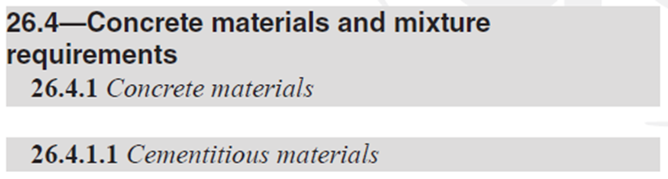
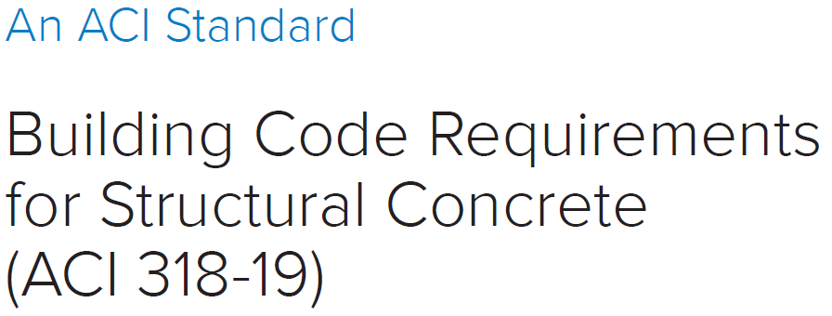
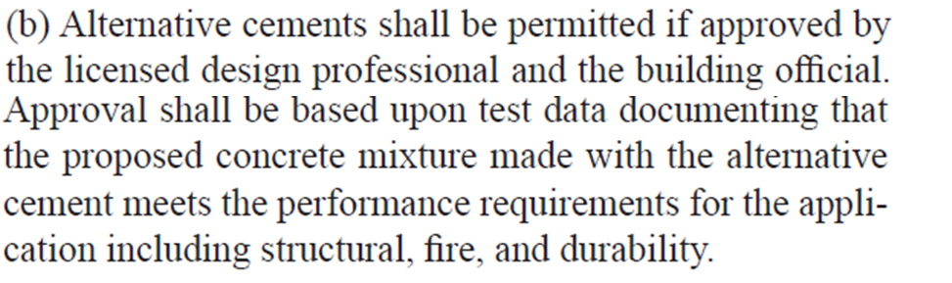

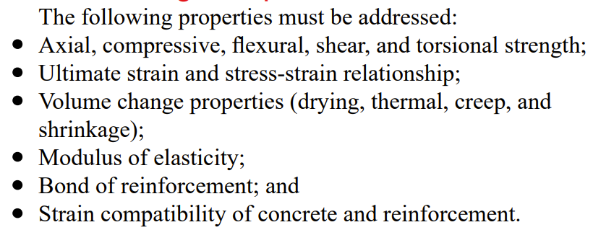

BCSA Cement in Structural Concrete

Slide 3
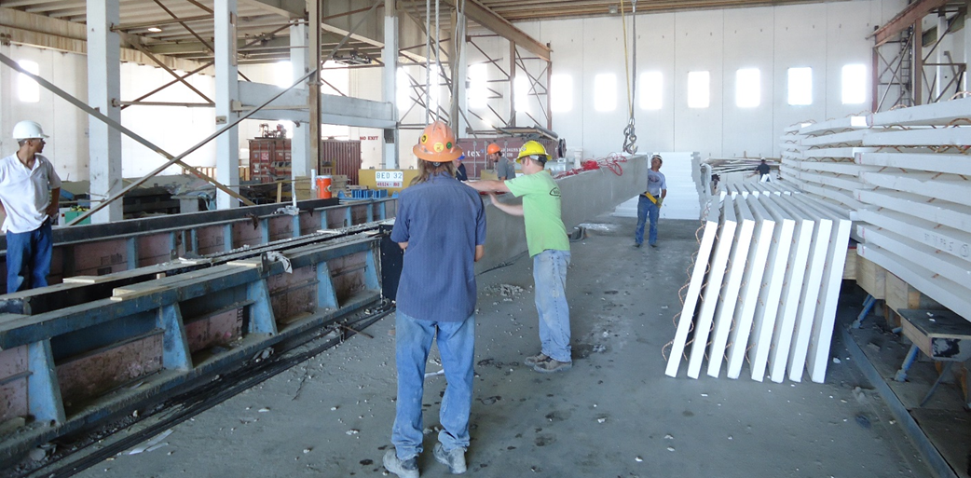
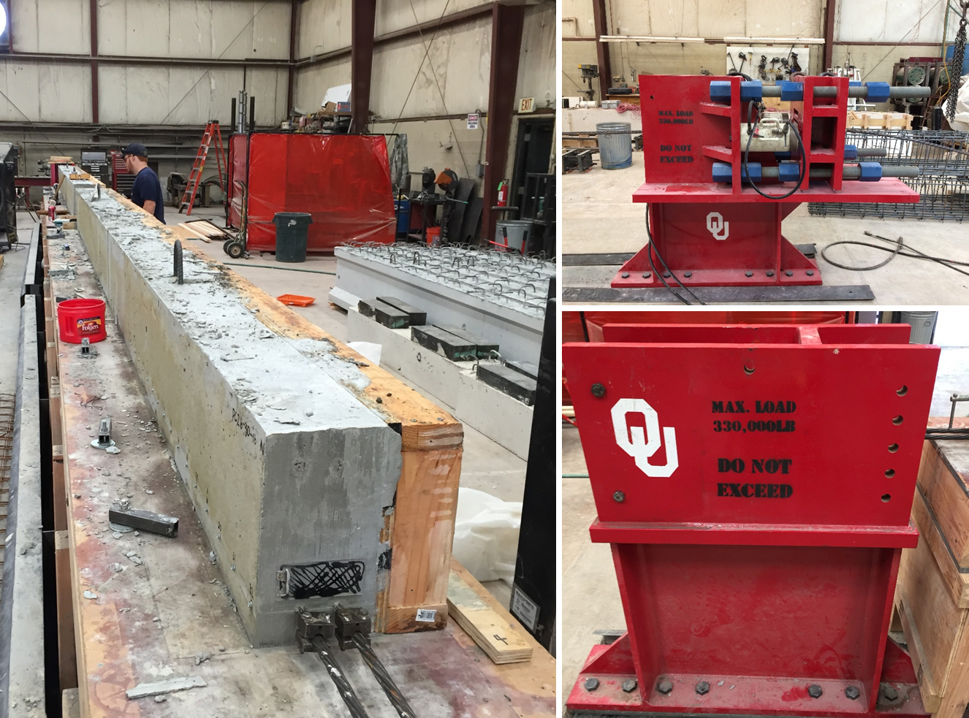
BCSA Cement in Structural Concrete
BCSA cement’s properties are useful for precast/prestressed and structural repair
  Low shrinkage
  Fast setting/fast strength gain
  Many practical questions remain
Past work at University of Oklahoma on prestressed concrete
  Improved prestress losses
  Good flexural strengths
  Good bond to prestressing strands

Slide 4
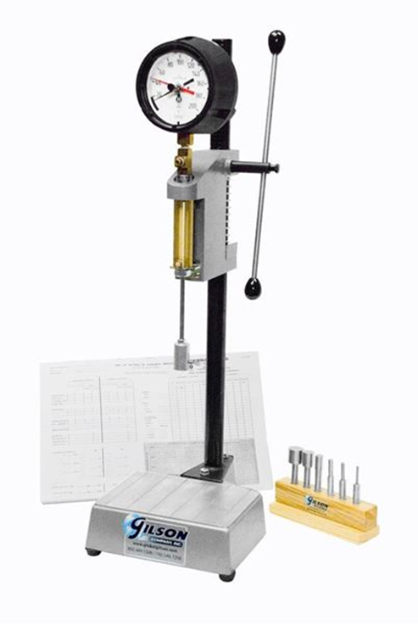
Initial Practical Concerns
Setting Time of BCSA Cement
100 F Ambient Temp. Example
Slump and Water Content
globalgilson.com

Slide 5
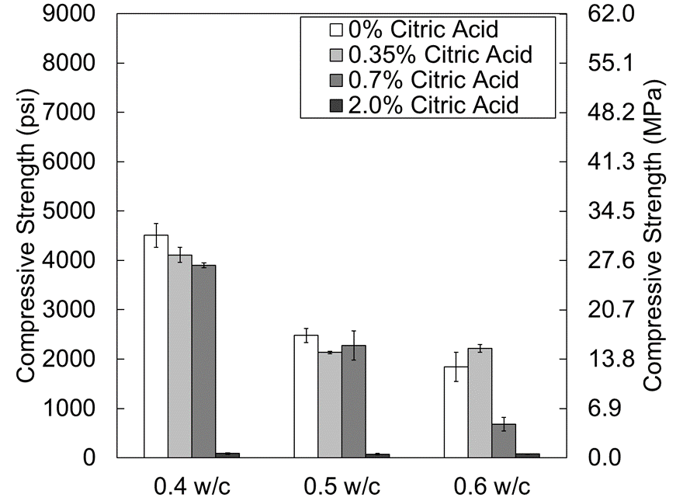
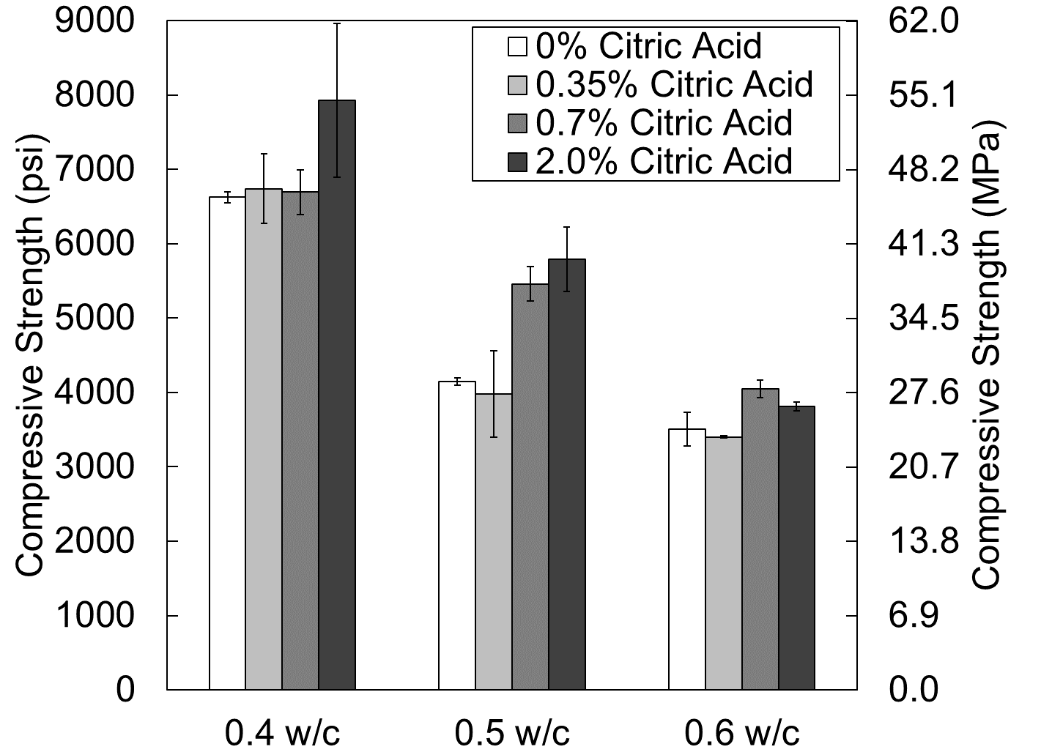
Initial Practical Concerns
w/c – strength relationship similar to PC
  3 hour strength
  28 day strength

Slide 6
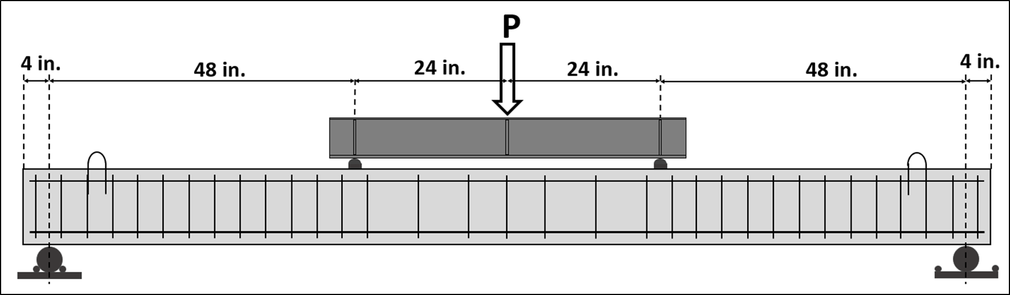
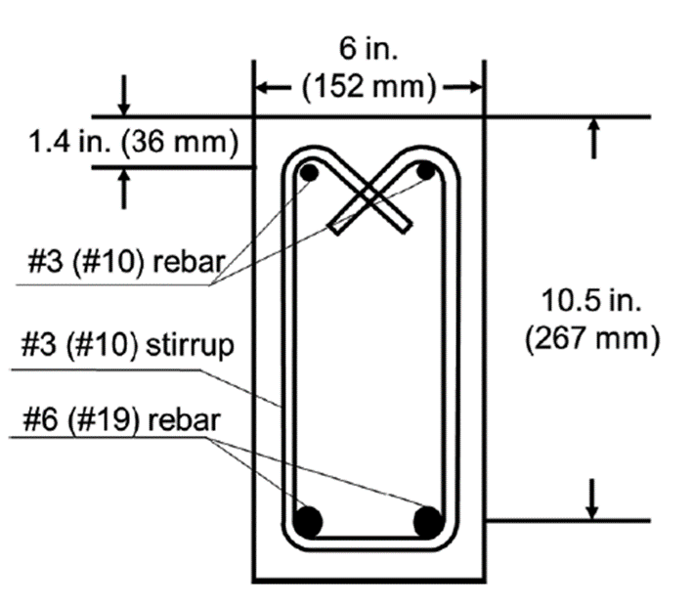
Flexural Strengths of BCSA Cement Concrete
12 reinforced concrete beams made with either PC or BCSA cement
  6 Tension Controlled
  6 Compression Controlled
Tested at different ages
Cook, G.W., Murray, C.D., “Early Age Performance of Reinforced Concrete Beams Made with BCSA Cement.” ACI Materials Journal 117, no. 01 (2020).

Slide 7
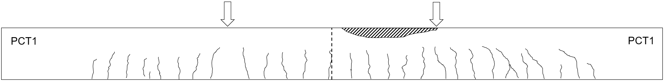
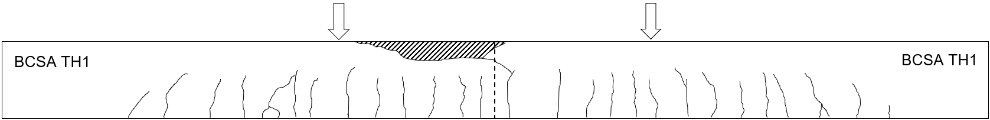
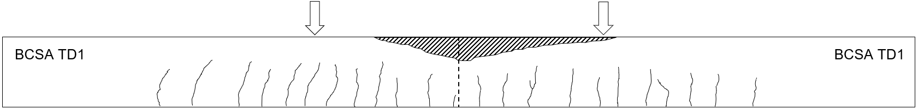
Flexural Strengths of BCSA Cement Concrete

Slide 8
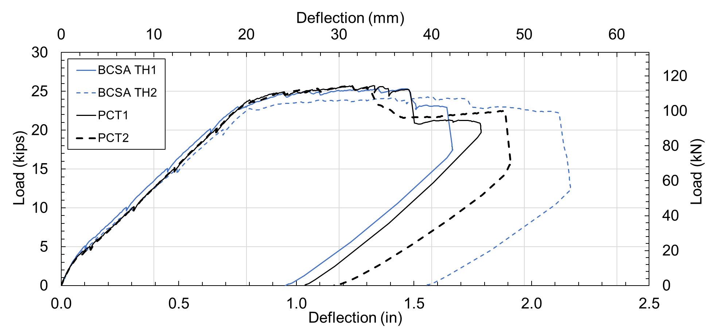
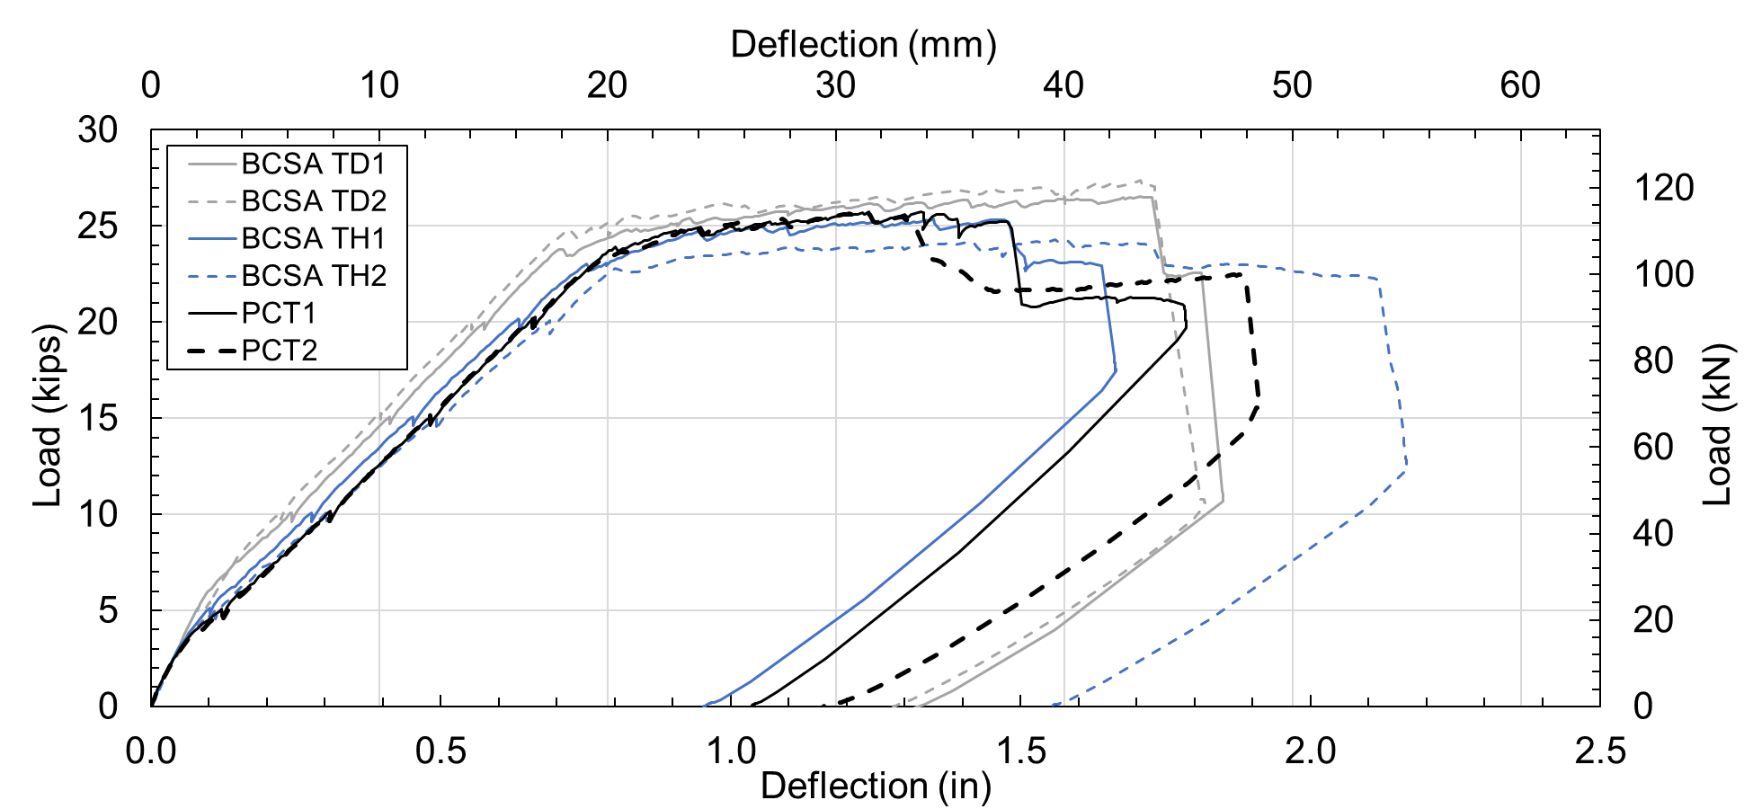
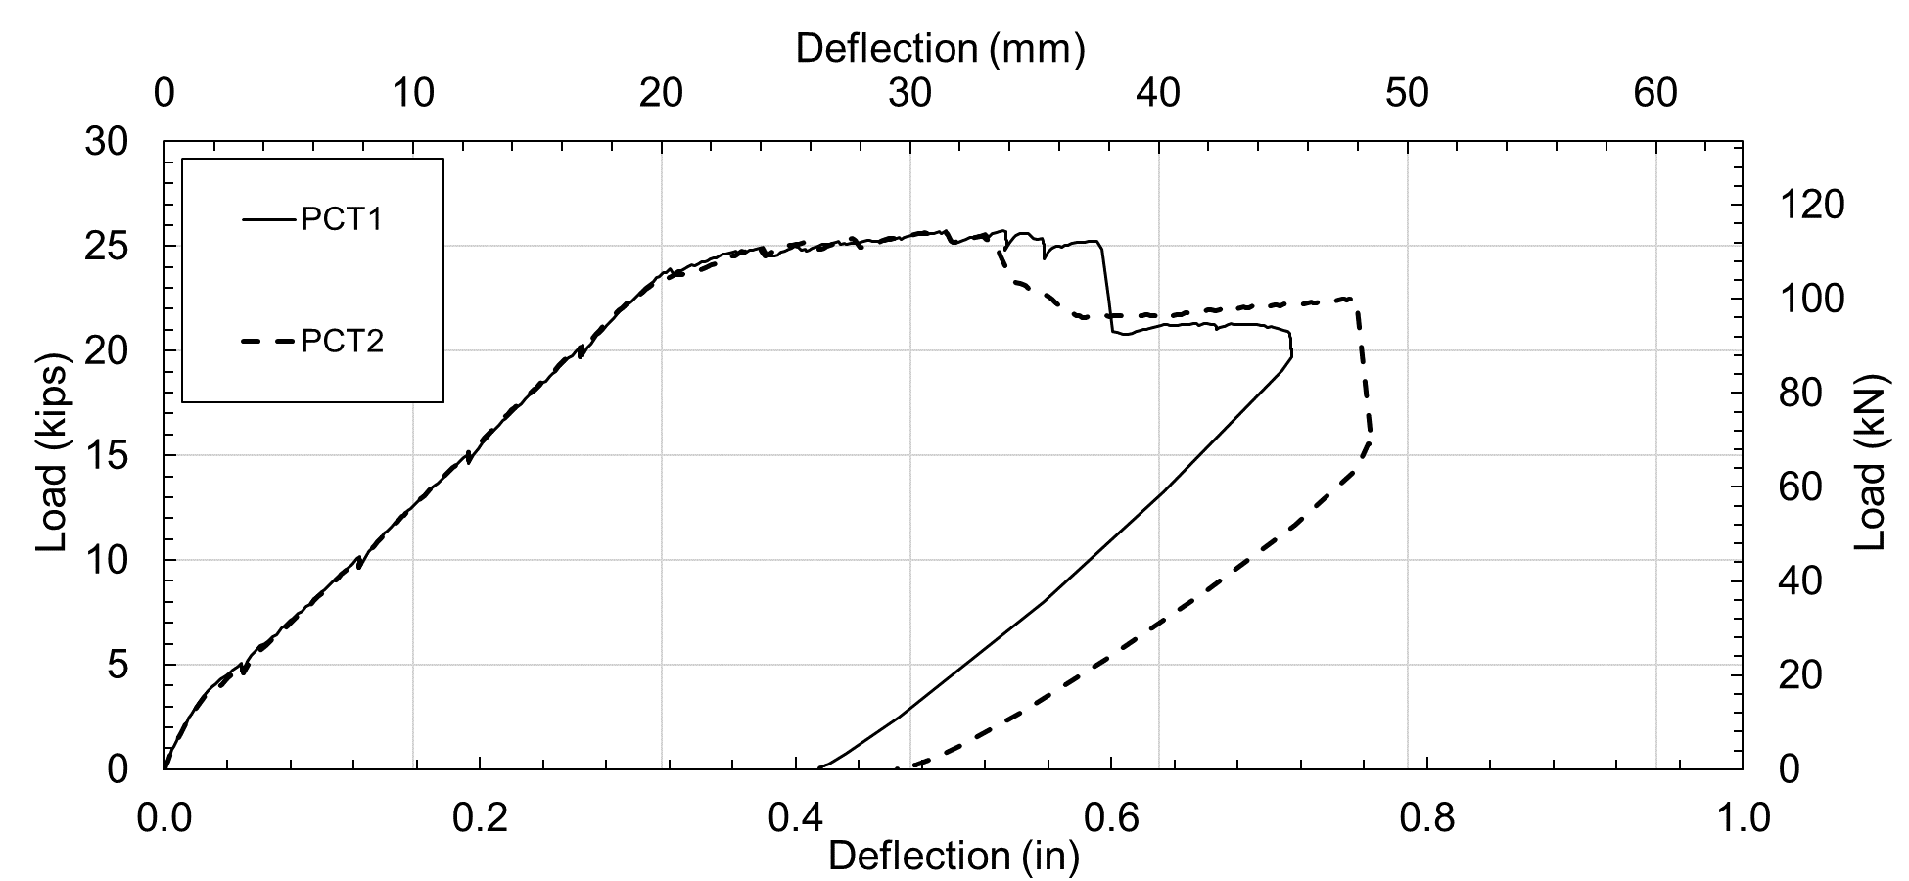
Flexural Strengths of BCSA Cement Concrete

Slide 9
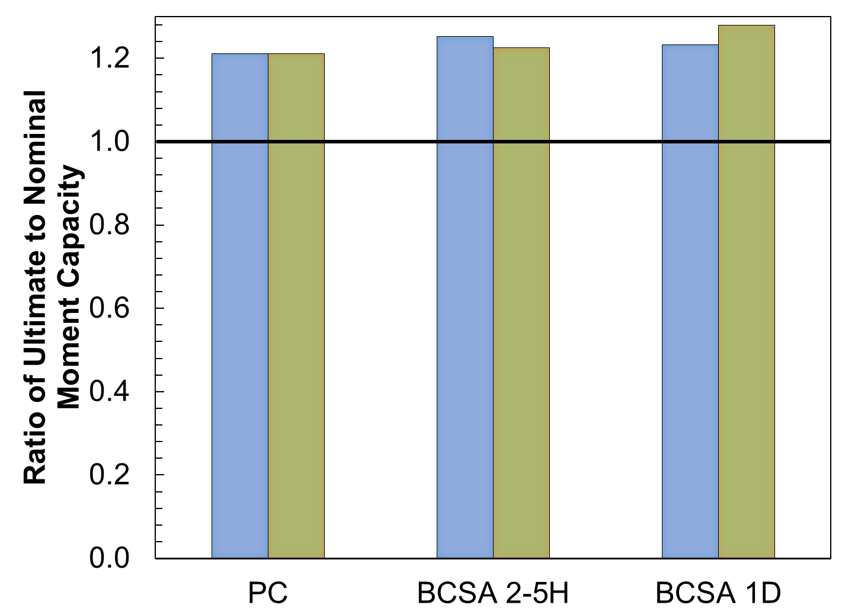


Flexural Strengths of BCSA Cement Concrete
$$\frac{Experimental Moment Capacity}{ACI Nominal Moment Capacity}$$
$$>1.0 GOOD$$

Slide 10
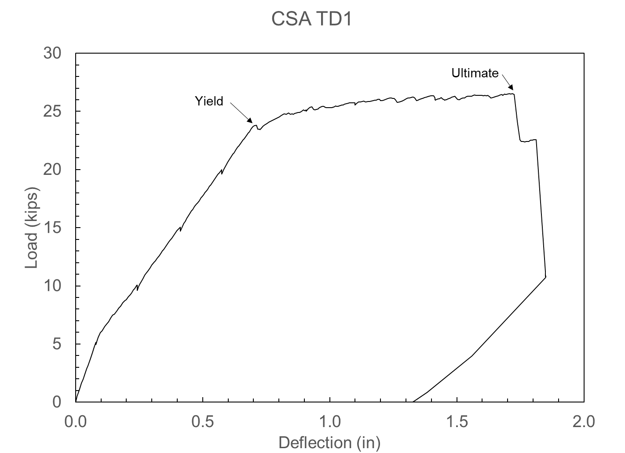
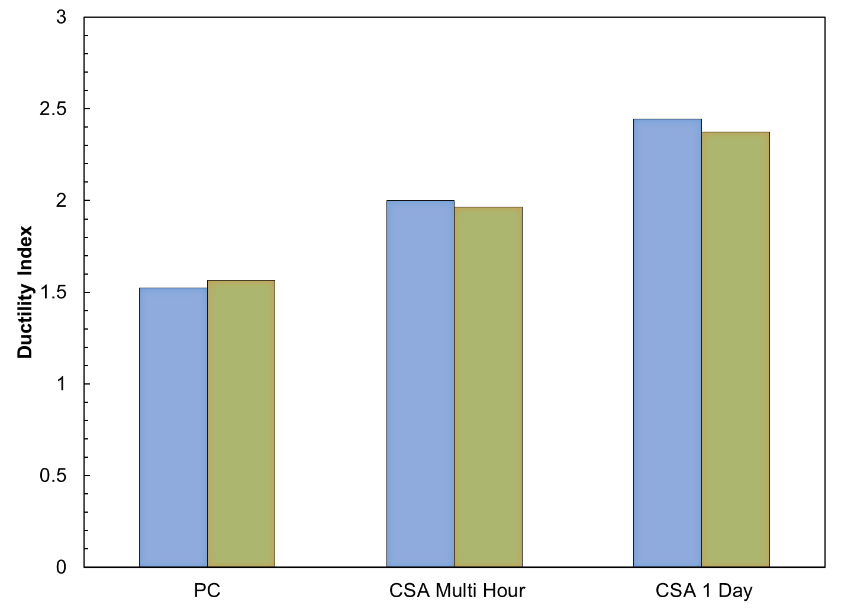

Flexural Strengths of BCSA Cement Concrete
Weaker Concrete
$Ductility Index=\frac{Deflection at Ultimate}{Deflection at Yield}$
BCSA Multi Hour
BCSA 1 Day

Slide 11
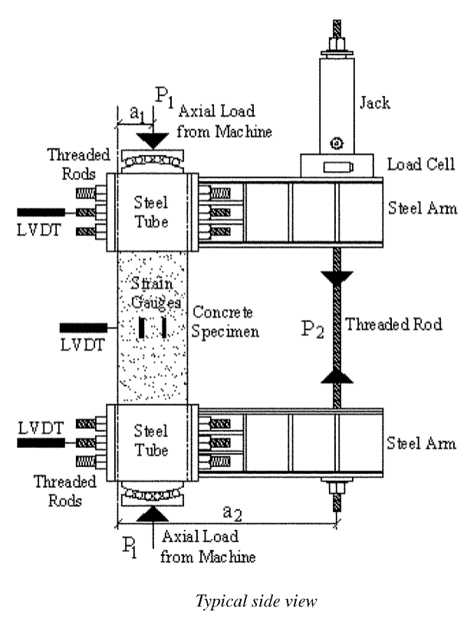
Current ACI CRC Study
Flexural stress-strain of BCSA cement concrete
Stress
Strain
ε_{cu} = 0.003
Mertol, H. C., Rizkalla, S., Zia, P., and Mirmiran, A.” Characteristics of compressive stress distribution in high-strength concrete.” ACI Structural Journal, Vol. 105, No. 5. 2008.

Slide 12
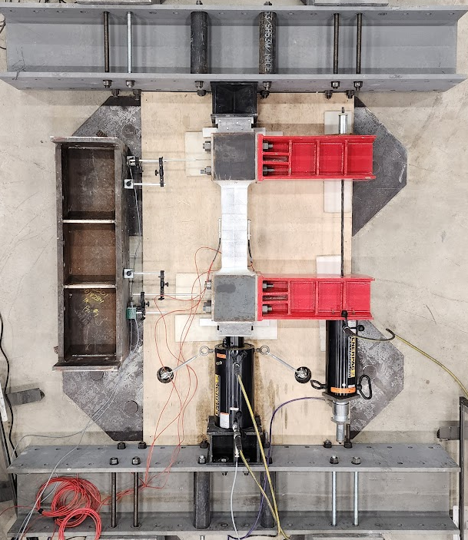
Current ACI CRC Study
Mertol, H. C., Rizkalla, S., Zia, P., and Mirmiran, A.” Characteristics of compressive stress distribution in high-strength concrete.” ACI Structural Journal, Vol. 105, No. 5. 2008.

Slide 13
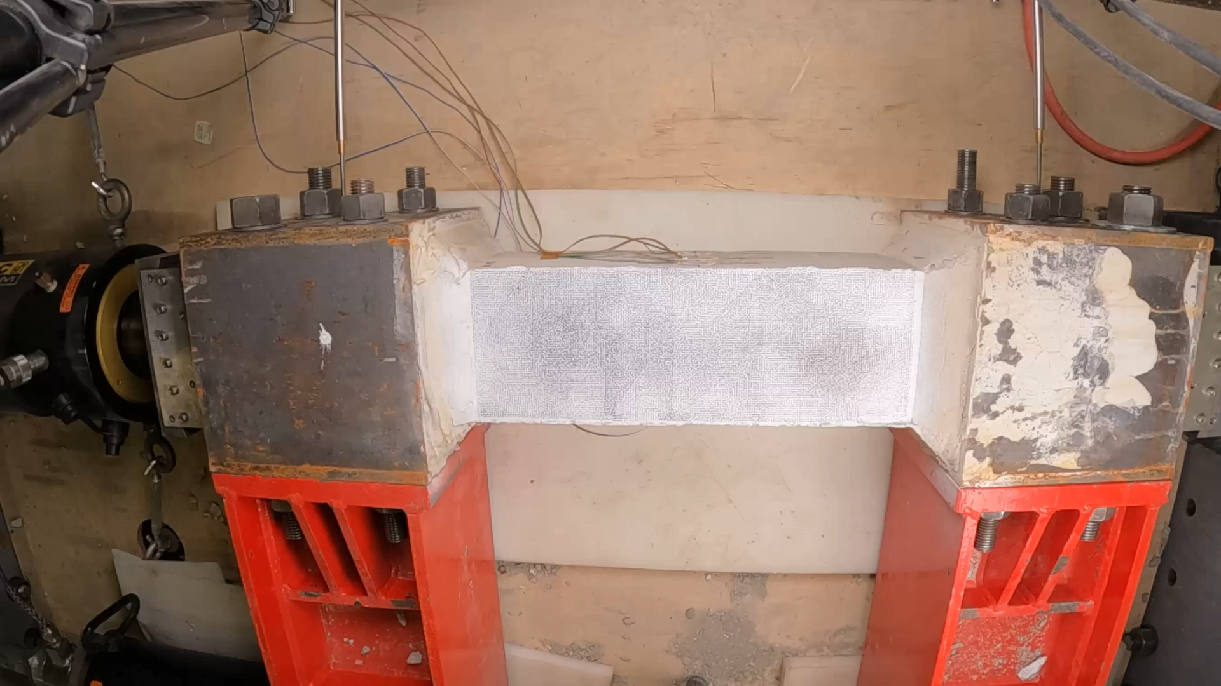
Current ACI CRC Study

Slide 14

Current ACI CRC Study

Slide 15
Shear Strength of BCSA Cement Concrete
Chesnut, C.W. and Murray, C.D. “Shear Capacity of Reinforced Concrete made with BCSA Cement.” ACI Structural Journal 120, no. 1 (2023).

Slide 16
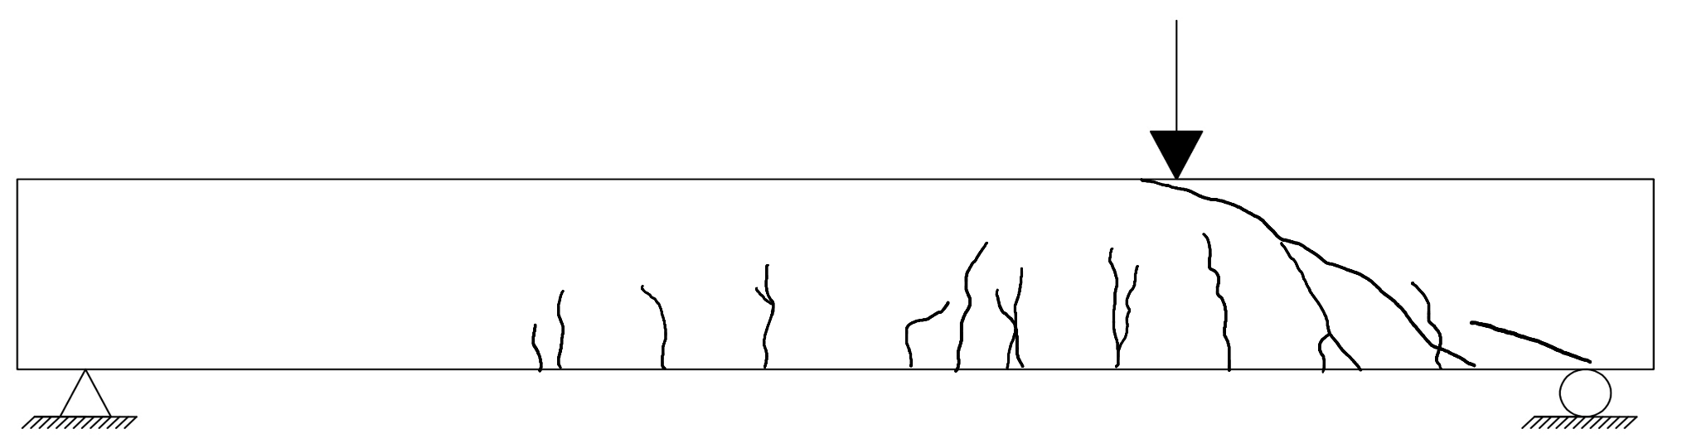
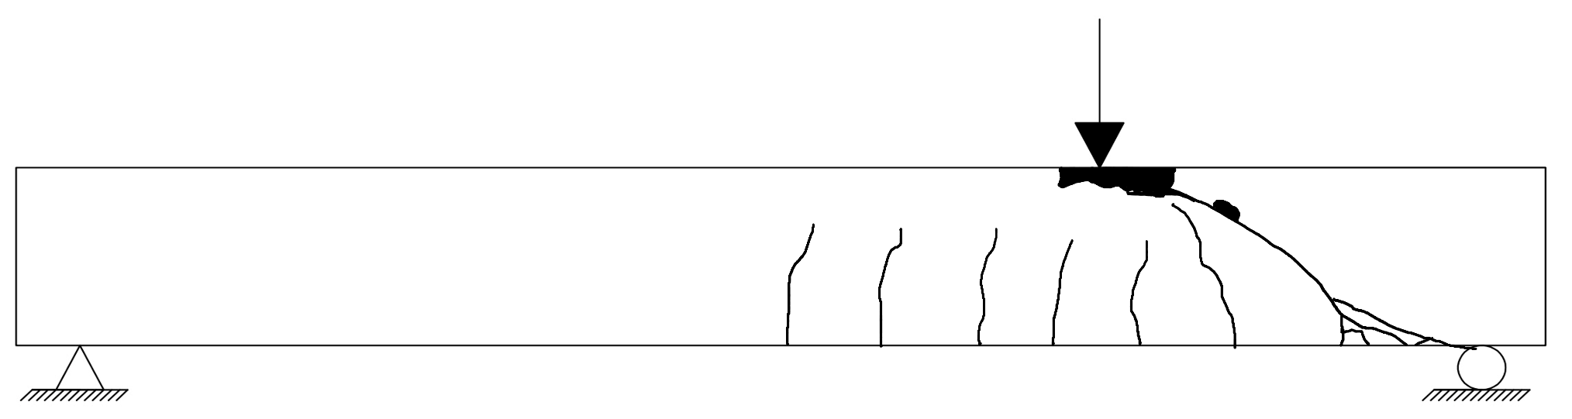
Shear Strength of BCSA Cement Concrete
PC
BCSA

Slide 17
Shear Strength of BCSA Cement Concrete

Slide 18
Conclusions
Code procedures appear to be adequate for predicting BCSA concrete structural strengths
  True for flexural and shear strengths
Ongoing work investigating stress-strain relationships
Unique mixture design considerations
  But major benefit is similarities to PC

Slide 19




Questions?
cdmurray@uark.edu
This material is based upon work supported by the Engineering Research and Development Center Geotechnical and Structures Laboratory (ERDC-GSL) under Contract No. W912HZ21C0037.

