Slide 1
I-30 Deck Park Phase I Planning Study
Reconnecting Communities Pilot (RCP) Program
May 23, 2023

Slide 2
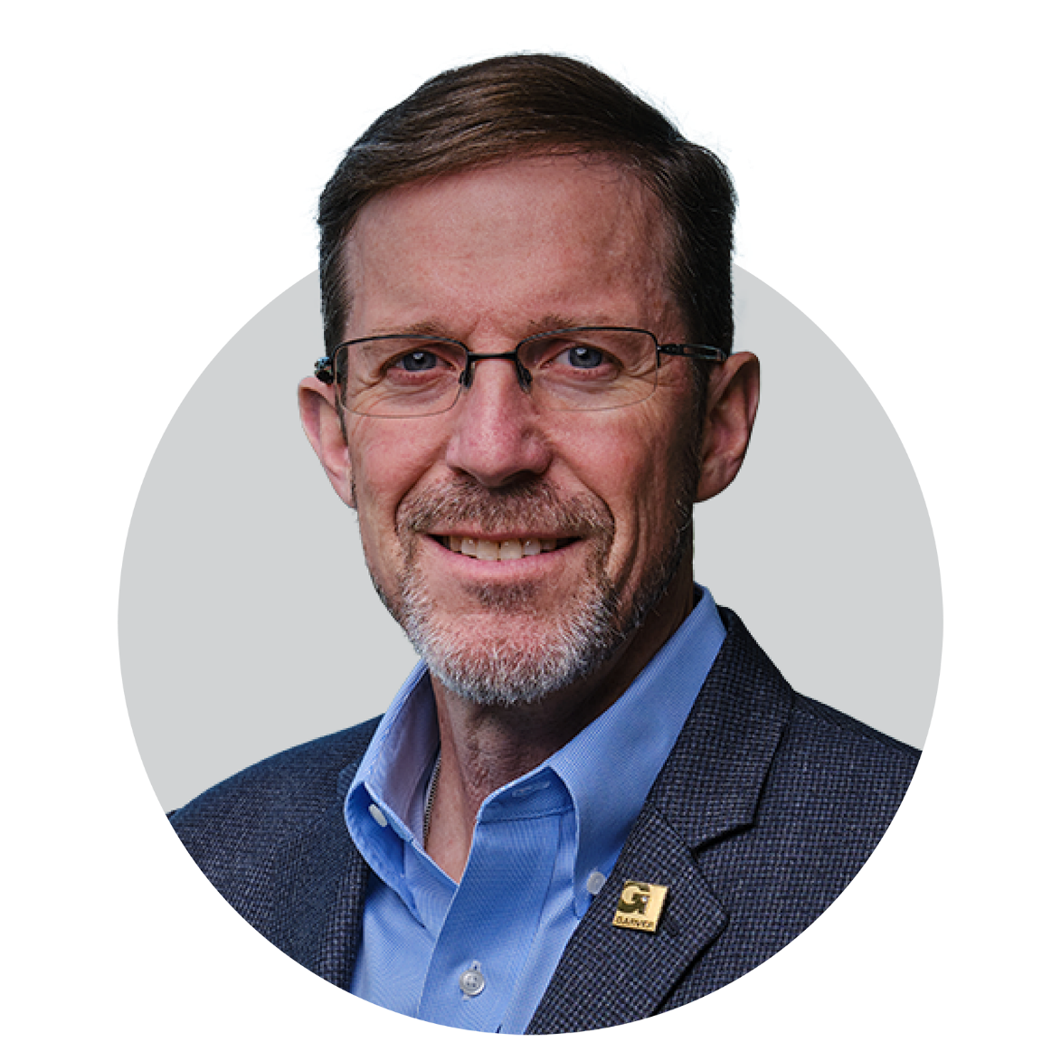
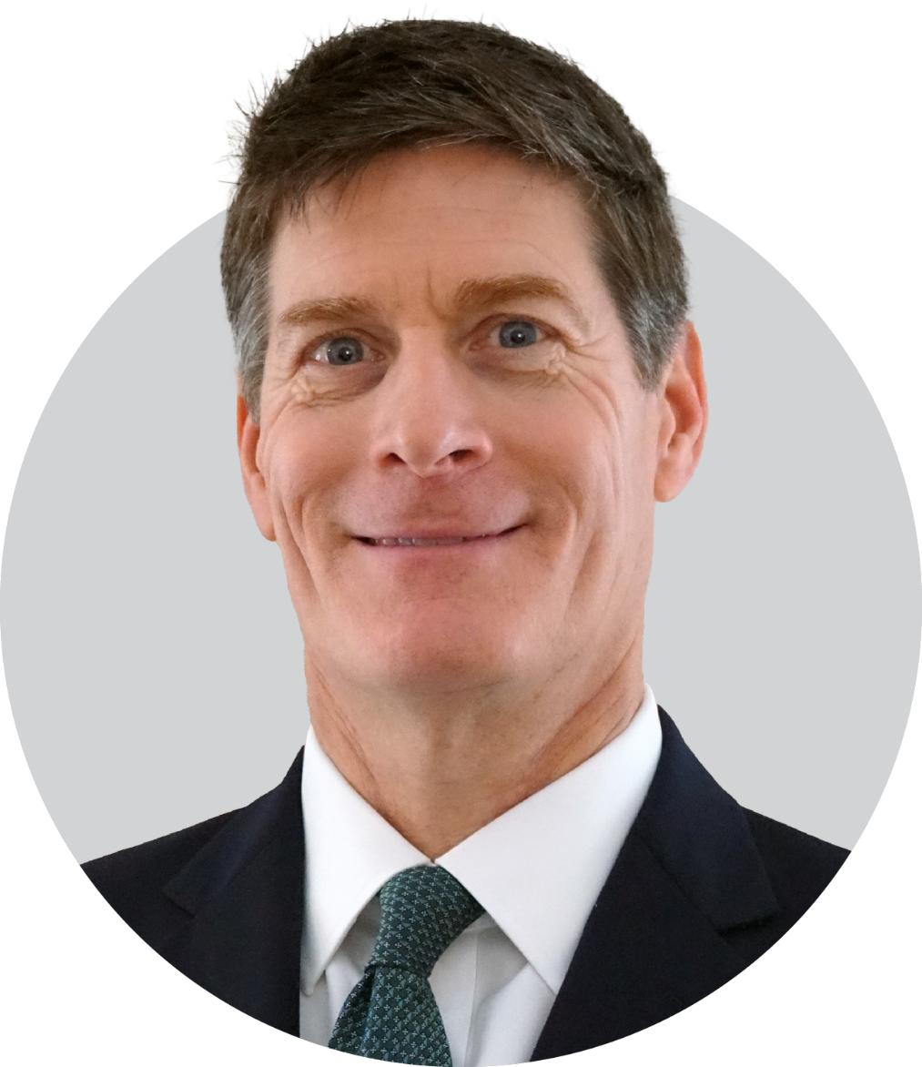
Presenters
Jerry Holder, Jr., PE
Bob Cook
Director of Enterprise Solutions / Senior Vice President
Government Relations Director

Slide 3
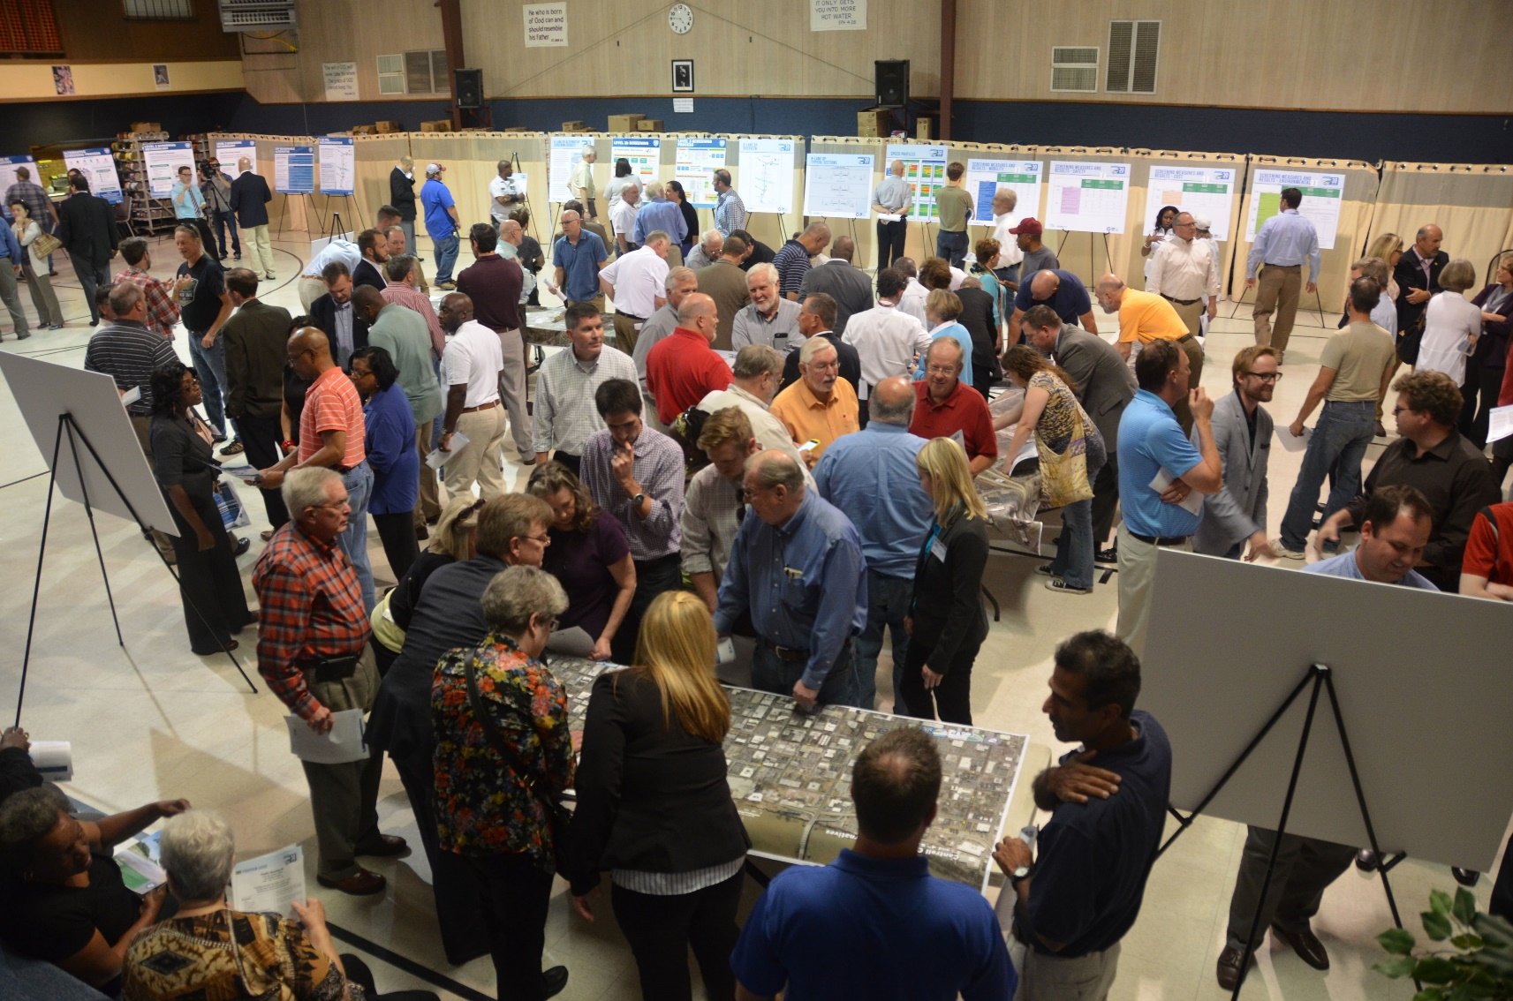
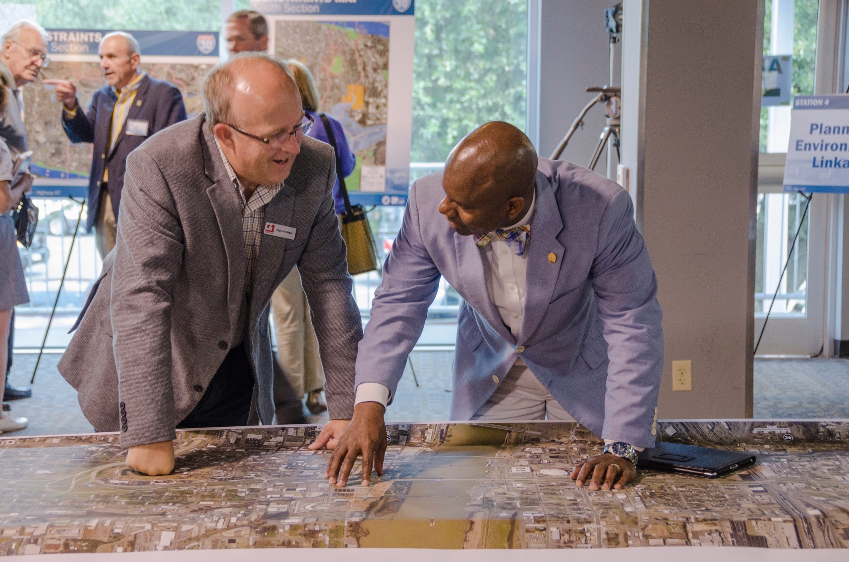
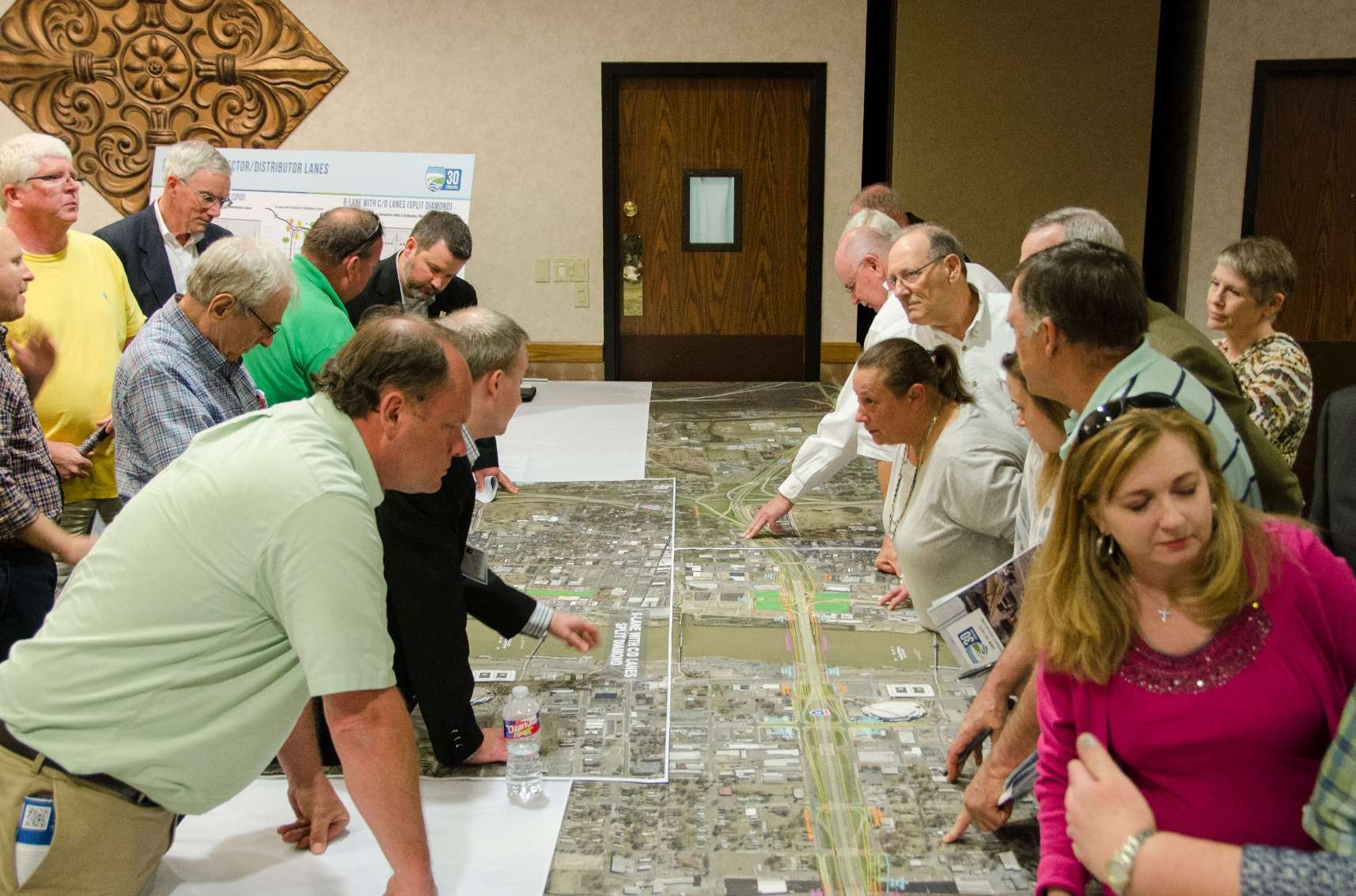
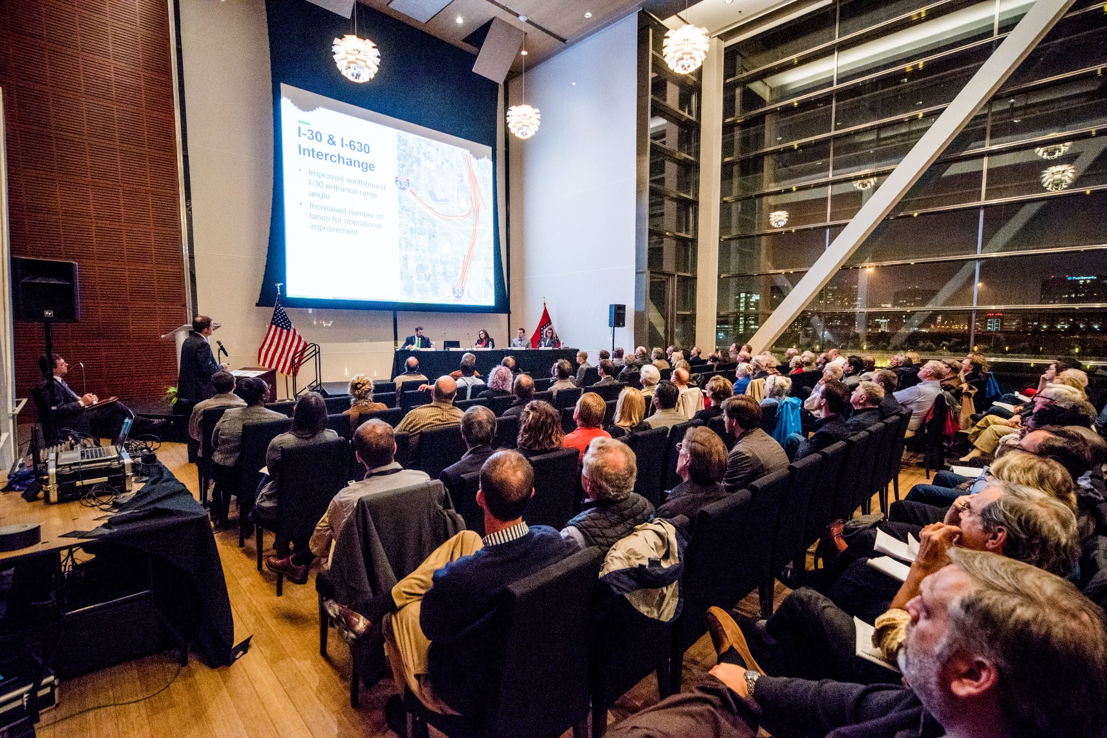
Project Summary
Designed with connectivity as a goal
Includes features to accommodate a future deck park between 6th and 9th Streets

Slide 4
Chamber of Commerce Partnership
Chamber President Jay Chesshir
Garver SME Bob Cook
50 for the Future

Slide 5
Reconnecting Communities Pilot (RCP) Program
Federal Agency: Department of Transportation
Bureau/Account: Federal Highway Administration
Funding Amount: $1B
Period of Availability: available until expended
Funding Mechanism: competitive grant
New Program: yes
Recipients: owner of an eligible facility (may partner with eligible entities for a planning grant)
Description: RCP Program will restore community connectivity by removing, retrofitting, or mitigating highways or other transportation facilities that create barriers to community connectivity, including to mobility, access, or economic development
Eligible Uses: Grants (≥$5M) for capital construction projects, including the removal and replacement of eligible facilities, and planning grants (≤$2M).

Slide 6
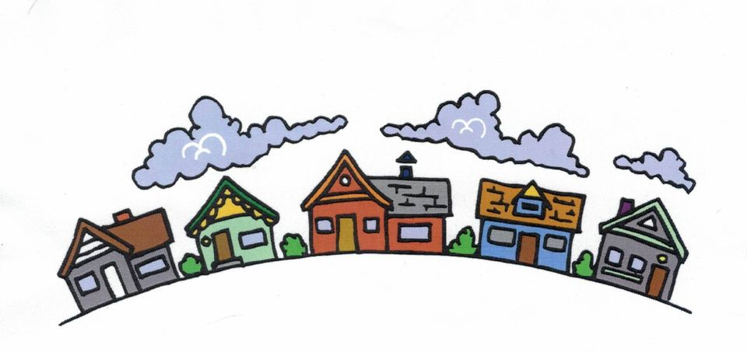
Grant Application Partnership
Primary Applicant City of Little Rock
Co-Applicants ARDOT Coalition of Downtown Neighborhoods
Community Partners/Supporters Arkansas Congressional Delegation Chamber of Commerce
Notes:
City of Little Rock: primary applicant with mayoral support and resolution from Council
ARDOT: co-applicant
Coalition of Downtown Neighborhoods: co-applicant and dozens of support letters
Arkansas Congressional Delegation: support letter to the USDOT
Chamber of Commerce: initiated the project and organized support

Slide 7
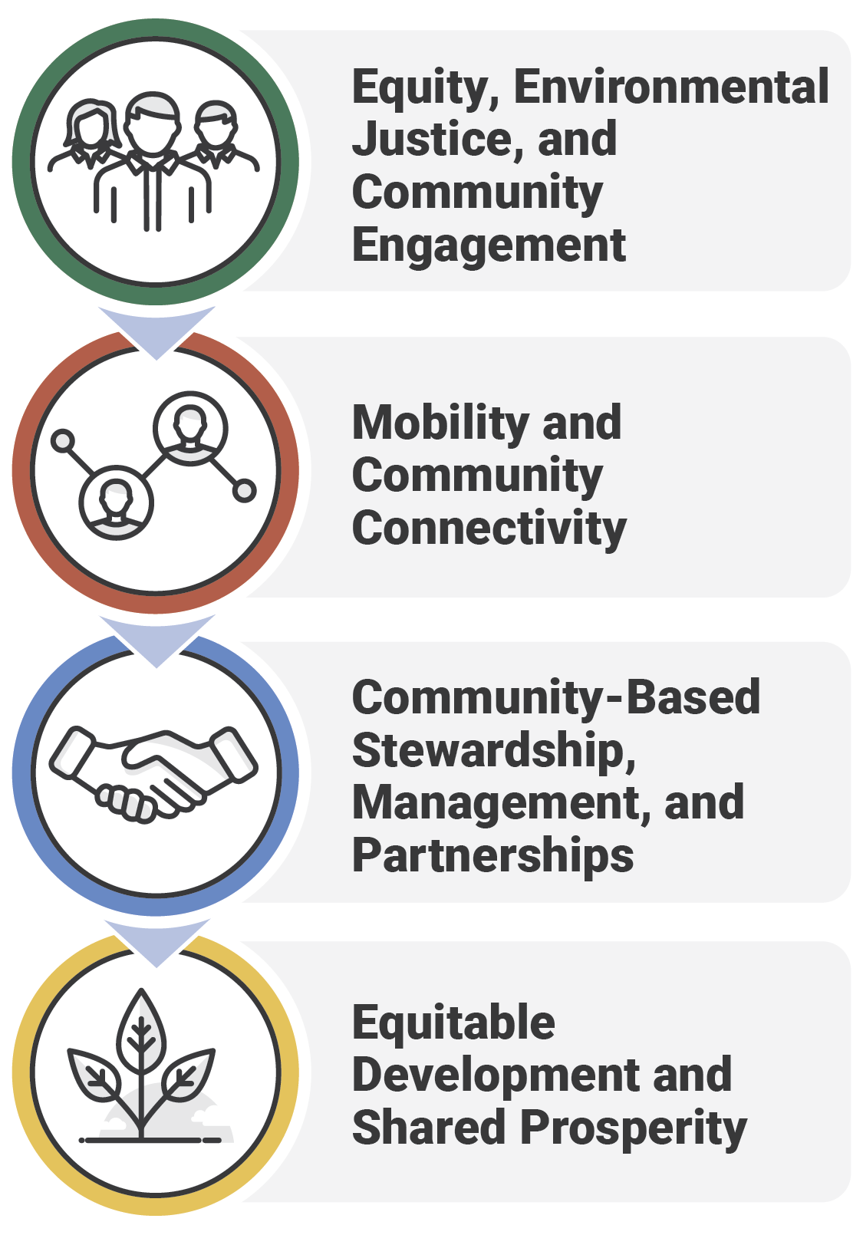
Grant Evaluation Criteria
Grant applications are evaluated based on merit criteria, project readiness, and benefit cost analysis. The four merit criteria are listed to the right.

Slide 8
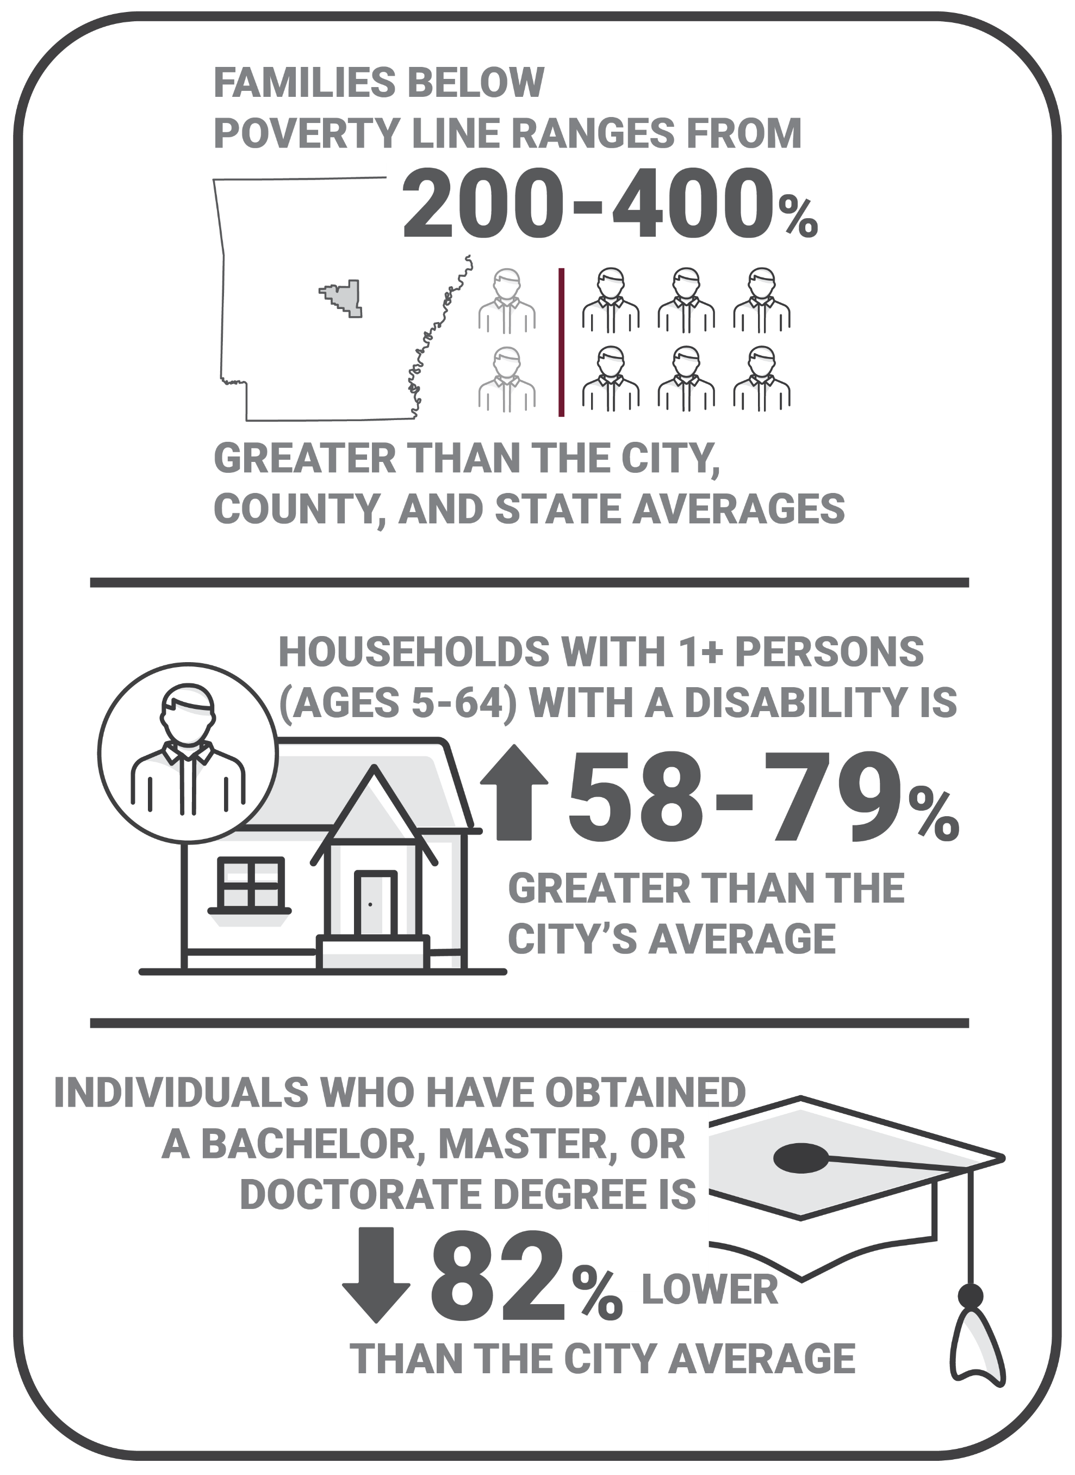
Impacts of the Original I-30 Construction
On the east side of I-30, communities are identified as Economically Disadvantaged (per EJScreen’s Socioeconomic Indicator)

Slide 9
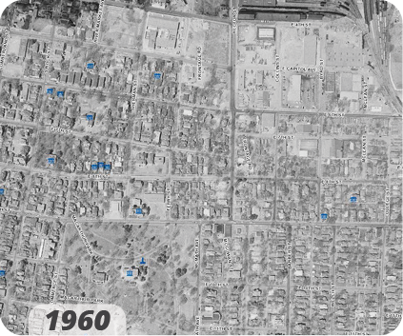
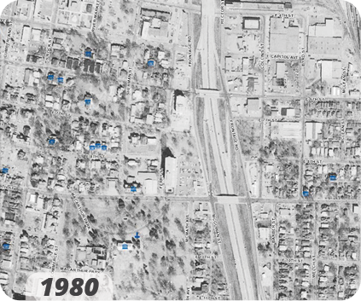
Impacts of the Original I-30 Construction
Construction of I-30 eliminated direct, at-grade access for the residents and businesses on the east side of the interstate.

Slide 10
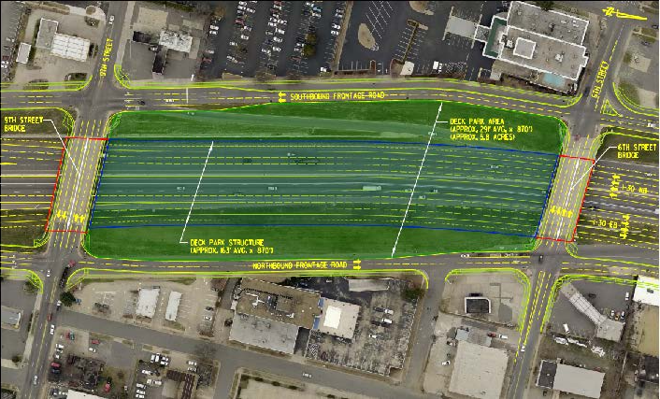
Benefits of the I-30 Deck Park
Reconnect the east and west communities along I-30
Foster community restoration and community stabilization
Spur economic mobility by providing opportunities to uplift small and local businesses
Provide additional avenues for a safe crossing of I-30 for cyclists and pedestrians

Slide 11
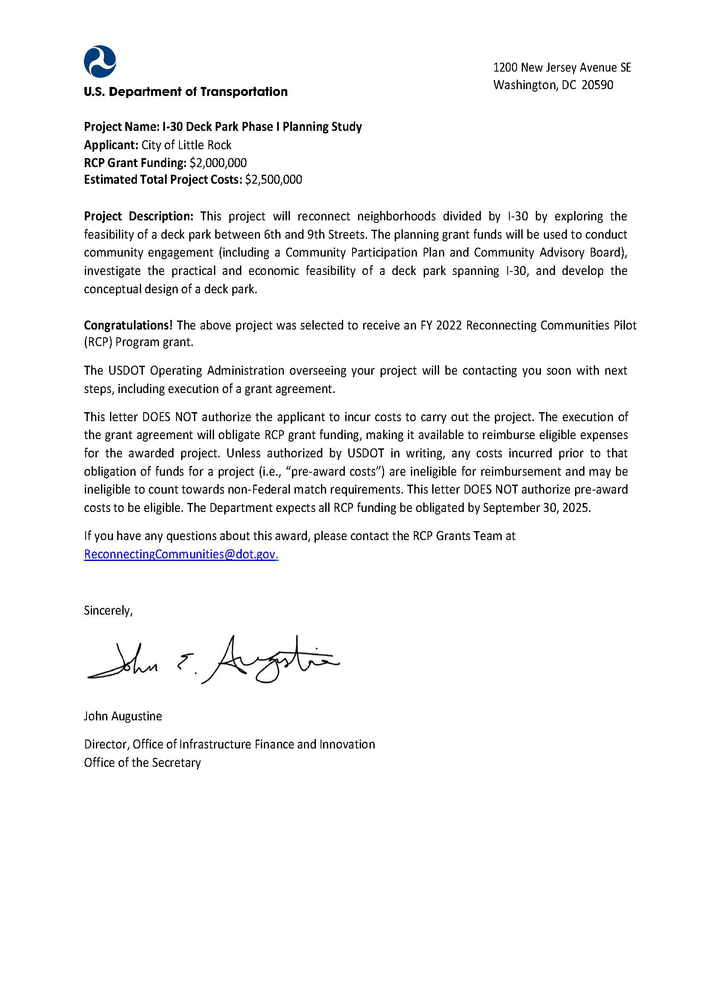
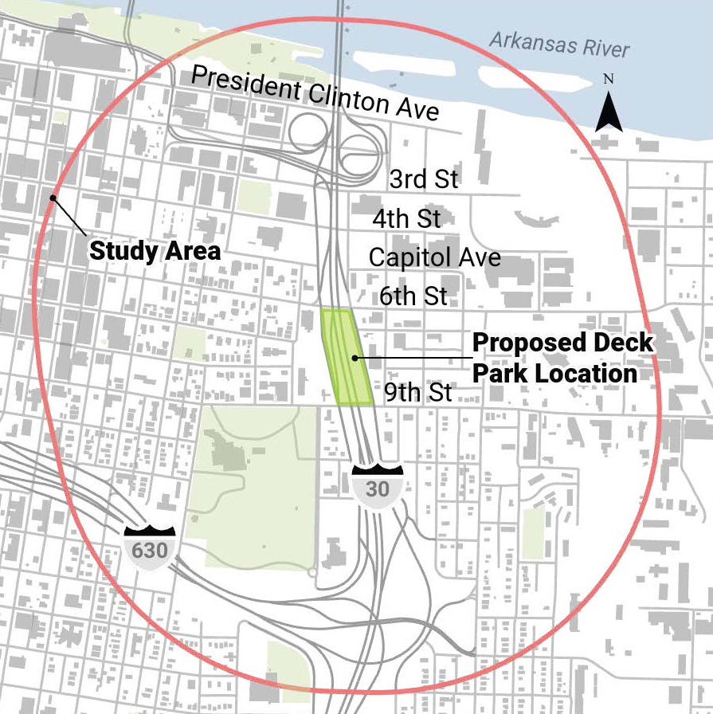
Awarded $2M Planning Grant

Slide 12
Awarded $2M Planning Grant
I-30 Deck Park Phase I Planning Study
RCP Grant Funding: $2M
Estimated Total Project Costs: $2.5M
Project Description: This project will reconnect neighborhoods divided by I-30 by exploring the feasibility of a deck park between 6th and 9th Streets. The grant funds will be used to conduct community engagement (including a Community Participation Plan and Community Advisory Board), investigate the practical and economic feasibility of a deck park spanning I-30, and develop the conceptual design of a deck park.

