Slide 1
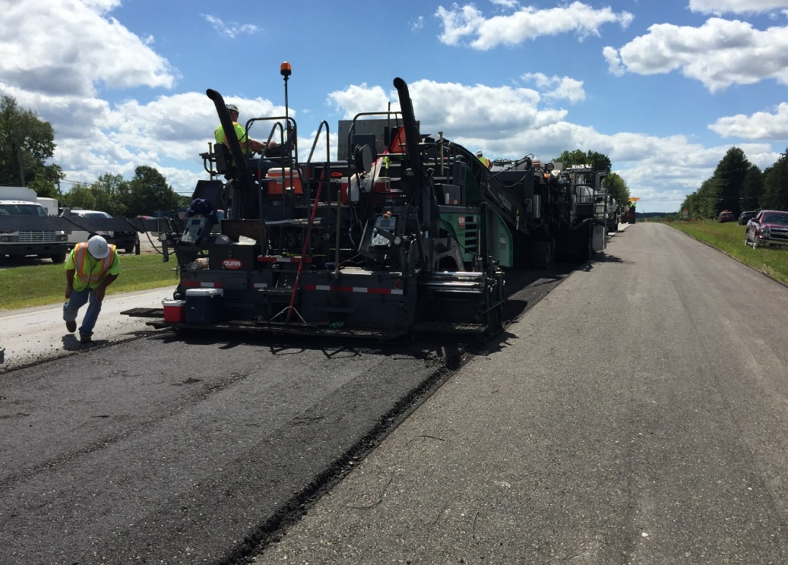


Agency’s Experience with Asphalt Pavement Recycling
2023 TRC Transportation Engineering
Conference & Equipment Expo
May 23-25, 2023
Lester Frank, Transportation and Pavement Engineer
Jason Dietz, Pavement and Materials Engineer
Source: FHWA

Slide 2
Disclaimers
The contents of this presentation do not have the force and effect of law and are not meant to bind the public in any way. This presentation is intended only to provide information to the public regarding existing requirements under the law or agency policies.
The U.S. Government does not endorse products or manufacturers. Trademarks or manufacturers’ names appear in this presentation only because they are considered essential to the objective of the presentation. They are included for informational purposes only and are not intended to reflect a preference, approval, or endorsement of any one product or entity.
Unless noted otherwise, FHWA is the source for all images in this presentation.

Slide 3

Sustainable Highway
Definition – Varies
Sustainable development – meets the needs of the present without comprising the ability of future generations to meet their own needs
Pavement management – a set of tools used to assist decision-makers at all levels in making better and more informed decisions
Notes:
Sustainable – Transportation infrastructure is designed, constructed, operated and maintained using context sensitive solutions, including increased use of recycled materials, sensitivity to the surrounding environment, and an increased awareness of future climate changes.

Slide 4
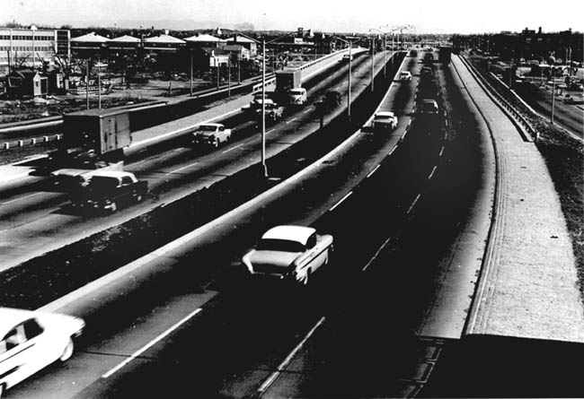
Need to Recycle
Need to reconstruct much of the infrastructure built in the 50’s and 60’s
Virgin materials are being depleted
The cost of virgin materials are increasing
Need to maximize the material resource
Advanced in technology to better control process
Notes:
- Interstate program just celebrated it’s 50 year anniversary.
Percentage of infrastructure coming of age.
Increased need to find new sources for quality, virgin aggregates

Slide 5
FHWA Policy - 2002
Recycled/Re-Use materials are viable resources
Recycled materials should get 1st consideration
Consider use of recycled materials early in the planning/design process
Economic benefits should be considered in the material selection process
Restricting the use of materials should be technically based
Material should not adversely impact the environment and should perform as intended
Notes:
5

Slide 6
Why Aren’t We There Now?
What are the material properties?
How should the material be extracted, processed and stored?
How is the manufacturing process controlled to maximize consistency?
How will the material perform?
How can we quantity the benefits?
What incentives are appropriate?
How do existing specs generate waste?
How can we remove the prohibition of materials?
Notes:
6

Slide 7
Increase Use of Alternative Materials
Advancing increased use of reclaimed asphalt pavement in highway construction
Advancing the use of industry by-products as highway materials
Advancing innovative approaches to re-using existing highway materials (in-place recycling)
Quantifying the benefits of using recycled materials

Slide 8
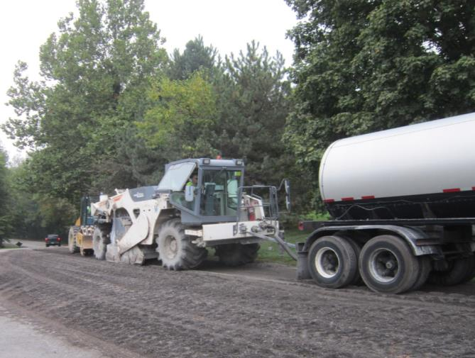
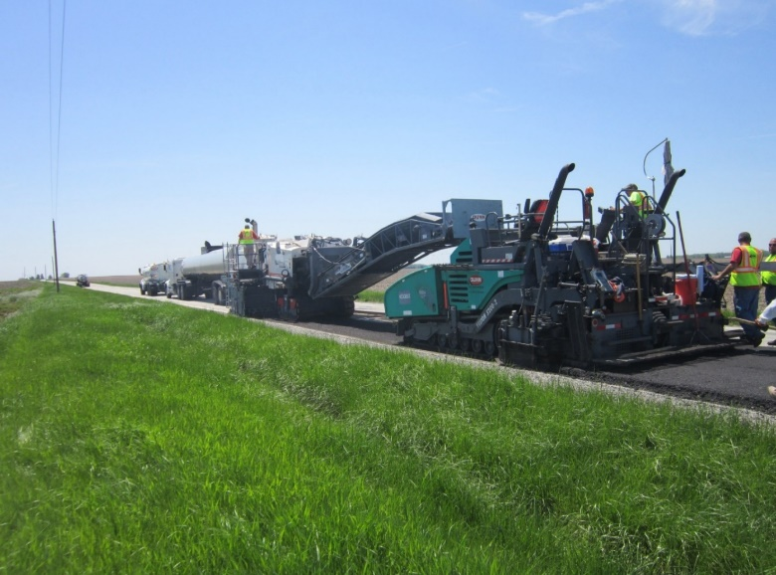
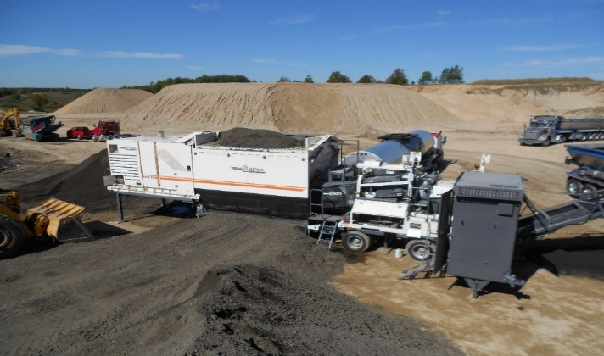
Cold Pavement Recycling Processes
Full Depth Reclamation (FDR) Typical Depth: 5 - 12 inches Stabilizer: Emulsified/ Foamed Asphalt or Portland Cement | Cold In-place Recycle (CIR) Typical Depth: 3 – 5 inches Stabilizer: Emulsified/ Foamed Asphalt | Cold Central Plant Recycle (CCPR) Typical Depth: 3 - 6 inches Stabilizer: Emulsified/ Foamed Asphalt
Agency Usage: Alternate to Reconstruction | Agency Usage: Alternate to Deeper Mill and Fill/ Partial Depth Patching | Agency Usage: Structural Base Layer

Slide 9
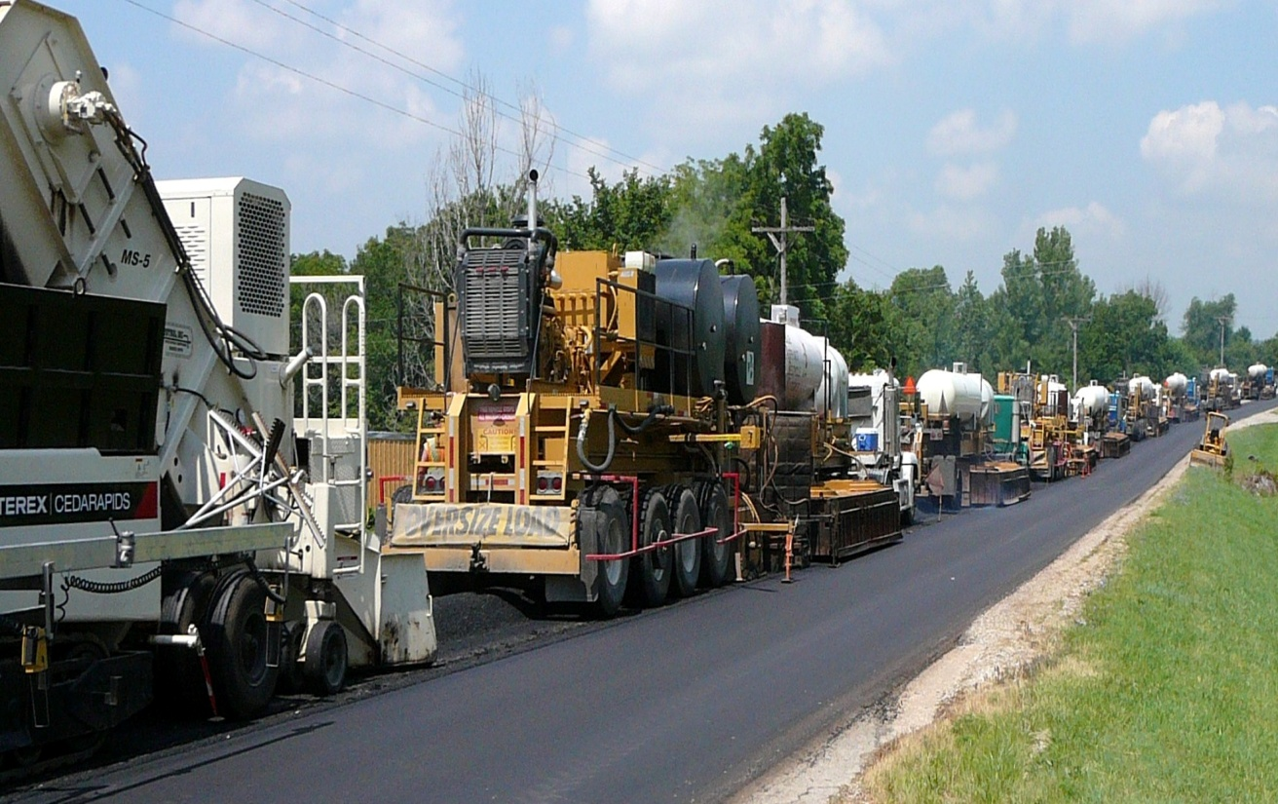
Hot Pavement Recycling Processes
Surface Recycling: Heating, reworking and rejuvenating the top one-two inch of an existing asphalt pavement in preparation of either a seal coat, micro-surfacing or overlay
Remixing: Heating, reworking and rejuvenating the top 1 to 2 inches of an existing asphalt pavement adding virgin aggregate and/or admix and mixing the newly recycled material in a pug mill mixing plant prior to laying, either as a binder or surface course
Repaving: Heating, reworking and rejuvenating the top one inch of an existing asphalt pavement and simultaneously applying an overlay

Slide 10
Number of Agencies and Contractors with Experience
In-place Recycling Method | States with Experience | Contractors with Experience
HIR | 34 | 24
CIR | 34 | 24
FDR | 33 | 28
NCHRP Synthesis 421 (2011)
Notes:
The status of in-place recycling use across the United States was assessed using an online survey from NCHRP Synthesis 421 (Appendix A). The survey collected information from “choose all that apply” questions and open-ended requests for experiences. Responses were received from 45 states, although not all states had experiences with in-place recycling. A total of 34 of the 45 states and one Canadian providence (Ontario) indicated experience with both HIR and CIR projects, and 33 of the 45 indicated experience with FDR projects.

Slide 11
Type of HIR Used By Agencies
Surfacing | Repaving | Remixing
AR, CA, CO, FL, IL, IA, KS, KY, MT, NC, NE, NV, TX, WY | AR, AZ, CO, FL, KS, KY, MT, MO, NC, TX, WY | AR, AZ, CA, CO, FL, ID, IA, KS, KY, MD, MO, NC, NY, TN, TX, VT, WA, WY
NCHRP Synthesis 421 (2011)
Notes:
Of the states with experience using HIR processes, HIR remixing was the most frequently used.
The Asphalt Recycling and Reclaiming Association (ARRA) membership list was used to identify contractors to invite to complete the same survey. Of the membership list, 50 members were identified as contractors. In this case, companies providing materials and services for in-place recycling processes included asphalt contractors (e.g., for overlays) and aggregate producers. A total of 33 completed surveys were received. Responses were sorted by experience with a specific in-place recycling process. Not all respondents had experience with all three methods.

Slide 12
Agency Experience with In-place Recycling Methods
Years of Experience | HIR | CIR | FDR
< 5 | MO, NV | DE, MO, NC, ND, OR, UT | AL, DE, MO, NC, NY, VA, WY
5 to 10 | AZ, GA, IL | IL, WY | AK, CA, CO, GA, IL, IA, MN
> 10 | AR, ON, CO, FL, ID, IA, KS, KY, MD, MT, NC, NE, NY, TX, WA | AZ, CA, CO, CT, ID, IA, KS, MN, MT, NE, NH, NV, NY, RI, SD, VT, WA, WI | CA, CT, ID, MT, ND, NE, NH, NV, SC, SD, TX, UT, VT, WI
We Don’t Use | AK, AL, CT, DC, DE, IN, MN, ND, NH, NJ, OR, RI, SC, SD, TN, UT, VT, WI, WY | AK, AL, AR, DC, FL, GA, IN, KY, NJ, SC, TN, TX | AR, DC, RI, IN, KS, KY, NJ, OR, RI, TN
NCHRP Synthesis 421 (2011)
Notes:
The years of experience with a recycling process. The number of states with fewer than 10 years of experience represents the potential growth of in-place recycling in the United States. FDR use has grown substantially over the past decade, followed by CIR use. Only a few states have implemented HIR in recent years. Between 14 and 18 states have more than 10 years of experience

Slide 13
Number of Lane-Miles Per Year That Are Recycled
Lane-Miles Recycled | HIR | CIR | FDR
< 50 | AR, CA, CO, FL, IL, IA, KS, KY, MT, NC, NE, NV, NY, TX, WY | AZ, CA, CO, CT, DE, ID, IL, IN, KS, MN, MT, NE, NH, OR, RI, SD, TN, TX, UT, VT, WA, WY | AL, CO, CT, DE, GA, IL, IN, IA, MN, MO, MT, NH, NY, OR, RI, SD, TN, TX, UT, VA, VT, WI
50 to 100 | CO | MO, NE, NY | AK, CA, ID, ND, NE, NV
> 100 | KS | IA, NV, WI | CA, SC
NCHRP Synthesis 421 (2011)
Notes:
Of the states with experience using HIR processes, HIR remixing was the most frequently used.
The number of states with fewer than 10 years of experience represents the potential growth of in-place recycling in the United States. FDR use has grown substantially over the past decade, followed by CIR use. Only a few states have implemented HIR in recent years. Between 14 and 18 states have more than 10 years of experience.

Slide 14
Agency Experience with Cold Recycling Processes
Type of Recycling | Less than 5 years |  | 5 to 10 years | More than 10 years | We don’t use this method
CCPR | Emulsions | CO, IN, MN, MT | NY, UT | PA, ME | AK, AL, AZ, CA, CT, FL, KS, KY, MI, MO, NC, NE, NV, OH, RI, SC, TN, VA
 | Foamed Asphalt | MN | GA, MD, NM, NY, VA | CA | AK, AL, AZ, CT, IN, FL, KS, KY, MI, MO, MT, NC, NE, NV, OH, RI
CIR | Emulsions | IN, VA | CO, DE, GA, IL, MD, MT, ND, NV, OR | AZ, CA, CO, IA, ID, MN, MO, NE, NH, NM, NY, PA, SD, UT, VT, WA | AK, AL, CT, FL, KS, KY, MI, OH, RI, SC, TN
 | Foamed Asphalt | SC, VA, TX | IL, MO, WI | IA, MN, NE, NV, NY | AK, AL, AZ, CA, CT, FL, IN, KS, KY, MI, MT, NC, OH, OR, RI, SD, TN, UT, VT
NCHRP Synthesis 569 (2021)

Slide 15
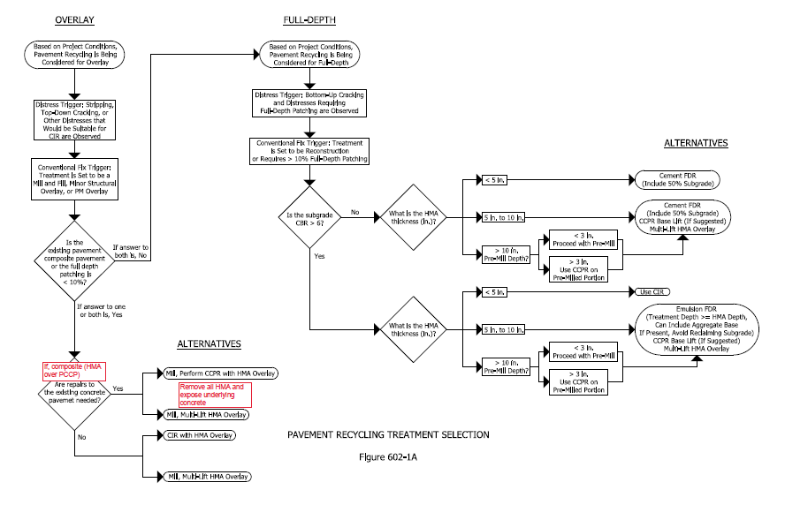
INDOT’s Pavement Recycling Treatment Flowchart
https://www.in.gov/dot/div/contracts/design/IDM.htm - Chapter 602

Slide 16
Barriers/Issues
Nationally recognized mix design
Structural design inputs
Curing times when emulsions are used
Acceptance testing protocols needed (NCHRP Report 960)
Requires specialized skills
Perceived reluctance to use technology
Need to document long term performance
More education and support
Notes:
16

Slide 17
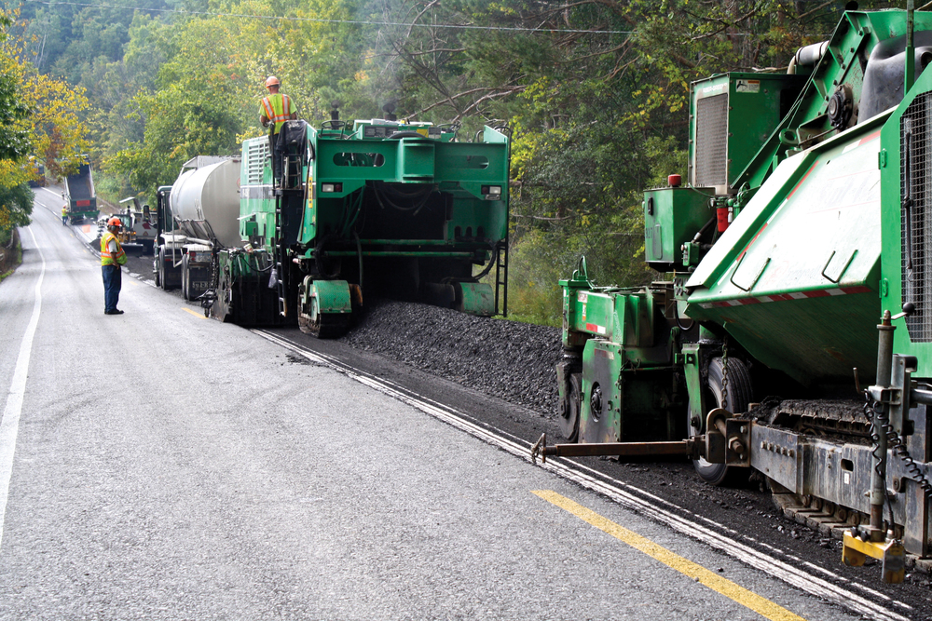
Thank you!
Questions?
Source: FHWA

