Slide 1
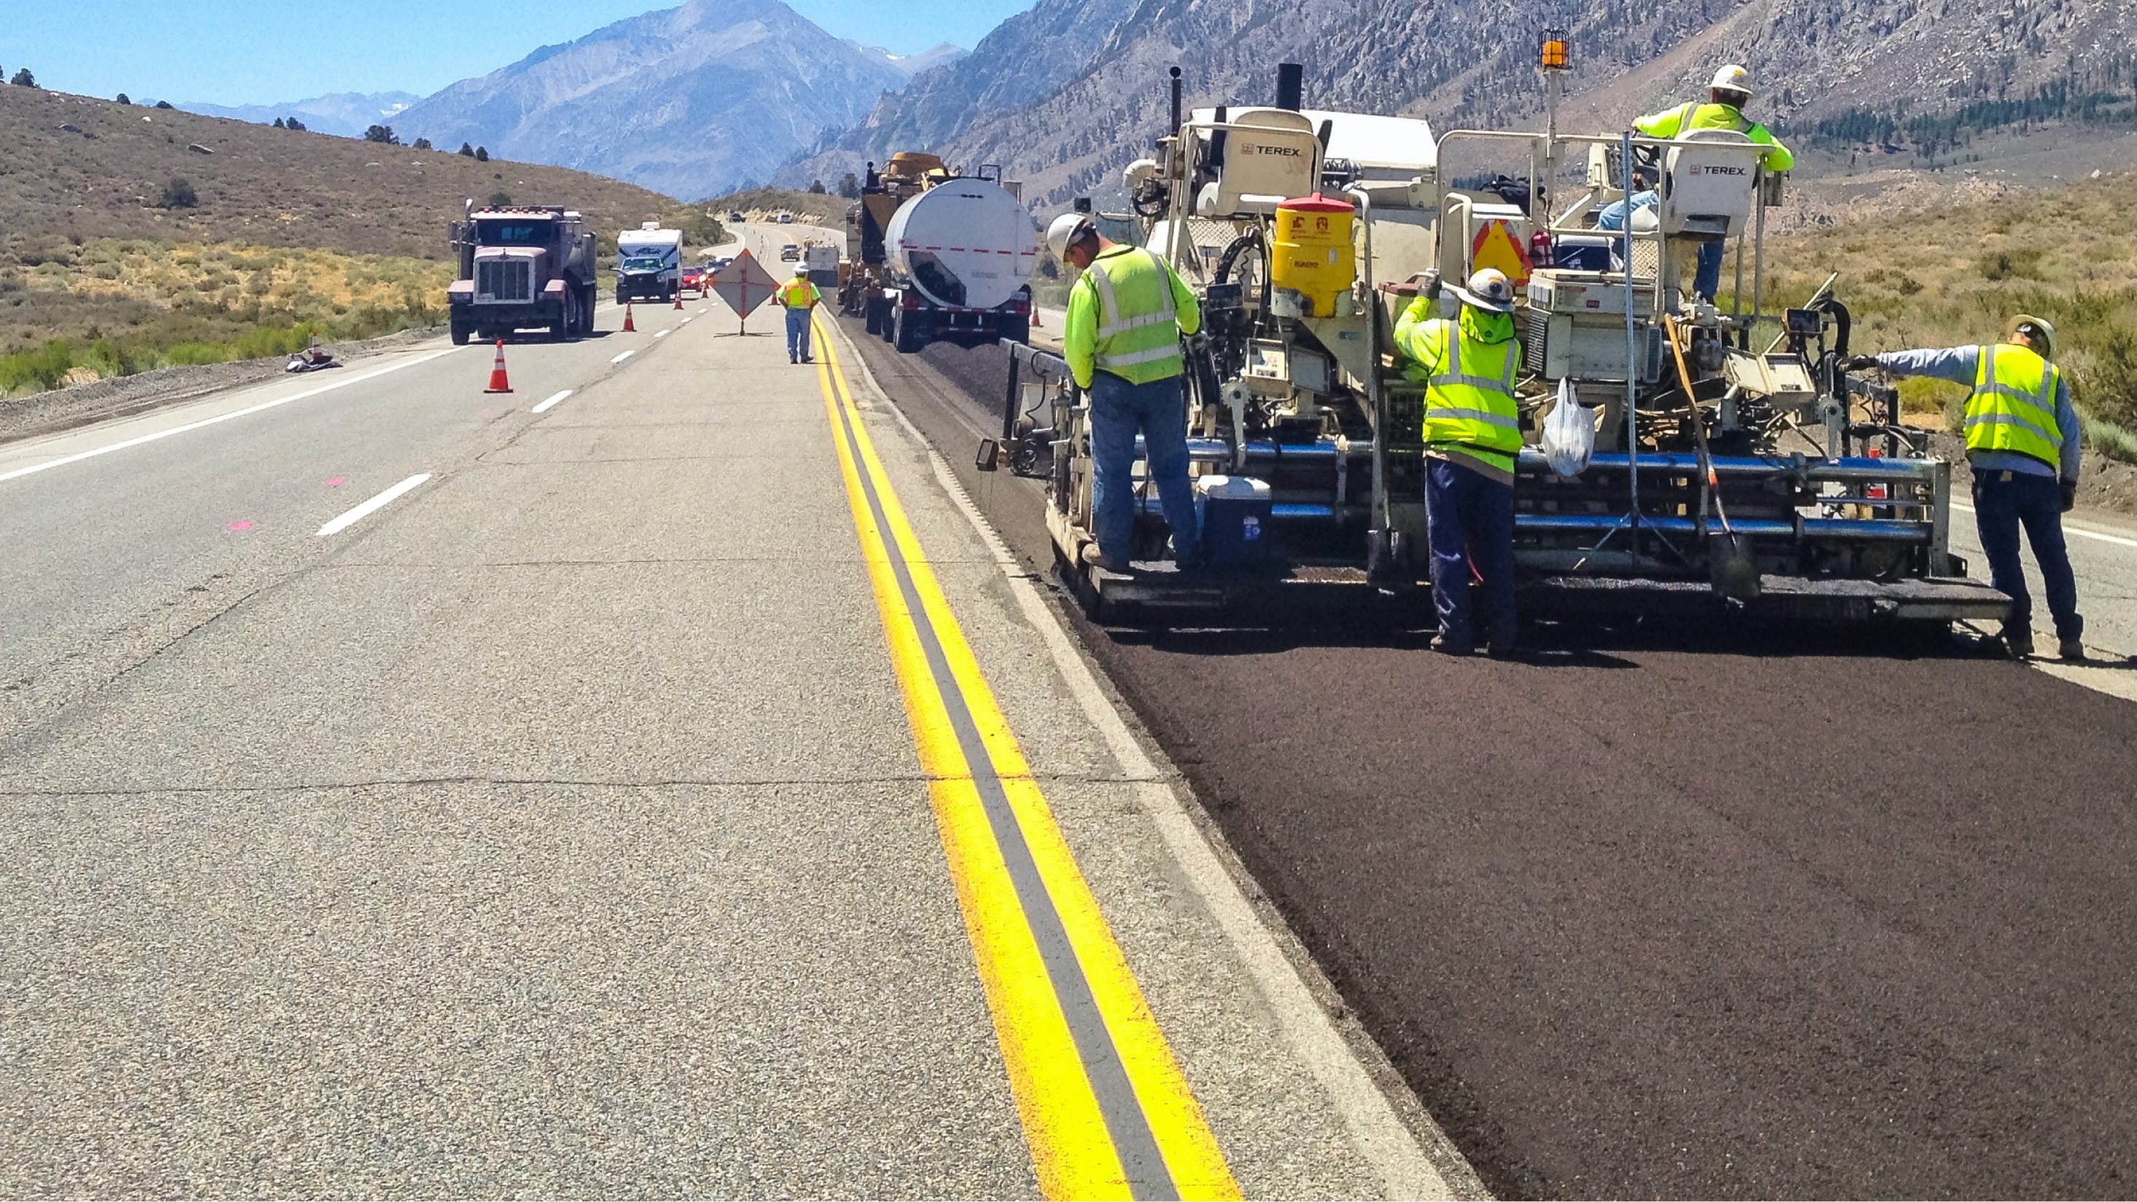
Cold In-Place Recycling and Cold Central Plant Recycling:
Materials, Sampling & Mix Design
Mike Hemsley, Jr
Technical Director – Mix Design, Paragon
April 24, 2023

Slide 2
CIR / CCPR Materials
Typical Materials
RAP or Millings
  NO Granular Base and No Subgrade
    Granular base is for FDR and Subgrade should not be used
Water
Emulsion or Asphalt Foam
Added RAP or Added Rock
  added materials – only if appropriate thickness or cross section is not present
  must be accounted for in the design
Chemical Stabilizer – Optional
  Hydrated Lime, Fly Ash, Cement or Other

Slide 3
CIR / CCPR Materials
Material Requirements
RAP or Millings
  Must be taken / sampled from the Roadway or Stockpile
  Watch for too many fines
Water
  Must be Potable
Emulsion or Asphalt Foam (not being covered)
  Specialty Emulsion Graded as a CSS-1H but is a specifically designed for CCPR / CIR applications
  Supplied by the Emulsion Supplier for the Mix Design
Chemical Stabilizer
  As needed or required

Slide 4
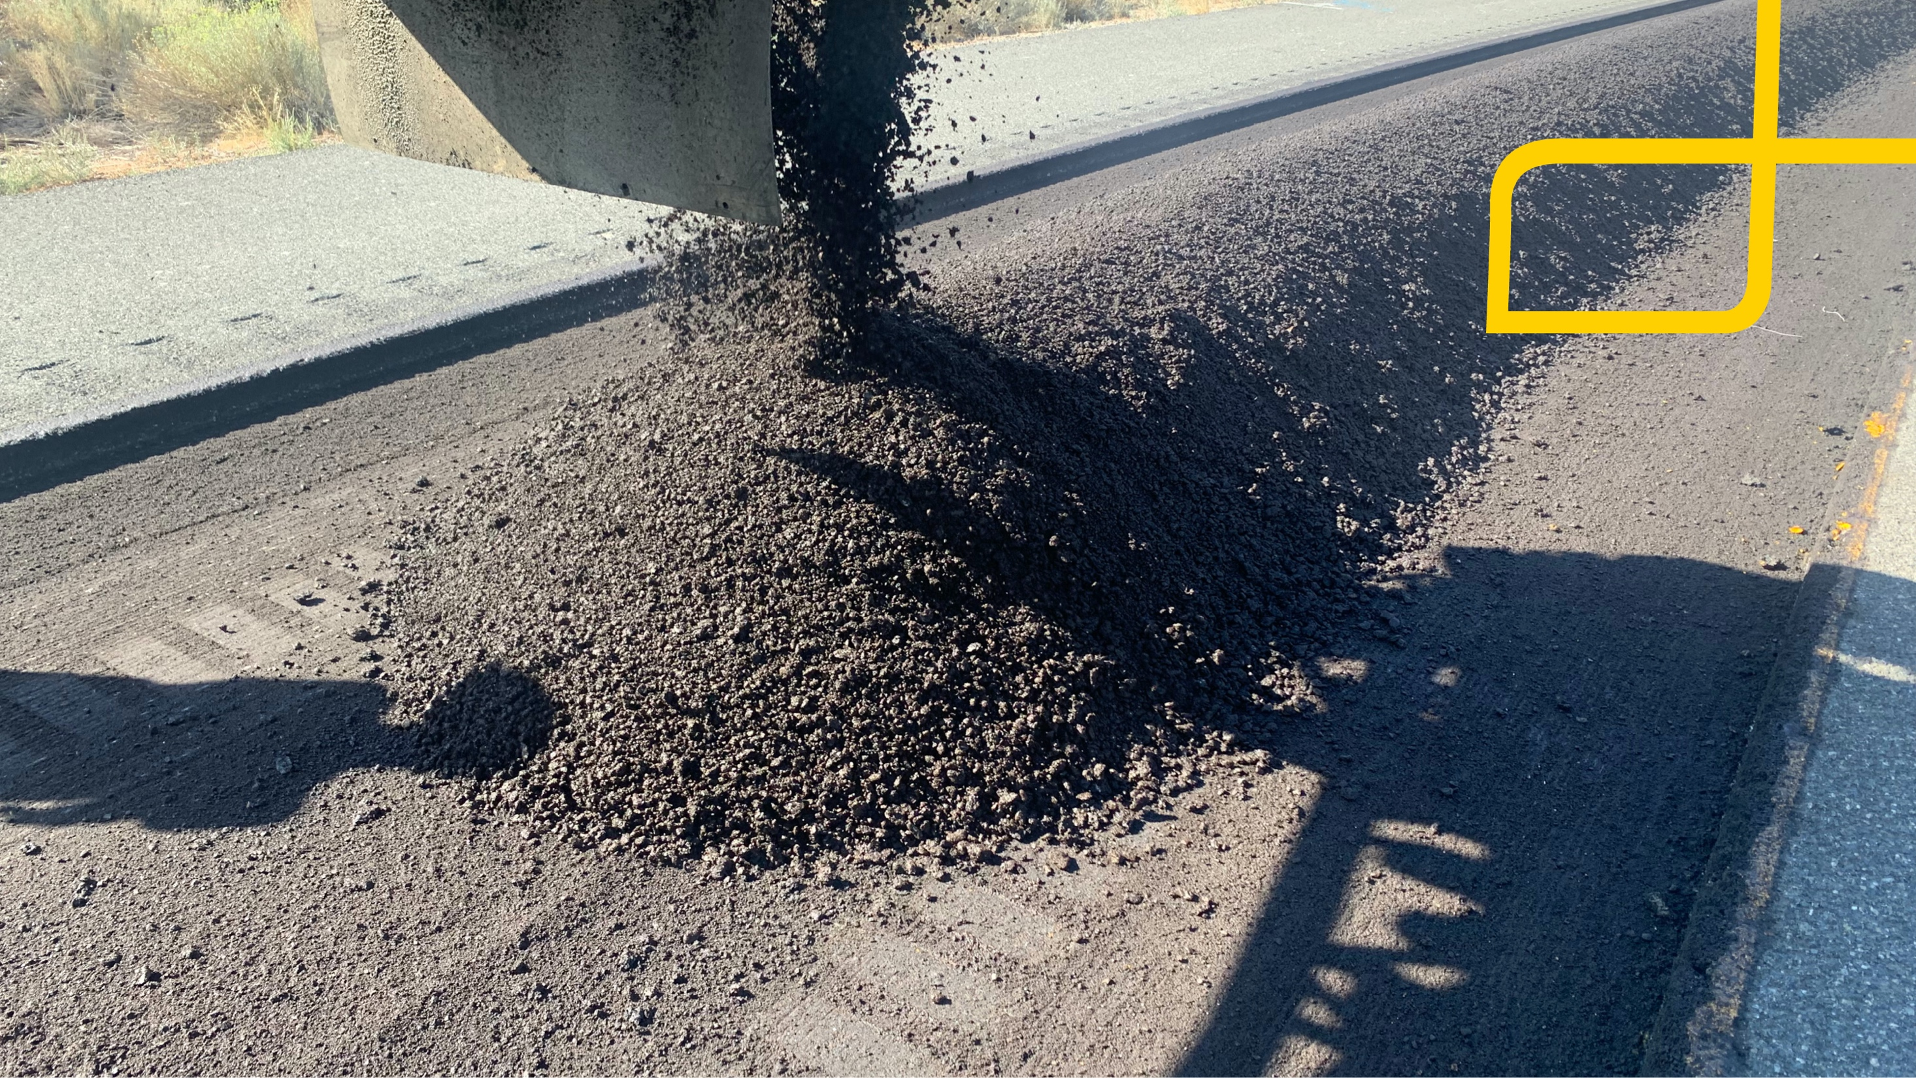

SAMPLING

Slide 5
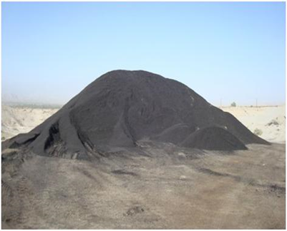
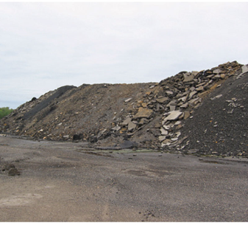
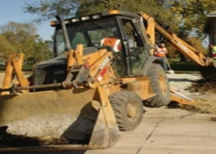
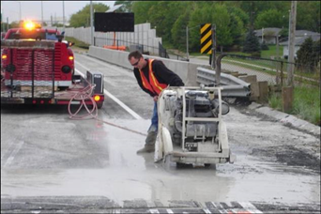
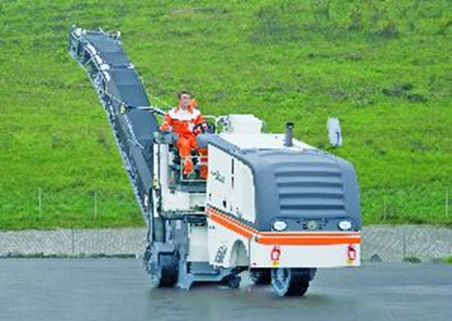
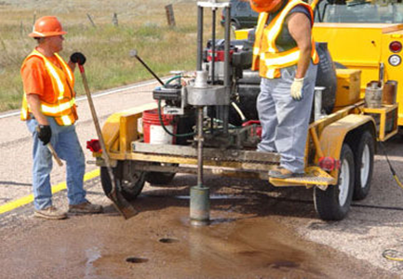
CIR / CCPR Sampling
Sampling
RAP Stockpiles
Back Hoe / Trenching
Milling Machine
Coring

Slide 6
CIR / CCPR Sampling
Sampling

Slide 7
CIR / CCPR Sampling
Sampling
Make sure you take enough sample
  Several trial designs may be required and its better to have too much than not enough
Make sure the samples are placed in sealed containers
  So In-situ moisture content may be determined
Make sure that samples from different locations are kept separate and labeled appropriately
  Multiple designs may be needed based on location
All sample location details should be recorded
  Lift thickness and Composition

Slide 8
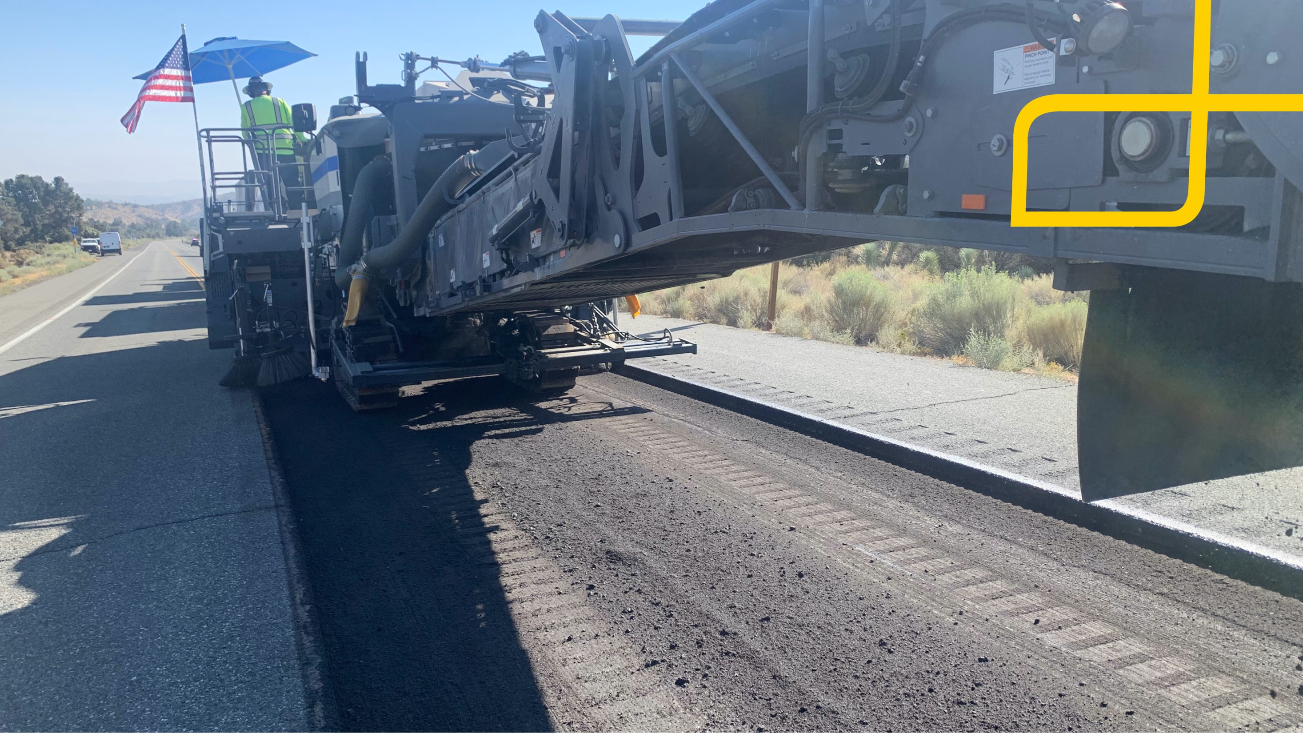
MATERIAL TESTS

Slide 9
CIR / CCPR Material Tests
Material Tests - RAP
Moisture Content (AASHTO T-255)
  % Moisture by weight of the Dry Aggregate (RAP)
Washed Gradation (AASHTO T-27)
  Sieve Analysis / Particle Size
  Include T-11 for percent passing the No 200 sieve
Asphalt Content (AASHTO T-164)
Extracted Gradation (AASHTO T-30)
  Material Properties

Slide 10
CIR / CCPR Material Tests
Material Tests - RAP
Plasticity Index (P.I.)
  Sometimes Checked but RAP probably won’t get a value
Bulk Gradation
  Used for Batching
    Allows for accurate proportioning
    Split on 1 ½”, 1”, ¾”, ½”, ³/₈” No 4, No 8, Pan
      #16 and #30 can be used - typical for research
    Weights are recorded and materials proportioned
    May be slightly different than your washed gradations

Slide 11
CIR / CCPR Material Tests
Material Tests - RAP
AL DOT
  Gradation (passing)
    2” = 100%
    1 ¾” = 97% to 100%
    No 200 = 0% to 20%
TX DOT
  Gradation (passing)
    1 ¾” = 100%
    ¾” = 85% max
ARRA
  Gradation (passing)
    Fine (¾” = 95-100 )
    Medium (¾” = 93-97)
    Coarse (¾” = 83-87)
    Sieves, 1 ¼”, ¾”, #4, #30, #200
  arra.org
  roadresource.org
MDOT Specs
  Gradation (passing)
    2” = 100%
    1 ¾” = 90% to 100%
    No 200 = 0% to 20%
ARDOT(411-1) Cold plant/cutback
  Aggregate Gradation (passing)
    ½” = 100%
    #4 = 60-80
    #8 = 43-63
    #50 = 15-28
    #200 = 4-10
  Recommended but Non-Specified Items - (Information/Report Only)
  - RAP Asphalt Content
  - RAP Extracted Gradation
  - Bulk Gradation

Slide 12
CIR / CCPR Material Tests
Material Tests - Emulsion
Specify CSS-1H grade emulsion
  Mixture Tests will determine Emulsion Suitability
  Specified as CSS-1H but it’s actually a Specialty Emulsion
AASHTO M-208
  Viscosity (AASHTO T-59)
    For Pumping
  Storage Stability, 24 hr
    For storage Characteristics – in case of storage
  Particle Charge
    Omit – inappropriate for application
  Sieve Test
    For emulsion quality
  Cement Mixing
    Omit – inappropriate for application
  Residue
    For asphalt content
  Penetration
    For asphalt suitability for region
  Ductility
    For asphalt suitability for region
  Solubility ( ? )

Slide 13
CIR / CCPR Material Tests
Material Tests - Emulsion
TX DOT
  Residue = 63% min
  Oil Distillate from Distillation = 0.5% max
  Sieve = 0.1% max
  25°C Penetration = 55dmm to 95dmm
MDOT Specs
  Viscosity, SFS 20 to 100
  Storage Stability, 24hr 1% max
  Sieve Test, 0.10% max
  Residue, 57% min
  25°c Penetration, dmm 40 to 90
  25°c Ductility, cm 40 min
  Solubility 97.5% min
Typical CCPR or CIR Emulsion
  Viscosity = 47 sec
  Storage = 0.15%
  Sieve = 0.00%
  Residue = 62.1%
  25°C Pen = 65dmm*
  25°C Duct = 90cm*
  * Can be changed to suit climate
AL DOT
  Residue = 63% min
  Oil Distillate from Distillation = 0.5% max
  Sieve = 0.1% max
  25°C Penetration = 55dmm to 95dmm
ARDOT Specs – M208
  Example – CSS-1H

Slide 14
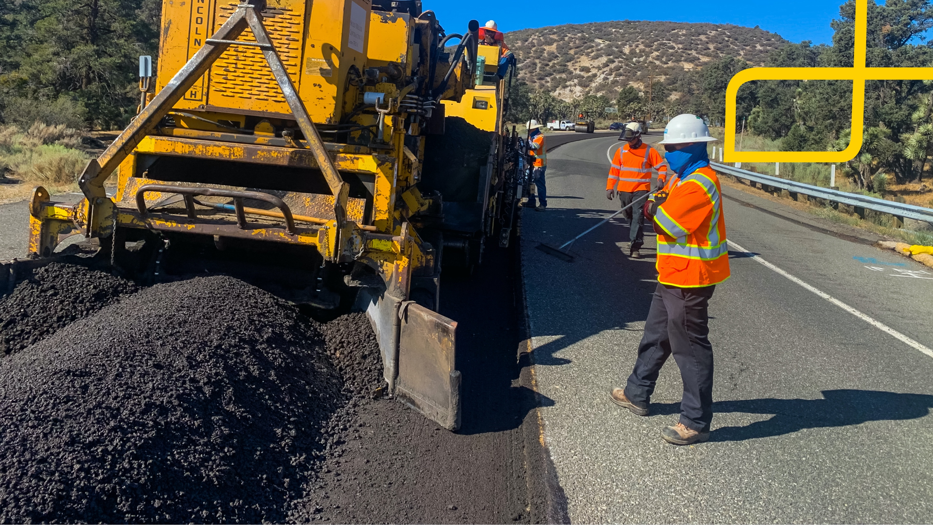
MIXTURE DESIGN

Slide 15
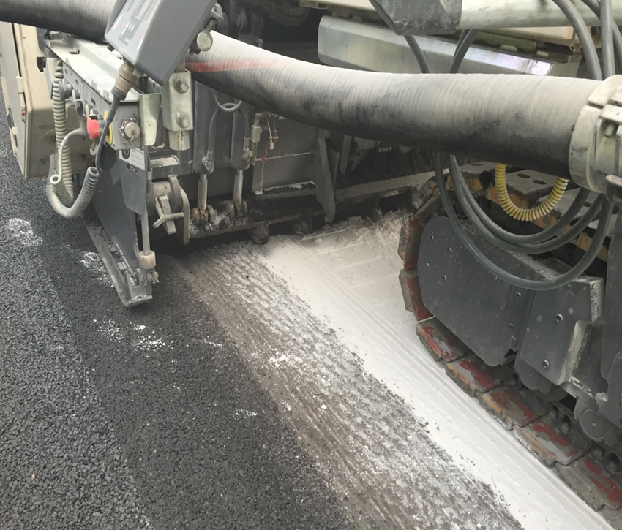
CIR / CCPR Mix Design
Mix Design
In the plant/field the mixing is very intense
A significant amount of energy is put into the mixing of the CIR / CCPR processes

Slide 16
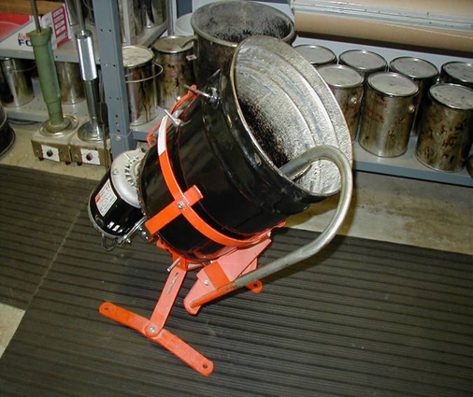
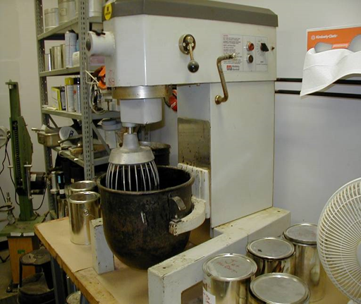
CIR / CCPR Mix Design
Mix Design - Mixing
Traditional HMA mixing equipment is Ok for CIR / CCPR but not for FDR
  These mixers do not provide enough energy to disperse the emulsion throughout the FDR mix.
  The CIR and CCPR Emulsions are a special emulsions that are designed to be mixed and then break quickly
  These emulsions, although graded and specified as a CSS-1H break more like Micro-Surfacing emulsion. The emulsion sets and cures fast, especially when compared to a CSS-1H (slow set) emulsion

Slide 17
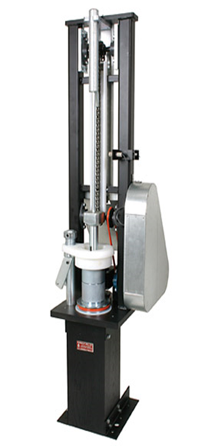
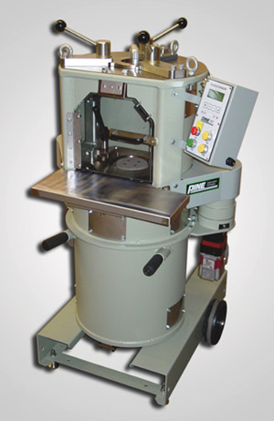
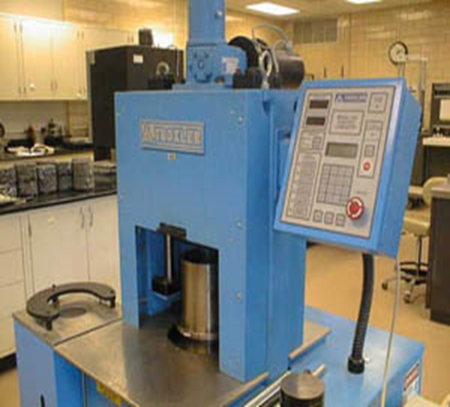
CIR / CCPR Mix Design
Mix Design - Compaction
The compaction should
  Simulate what is seen in the field
  Give repeatable/good results
  Be easy to use and have a sample extruder
Marshall Hammer
Super-Pave Gyratory Compactors (SGC)
  Just be careful of the water that is released during compaction

Slide 18
CIR / CCPR Mix Design
Mix Design - Compaction
Kneading Compactors
  SGC Compactors
    30-50 Gyrations seems to be adequate for CIRR / CCPR mixtures although other levels can also be used
Compaction Hammers (Impact)
  Marshall Hammer
    50 blows / side
    75 blows / side

Slide 19
CIR / CCPR Mix Design
Mix Design - Compaction
What kind is better?
Gyratory - It produces a type of compaction that is closer to what is seen in the field.
  Pneumatic – kneading (used for density)
  Steel Wheel – Compressive (used mostly for finishing)
  Vibratory - kneading
Impact Hammer
  Compressive / Impact

Slide 20
CIR / CCPR Mix Design
Mix Design
Start with Hand Mixes for CIR / CCPR
  Takes a Trained Technician
  Use an Estimated Emulsion Content
  Defines optimum water content for the mixtures
  Adjust for total fluids for remaining emulsion contents
Rice Gravity (AASHTO T-209)*
  on Cured Emulsion Mix
Bulk Gravity (AASHTO T-166)*
  on Compacted and Cured samples
Tensile Strength Ratio (T-283)*
  both Dry and Wet, psi
Marshall Testing (T-245) *
  Strength and Flow
  Retained Marshall
  Marshall Quotient (?)
Boil Test *
  on Emulsion Mix
Raveling Test for CIR Mixes (ASTM D-7196)
  on a compacted but uncured Emulsion Mix
*You must account for the water in the emulsion and deduct that from the added water content. Deviations may apply for the test methods referenced.

Slide 21
CIR / CCPR Mix Design
Mix Design - Notes
Back out the moisture in the emulsion and make optimization samples for curves
  An example (I am using unrealistic numbers for ease of calculating)
    if the Optimum Water Content is determined to be 10%
      Determined from hand mixes
      You want to use an Emulsion content of 3%
    The Emulsion Residue is 67%
      1% Water is being added by the emulsion
      2% Asphalt is being added by the emulsion
    Moisture Content of the RAP is 2%
    1% Water must be deducted from the Water Total
    7% Water and 3% Emulsion is then Added to the Mixture
    (1% water from the emulsion and 2% in-situ water in the RAP
The moisture, in the emulsion, must be accounted for

Slide 22
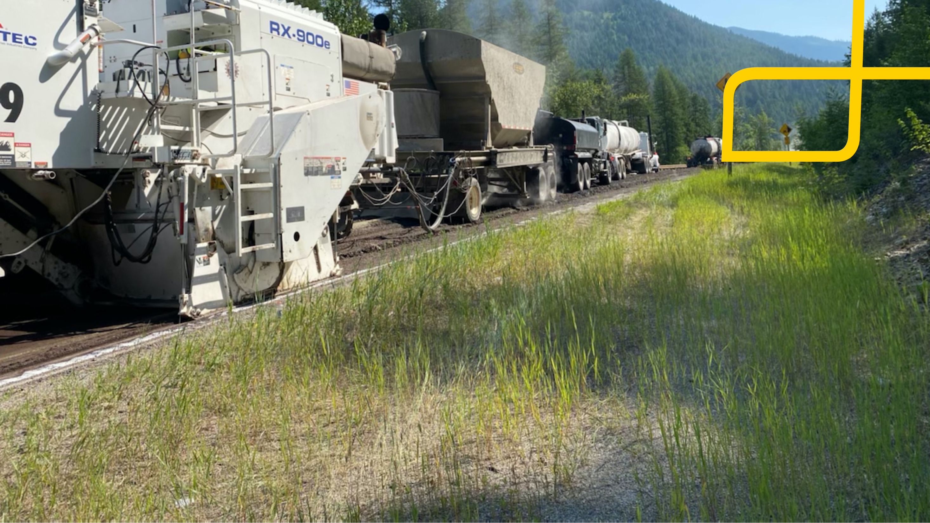
MIX DESIGN TESTS

Slide 23
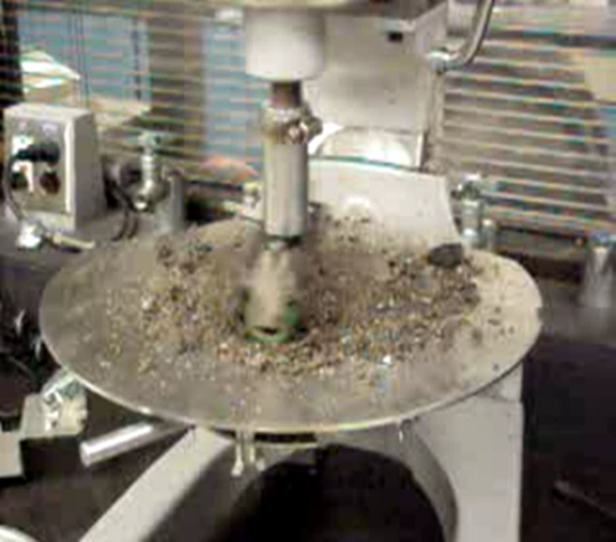
CIR / CCPR Mix Design
Mix Design – Tests
IDT, psi
  A TSR is being generated
    IDT Can be generated from the DRY TSR
    Can be collected as information only until enough information is gathered to generate a spec
    45 psi min is typical for Dry samples
Marshall Strength
  Ideal in determining strength
  1250 lbs min
Marshall Quotient (experimental)
  35,000 lbs/in max
  Optimizes Strength and Flexibility (Flow)
  Gathered from Marshall Strength/Flow
Dynamic or Resilient Modulus
  Used in determining a Structural Number
  Information only
Raveling Test
  Used to determine the integrity of the Mixture
  Indicates the suitability for early traffic
Boil Test

Slide 24
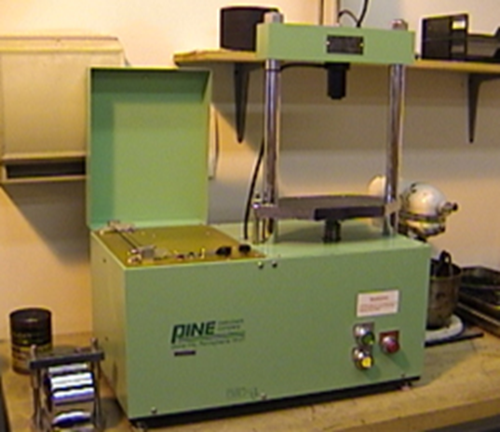
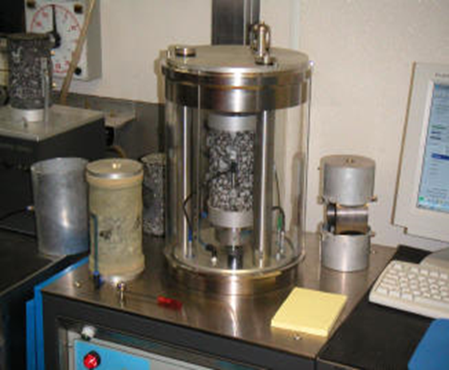
CIR / CCPR Mix Design
Mix Design – Report
Hand Mixes
  Determines Water content
Bulk Gravity (DRY)
Gmm (Theo. Max Gravity)
Air Voids (Dry)
Boil Tests
Dynamic Modulus (E*) ?
Dry IDT Strength, psi
Wet IDT Strength, psi
% Retained Strength
Marshall Stability/Flow (25°C/40°C)
Wet Marshall Stability
% Retained Stability
Marshall Quotient ( ? )
Raveling Test

Slide 25
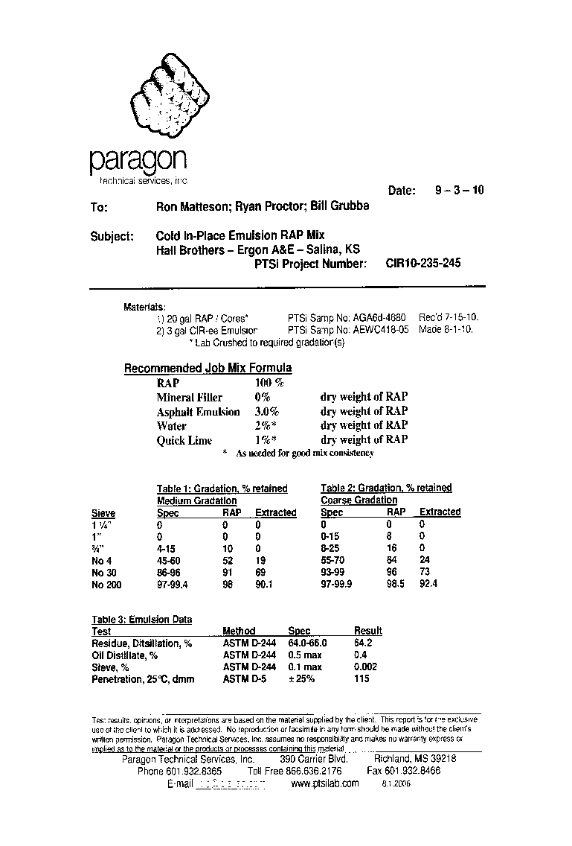
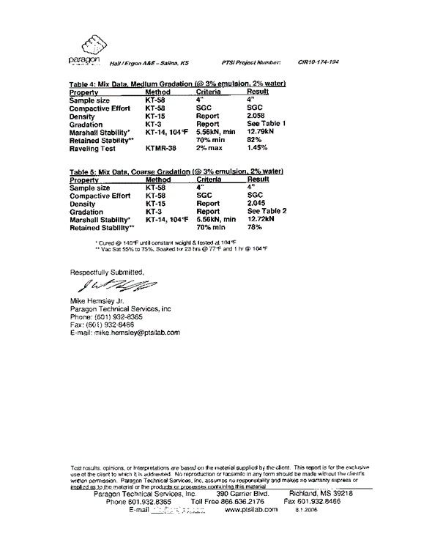
CIR / CCPR Mix Design
Mix Design – Report
A Kansas CIR Example

Slide 26
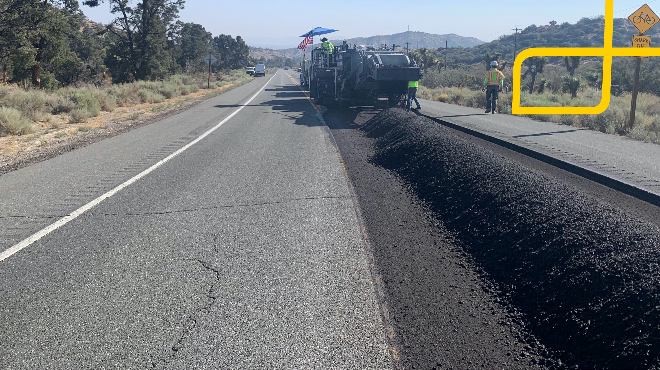
Mike Hemsley
Paragon Technical Services, Inc
Mike.Hemsley@ptsilab.com
QUESTIONS ?

