Slide 1
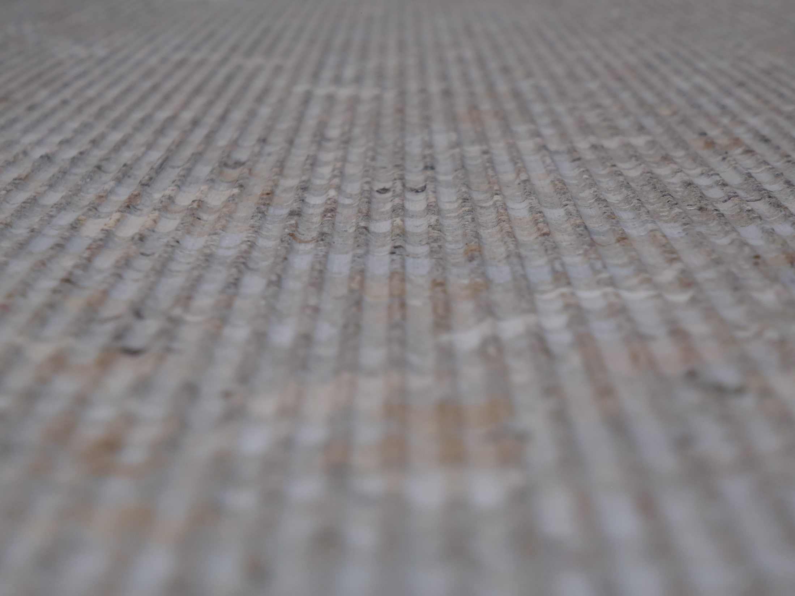

Concrete Pavement Sustainable Solutions for Today and Tomorrow
ARDOT TRC Conference
2023

Slide 2


Introduction
John Roberts
  Executive Director - International Grooving and Grinding Association
  Vice President – American Concrete Pavement Association’s Pavement Preservation Partnership

Slide 3

Overcoming Challenges
Since the beginning, men and woman have overcome overwhelming challenges while building roadways to better the way of life for their contemporaries.

Slide 4
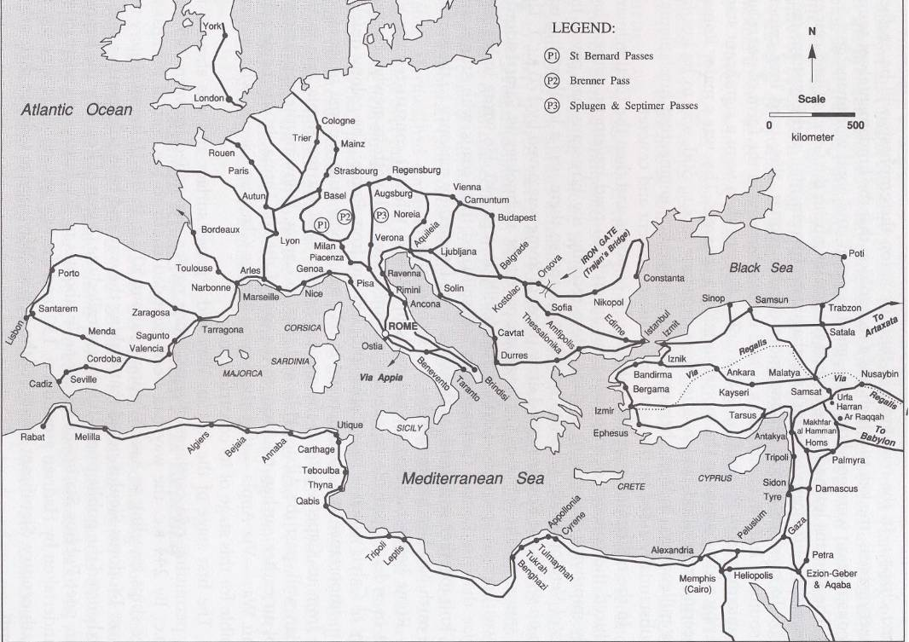
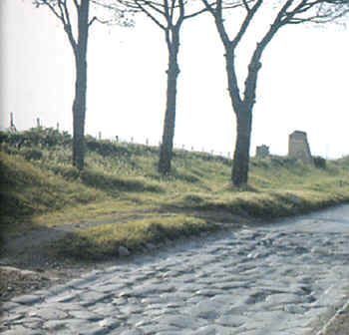
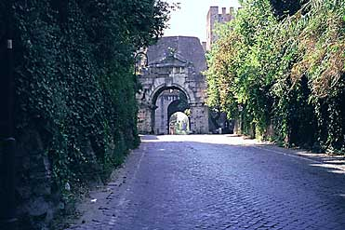
Appian Way – Roman Road
Notes:
This industry has never been afraid of great challenges, dating back to the days of the Romans and their building of a road network across the whole of Europe

Slide 5
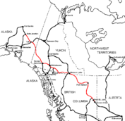
Alaska-Canadian Highway(ALCAN)
Notes:
Or while considering more recent feats such as the construction of the ALCAN highway built during WWII which connects the contiguous US to Alaska through Canada.

Slide 6

The Game Has Changed
Minimal system expansion
Maintain the present system
Minimize traffic disruptions
Increase safety
Address customer’s needs
  Reduce roughness/noise
Save money
Protect the Environment
I-10 Katy Freeway – Houston TX
26 lanes wide – All Diamond Ground

Slide 7

The New Challenge - Sustainability
Preserving our planet for the generations that follow while meeting the needs for today’s society.
It’s a balancing act!
Notes:
While we don’t have the physical challenges facing us as our predecessors did, we do have a unique challenge of our own…. Preserving our planet for the generations that will follow.

Slide 8
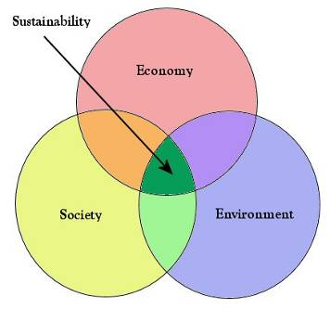
Sustainability – PCCP Perspective
  Economic
    Cost
    Longevity
  Social
    Traffic
    Traffic Noise
    Safety
  Environmental
Notes:
Here is where we tie the attributes of grinding to sustainability. Remind the audience that sustainability is comprised of the above listed elements.

Slide 9

Don’t Be Discouraged!

Slide 10
BIL/IILJ Carbon Reduction Initiative
Carbon Reduction Strategy
Requires each State, in consultation with any MPO designated within the State, to– [§ 11403; 23 U.S.C. 175(d)]
  develop a carbon reduction strategy not later than 2 years after enactment; [§ 11403; 23 U.S.C. 175(d)(1)] and
  update that strategy at least every four years; [§ 11403; 23 U.S.C. 175(d)(3)]
Requires the carbon reduction strategy to–
  support efforts–and identify projects and strategies–to support the reduction of transportation emissions;
  at the State's discretion, quantify the total carbon emissions from production, transport, and use of materials used in the construction of transportation facilities in the State; and
  be appropriate to the population density and context of the State, including any MPO designated within the State. [§ 11403; 23 U.S.C. 175(d)(2)]
Allows the carbon reduction strategy to include projects and strategies for safe, reliable, and cost-effective options to–
  reduce traffic congestion by facilitating the use of alternatives to single-occupant vehicle trips, including public transportation facilities, pedestrian facilities, bicycle facilities, and shared or pooled vehicle trips within the State or an area served by the relevant MPO;
  facilitate use of vehicles or modes of travel that result in lower transportation emissions per person-mile traveled as compared to existing vehicles and modes; and
  facilitate approaches to the construction of transportation assets that result in lower transportation emissions as compared to existing approaches. [§ 11403; 23 U.S.C. 175(d)(2)(B)]
Requires FHWA to–
  review the State's process for developing its carbon reduction strategy and certify that the strategy meets statutory requirements; and
  at the request of a State, provide technical assistance in the development of the strategy. [§ 11403; 23 U.S.C. 175(d)(4) and (5)]

Slide 11
Tomorrow’s Technologies Here Today
Transportation agencies already have access to a variety of sustainable, concrete-based pavement preservation and maintenance solutions. What is needed is not necessarily new technologies or solutions, but a proactive mindset toward using them.
Notes:
Here is where we tie CPR to increased longevity.

Slide 12
What are Sustainable Pavement Attributes?
Enhancement of characteristics like smoothness, quiet ride, skid resistance and reflectivity
Reduction of wear and tear on vehicles from poor pavement surfaces and increased fuel economy
Rehabilitation for a fraction of the cost of reconstruction
Reduction of the “first use” of natural or manufactured materials over the life of the pavement
Minimized frequency and duration of work zones which will reduce work-zone fatalities and will reduce vehicle emissions due to work-zone related traffic delays
Long Life - LONGEVITY
Notes:
READ THE LIST

Slide 13
Fuel Efficiency
Multiple studies have found that pavement roughness reduces vehicle fuel efficiency
  Keeping smooth pavements smooth reduces economic and environmental impact (Less fuel use and emissions)
MIT work cites significant, improvement in fuel efficiency when vehicles are operating on a smooth, rigid concrete pavement
Over a 30 to 50 year design life, this can be huge

Slide 14
Safety
Most important attribute of a pavement surface
Must maintain sufficient macro-texture, improving skid resistance
Smooth pavements are safer than rough pavements
Saving lives and minimizing accidents are huge social benefits

Slide 15
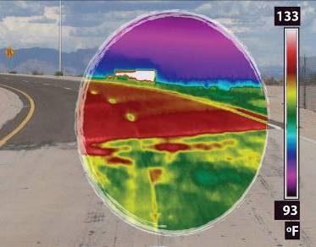
Light Colored and Cool
Urban Heat Island Mitigation:
Urban areas up to 9°F warmer due to UHI → greater energy use and resulting pollution
PCCP is an effective mitigation strategy
  lower city temperatures
  lower cooling costs
  reduce smog formation

Slide 16
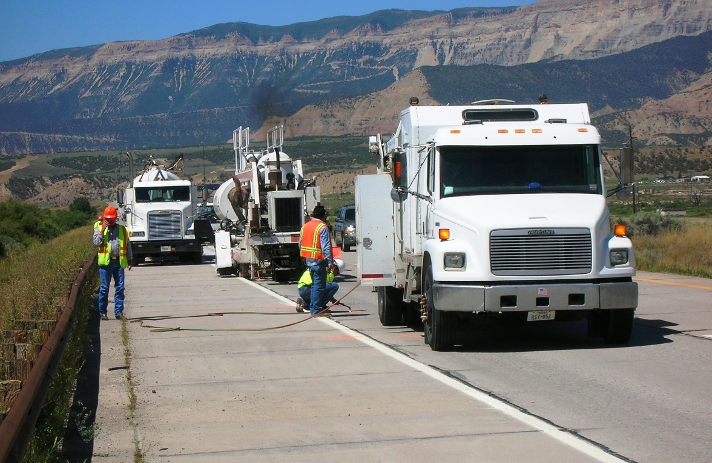
Diamond Saw-Cut Surface Textures
Increasingly Specifiers are utilizing diamond saw-cut surfaces to reduce roughness, reduce noise, increase friction and extend the life of their pavements, bridges, tunnels and runways.
  Economical
  Long-lasting
  Effective
  Environmentally Friendly
I-70 Rifle Colorado

Slide 17
Advantages of Saw-Cut Textures
Costs are competitive and stable over time;
Enhances smoothness, surface friction and safety
Can be accomplished during off-peak hours with short lane closures
Texturing of one lane does not require grinding of the adjacent lane
Does not affect overhead clearances underneath bridges, signs or tunnels
Blends patching and other surface irregularities into a consistent, smooth surface
Environmentally friendly

Slide 18
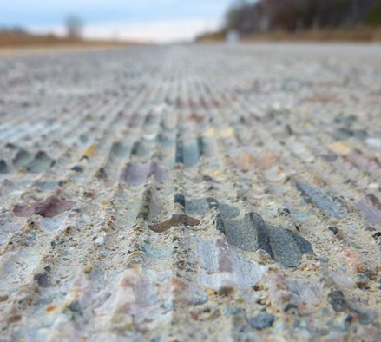
Diamond Saw-Cut Surface Textures
Diamond Grinding
Safety Grooving
Next Generation Concrete Surface

Slide 19
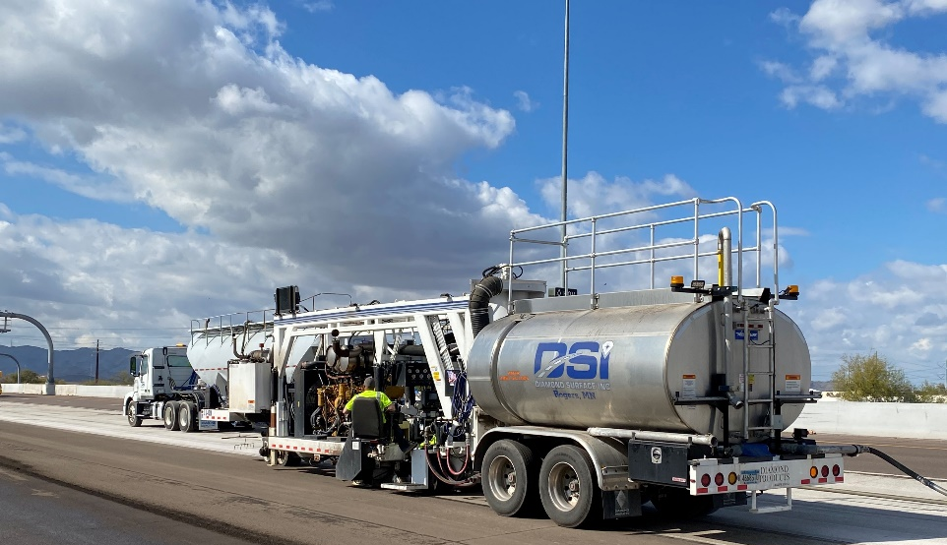
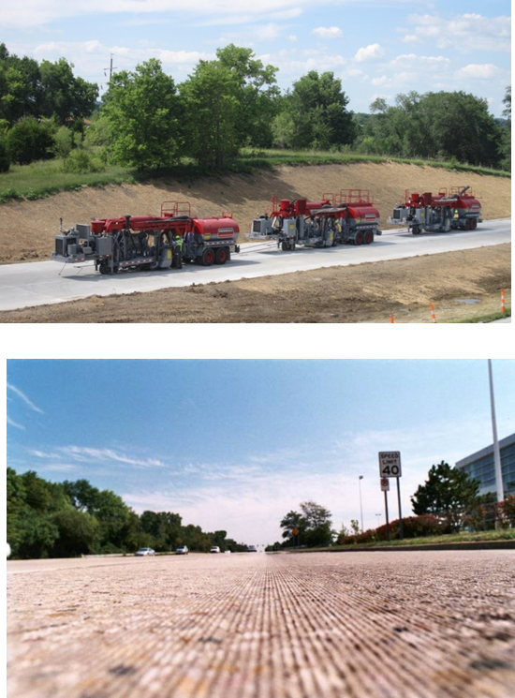
What Is Diamond Grinding?
Removal of thin surface layer of hardened PCC using closely spaced diamond saw blades
Results in smooth, level pavement surface
Provides a longitudinal texture with desirable friction and low noise characteristics

Slide 20


Slide 21
Diamond Ground Tunnel Pavements

Slide 22
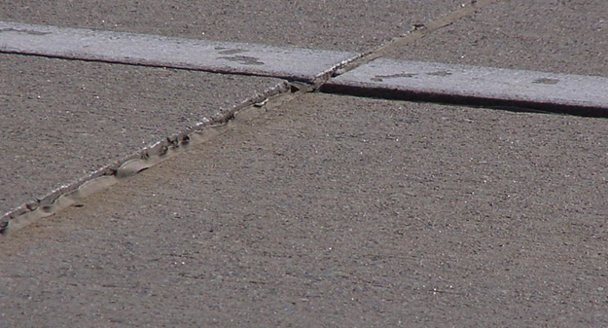

Pavement Problems Addressed
Faulting at joints and cracks
Built-in or construction roughness
Polished surface
Wheel-path rutting
Curling and warping
Inadequate transverse slope
Unacceptable noise level

Slide 23
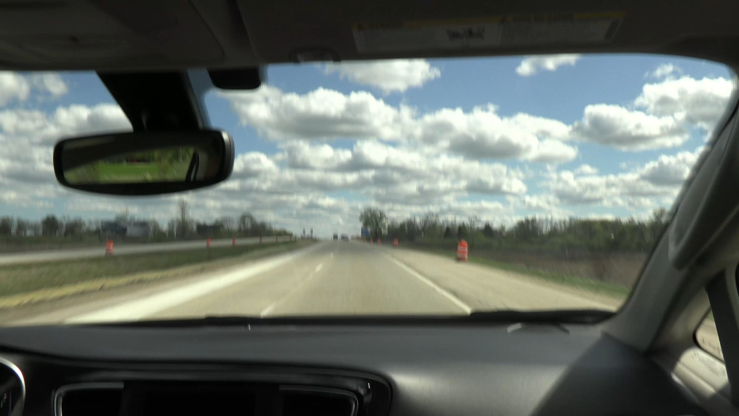
US-45 West Bend WI – Pre Grind

Slide 24

US-45 West Bend WI - Post Grind

Slide 25
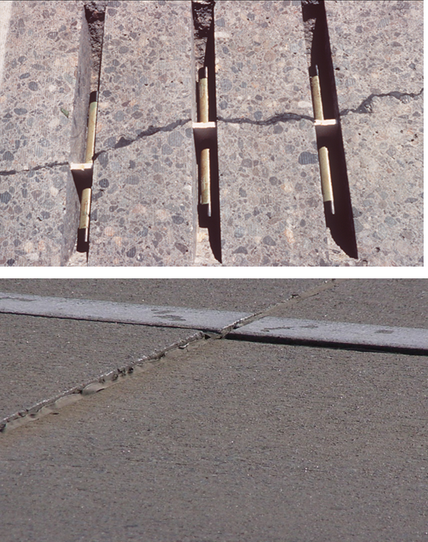
Dowel Bar Retrofit - DBR
Placement of load transfer devices across transverse joints or cracks of existing pavements.
Used to limit future faulting.
First production use of DBR in 1992 by WSDOT. Over 8 million bars retrofitted in the USA since that time adding decades of pavement life.

Slide 26
Purpose of Dowel Bar Retrofit
Reestablish load-transfer across joints or cracks
  Load-transfer is a slab’s ability to transfer part of its load to its neighboring slab
Used in JRC and JPC pavements to limit future faulting
= x
L
= 0
U
Load Transfer = 0% (Poor)
= x
= x
L
U
Load Transfer = 100% (Good)

Slide 27
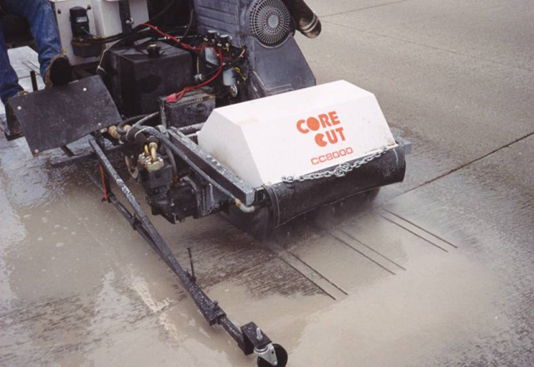
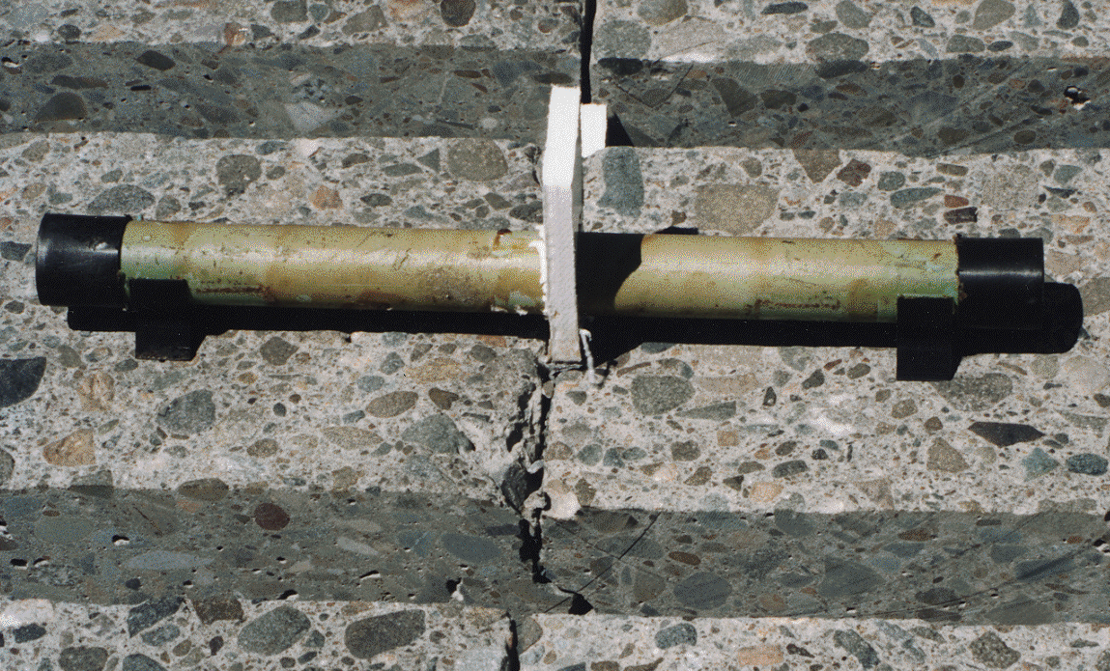
Dowel Slot Alignment
Correctly Aligned
Dowel Slots
Centerline

Slide 28
DBR Performance)
Washington State DOT
Average in-service Age:
18 yrs
Average Age at DBR:
34 yrs

Slide 29
Smoothness and Fuel Consumption
It is well-documented that vehicle fuel efficiency is related to the smoothness of the pavement
  Smoother pavements result in less fuel consumption and less carbon emissions
  This is foundational to the World Bank HDM 4 model and has been validated by recent research by NCHRP, Caltrans, and in Europe

Slide 30
CALTRANS Fuel Efficiency Research

Slide 31
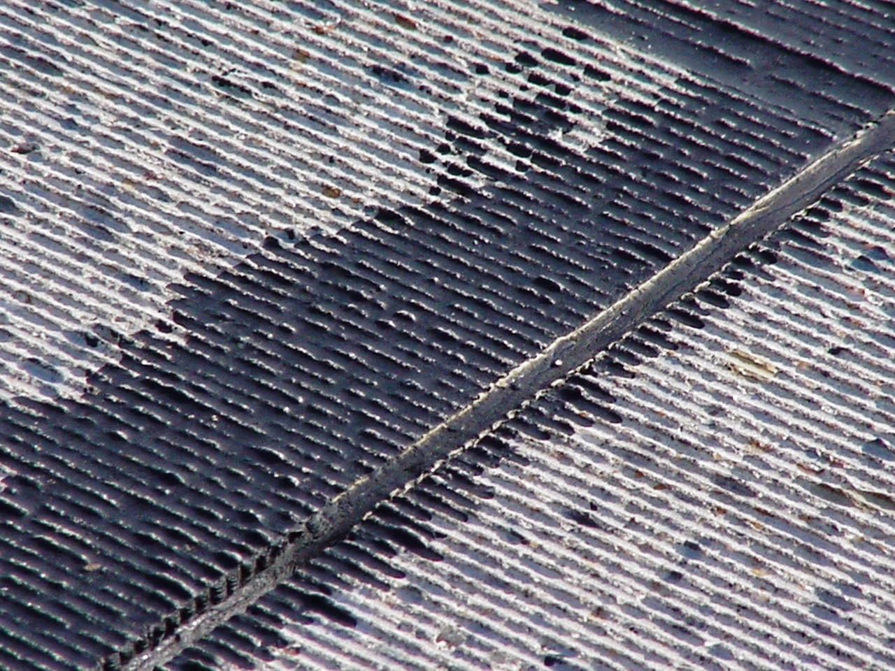
Safety, Surface Texture and Friction
Wisconsin DOT and Marquette University found that, overall accident rates for ground surfaces were 40% less than for un-ground surfaces over a 6-year research period, 57% in wet weather conditions

Slide 32
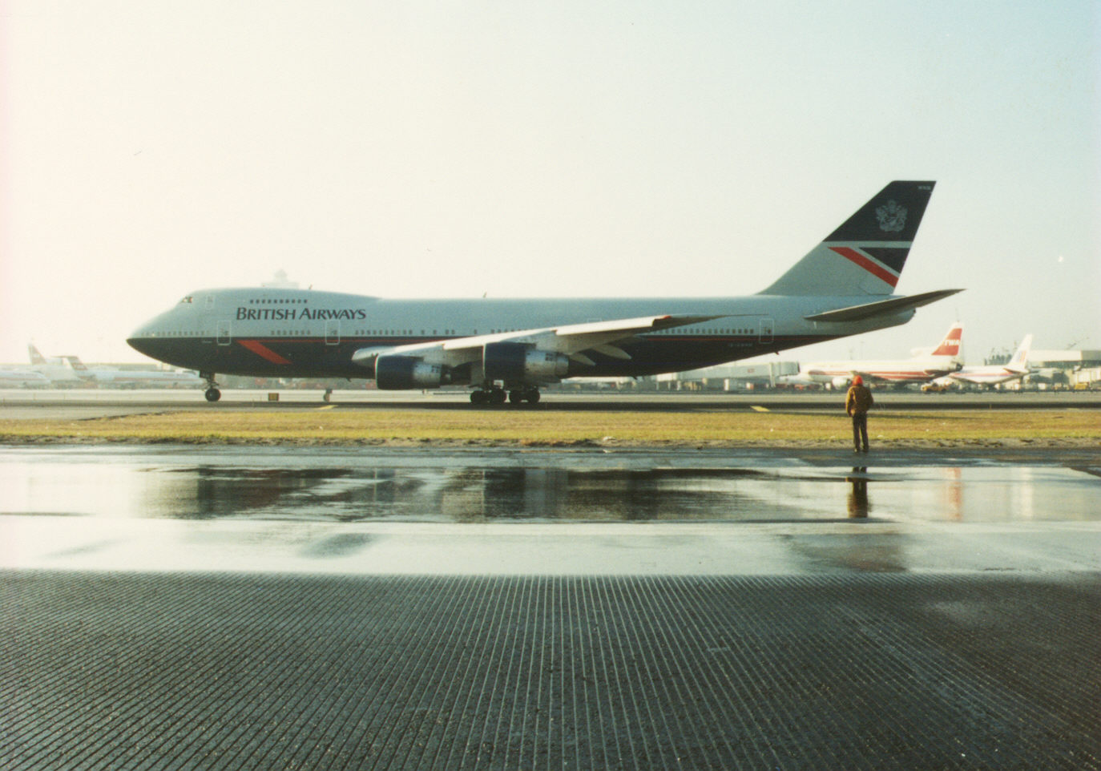
What are the benefits of safety grooving?

Slide 33
Diamond Grinding
Width of diamond blades
(.125 inches)
Land area- .08 inches for hard aggregate
- .110 inches for soft aggregate
Diamond Grooving
Saw blade thickness
(.125 inches)
.75 inches
.125 inches
Notes:
The land area for grinding differs depending on the hardness of aggregate. Grooves are more widely spaced with diamond grooving.

Slide 34
CALTRANS Grooved Pavement Study
Study conducted over a four-year period
All grooved and un-grooved control sections located on freeways in urban Los Angeles County
Study includes 322 lane-miles of grooved pavement
Study includes 750 lane-miles of un-grooved control sections

Slide 35

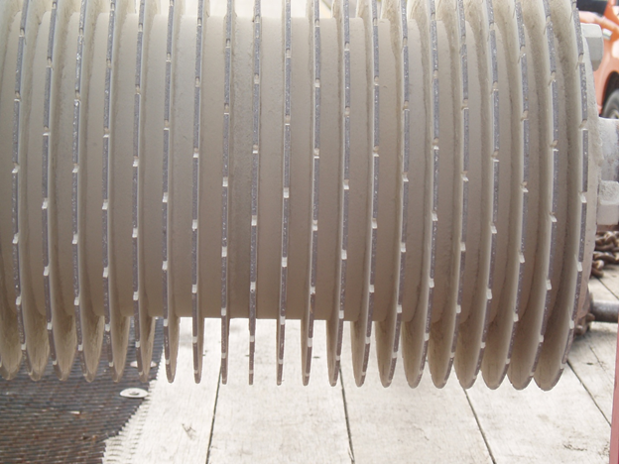
Caltrans Grooving Research

Slide 36
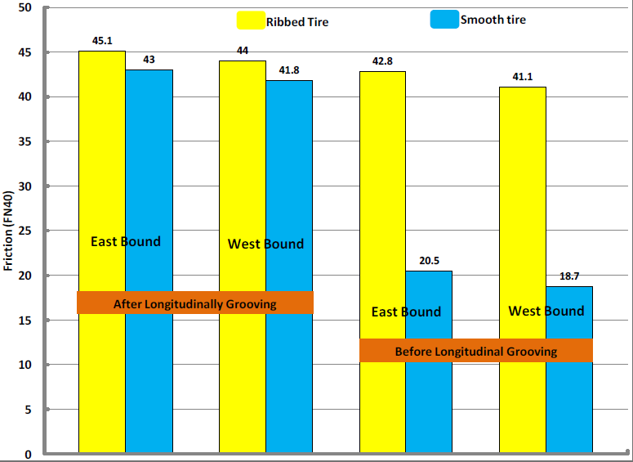
Friction Enhancement by Grooving
I-70 Surface Texture Research Section by KDOT

Slide 37
Quiet Pavements
Quiet pavements are good neighbors
Reduces social costs
Diamond grinding keeps pavements quiet
  Thin asphalt rubber overlays contribute to urban heat island and lack acoustic longevity
  NGCS is most recent example of an industry innovation to address noise

Slide 38
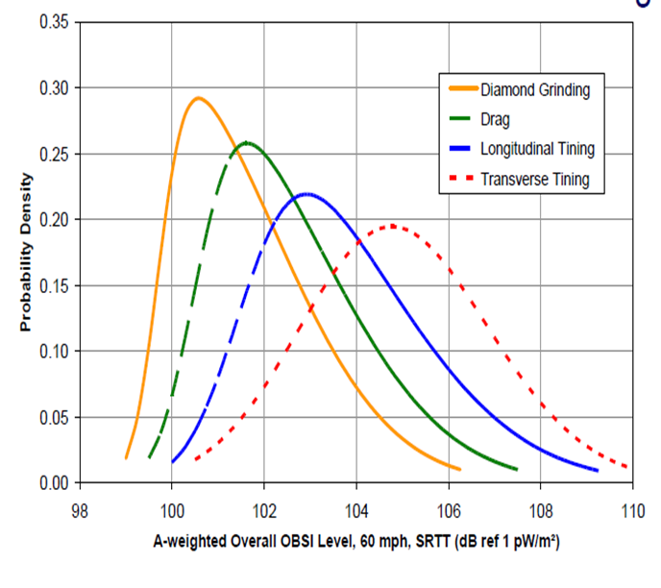
Diamond Ground Surfaces Are Quiet
Research conducted by the National Concrete Pavement Technology Center shows diamond grinding as the most quiet PCCP surface texture commonly used

Slide 39
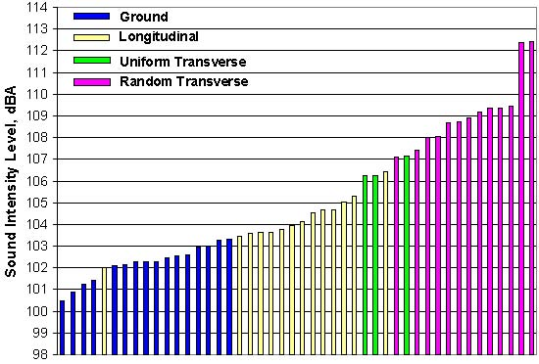
CA and AZ PCCP Noise Test Results

Slide 40

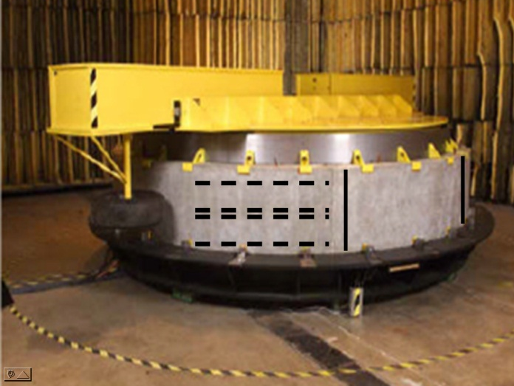
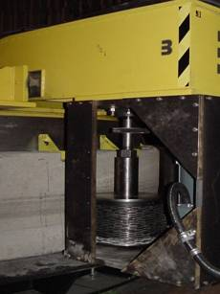
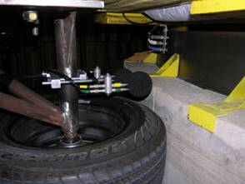
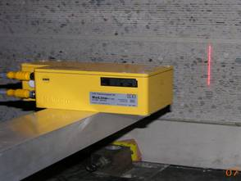
Industry Partners With Purdue University to Develop Quieter Diamond Saw-cut Surfaces
Notes:
Here are a few pics of the Purdue TPAT.
The upper left shows a picture of the entire unit. It is essentially 12 foot diameter drum to which they affix curved concrete sections containing various textures. On top is a beam that rotates around the drum with instrumented tires mounted on each side of the beam. The TPTA is unique in that it allows testing of multiple surfaces under controlled laboratory conditions. This allows more efficient and precise testing without the expense of test section construction and attendant traffic control and safety issues.
The upper right photo is a pic of the DG unit built by IGGA members that allowed Purdue to impart saw cut textures on the curved concrete sections.
The lower left show a picture of the OBSI noise testing apparatus mounted near the test tire.
And the lower right pic shows the line laser used to measure macro texture.

Slide 41
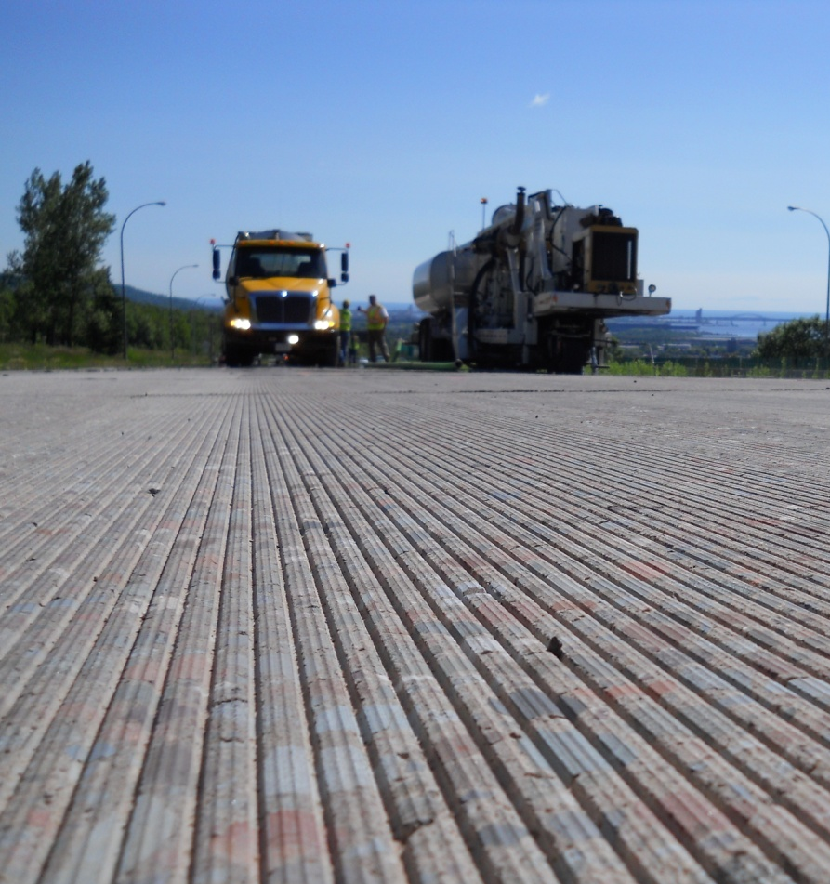
Purdue Research Produces the Next Generation Concrete Surface (NGCS)

Slide 42
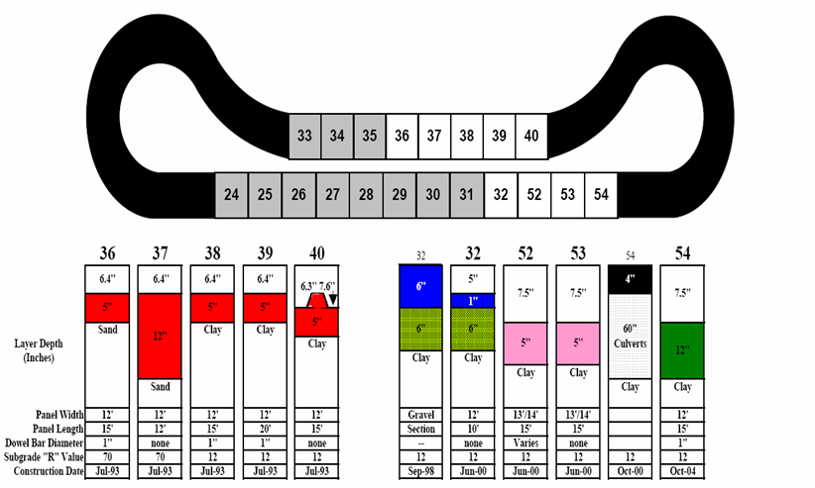
NGCS Field Validation is Conducted at MNROAD With Minnesota DOT
Notes:
Once the NGCS surface had been verified on the Purdue TPTA, it became necessary to verify its performance on a real road when constructed with actual diamond grinding equipment. Therefore, an agency partner was necessary.
The Minnesota Department of Transportation (MnDOT) joined the effort and provided a location on their MN ROAD low volume road test track. In the summer of 2007, the IGGA funded Diamond Surfaces, Inc. to construct the Purdue NGCS surfaces at the MnROAD’s facility. The single pass and double pass NGCS surfaces were successfully constructed and verified the efficacy of the TPTA to effectively predict the noise levels of field installations¹. The Purdue research indicated the NGCS should be approximately 3 dBA lower than the conventional diamond ground textures evaluated and the MN ROAD testing verified this finding.

Slide 43
Comparison to Other Pavement Surfaces
Notes:
Based on the information provide from MNROAD, and the Arizona DOT, we were able to make the following comparisons. Asphalt Rubber Friction Courses (ARFC) once trafficked on get louder over time. Explain slide.

Slide 44
Kansas DOT I-70 Results
Notes:
We also have a few other surfaces we are developing including NGCS Lite, which is a renewal surface texture that can be applied to existing NGCS sections in the event that friction or noise benefit is diminished over time.

Slide 45
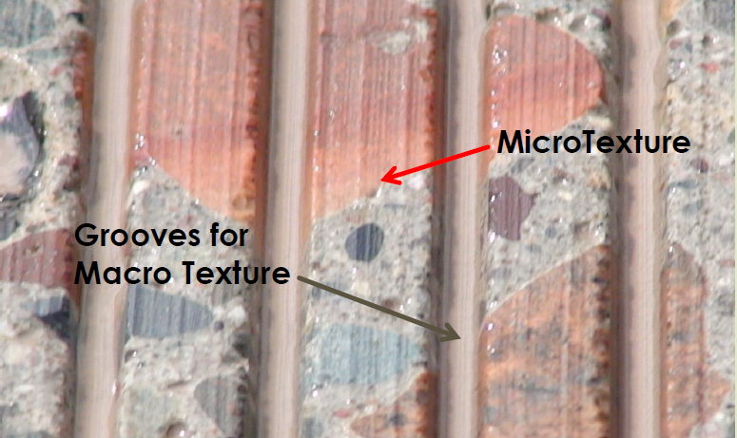
NGCS Provides Great Friction
NGCS utilizes both grinding and grooving providing a safe surface. The grinding exposes the microtexture while the grooving provides excellent macrotexture for wet weather conditions.

Slide 46
Grinding Increases Carbonation
Diamond Grinding is a carbon neutral process… possibly carbon negative!
Diamond grinding every 10 to 15 years creates a “fresh” surface with more surface area for carbonation
  Will more than double the amount of sequestered CO₂
Overlaying concrete with asphalt will shut out atmospheric CO₂ and terminate sequestration

Slide 47
MIT IRI Fuel Savings Calculator
Case Study I-90 Albany NY (6-Lane Divided PCCP Highway)
  57,000 AADT
  17% Trucks
  Pre-grind IRI Average 95 in/mile
  Post-grind IRI Average 40 in/mile
Annual Fuel Cost Savings For Motorists $67,000/mile/year
Annual Carbon Savings 104,000 metric tons/mile/year

Slide 48
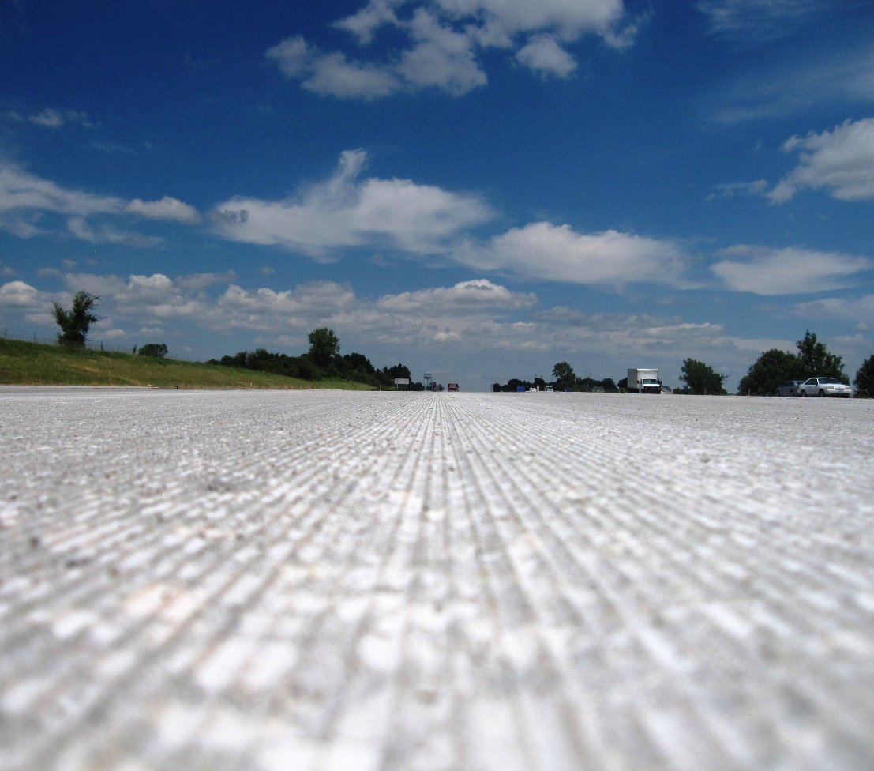
Diamond Saw-Cut Surface Textures
By far, the most sustainable pavement preservation treatments available

Slide 49
Begin With the End in Mind
Construct pavements capable of extended design life (50 years and more)
Build pavement with additional sacrificial thickness allowing for subsequent surface removal to improve ride, friction, noise, etc.
Anticipate future repair cycles – incorporate pavement preservation in your plan (What will repair materials cost in the future?)
Spend now, save later

Slide 50


Slide 51
Summary
This is a challenging time for the industry, Innovative, cost-effective solutions are needed to meet these challenges
Diamond Grinding techniques provide sustainable benefits such as increased friction (safety), reduced noise, improved smoothness and long life
Diamond grinding can lower your carbon footprint
Diamond saw-cut textures can reduce accidents
Diamond saw-cut textures should be programed into your pavement management programs
IGGA and ACPA are ready to assist!

Slide 52
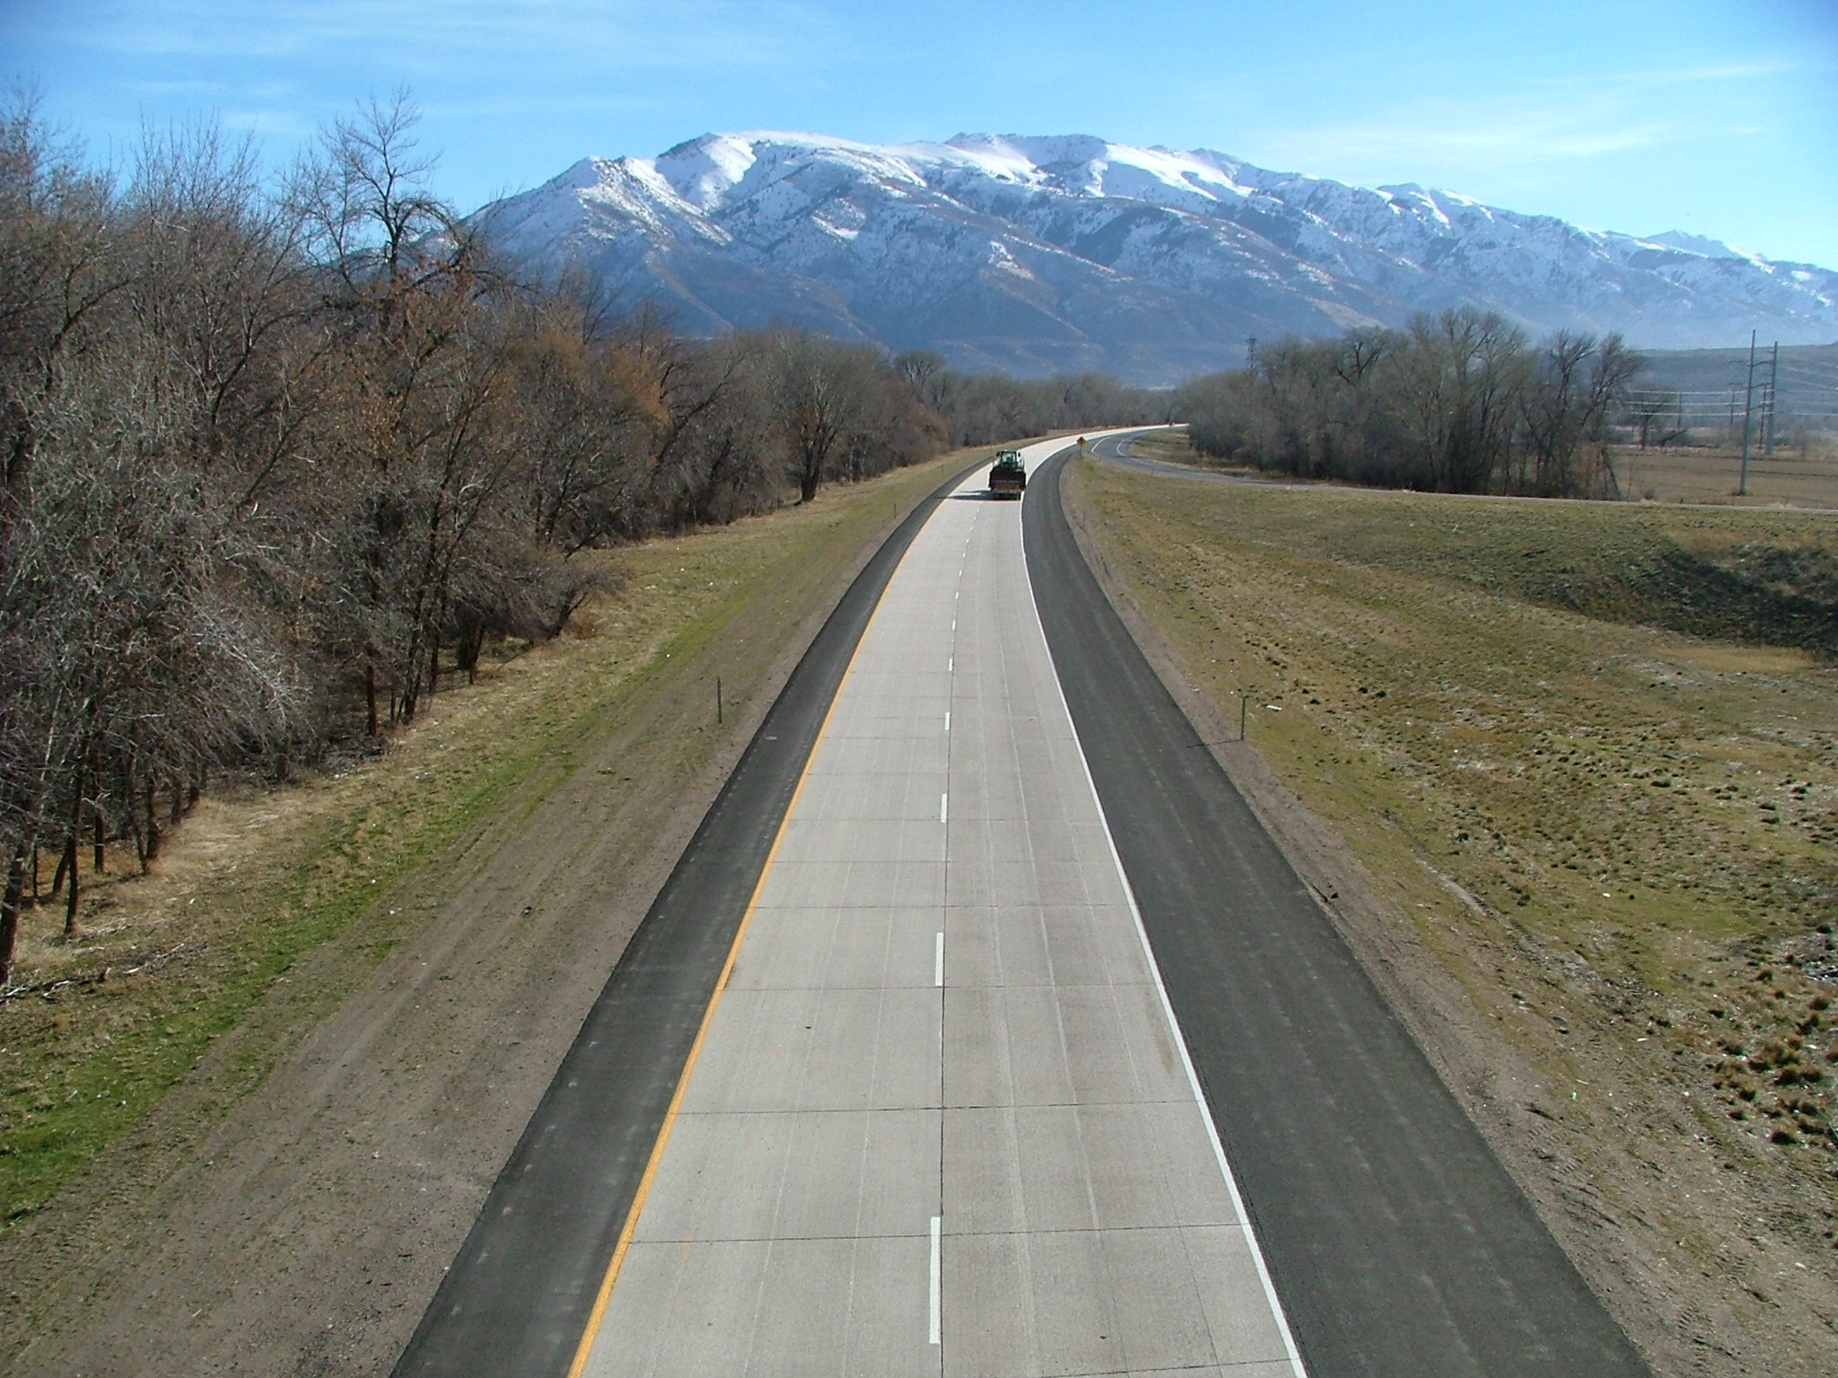
VISIT US ON THE WEB
International Grooving and Grinding Association
www.igga.net

