Slide 1
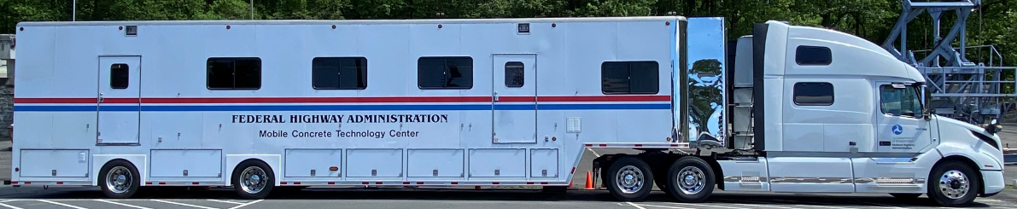
MCTC and Emerging Concrete Technology
2023 TRC Transportation Engineering Conference
May 24th 2023
Robert Conway, PE CCM
Senior Pavement & Material Engineer
FHWA, Resource Center

Slide 2
Mobile Concrete Technology Center
Funded by the Accelerated Implementation and Deployment of Pavement Technologies Program
Unique
Program evolves to meet stakeholder needs

Slide 3






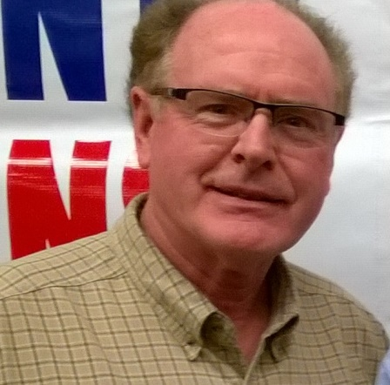

MCTC Team
Bob Conway
Mike Praul
Lisa McDaniel
Nicolai Morari
Josh Brinegar
Jagan Gudimettla
Jim Grove
Jerry Clemons

Slide 4
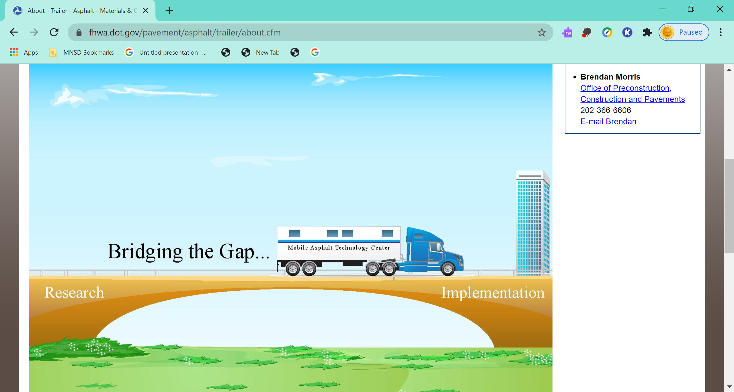
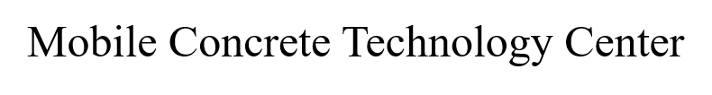
MCTC Program Mission
Implement new & under-used concrete technologies
Demonstrate benefits of performance specifications in both agency quality assurance (QA) programs & industry quality control (QC) applications
Advance States’ concrete programs
  Specification review
  Technical assistance
  Training
  Troubleshooting
Better concrete

Slide 5
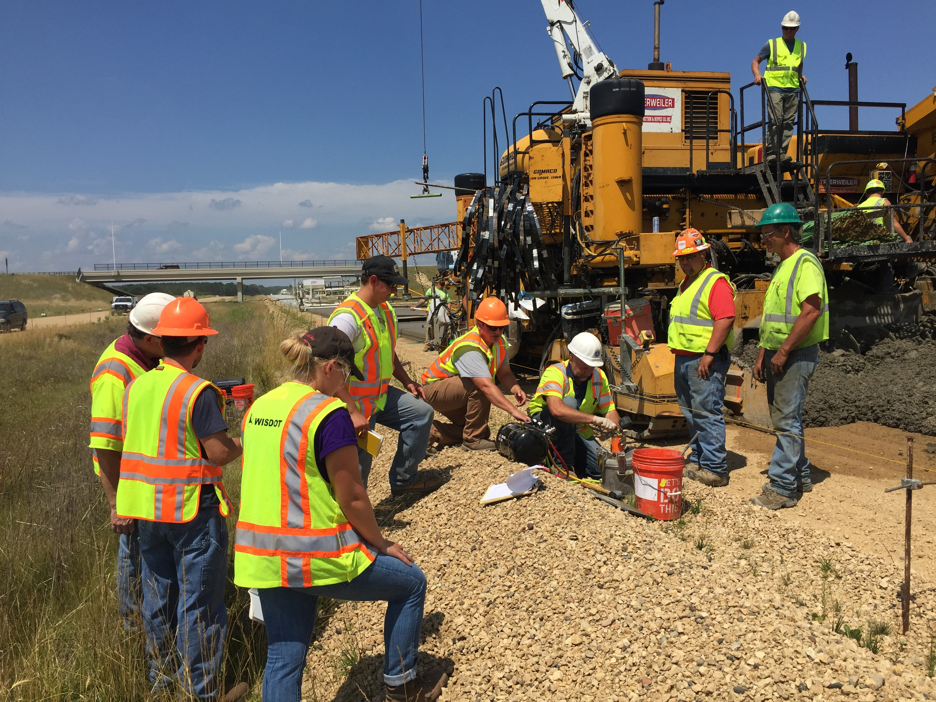
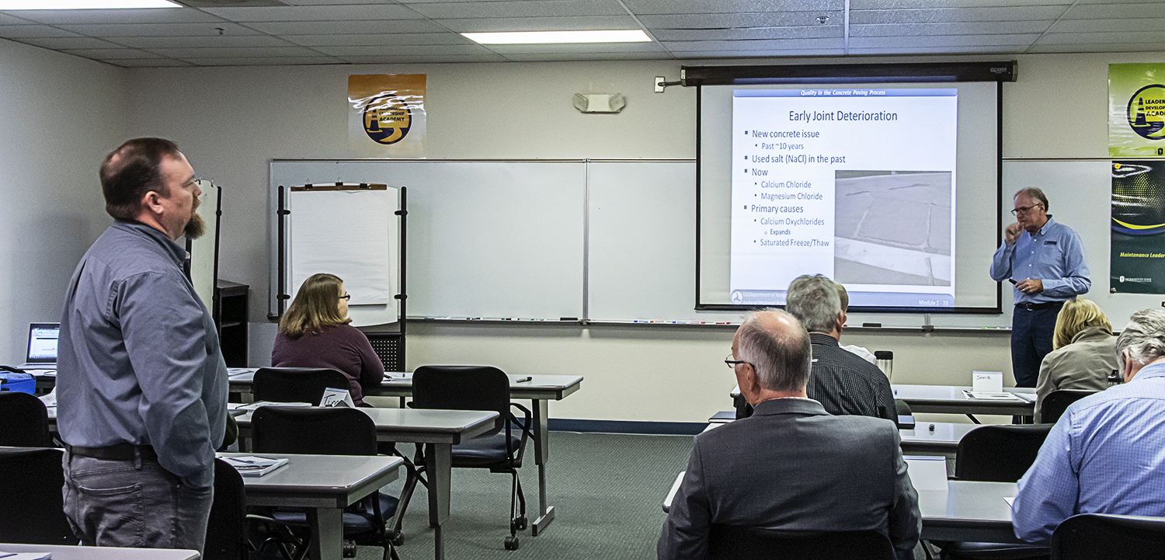
Program Activities
Field visits to active construction projects
Quality in the Concrete Paving Process workshops
Equipment Loan Program
Technical assistance/specification reviews
Conferences/Open houses
Support TFHRC and other research
Publications to promote the FHWA concrete program and advance concrete technology

Slide 6
MCTC Field Visits (since 2008)
ME
WA
NH
MT
ND
VT
OR
MN
ID
SD
WI
NY
WY
MI
RI
NV
NE
IA
PA
NJ
UT
IL
IN
OH
CA
CO
WV
DE
KS
MO
KY
VA
TN
NC
MD
AZ
NM
OK
AR
SC
MS
AL
GA
TX
LA
AK
FL
HI

Slide 7
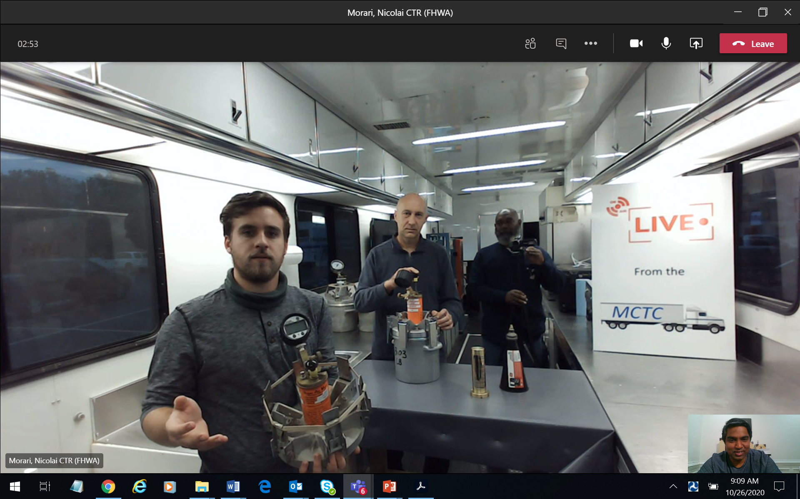
“Live From the MCTC” Training/Workshops
Super Air Meter (SAM)
Surface/Bulk Resistivity
Maturity
Box Test/V-Kelly
Semi-adiabatic calorimeter
Phoenix (fresh water content)
Pulse Induction Technology (MIT-SCAN-T3)
MIT-DOWEL-SCAN
HIPERPAV®
Optimized Gradation software

Slide 8
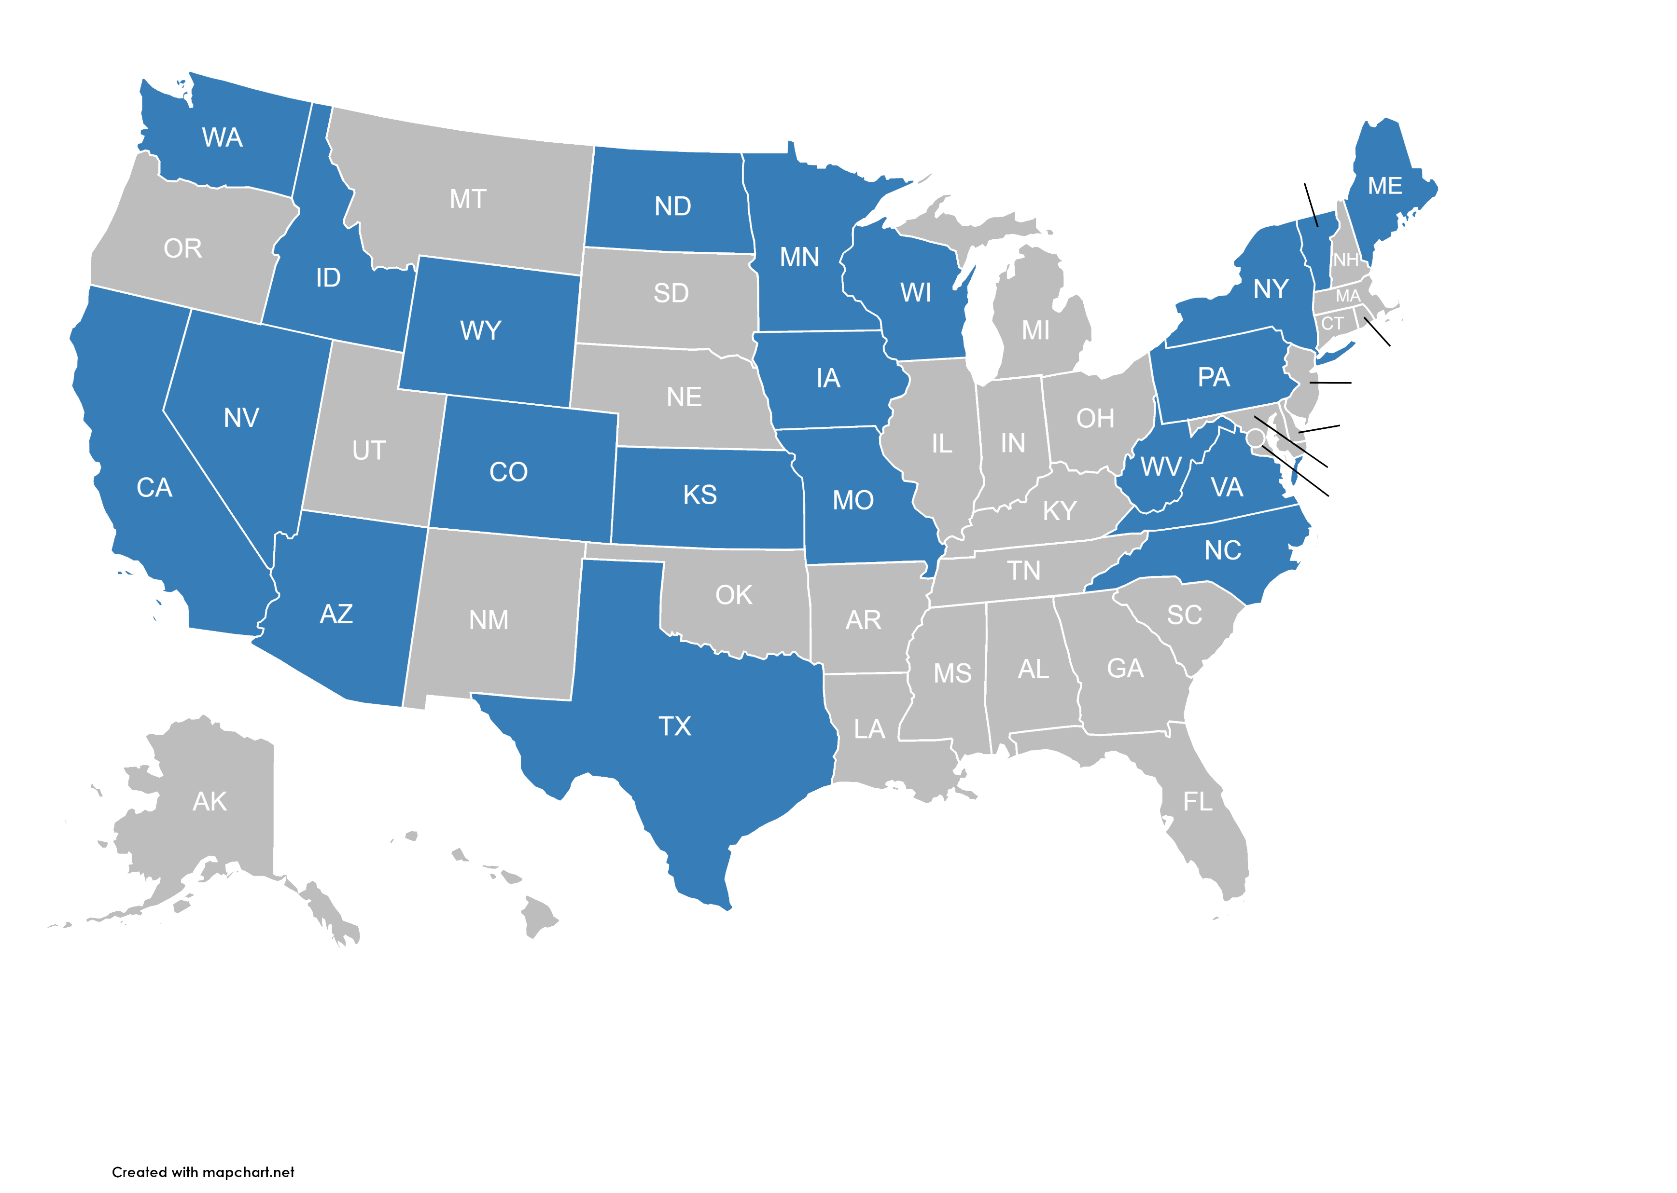
MCTC Virtual Sessions (2020-2021)

Slide 9


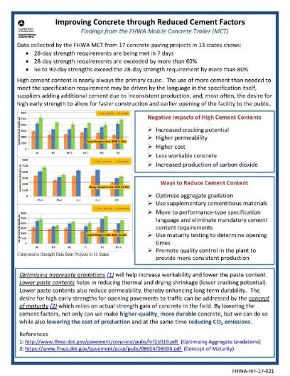
One Pager Series
New effort to use MCTC data
Narrowly focused
Meant to stir interest and point reader to resources
    1st: Cement content
    2nd: Optimized Mix Design
    3rd: Cores vs. Cylinders
    4th: NDT Pavement Thickness
    5th: Tining/Surface Texture
    6th: Surface Resistivity Test
    7th: Maturity
www.fhwa.dot.gov/pavement/concrete/trailer/resources
    8th: Curing
    9th: SCM’s
    10th: Calorimetry
    11th: Workability
    12th: Air Entrainment
    13th: Stringless Paving
    14th: Water Reducing Admixtures

Slide 10
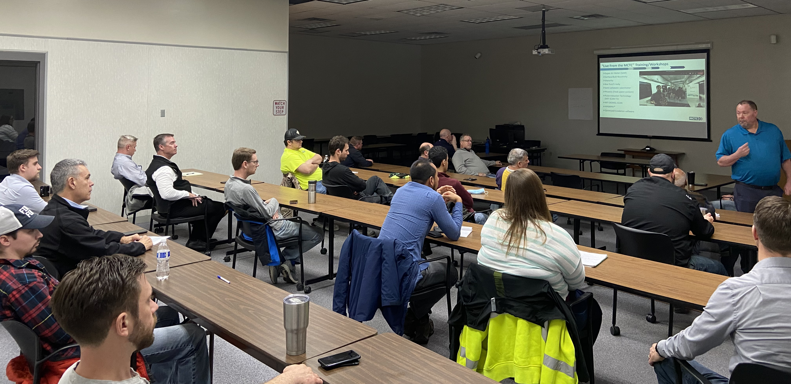
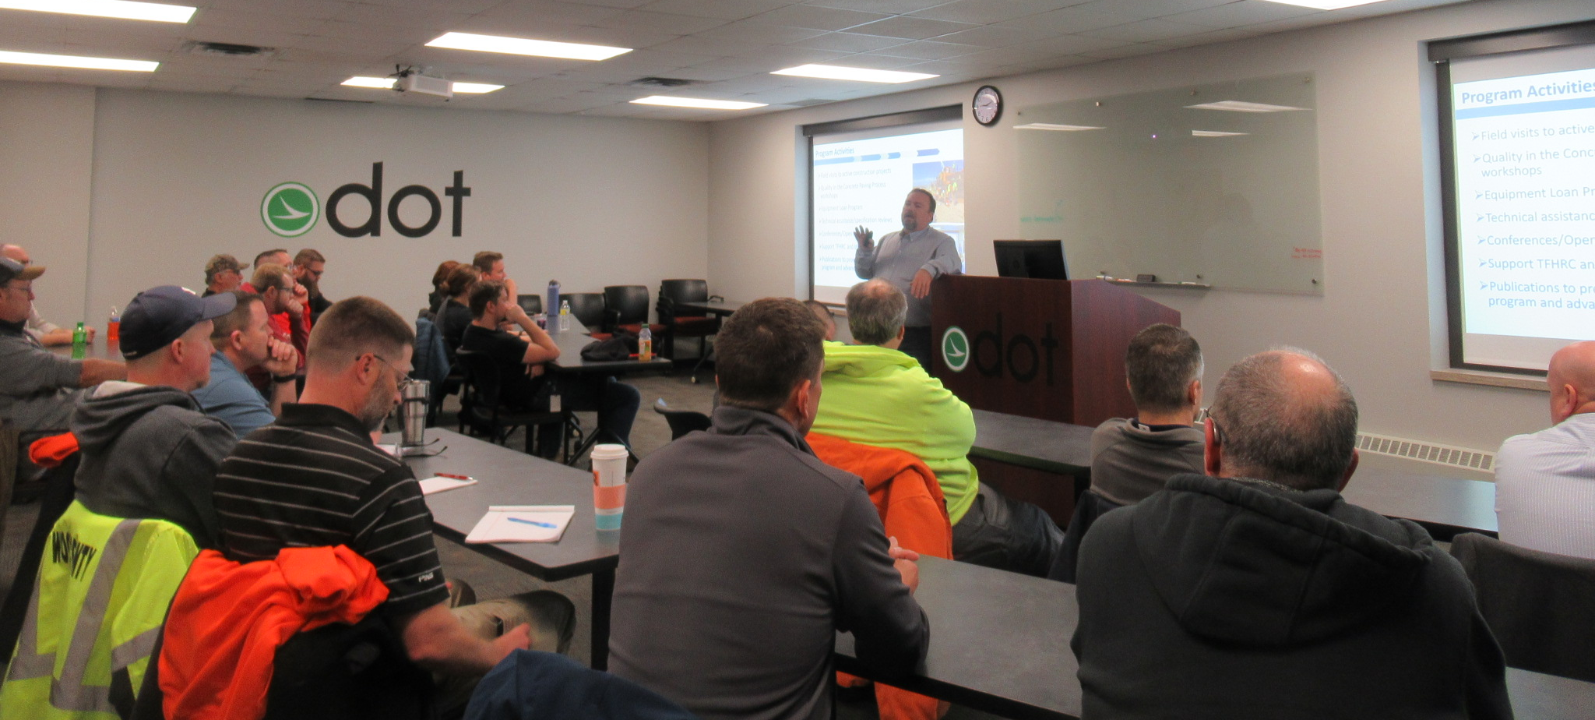
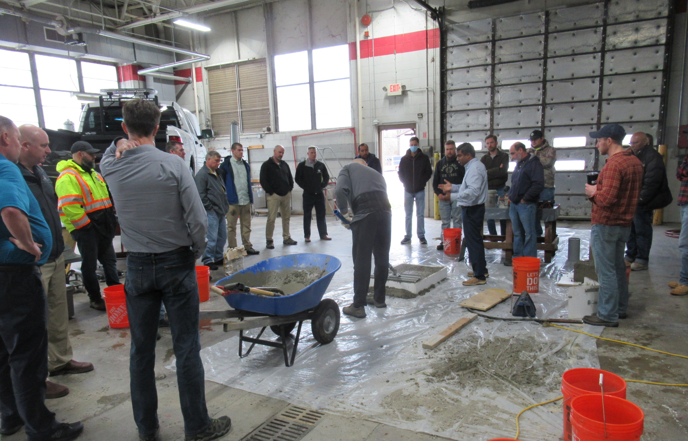
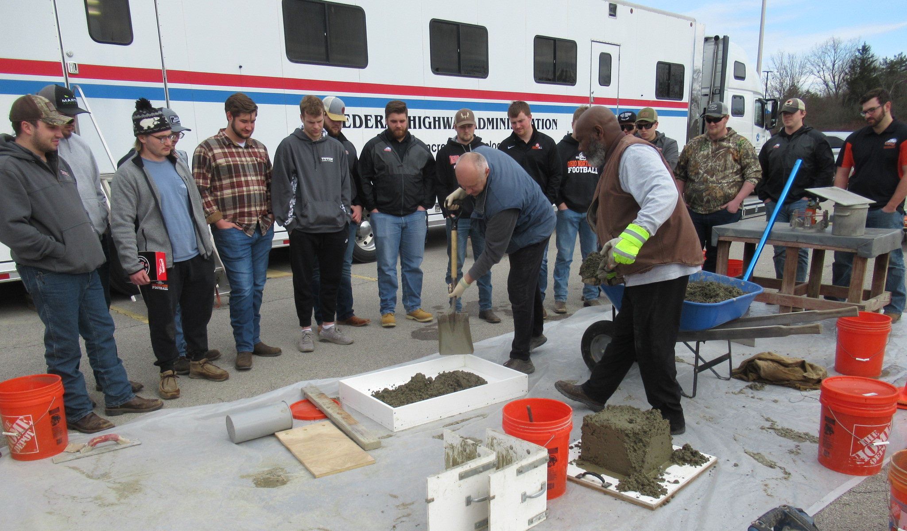
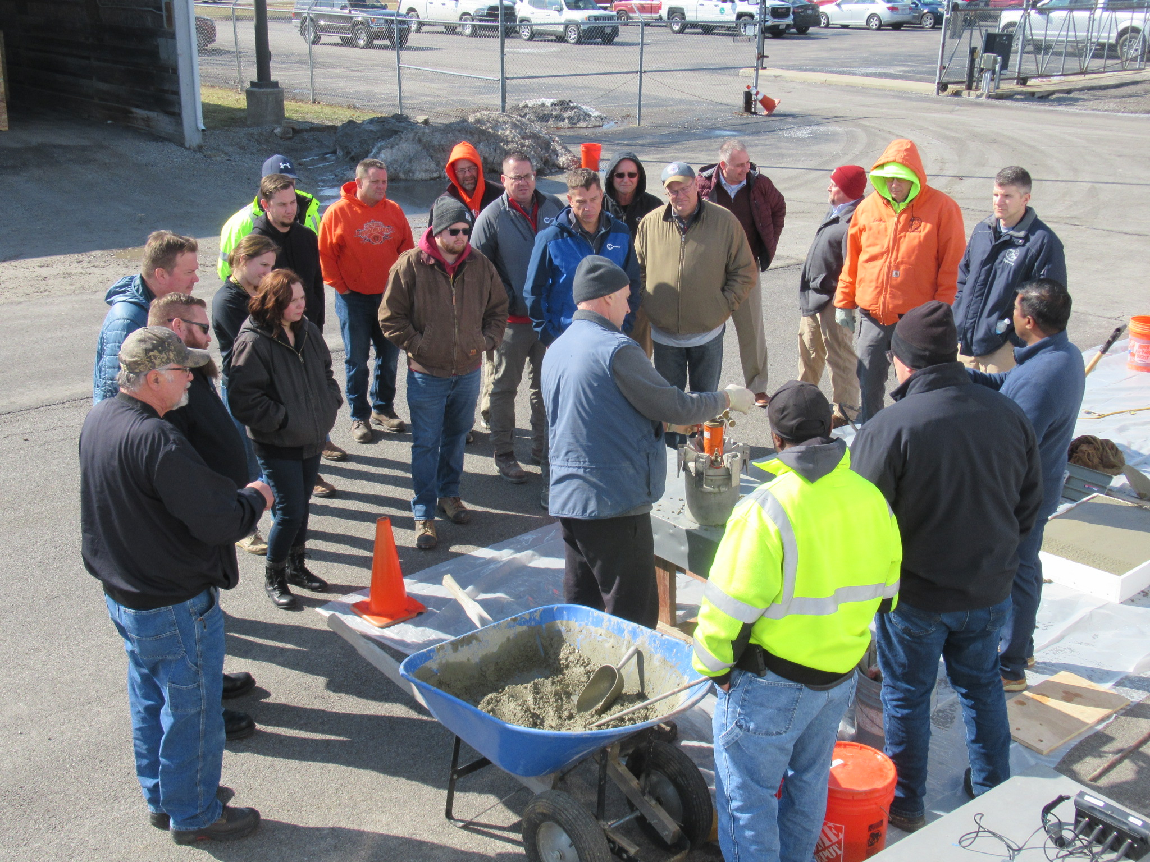
Technology Tour Across Ohio – 2 weeks, 6 cities

Slide 11
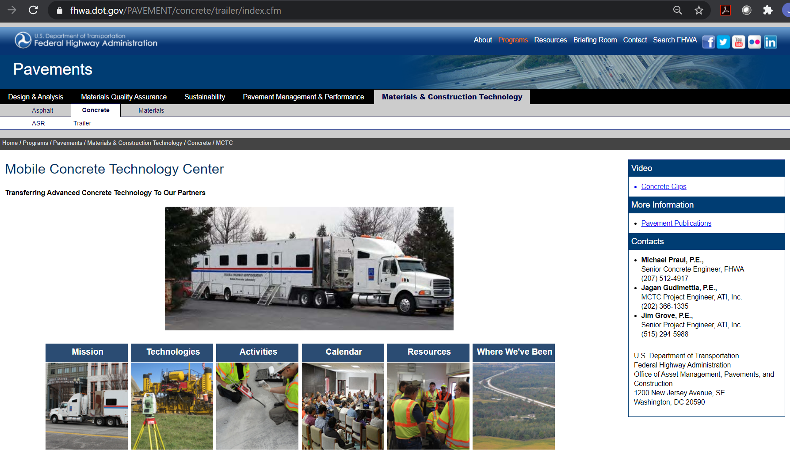
MCTC Website
https://www.fhwa.dot.gov/MCTC

Slide 12
1. Optimized Gradation

Slide 13

Performance Engineered Mixtures and Sustainability
Ways to Optimize Cement Content
Performance-type specifications; eliminate mandatory minimum cement content requirements
Optimize aggregate gradation
Use supplementary cementitious materials
Use maturity to determine opening times
Quality control during production to provide more consistent concrete

Slide 14
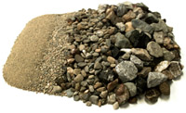
Optimized Combined Gradation
What will it do for me?
  _____
  _____
  _____
  _____
  _____
  Less paste=> Lower permeability
  Less paste=> Reduced thermal shrinkage
  Less paste=> Reduced drying shrinkage
  Improved workability
  Reduce segregation potential
  Reduce cost
  Equal or higher strength
  Improve sustainability

Slide 15
Achieving Optimized Combined Gradation
Existing analysis tools
  Shilstone Coarseness/Workability Factor Chart
  0.45 Power Chart
  Percent Retained on Each Sieve Chart (8-18 band)
Each tool tells us something different about the gradation
New analysis method – Tarantula Curve

Slide 16

Optimized Gradation Tool
Spreadsheets available for structural or paving applications.

Slide 17
Optimized?

Slide 18
2. Slump

Slide 19
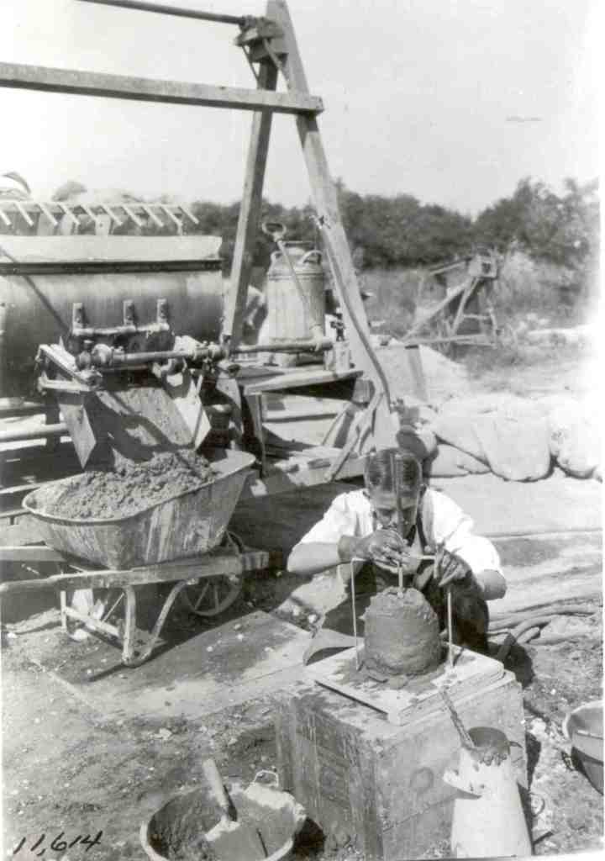
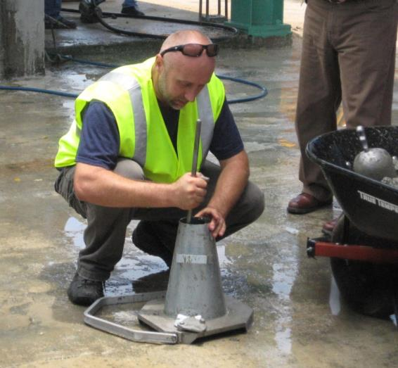
Changes in Slump Testing
  100 Years ago
  Today
What has changed?

Slide 20

What do we really want to find out using the slump test?
Water content?
  Historically, an indicator of water content
  Today, water reducers will change the slump with no changed in water
  SCMs impact
Workability/flowability?
  Slump does not account for energy being added through vibration
Change
  Slump can ONLY tell us something has changed
  QC tool only
1922
Image Pixabay

Slide 21
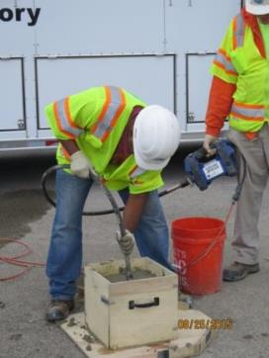
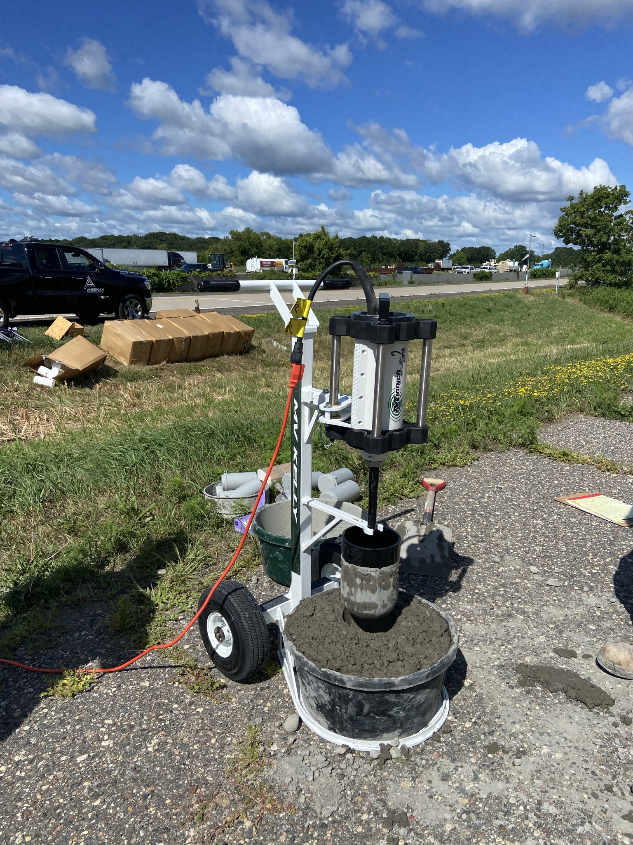
Box Test and VKelly

Slide 22
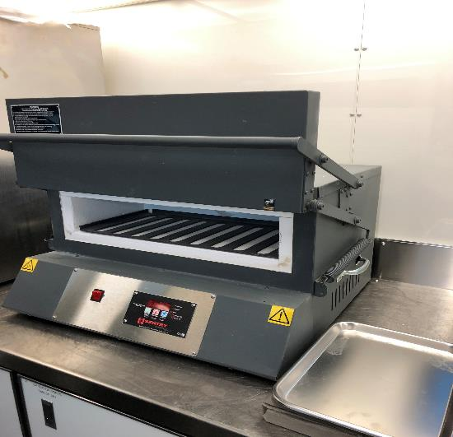
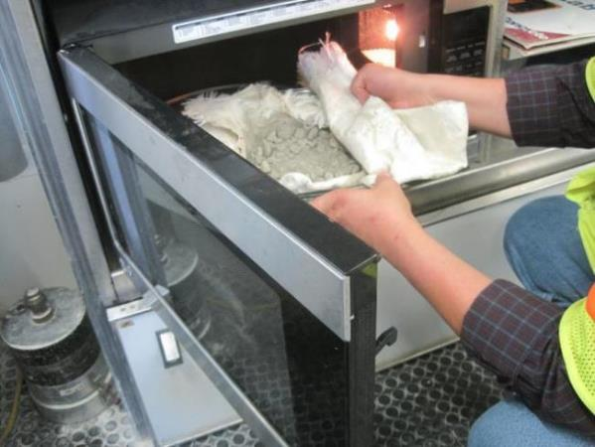
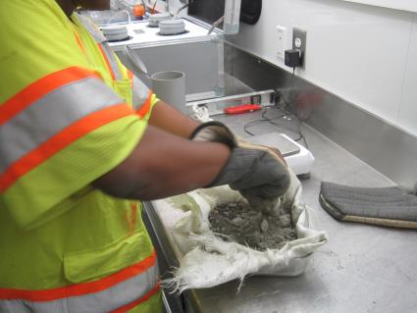
Phoenix vs. Microwave Water Content

Slide 23
3. 56-day Testing

Slide 24
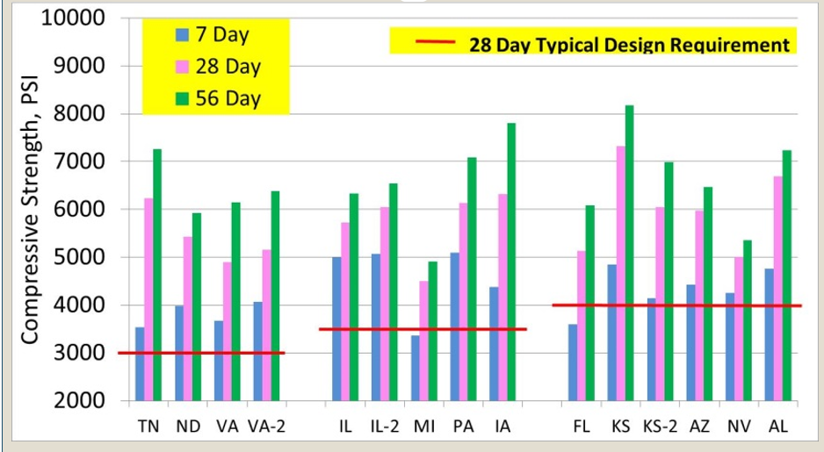
MCTC Data

Slide 25
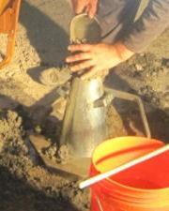
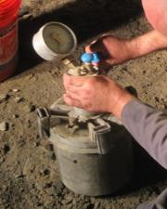
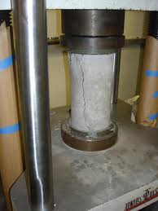

Concrete Acceptance Practices
How do we accept concrete?
  Slump
  Strength
  Total air
  Temperature
  Thickness
  Ride
How do we adjust price?
  Strength
Lower Right Image: Pixabay

Slide 26
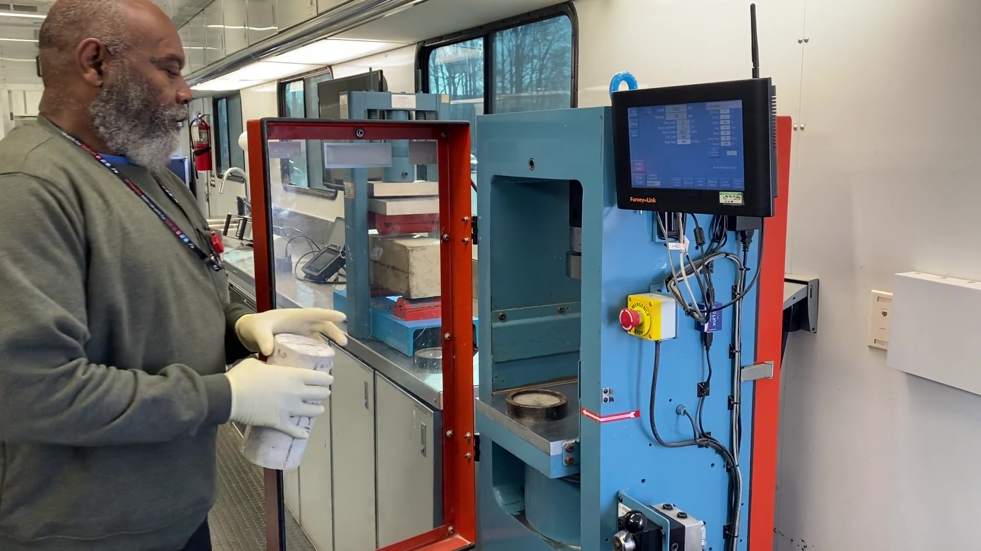
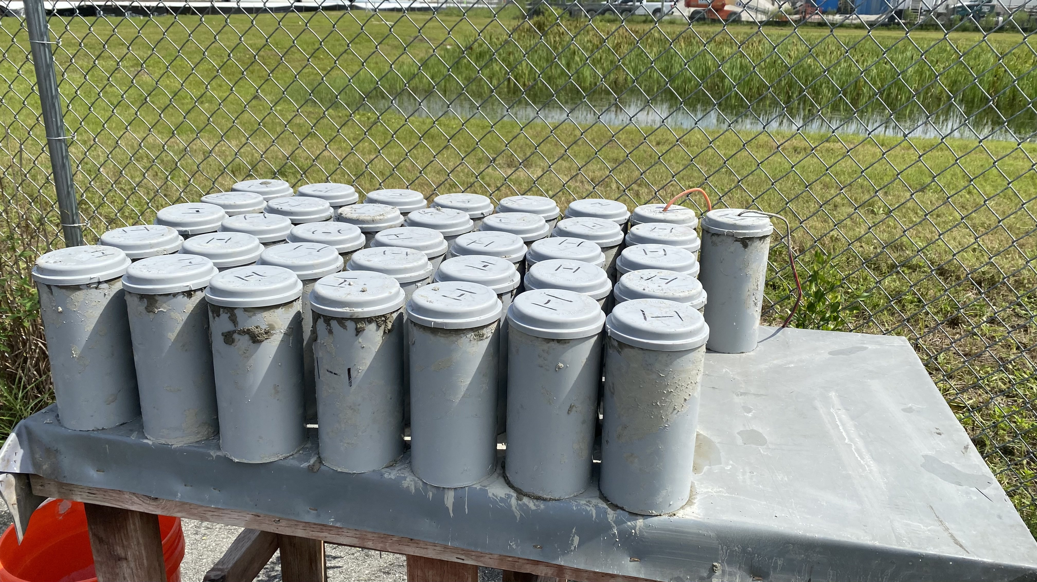
The Great 28
Wrong time
Wrong cementitious system
Implications
  Cost
  Durability
  Deck Cracking

Slide 27
4. Resistivity Test

Slide 28

Permeability
The ease with which fluids can penetrate the concrete
Only the paste contributes
Durability damage is governed by permeability
Amount of Pores (porosity)
How pores are connected (tortuosity)
Notes:
Two biggest factors impacting durability are the amount of pores

Slide 29
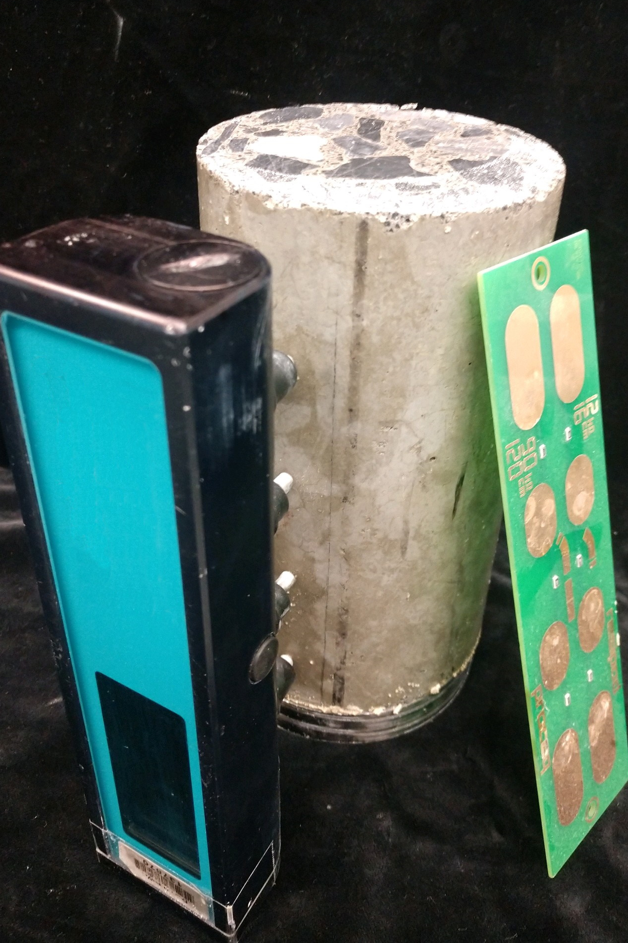
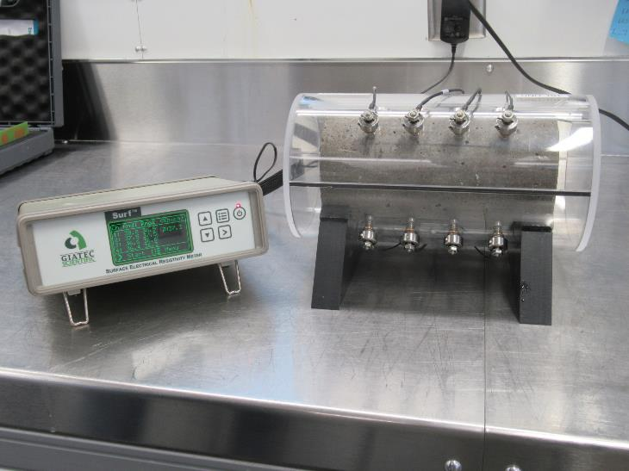
Resistivity Tests

Slide 30
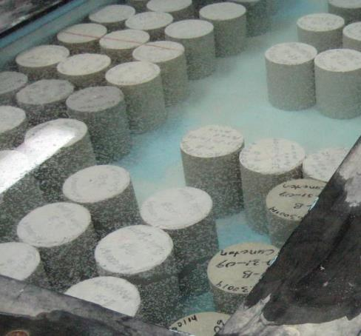
Resistivity Results
Curing of the cylinders is extremely important for SR
Consistent test procedure is necessary for comparison of results

Slide 31
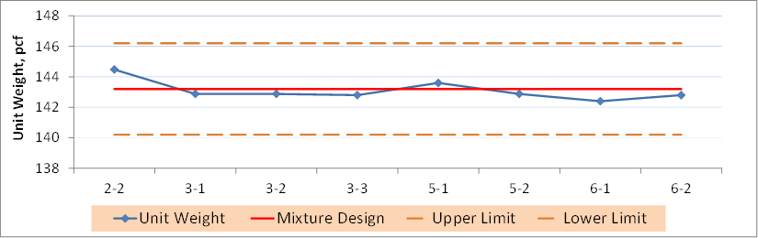
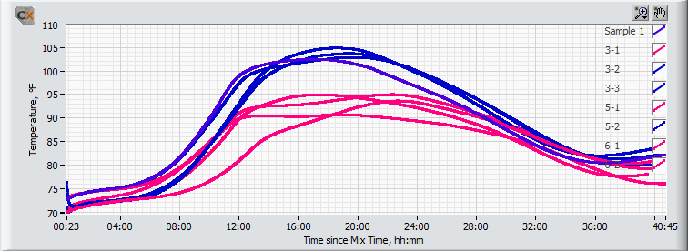
56 Day Testing—A Real Example
Real Time QC
Acceptance
Unit Weight – Real Time
Real time tests predict later age properties
Surface Resistivity at 28 Days
Heat Signature – Info in a day
Surface Resistivity at 56 Days

Slide 32
5. Performance Specification/PEM

Slide 33
Prescriptive vs. Performance Specifications
Agency dictates how the material or product is formulated and constructed
Based on past experience
Minimal/uncertain ability to innovate
Requires agency to have proper manpower and skill set to provide oversight
Agency identifies desired characteristics of the material or product
Contractor controls how to provide those characteristics
Maximum ability to innovate
Reduced oversight burden on agency
Prescriptive
Performance

Slide 34
Performance Engineered Mixture Concepts
Get beyond slump, strength, and total air content as determinants of concrete quality
Incorporate tests that correlate to service life durability
Appropriately apply those tests in agency acceptance and contractor quality control programs
Develop specifications and practices to leverage quality control
Remove prescriptive restraints from specifications
  Minimum cement content
  Single aggregate gradation
  Slump

Slide 35
PEM Pooled Fund and Incentive Projects
19 States + FHWA + Industry (December 2022)
PEM Implementation Incentive Pilot Projects

Slide 36

Questions?
Contact info:
Robert.conway@dot.gov
202-906-0536
Image Pixabay

