Slide 2
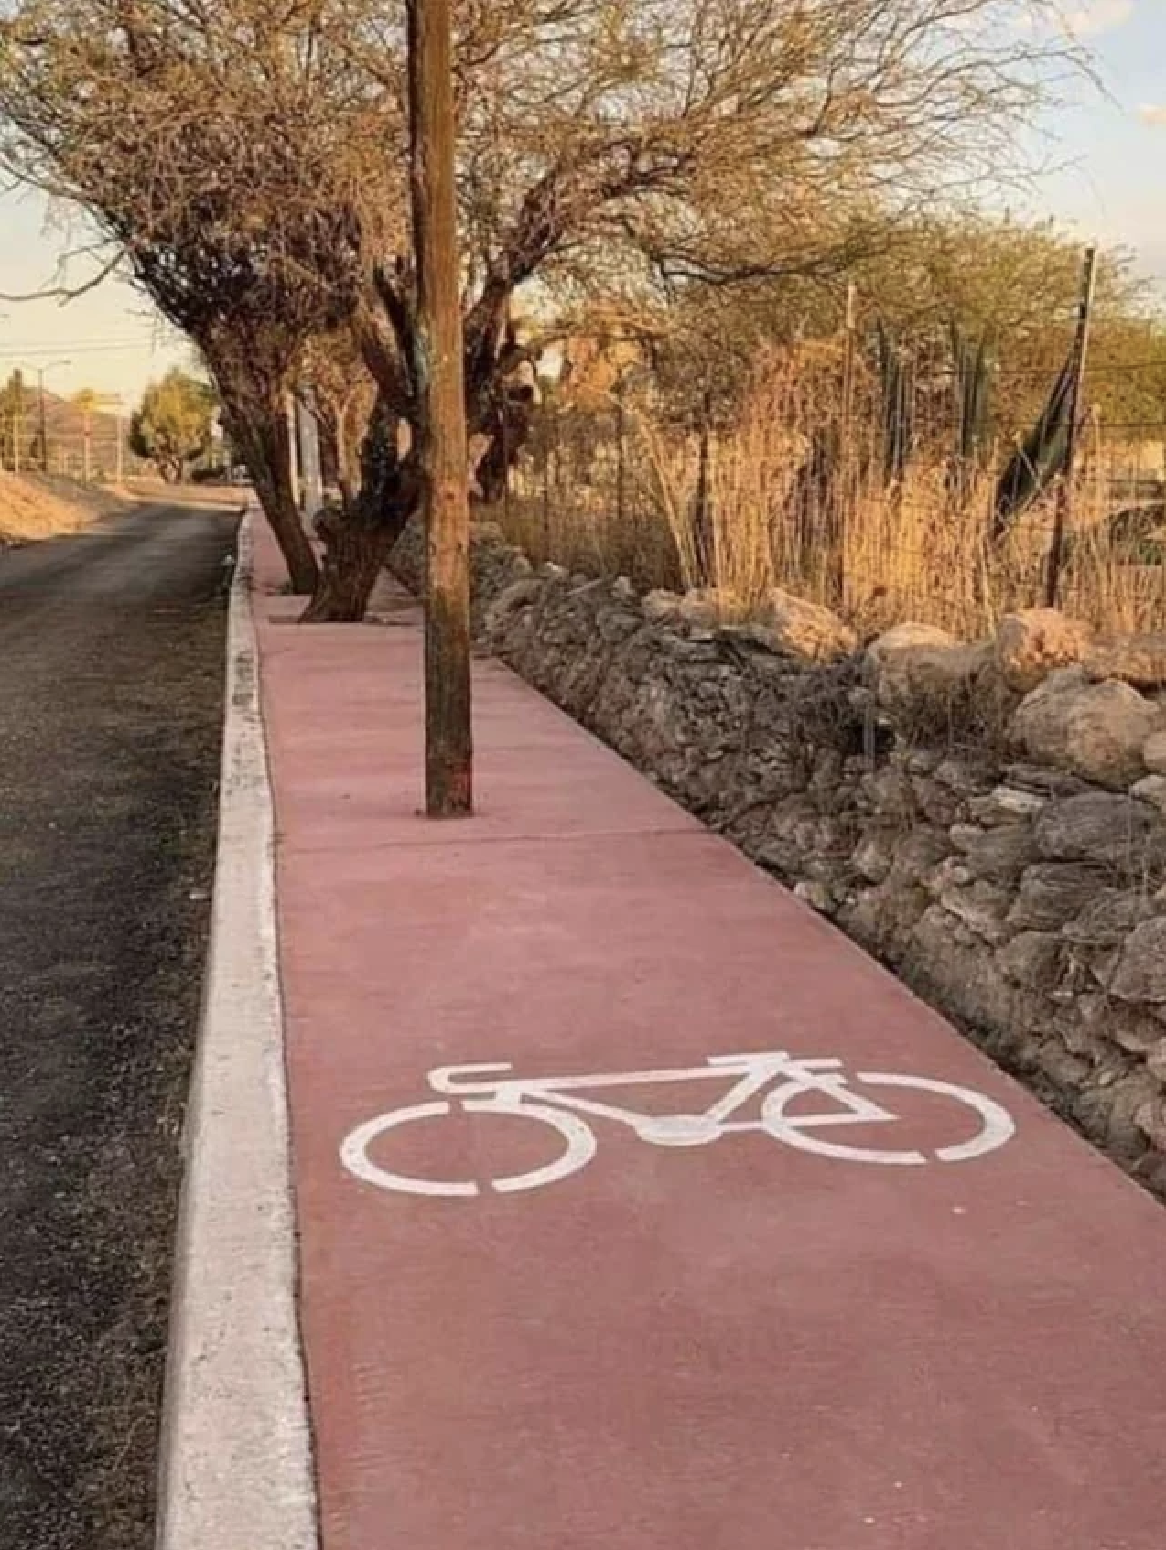

Slide 4
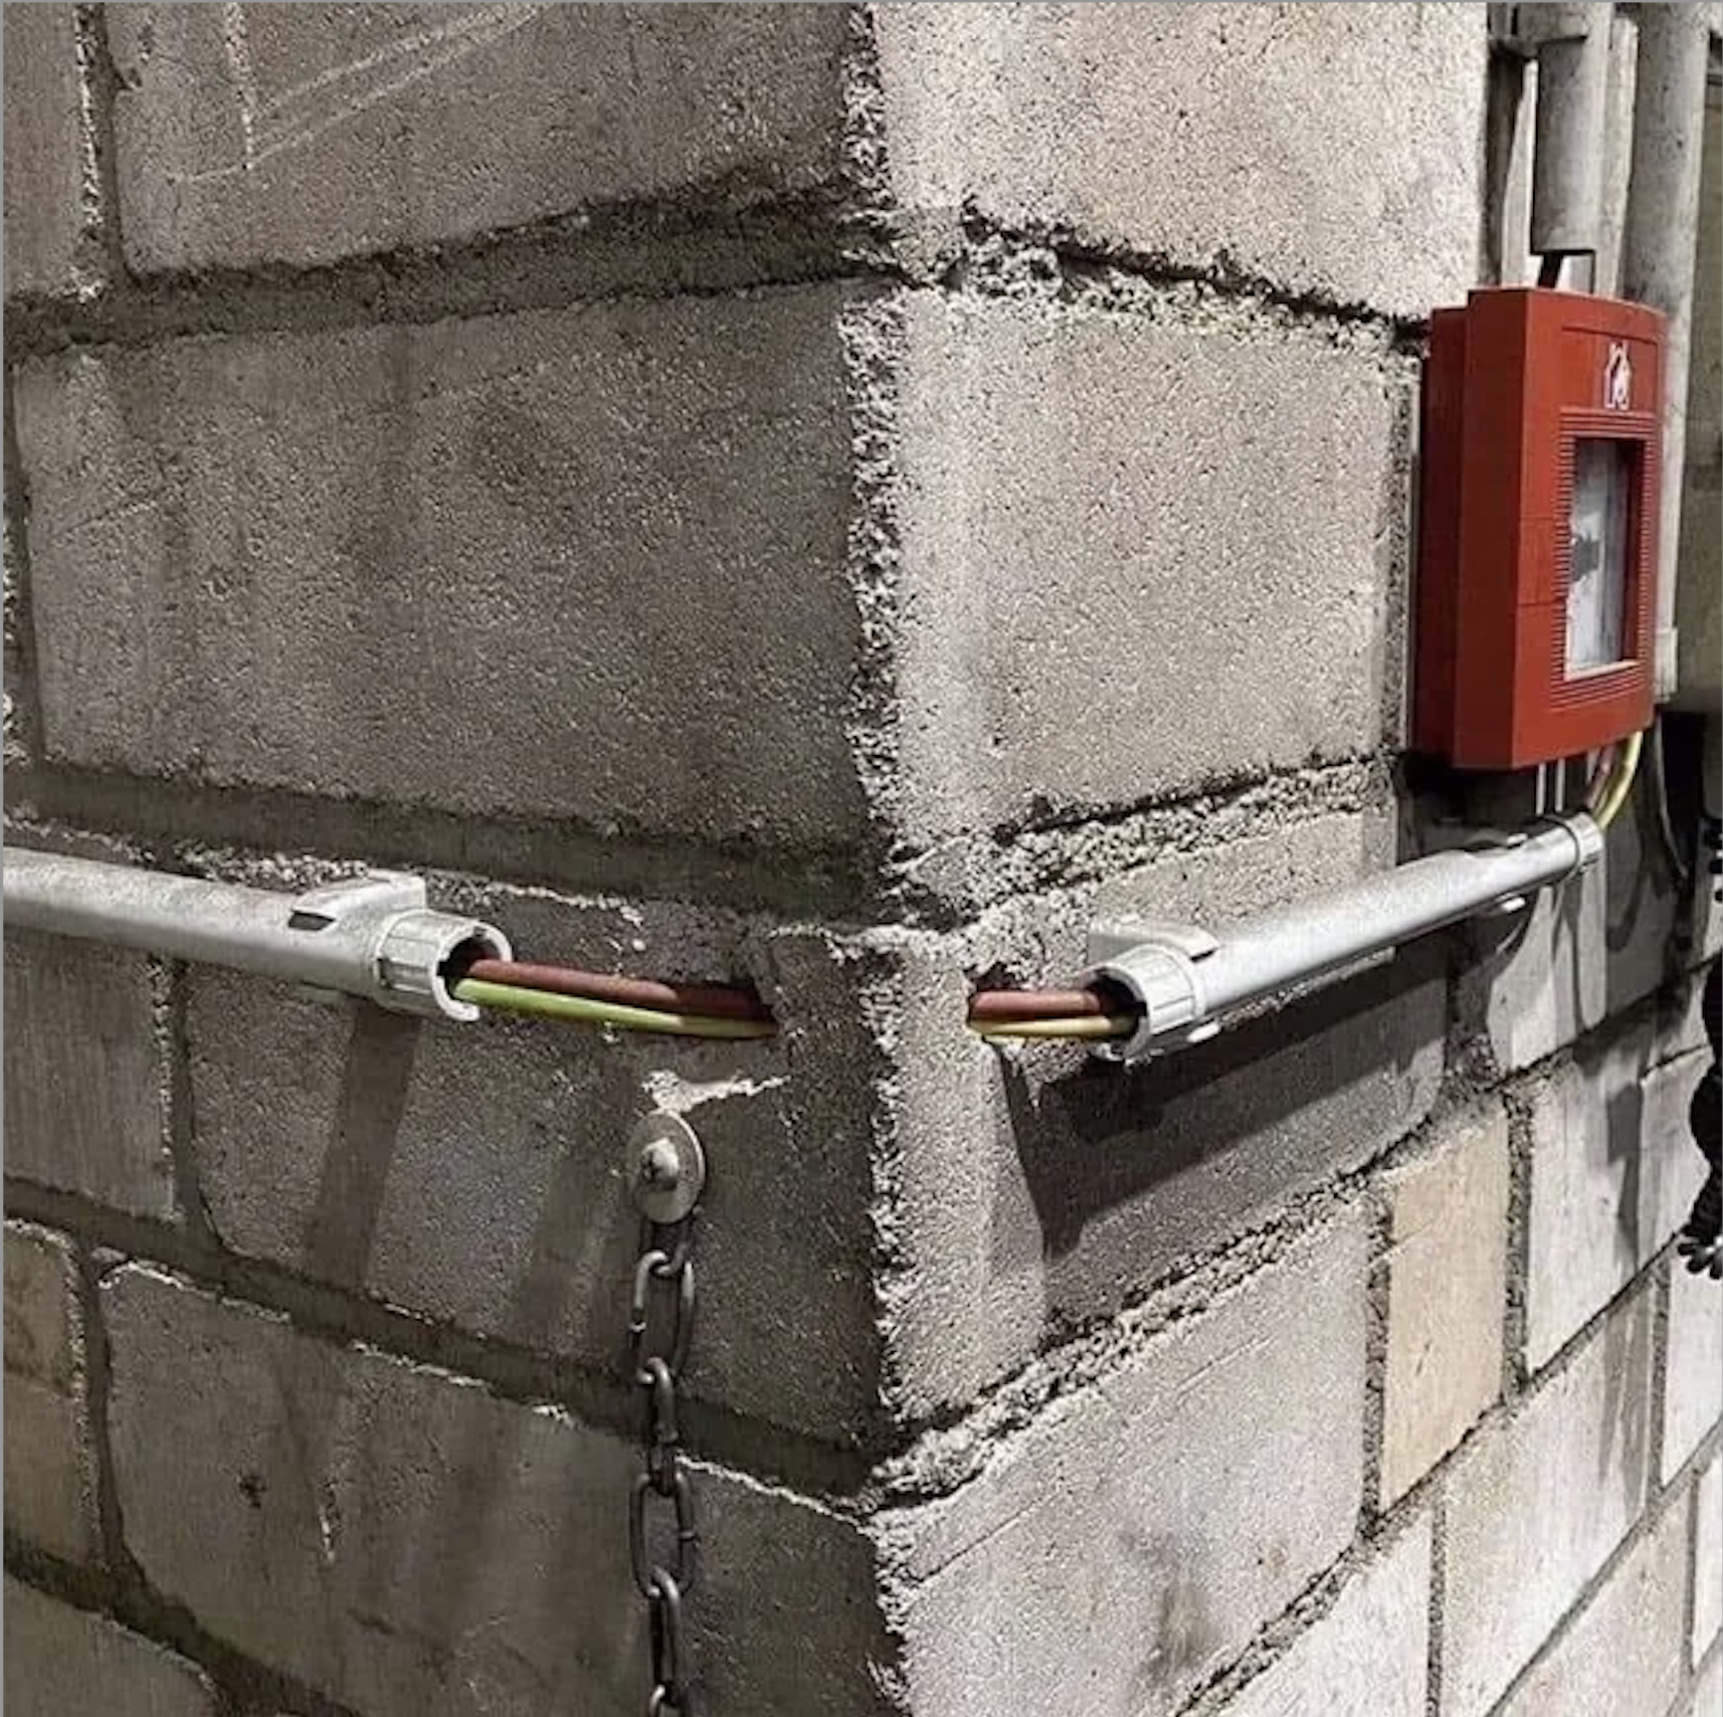

Slide 6
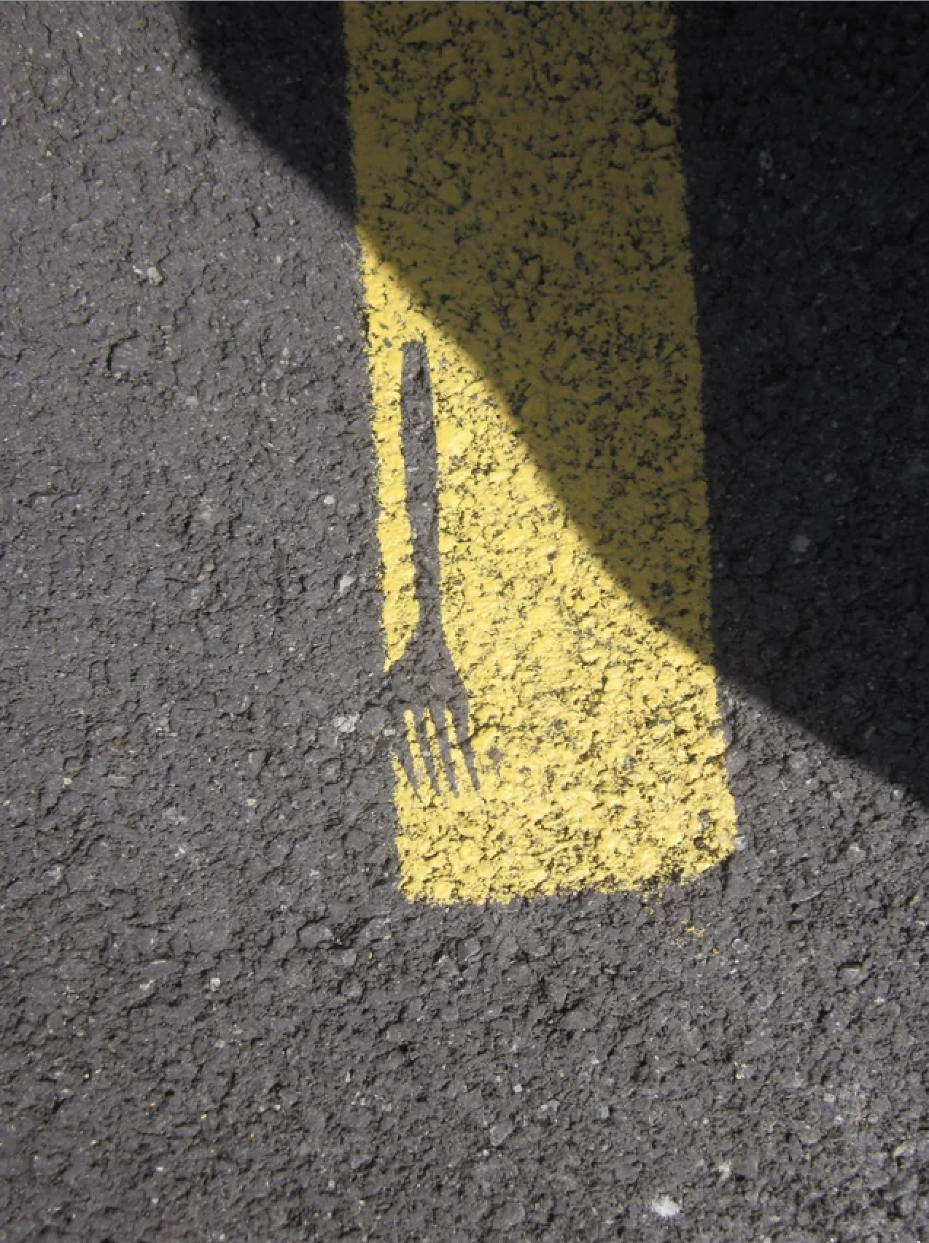

Slide 8
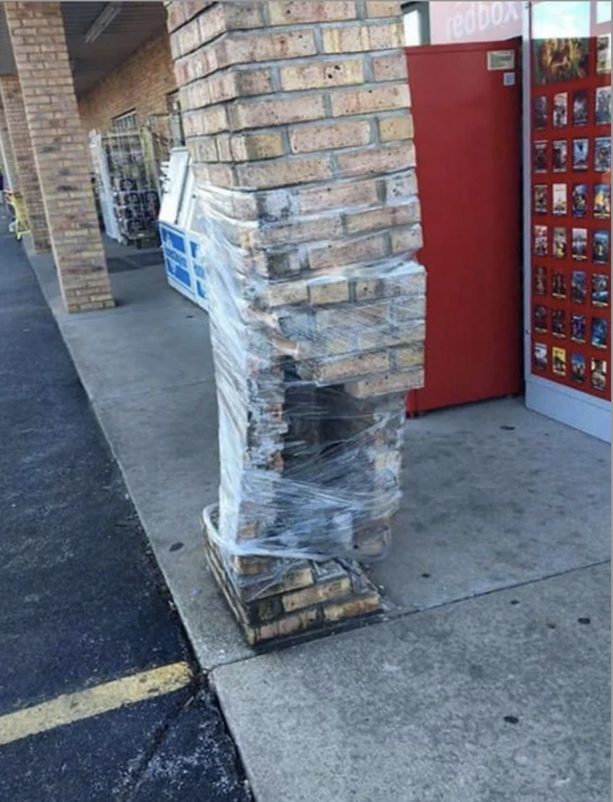

Slide 10
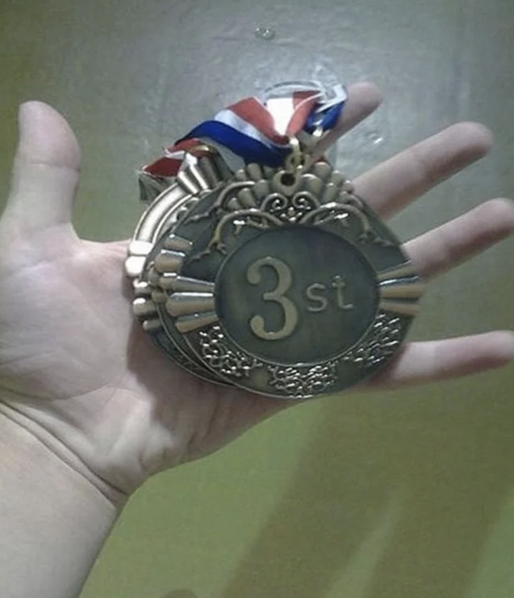

Slide 12
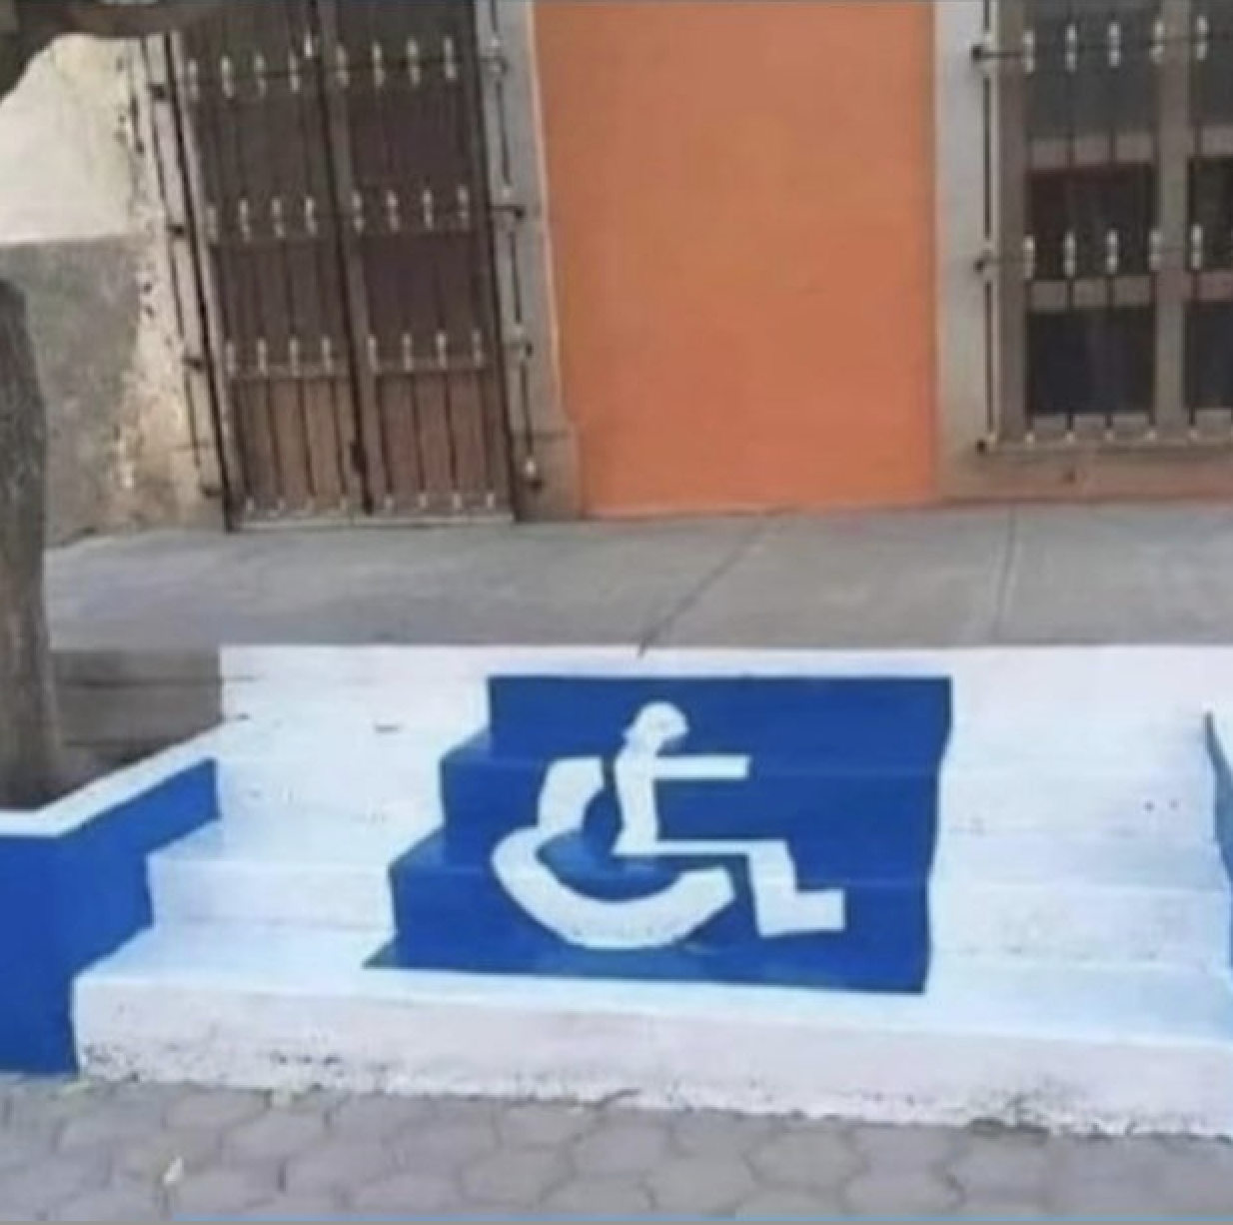

Slide 13
“SOMEBODY NEEDS TO DO SOMETHING ABOUT THIS”
Notes:
Work, school, church, aunt Lo Lou’s house- Late last summer the Materials Division started to float the idea that we want the people to take on anything falling into this category that is even remotely materials related.

Slide 14
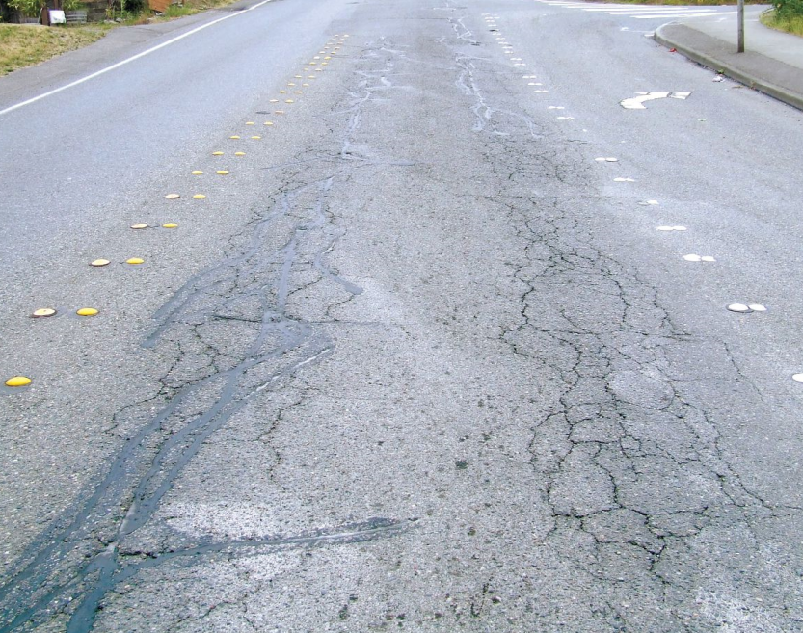
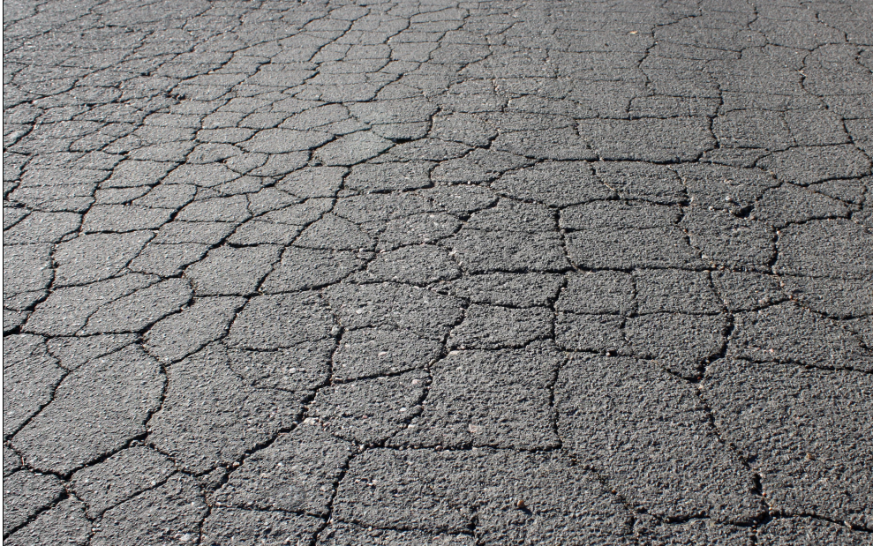
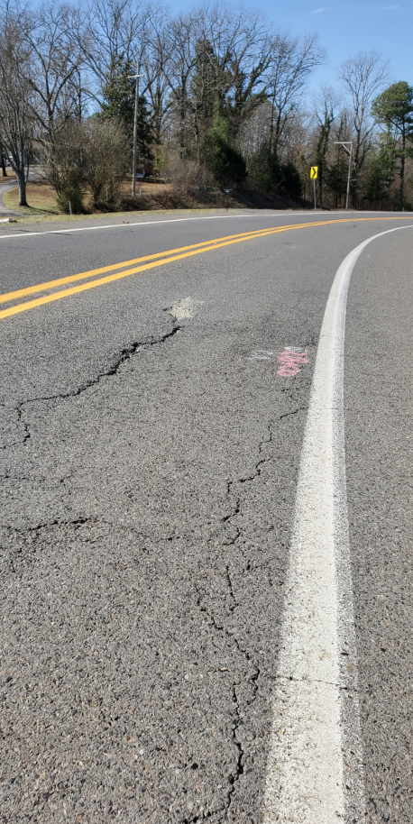
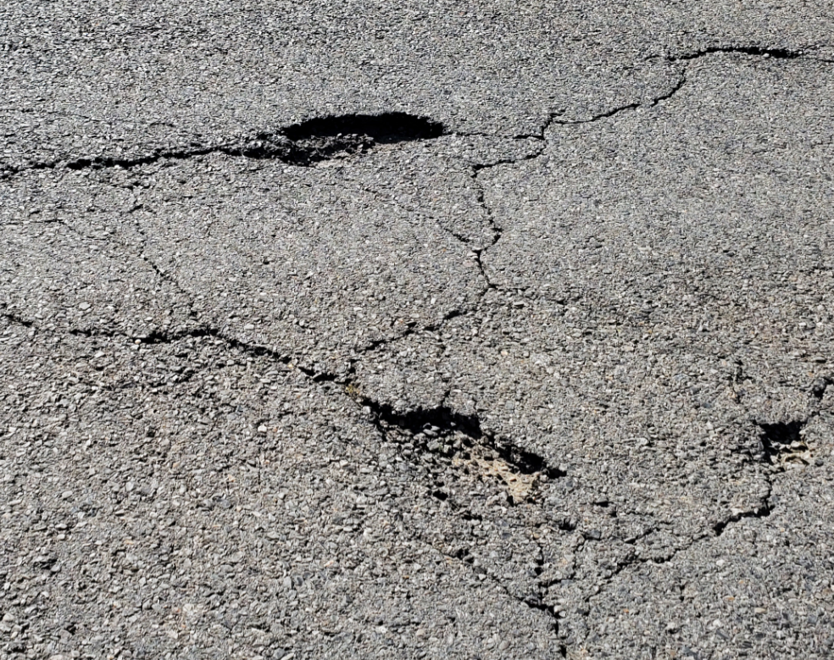
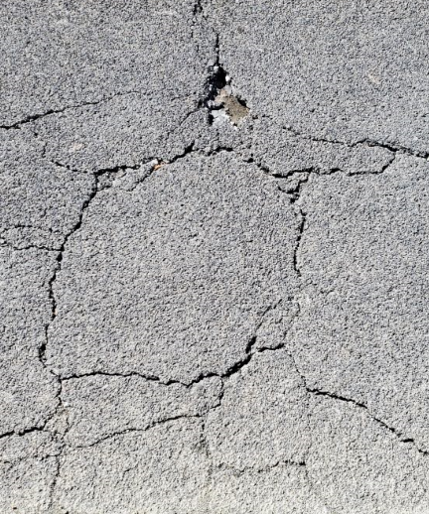
“SOMEBODY NEEDS TO DO SOMETHING ABOUT THIS”
Notes:
The overwhelming and immediate response we got was Asphalt! Doesn’t Last, Isn’t durable, Cracks, too dry It needs more oil

Slide 17
ADD MORE OIL

Slide 19
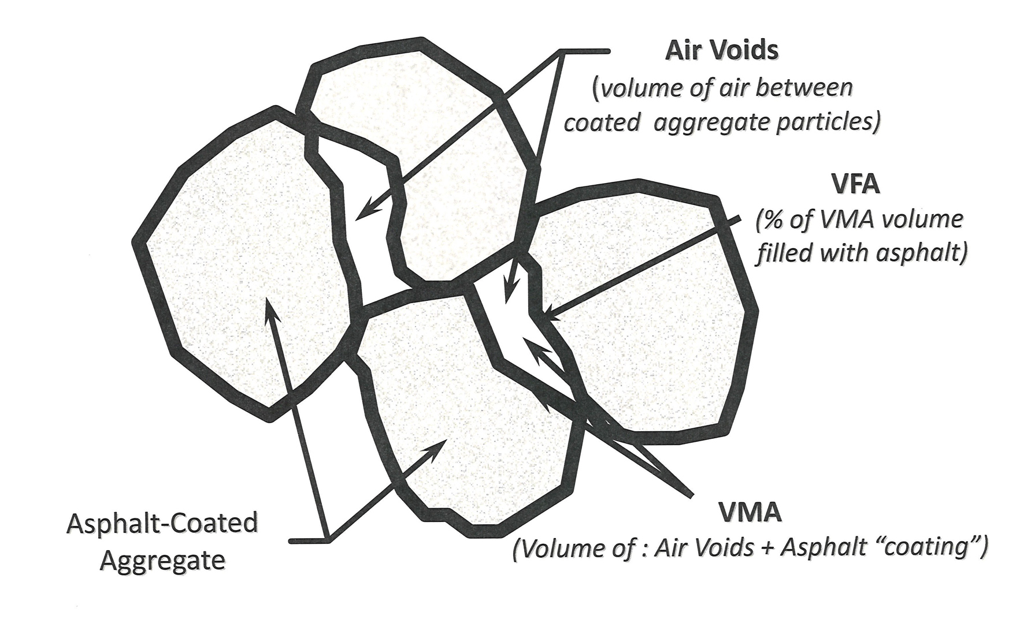
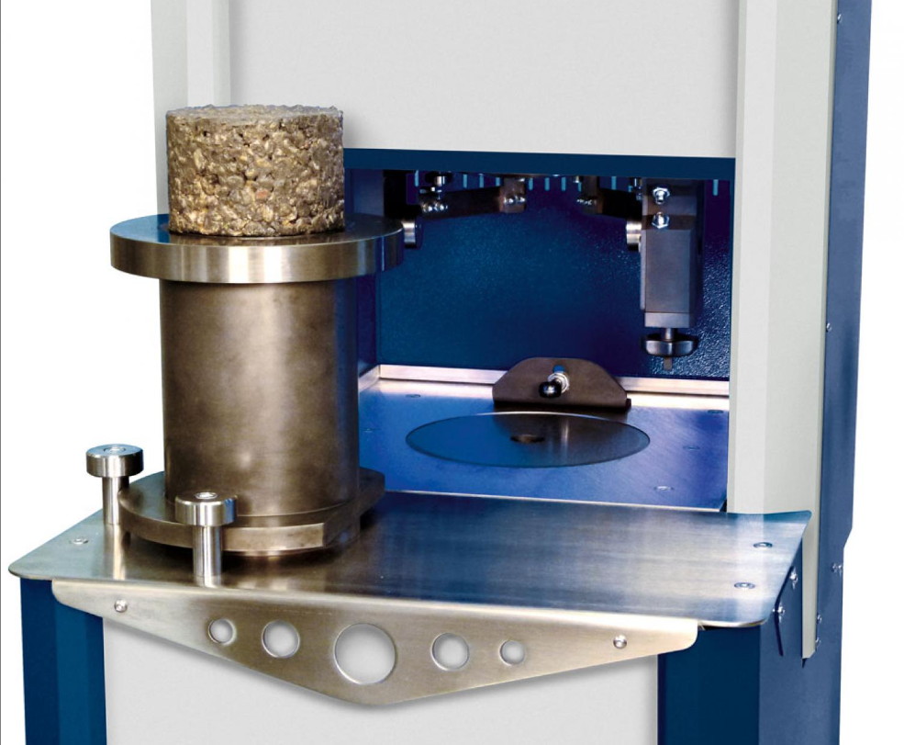
SUPERPAVE ASPHALT DESIGN
Notes:
The basic idea for a superpave design is for the ratio of these elements or (volumetrics) to be within the specified ranges at a specified compactive effort.

Slide 20
SUPERPAVE ASPHALT DESIGN
Air Voids = 4.0%
VMA = 14.0 – 16.0
Air
Voids
VMA
%Gmm @ N_{initial}
N_{initial}
N_{design}
Notes:
Graphic of Gyratory Compaction Ccuve

Slide 21
ADD MORE OIL
Air
Voids
VMA
N_{initial}
N_{design}
Notes:
If we simply add more oli- likely hit target for volumetrics

Slide 22
ADD MORE OIL
Air Voids @ Ndesign = lower
VMA @ Ndesign = higher
Rut depth = higher
N_{initial}
N_{design}

Slide 23
ADD MORE OIL
%Gmm @ N_{initial} = higher
N_{initial}
N_{design}
Notes:
Side Note-You may see some jobs coming up where we recommend removing the Ninitial req. because mixes that are too sensitive should fail the rut test.

Slide 24
TRC 2201: Update to ARDOT Superpave Gyratory Compaction Specification to Increase Pavement Durability
Notes:
Chris Abade

Slide 25
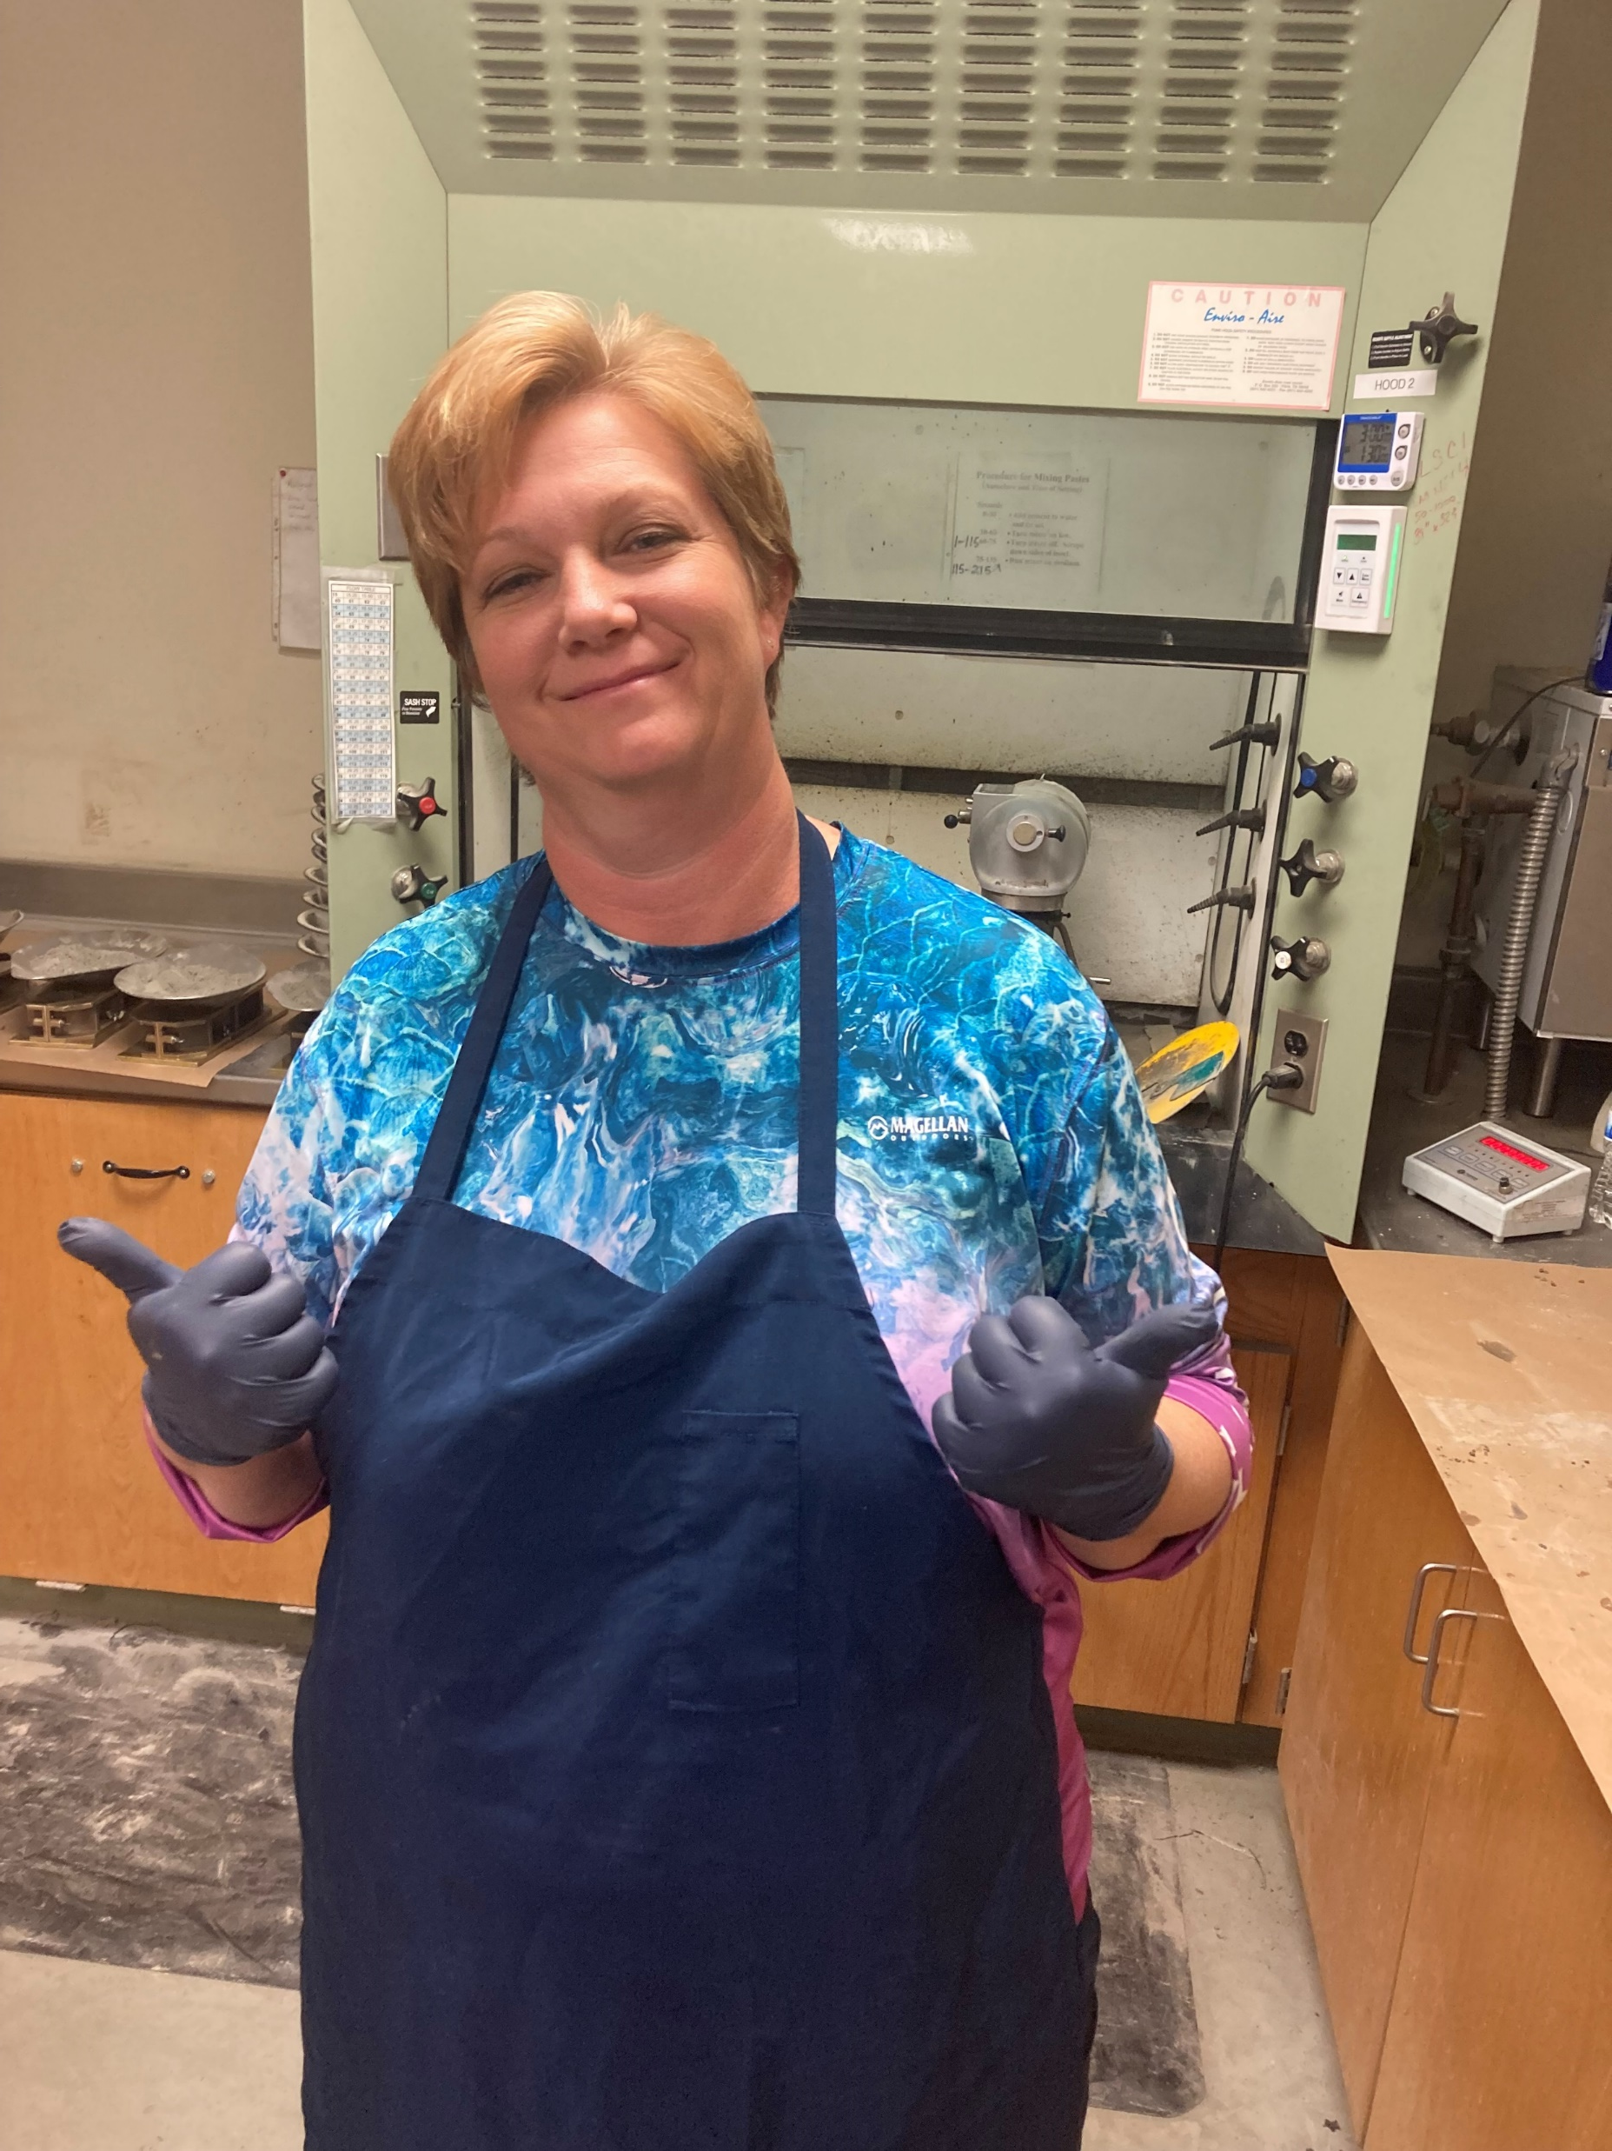
Notes:
There are a lot of people
Lots of hands on the steering wheel
TRC 2201 will be the most successful

Slide 26
Notes:
There are a lot of people
Lots of hands on the steering wheel
TRC 2201 will be the most successful

Slide 27
Notes:
Stake holders -

Slide 28
Notes:
Meeting last fall
Shake Hands – Smile , but we are talking about change and there’s a little tension and some trust issues

Slide 29
THE KEY TO SUCCESS

Slide 30
Notes:
Industry and even U of A buy it

Slide 31
PRODUCE
AMAZING
ASPHALT
Notes:
Not good, better, cheap
What does amazing asphalt look like?

Slide 32
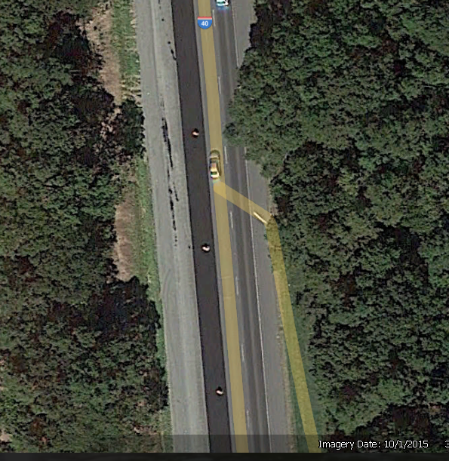
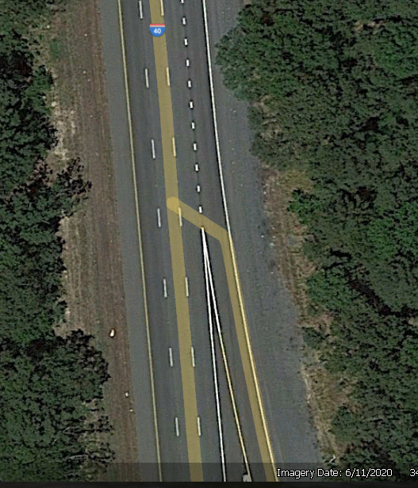
2015
2020

Slide 33
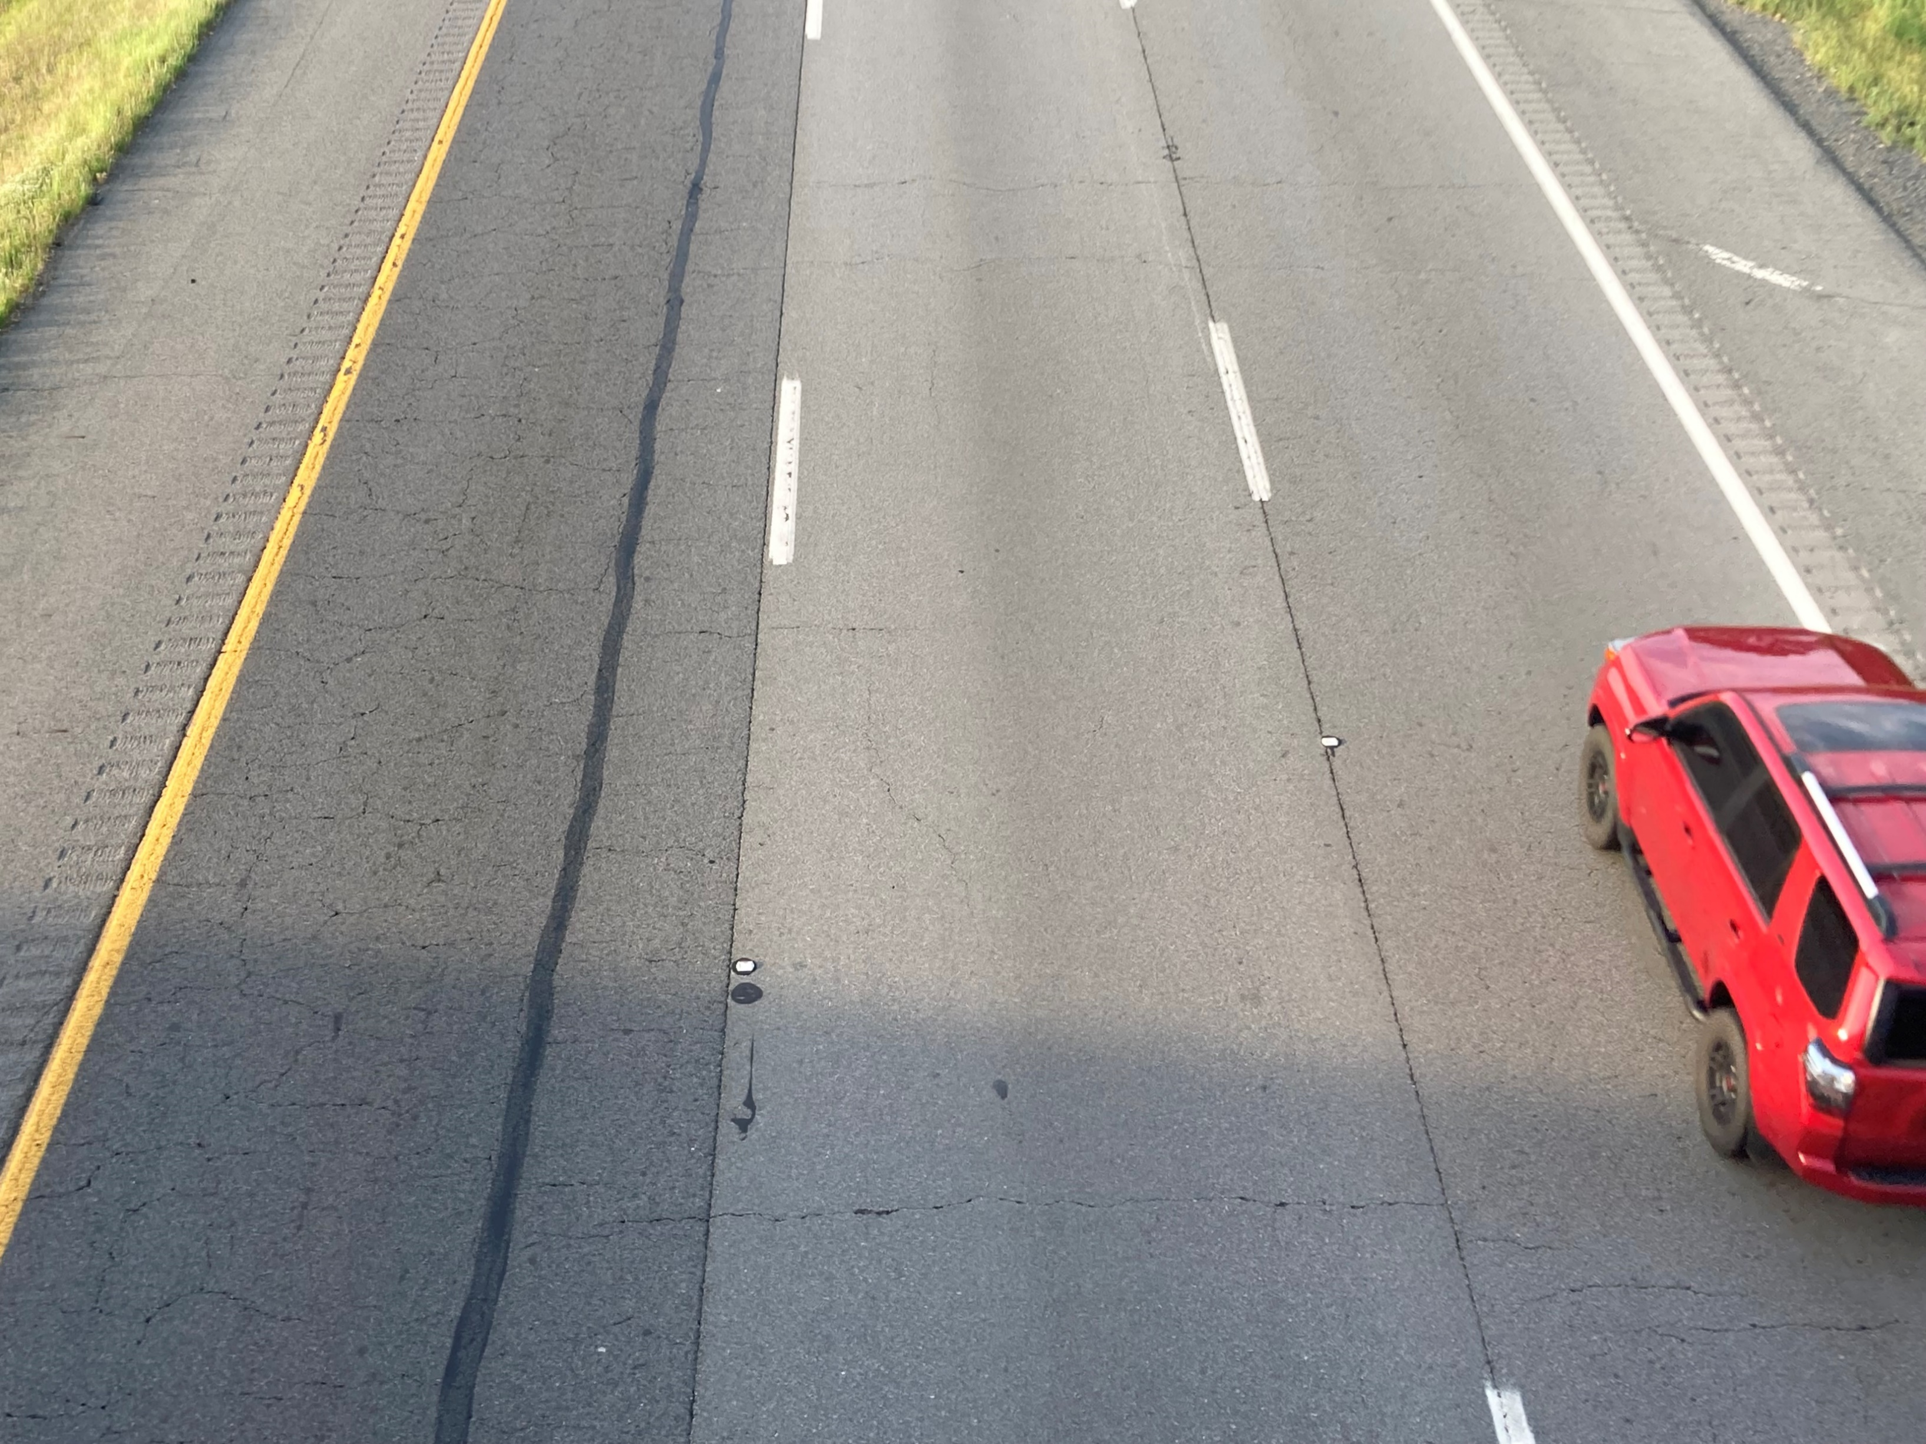
1998
2015

Slide 34
2015

Slide 35
1998
2015

Slide 36
1998

Slide 37
“SOMEBODY NEEDS TO DO SOMETHING ABOUT THIS”
1998

Slide 38
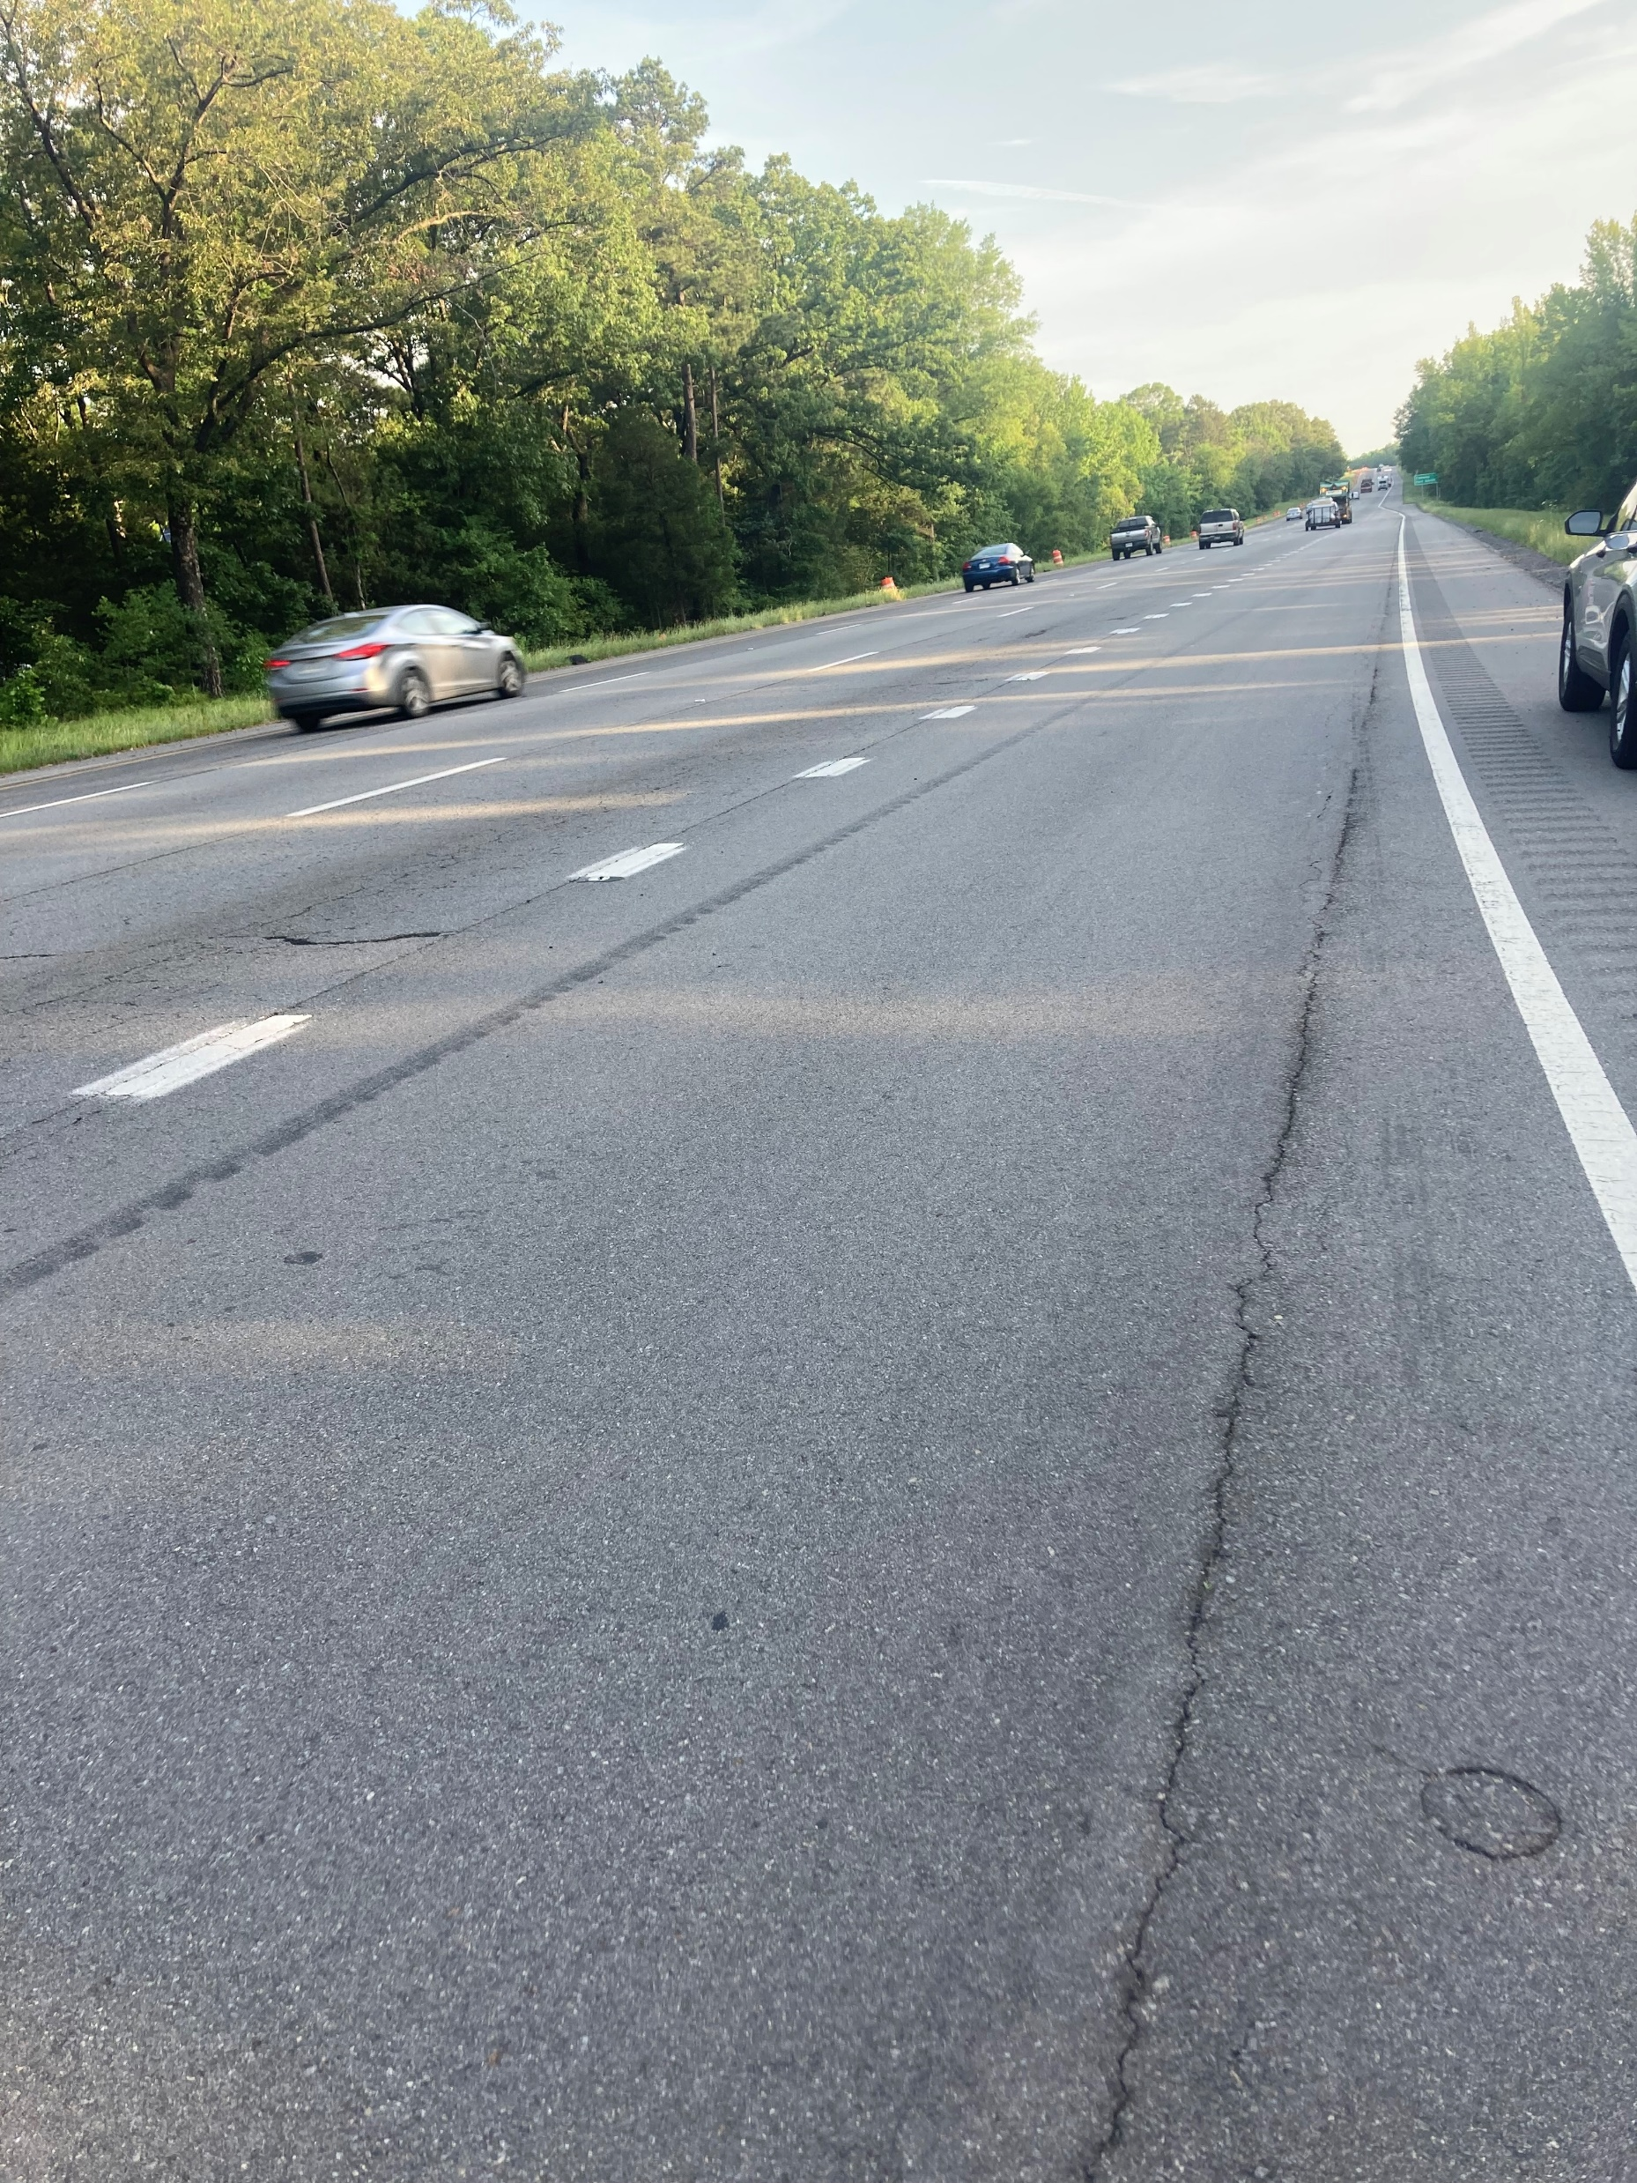
2020
Notes:
How do we produce amazing asphalt??? I think all decisions related to asphalt need to be judged by this complex matrix

Slide 41
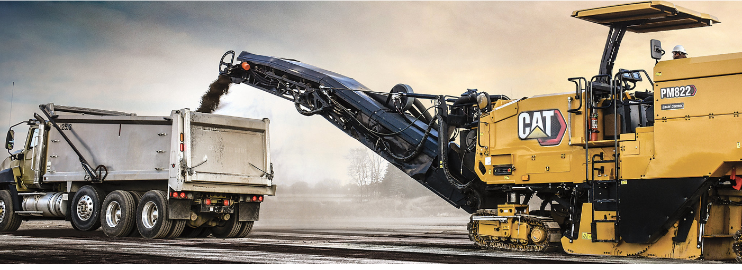
RECYCLED ASPHALT PAVEMENT
Notes:
DMS’s did a survey of every RAP stockpile in the state.

Slide 42
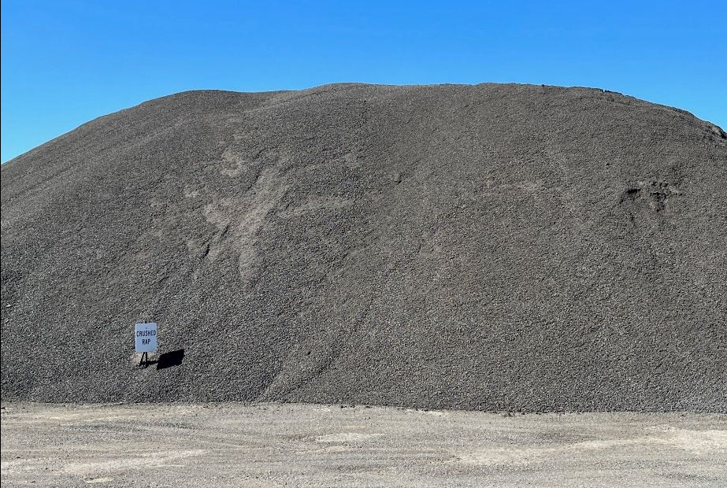

Slide 43
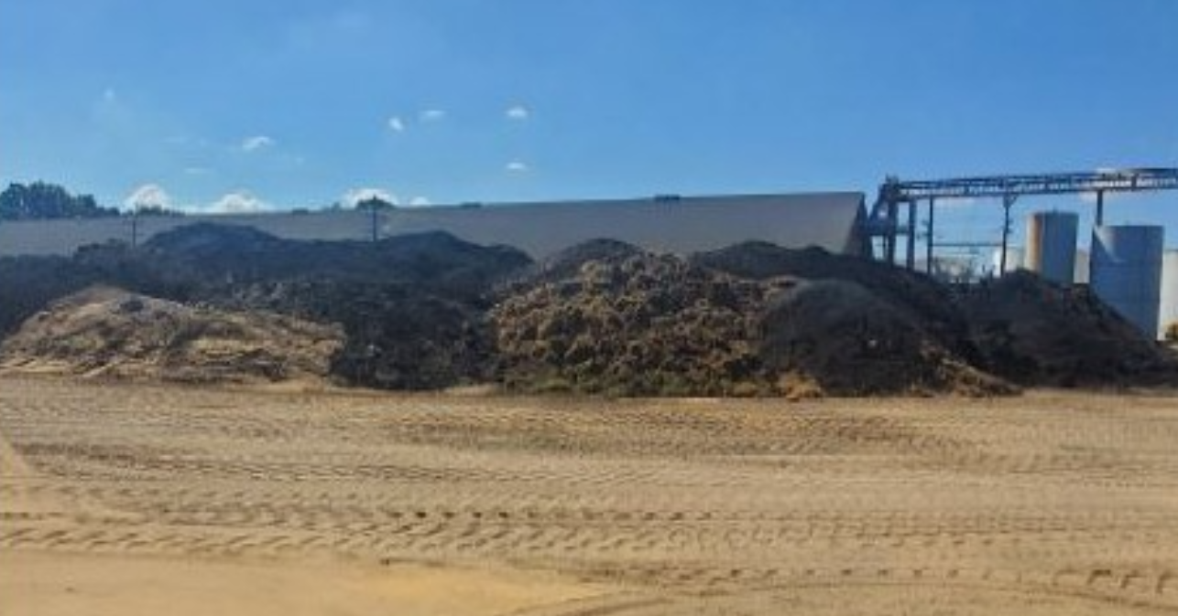

Slide 44
RAP Sources
State Millings
Power BI Desktop
Public Millings
Parking Lots
Plant Waste
1.0
Percent of RAP
0.5
0.0
Diamond B Co…
North Central …
Cranford - Littl…
Hutchens Cons…
Jay-Pac - Plum…
Hutchens Cons…
APAC TN - Forr…
Hutchens Cons…
Redstone - Gur…
Atlas Asphalt - …
Redstone - #1, …
Atlas Asphalt - …
APAC - Old Cas…
APAC TN - Wes…
Atlas Asphalt - …
Grant Garret Ex…
PBSG - #1 - Pin…
APAC Central - …
APAC Central - …
APAC Central - …
Rogers Group -…
Blackstone - #1…
Delta Asphalt - …
Rogers Group -…
Delta Asphalt - …
Delta Asphalt - …
Delta Asphalt - …
PBSG - #3 - Mo…
RK Hall - Texark…
Plant
Method of Marking/Separating Stockpiles
Distance & Signs 2
Method of Processing RAP
Screen Oversize 3
Signs 6
Crush All 12
Distance 21
Screen & Crush Oversize 14

Slide 45
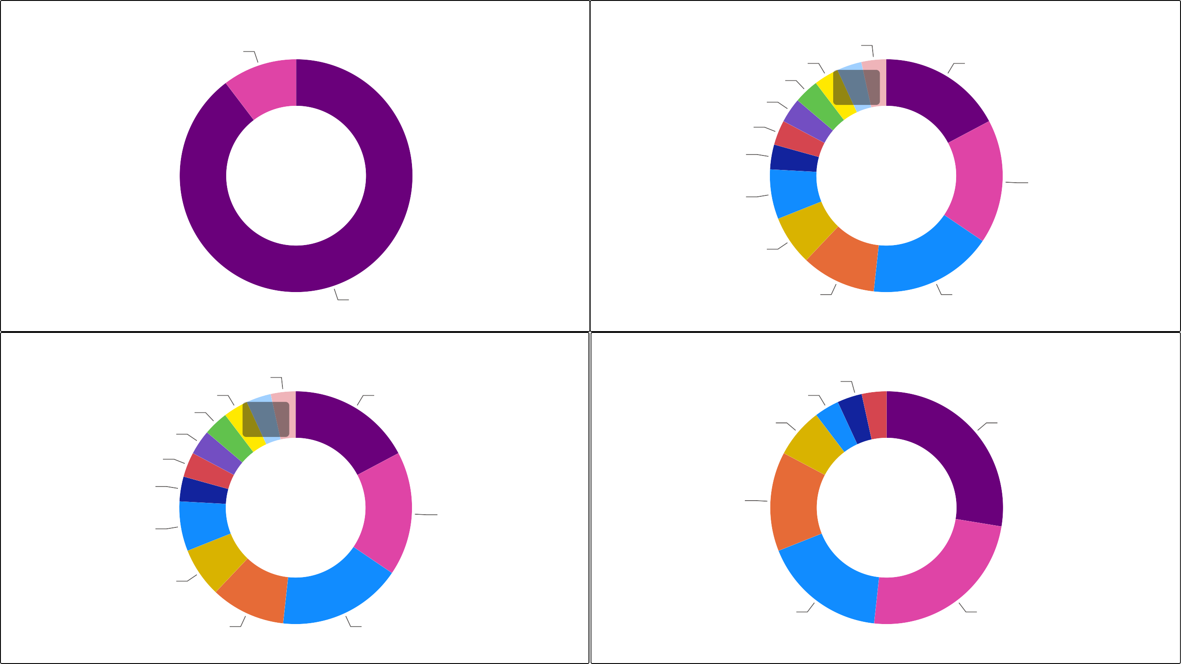
Method For Determination of Binder Content
Power BI Desktop
Frequency of Binder Content Testing
Vacuum Extraction 3
Weekly 1
Daily 1
Biweekly 1
750 tons 1
250 tons 1
2000 tons 5
Per Job 1
1500 tons 1
Monthly 2
500 tons 5
As Required 2
Ignition Oven 26
1000 tons 3
Mix Design Only 5
Frequency of Gradation Testing
Frequency of Specific Gravity Testing
Daily
Weekly 1
1
Daily 1
Biweekly 1
750 tons 1
250 tons 1
1500 tons 1
2000 tons 5
1500 tons 1
Quarterly 2
Per Job 1
N/A 8
500 tons 5
500 Tons 4
Monthly 2
As Required 2
Yearly 5
Mix Design Only 7
1000 tons 3
Mix Design Only 5
Notes:
Inconsisetncy with Quality Control Uniform acccross the industry-

Slide 46
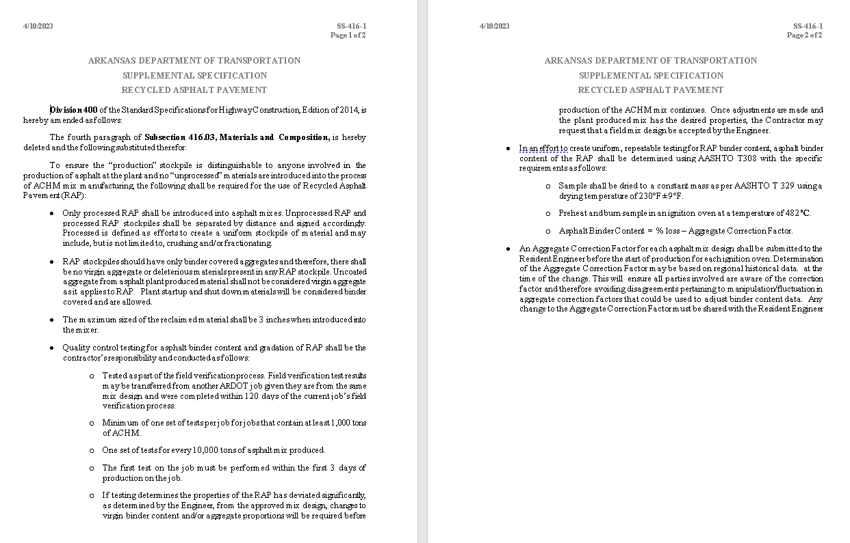
Notes:
Quality Pavement Conference learning how to partner with the contractor
RAP Best Practices Specification

Slide 47
Notes:
When they saw things from our perspective – their attituedes

Slide 48
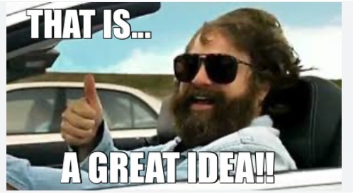

Slide 49
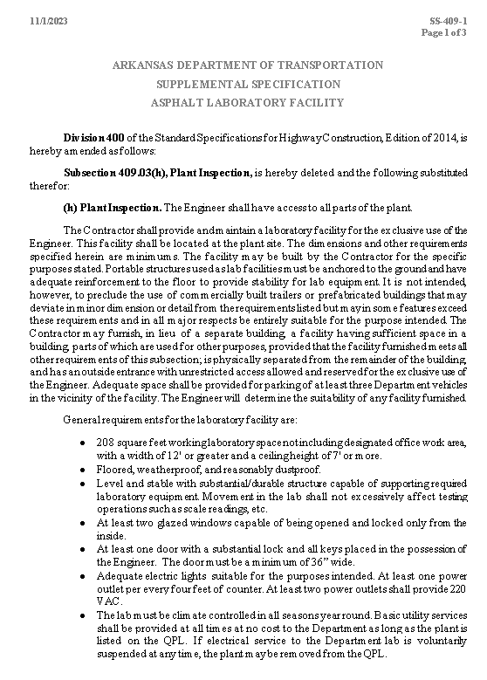
Notes:
More functional- Safer- Tied to Plant inspection
Reasonable Compliance
Go into effect in the November letting-Will soon be published on the PM website

Slide 50
TRC 2201: Balanced Mix Design
Notes:
Cross County

Slide 52
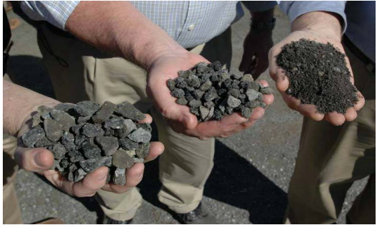

Slide 53
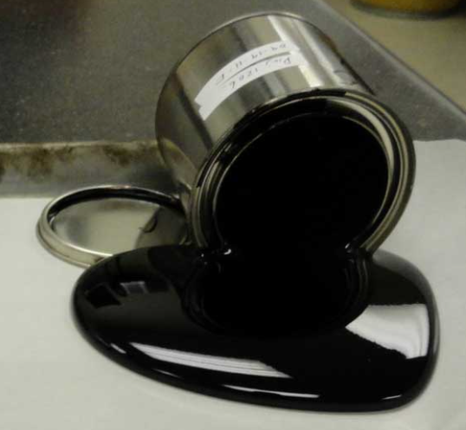

Slide 54
Notes:
Best possible resistance to Rutting and Cracking

Slide 58
Air
Voids
VMA

Slide 59
Air
Voids
VMA
N_{initial}
N_{design}
Notes:
If we simply add more oli- likely hit target for volumetrics

Slide 60
Air
Voids
VMA
N_{design}
N_{initial}
Notes:
If we simply add more oli- likely hit target for volumetrics

Slide 61
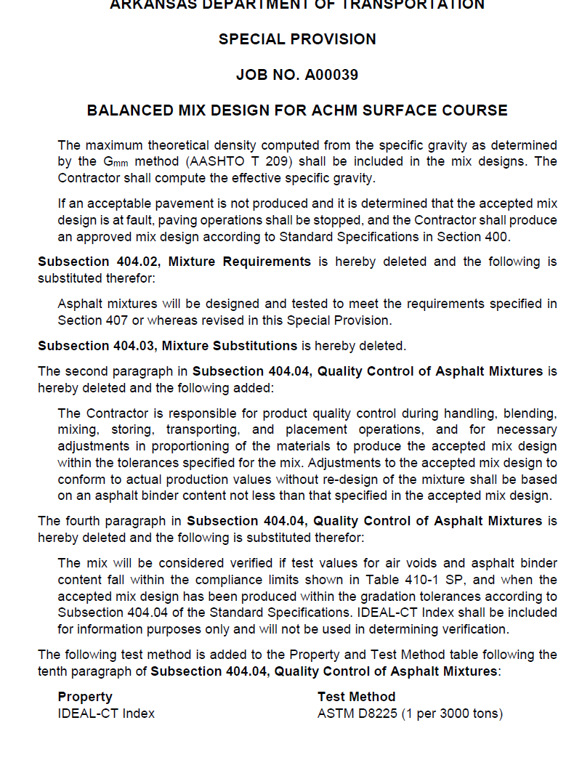
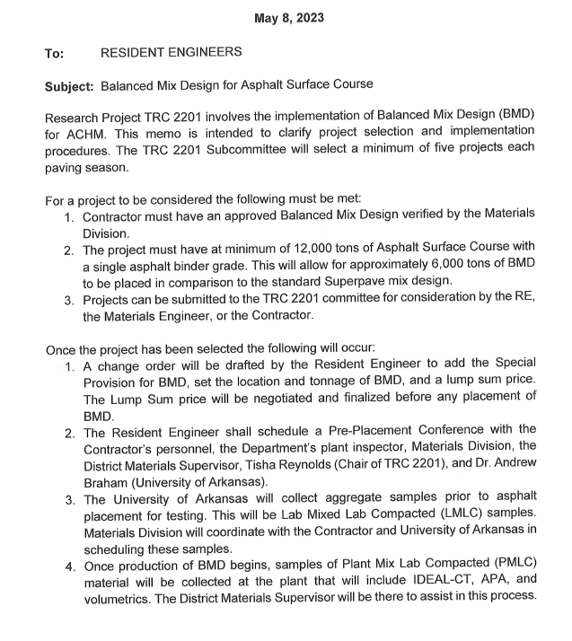

Slide 62
Notes:
Very intelligent kids that don’t really know anything about anything. Goals – Success- achievements like those are things you get to one day- and then your there. That mindset is why superpave design has reached the end of its useful life. Revising specifications, keeping up with performance, and addressing issues little by little is tedious, but if we do those things, and we continue seek improvement 15-20-25 years from now people will look at our pavements and be impressed- Unless they come from Texas

