Slide 1

Protection of
Cultural resources during construction
Kristina Boykin
Cultural Resources Section Head
Environmental Division
Notes:
In the Environmental Division, most of our work occurs before ROW acquisition can take place and well before construction.
However, sometimes we have commitments to fulfill at the request of the State Historic Preservation Officer or from various Native American tribes or certain discoveries may happen that result in revisiting jobs during construction.
I want to discuss today (1) what cultural resources consist of so that others know what to look for, (2) what is done to limit potential impacts to the resources during construction, and (3) what measures/protocols are in place for when unexpected situations occur.

Slide 2
National Historic Preservation Act
Section 106 of the National Historic Preservation Act and implementing regulation, 36 CFR Part 800
Consultation
Identification and Evaluation for National Register of Historic Places
Assessment of Effects to Historic Properties
Mitigation or Commitments
Notes:
Why does ARDOT have the Cultural Resources Section?
The Cultural Resources Section operates under Section 106 of the National Historic Preservation Act (NHPA) and its implementing regulation, 36 CFR Part 800 is how we fulfill the requirements of Section 106.
Section 106 requires federal agencies to assess the effects of an undertaking on historic properties.
Historic properties are defined as prehistoric or historic districts, sites, structures, buildings, and objects that are listed and are eligible for listing in the National Register of Historic Places.
How do you assess the effects of an undertaking?
Consultation – the scale of consultation depends on the scope of the project itself and includes federal and state agencies, the Native American tribes, local entities, such as city or county mayors or judges, historical societies and the general public.
Identify and evaluate properties for the National Register
Architectural and archeological field surveys are done to identify and assess the impacts of previously recorded or newly discovered cultural resources for our projects. A historic property is evaluated under certain criteria for the National Register of Historic Places.
Documentation is provided to the State Historic Preservation Officer for concurrence on our whether we think these properties are eligible or not for the National Register. And then one for assessment of effects.
If there is an adverse effect to a historic property, if avoidance or minimization is not possible, structures, such as bridges, are usually mitigated through architectural documentation and photographs, plaques, interpretative signs, and 3D laser scanning. Archeological sites are mitigated by doing an excavation and documentation of the impacted portion of the site .

Slide 3
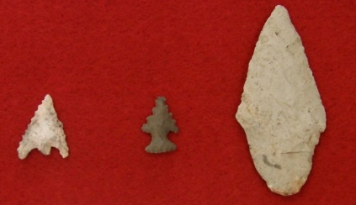
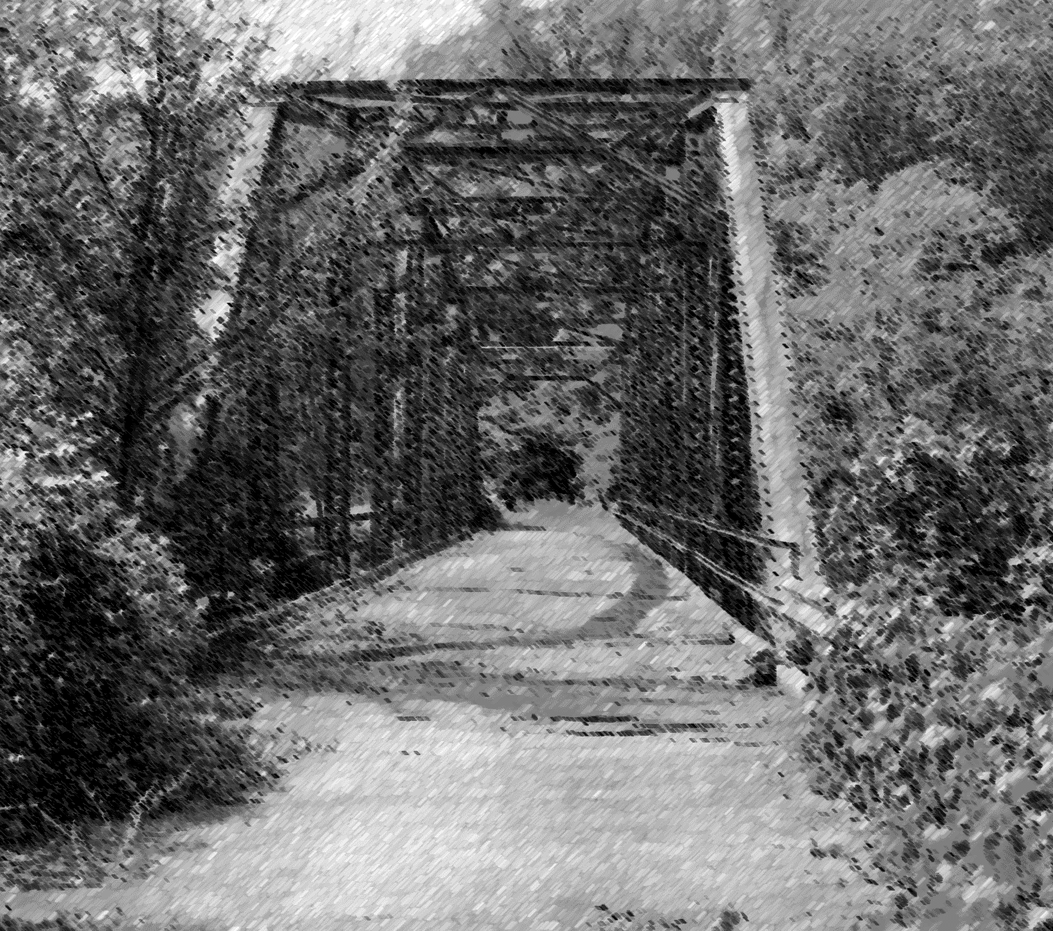
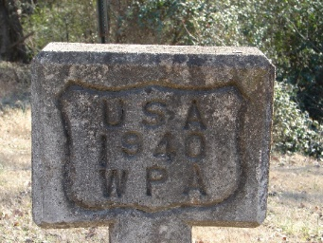
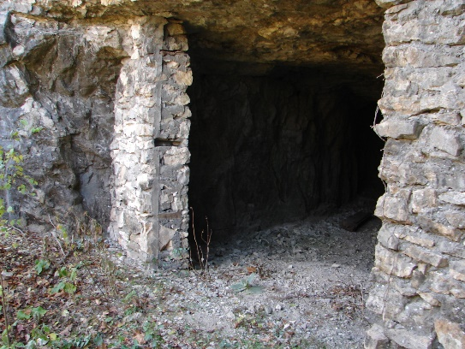
Cultural Resources
Archeological sites – Native American (camp, village, rock shelter, quarry, mounds) and Historic (battlefield, homeplace, ruins of a structure)
Artifacts
Structures – bridges, historic trails or roads, railroads, earthworks
Buildings – house, offices, schools, and many more
Landscapes
Objects – markers, monument, sculpture
Cemeteries or graves
Notes:
Cultural resources is a broader term than historic properties because it is not limited to those resources that are eligible or listed for the National Register of Historic Places. Cultural resources encompasses all physical evidence of past human activity that is 50 years of age or older, which may include the items listed above. These are what we are looking for when out in the field.
The difference is: If we are not impacting an archeological site from one of our projects, then we are not going to conduct the work to assess its eligibility for the National Register. So it remains undetermined. However, we still want to ensure that no harm comes to this resource and others during construction.

Slide 4
Special Provisions
Restraining Condition
Historic Property Monitoring
Vibration Monitoring
Archeological Monitoring
Removal of Historic Truss Span of Bridge Number
Removal and Relocation of Historic Markers
Notes:
For those jobs, we will include a Special Provision (or multiple ones) in Construction Contracts that will protect or minimize harm to a cultural resource during construction.

Slide 5
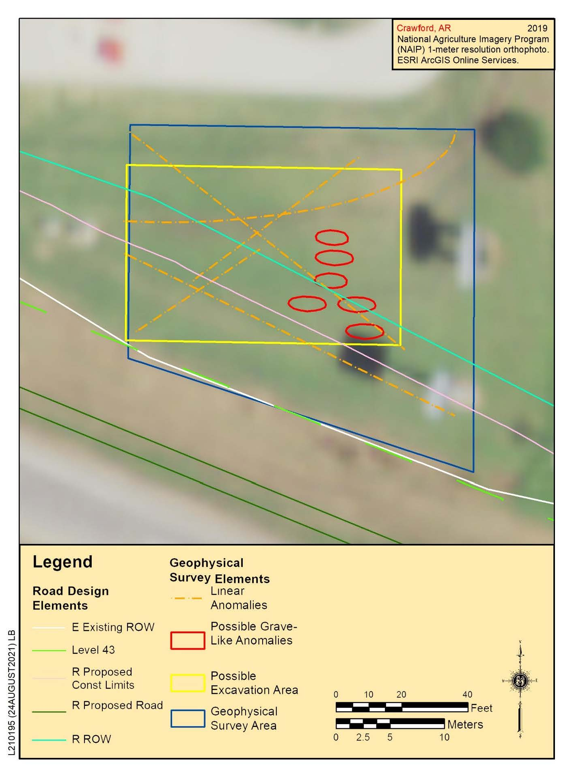
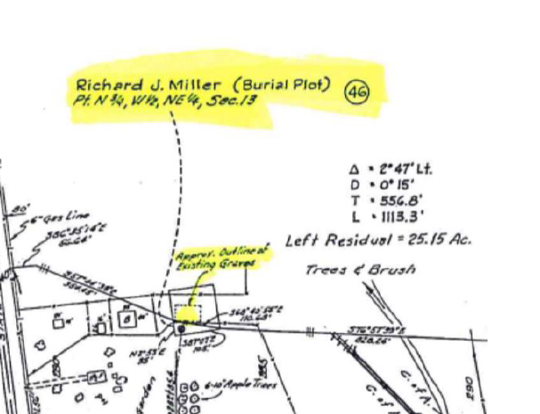
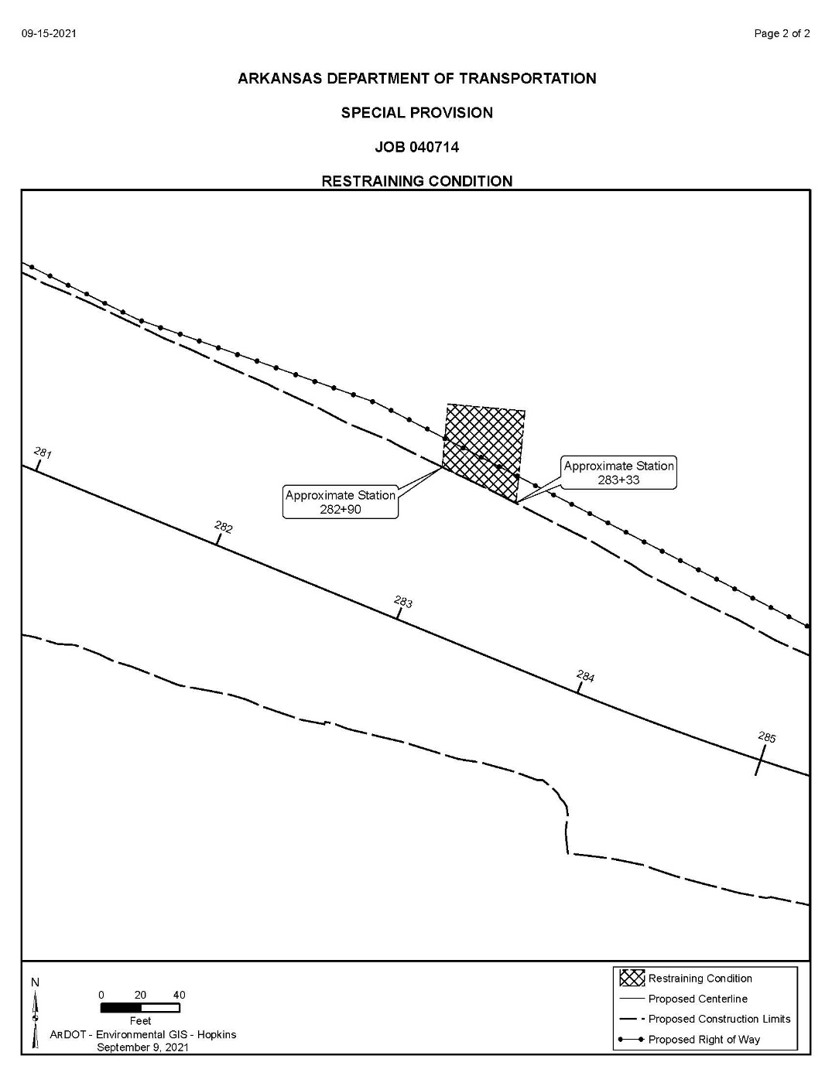
Restraining Condition Special Provision
Notes:
Restraining Conditions Special Provisions are about avoiding construction activity within the designated area including utility relocation, any off-site location use, and any other ground disturbing activities. We use these for a variety of different resources, such cemeteries/graves, structures, sites, etc.
For this job, near Van Buren, ROW Division staff found in previous plans for I-40 construction a possible burial plot. We conducted various research and could not confirm if graves were there or not. We had one of our consultants perform Ground Penetrating Radar to see if burials were there. They found around six possible burials and we had this Restraining Condition done for these unmarked historic graves to avoid work in that area during construction.

Slide 6
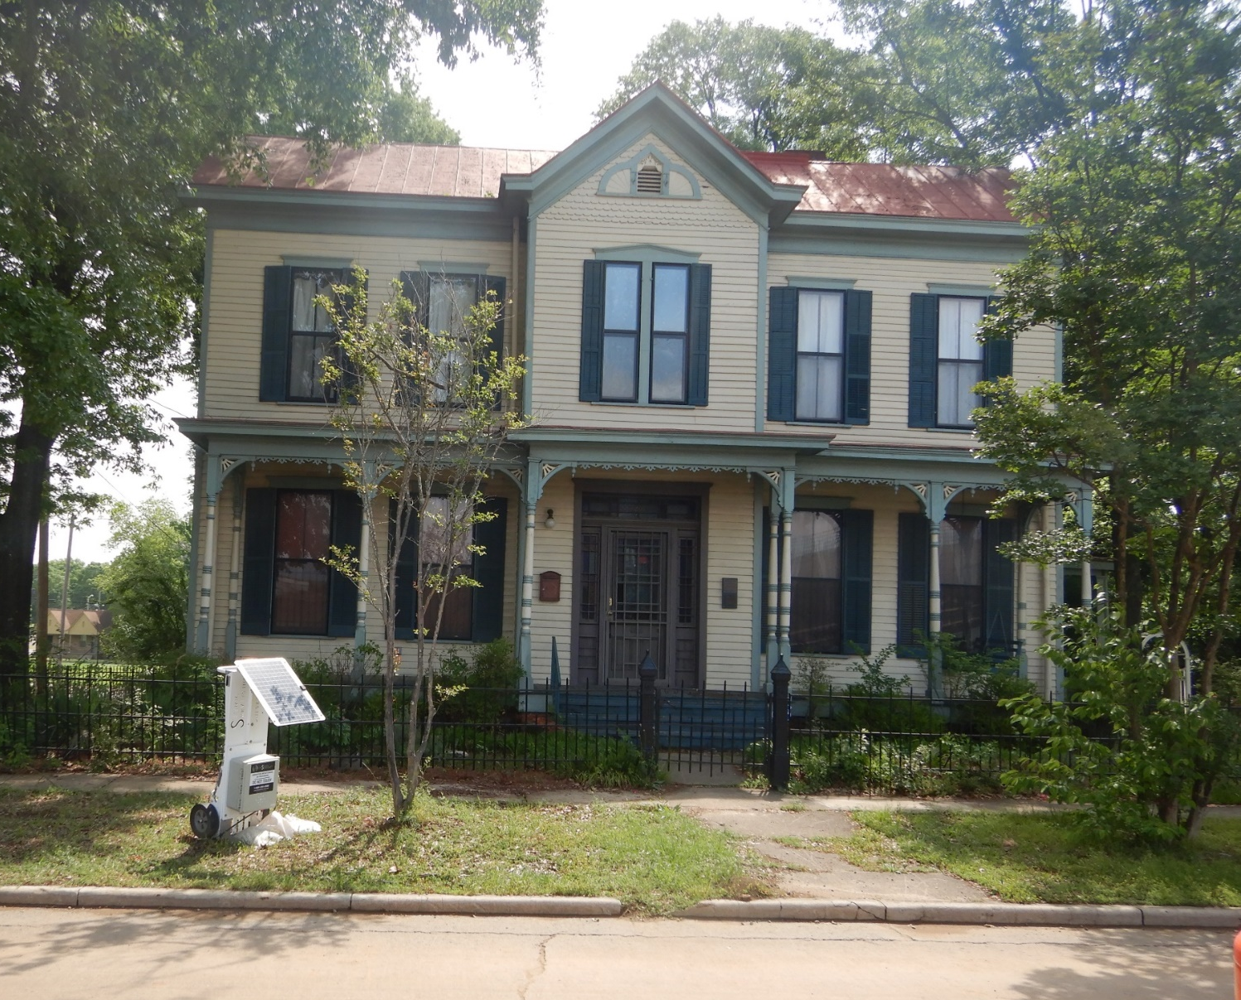
Historic Property & Vibration Monitoring Special Provision
Notes:
Restraining Conditions can often be accompanied by a Monitoring Special Provision. Either an architectural historian or an archeologist will be notified by the Resident Engineer two weeks prior to the start of construction. This allows the staff to coordinate schedules with the Contractor to be on-site.
For historic structures, we typically have monitoring associated with the use of vibratory equipment and want to avoid causing structural damage. This can be done by actively monitoring vibration within that area and surveys of the building’s condition prior to and after construction. Receptors are placed and maximum thresholds that should not be exceeded are established for certain activities (compaction of fill and pile driving). For 30 Crossing, the Contractor has this equipment set up that will send out a notification if work is exceeding thresholds established for the Reichardt House located east of the I-30/I-630 interchange.

Slide 7
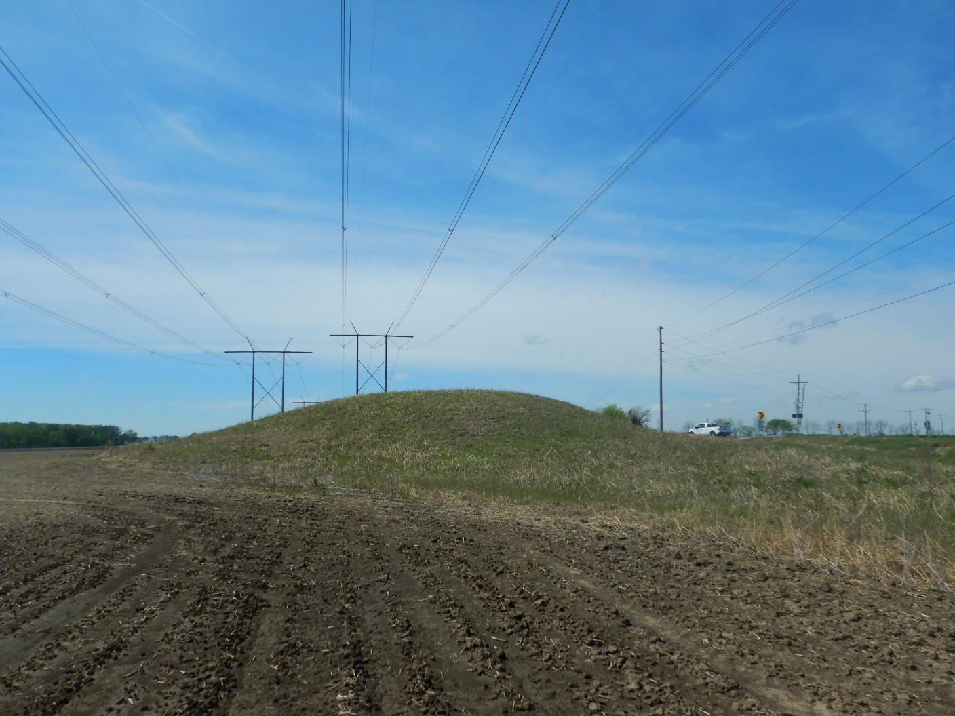
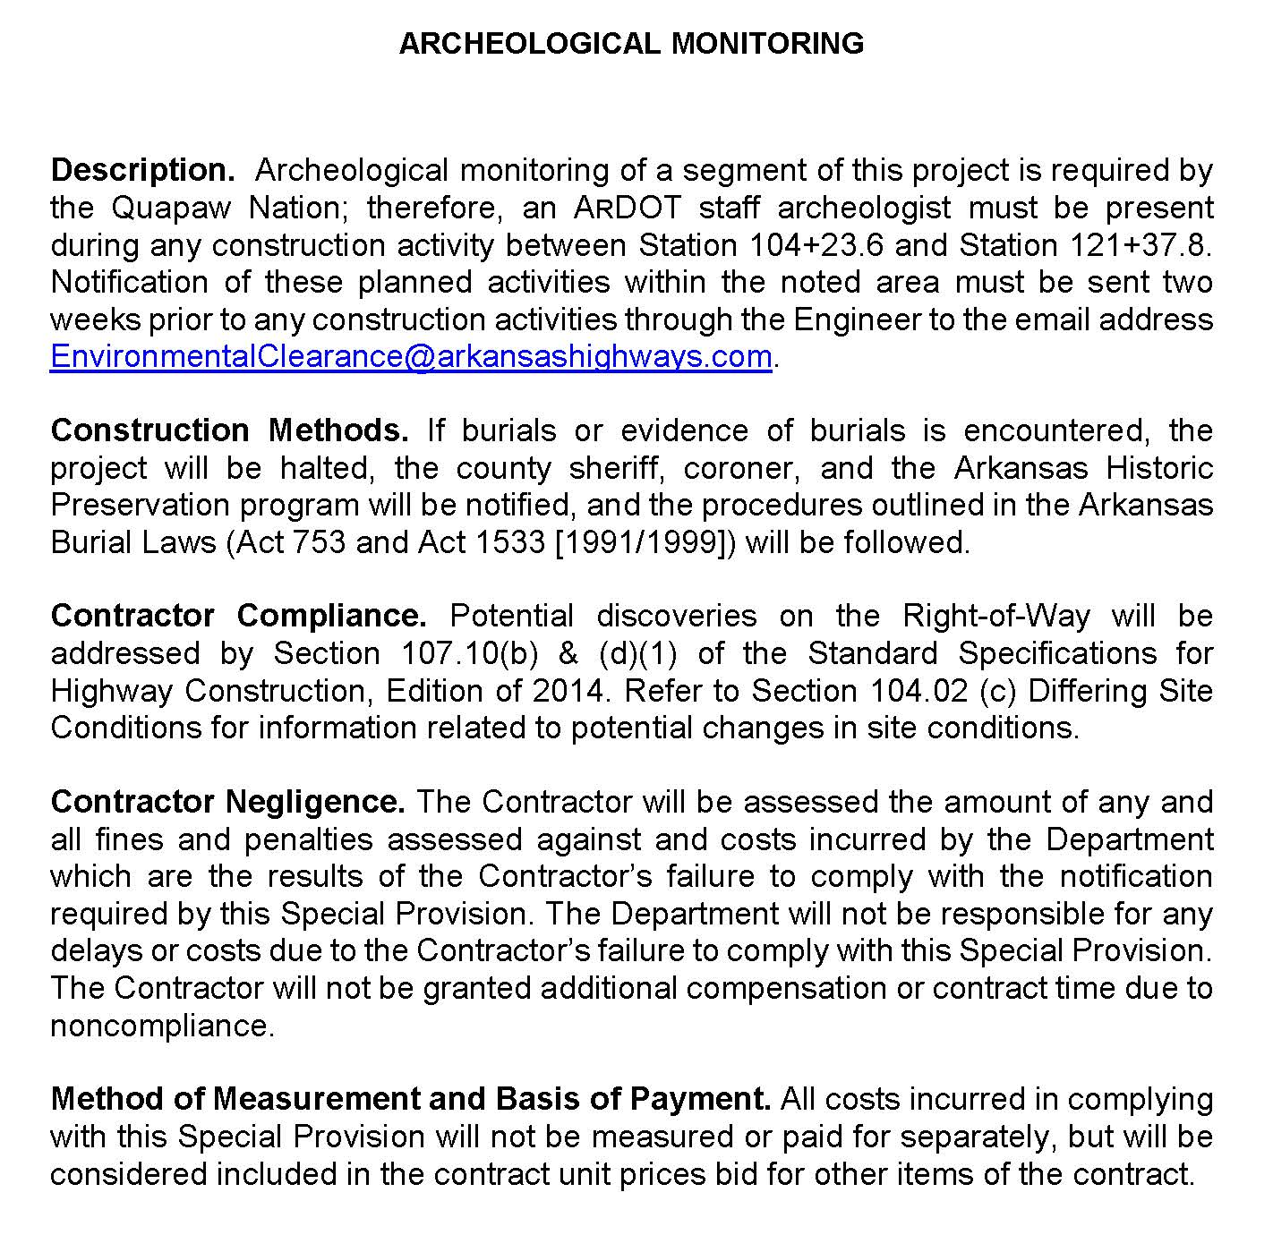
Archeological Monitoring Special Provision
Notes:
For archeological monitoring SP, an archeologist is required to monitor any ground disturbing activity in a specified area. Sometimes, this is a recommendation that staff archeologists may make because of the proximity of the site to the proposed ROW limits. It may be a condition that the State Historic Preservation Officer (SHPO) makes or that a Tribe will request.
A project near Osceola had a sacred mound site belonging to the Quapaw Nation. We were aware of it and consulted with this Tribe before this project was even programmed. The Quapaw requested an ARDOT archeologist and one of their Tribal archeologist to be on-site to monitor during construction.
While monitoring, if the archeologist suspects any evidence of a site, they will halt construction to examine the area in detail. No work is to continue until they give the all clear.

Slide 8
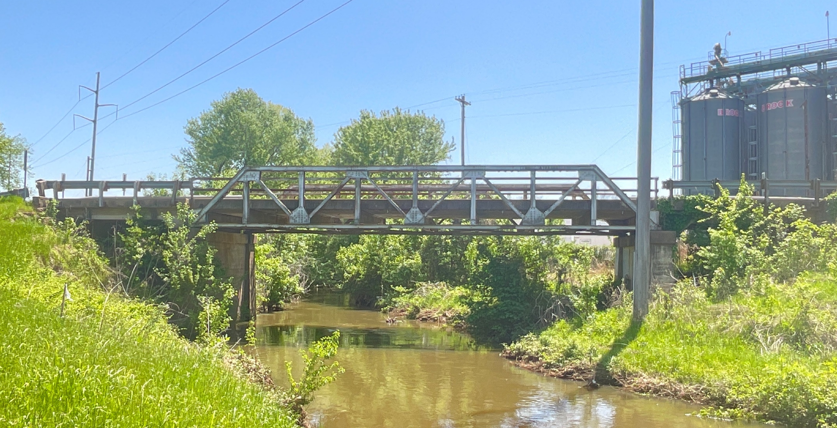
Removal and Relocation of Historic Truss Bridge
Special Provision
Notes:
As part of our Historic Bridge Program, we market bridges for donation to other entities. When a city or county accepts a bridge for reuse at another location, we include an SP so that the truss will be dismantled in a certain way. The small pieces (nuts, pins, bolts) should be boxed. The larger sections of the truss are to be measured and labeled.
Bridge M1144 is a pony truss on Hwy. 64B in Alma that will be replaced. This bridge will be donated to the City of Greenwood for reuse on a pedestrian trail. This SP also states that the Contractor shall transport, deliver, and unload all truss pieces at the City’s designated location.

Slide 9
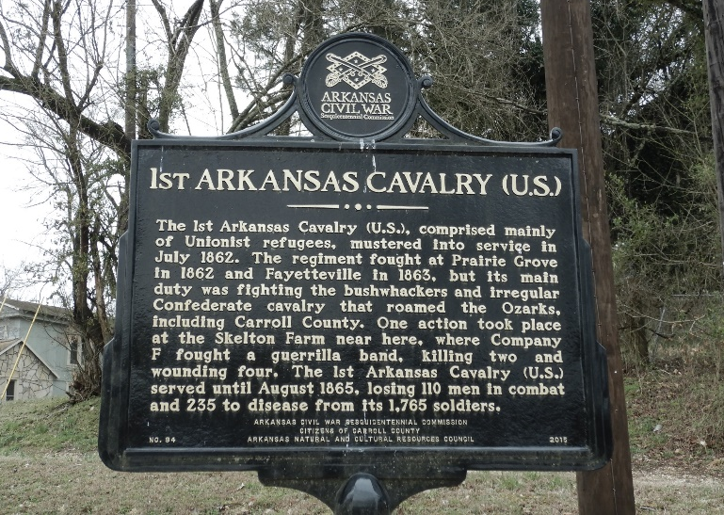
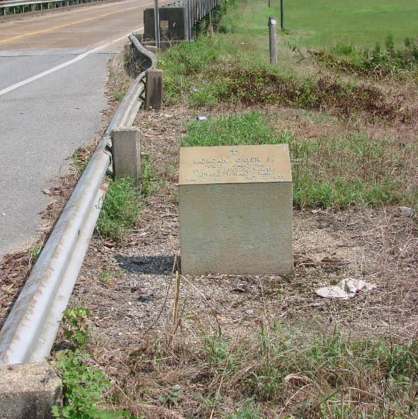
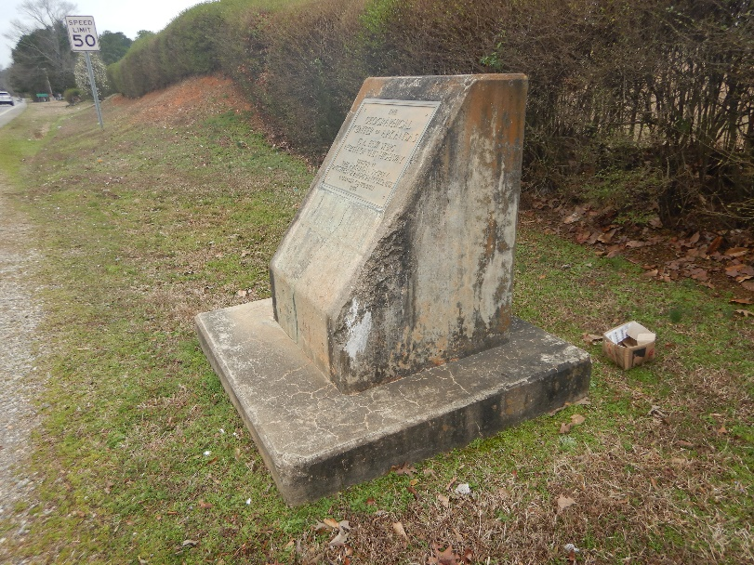
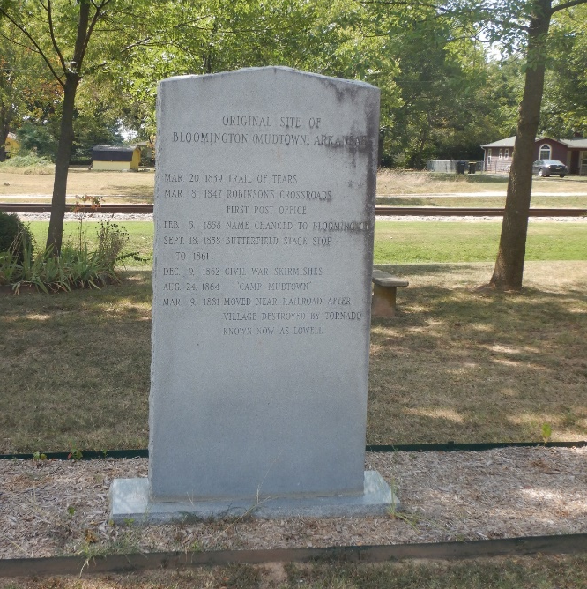
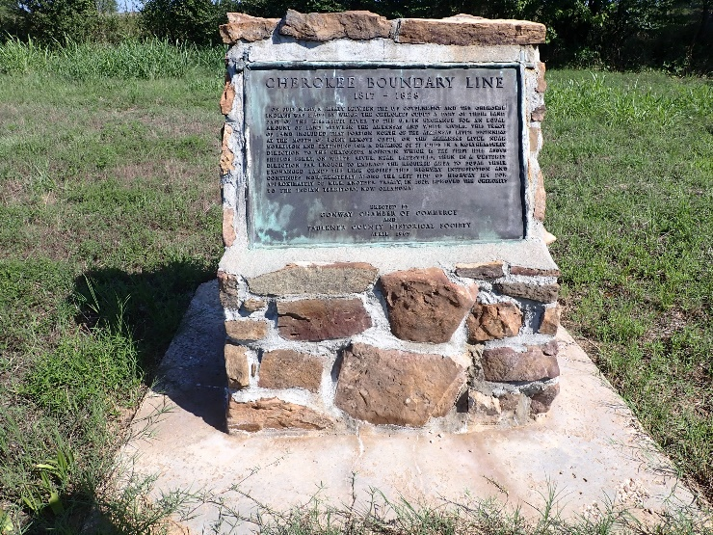
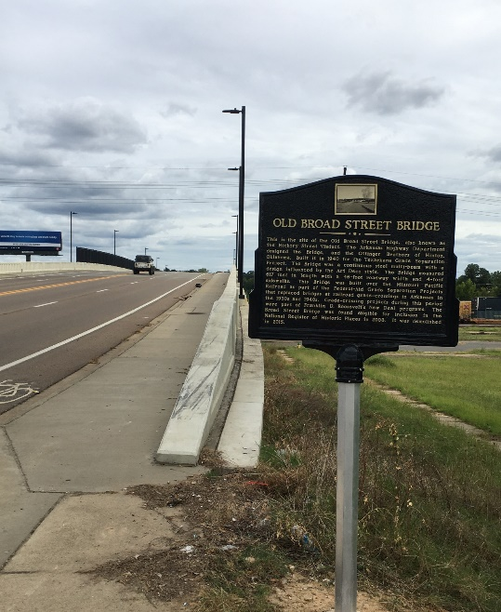
Removal and Relocation of Historic Marker Special Provision
Civil War Marker on Hwy. 187 (Carroll County)
will be relocated after construction.
Revolutionary War Veteran Monument on Hwy. 67 (Arkadelphia) will be relocated after construction.
Geographical Center of Arkansas Marker along Hwy. 5 (Saline County) will be avoided during construction.
Cherokee Boundary Line Monument on Hwy. 285 (Faulkner County) was rebuilt after construction.
Mudtown Marker on Old Wire Rd. was relocated to Lowell Historical Museum.
Old Broad Street Bridge Marker on Hwy. 71
(Miller County) was installed by district sign crew.
Notes:
Removal and Relocation of Historic Marker SP –
We have varying types of historic markers, which are often erected by other agencies, organizations, or even by ARDOT within the existing ROW. These agencies want to ensure their protection and continued use. This SP requires for a marker to removed and stored during construction and relocated to close as possible to original location after construction is complete.

Slide 10
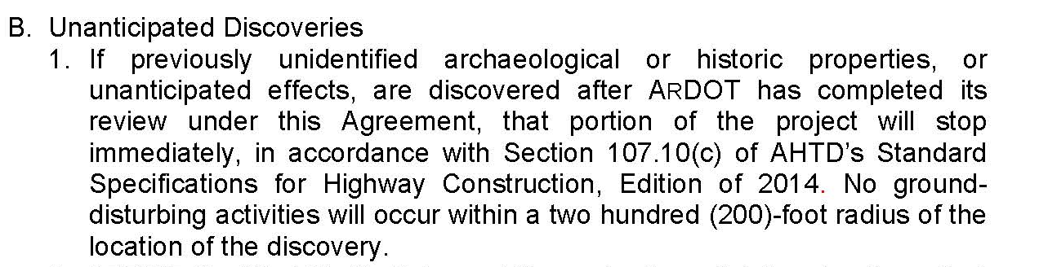
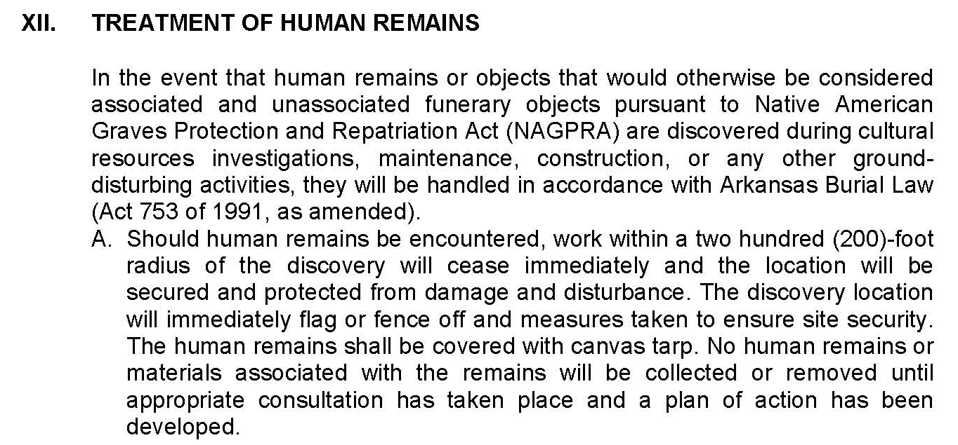
Section 106 Programmatic Agreement
Stipulation XI. Unanticipated Discoveries
Stipulation XII. Treatment of Human Remains
Notes:
Some situations arise during construction that were not or cannot be accounted for with Special Provisions. We have unanticipated discoveries of archeological sites, historic properties, human remains/graves, etc. To deal with these situations, we have a Section 106 Programmatic Agreement that outlines procedures to follow when these events occur in two different stipulations of this agreement.
This agreement was executed in February 2021. I worked with David Henning to get the procedures for these two stipulations put in the contracts as a supplemental specification to Section 107 in the Standard Specifications for Highway Construction.

Slide 11
Stipulation XI in the PA : Unanticipated Discoveries
Procedures
Halt construction in a 200-foot buffer around the discovery
Notify ArDOT Cultural Resources personnel
Identification of findings
Consultation with all applicable parties
Plan for avoidance, minimizing, or mitigating
Follow plan and document findings
Once cultural resources have received approval, then work can continue in that area.
Notes:
Stipulation XI covers who to contact and the timeframe to contact certain personnel, the responsible parties, and review times for documentation.

Slide 12
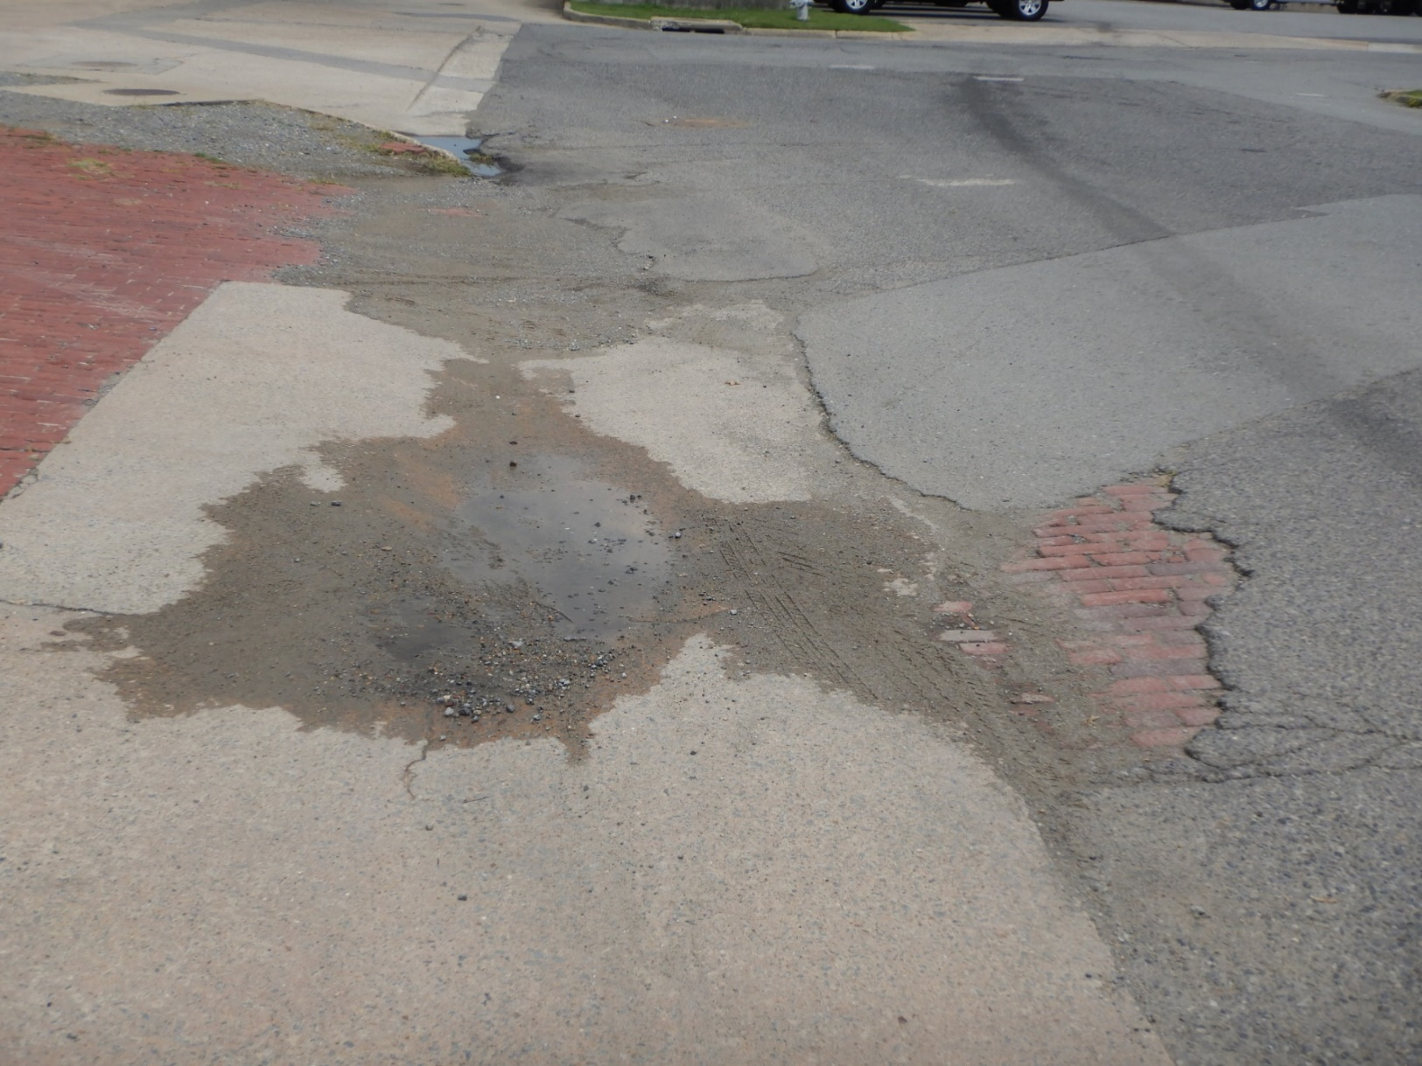
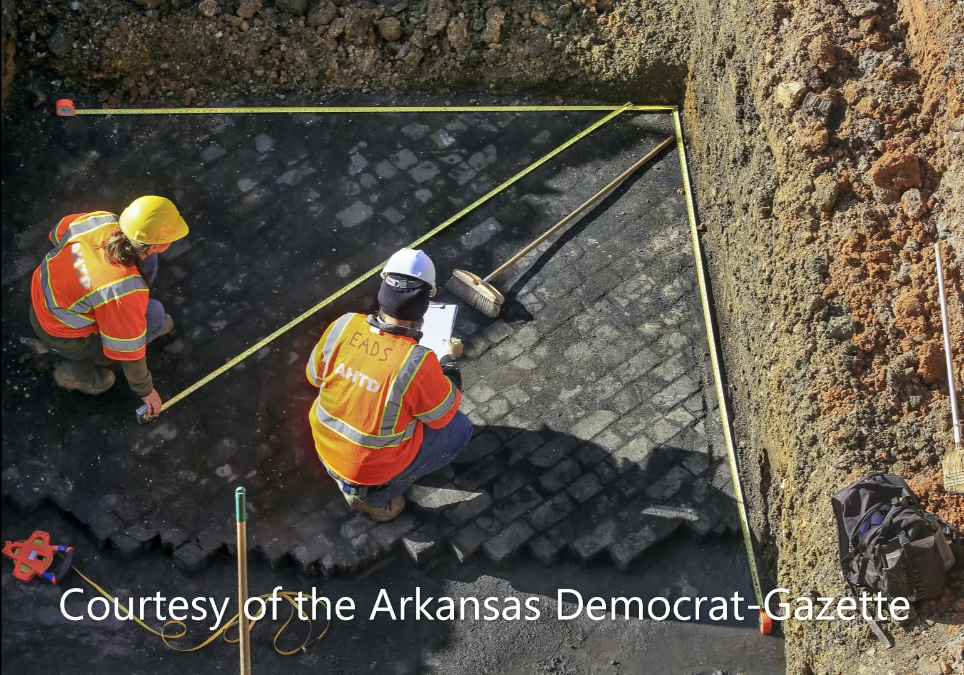
Historic sites/structures encountered
Roads
Wells
Foundations, Walls, and Other Features
Artifacts – ceramics, glass, building materials (nails and bricks), personal items, metal, and faunal remains
Notes:
Some cultural resources may only be fully revealed from deep excavation on a job site. In addition to what examples were previously mentioned, what should Contractors, Inspectors, and other personnel be on the lookout for during construction?
In more urban areas, roads like the wood block road revealed during the Broadway Bridge replacement. Also the possibility of brick roads. This photograph actually shows a small segment of a brick road near the Arkansas Democrat Gazette building that is part of the monitoring on 30 Crossing.

Slide 13
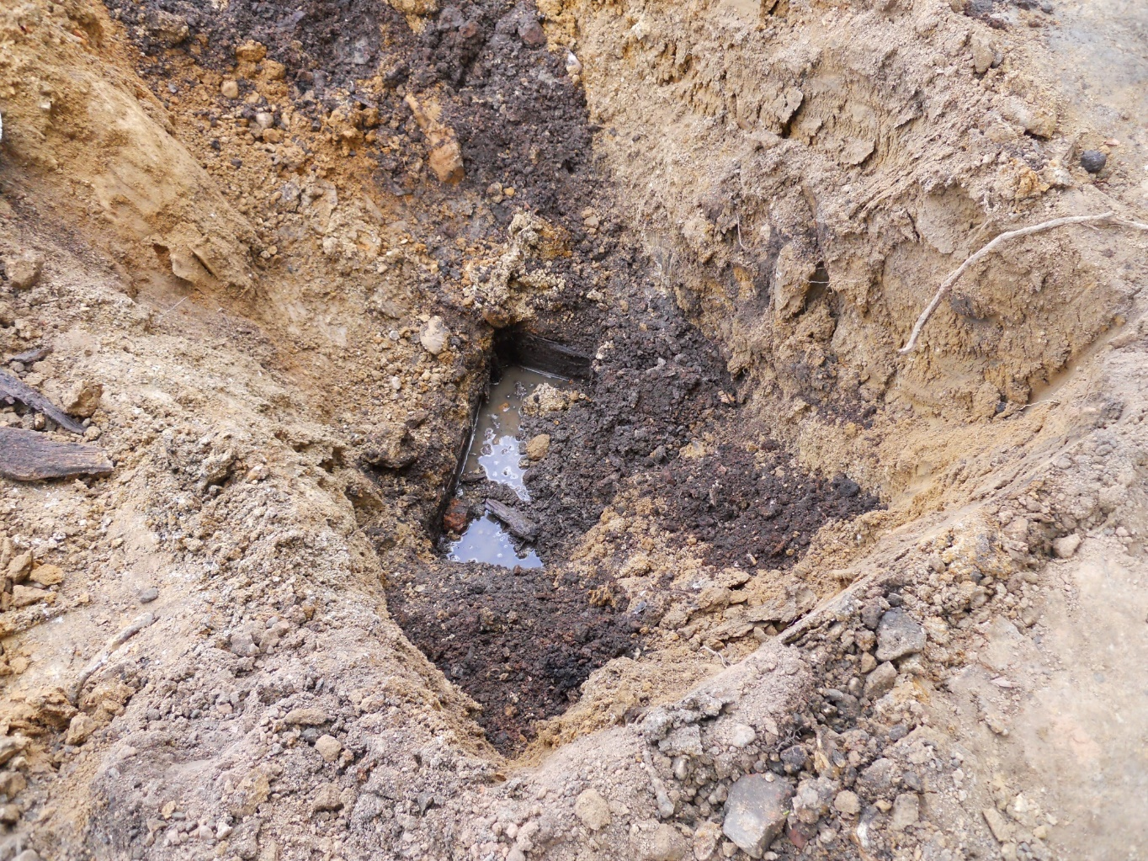
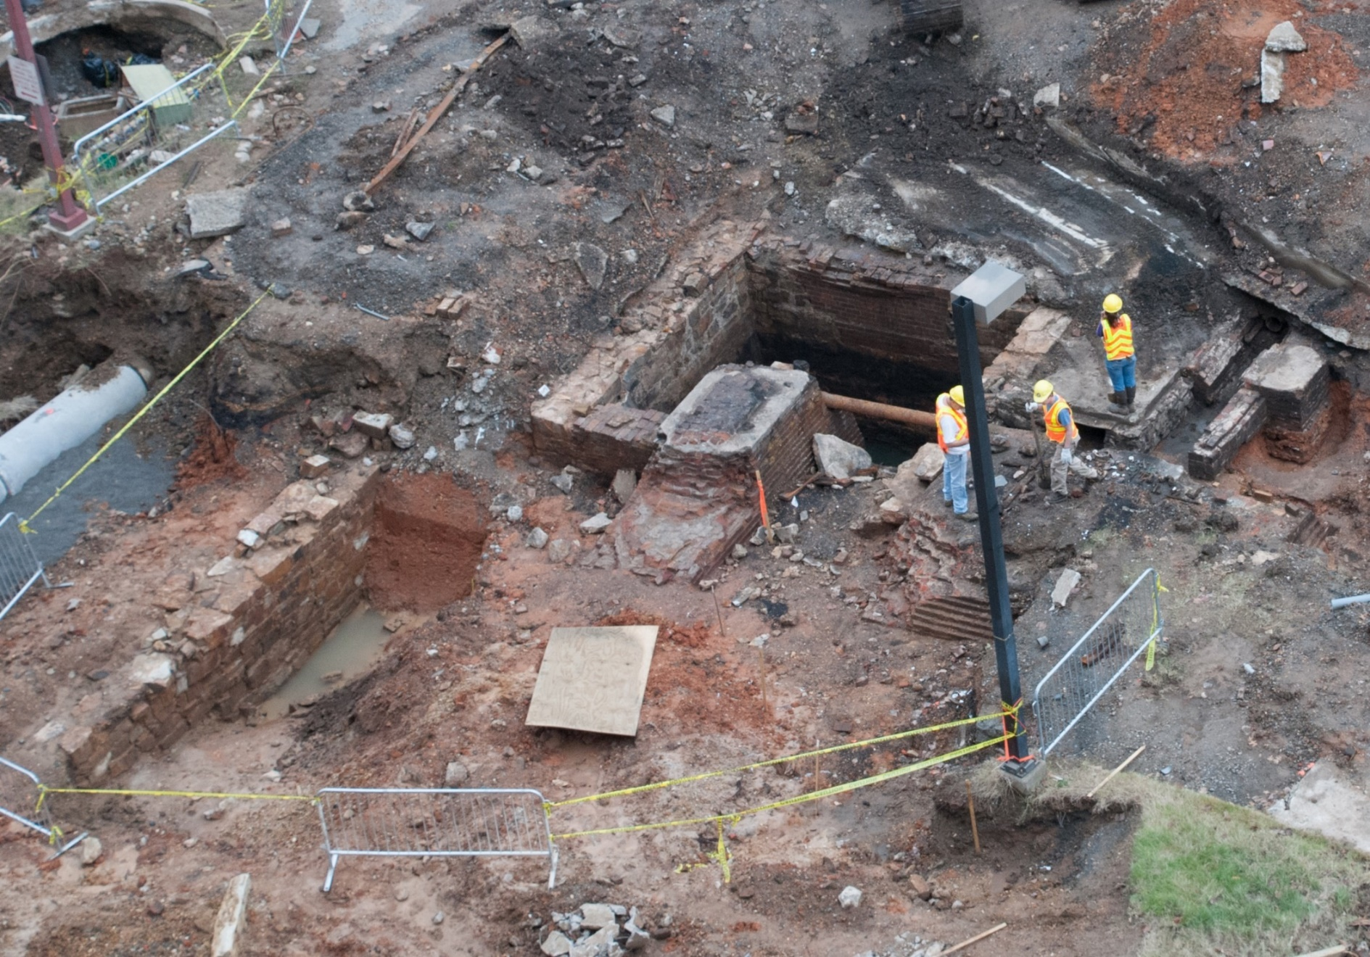
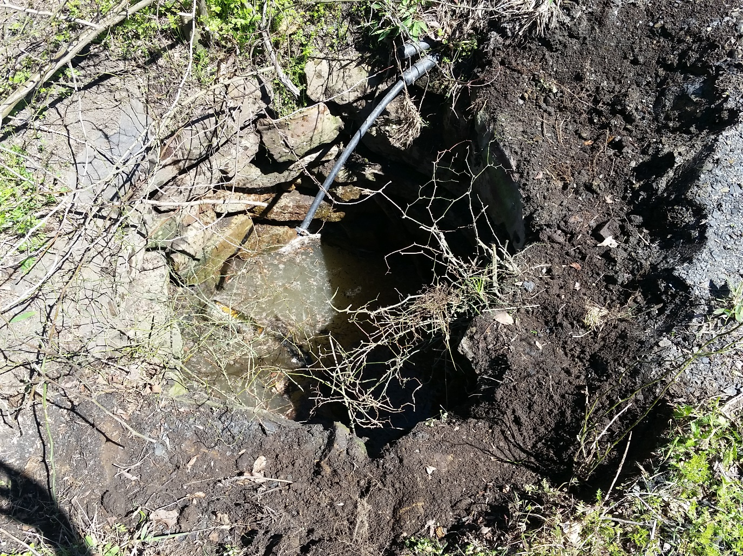
Notes:
Wells. Square or circular are the most common. You can have wood, rock, stone and mortar, or concrete wells.
Foundations, Walls, & Features – this is a photograph of the 1st discovery at the Broadway Bridge; you have a square cistern, a stone and mortar wall, brick foundations, stone foundations. This was buried under 3 feet of fill material.
Another project had a buried stone walkway associated with an 1870s structure.

Slide 14
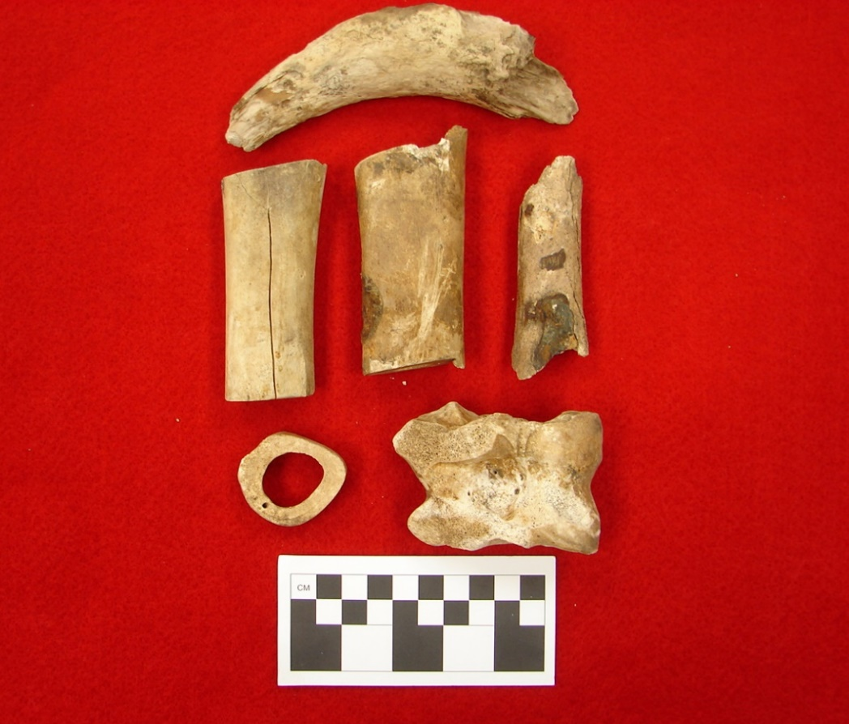
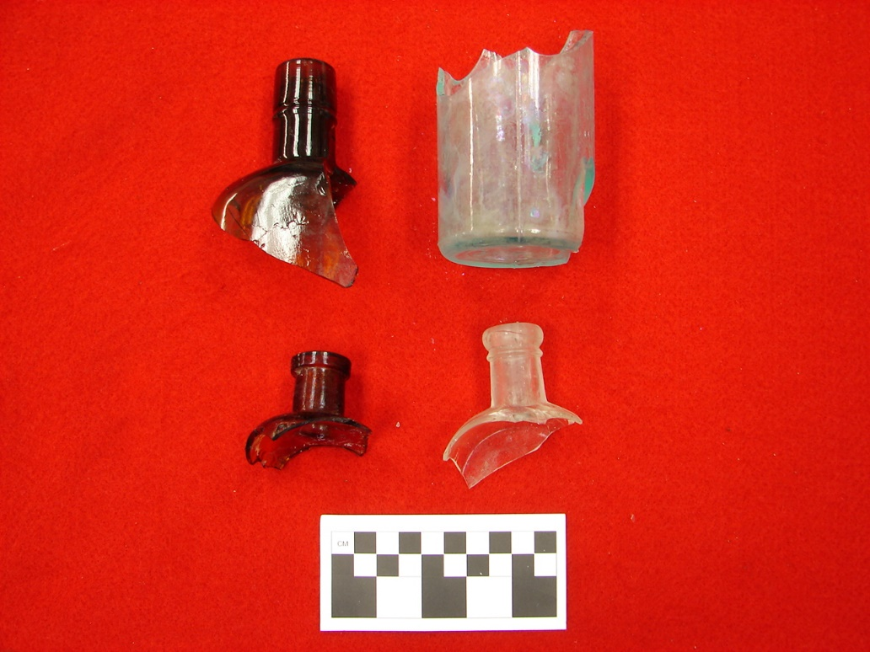
Notes:
Historic artifacts are remnants left from activities associated with a place. Historic artifacts commonly found are ceramics, glass bottles, toys, clothing, or other person items, structural remains (nails, brick), metal objects, or animal remains.

Slide 15
Native American sites encountered
Flakes, pottery, bifaces or other tools, arrowheads, or fragments
Rock piles (possible burials)
Notes:
The changing landscape may have destroyed or just obscured signs of Native American occupation. Common artifacts associated with Native Americans are flakes, pottery, bifaces, arrowheads or their fragments.
There are also rock piles arranged in a certain pattern that could be possible burials. Sometimes, this is associated with the Trail of Tears removal corridor.

Slide 16
Stipulation XII in the PA : Treatment of Human Remains
Procedures
Halt construction in a 200-foot buffer
Secure the area – flag or fence off are and cover remains with a canvas tarp
Notify ArDOT Cultural Resources personnel
ArDOT Cultural Resources shall notify the Chief Medical Examiner and consulting parties.
Identify remains
Plan for avoidance, minimizing, or mitigating
If cannot avoid by redesign, then the consulting parties will have to agree upon a plan.
Follow plan and document findings
Once cultural resources have received approval, then work can continue in that area.
Notes:
Stipulation XII covers the findings of human remains/graves/burial goods.
Discovery of Human Remains – any bone found needs to be assessed to determine if it could be human remains. ARDOT archeologist has to assess if it is human bones. If they are human, then we are required to notify law enforcement and the Chief Medical Officer, to see if it is a crime scene. If not, then consult with SHPO, and try to find the ancestors, if possible. If the remains are not historic, then we consult with Native American tribes.
Knowingly disturbing human remains and associated burial artifacts violates the Arkansas Burial Law of 1991 and can result in penalties and possible jail time.

Slide 17
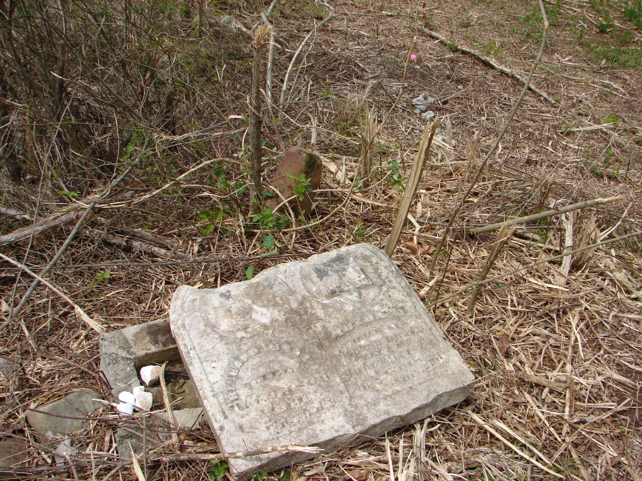
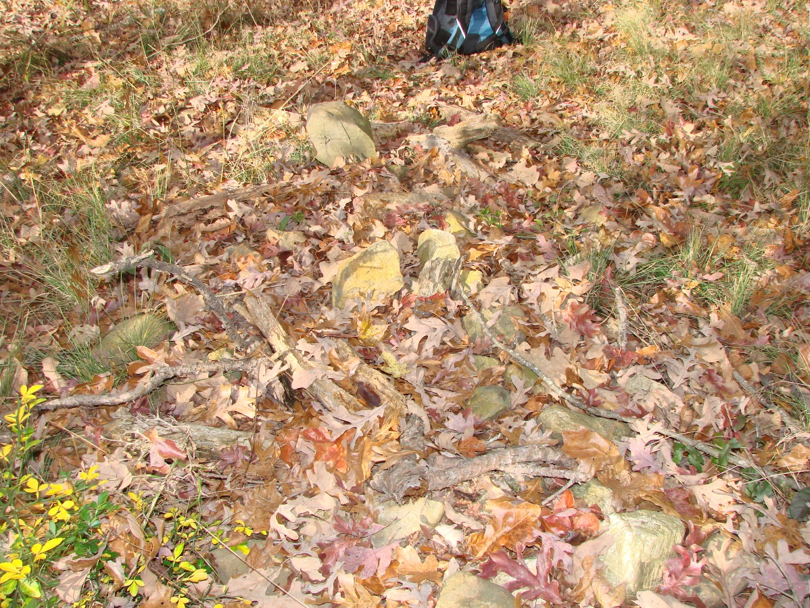
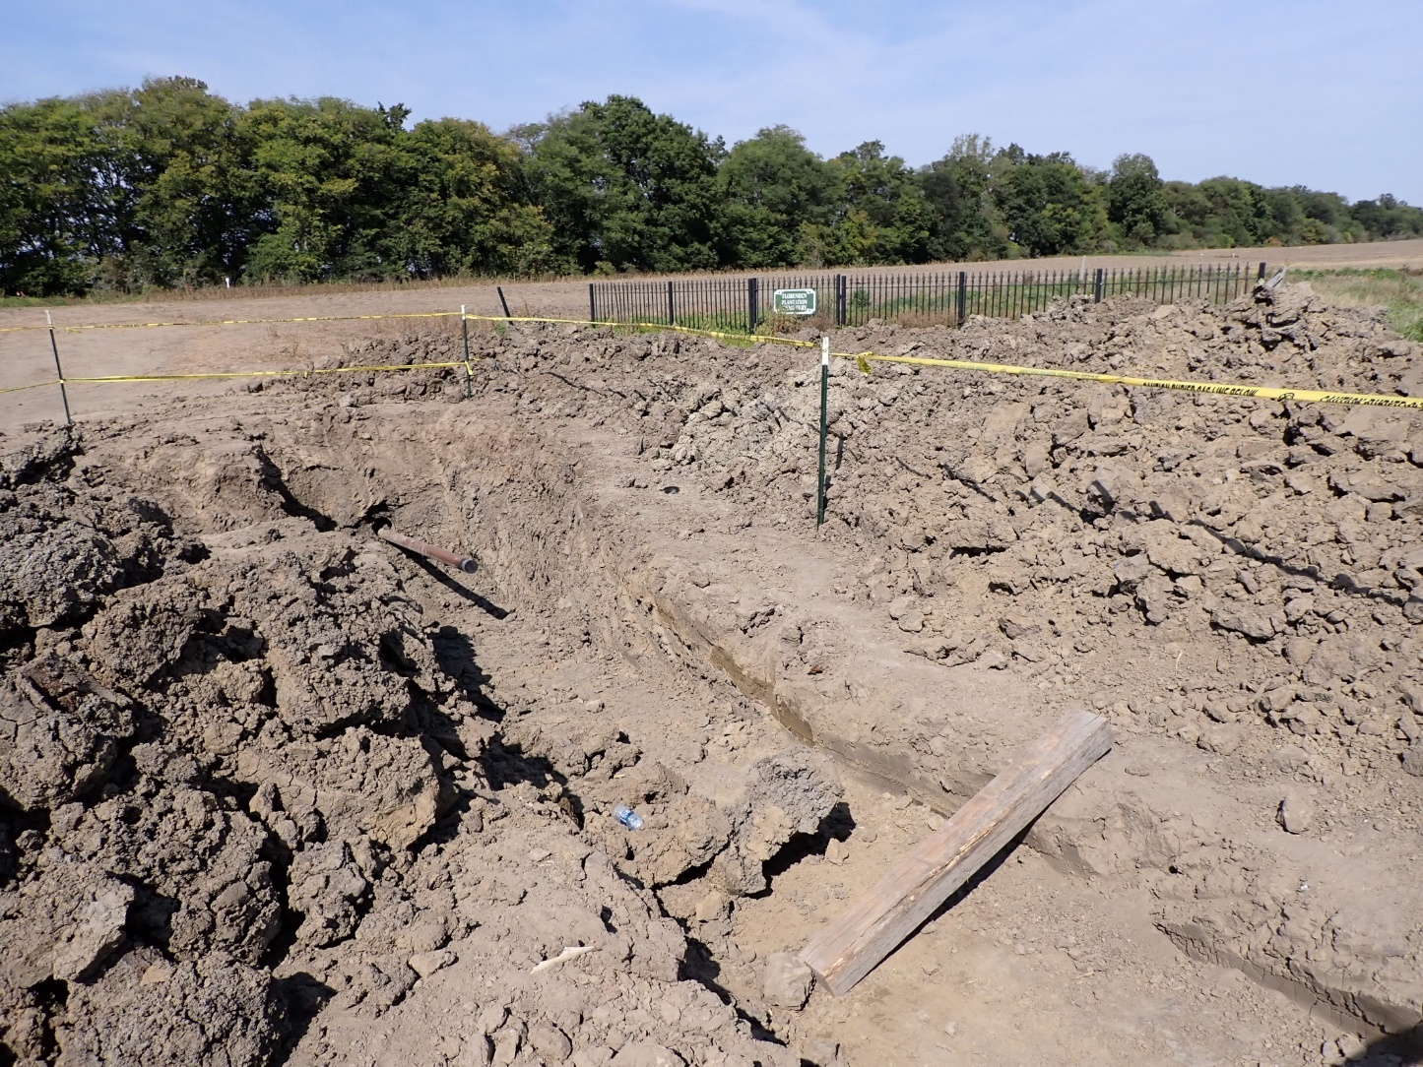
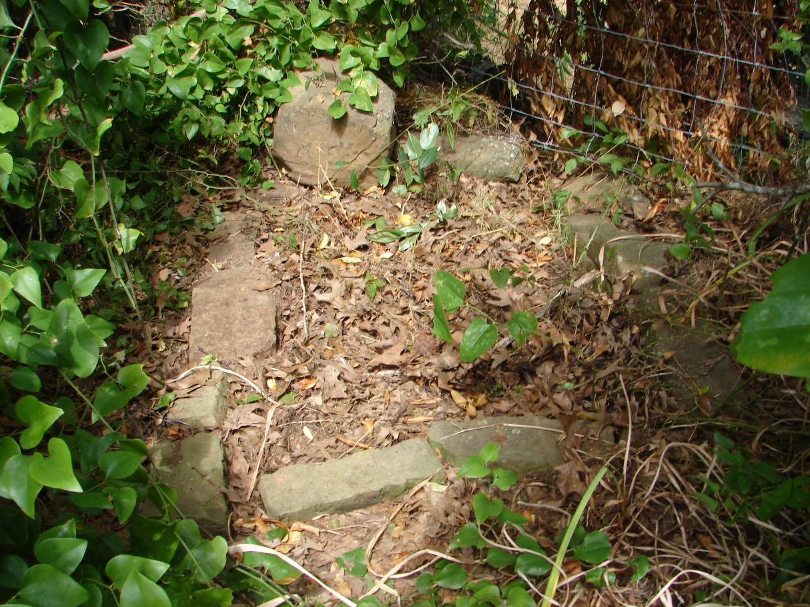
Notes:
Examples of graves found can be varied depending on the location or circumstances. Graves reported by a landowner. In the 1870s, a local family history reported that thieves were pillaging the area. These thieves were finally caught and killed by vigilantes and buried where they were captured (there were six graves at this spot). Each grave covered by native stones. Fortunately, these graves were located away from the project area.
We had graves within or close to our existing ROW. The one in the upper left corner is off Hwy. 10 right on our existing ROW and the one in the bottom left corner was adjacent to the existing ROW and within our proposed ROW. We relocated the burial to a cemetery at the request of a property owner/descendant.
We recently had a discovery situation with human remains found by the gas utility company when they were relocating their line. It was a burial located outside of what we thought were defined cemetery boundaries. As it turns out, the landowner just erected an arbitrary fence after the farmer plowed up human remains in the late 2000s. We were notified and went through the proper procedures to get this situation corrected.
We never wish to cause delays or shut down job sites for an extended period time. These procedures are in place to eliminate delays and keep the process going.

Slide 18
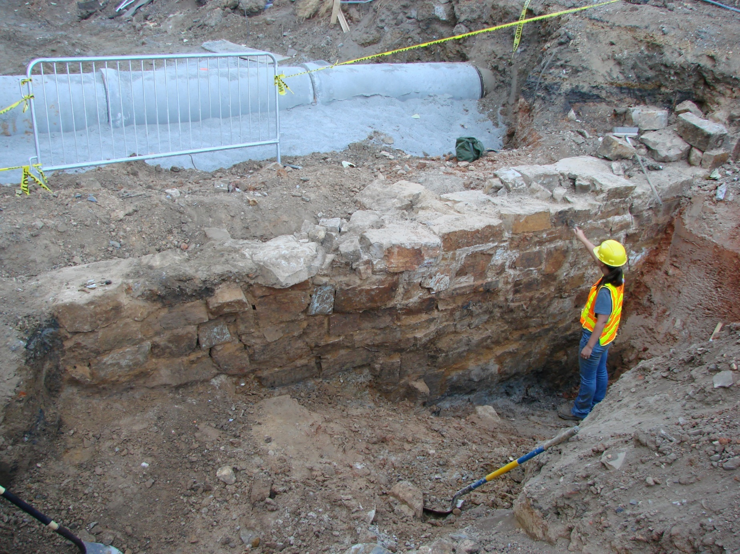
Questions
Notes:
While the Cultural Resources Section has processes to identify these resources prior to construction, Special Provisions, Section 106 Programmatic Agreement, and Supplement Specs. afford additional protection to these resources during construction. And no matter what you do, some jobs just never go away.

