Slide 1
Response Planning for Transportation Emergencies and Disasters
2023 Transportation Research Committee Annual Conference
May 23 - 25, 2023 / Hot Springs, AR
An overview of emergency action planning standards and practices
Aaron Adams, mep, mcp
Emergency management coordinator
Ardot maintenance division

Slide 2
First Things First……
There are several KINDS of Response Plans, AND there are several TYPES of Response Plans:
Kinds of Response Plans
Strategic
Tactical
Contingency
Types of Response Plans
Frameworks & Playbooks
All-Hazards Response Plans
Joint Operations Plans
Action Plans
Today's presentation is focused on Strategic and Tactical Action Planning.

Slide 3
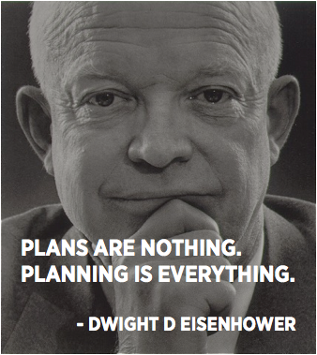
ARDOT Action Planning
Action Planning
Can occur pre- or post-event
Must include the personnel that will execute / implement
Informed by impact scope of the event, risk to personnel and the public, and policy
The planning process must generate a product that identifies: WHO will do WHAT under SPECIFIED CONDITIONS in an EXACT LOCATION in a SPECIFIED TIMEFRAME and under WHOSE AUTHORITY
The Action Plan is couched in the Three Universal Response Priorities (IAW the National Incident Management System [NIMS]):
Life Safety
Property / Environment Protection
Incident Stabilization
Common Operating Picture, Communications procedures, and Safety Messaging are critical components that CANNOT be left out

Slide 4
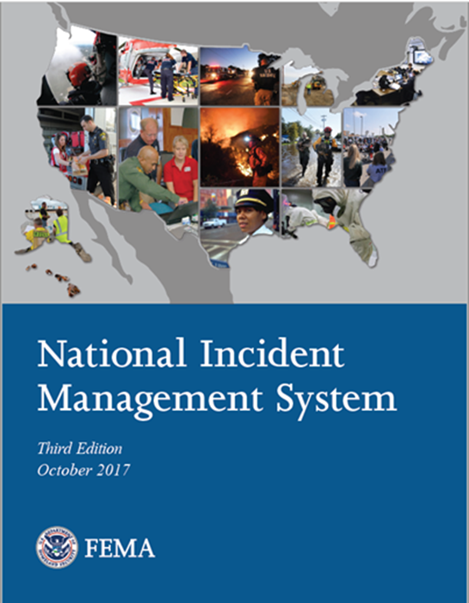
ARDOT EOC: Strategic and Tactical Planning Interface
The ARDOT EOC bridges Strategic efforts at the HQ level with the Tactical efforts occurring in the Districts.
The development process and distribution of the Action Plan is managed by the EOC Planning Section.
The implementation of the Action Plan is managed by the Operations Section.
The EOC Manager is responsible for ensuring that the development and implementation processes are conducted efficiently and in accordance with policies and directives.
All of these activities are components of ARDOT’s mandatory implementation of the National Incident Management System (NIMS).

Slide 5
The EOC Action Planning Process

Slide 6
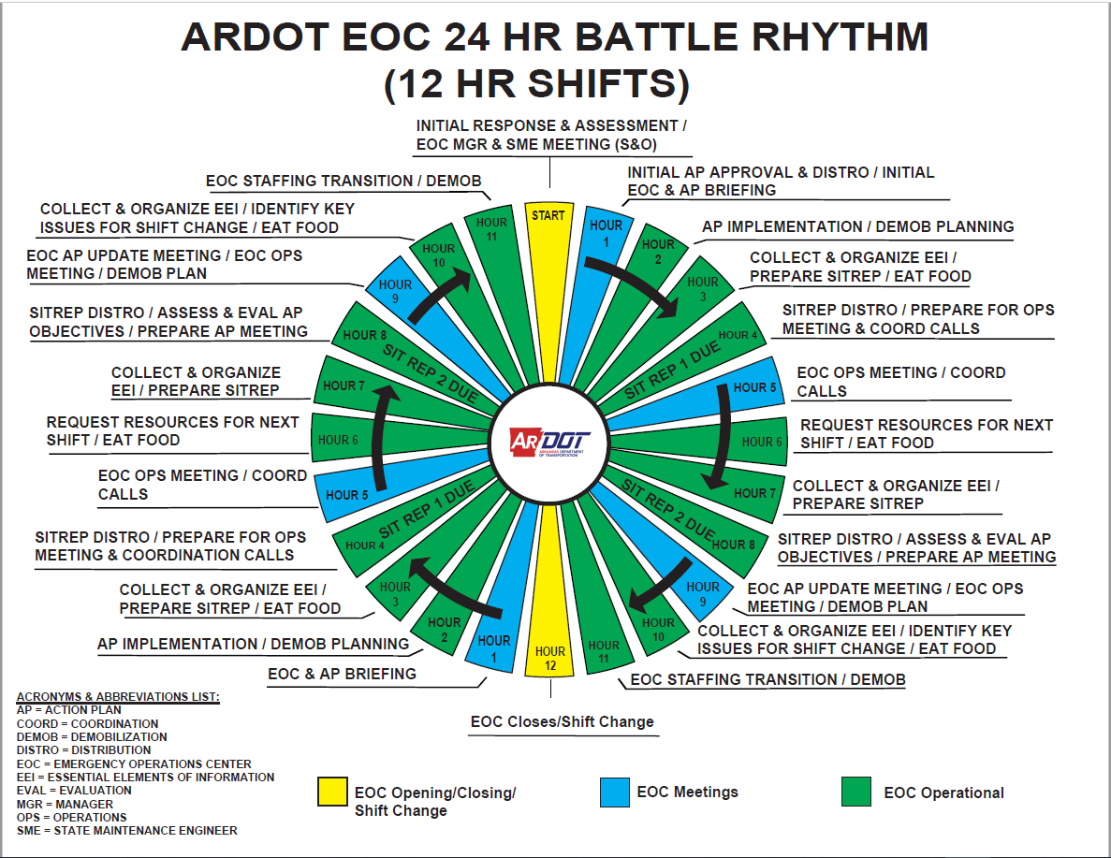
Operational Battle Rhythm

Slide 7
Why is this important to ARDOT?
As stated earlier, an Action Plan is necessary to determine who will do what in a certain scenario, and most importantly, determines:
WHO has authority:
In most disaster scenarios this is shared amongst multiple Authorities Having Jurisdiction (AHJ)
AHJ is typified by statutes, ordnances, and/or regulatory codes that specifically identify agencies, departments, offices, and/or individuals as responsible for managing the incident, making life-saving decisions, and enforcing procedures and standards of a code.
WHO is in charge:
Utilization of the National Incident Management System (NIMS) ensures that the appropriate and legally obligated entities have COMMAND AUTHORITY of the situation AT THE SCENE of the event as well as appropriate COORDINATION CAPABILITY at HQ to support the on-scene response.
This is accomplished by utilizing the Incident Command System (ICS) and Emergency Operations Center management (both being key components of the NIMS).

Slide 8
Okay…but really, why is this Important to ARDOT??
0745 CST, MAY 26, 2002

Slide 9
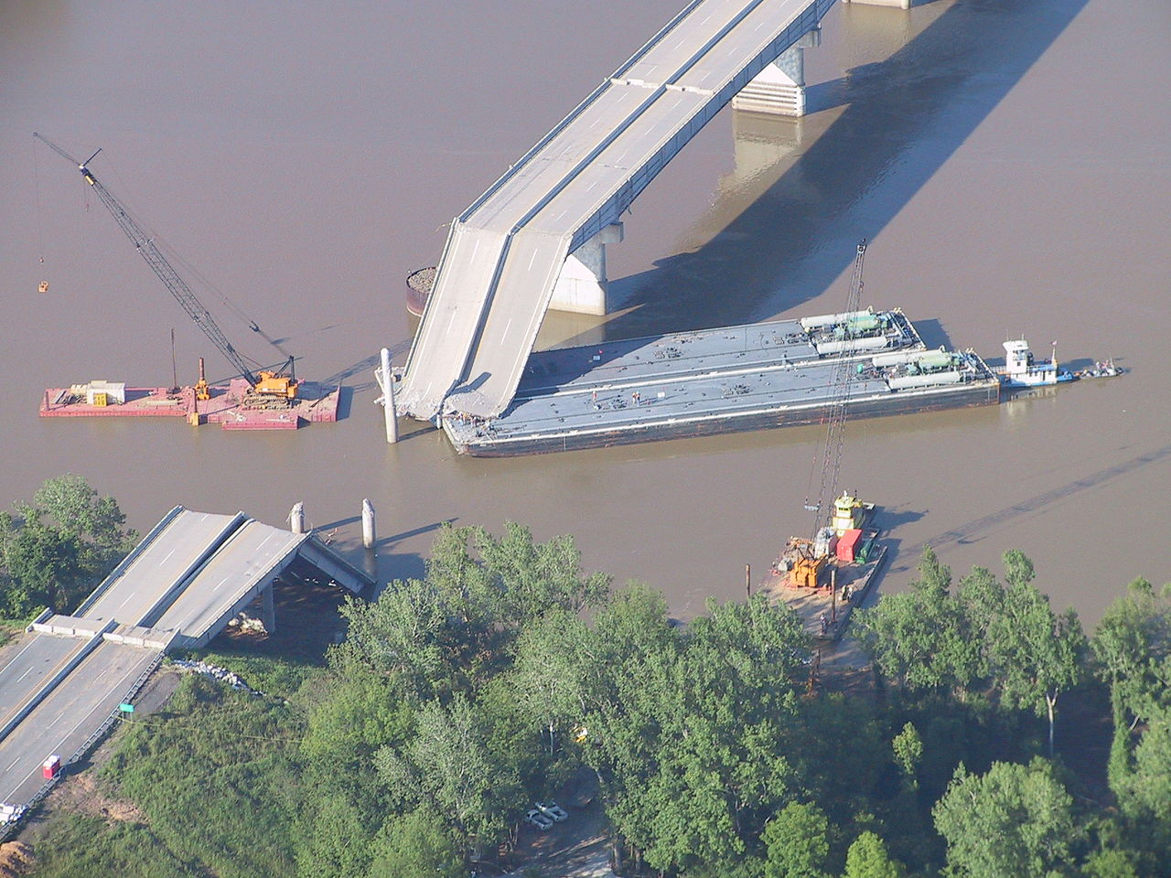
I-40 Bridge Disaster – Webber Falls, Oklahoma
Barge Strike resulting in a collapse of a 580-foot section of the I-40 bridge into the Arkansas River
8 passenger vehicles and 3 semi-trucks fell into the water or on top of collapsed pieces of the bridge
14 fatalities
11 serious injuries
Survivors were rescued by local anglers participating in a bass tournament
~ 20k vehicles per day re-routed for 2 months while repairs were made

Slide 10
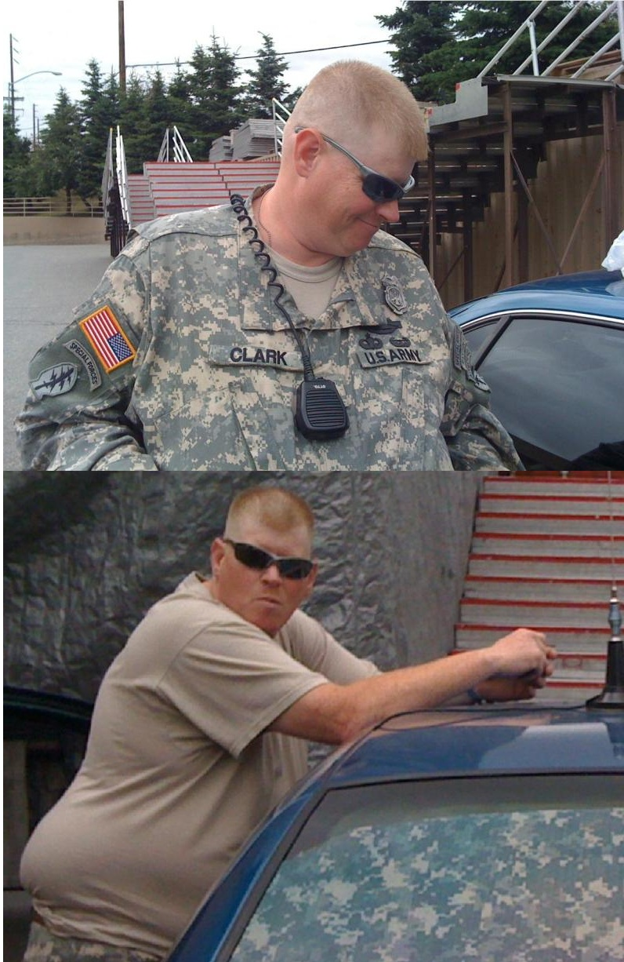
William James Clark
Two time convicted felon.
Happened to be in the area at the time of the event.
Took advantage of the initial response confusion.
Arrived at the scene impersonating a US Army Captain and took control of the scene for 2 and a half days.
Directed FBI agents investigating the scene.
Ordered resources for recovery efforts.
Denied the Governor of Oklahoma’s request to conduct a press conference near the scene.
Stayed at local hotels free of charge.
“Commandeered” a response truck from a local car dealership.
Acquired free meals and “response equipment” from local businesses.
Made false claims that he personally rescued a mother and child from the bridge.
Accused the local responders of “bumbling the response” and causing fatalities.

Slide 11
Consequences for Mr. Clark
Mr. Clark fled the scene two and a half days later after local responders challenged his credentials.
He was arrested several days later in Toronto by the Mounties and extradited back to Oklahoma where he plead guilty to multiple felony charges.
He was sentenced and served 5 years in federal prison; Clark was released in September of 2007.
Shortly thereafter he resumed his felonious behaviors including check fraud, theft, impersonating a federal official, and calling the Russian Embassy to inform them of a plot to assassinate Russian President Vladmir Putin.

Slide 12
WHO IS IN CHARGE?
When a vacuum of command, action planning, public interface, and technically proficient response coordination occurs, these vacuums WILL ALWAYS be filled by someone.
Who will that someone be?

Slide 13
Action Planning is not a Best Practice, It’s a Requirement
The public expects, and rightfully deserves, to have effective government services before, DURING, and after a disaster.
Our ability to develop and implement effective Action Plans comes through:
Training
Exercises
Real-World experience
Winter Weather Events has provided ARDOT with a regular interval of practice in developing and implementing Action Plans.

Slide 14
2023 Winter Weather Action Plans

Slide 15
“We do not rise to the level of our expectations. We fall to the level of our training and experience.”
- Archilocus, 650 BCE

Slide 16
Want more information about the ARDOT Emergency Management Program?
Michael Kelly, PE, PS
Staff Maintenance Engineer
501-569-2095 office
501-837-6519 mobile
Michael.Kelly@ardot.gov
Aaron Adams, MEP, MCP
Emergency Management Coordinator
501-569-2977 office
501-258-9905 mobile
Aaron.Adams@ardot.gov

