Slide 1
Wildland Fire and Infrastructure
Robert Murphy

Slide 2
What is the relationship between wildland fire and infrastructure?

Slide 3
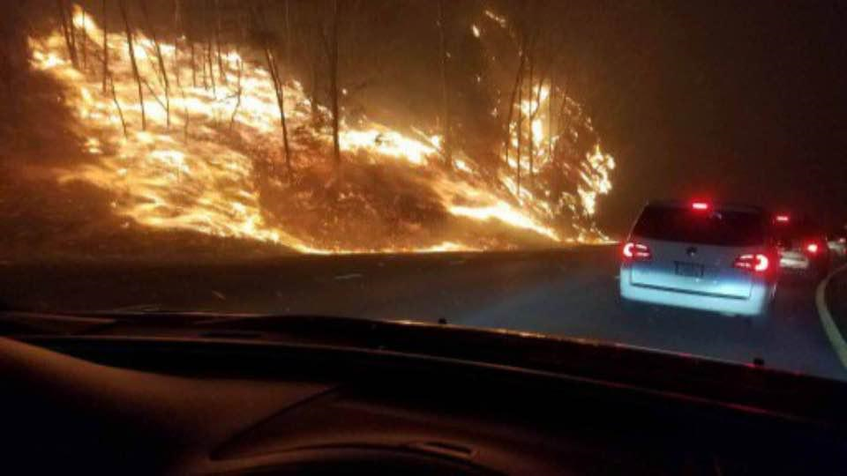

Slide 4
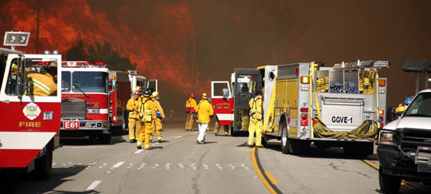

Slide 5
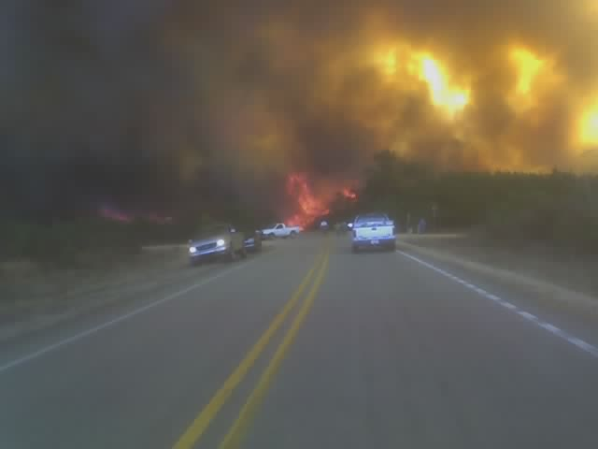
Wildland Fire and Infrastructure
Robert Murphy

Slide 6
Wildland Fire and Infrastructure
Robert Murphy

Slide 7
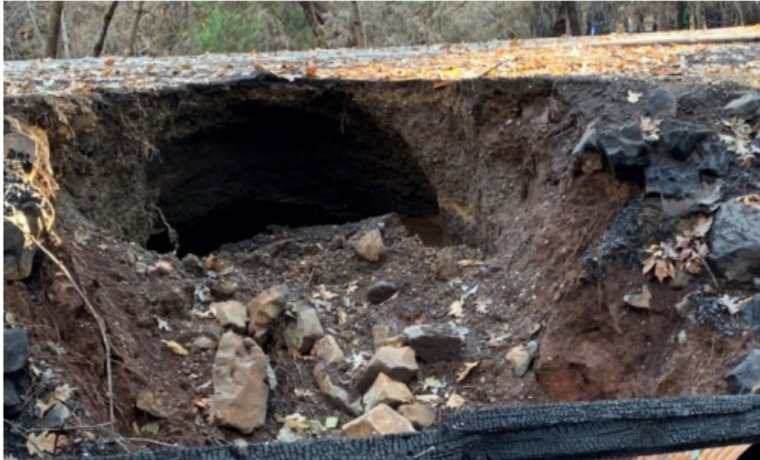
Wildland Fire and Infrastructure
Robert Murphy

Slide 8
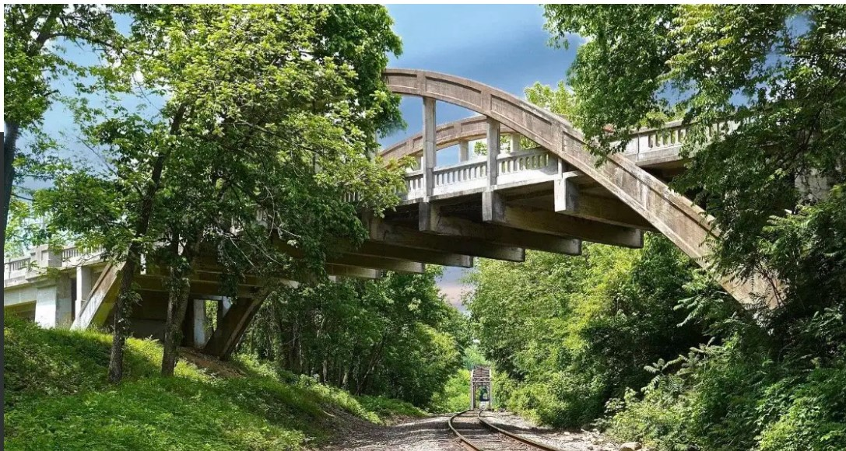
Wildland Fire and Infrastructure
Robert Murphy

Slide 9
How can we minimize the impacts of fire?

Slide 10
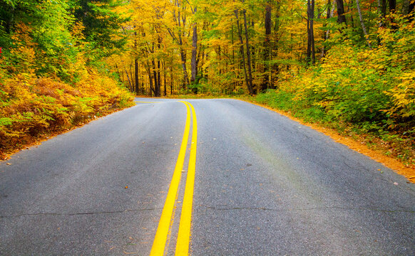

Slide 11
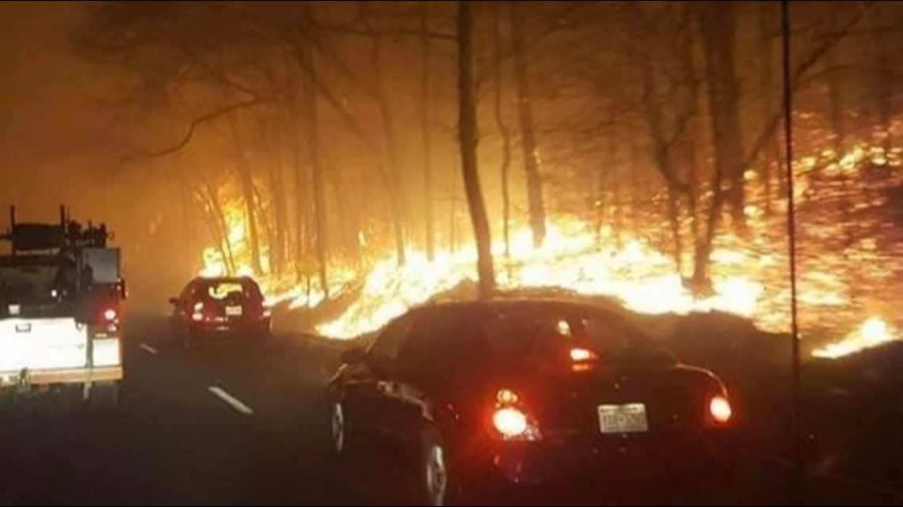

Slide 12
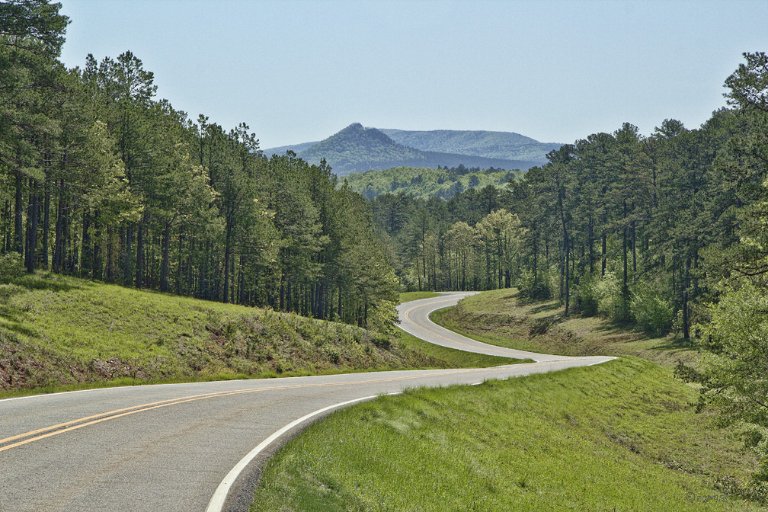

Slide 13
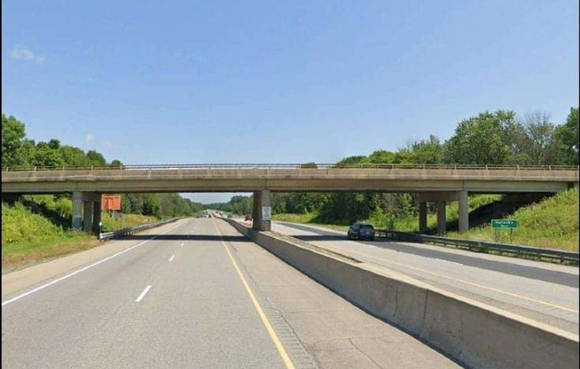

Slide 14
Questions?

