Slide 1
Type IL
Portland-Limestone Cement
2023

Slide 2
Type IL
Portland-Limestone Cement
Learning Objectives:
What is Portland-Limestone Cement?
Why is PLC even a “thing”, and Why should I care?
How is PLC made, and How does PLC work in concrete?

Slide 3
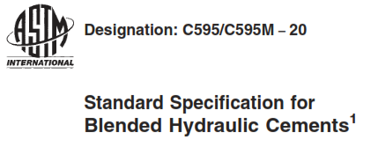
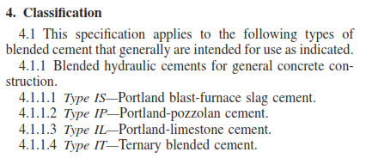
What is PLC?
Modified formulation of portland cement
  Complies with ASTM C595
  Allows 5 to 15% replacement of clinker using interground limestone (typically 10-12%)
  Designed with similar chemistry and physical requirements as OPC
The naming practice for blended cements:
  Binary blended cement with 90% portland cement and 10% limestone = Type IL(10)
  Table 5 allows a range of ±2.5% from the target value of limestone addition.

Slide 4
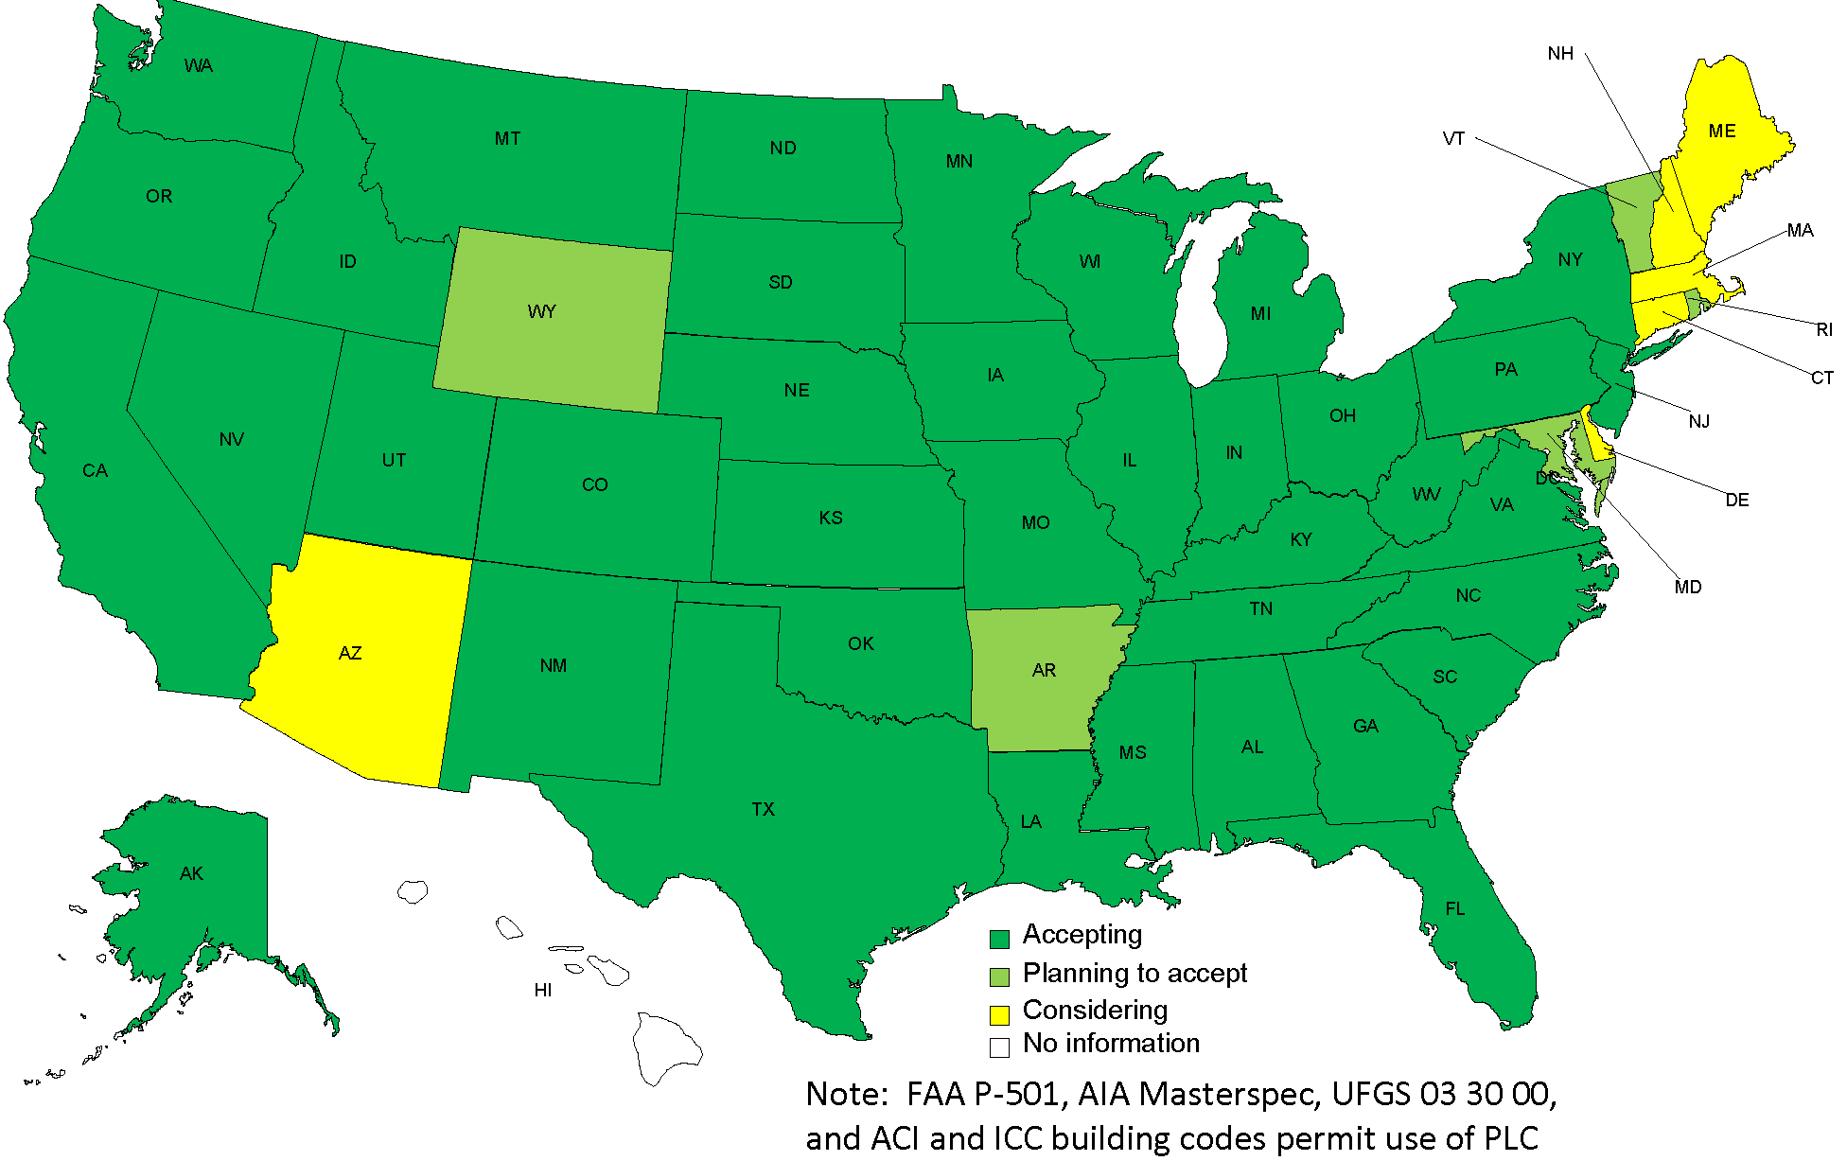
Why is PLC even a “thing”?
Blended cements have been around since 1965, used in Europe and Canada, and Type IL cement was adopted into ASTM C595 / AASHTO M 240 in 2012.
Reduction in Greenhouse Gas (GHG) equivalents, or CO₂ emissions in cement manufacturing by replacing some of the clinker with limestone;
Lower clinker factors (~83%) allow more cement to be made from less clinker with lower CO₂ emissions.
Permitted by Codes, Standards & Specs:
  ACI 318, ACI 301, ASTM C94 & AIA MasterSpec
Producing PLC
State DOT Acceptance of PLC, as of December 2021

Slide 5
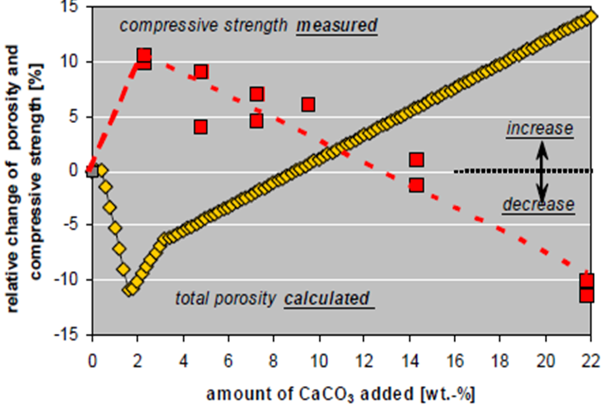
Why 15%?
Based on experience in Europe & Canada, concrete strength decreases at approx. 12-15% limestone addition to a level below the reference concrete strength using OPC.
As a result of interground limestone addition, higher concrete density should result in higher concrete strength.
Matschei, T., et al, “Relationships of Cement Paste Mineralogy to Porosity and Mechanical Properties,” presentation at International Conference on Modelling of Heterogeneous Materials with Applications in Construction and Biomedical Engineering, Prague, Czech Republic, 25-27 June 2007b.
Notes:
Based on European and Canadian experience, cements with up to 15% limestone can have equivalent performance to portland cements. The red line here refers to data for the relative compressive strength at various levels of limestone. Compressive strength increases by up to 10% with 3% limestone; as limestone contents increase, strength is still higher, but decreasing until about 12 to 15% limestone. The yellow line proposes one reason. It is based on particle packing and thermodynamic modeling that shows how porosity decreases with increasing amounts of limestone up to about 10% or 12%. Denser mortars and concretes are stronger. The base cement characteristics and limestone properties (PSD) will shift these curves somewhat.
The impact of the several small effects add up to a small but measurable impact on real properties, such as strength.
Matschei, T.; Glasser, F. P.; Herfort, D.; and Lothenbach, B., “Relationships of Cement Paste Mineralogy to Porosity and Mechanical Properties,” presentation at International Conference on Modelling of Heterogeneous Materials with Applications in Construction and Biomedical Engineering, Prague, Czech Republic, 25-27 June 2007b.

Slide 6

How is PLC Made?
Ordinary Portland Cement is made by grinding clinker (the main energy-intensive ingredient) along with gypsum and limestone into a fine powder.
Currently, OPC is made with up to 5% interground limestone; PLC is made by intergrinding 5% to 15% of a high grade limestone. Both products use the same clinker, there’s just less of it in a ton of portland-limestone cement.
The limestone is subjected to three quality assurance tests prior to its use in manufacturing PLC:
  Calcium Carbonate Content
  Clay Content (Methylene Blue Index)
  Total Organic Carbon Content
Limestone

Slide 7
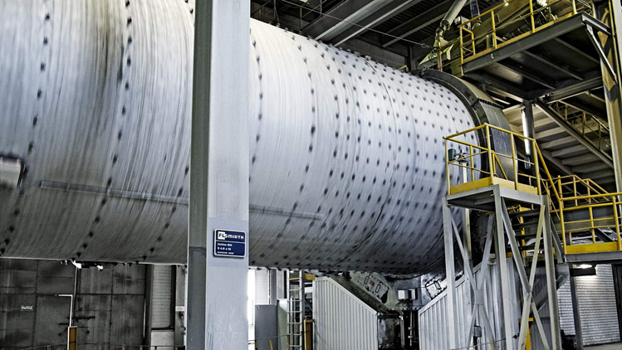
How is PLC Made?
Modifications to material handling belts or feeders at the cement plants may be required to accommodate the larger ratio of limestone going into the finish mills (often designed to handle up to 5% limestone or gypsum).
In order to achieve “equivalent performance” when compared to concrete made with OPC, PLC will necessarily exhibit a higher fineness, which can reduce finish mill production.
  Typically expect ~8 to 10 m²/kg increase in Blaine fineness for every 2% addition of interground limestone.

Slide 8
Impact on Concrete Producers:
(New) Product Development
Ideas &
Research →
Strategic
Planning →
Development
& Testing →
Product
Launch →
The product is already in the market, and DOT approved* (some DOTs may require additional testing for mixture validation);
Equivalent performance.
Consider which of your plant(s) will provide PLC to which customers or types of work;
How will PLC be integrated into your plant system?
Compare fresh and hardened properties in mixtures using PLC vs. Type I,II cement; adjust Admixture dosage or SCM replacement % to achieve desired results; Submittals.
Finalize product positioning and pricing; coordinate logistics; promote structural & environmental benefits.

Slide 9
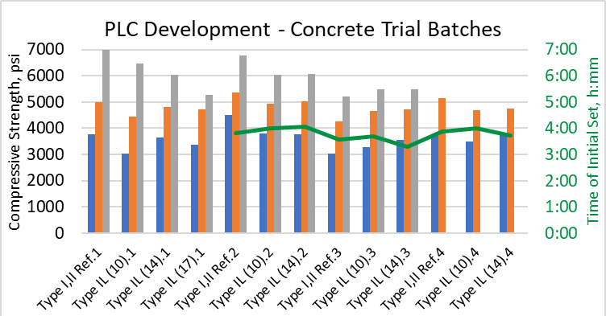
How does PLC work in concrete?
Key benefits of using PLC in concrete:
Stronger
Better setting times *
Improved finishability
Better durability *
Better for the environment
Setting times may be slightly faster, and can be optimized using mineral and chemical admixtures as needed.
Ideas & Research
Durability is typically achieved through the use of SCMs and lower w/cm ratios as compared to concrete mixtures using OPC;
PLC makes those durability properties better.
Reduction in CO₂ emissions of approx. 8 to 10%, primarily by lowering the clinker factor in finished cement using interground limestone.

Slide 10
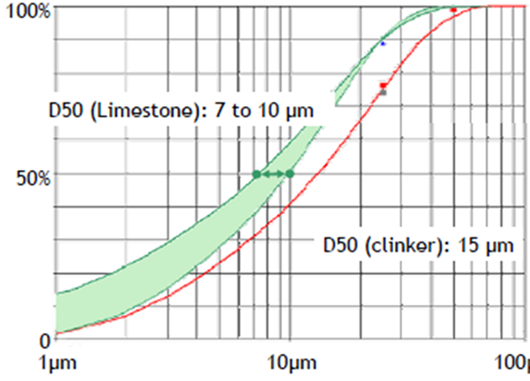
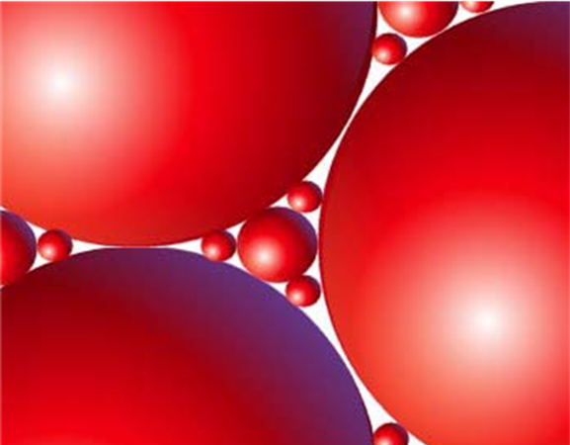

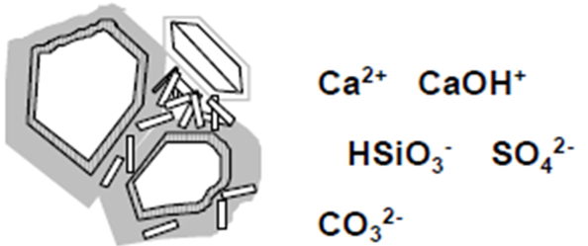
How does PLC improve concrete?
Three primary mechanisms:
Denser packing of cement paste due to limestone fineness and particle size distribution (can actually reduce the water demand).
Increased nucleation sites for growth of cementitious products during hydration.
Chemical reactivity – particularly Calcium CarboAluminates – which decrease porosity and improve durability.
Ideas & Research
http://www.firstrays.com/particle_packing.htm
Matschei et al 2007

Slide 11
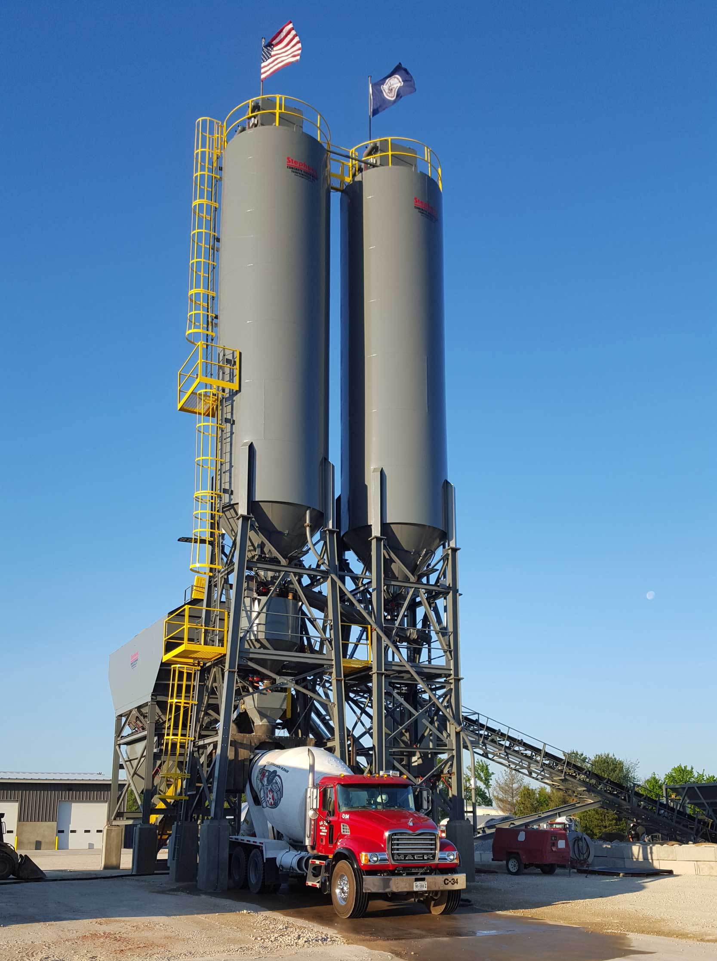
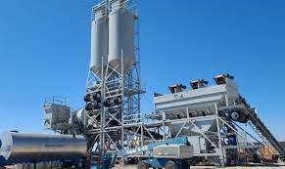
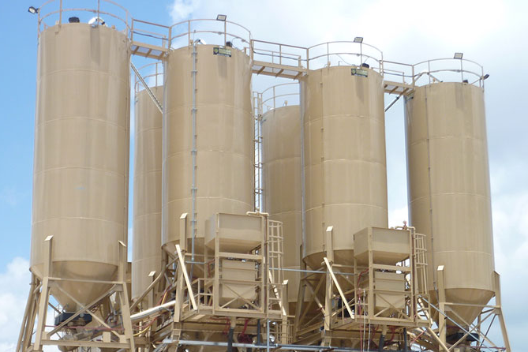
Impact on Concrete Producers:
Logistics
After conducting comparison testing and successfully developing mixtures using PLC, it’s necessary to determine where the cement is going to go:
  Some choose to ADD PLC to one of their existing silos;
  Some choose to ADD an additional silo to their plant;
  Some choose to REPLACE Type I,II with PLC.
Must coordinate tankers, silos, products and mix designs.
Strategic Planning

Slide 12
Impact on Concrete Producers:
Product Development & Testing
Collect materials and test common mixtures, comparing the performance of Type IL mixtures vs. Reference Type I,II mixtures.
Consider testing with different Admixtures to evaluate dosage
and setting characteristics at various temperatures.
As with any other source change, make adjustments to PLC mixture proportions as needed to achieve optimum results.
Development & Testing

Slide 13
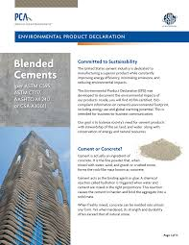
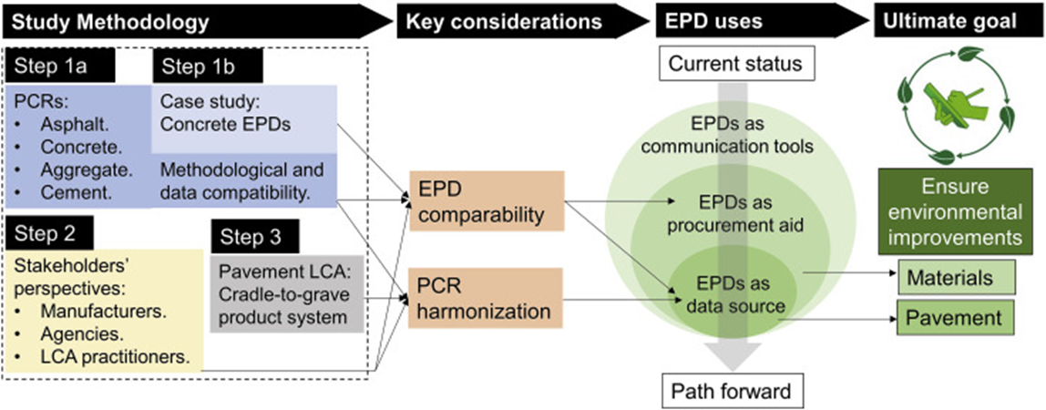
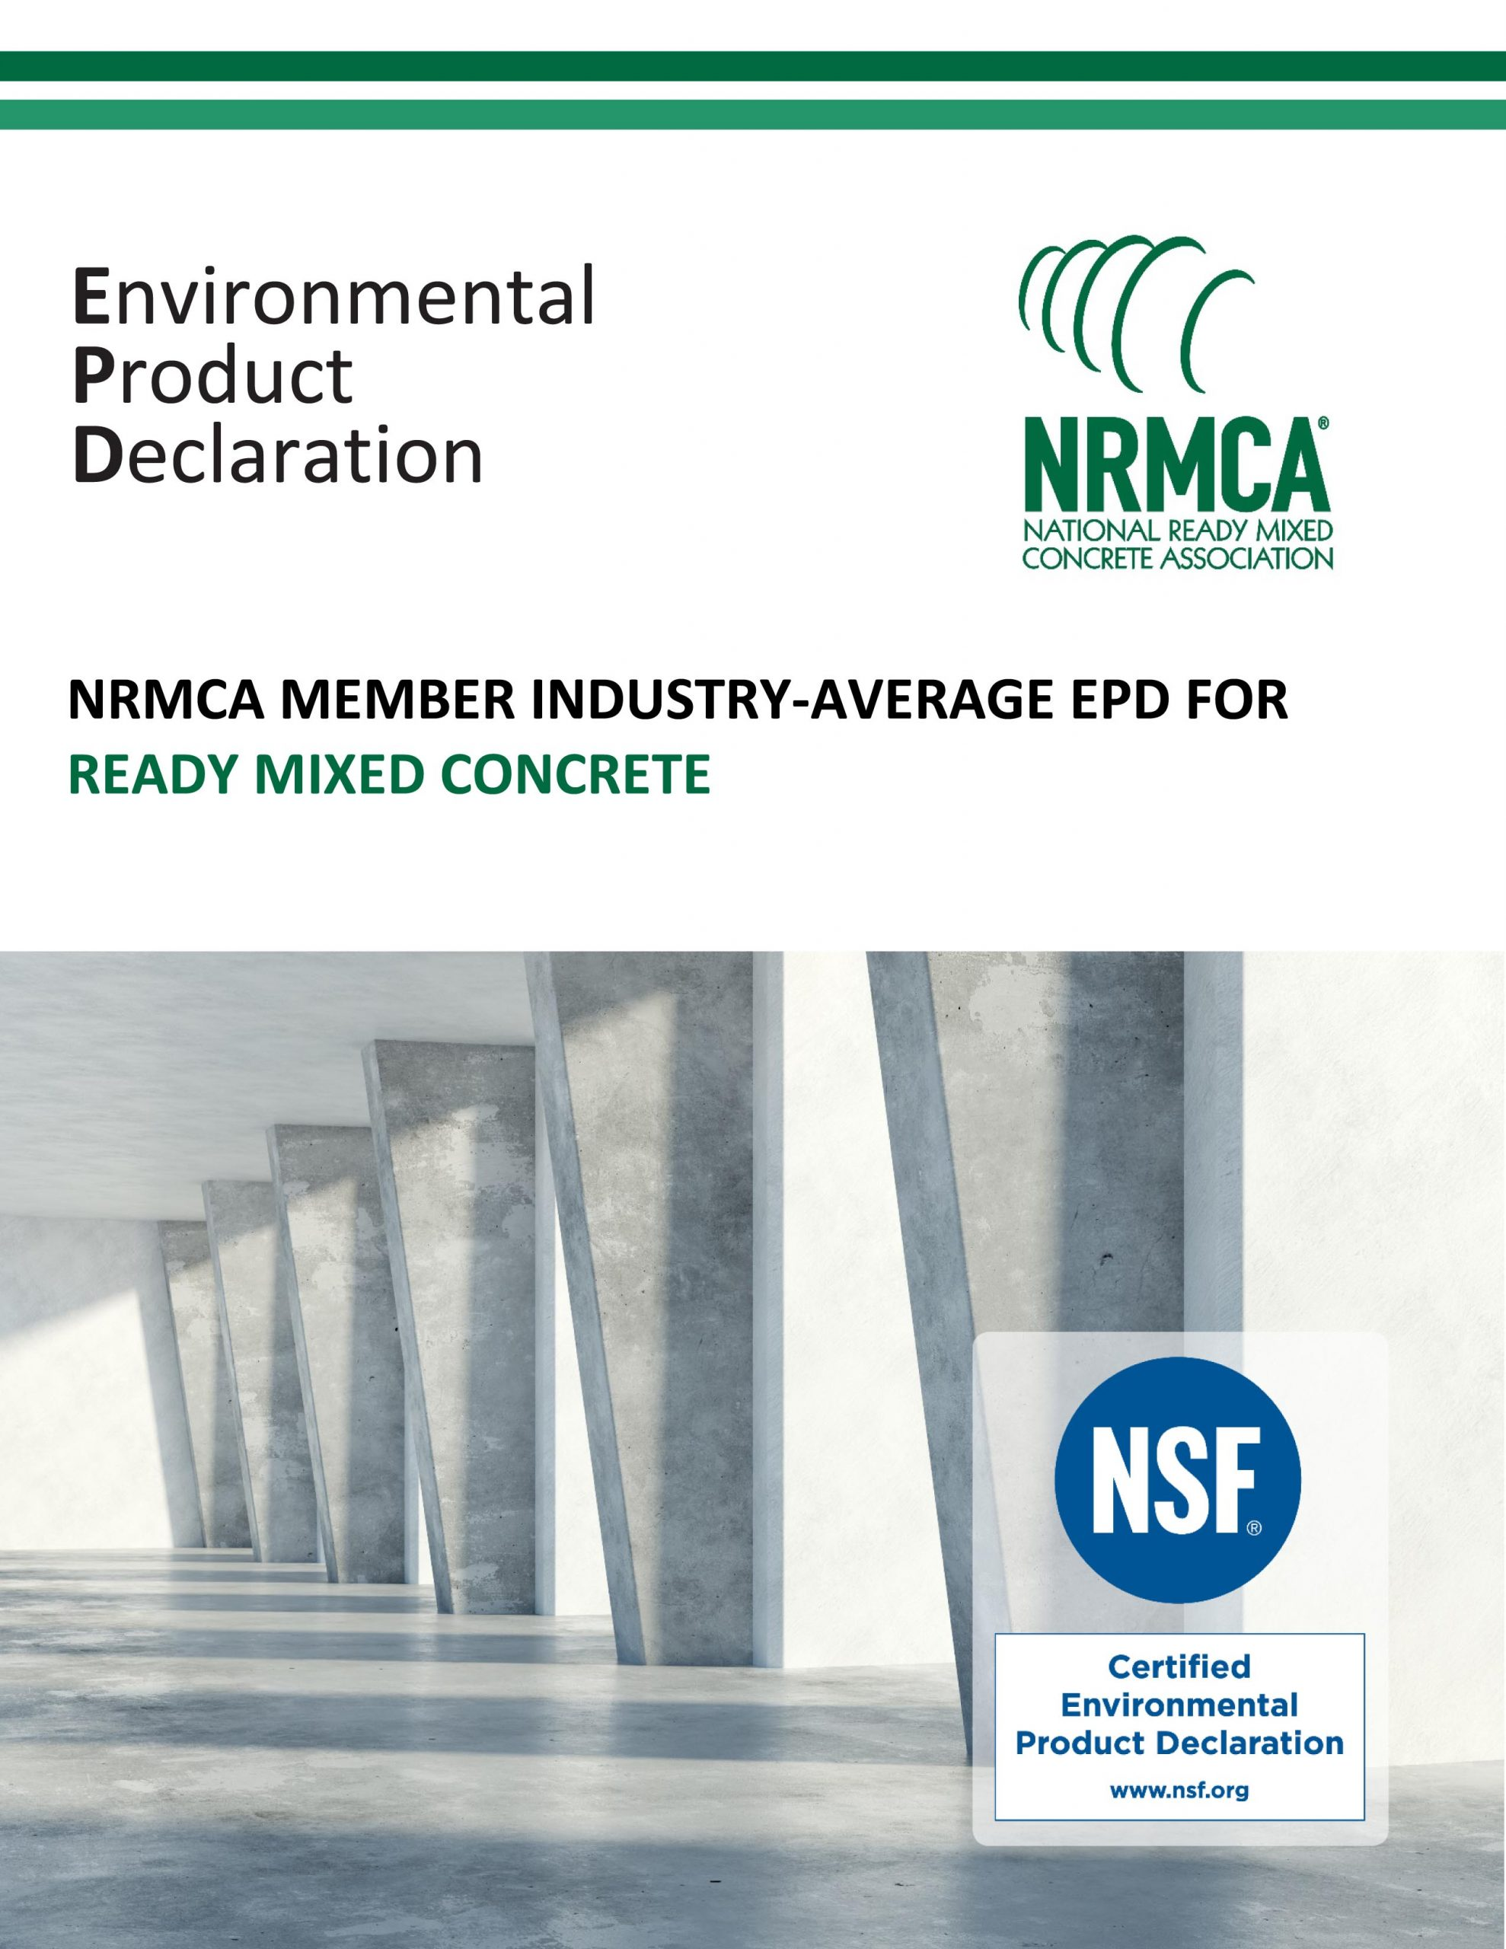
Impact on Concrete Producers:
Environmental Product Declaration
PCR → LCA → EPD (NRMCA Industry Member Avg. for Ready Mixed Concrete)
Development & Testing
Note 1
1: www.nrmca.org/wp-content/uploads/2020/02/NRMCA_LCA_ReportV3_20200416.pdf
2: www.nrmca.org/wp-content/uploads/2020/02/NRMCA_EPD10294.pdf
Note 2

Slide 14
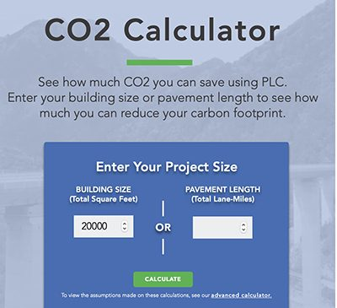
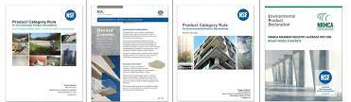
Impact on Concrete Producers:
Product Launch, Promotion
Updated concrete submittals reflecting PLC
Decide whether to use Industry Average EPD values or pursue self-declared EPDs for specific concrete mixtures
Product Launch
Cement PCR
Cement EPD
Concrete PCR
Concrete EPD
https://www.greenercement.com

Slide 15
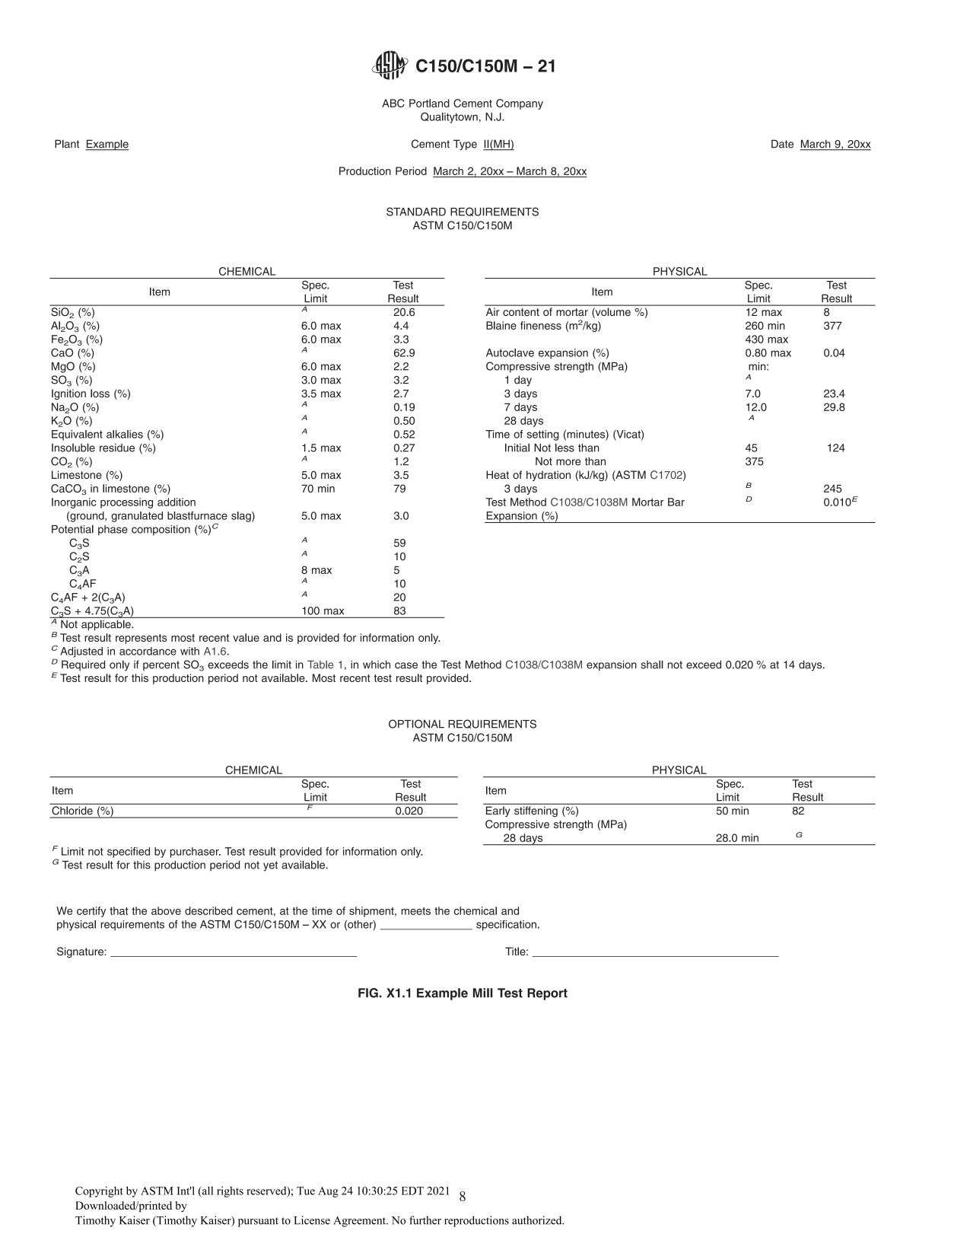
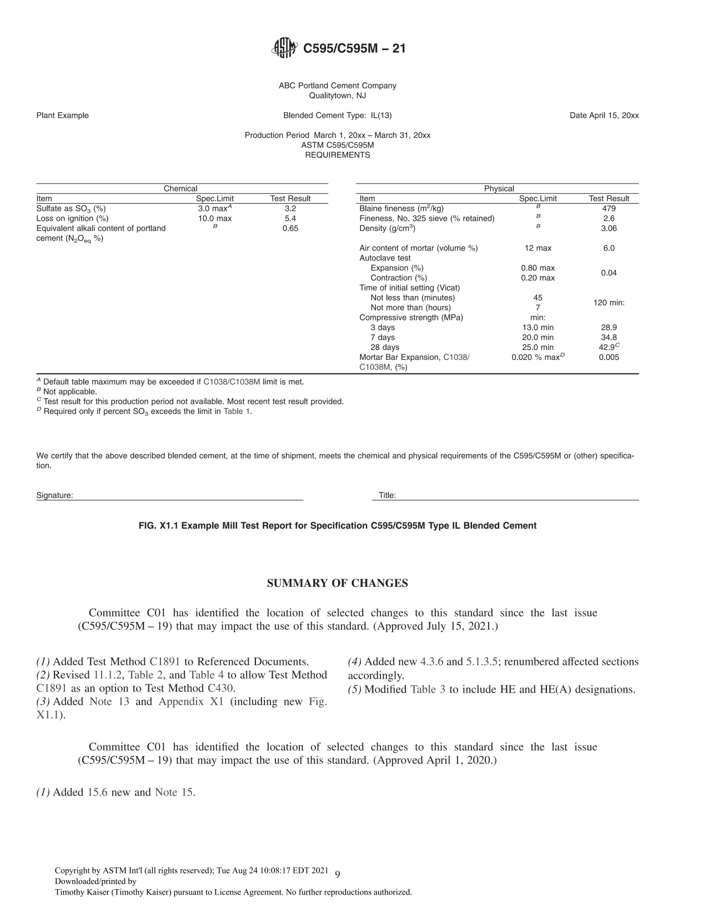
Mill Test Reports: C595 vs. C150
There are fewer Chemical requirements in C595 than in C150, with the emphasis on the Physical properties of cement.

Slide 16
C595 Footnotes:
^{A} Default table maximum may be exceeded if C1038 limit is met.
^{B} Not applicable.
^{C} Test result for this production period not available. Most recent test result provided.
^{D} Required only of percent SO₃ exceeds the limit in Table 1.

Slide 17
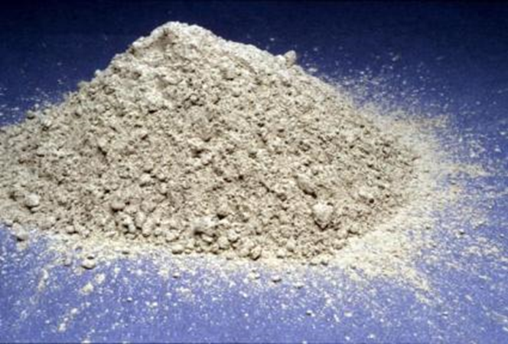
PLC Summary
Type IL cement
  is an optimized blended cement manufactured to comply with the requirements of ASTM C595;
  combines finely ground cement clinker, gypsum and up to 15% limestone;
  is formulated to provide equivalent strength and durability properties of concrete mixtures using Ordinary Portland Cement;
Concrete made with Portland-Limestone Cement:
is proportioned, mixed, handled and finished the same;
can be used in the same applications as concrete made with OPC;
has enhanced durability properties using the same strategies as OPC.

Slide 18
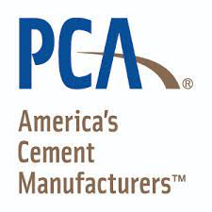
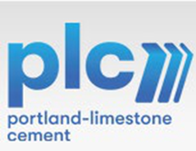



for more information…
Portland Cement Association – https://www.cement.org
CO₂ Calculator - https://www.greenercement.com
State-of-the-Art Report on the Use of Limestone in Cements at Levels of up to 15%, Tennis, P., Thomas, M.D.A., Weiss, J., SN3148 - PCA 2011
Performance of Portland Limestone Cements, Barrett, T., Sun, H., Nantung, T., Weiss, J., https://doi.org/10.3141/2441-15 , TRB 2014
Concrete Construction – The Advantages of Portland-Limestone Cement, August 12, 2014 www.concreteconstruction.net
Relationships of Cement Paste Mineralogy to Porosity and Mechanical Properties / Matschei, T., Glasser, F.P., Herfort, D., Lothenbach, B. / www.abdn.pure.elsevier.com/en University of Aberdeen 2007

Slide 19
Thank you for your interest in
Portland Limestone Cement
Presented by:
Ryan Parker, Buzzi Unicem USA
(615) 979-2828 Ryan.parker@buzziunicemusa.com

