Slide 1

In-Place Pavement Recycling:
Overview, Concepts, and Applications
TRC Transportation Engineering Conference & Equipment Expo
May 24, 2023
Stephen A (Steve) Cross, PhD, PE
S Cross & Associates, LLC
Technical Director
Asphalt Recycling & Reclaiming Association

Slide 2

ARRA Disciplines
    Cold Planing (CP)
    Hot In-place Recycling (HIR)
    Cold Recycling (CR)
      Cold In-place Recycling (CIR)
      Cold Central Plant Recycling (CCPR)
    Full Depth Reclamation (FDR)
      Soil & Base Stabilization

Slide 3
In-Place Recycling is Sustainable & Cost Effective
Reuses 90-100% of existing materials, in-place
Costs 20-50% less than traditional methods
Produces up to 90% less greenhouse gasses
Reduces user delays
  20 to 40% faster construction
Proven Performance

Slide 4
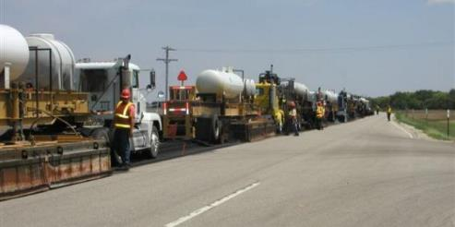
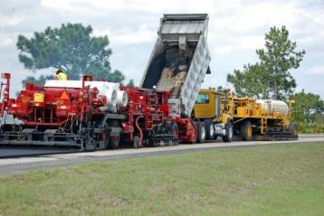
Hot In-place Recycling
HIR uses heat to soften the existing asphalt pavement
Consists of 1 or more pre-heater units and a heater scarification unit
Scarifies the heated, softened pavement
Adds rejuvenating agent and additives (if desired)
Mix and place rejuvenated mix
Compact pavement in one continuous process.
Usually requires surface course

Slide 5
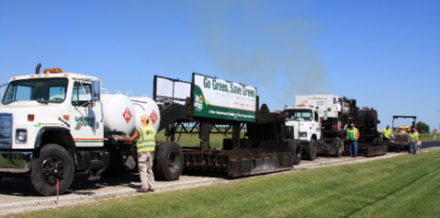
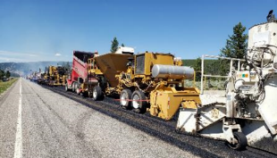
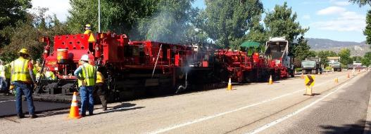
Hot In-Place Recycling
Three Methods
  Surface Recycling
    Single Pass
    Multiple Pass – (allows deeper treatment)
  Remixing – can add new aggregates or HMA
    Single Pass
    Multiple Pass – (allows deeper treatment)
  Repaving – places integral HMA overlay

Slide 6
HIR Project Selection
HIR is most effective as a maintenance/ minor rehabilitation process
HIR treats distress in the upper 1-2 inches of the existing pavement
HIR is not meant to address structural failures of a pavement
Not all processes treat all distresses equally
HIR can be used almost anywhere you would consider using mill and fill or a leveling course with an HMA overlay

Slide 7
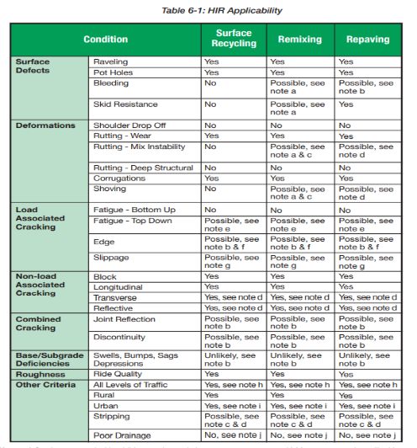

HIR Applicability (Table 6-1)
Link to table: www.roadresource.org
Treatment Toolbox/Treatment Resource Center/HIR/Pre-Construction/Site Selection

Slide 8
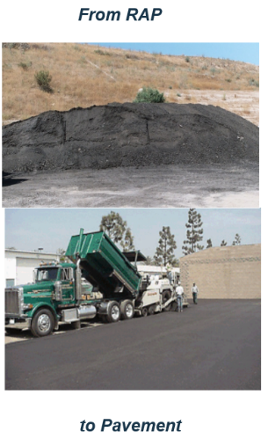
Cold Central Plant Recycling
Clean Rap = New Pavement:
  Stockpiled and kept clean
  Crushed RAP to gradation
  Mixed with bituminous recycling agent in central plant
  Transported to lay down area
  Paved as a recycled mix
  Compacted to specified density
  Readied for surface treatment

Slide 9
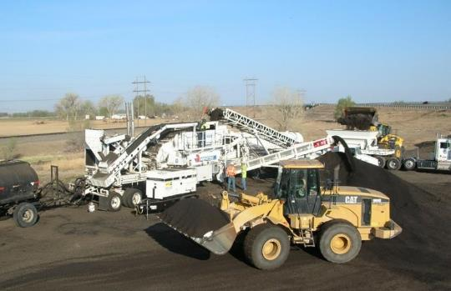
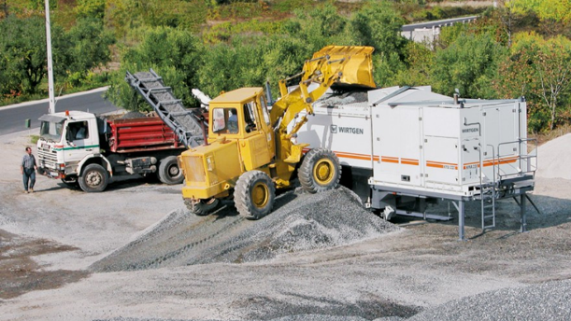
Cold Central Plant Recycling
Can use Processing Plant from a multi-unit CIR train set up in a stationary mode or a central mix plant. Some drum mix plants, with modifications, can produce a CCPR mix.

Slide 10
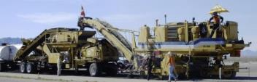



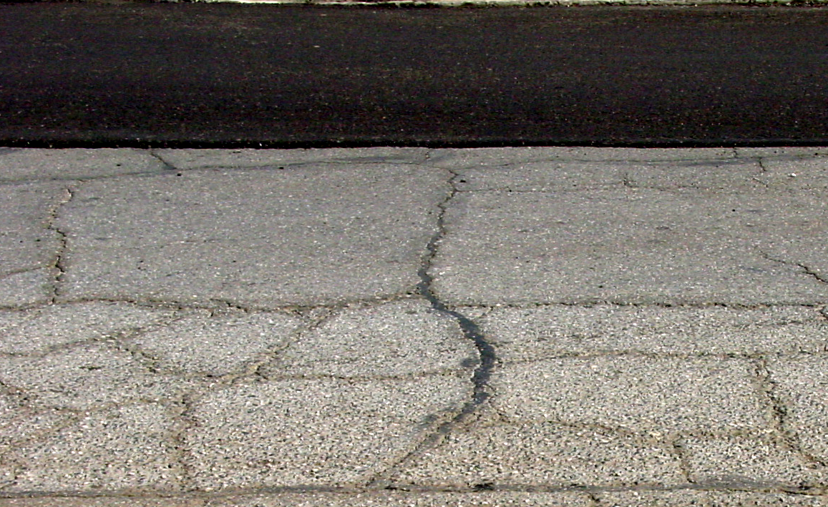
Cold In-place Recycling
Recycled AC
4” Distressed AC
>1”
Recycle AC to:
Stable Base
Within 1” of less
Supportive
Material
6” Stable Base
Native Soil

Slide 11
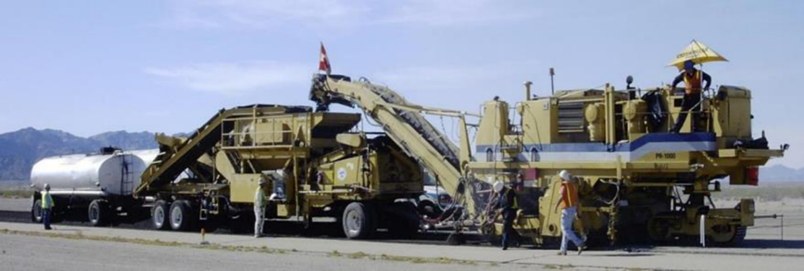
Multi-Unit Train
Controls top size of RAP with crushing & screening unit
Adds recycling agent based on mass of material entering pugmill
Type of recycling agent: Emulsified or Foamed Asphalt

Slide 12
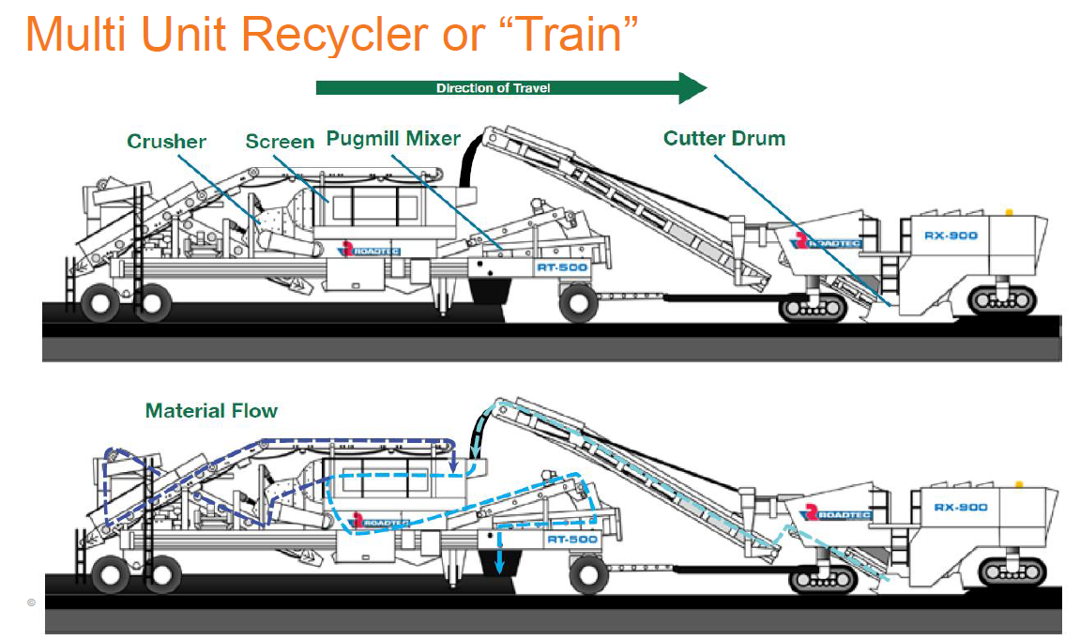
Multi Unit Train

Slide 13
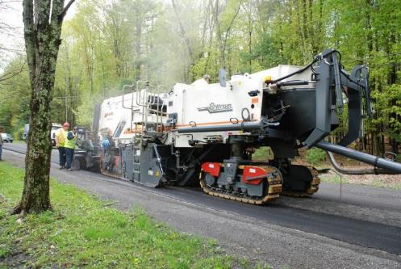
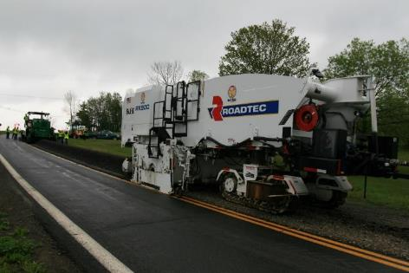
Single Unit Train
Controls top size of RAP with down cut and forward speed
Adds recycling agent to cutting chamber based on assumed unit weight & volume of material
Type of recycling agent: Emulsified or Foamed asphalt

Slide 14
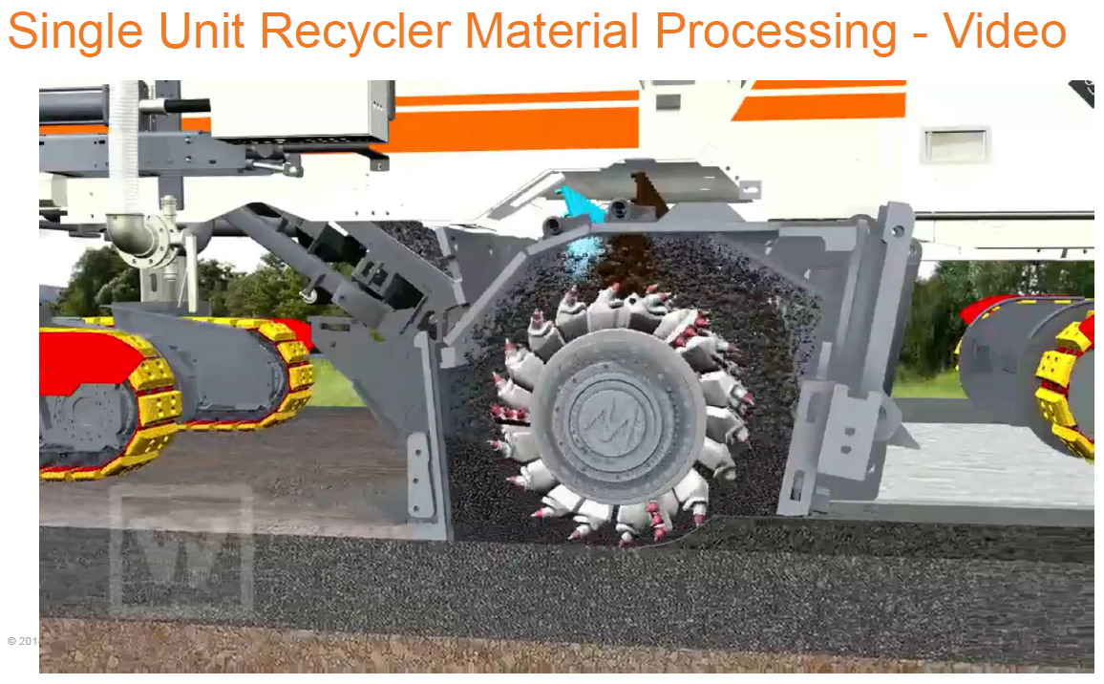
Single Unit Train

Slide 15
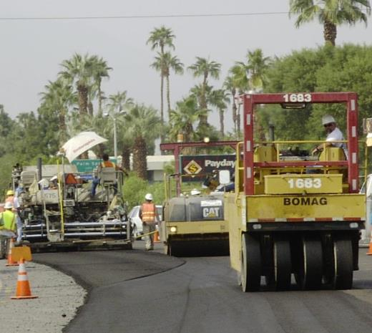
CIR & CCPR Compaction
ARRA Recommends:
  Minimum 3 rollers
  Minimum 1 pneumatic-tired roller 23-25 tons
  Minimum 1 double drum vibratory steel-wheeled roller 10-12 tons
  Working water spray systems.
  Compact to 95-105% of a control strip density

Slide 16
CIR Project Selection
The CR (CIR & CCPR) processes are not suited to address structural failures of the pavement such as structural rutting, severe fatigue cracking or base/subgrade instability.
CIR is meant to treat non-load associated distresses and most structural distresses that occur in the top 2-5+ inches of the pavement structure
CIR is an excellent treatment to mitigate transverse or reflective cracking.

Slide 17

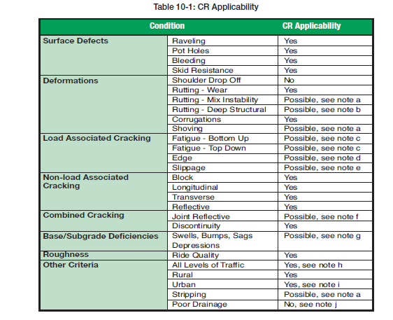
CR Applicability
(Table 10-1)
Link to table: ww.roadresource.org
Treatment Toolbox/Treatment Resource Center/CIR or CCPR/Pre-Construction/Site Selection

Slide 18
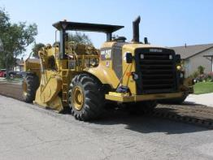
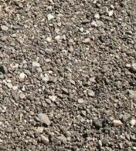

Full Depth Reclamation
Stabilized Base
Distressed AC
Improves existing materials in-place to provide greater structural support and reduction of imported material.
Base
Native Sub-base
Notes:
18

Slide 19
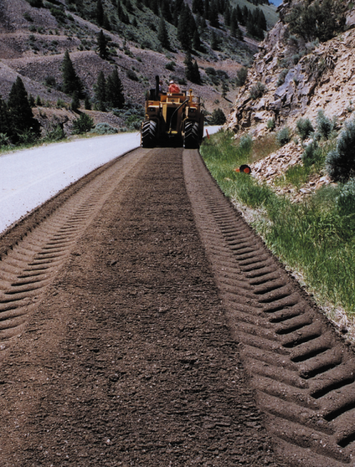
Types of FDR
  Pulverization
  Mechanical Stabilization
    Corrective Aggregate/RAP
  Bituminous Stabilization
    Foamed Asphalt
    Emulsified Asphalt
  Chemical Stabilization
    Cement/CKD
    Lime/LKD
    Type C Fly Ash

Slide 20

Pavement Distresses Corrected by FDR
All forms of cracking
Reduced ride quality
Permanent deformation
Loss of bond
Raveling, potholes, bleeding
Excessive shoulder drop off
Inadequate structural capacity
Subgrade instability
Chapter 14: FDR Detailed Project Analysis

Slide 21
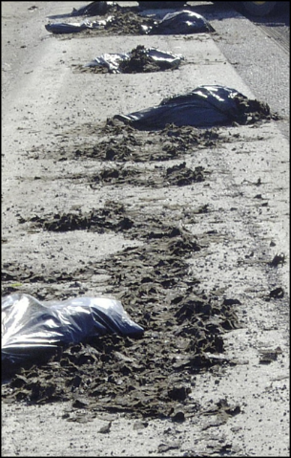
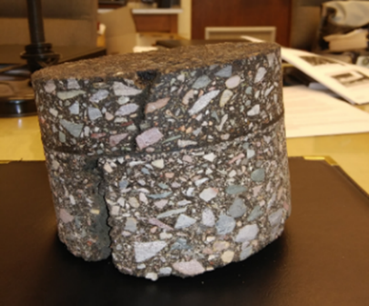
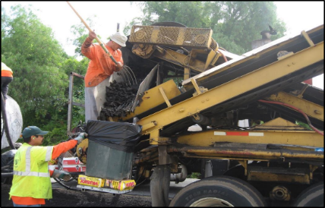
Examine Pavement Cores
For HIR & CIR verify that sufficient thickness exists to recycle the pavement to the planned thickness (1-2 inches below recycling depth)
Verify that no paving fabrics are within 1 inch of the planned recycling depth for HIR.
Paving fabrics can be recycled with CIR.
It can be very difficult to recycle paving fabrics with FDR
Notes:
A minimum of 3 inches (75 mm) of asphalt pavement is generally required for HIR. HIR treatment depth should stay a minimum of 3/4 inches (19 mm) above or below a lift to prevent possible delamination. In addition, HIR treatment depth should extend below the depth of any stripped layers. HIR will remix and recoat the stripped aggregate but unless the mixture is modified to address the stripping problem, it may eventually reoccur.
Asphalt pavements with paving fabrics within the structure can be successfully recycled. However, paving fabrics within 1 inch of the proposed recycling depth cannot be recycled.

Slide 22
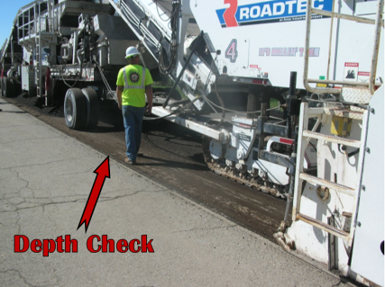
Grade & Cross Slope w/ CIR
You can mill to a constant depth or to a cross slope. You cannot do both.
Typical depth tolerance is 1/4 inch
If slope correction is greater than 0.25 – 0.5% you cannot meet depth tolerance
Either pre-mill, profile mill or correct slope with HMA overlay.

Slide 23

ARRA Resources
Basic Asphalt Recycling Manual
ARRA Best Practice Guidelines
FHWA Pocket Guides & Tech Brief
Transportation Curriculum Coordination Council (TC3) web based courses
New PPRA web site (www.roadresource.org)

Slide 24

BARM
Cold Planing
Hot In-place Recycling
Cold Recycling
Full Depth Reclamation
  Detailed Project Analysis
  Mix Design
  Construction
  Project Specifications and Inspection
FHWA –HIF-14-001

Slide 25
ARRA Best Practice Guidelines
(Developed to Complement BARM)
Series 100 Construction Best Practice Guidelines
  Suggested Specification Language
Series 200 Project Sampling & Mix Design Guidelines
Series 300 QC Guidelines
  Recommended Quality Control Checks and Remediation Actions
All Provide User Notes for More Information

Slide 26
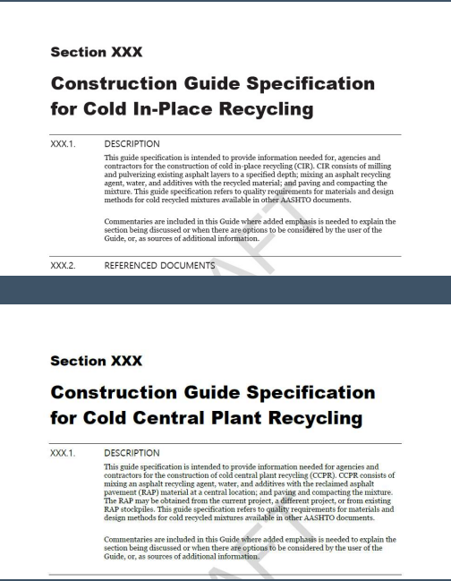
NCHRP 14-43 Construction Guide Specifications for CCPR and CIR
Deliverables
  Guide Specification in AASHTO format
  Commentary
  Best Practice Guideline
  QA Guide
  Referenced ARRA’s Best Practice Guidelines (CR101 & CR 301)
In publication (web only 363)

Slide 27

Transportation Curriculum Coordination Council (TC3)
Web Based Inspector Training Courses on:
  HIR – No. 2590
  CIR – No. 2509
  FDR – No. 2539
Free at Checkout (for now)
Consist of Modules Covering
  Introduction
  Pre-Production Activities
  Full Production
  Post Construction Activities
https://store.transportation.org/
Item/TrainingDetails?ID=2509

Slide 28
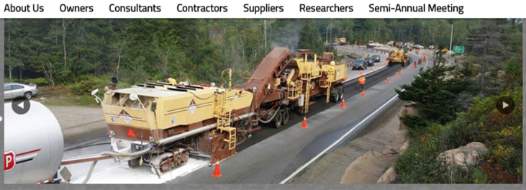

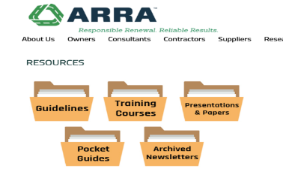
www.ARRA.org

Slide 29


www.roadresource.org
Joint Venture of ARRA, AEMA & ISSA

Slide 30

Treatment Toolbox
Which Treatment is Best for my Road?
  Explore by Pavement Criteria
  Explore by Pavement Photos
Treatment Resource Center
Find a Contractor/Supplier

Slide 31
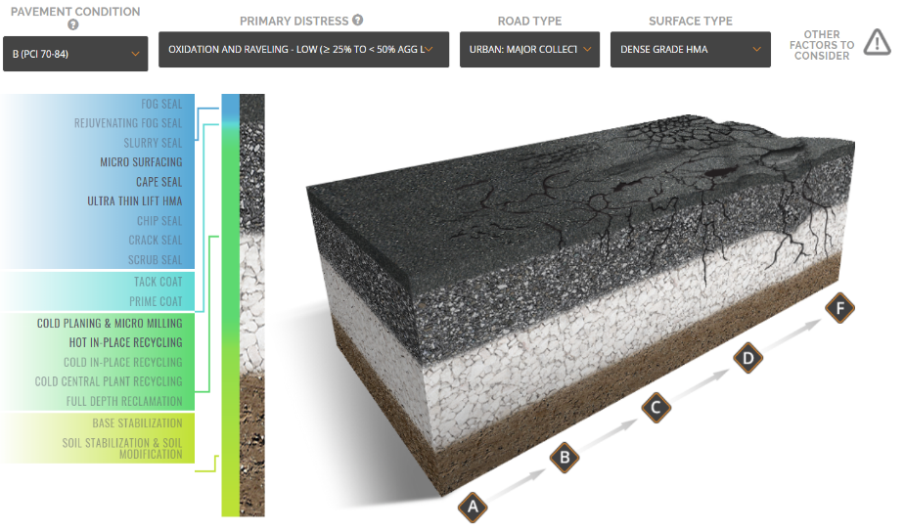
Treatment Toolbox: Which treatment is right
for my road? Pavement Condition
Notes:
From our research, we learned this is the tool agency level guys want to springboard their entries into progressive management.
Not meant to be a diagnosis for your pavement, but to educate and demonstrate capabilities by treatment. Get them thinking about it.
Pavement Criteria
Input Pavement Condition, Primary Distress, Road Type, Surface Type
List of possible treatments highlights (user clicks for information on each treatment, taken to Treatment Resource Center)
Photo Selector
around 100 photos of roads organized by varying levels of distress, categorized into A, B, C, D, F pavement conditions.
User inputs Primary Distress / Issue
Filters photos– User learns pavement condition and distresses. Associated with each photo is a list of possible treatments
(User clicks for information, taken to Treatment Resource Center)

Slide 32
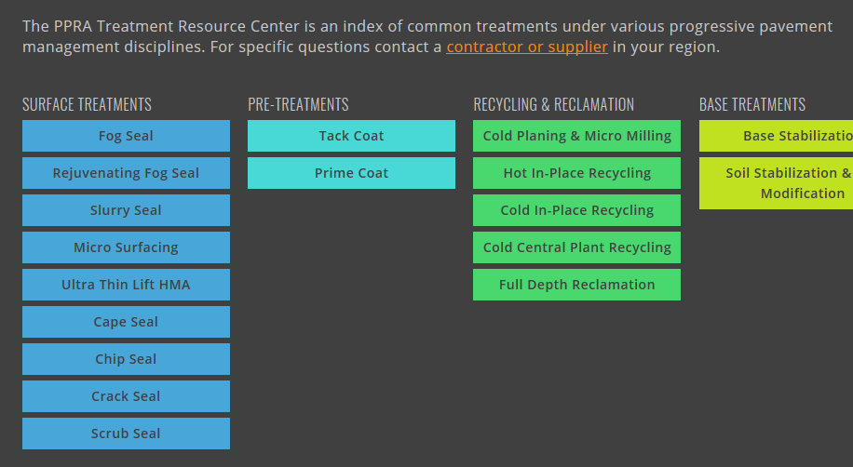
Treatment Resource Center

Slide 33

Recycling Tab
Why Recycling & Reclaiming
  Lower Costs
  Engineering Benefits
  Environmental Benefits
  Time Savings
Structural Comparison
  About
  Calculator
ARRA Publications
About ARRA

Slide 34


Thank You
Stephen A Cross, PhD, PE
S Cross & Associates
Technical Director
ARRA
steve.cross@okstate.edu

Slide 35
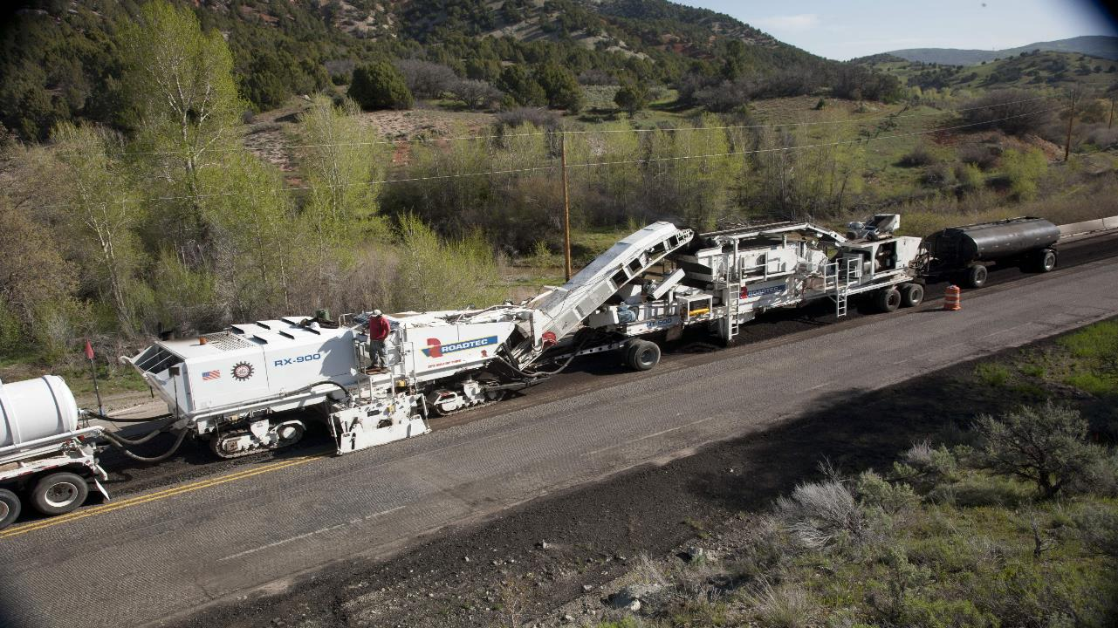

Thank You
For more information on the ARRA disciplines visit www.roadresource.org
800 Roosevelt Road, Building C-312
Glen Ellyn, IL 60137
603.942.6578

