Slide 1
Presentation on
TRRGP 2021 - Feasibility Assessment of Reclaimed Fly Ash (RFA) and Ground Tire Rubber (GTR) Modified Concrete
PI: Dr. Zahid Hossain, Professor of Civil Engineering
GRA: Abu Sayed Mohammad Akid, Graduate Student
Arkansas State University
1

Slide 2
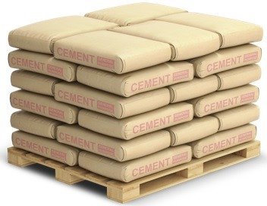
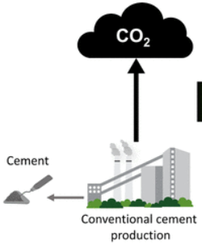
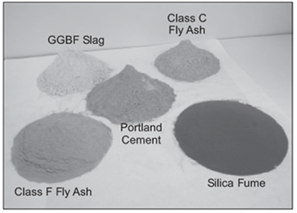
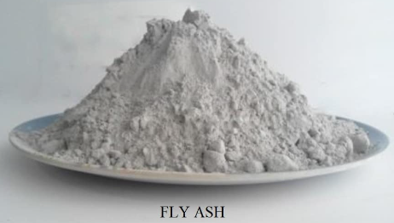
background
Most widely utilized
Rapid development
Increase in demand
CO₂ emissions
Incorporation of SCMs in concrete:
=> Reduce carbon footprint
=> Enhance durability performance
=> Reduce cement consumption cost
Incorporating SCMs
Commonly used SCM
Changing fuel sources in some power plants => decline in fly ash availability
Therefore, it is crucial to find alternative SCM to address the likely shortage of fly ash.
2

Slide 3
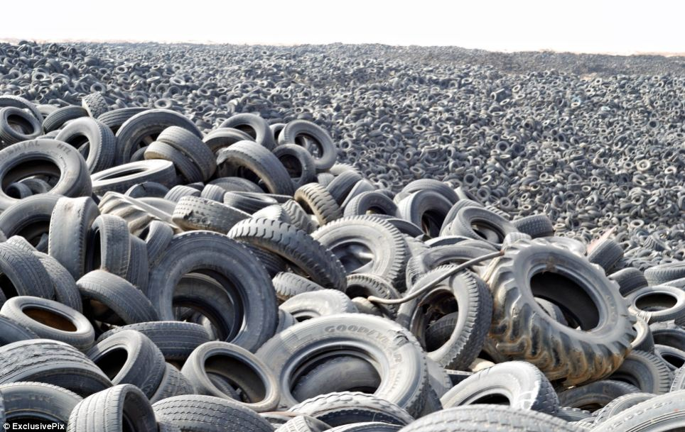
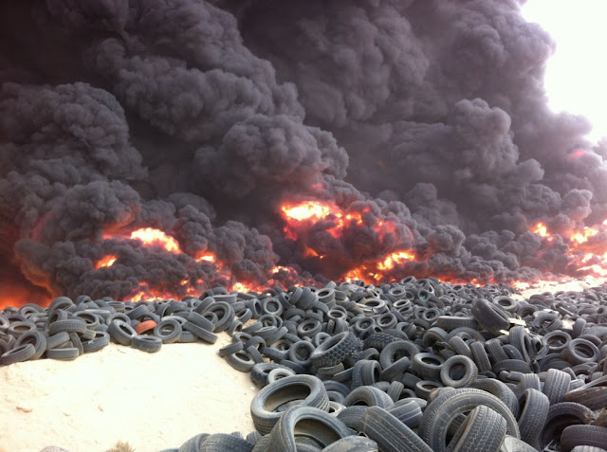
background
Generation of millions of waste automobile tires
An ever-growing issue for solid waste management authorities in Arkansas
Using waste tires as fuel generates toxic gases
Dumping them in landfills ≈ not sustainable
Crucial to minimize the issues of managing and disposing of waste tires
Incorporating waste tire rubber into concrete as construction material
Concrete
Ongoing study aims to investigate fresh, mechanical, and durability properties of concrete incorporating Class F fly ash (FFA) and reclaimed fly ash (RFA), and waste ground tire rubber (GTR) as a replacement for sand and cement.
3

Slide 4
Objectives
Investigate fresh and mechanical properties of GTR-modified concrete containing FFA and RFA.
Evaluate the long-term durability of GTR-modified concrete containing FFA and RFA.
Determine optimum dosage of GTR in concrete in terms of overall performance.
4

Slide 5
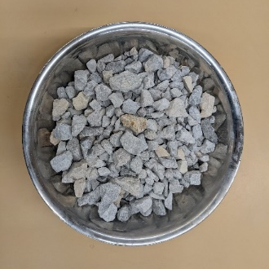
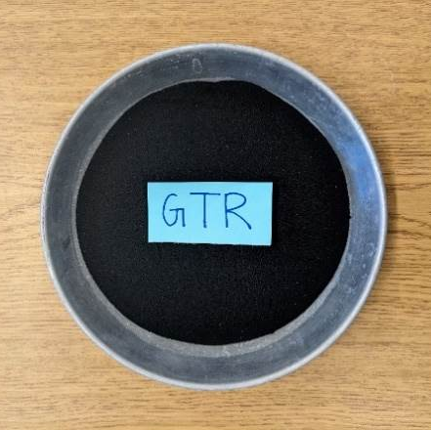
Materials
Table: Concrete ingredients
Materials | Type
Coarse aggregate | Crushed limestone
Fine aggregate | Concrete sand Ground tire rubber (GTR) ≈ #40-80 mesh particles
Binder | ASTM C150 Type I/II Portland cement (PC)
Supplementary cementitious materials (SCMs) | Class F fly ash (FFA) Reclaimed fly ash (RFA) Micronized rubber powder (MRP) ≈ #200 mesh particles
Chemical admixture | Air-entraining admixture (Daravair 1400) Water reducer (ADVA 140M)
Water | Fresh potable tap water
Table: Chemical compositions of cement and SCMs
Material | CaO | SiO₂ | Al₂O₃ | Fe₂O₃ | SO₃ | MgO | K₂O | Na₂O
PC | 64.80 | 19.80 | 4.70 | 3.80 | 3.38 | 2.20 | 0.54 | 0.16
FFA | 8.42 | 57.19 | 20.21 | 10.18 | 1.18 | 1.58 | 2.68 | 1.15
RFA | 1.85 | 53.39 | 28.01 | 7.72 | 0.09 | 1.00 | 2.24 | 0.33
5

Slide 6
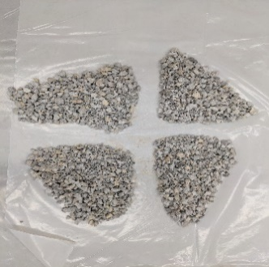
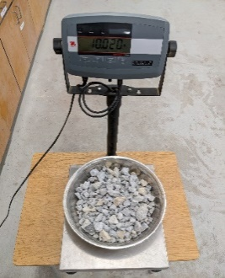
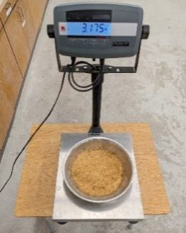
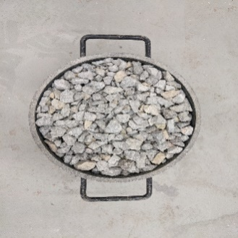
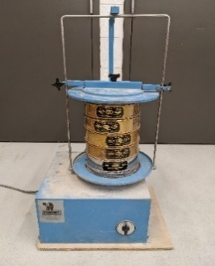
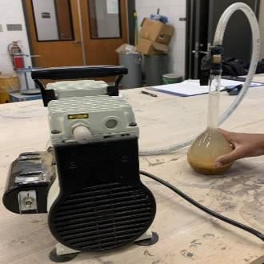
Materials properties
Table: Physical properties of aggregates
Properties | Limestone | Sand
Moisture content (%) | 0.20 | 0.16
Unit weight (lb/ft³) | 100.5 | -
Maximum size (inch) | 1-1/2 | -
Nominal maximum size (inch) | 1 | -
Fineness modulus | - | 2.56
Bulk specific gravity (dry) | 2.76 | 2.61
Bulk specific gravity (SSD) | 2.78 | 2.63
Apparent specific gravity | 2.82 | 2.67
Absorption (%) | 0.80 | 0.88
Figure: Gradation curve of coarse and fine aggregate
(a)
(b)
(c)
(d)
(e)
(f)
Figure: (a) Quartering of limestone (b-c) moisture content of limestone and sand (d) unit weight of limestone
(e) sieve analysis of sand and (f) specific gravity of sand
6

Slide 7
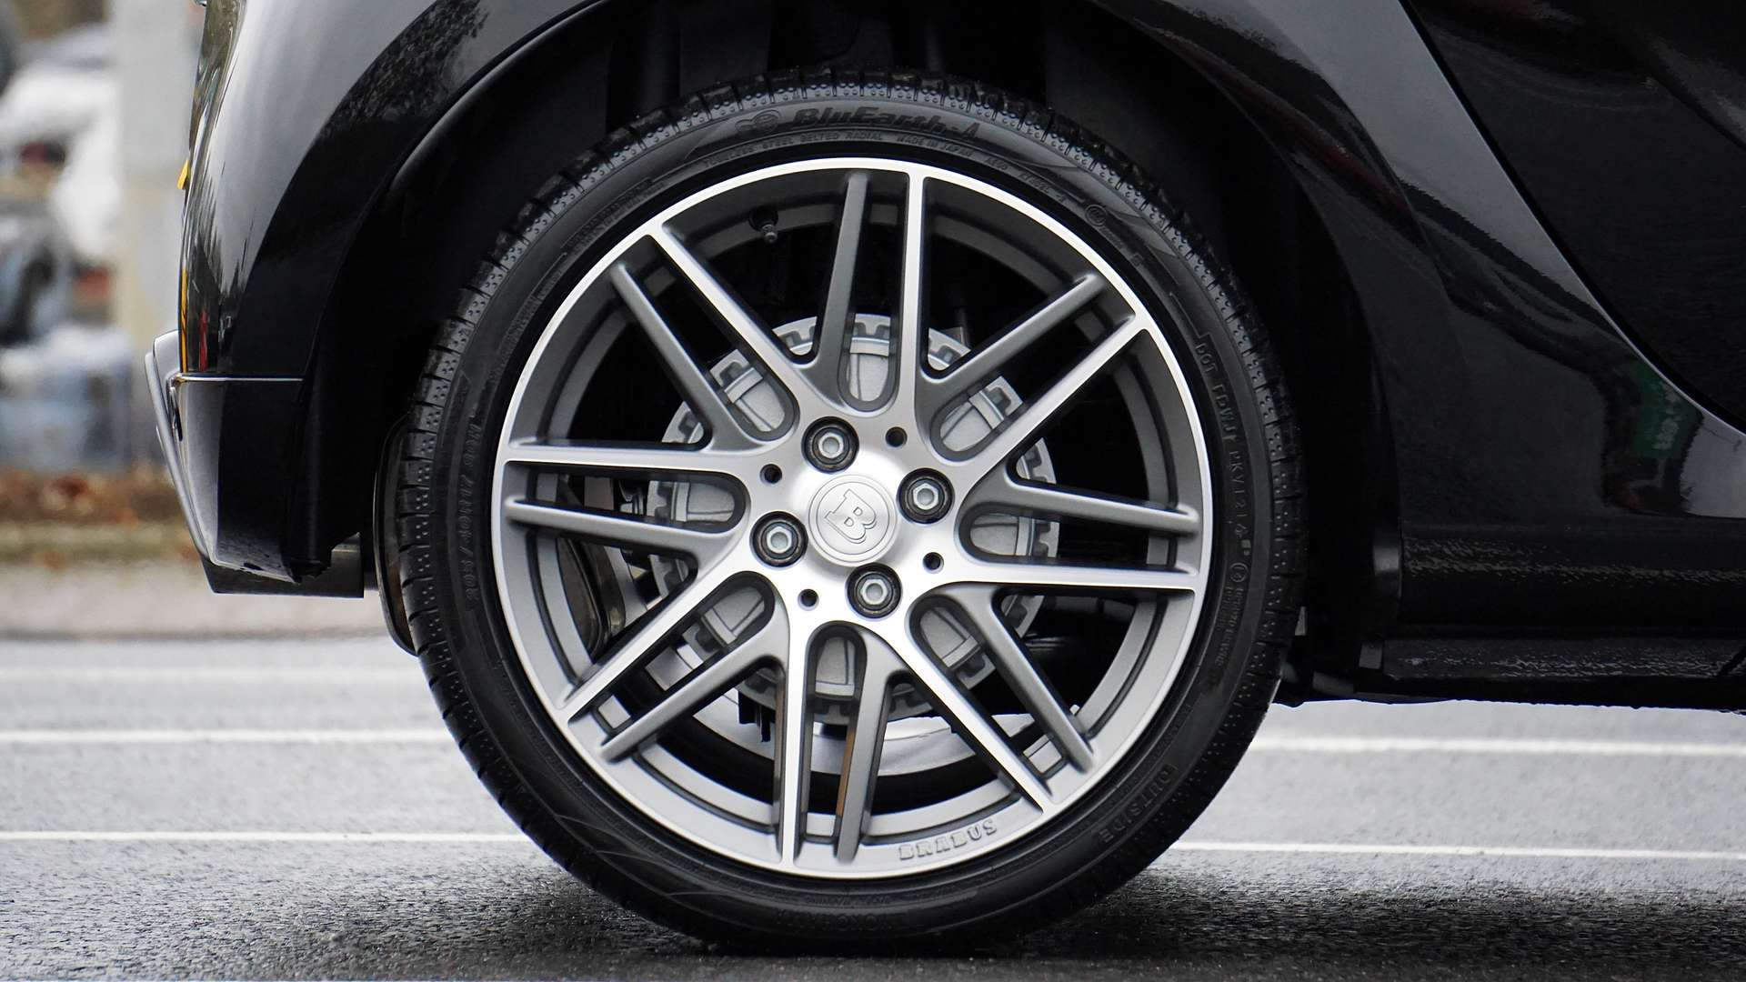
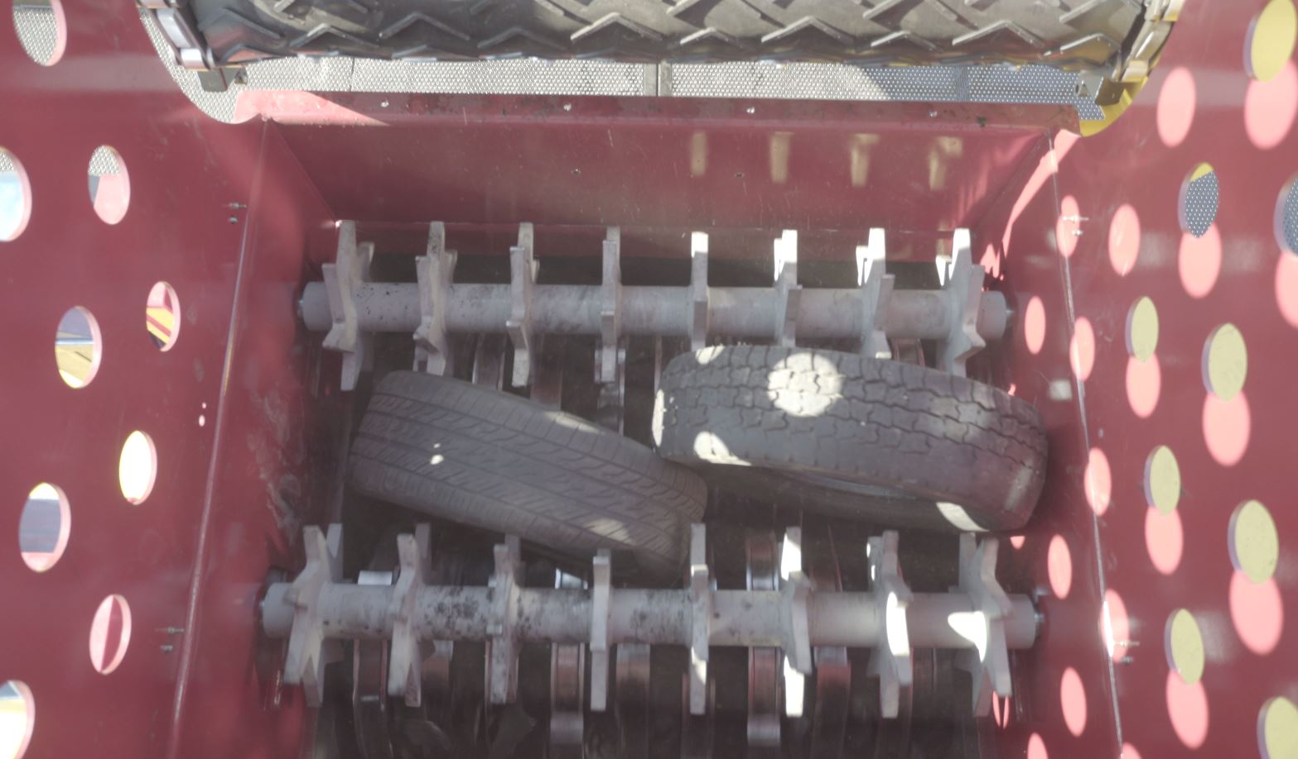
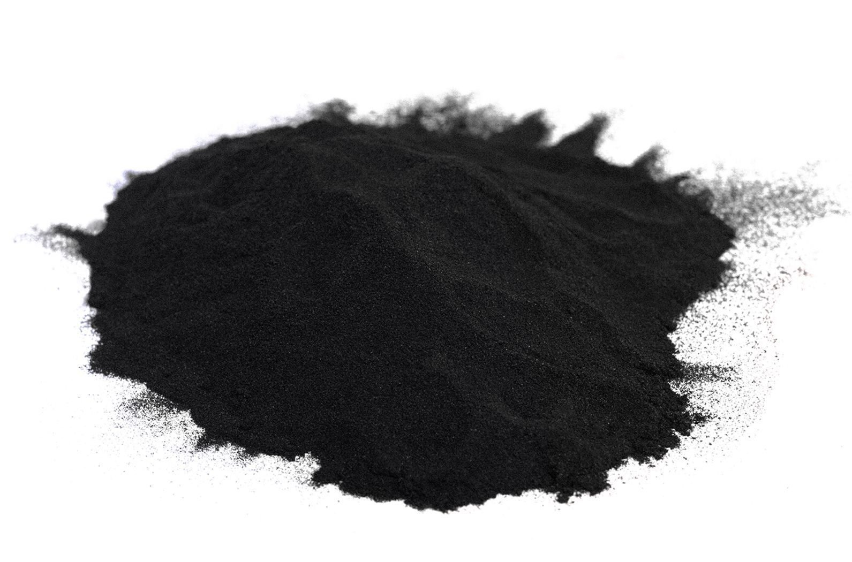
Materials properties
Table: Properties of ground tire rubber (GTR)
Properties | Minimum | Maximum | Test method
Acetone extractables | 6.0% | 22.0% | TGA
Ash content | - | 8.0% | TGA
Carbon black | 26.0% | 38.0% | TGA
Natural rubber | 10.0% | 35.0% | TGA
Rubber hydrocarbon | 42.00% | - | TGA
Moisture content | - | 1.0% | ASTM D5603
Fiber content | - | 0.01% | ASTM D5603
Metal content | - | 0.10% | ASTM D5603
Bulk density | 22 lb./ft³ | 28 lb./ft³ | ASTM D5603
Specific gravity | 1.10 | 1.15 | Typical
7

Slide 8
Mixture proportions
Table: Concrete mixture proportions
Mix no. | Mixture ID | Cement (%) | FFA (%) | RFA (%) | GTR (%) | MRP (%) | Sand (%) | Remarks
1 | F20 | 80 | 20 | - | - | - | 100 | Control
2 | R20 | 80 | - | 20 | - | - | 100 | RFA based
3 | F20-S95-G5 | 80 | 20 | - | 5 | - | 95 | GTR as sand replacement (FFA mixes)
4 | F20-S90-G10 | 80 | 20 | - | 10 | - | 90
5 | F20-S85-G15 | 80 | 20 | - | 15 | - | 85
6 | R20-S95-G5 | 80 | - | 20 | 5 | - | 95 | GTR as sand replacement (RFA mixes)
7 | R20-S90-G10 | 80 | - | 20 | 10 | - | 90
8 | R20-S85-G15 | 80 | - | 20 | 15 | - | 85
9 | F16-P4 | 80 | 16 | - | - | 4 | 100 | MRP as filler (FFA mixes)
10 | F13-P7 | 80 | 13 | - | - | 7 | 100
11 | F10-P10 | 80 | 10 | - | - | 10 | 100
12 | R16-P4 | 80 | - | 16 | - | 4 | 100 | MRP as filler (RFA mixes)
13 | R13-P7 | 80 | - | 13 | - | 7 | 100
14 | R10-P10 | 80 | - | 10 | - | 10 | 100
Note: GTR = Mesh #40-80 particles and MRP = Mesh #200 passing particles
8

Slide 9
Test methods
Table: Test descriptions
Properties | Test name | Specimen size | Testing age | Test standard
Fresh properties | Slump (workability) Temperature Unit weight Air content** | 100 x 200 x 300 mm - 0.25 cft 0.25 cft | Immediately | ASTM C143 ASTM C1064 ASTM C138 ASTM C231
Mechanical properties | Compressive strength Splitting tensile strength Flexural strength Modulus of elasticity | 100 x 200 mm 100 x 200 mm 100 x 200 mm 150 x 300 mm | 7, 28 and 90 days 28 days 28 days 28 days | ASTM C39 ASTM C496 ASTM C78 ASTM C469
Durability properties | Drying shrinkage | 75 x 75 x 250 mm | 4, 7, 14, 28, 56, 90, 112 and 224 days | ASTM C157
 | Alkali-silica reaction (ASR) | 25 x 25 x 250 mm | 4, 8, 12, 14, 16, 20, 24 and 28 days | ASTM C1567
 | Sulfate attack | 25 x 25 x 250 mm | 1, 2, 3, 4, 8, 13 and 15 weeks | ASTM C1012
 | Surface scaling resistance | 75 x 75 x 250 mm | 15 cycles | ASTM C672
**Using the pressure meter and super air meter (SAM)
9

Slide 10
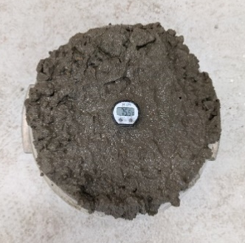
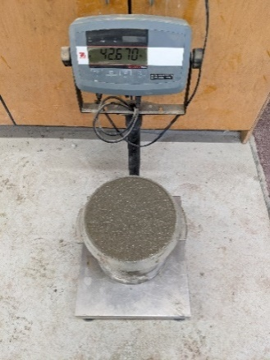
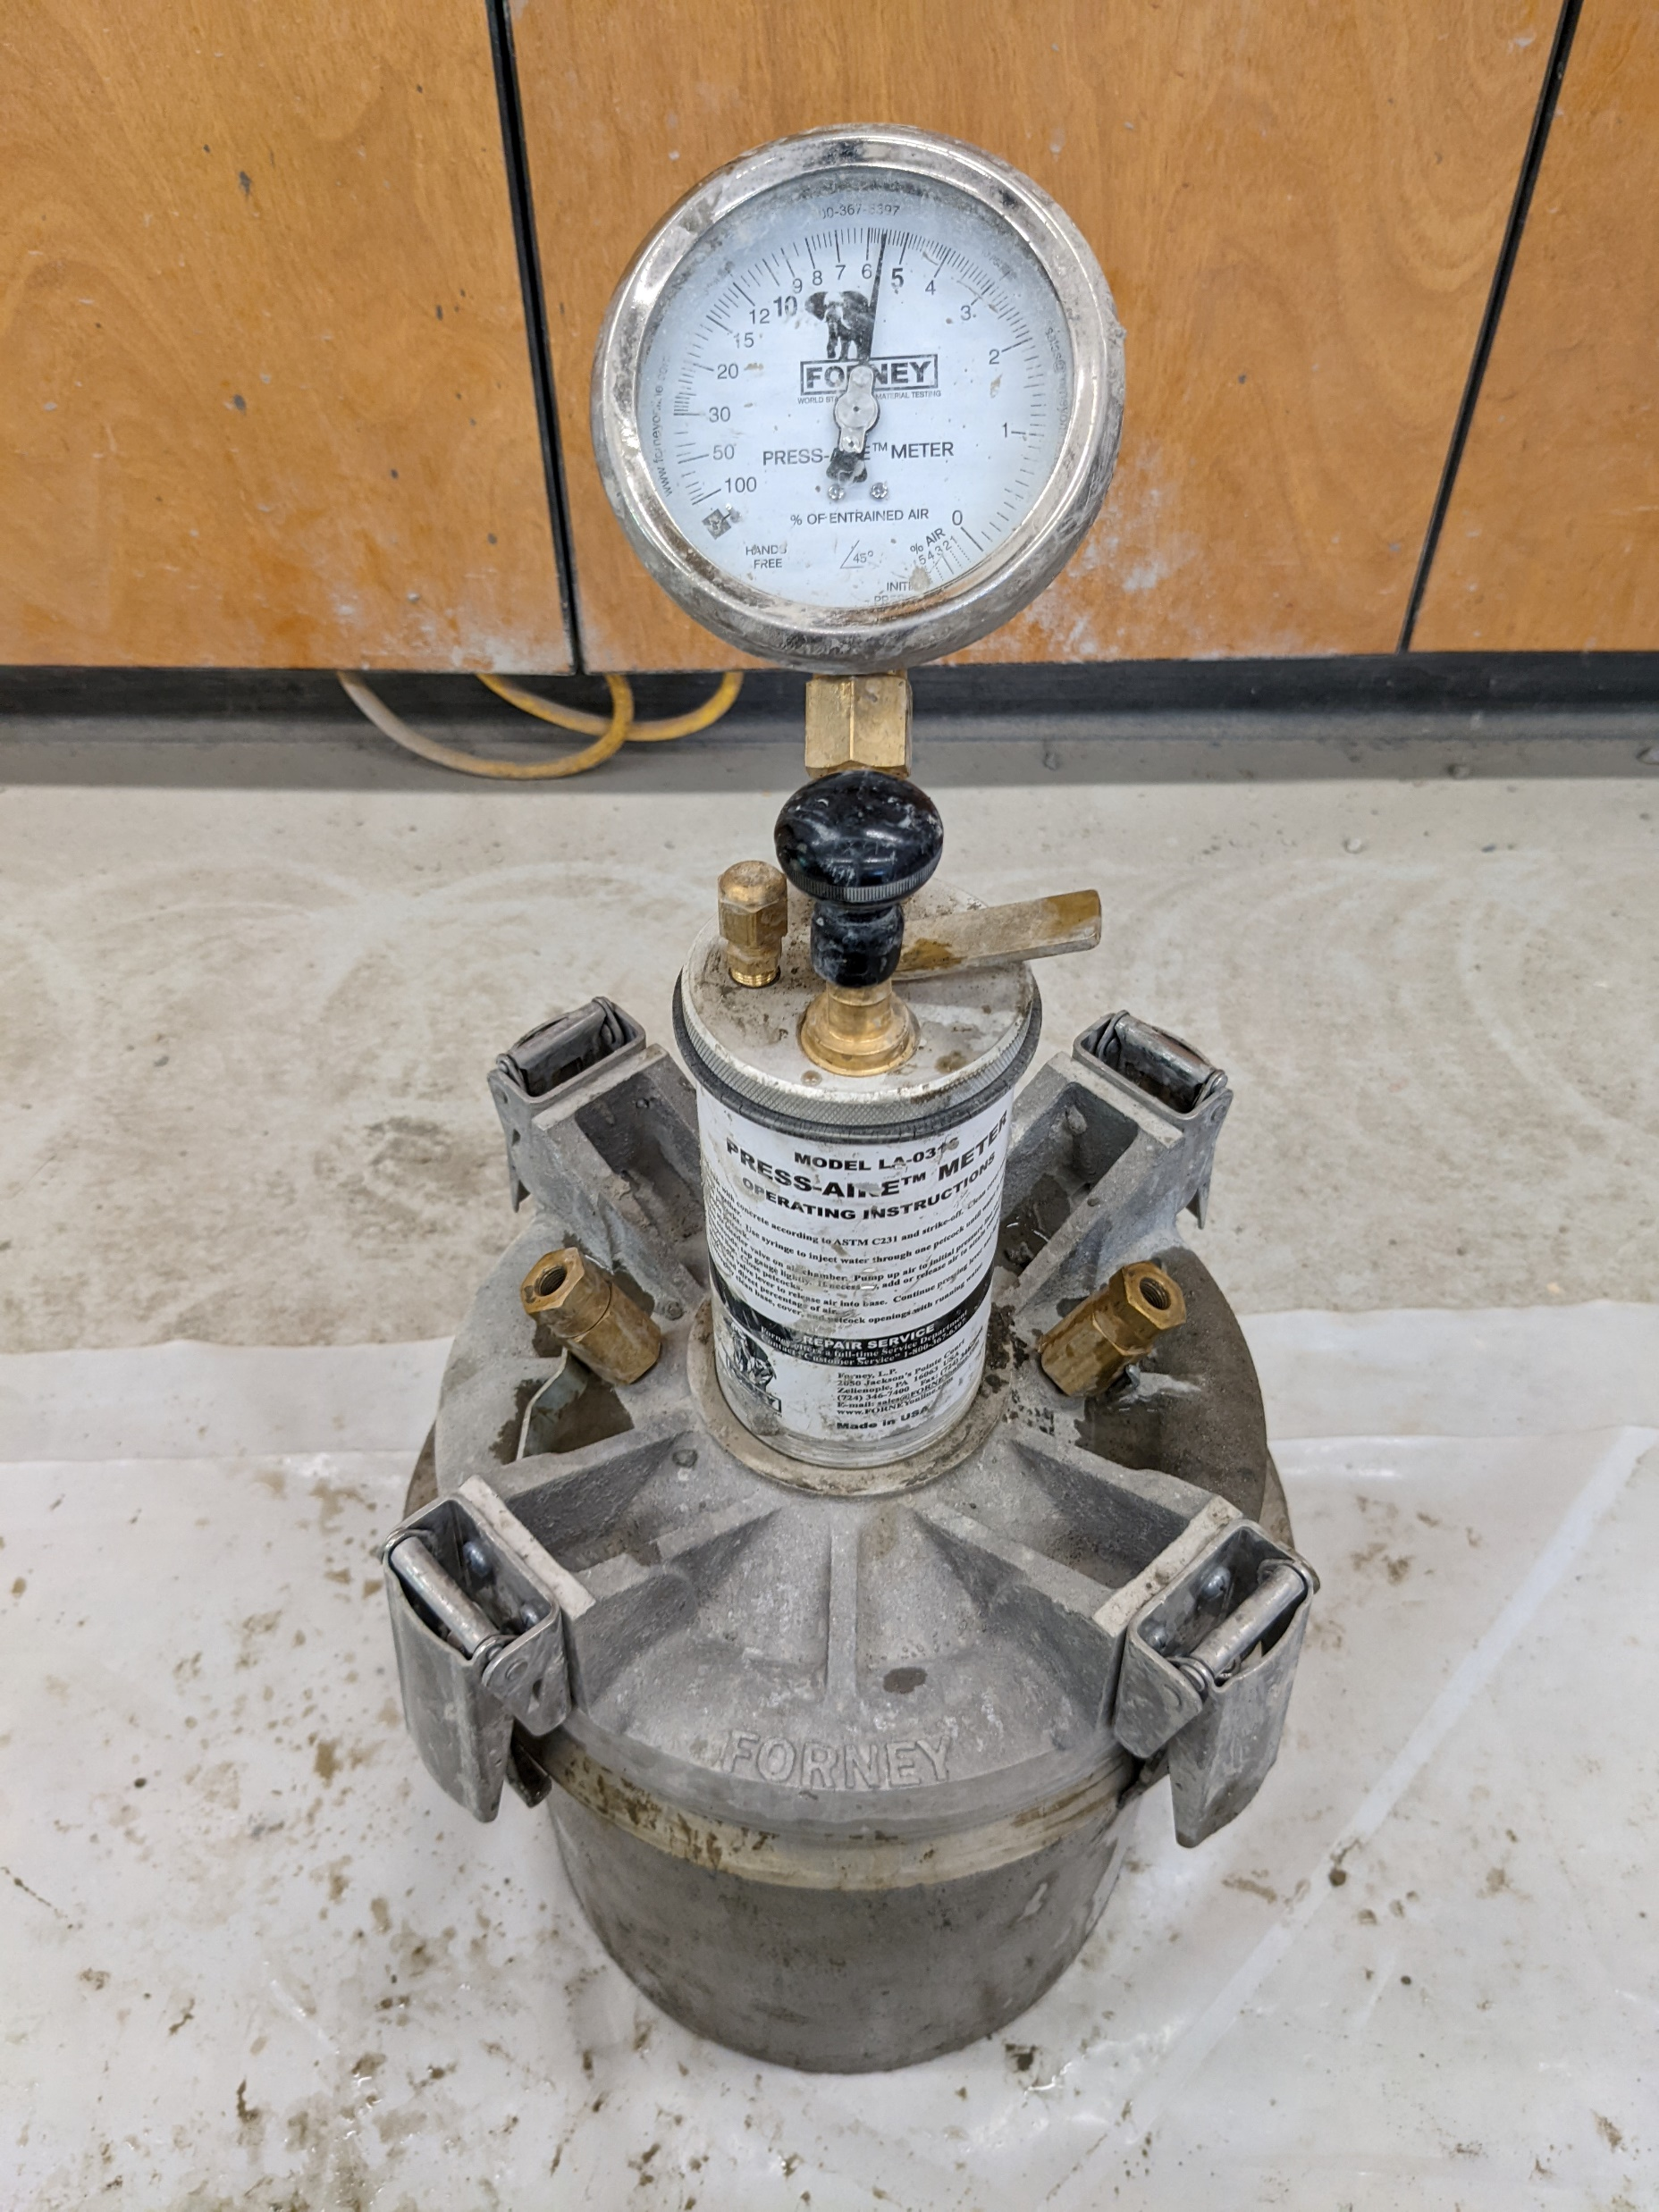
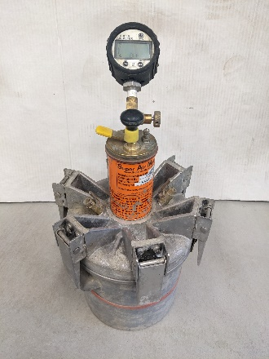
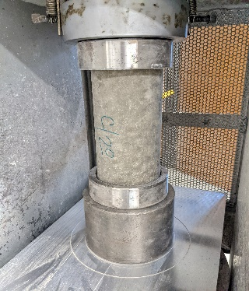
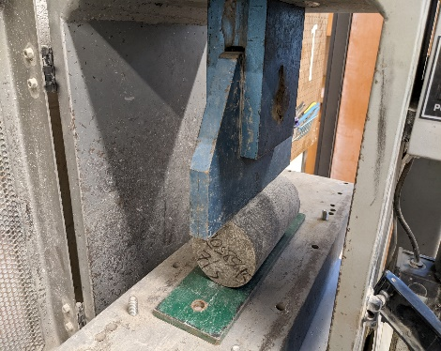
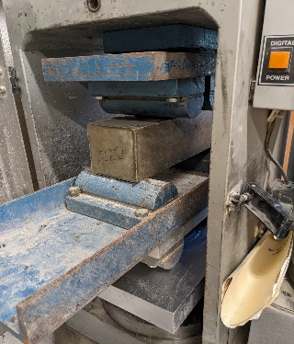
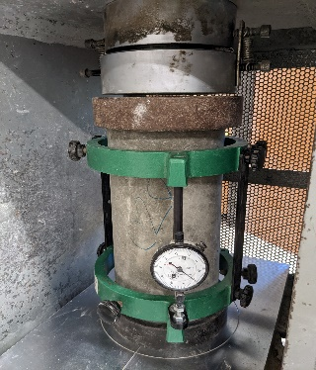
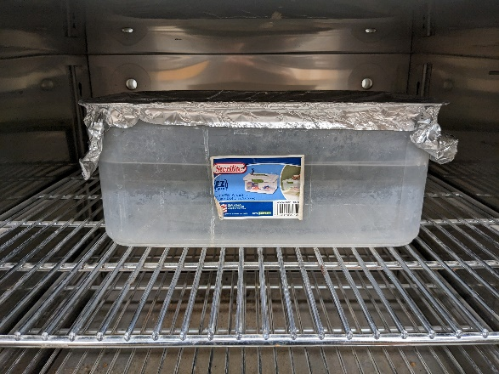
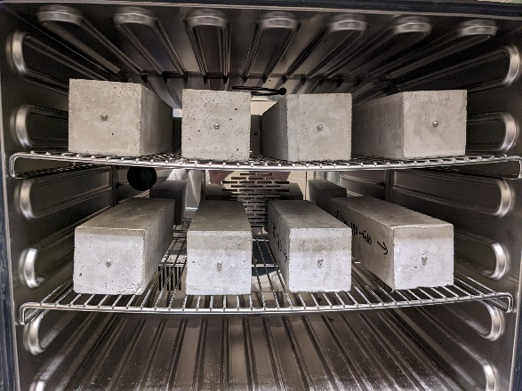
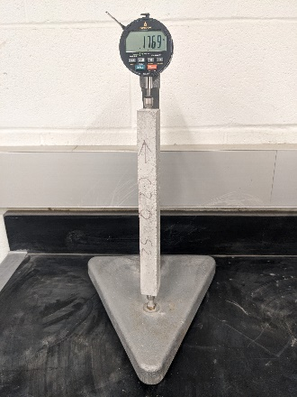
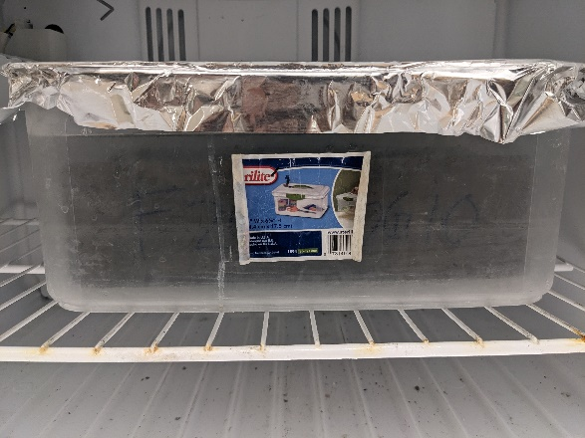
Test setup
(a)
(b)
(c)
(d)
(e)
(f)
(g)
(h)
(i)
(j)
(k)
(l)
(m)
Figure: (a) slump (b) temperature (c) unit weight (d-e) air content by pressure meter and SAM (f) compressive strength (g) splitting tensile strength (h) flexural strength (i) modulus of elasticity (j) ASR: curing specimen in NaOH Solution at 80°C (k) drying shrinkage: air curing (l) sulfate attack: taking reading (m) scaling: specimen submerged in CaCl₂ solution
10

Slide 11
Results & discussion
Reduction in slump =
GTR-modified concrete
≈
Rough surface
of the tire rubber particles in the mixture
Figure: Slump test results of concrete mixtures
11

Slide 12
Results & discussion
Table: Temperature of concrete mixtures
Mixture ID | Temperature (°F) | Mixture ID | Temperature (°F)
F20 | 74 | R20 | 74
F20-S95-G5 | 79 | R20-S95-G5 | 77
F20-S90-G10 | 76 | R20-S90-G10 | 71
F20-S85-G15 | 76 | R20-S85-G15 | 76
F16-P4 | 77 | R16-P4 | 76
F13-P7 | 78 | R13-P7 | 76
F10-P10 | 76 | R10-P10 | 76
12

Slide 13
Results & discussion
Reduction in unit weight =
GTR-modified concrete
≈
The low specific gravity of the tire rubber particles compared to sand
Figure: Unit weight of concrete mixtures
13

Slide 14
Results & discussion
Increase in air content =
GTR-modified concrete
≈
The nonpolar nature of tire rubber particles and their tendency to repel water and entrap air in concrete
Figure: Air content of concrete mixtures
14

Slide 15
Results & discussion
Decrease in compressive strength =
GTR-modified concrete
≈
The weak bond between the tire rubber particles and cement paste in concrete
Figure: Compressive strength of concrete mixtures
15

Slide 16
Results & discussion
Reduction in tensile strength =
GTR-modified concrete
≈
The weak bonding at the interfacial transition zone (ITZ)
Figure: Splitting tensile strength of concrete mixtures at 28 days
16

Slide 17
Results & discussion
Reduction in flexural strength =
GTR-modified concrete
≈
Poor interlocking
Figure: Flexural strength of concrete mixtures at 28 days
17

Slide 18
Results & discussion
Figure: Modulus of elasticity of concrete mixtures at 28 days
18

Slide 19
Results & discussion
Reduction in ASR expansion =
GTR-modified concrete
≈
Tire rubber particles internally absorbed the expansive stress caused by ASR gel
Figure: ASR expansion of mixtures containing FFA
19

Slide 20
Results & discussion
Reduction in ASR expansion =
RFA-modified concrete
≈
Lower alkali content compared to FFA
Figure: ASR expansion of mixtures containing RFA
20

Slide 21
conclusions
Incorporation of GTR in concrete; reduction in workability and unit weight and increase in air content compared to control mix.
RFA-modified concrete; same trend except for increasing the unit weight.
Inclusion of GTR in concrete; decrease in strength properties such as compressive, splitting tensile and flexural strength and modulus of elasticity.
RFA-modified concrete; higher compressive strength at 90 days compared to FFA.
Adding GTR and RFA into concrete; reduction in ASR expansion compared to control mix.
Works ongoing: drying shrinkage, sulfate attack, surface scaling resistance, and super air meter (SAM).
The findings of this study will benefit concrete professionals and researchers to utilize GTR in preparing sustainable, durable, and low-cost concrete.
21

Slide 22
acknowledgements
Research Sponsors:
ARDOT
USDOT Through Tran-SET
ARMCA
Industry Partners:
NEAR Ready-Mix Concrete (Mr. Eric Gohn)
Boral Resources
A-State Facility Management
Suppliers:
Liberty Tires
Entech, Inc.
22

Slide 23
Thank you
Contact:
Dr. Zahid Hossain - mhossain@astate.edu
Abu Sayed Mohammad Akid - abusayed.akid@smail.astate.edu
23

