Slide 1
Sacrificial Surfaces: The Defenders of our Pavement Structure
Sarah Tamayo, PE
TRC Transportation Engineering Conference & Equipment Expo
5/23/2023

Slide 2
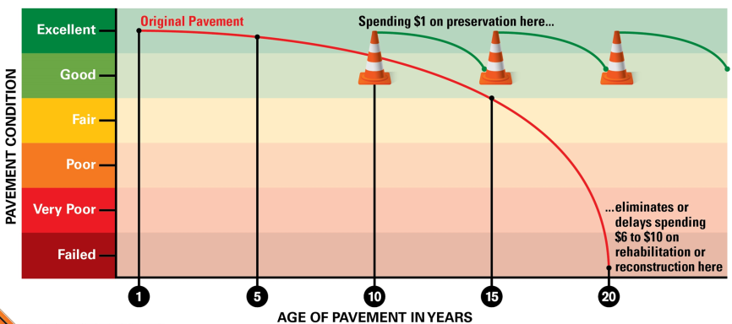
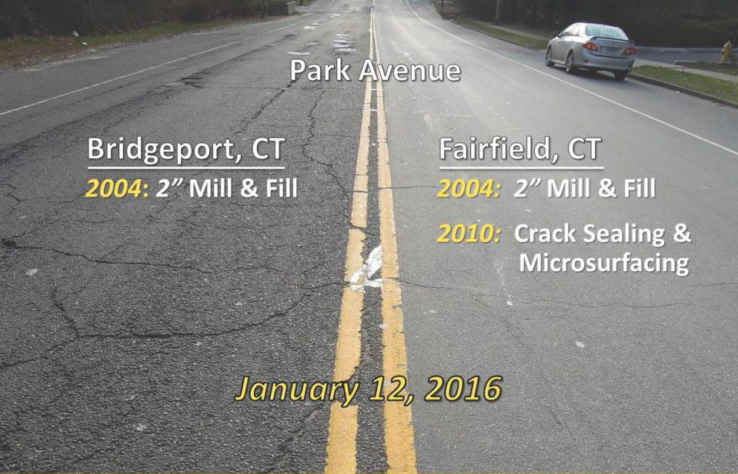
Pavement Preservation in a Nutshell
Right Treatment, Right Road, Right Time
Keeping Good Roads Good
Pavement Preservation programs and activities are defined as “programs employing a network level, long-term strategy that enhances pavement performance by using an integrated, cost-effective set of practices that extend pavement life, improve safety, and meet road user expectations”
Notes:
I really don’t think that I need to go into what pavement preservation is. I’ve ran into a few people who could quote verbatim lines from my past presentations, but just as a refresher here you go ☺. Before I get into the meat of my presentation, I do want to talk briefly about a few select pavement preservation treatments.

Slide 3
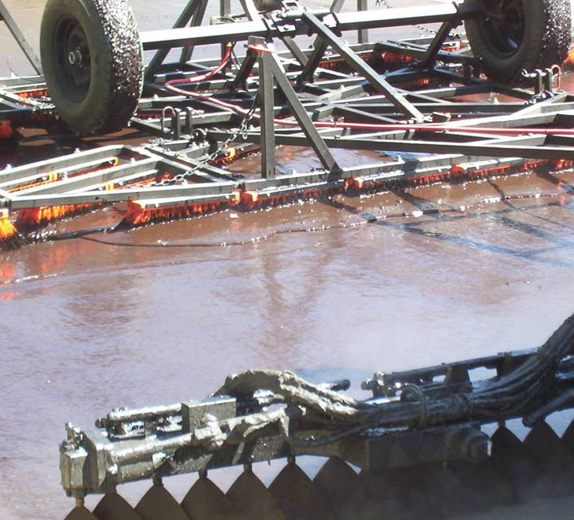
Scrub Seal
A scrub seal is an application that is very close to a chip seal treatment where asphalt emulsion and crushed rock are placed on an asphalt pavement surface. The only difference is that the asphalt emulsion is applied to the road surface through a series of brooms placed at different angles.
Notes:
Who here knows what a scrub seal is?
Does anyone disagree with me that they are an awesome treatment for environmentally cracked non-aphn roads?
We feel that scrub seals is one of many success stories as far as newer treatments in our pavement preservation toolbox.
This may surprise some of you but our first attempt at a scrub seal was a complete failure as far as the results that we were expecting

Slide 4
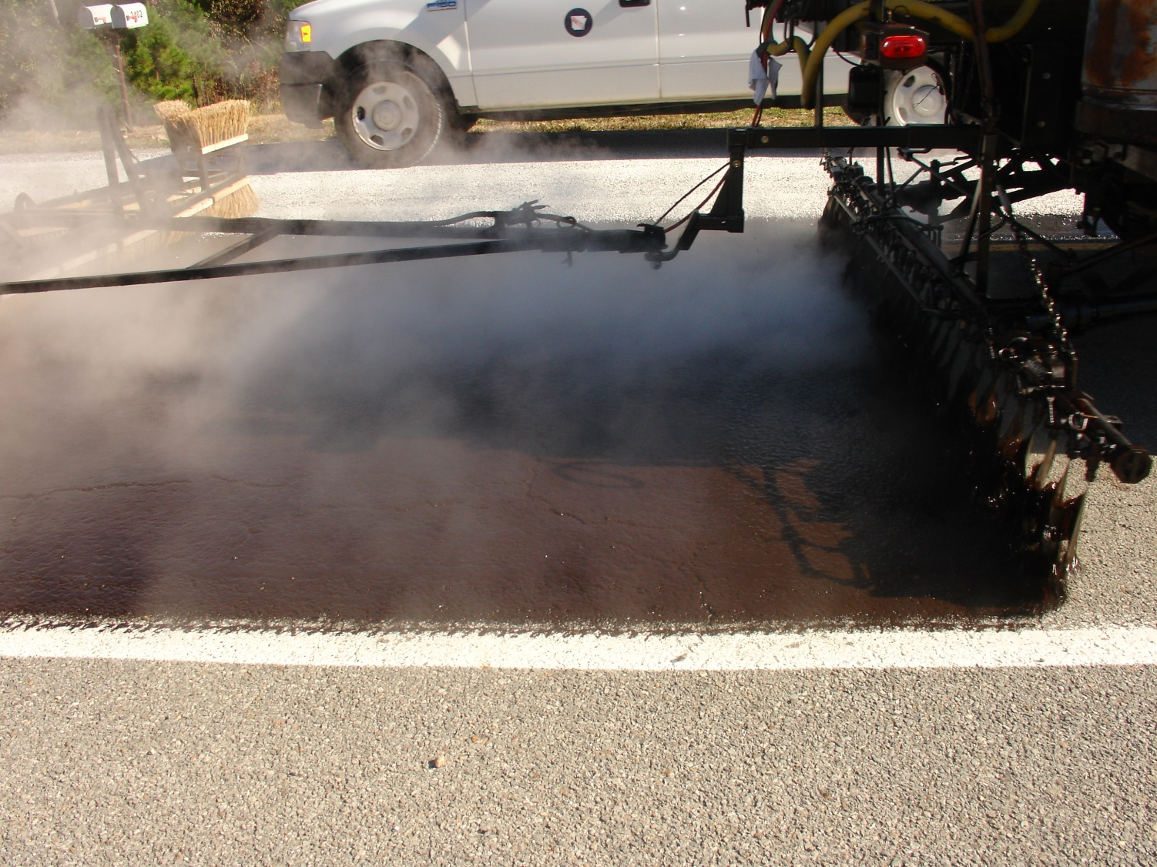
First Scrub Seal – 10/14/2010
Notes:
We thought that we had done everything right. We had selected a road that had heavy environmental cracking. Industry had brought in an “expert” to be on site for our first attempt

Slide 5
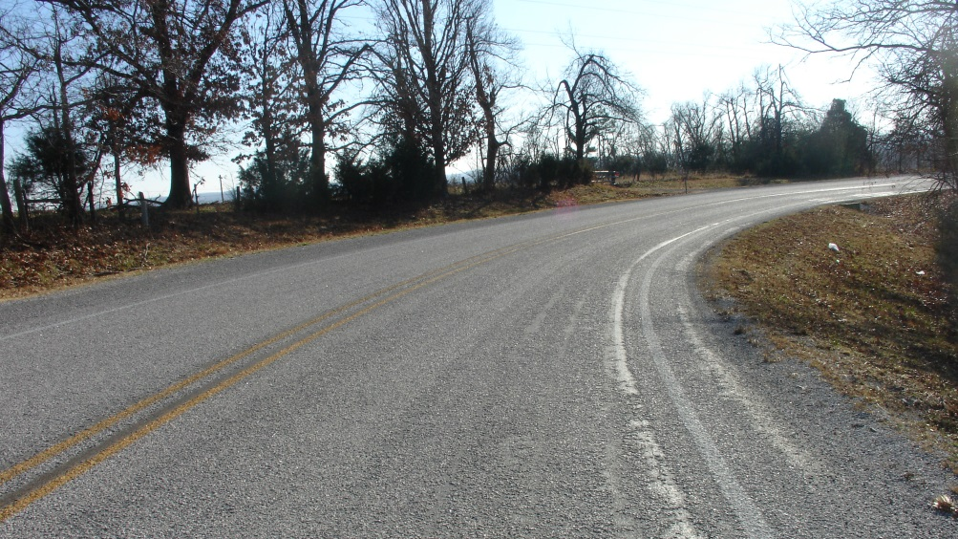
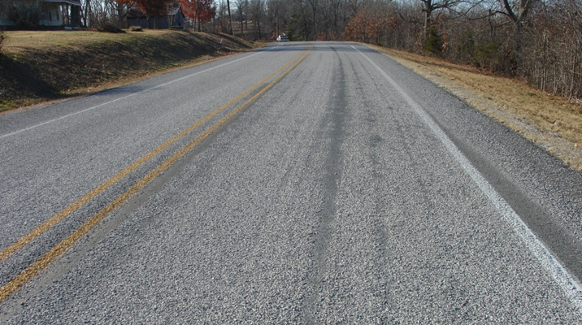
First Scrub Seal – 12/22/2010
Notes:
We went back for a site visit in December and there was about as much gravel on the shoulder as there was on the pavement

Slide 6
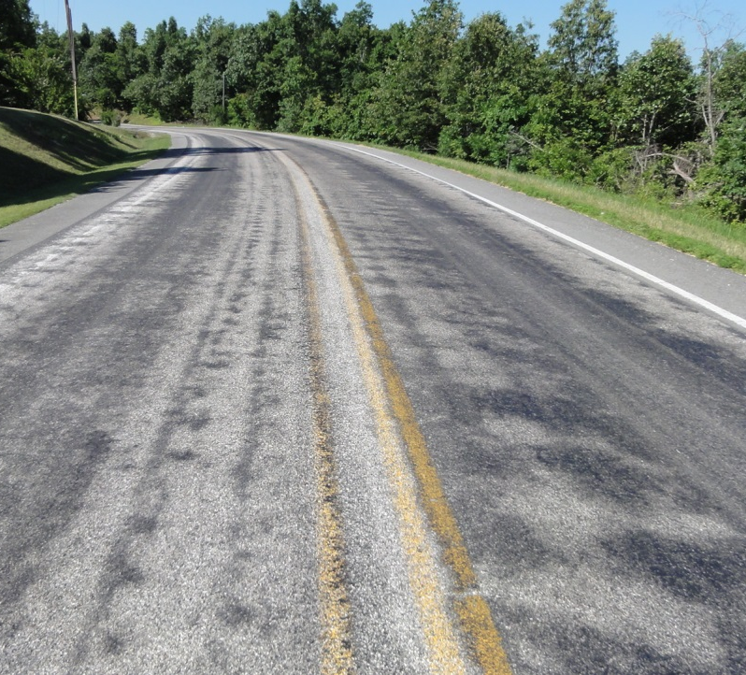
First Scrub Seal – 6/23/2011
We did not have the wave of tack in front of the broom
The tongue of the broom sled was too long
Did not secure the broom sled to the sides of the bumper to help prevent off tracking
Notes:
And by the spring there were hardly any chips left. The project was a failure, but it wasn’t the treatment that failed it was us.

Slide 7
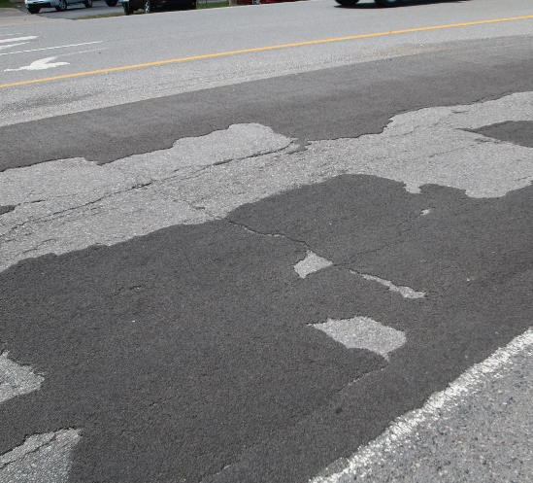
012238 – High Friction Surface Treatment aka The Ramp Job
Delamination
High Shear Stresses – due to short radius curves, high traffic counts, and heavy loads
Asphalt Substrate Failure
Poor pavement condition
Improper surface cleaning
Stiffness of epoxy and flexibility of asphalt
Notes:
We had worked with industry and FHWA to come up with a Spec and prior to Job 012238 we did have two mostly successful HFST jobs.
So why did Job 012238 fail? We know there were major delamination issue which could have been caused by high shear stresses on the ramps, the asphalt could have been in too poor of condition to hold the bond, maybe there wasn’t good surface preperation

Slide 8
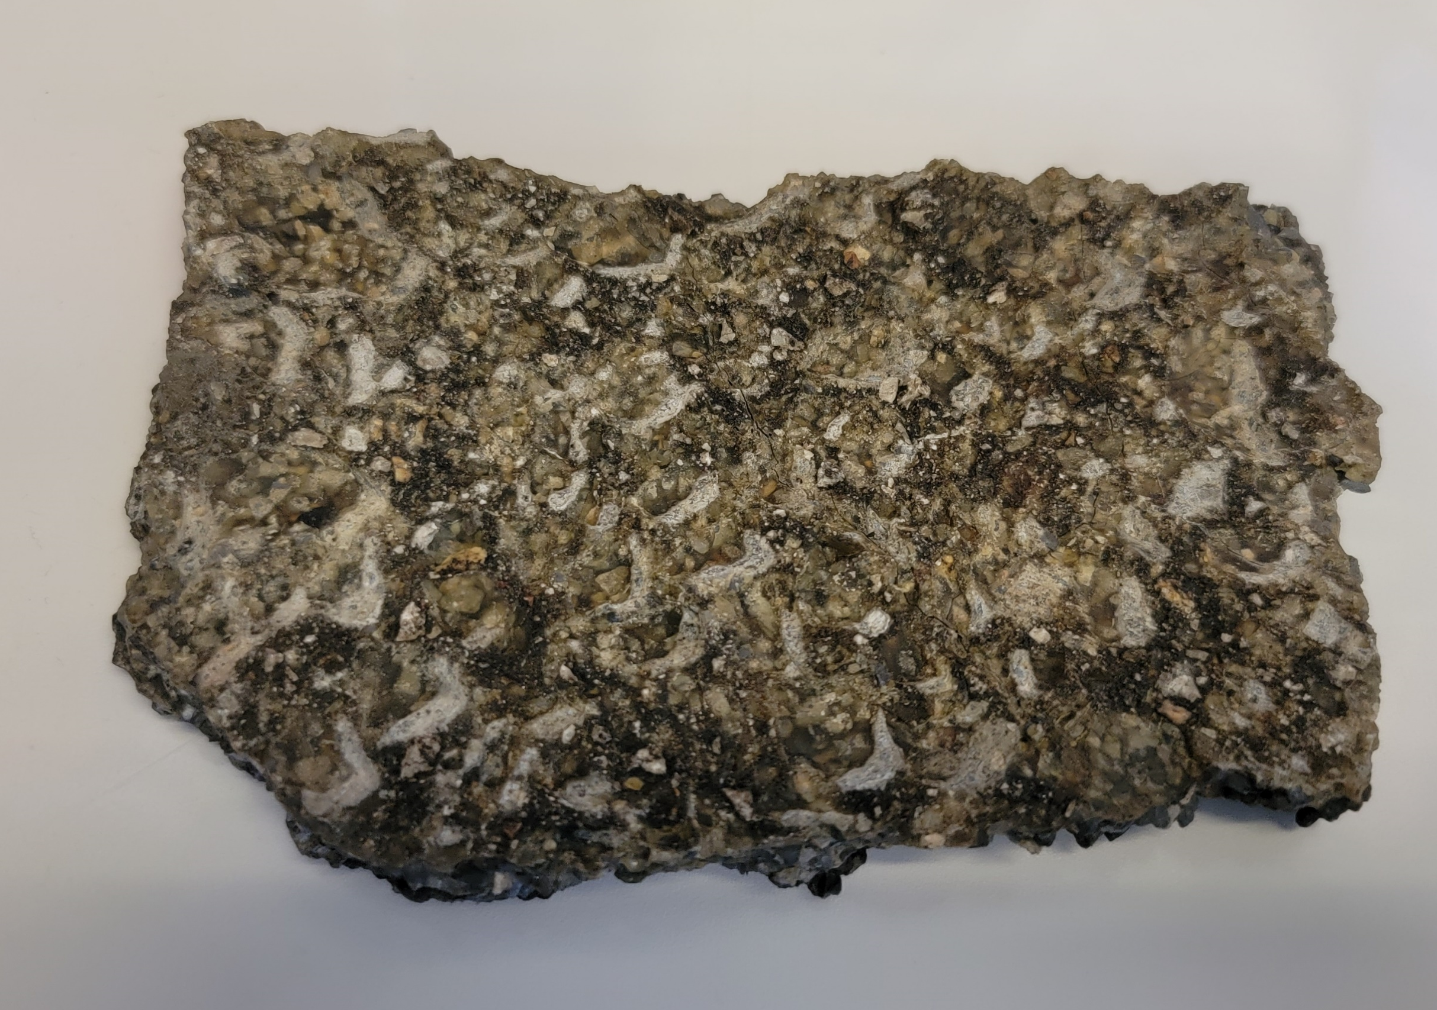
HFST
Pavement Condition
Check it
Fix it
Change SP to include semi automated application
Look at possibly changing the application system
Chip seal
Micro
Put a picture of the HFST underside
Notes:
Most likely it wasn’t the HFST that failed it was human error whether it was site selection or the application process. We have made some changes to the SP since this project but I think we can make a few more changes to help ensure we don’t have these problems in the future.
We now make sure that the pavement is in good enough condition to support HFST and we have made some changes to the surface preparation.
We could also look at changing the spec to allow for semi automated which would open up the process to more contractors and possibly get better results
We could also look at including the aggregates from HFST into chip seals or microsurfacing, which would help reduce the price and possible allow us to do some work ourselves.
Bottom line is HFST does work to reduce crash rates we need to adjust what we are doing to make it a success.

Slide 9
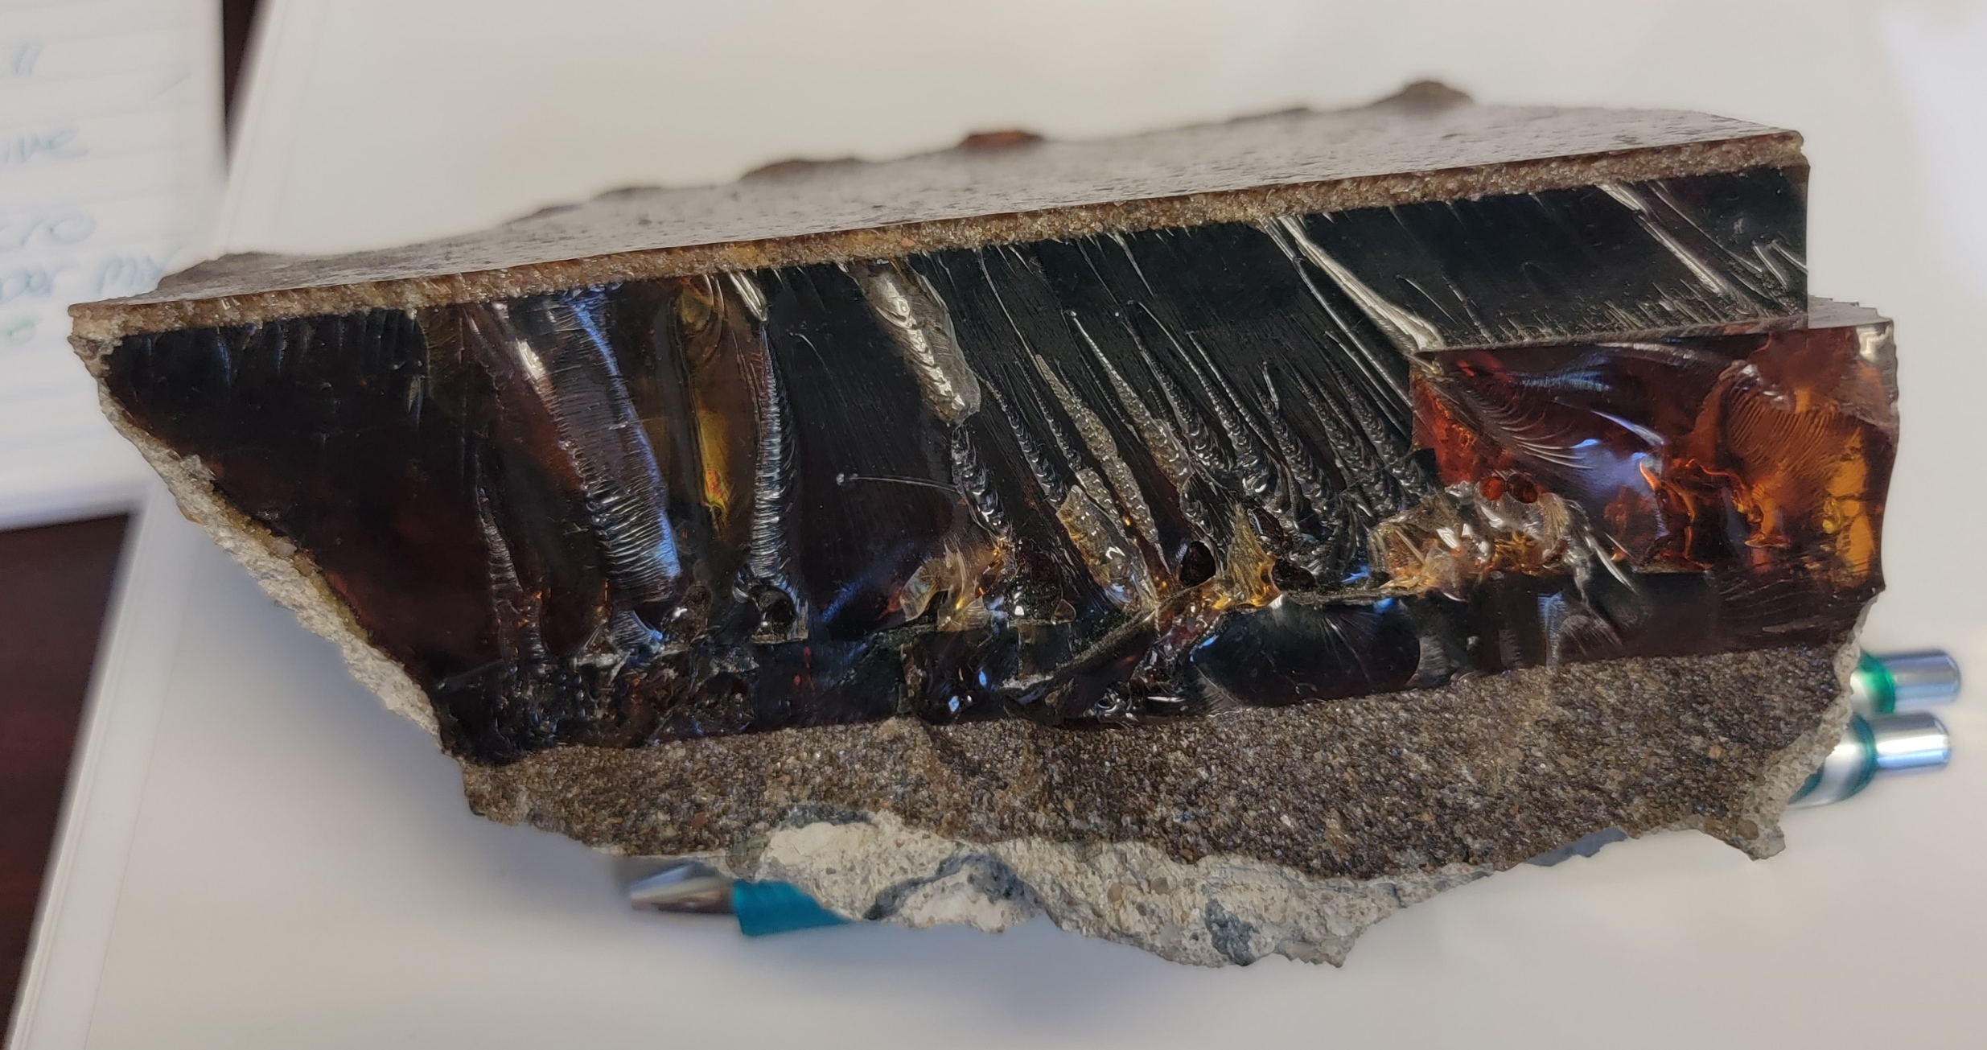
Epoxy Patching
Put picture of epoxy patch
Notes:
This is a chunk of an epoxy patch off of I30. The patch failed but the epoxy didn’t, You can see the epoxy bonded with the concrete but the concrete under the epoxy failed.

Slide 10
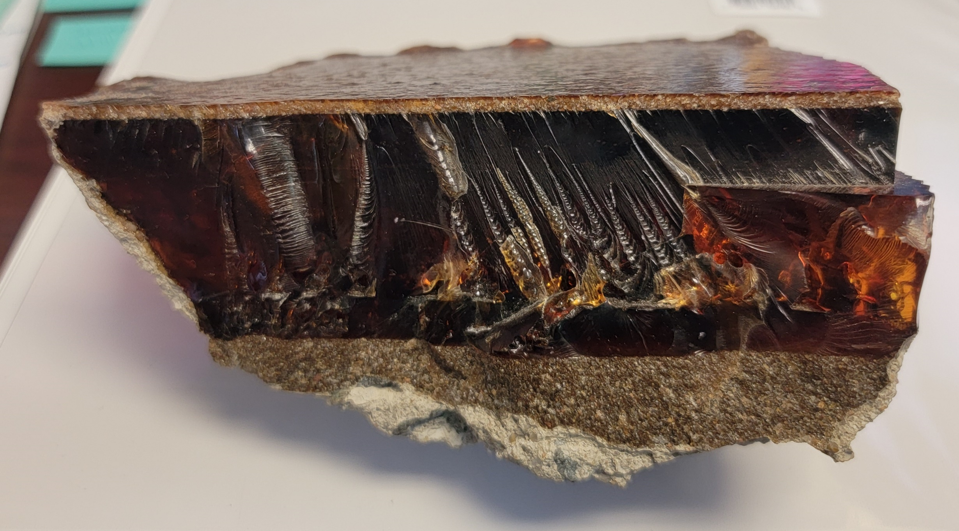
Failures?
Notes:
You may be wondering why I’m taking time from the awesome topic of sacrificial surfaces to talk about how past treatments have failed. You may have noticed a theme all these failures where human error and not the treatment themselves. Well, we have had a failure

Slide 11
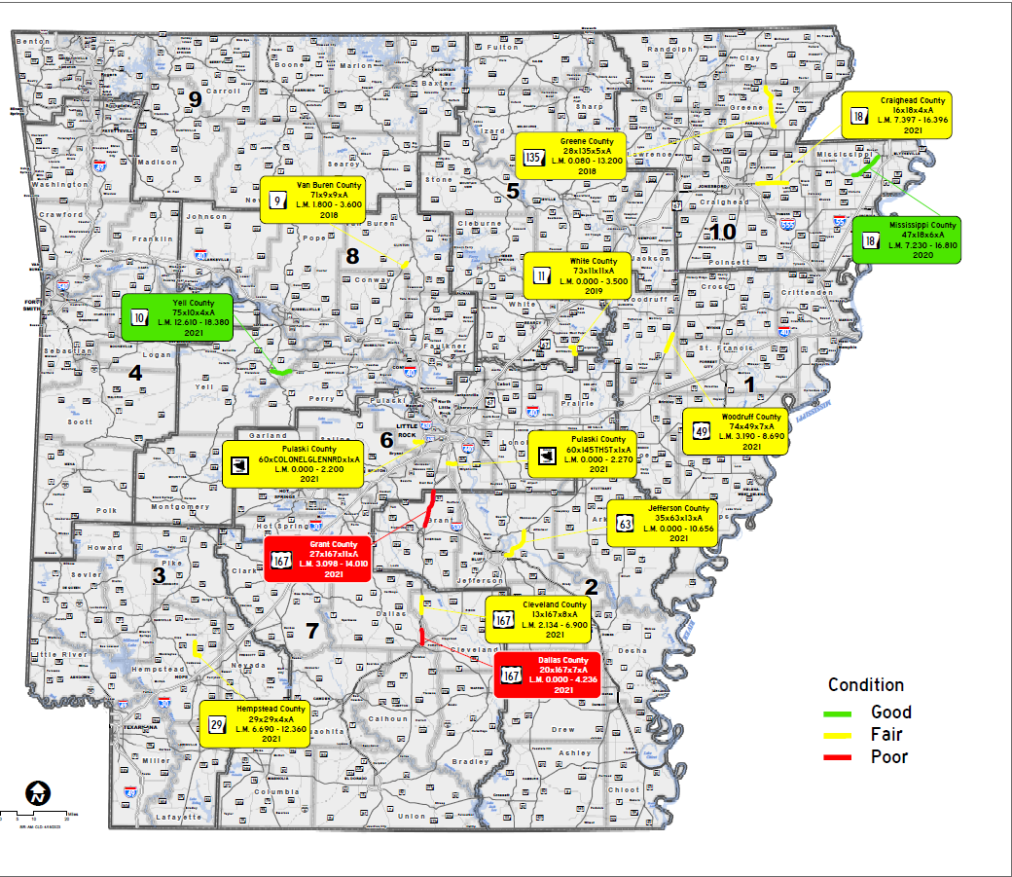
Microsurfacing Hwy. 167
We currently have microsurfacing on 15 locations across the state
The first Microsurfacing project was placed in 2018
Two locations where it has failed on (Hwy 167)
Notes:
On a microsurfacing job. In total we have 15 different locations where we have put microsurfacing down and out of the 15 locations we have had 2 fail by delaminating. I don’t know 100% what caused the failure, most likely the underlying pavement was probably to far down the pavement deterioration curve for a microsurfacing. And prior to this failure occurring we had realized that it is nearly impossible to select microsurfacing jobs 2 to 4 years in advance. So we have asked for a line item in the STIP like we do for chip seals so we can select locations a year out. We also want to take a step back and start placing micros on lower volume routes. Our thought is to select some non-aphn routes rutting and chip seals already on them. Microsurfacing can fill ruts up to two inches and by placing a micro ontop of a chip seal you get a combination treatment call a cape seal. This double layer treatment should last longer and perform better then either a chipseal or a micro would do by there self. Our request hasn’t been approved, we have been asked to come up with a few 2 – 3 locations as a proof of concept, which we are currently working on.
With Microsurfacing or any other new treatment we try we always do our best to ensure we don’t have failures, unfortunately things don’t always go as planned. When we do have failures we go back figure out what happened and try to make sure that it doesn’t happen again. What we need your help with is not automatically blaming the treatment, because most like its not the treatment it’s the human factor.

Slide 13
Does the Roadway Design Division design structurally sound pavements?
Notes:
Easy question…. Does the Roadway Design division design structurally sound pavements? (show of hands)
I hope everyone agrees or we have a big problem.
I have complete confidence that Roadway can and does design structurally sound pavements.

Slide 14
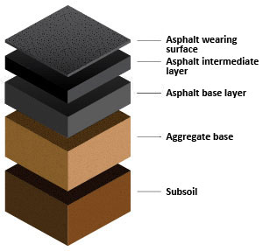
Notes:
So, baring any unforeseen changes like the addition of a manufacturing facility or major unexpected increase to the population the amount of pavement that Roadway design puts in the plans should be enough to handle all the projected traffic loads correct?

Slide 15
Does “the pavement need more structure?”
Notes:
Why do we say “the pavement needs more structure”
I do want to make one point clear we are talking about highways that have been designed we are not talking about highways that were game trails that became foot paths that became wagon trails that became dirt roads that became gravel roads that got a surface layer put on them.
Our pavement needs more structure is hands down one of the most common comments we get back when we recommend mill & overlays, thin overlays, and UTBWC for preservations treatments.

Slide 16
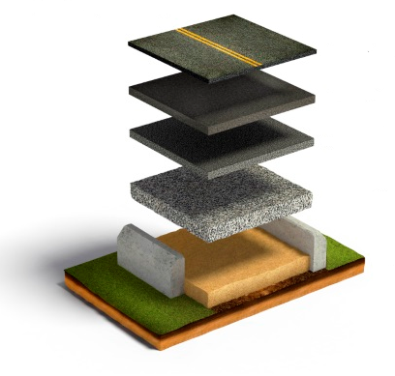
Names for the Top Layer of Pavement
Surface Layer
Wearing Course
The Roof of the Pavement
Sacrificial Layer
Notes:
There are several names for the top layer of pavement, a few are surface layer, wearing course, the roof, and the best (at least to me) Sacrificial Layer.
Per the Oxford dictionary it is “relating to or constituting a sacrifice” (Not helpful) but the Technical definition is
“Designed to be used or destroyed in fulfilling a purpose or function”

Slide 17
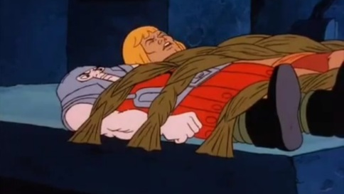
Sacrificial Surfaces: The Defenders of our Pavement Structure
Notes:
And that is exactly what the surface of our pavements do they protecting the underlying layers from sunlight, tire wear, breaking forces, ect

Slide 18
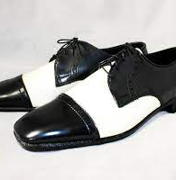
Example: Your Favorite Dress Shoes
Notes:
Lets look at this in a different way – you have your favorite pair of dress shoes you wear them 24/7. You wear them so much that

Slide 19
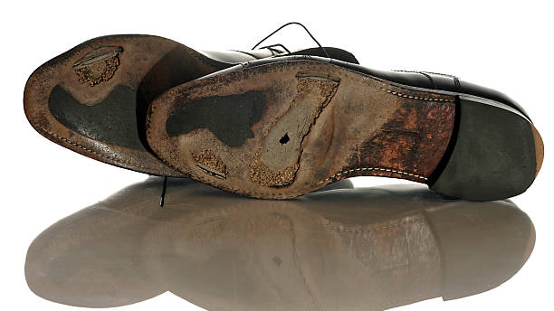
Notes:
You wear holes in the soles
What do you do
Go out and by new shoes $$$$$
Go get them resoled make them good as new or

Slide 20
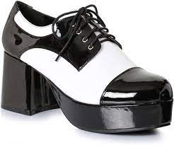
Notes:
Do you slap some bondo in the holes and put another sole over the old one?
Personally I would get them resoled, that additional layer isn’t adding anything, its warn out it has taken all the force from the steps it could take and has nothing is left. Leaving that old warn out nonflexible layer in may cause your new sole to wear out faster. The only thing leaving the old layer in does is add height.

Slide 21
Moving Forward with System Preservation and Pavement Preservation
Notes:
As we move forward with system preservation and pavement preservation, we are doing less reconstruction and we are treating our pavements more like a perpetual pavement.

Slide 22
FHWA Defines Perpetual Pavement as:
A perpetual pavement is defined as an asphalt pavement designed and built to last longer than 50 years without requiring major structural rehabilitation or reconstruction and needing only periodic surface renewal in response to distresses confined to the top of the pavement. The basic premise is that an adequately thick asphalt pavement placed on a stable foundation will resist distresses that form at the bottom of a pavement structure and are costly to correct. By limiting distress formation to the pavement surface layer, the pavement life can be extended in perpetuity by rejuvenating the pavement surface materials and remove and replace the type of maintenance operation.
Notes:
Read Definition
I’m not saying all our pavements are going to last 50+ year but with proper preservation strategies they will last much longer.
So… sacrificial surfaces is a term that we need to keep in the back of our mind. Preservation treatments aren’t meant to last for ever and just like the top surface layer of asphalt they will need to be removed and replaced once their purpose has been for filled.

Slide 23
To Mill or Not to Mill? That is the Question
Surface Condition
What distresses are in the surface layer
How sever are the distresses
Is the surface layer from a problematic mix design
Underlying Pavement Structure
How thick is the pavement
Does the pavement have adequate structure
Is there any Stripping
What is the traffic like
Is this route on the APHN
Is the surface layer bonded to the underlying pavement
Notes:
So…. What goes into the decision on to mill or overlay, there is actually several factors that come into play (read slide)
Typically we don’t core and run FWD on every job but if there is any concern from district or design we are more than happy to collect the additional information

Slide 24
Overlay or Mill?
Notes:
For the last few minutes of my presentation I would like to go through a couple of examples and get your alls thoughts

Slide 25
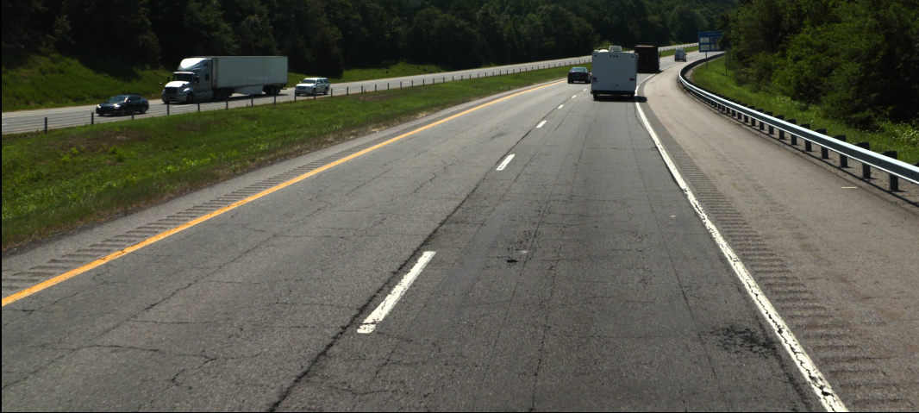
Overlay or Mill?

Slide 26
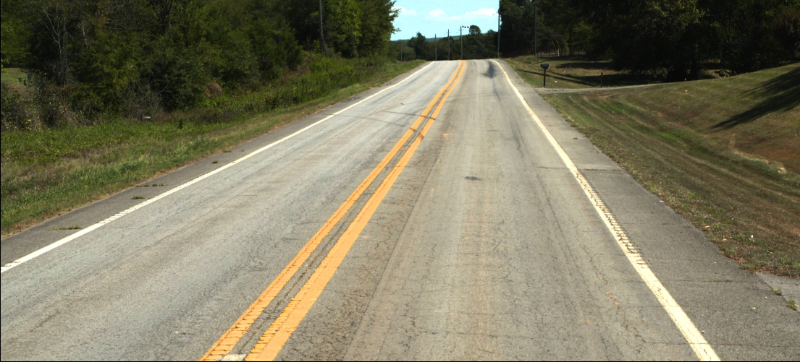
Overlay or Mill?

Slide 27
Overlay or Mill?

Slide 28
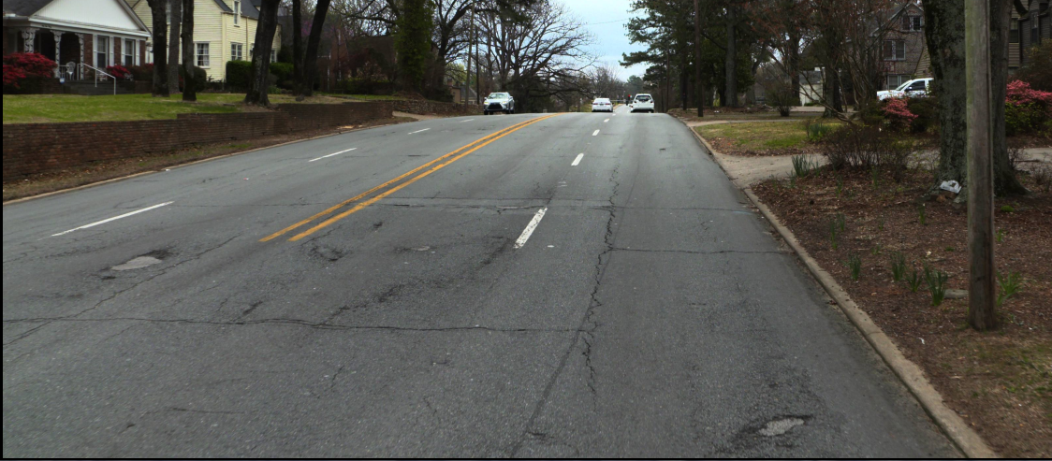
Mill 2” or Mill 4”

Slide 30
Questions?
Sarah Tamayo, PE
Sarah.Tamayo@ardot.gov

