Slide 1
THE DATA
BUFFET
ROADS
BRIDGES
PROJECTS
ASSETS
Our Appetite for Spatial
Data Governance and Transparency
Sharon Hawkins
ARDOT – GIS and Mapping

Slide 2
Presentation Agenda
The Wide Variety of Data at ARDOT
Remembering Our Data Challenges
New on the Menu
Developing the Recipe for
Data Governance
Celebrating Each Step

Slide 3
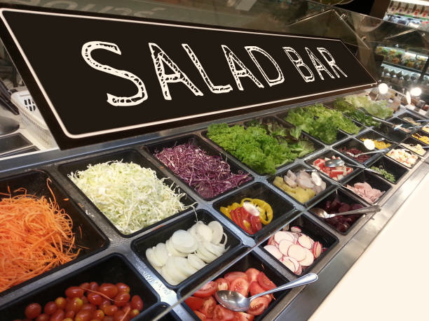
san1\
Reproduction
archive
csd5\
Infobase
Route Change
Application
HEAD
CHEF
HEAD
CHEF
HEAD
CHEF
csd5\infobase
Administrative Orders (Holidays, etc…)
Searchable Commission Minutes Since 1953
Full Scanned MOs Since 2013

Slide 4
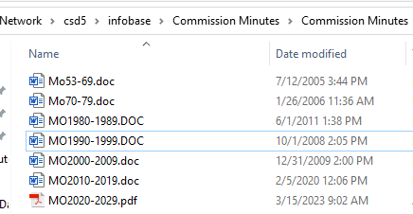
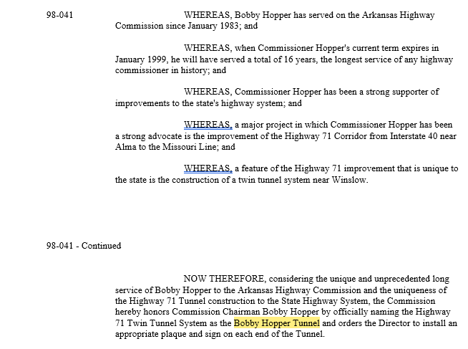
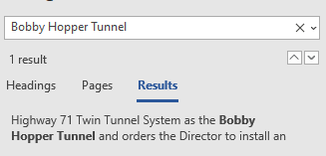
san1\
Reproduction
archive
csd5\
Infobase
Route Change
Application
HEAD
CHEF
HEAD
CHEF
HEAD
CHEF

Slide 5
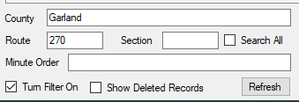
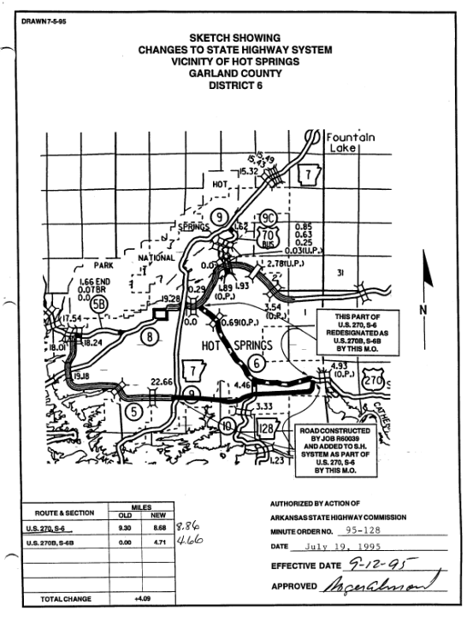
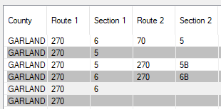
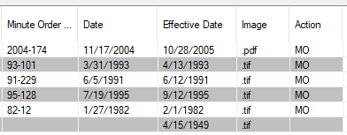
san1\
Reproduction
archive
csd5\
Infobase
Route Change
Application
HEAD
CHEF
HEAD
CHEF
HEAD
CHEF
Route Change Application

Slide 6
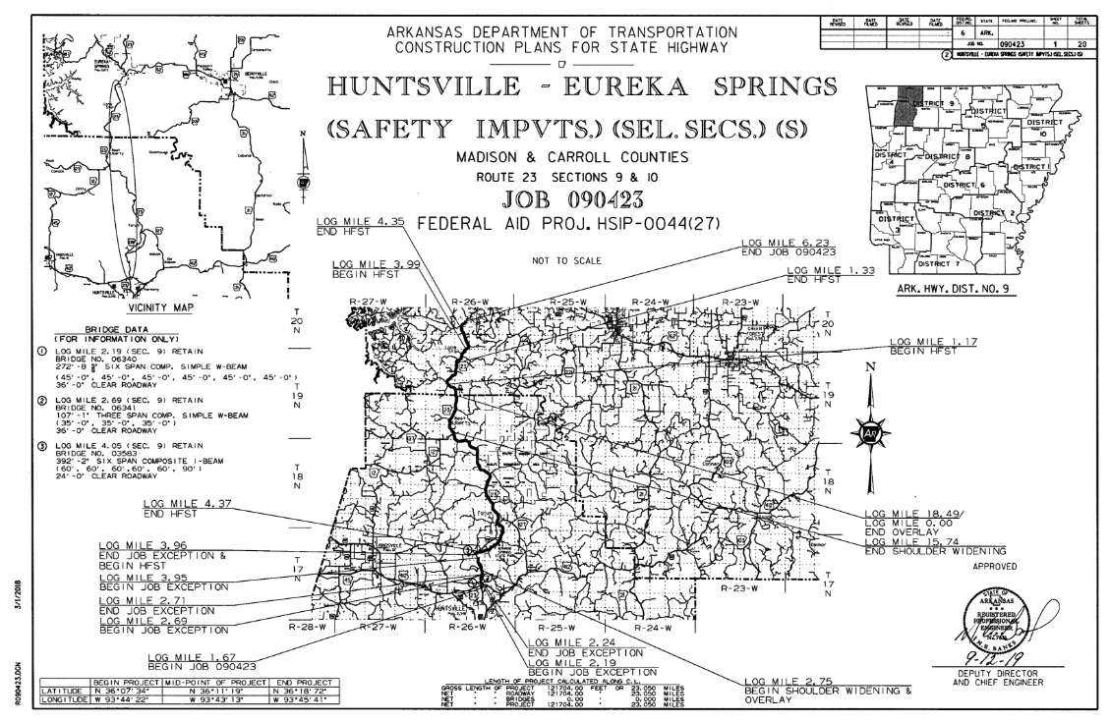
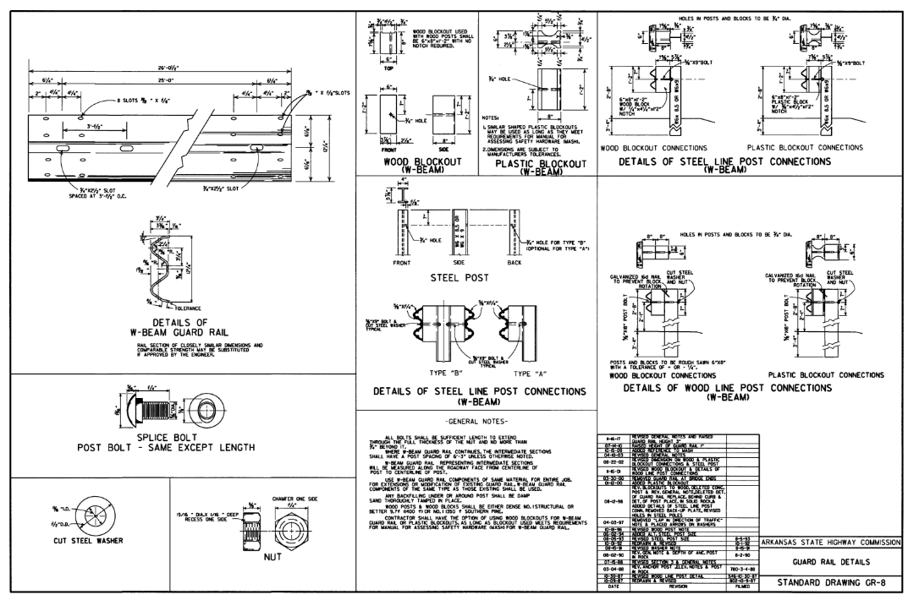
san1\
Reproduction
archive
csd5\
Infobase
Route Change
Application
HEAD
CHEF
HEAD
CHEF
HEAD
CHEF
san1\ReproductionArchive
Scanned Documents for Active and Historic Jobs
by Job Number

Slide 7
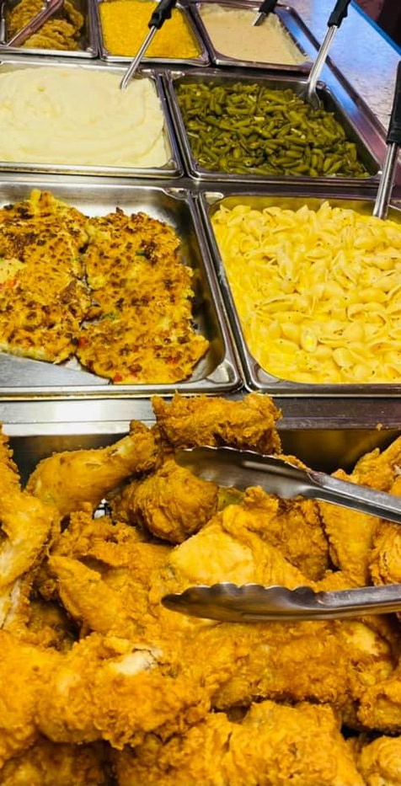
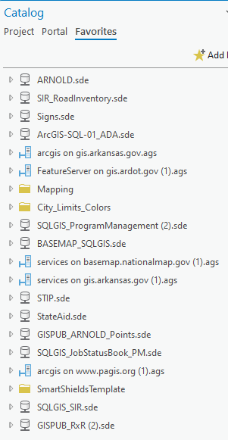
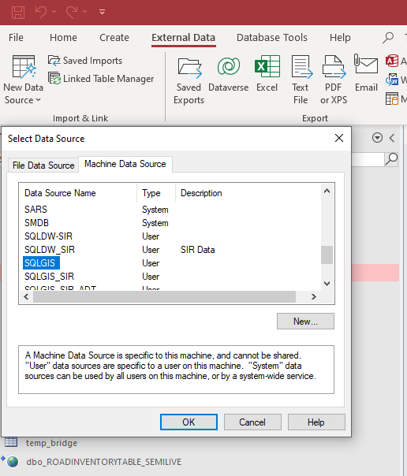
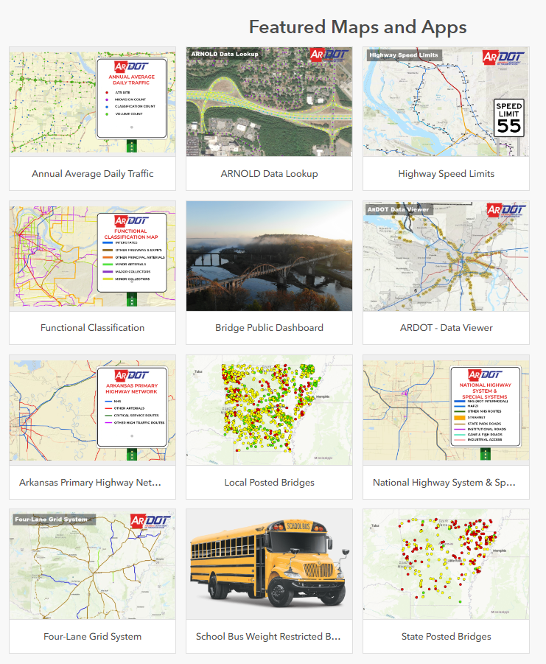
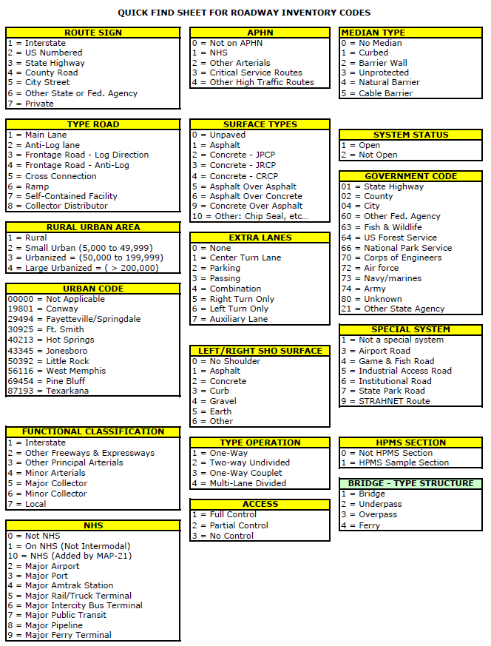
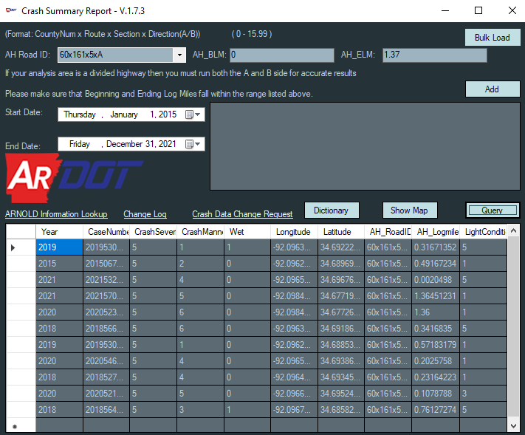
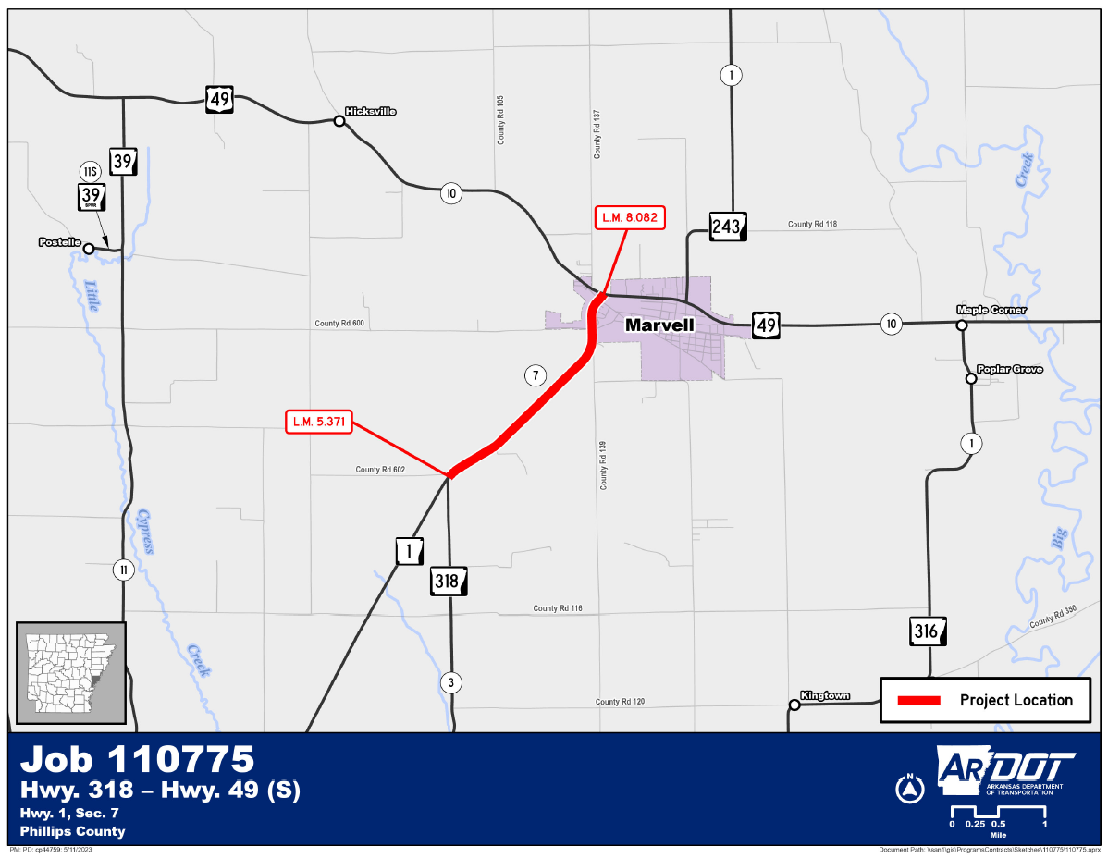
CRASH
AVERAGE
DAILY
TRAFFIC
BRIDGE
INVENTORY
JOB
STATUS
ROAD
INVENTORY
ARNOLD

Slide 8
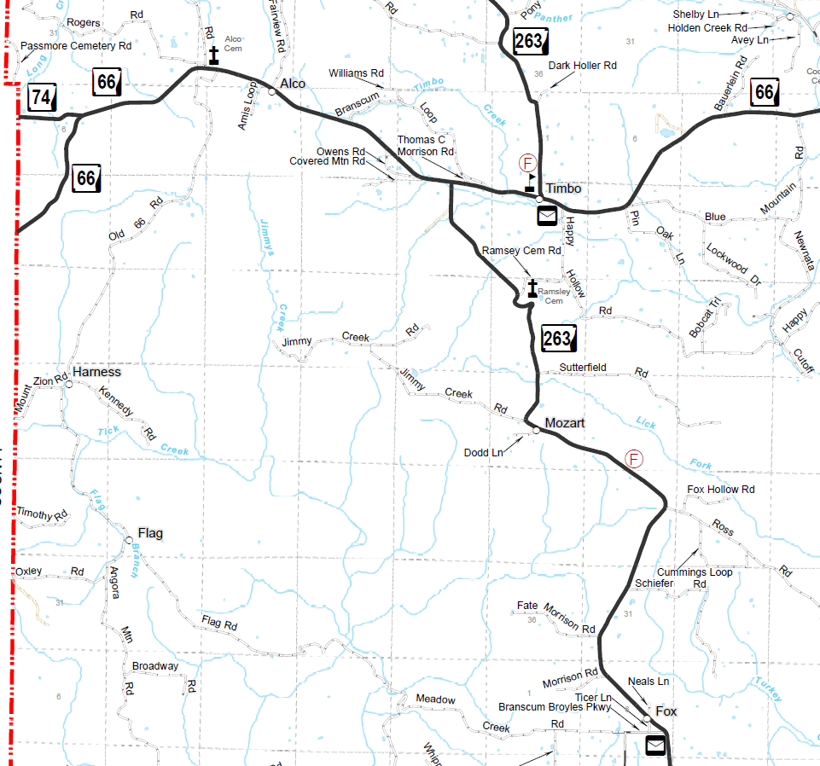
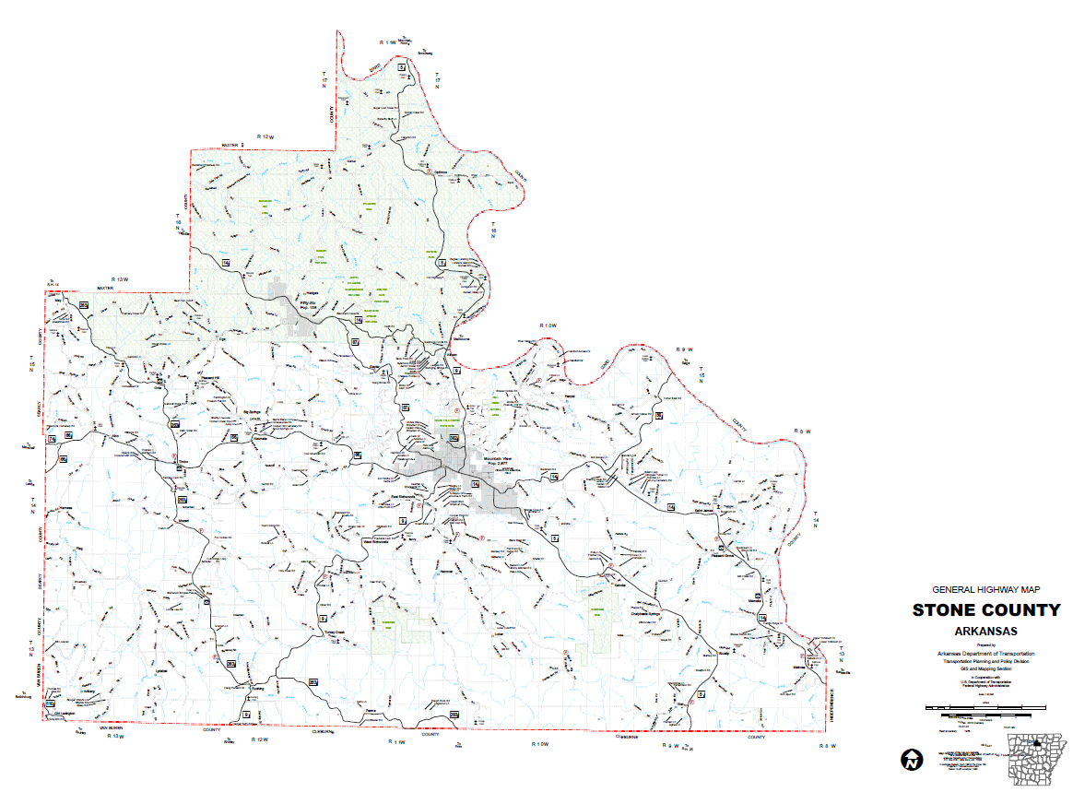
LiDAR
New
County
Maps
NPMRDS

Slide 9
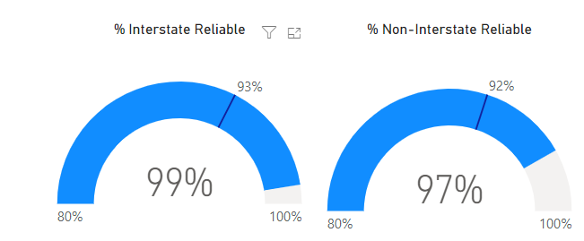
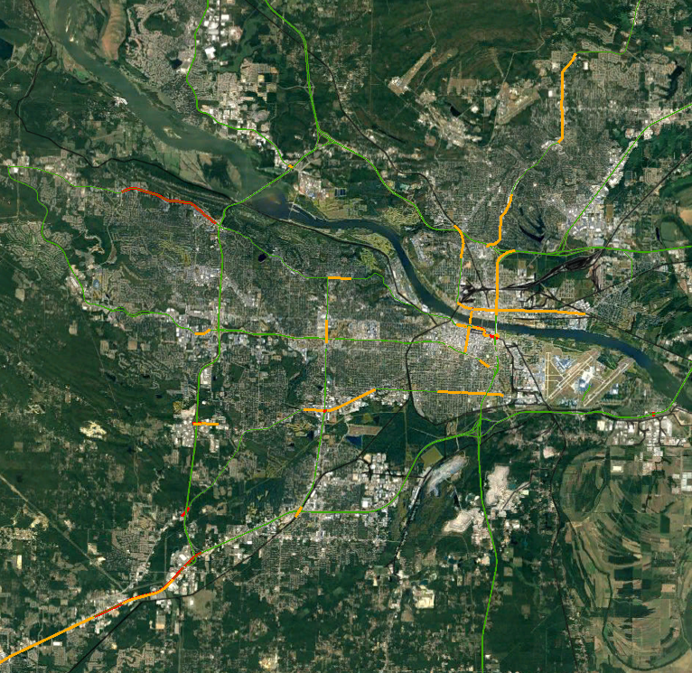
LiDAR
New
County
Maps
NPMRDS
National Performance Management Research Data Set

Slide 10
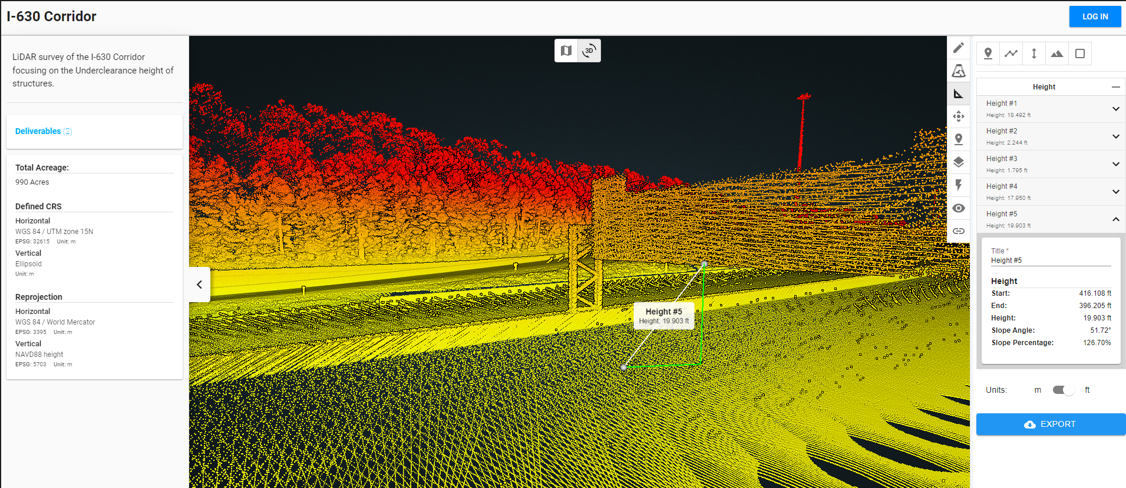
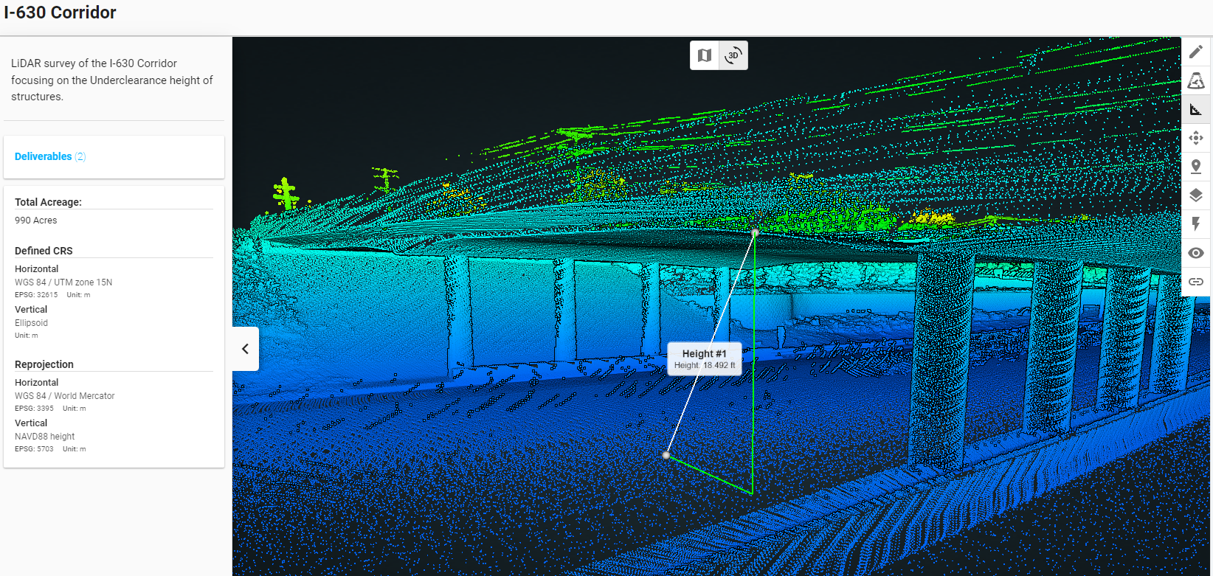
LiDAR
New
County
Maps
NPMRDS

Slide 11
Hidden
Candy
Drawer

Slide 12
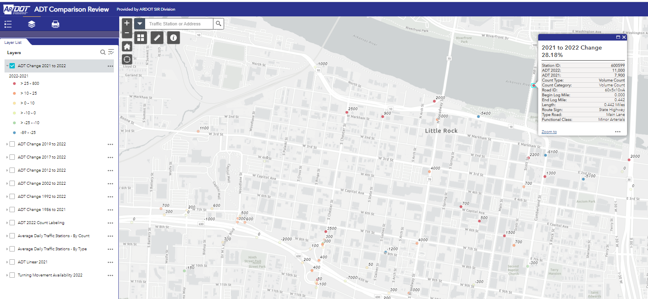
Hidden
Candy
Drawer

Slide 13
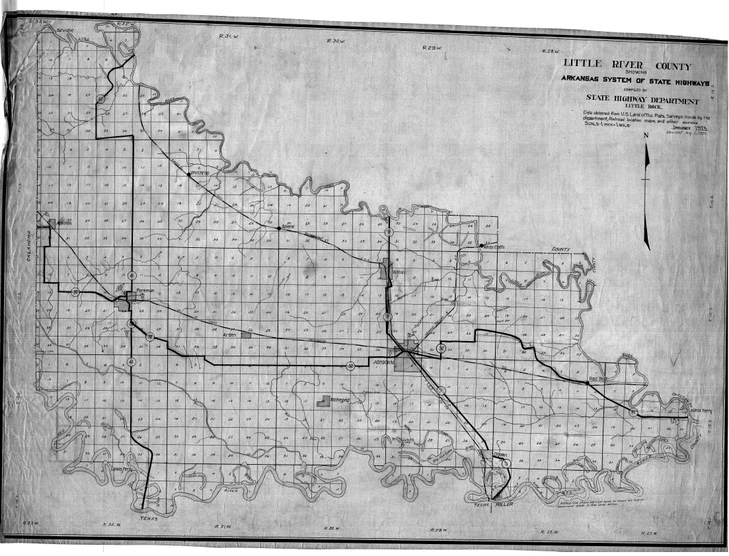
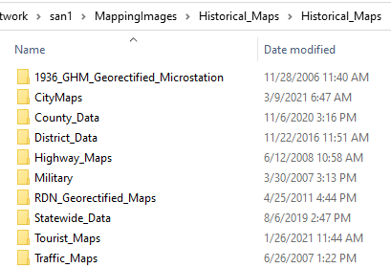
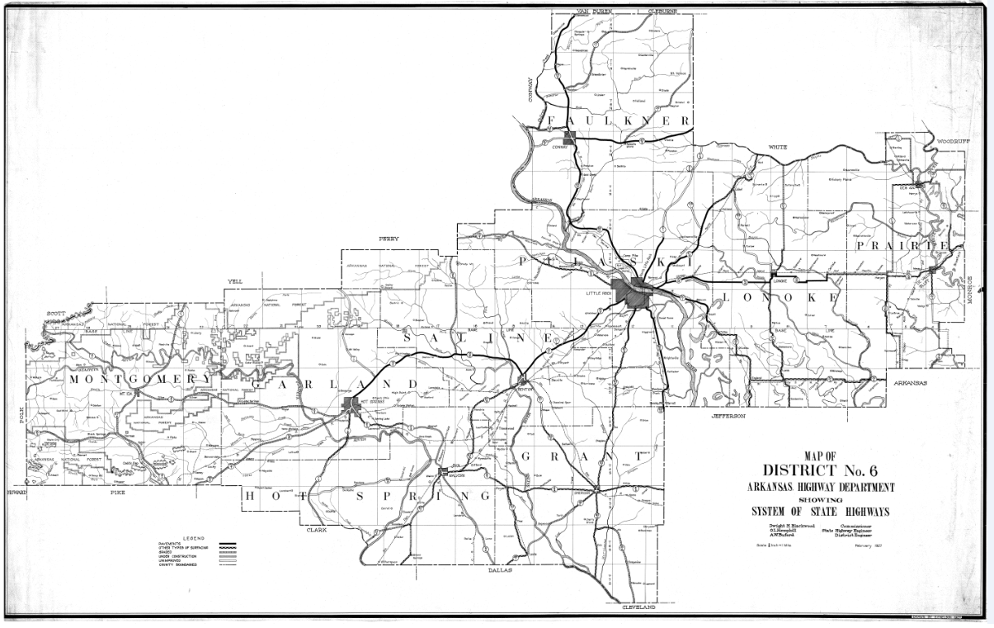
Hidden
Candy
Drawer

Slide 14
DATA
INDIGESTION

Slide 15
DATA INDIGESTION
IT DIVISION
How Many Access Databases are
on ARDOT’s Network?

Slide 16
DATA INDIGESTION
365,000
Equals 120 Access Databases per ARDOT employee
279,000 or 76.5% of those have not been utilized in over 5 years

Slide 17
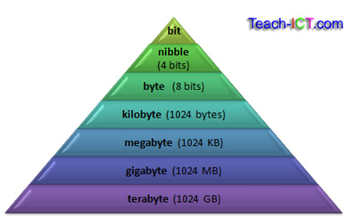
DATA INDIGESTION
Total Amount of Data Stored on the ARDOT Network in Terabytes (TB)?
1 Terabyte can:
Hold 3.6 Million Images
Hold 300 Hours of Quality Video
Hold 1,000 copies of Encyclopedia Britannica

Slide 18
DATA INDIGESTION
843.4 TB
411 TB or 48.7% of that data has not been utilized in over 5 years

Slide 19
Data Challenges
COMMUNICATION
DATA
ACCESSIBILITY
DATA
DOCUMENTATION
DUPLICATION OF
EFFORT
Discussing Data
DATA
STANDARDS
Where’s the Data?
Data Catalog/Data Dictionaries
One Authoritative Source
Field Names, Data Types, Accuracy, Attributes
https://www.christianpost.com

Slide 20
Data Challenges
HEAD
CHEF
HEAD
CHEF
HEAD
CHEF
HEAD
CHEF
HEAD
CHEF

Slide 21
ARDOT Efficiency Study
Recommendation #1
Key Performance Indicators
(Performance Measures)
Choose from:
Bridges
Pavement
Safety
Program Funding
New on the Menu

Slide 22
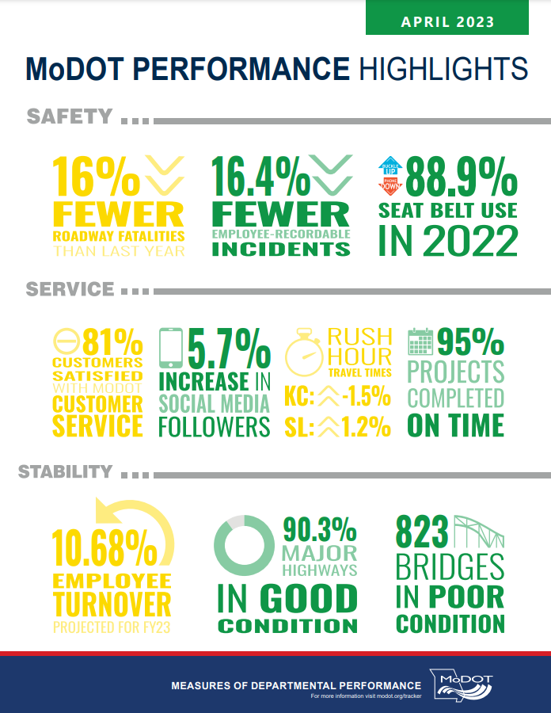
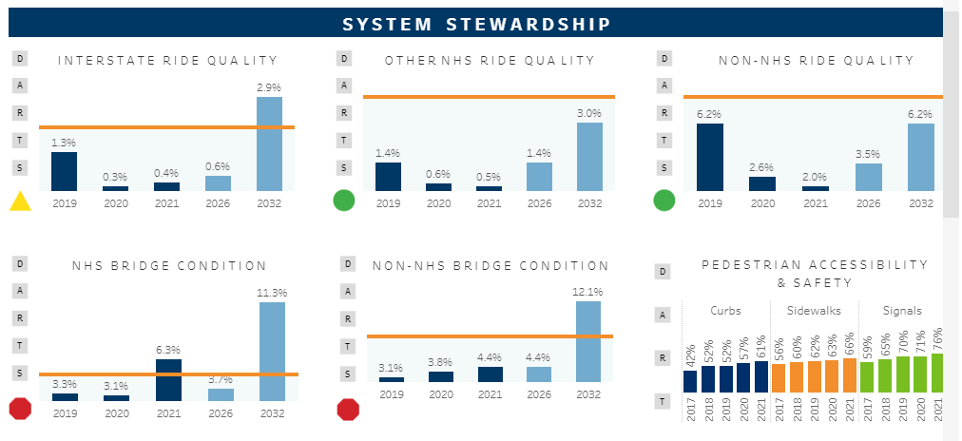
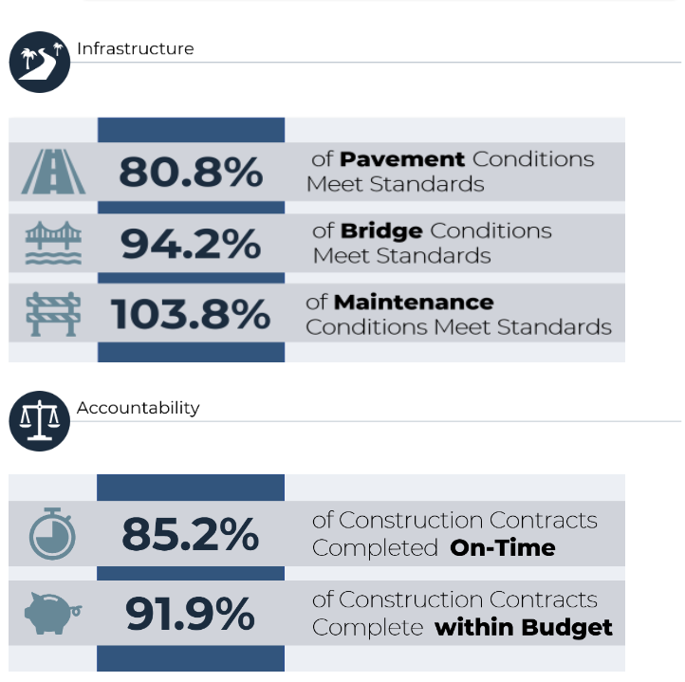
Virginia
Missouri
Minnesota
Florida

Slide 23
Data Survey
Build Your Own Response
Kind of Data
Where is the Data
Data Attributes (Dictionary)
Maintenance of Data
New on the Menu

Slide 24
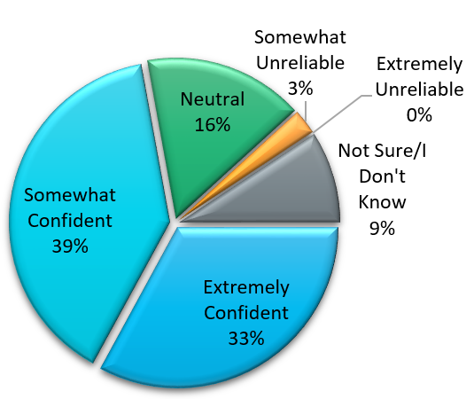
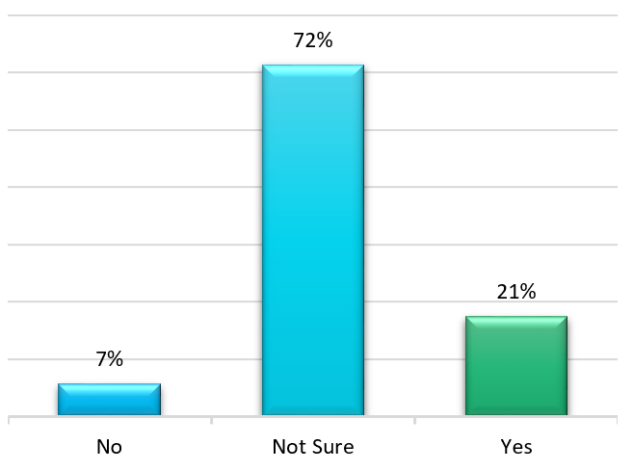
Data Survey 2017
CONFIDENT IN DATA?
DATA DOCUMENTATION EXISTS?

Slide 25
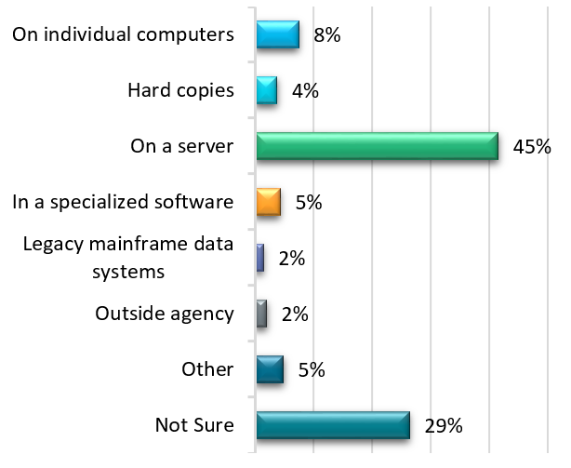
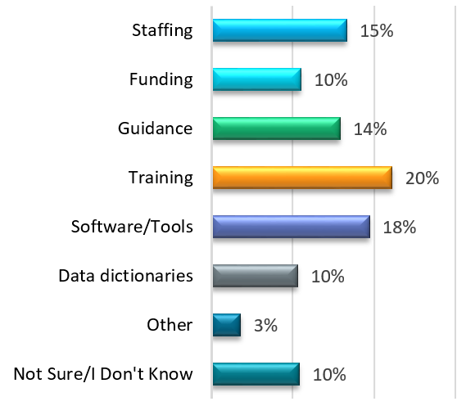
Data Survey 2017
WHERE’S THE DATA?
DATA NEEDS?

Slide 26
Data Survey 2017

Slide 27
Data Survey 2017

Slide 28
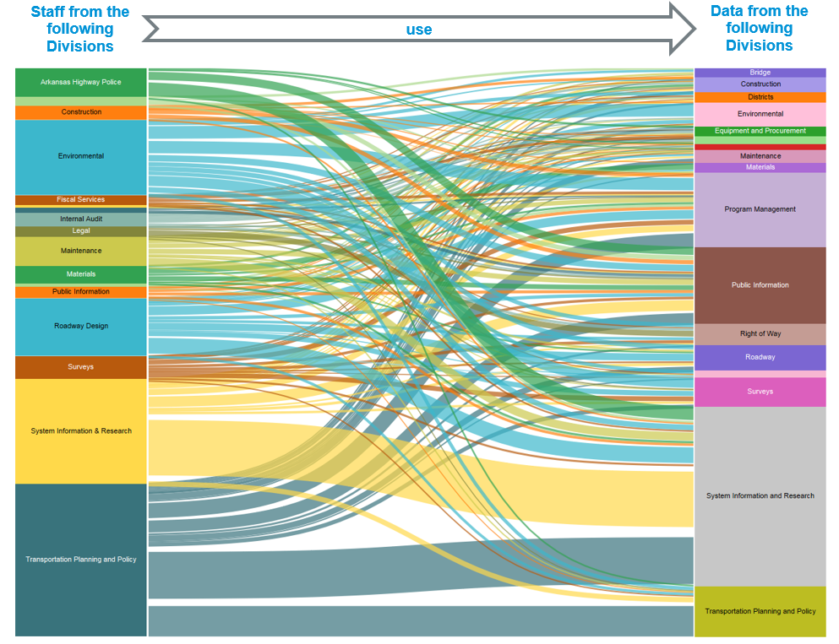
Data Survey 2017

Slide 29
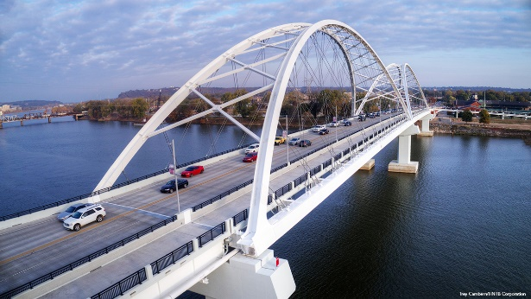
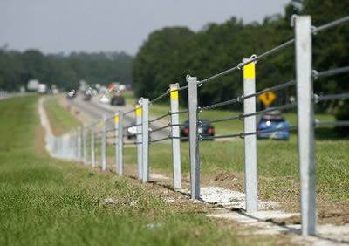
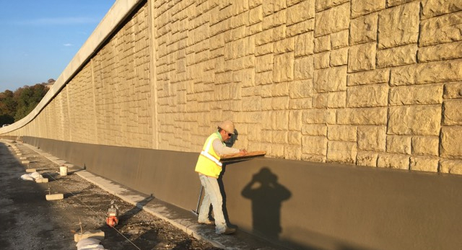
Data Governance
Recognize that Data is also an asset that must be actively managed and maintained

Slide 30
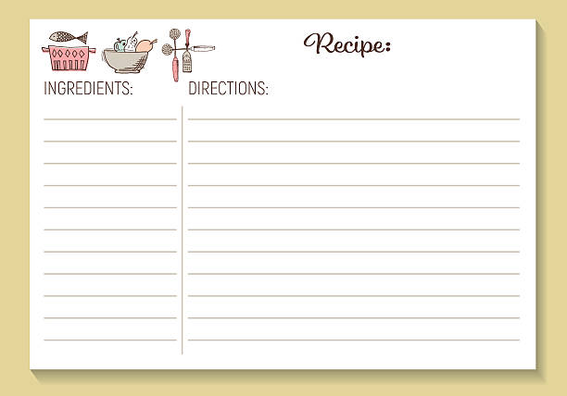
DATA
Develop and Send a Data Survey – Respond as Needed
DATA ABOUT DATA
Develop and Share Data Catalog and Data Dictionaries
Drafting a Recipe for Data Governance

Slide 31
A Path to Data Governance
DATA CATALOG
DATA DICTIONARY
Lists All Available Data Sets
Where is the Data
Clarify Owners
Information to understand the purpose and how to use the data
List/Definition of attributes
Type Field (Text, Number, etc…)
Number characters allowed
Information expected/required
Temporality and limitations
METADATA

Slide 32
A Path to Data Governance
“METADATA
IS A
LOVE NOTE
TO THE FUTURE”
Unknown

Slide 33
DATA
Develop and Send the Data Survey – Respond as Needed
DATA ABOUT DATA
Develop and Share Data Catalog and Data Dictionaries
DATA ADVERTISING
AND OUTREACH
Create Newsletters – E-mails – Training – Lunch n’ Learns
FORMAL GOVERNANCE
STRUCTURE
Decision Making Body with Clear Authority and Responsibilities
TIME/DEDICATION
Make Data Governance a Priority
Drafting a Recipe for Data Governance

Slide 34
Celebrating Each Step
ARDOT Administration supports moving Data Governance forward
IT Division + Data Owners/Users collaboration with database creation, maintenance, and storage
95% of all spatial data across ARDOT is ARNOLD compliant
Datasets across the Department that have solid policy/procedures/documentation in place

Slide 35
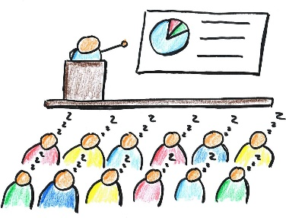
Talking about data isn’t always exciting…
https://freepowerpointtemplates.com/article/boring-presentations-problem/

Slide 36
THANK YOU

