Slide 1
Traffic Signal Warrants
Stephen Sichmeller, P.E.
Asst. Division Head – NWA
Roadway Design Division

Slide 2
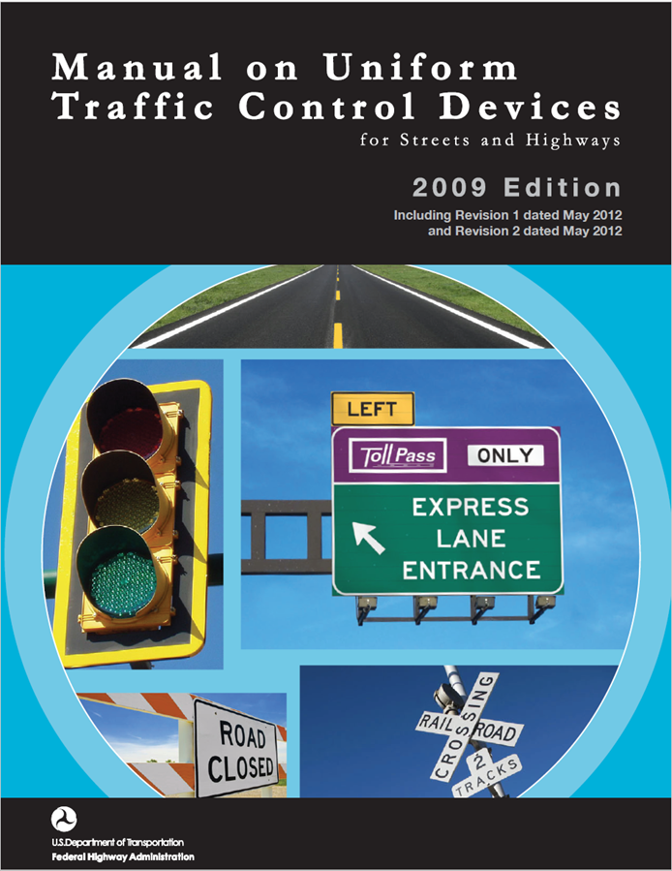
part 4

Slide 3
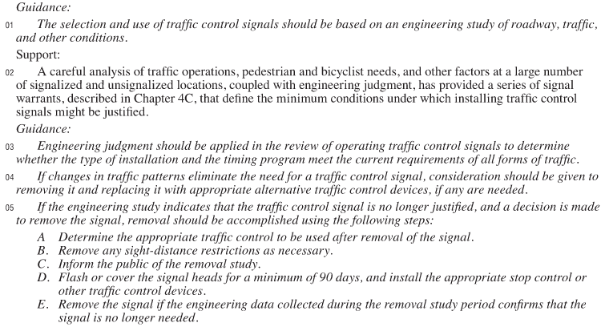
Section 4B.02 Basis of Installation or Removal of Traffic Control Signals

Slide 4
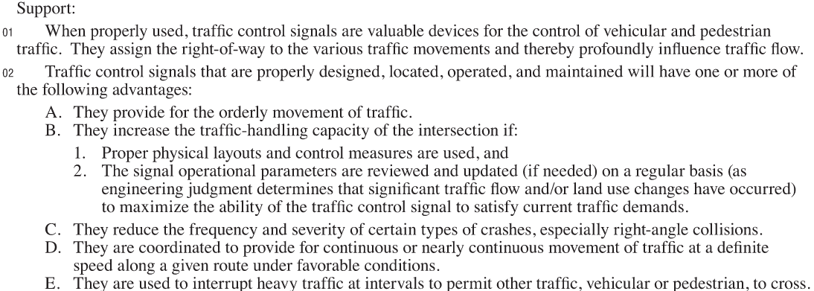
Section 4B.03 Advantages and Disadvantages of Traffic Control Signals

Slide 5
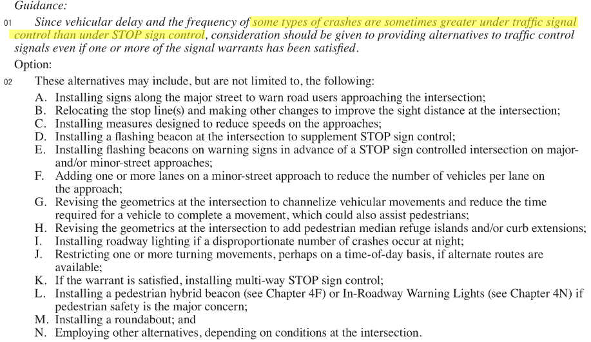
Section 4B.04 Alternatives to Traffic Control Signals

Slide 6
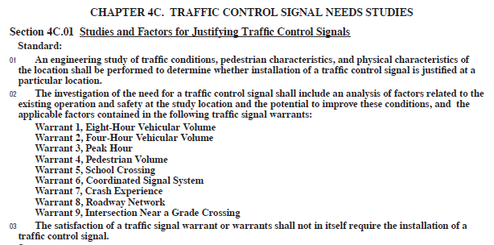
WARRANTS FOR TRAFFIC SIGNALIZATION

Slide 7
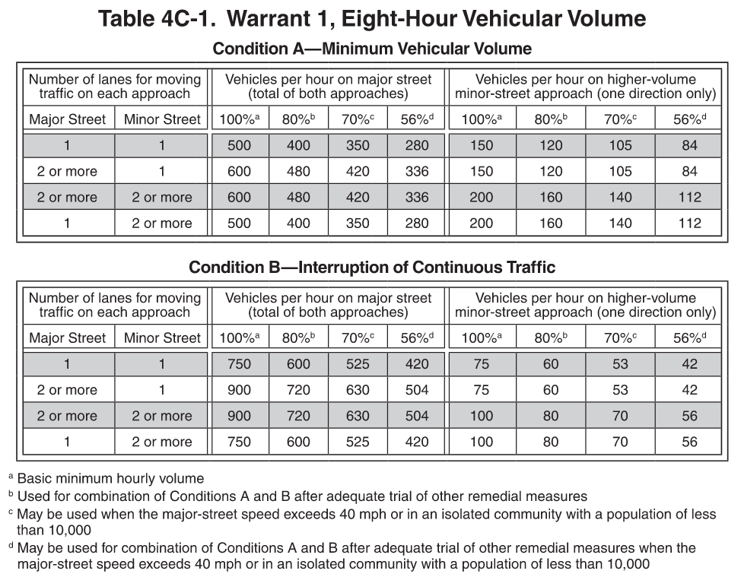
Warrant 1, eight-hour vehicular volume

Slide 8
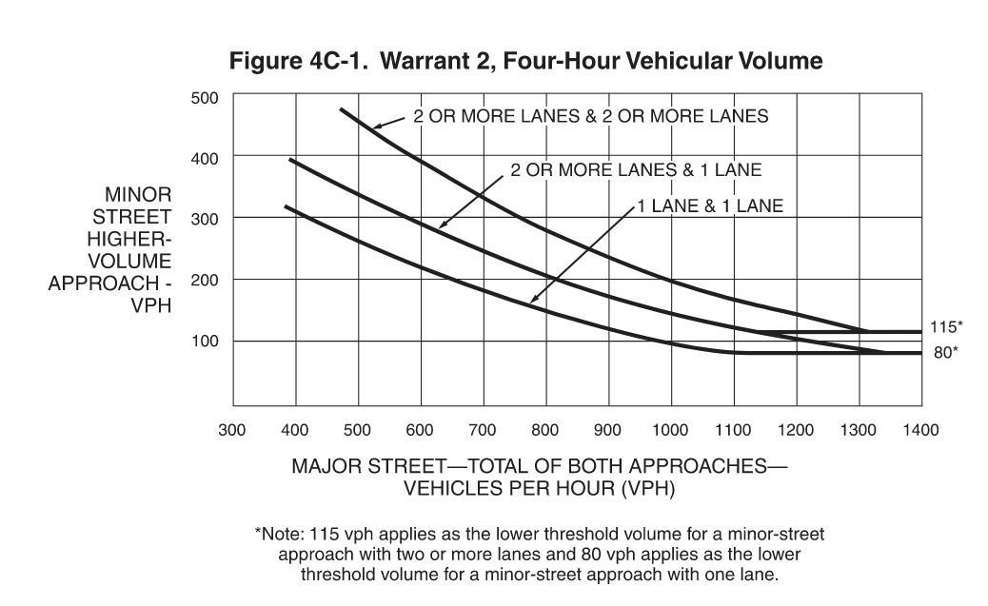
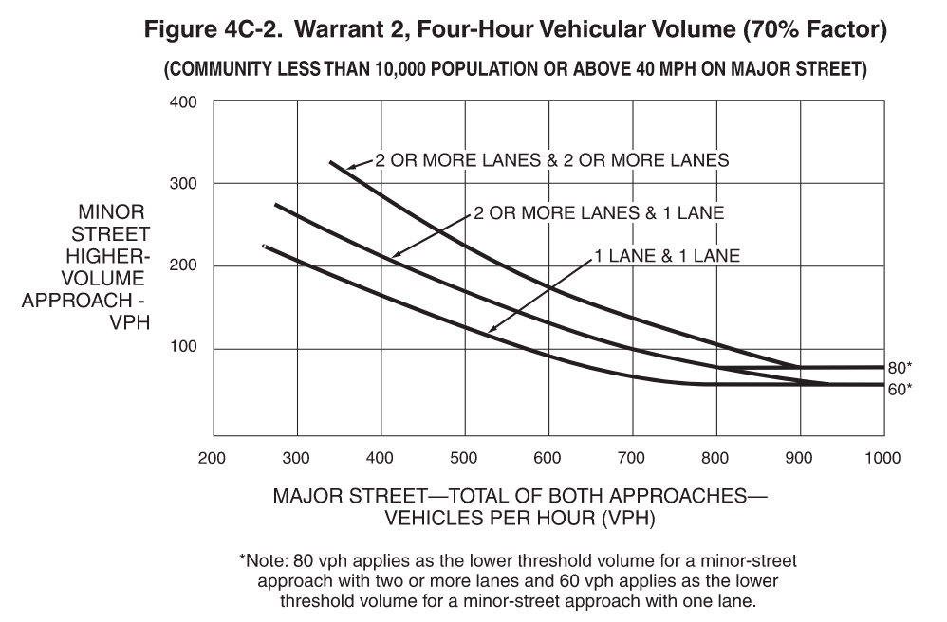
Warrant 2, four-hour vehicular volume

Slide 9
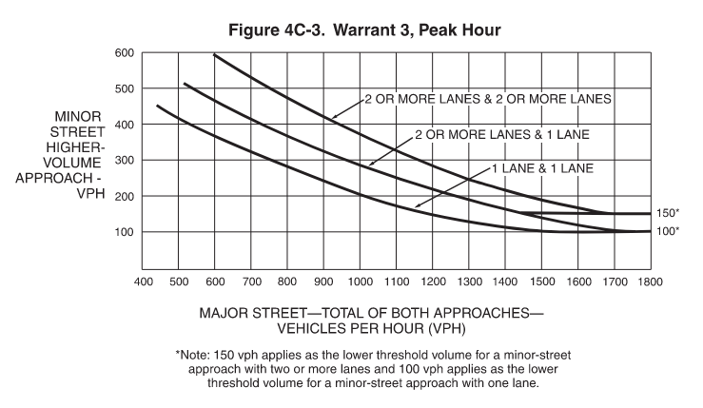
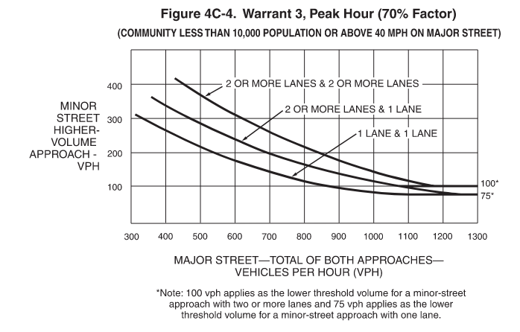
Warrant 3, peak hour

Slide 10
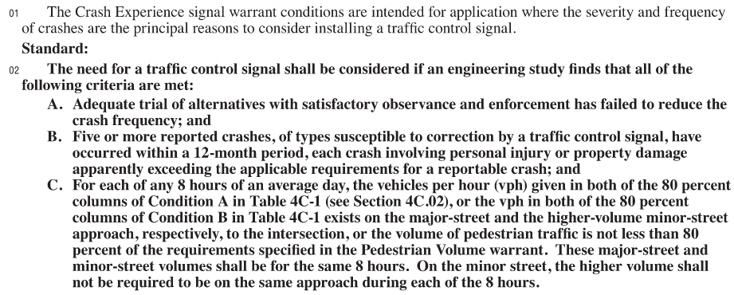
Warrant 7, crash experience

Slide 11
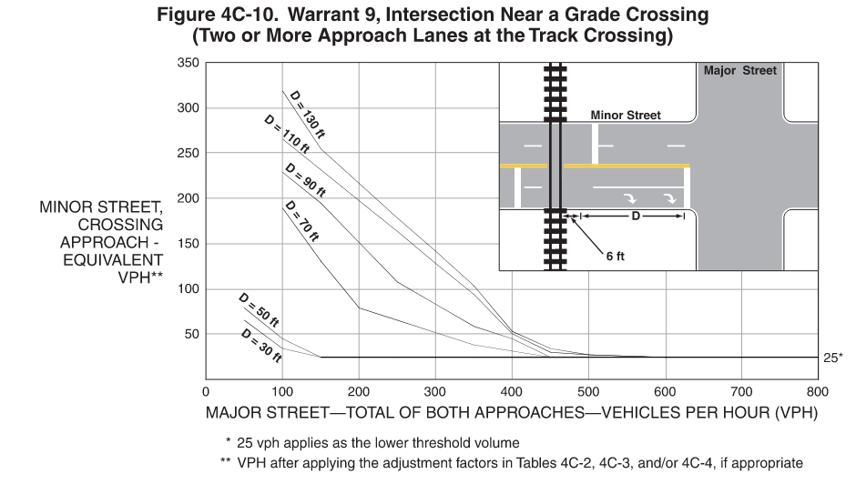
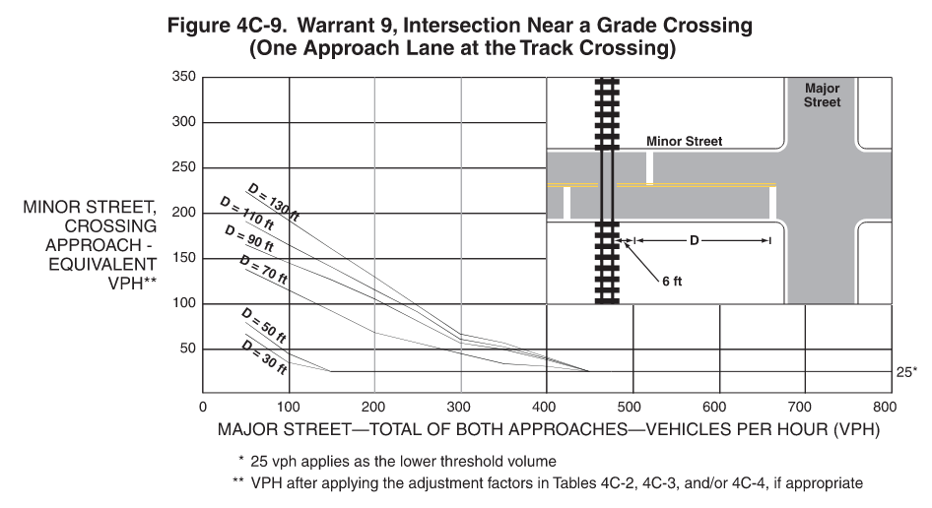
Warrant 9, intersection near a grade crossing

Slide 12
Warrant 4, pedestrian volume warrant 5, school crossing warrant 6, coordinated signal system warrant 8, roadway network

Slide 13
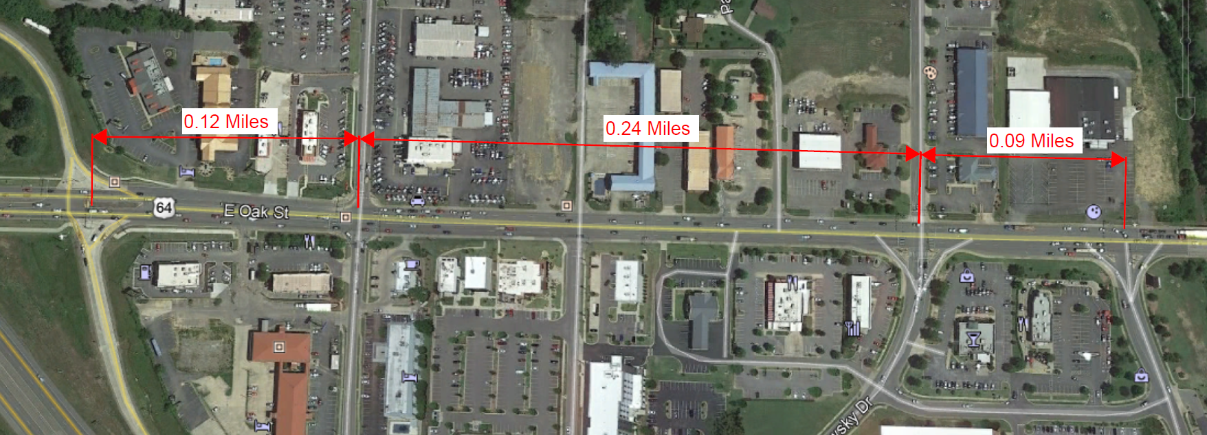
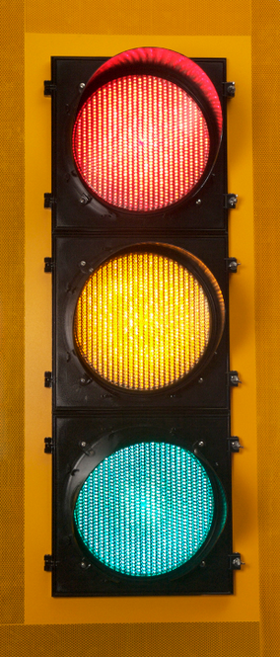
Traffic signal spacing
Copyright © 2021 University of Florida. All Rights Reserved.
HCS™ Signal Warrants Version 7.8.5
Generated: 3/16/2021 7:47:21 AM

Slide 15
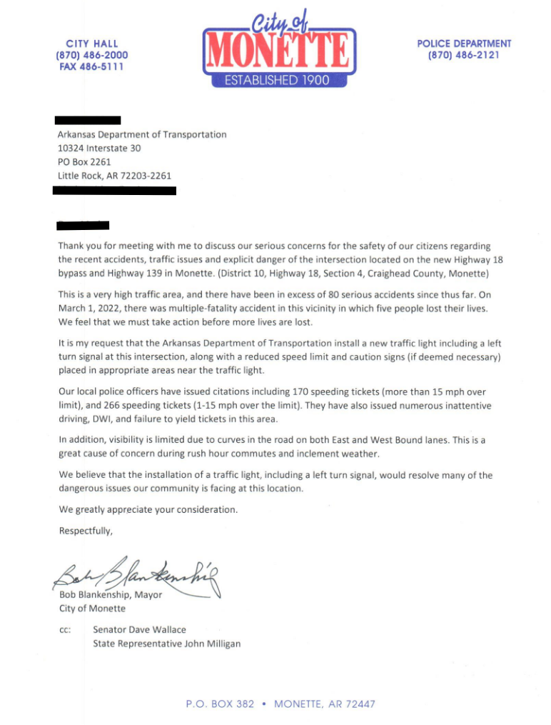
REQUESTS FOR A NEW TRAFFIC SIGNAL ON A STATE HIGHWAY MADE BY THE LOCAL MUNICIPALITY

Slide 16
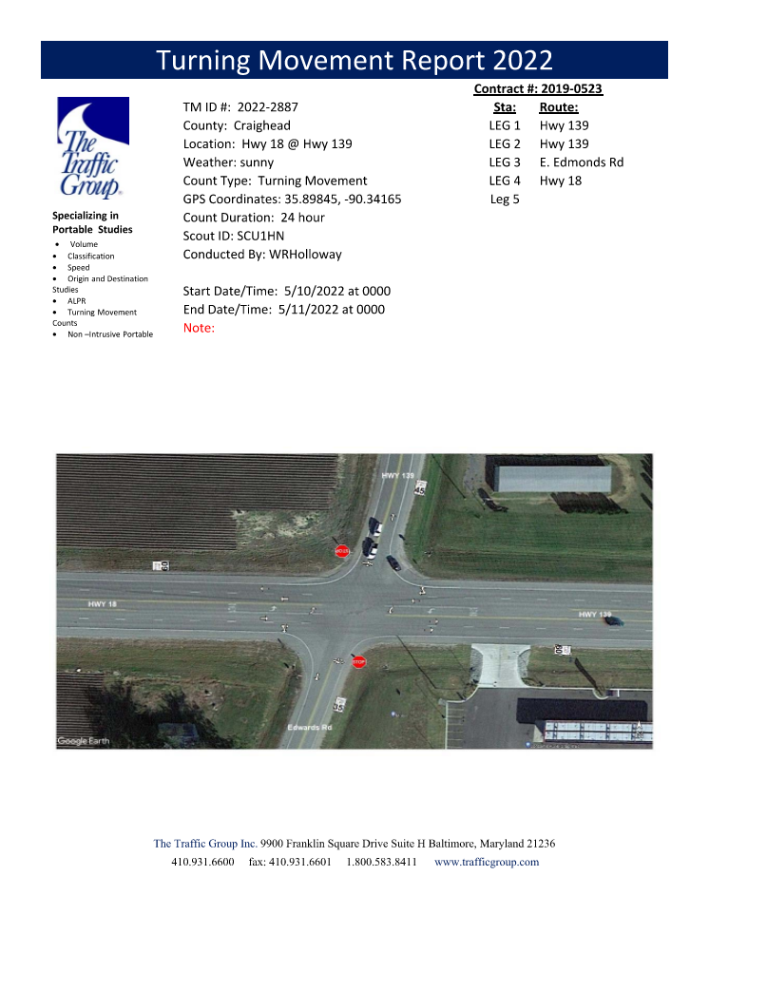
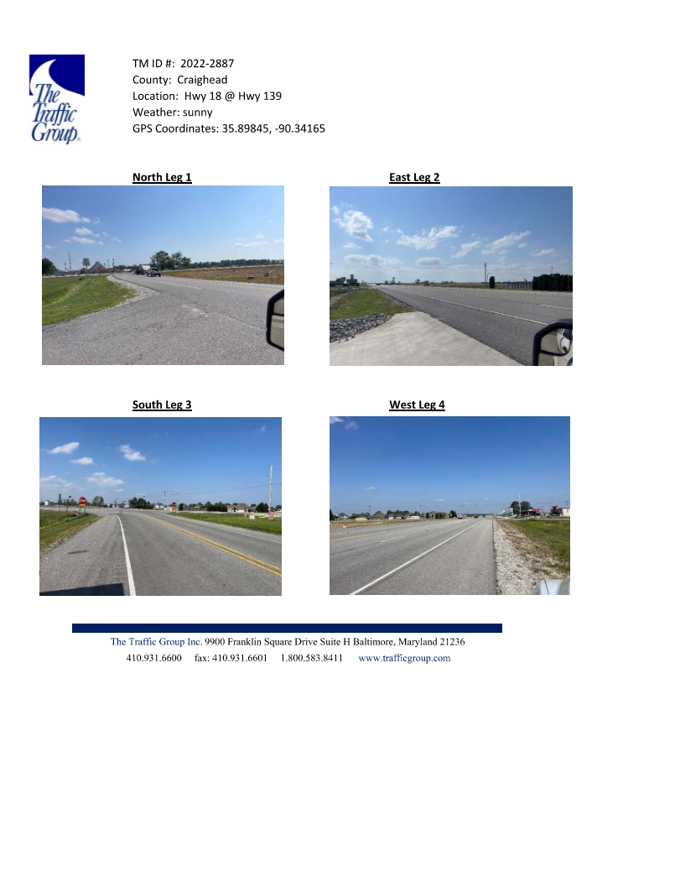
TRAFFIC COUNTS

Slide 17
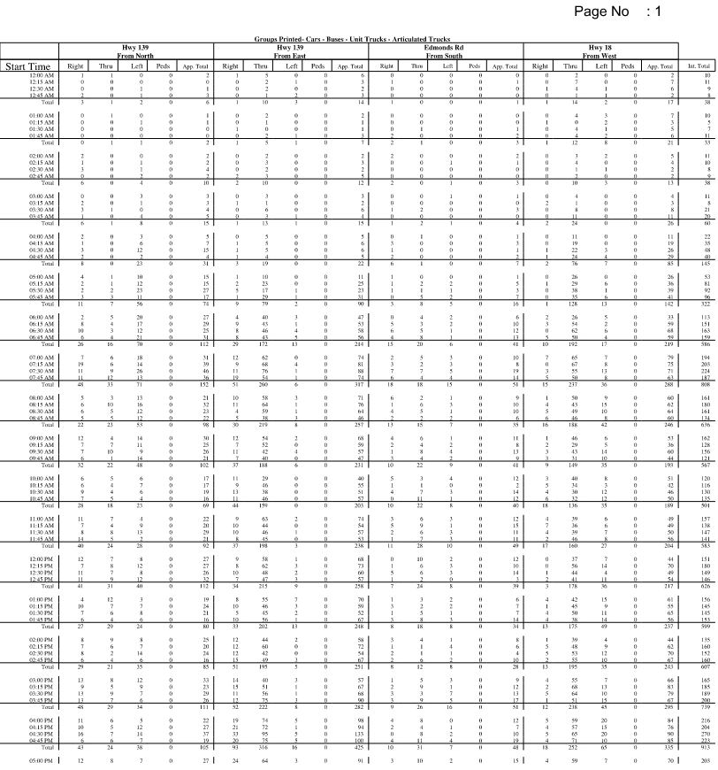
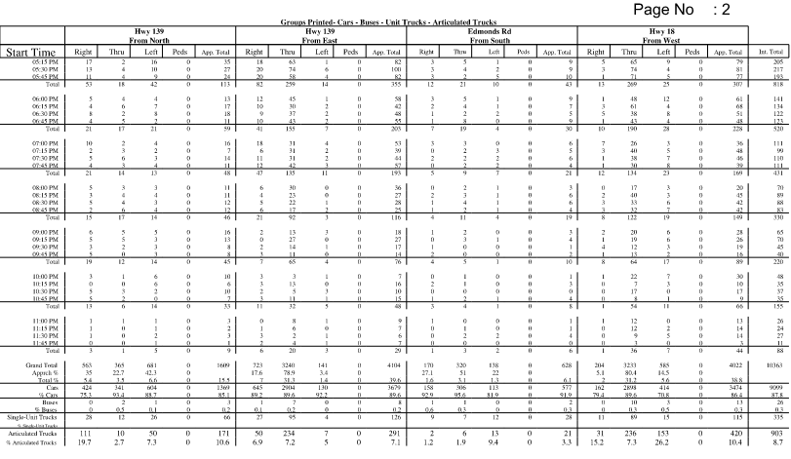
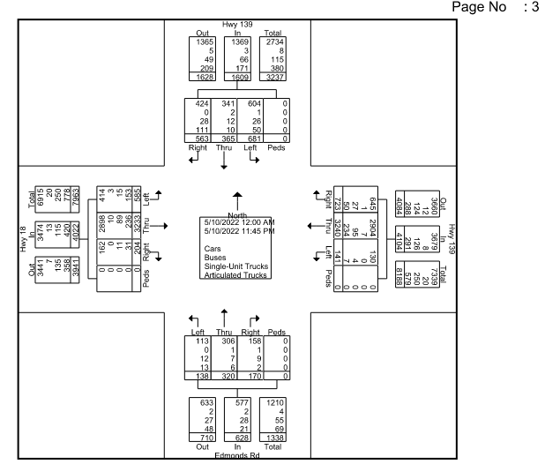
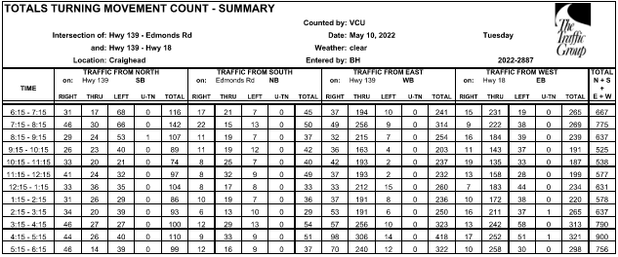

Slide 18
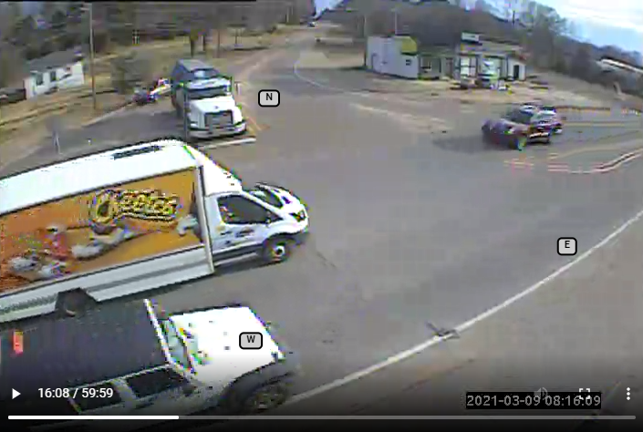
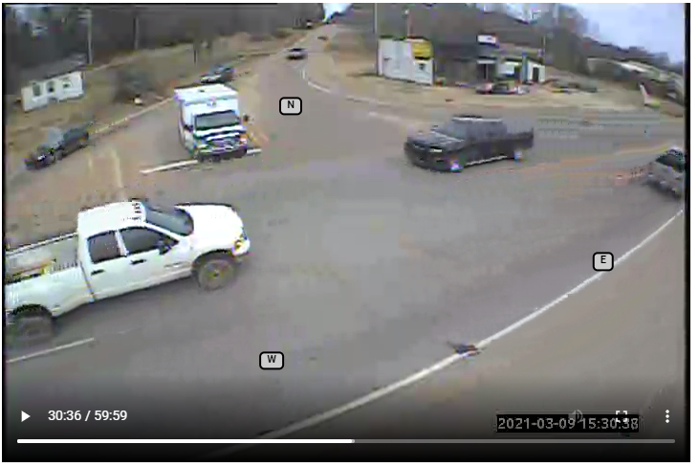
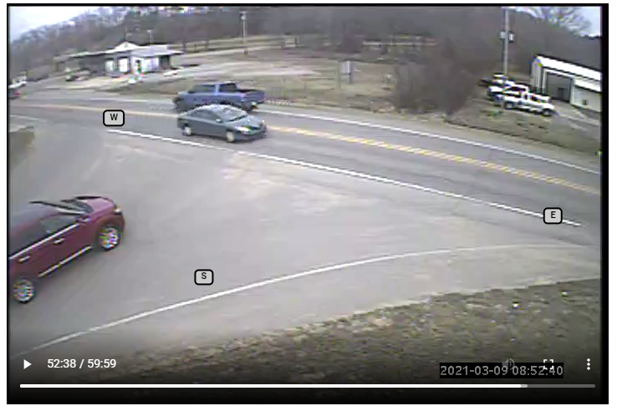
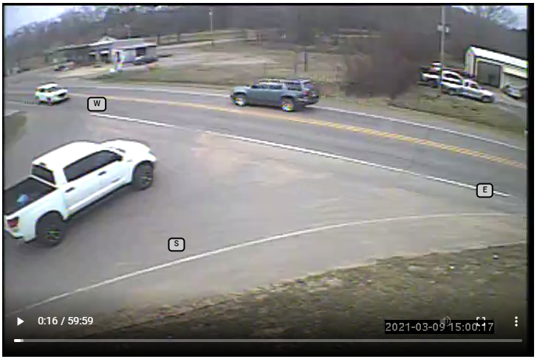

Slide 19
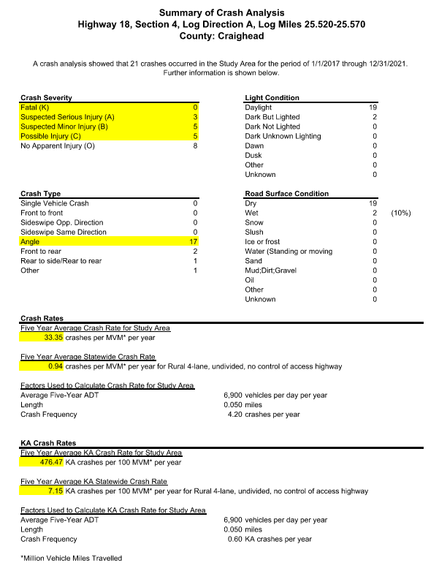
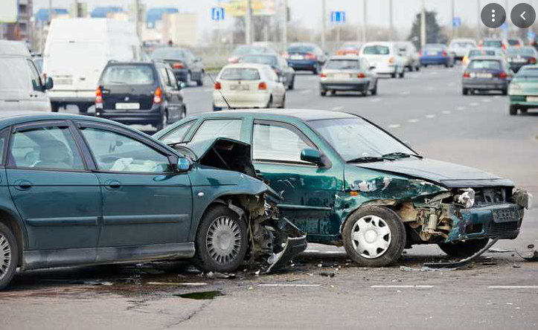
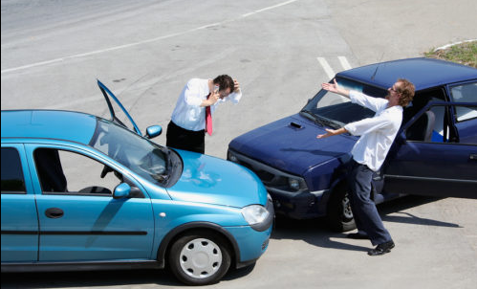
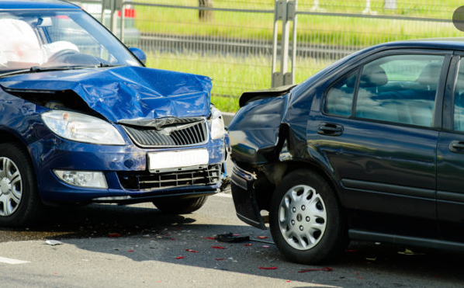
Crash data

Slide 20
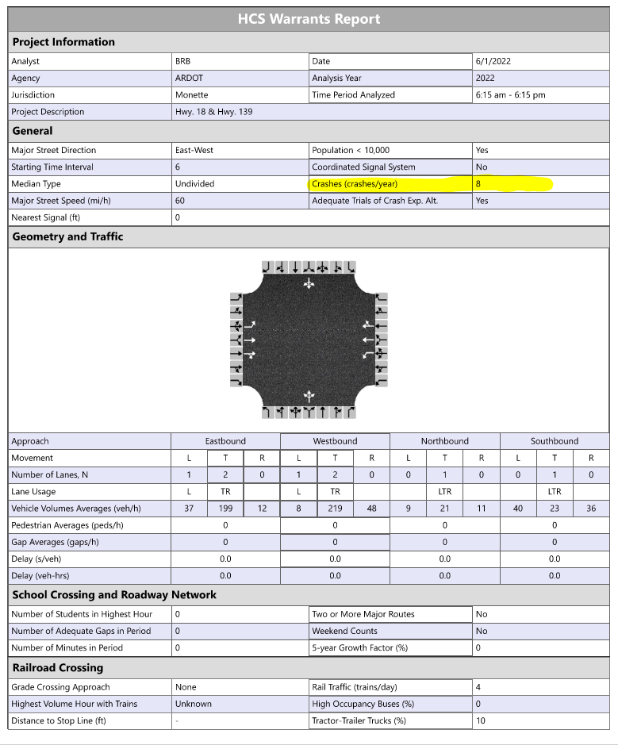
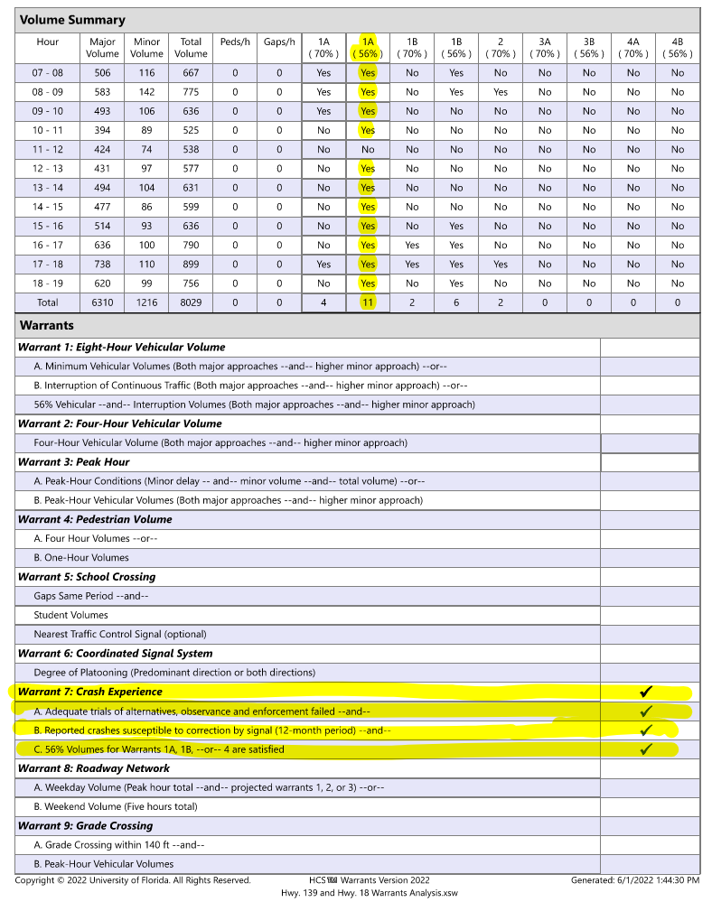
SIGNAL WARRANTS REPORT

Slide 21
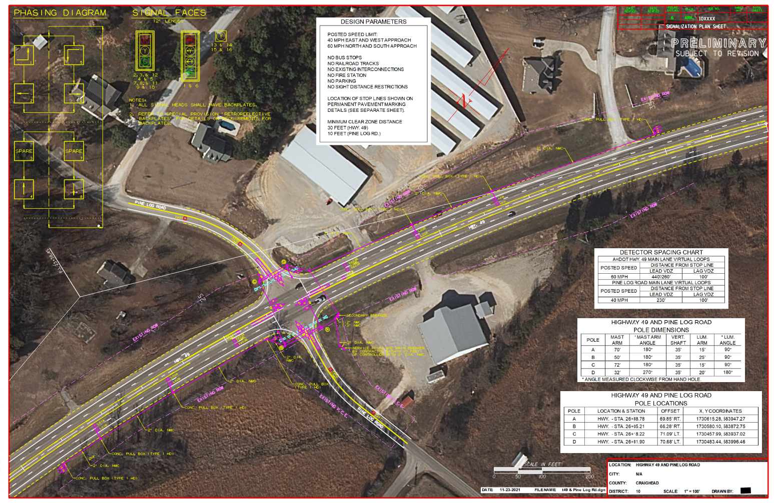
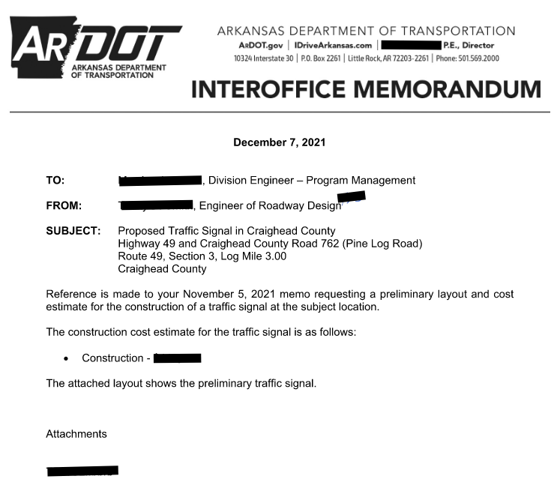
Preliminary layout and cost estimate

Slide 22
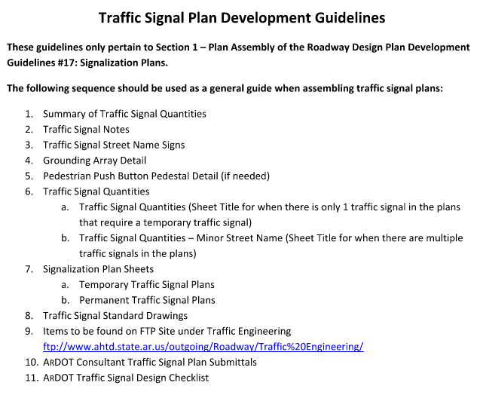
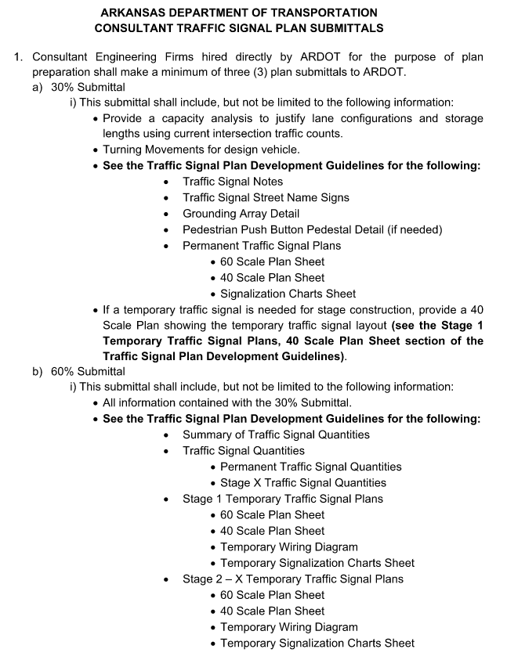
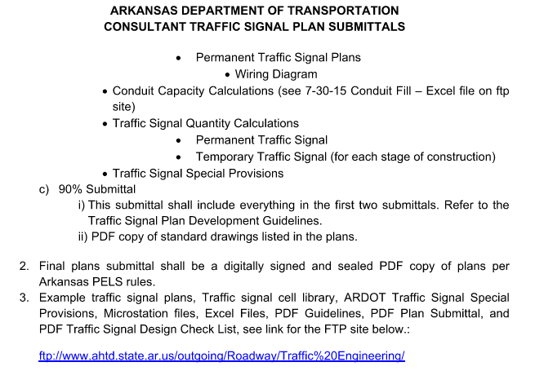
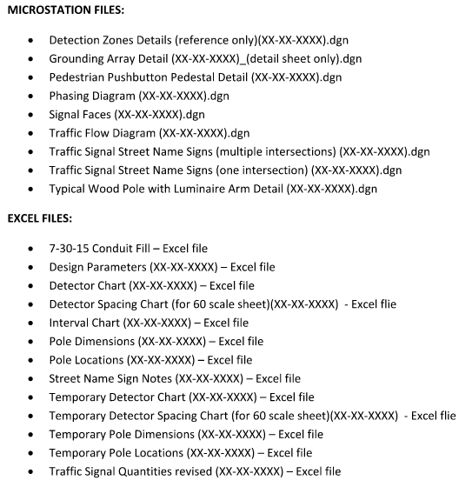
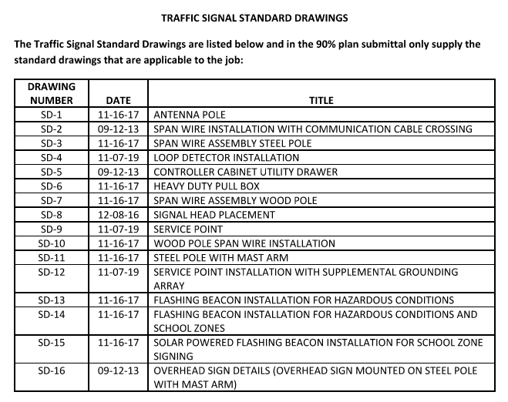
Traffic signal plan development

Slide 23
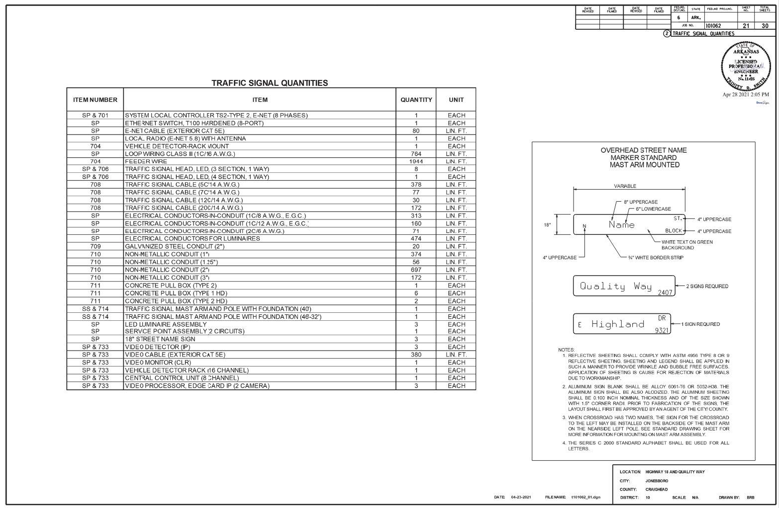
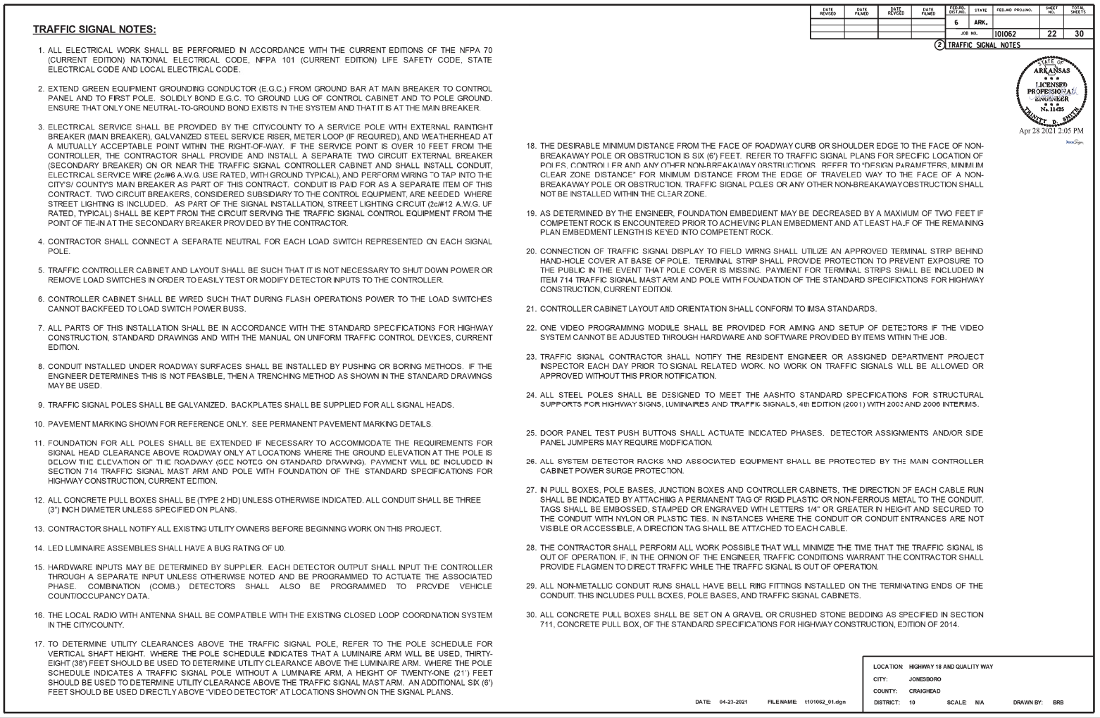
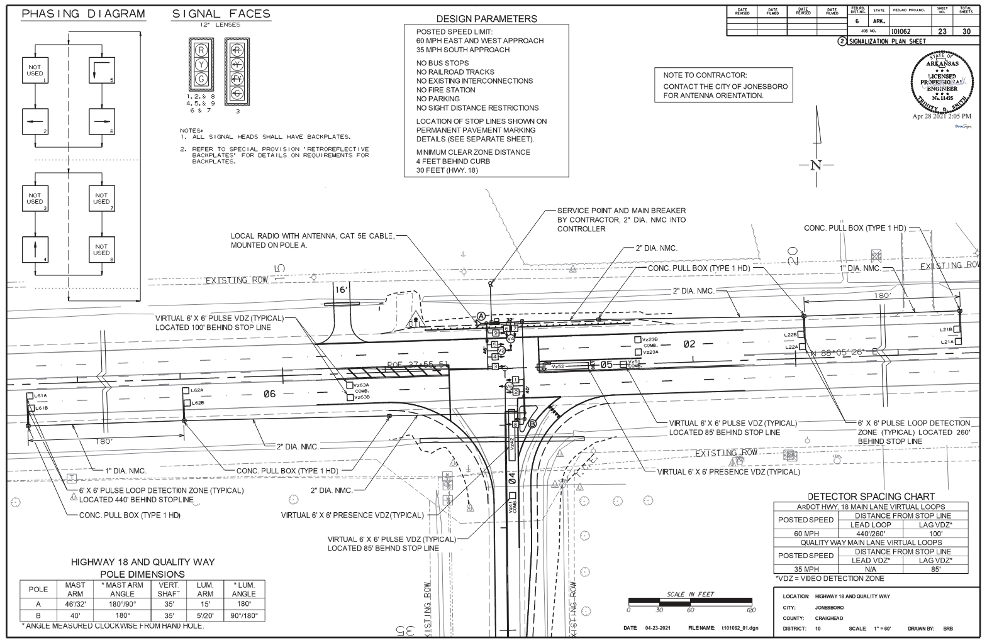
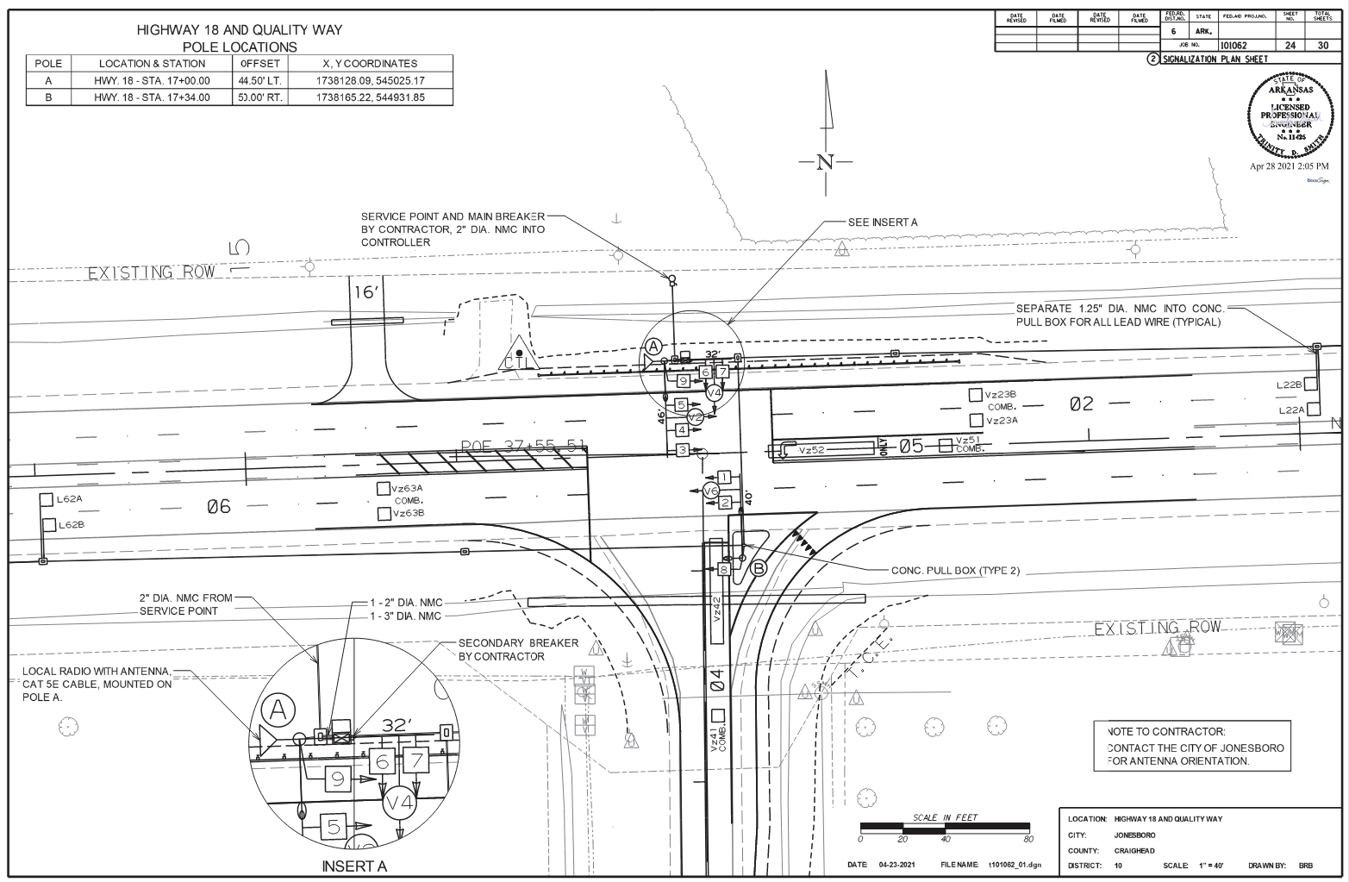
Traffic signal plans

Slide 24
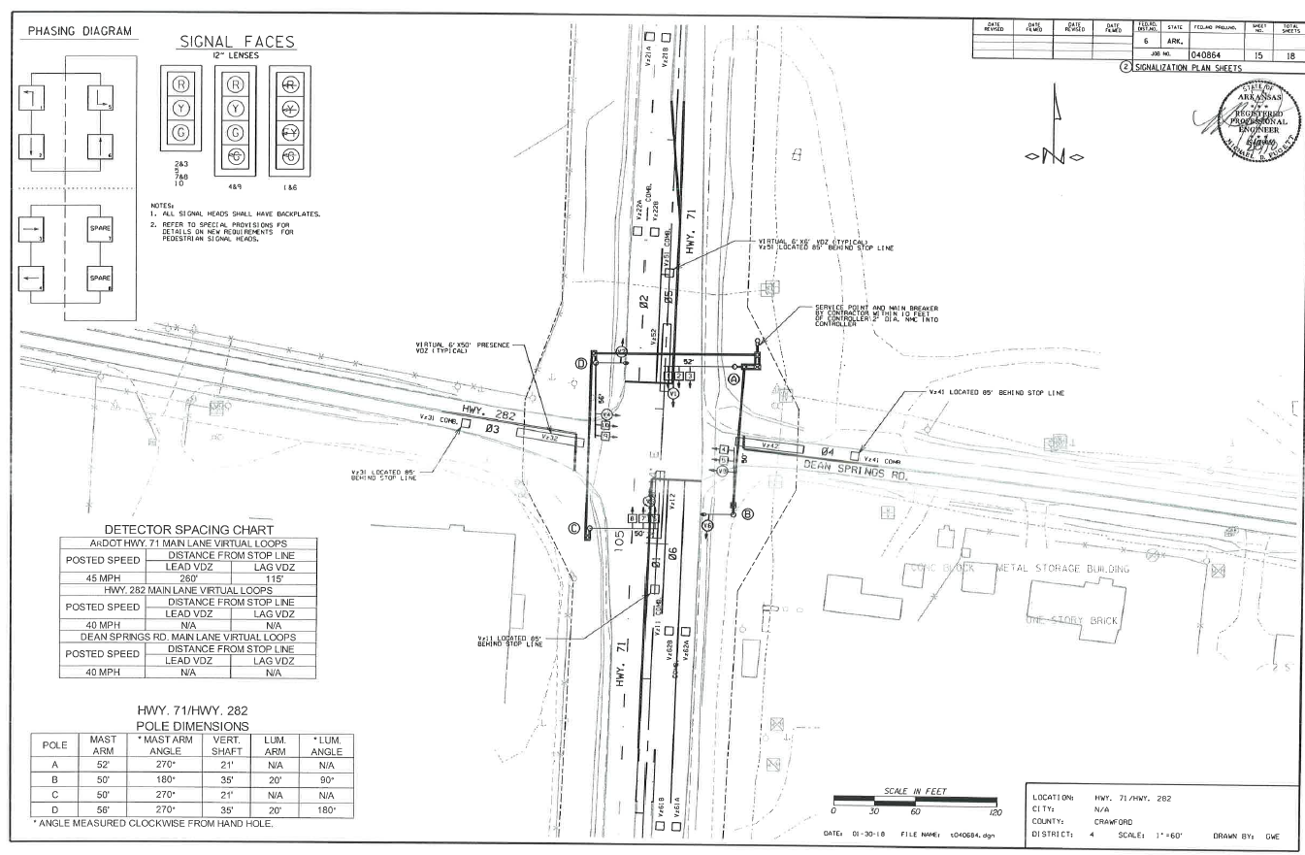
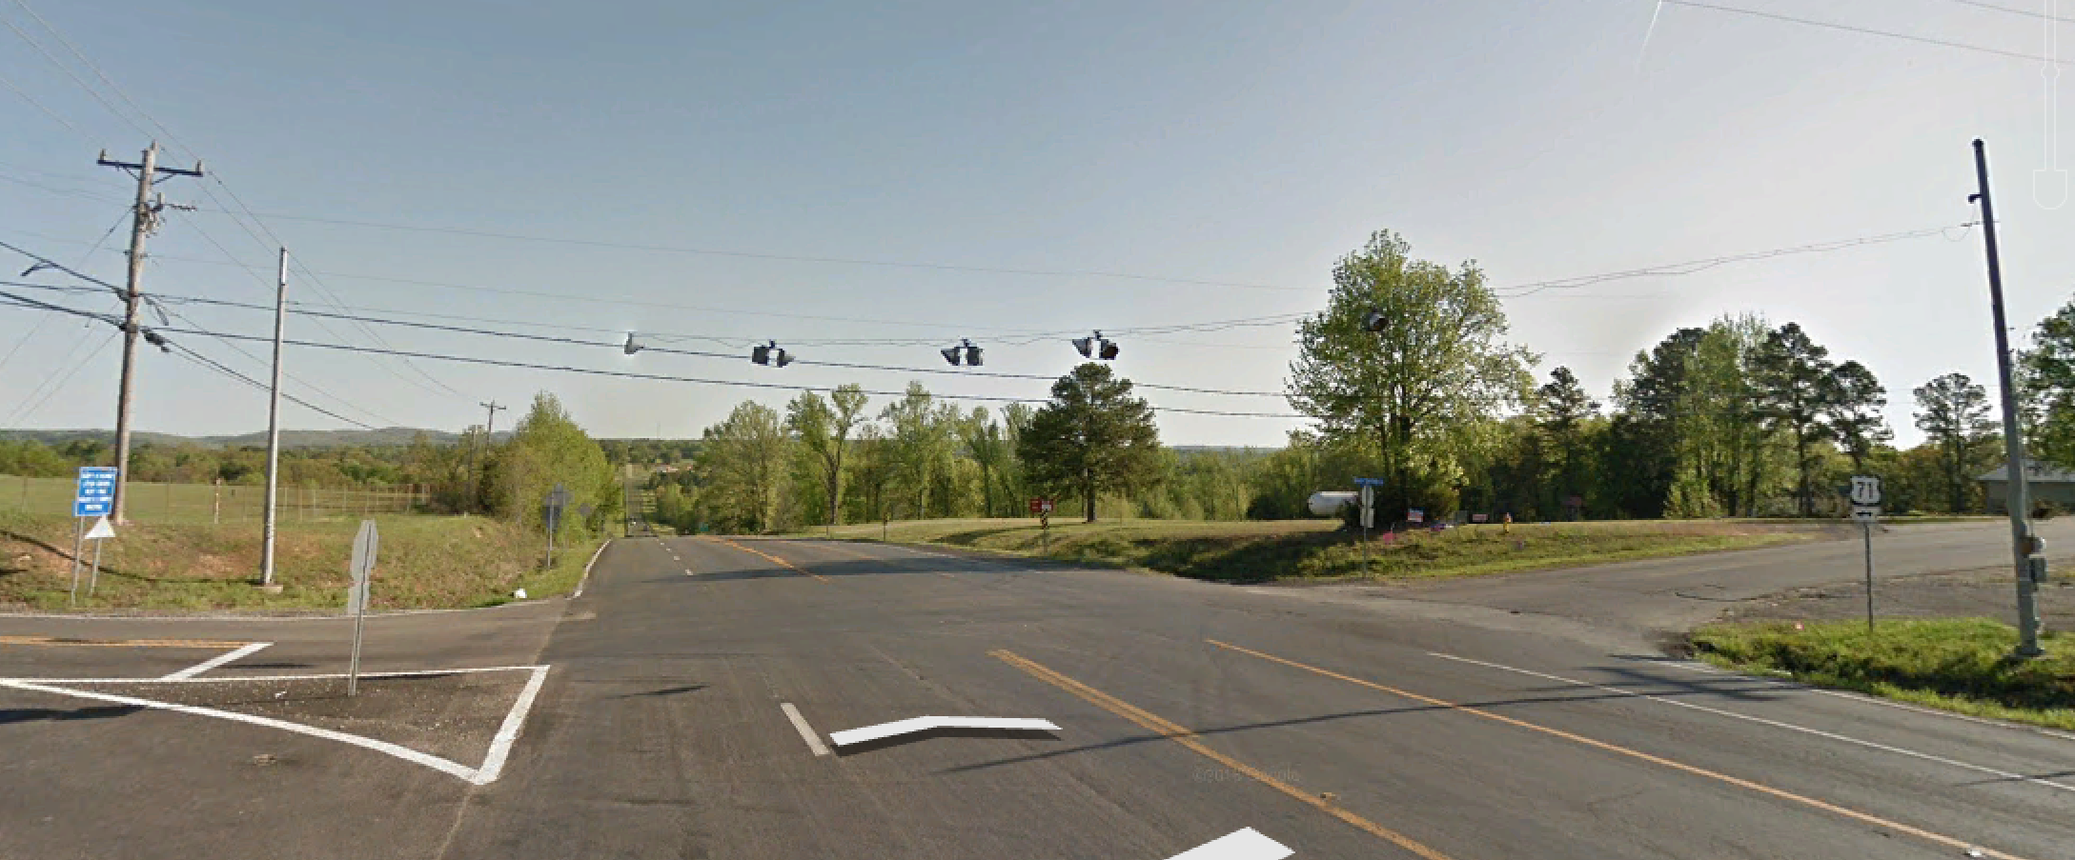
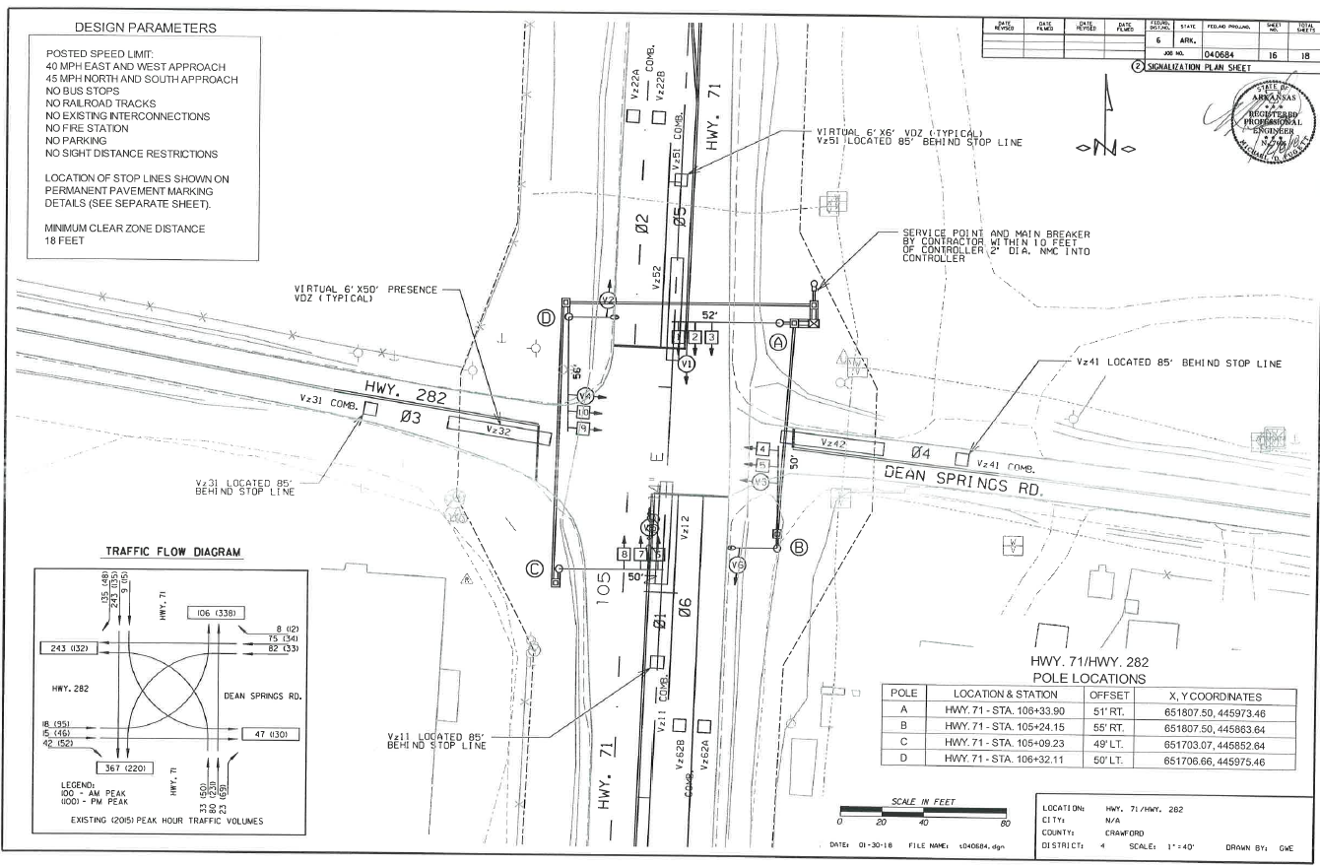
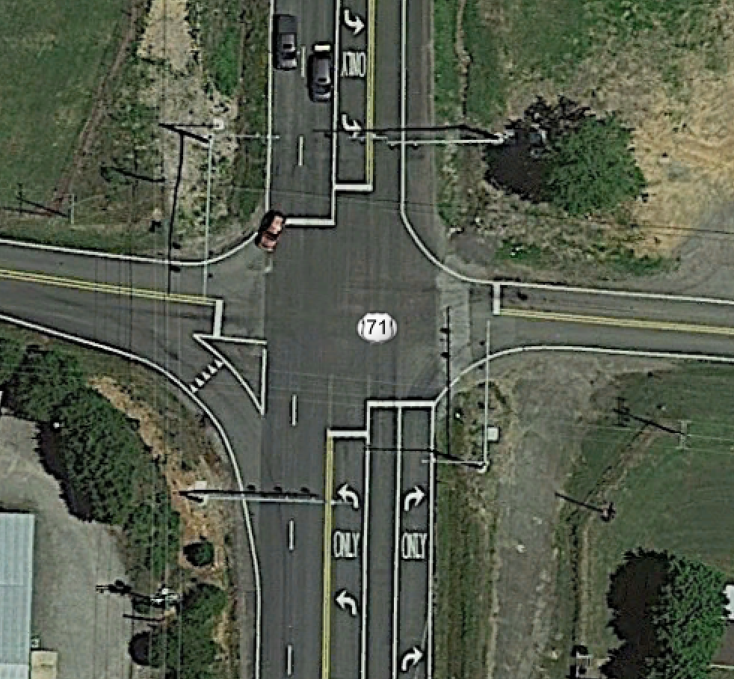
Traffic signal plans
Before
AFTER

Slide 25
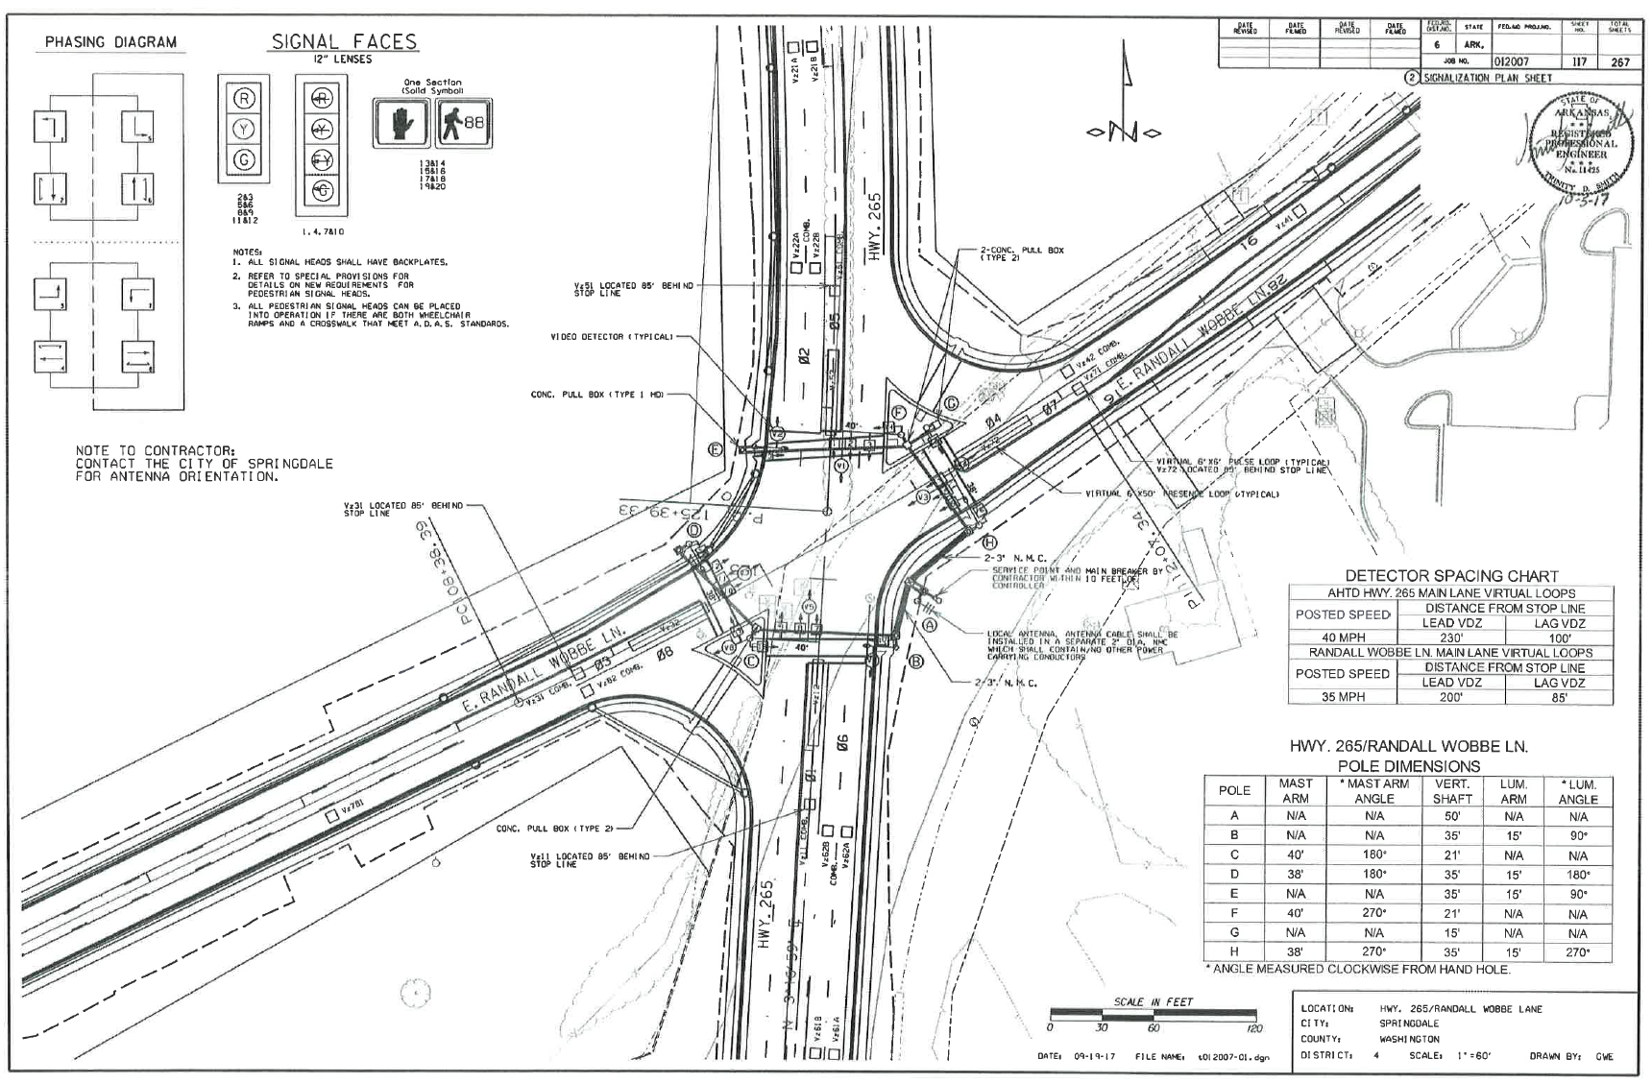
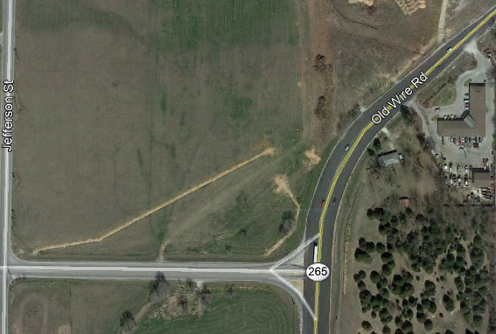
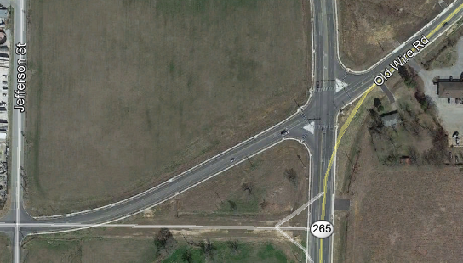
Traffic signal plans
Before
AFTER

Slide 26
TRAFFIC SIGNAL TIMING

Slide 27
TIME SPACE DIAGRAM

Slide 28
TRAFFIC SIGNAL TIMING – CONTROLLER INPUTS

Slide 29
SYNCHRO REPORTS – SIGNAL TIMING

Slide 30
LEFT TURN PHASING DETERMINATION

Slide 31
TRAFFIC SIGNAL EQUIPMENT

Slide 32
ABOVE GROUND VEHICLE DETECTION
VIDEO CAMERAS
VIDEO CAMERA WITH RADAR
RADAR

Slide 33
IN-GROUND VEHICLE DETECTION – LOOP DETECTORS

Slide 34
COMMUNICATIONS
SPREAD SPECTRUM RADIO WITH ANTENNA
CELLULAR MODEMS
ETHERNET RADIO WITH INTEGRATED ANTENNA

Slide 35
TRAFFIC SIGNALS WITH RAILROAD PREEMPTION

Slide 36
SIX-LEGGED SIGNALIZATION INTERSECTION

Slide 37
PEDESTRIAN HYBRID BEACON SIGNAL

Slide 38
EMERGENCY VEHICLE TRAFFIC SIGNAL

Slide 39
SINGLE-POINT URBAN INTERCHANGES

